Slide 1
Tightly-coupling In Situ Terms With Concepts While They Are Still In Transit Hank Childs Lawrence Berkeley / Univ. of Oregon November 16, 2015
Notes:
Want to focus on middle picture
RTI: gravity causes mixing
27B … really big for 2006, 3K^3
Now 1T, and getting bigger
So there’s a Big Data problem here
But I think the real story is in the details of the analysis.
Really two analyses: my movie, Valerio’s topology
And we probably won’t be able to do the latter when we get to the exascale
This talk is to explain why, and to explain what we can do about it

Slide 2
Possible in situ visualization scenarios
Visualization could be a service in this system (tightly coupled)…
Physics #1
Physics #1
Physics #1
Physics #1
Physics #1
Physics #2
Physics #2
Physics #2
Physics #2
…
Physics #2
…
…
…
…
…
Physics #n
Physics #n
Physics #n
Physics #n
Physics #n
Services
Viz
Services
Viz
Services
Viz
Services
Viz
Services
Viz
… or visualization could be done on a separate node located nearby dedicated to visualization/analysis/IO/etc. (loosely coupled)
Physics #1
Physics #1
Physics #2
Physics #2
One of many nodes dedicated to vis/analysis/IO
…
…
Physics #n
Physics #n
Services
Viz
Services
Viz
Physics #1
Physics #1
Physics #2
Physics #2
…
…
… And many more configurations
Physics #n
Physics #n
Services
Services
Viz
Viz

Slide 3
Summarizing flavors of in situ
In Situ Technique | Aliases | Description | Negative Aspects
Tightly coupled | Synchronous, co-processing, in situ | Visualization and analysis have direct access to memory of simulation code | Very memory constrained Large potential impact (performance, crashes)
Loosely coupled | Asynchronous, concurrent, in transit | Visualization and analysis run on concurrent resources and access data over network | Data movement costs Requires separate resources
Hybrid |  | Data is reduced in a tightly coupled setting and sent to a concurrent resource | Complex Shares negative aspects (to a lesser extent) of others

Slide 4
Question to you
I run a visualization program on the same node as the simulation
They do not share memory
Is this “loosely-coupled” or “tightly-coupled”?
Is it “in transit”?
I believe inconsistent terms is an issue for our community and we should sort this out as soon as possible.

Slide 5
This will take a community effort
Plan: email discussions, perhaps telecons
Outcome: short paper with proposed namings
Hope: large community participation, widespread agreement on naming
Hope community goes beyond DOE

Slide 6
Tightly-coupling In Situ Terms With Concepts While They Are Still In Transit Hank Childs Lawrence Berkeley / Univ. of Oregon November 16, 2015
Notes:
Want to focus on middle picture
RTI: gravity causes mixing
27B … really big for 2006, 3K^3
Now 1T, and getting bigger
So there’s a Big Data problem here
But I think the real story is in the details of the analysis.
Really two analyses: my movie, Valerio’s topology
And we probably won’t be able to do the latter when we get to the exascale
This talk is to explain why, and to explain what we can do about it

Slide 7
The In Situ Terminology Project Hank Childs A Very Large Group Lawrence Berkeley / Univ. of Oregon April 28, 2016
Notes:
Want to focus on middle picture
RTI: gravity causes mixing
27B … really big for 2006, 3K^3
Now 1T, and getting bigger
So there’s a Big Data problem here
But I think the real story is in the details of the analysis.
Really two analyses: my movie, Valerio’s topology
And we probably won’t be able to do the latter when we get to the exascale
This talk is to explain why, and to explain what we can do about it

Slide 8
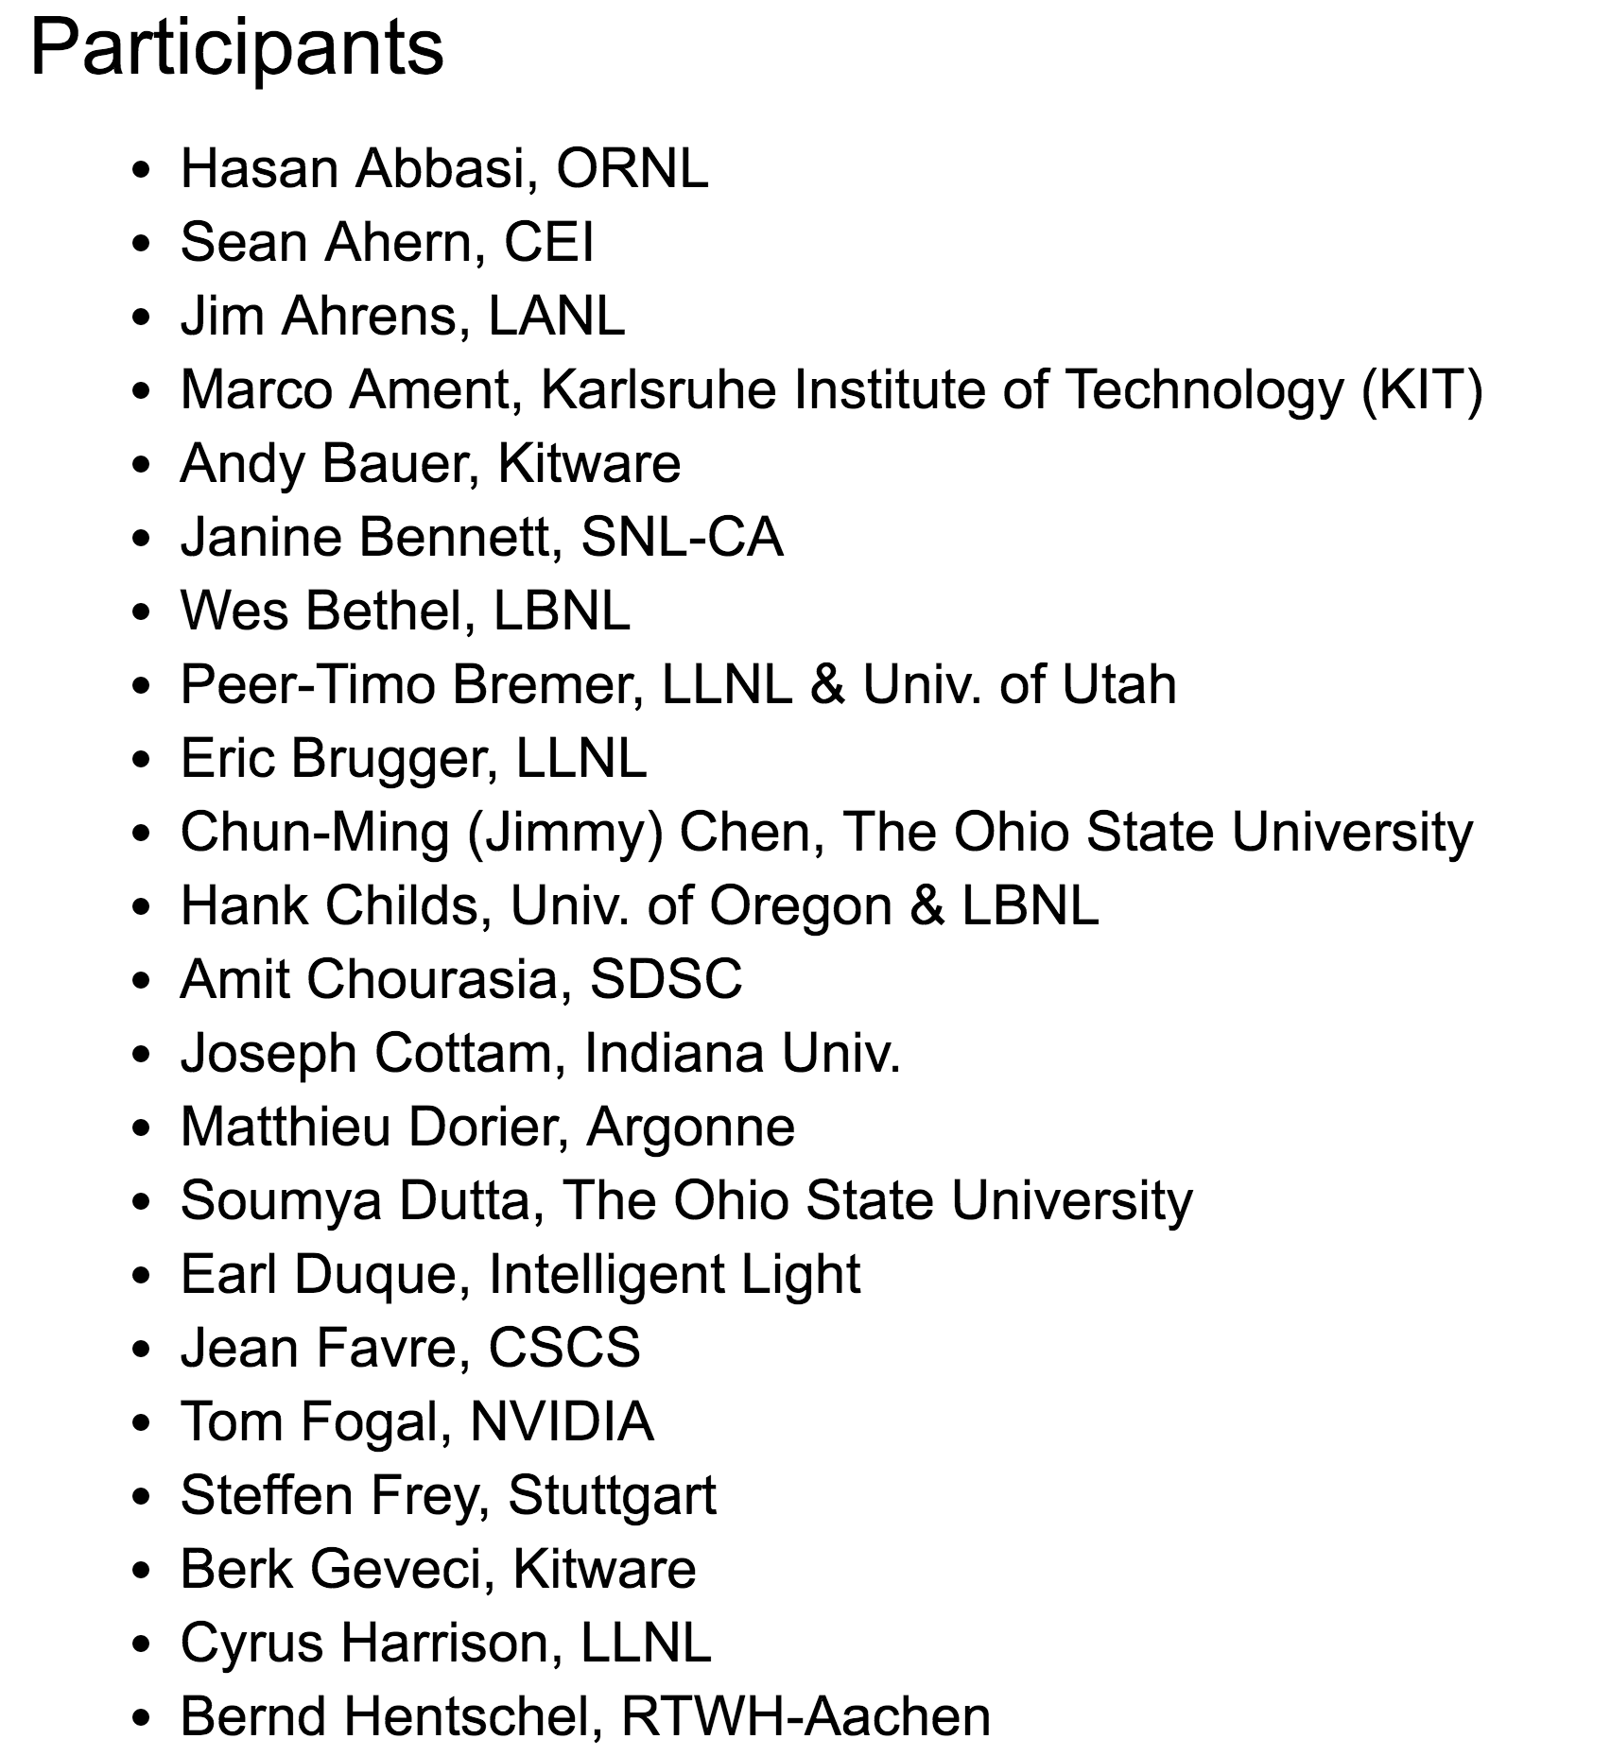
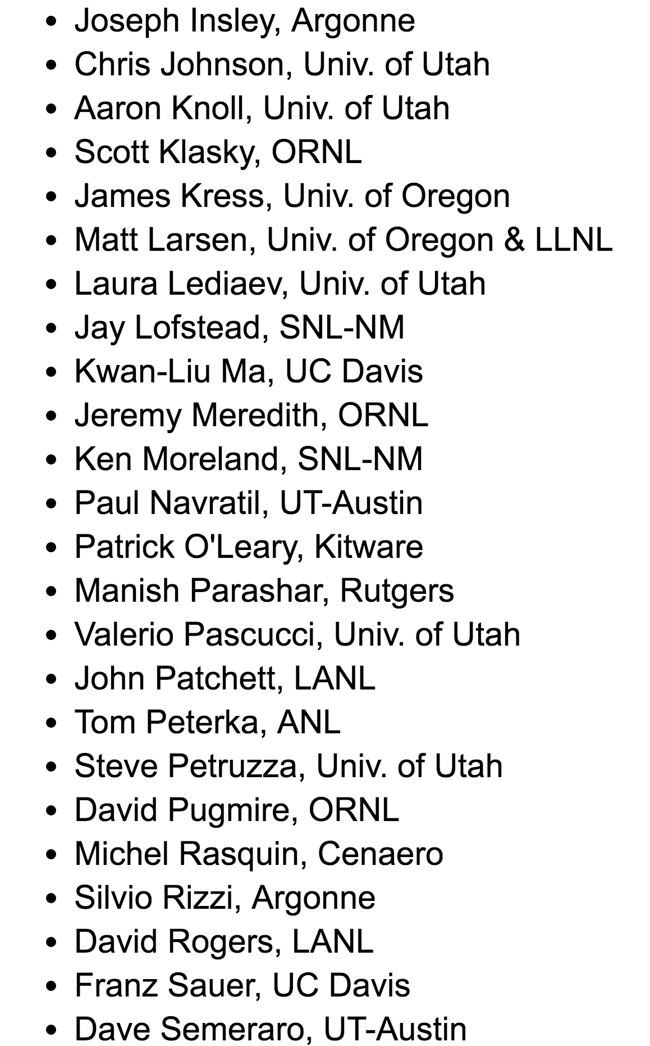
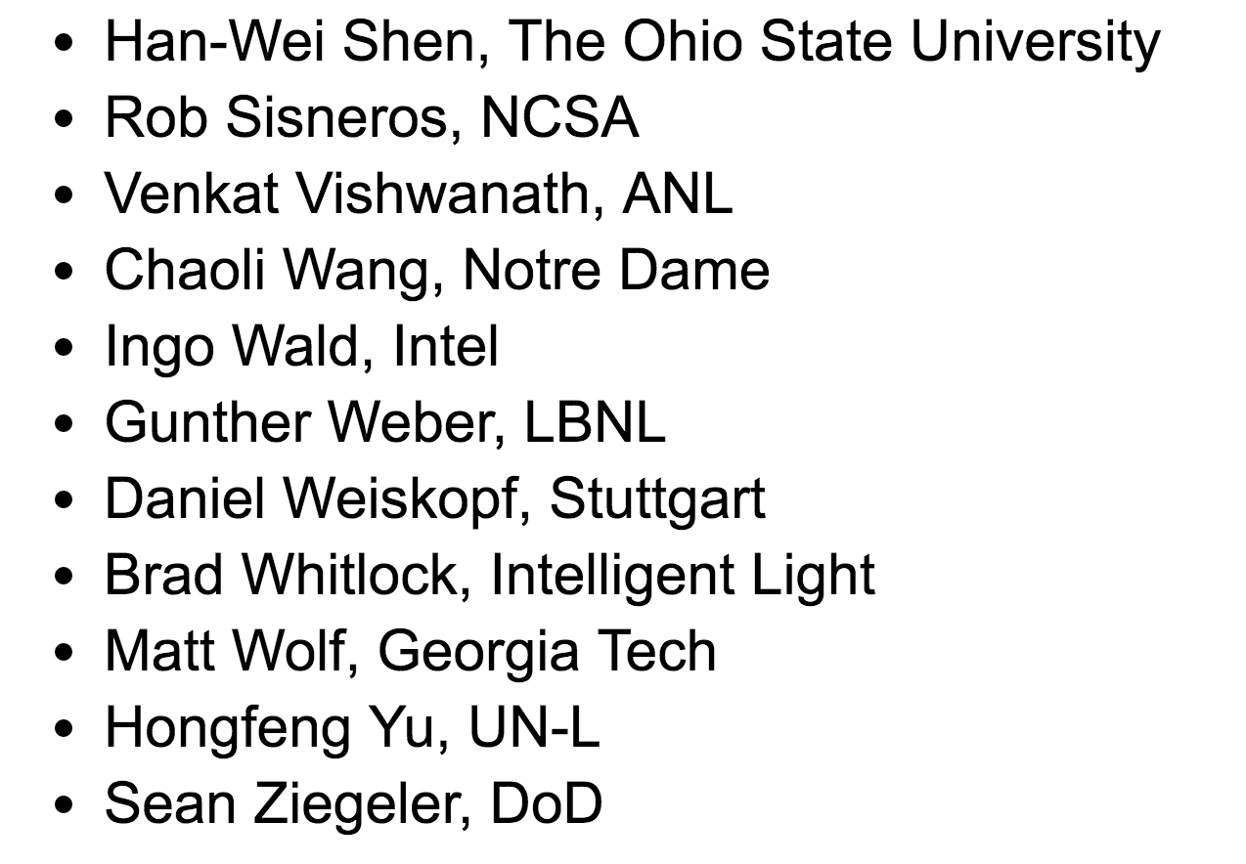
My Co-Authors

Slide 9
Process
Combination of:
wiki editing
surveys
telecons (6-8)

Slide 10
Approach
Observation: lots of orthogonal dimensions that describe an in situ system
Task 1: Identify those dimensions
Task 2: Identify options for those dimensions
So how is an in situ system described?
→ description of in situ system is done by identifying which options they have chosen for a given dimension

Slide 11
Axes (i.e., the orthogonal dimensions)
Integration Type
Proximity
Access
Division of Execution
Operation Controls
Output Type

Slide 12
#1: Integration Type
Application-Aware
Application-Unaware

Slide 13
#1: Integration Type
Application-Aware
Bespoke: custom vis and analysis written specifically for a single simulation code and tailored to its needs
Dedicated API: the framework is dedicated to visualization and analysis, and so the simulation code is aware that interactions with this API are for the purpose of visualization and analysis
Multi-purpose API: the scope of the framework is data, meaning that it includes visualization and analysis, but that it also might include I/O or data movement between components

Slide 14
#1: Integration Type
Application-Unaware
Interposition: placing a dynamically-loaded library containing symbols known to the simulation code into the place of the original library that the simulation code was expecting (LD_PRELOAD)
Inspection: inspect memory to infer patterns in data layout and automatically add in situ processing (debuggers do this)
???

Slide 15
#2: Proximity
On Node
Off Node, Same Computing Resource
Different Computing Resource

Slide 16
#2: Proximity
On Node ← use memory hierarchy
registers
L1-cache
L2-cache
L3-cache
Random-access memory
NUMA accesses
NV-RAM
Local disk

Slide 17
#2: Proximity
Off Node, Same Computing Resource
Quantify number of hops?
Different Computing Resource
Strains usage of term in situ?

Slide 18
#3: Access
Direct Access: in situ routines run in the same logical memory space as the simulation code
Indirect Access: in situ routines run in a distinct logical memory space from the simulation code

Slide 19
#3: Access
Direct Access: in situ routines run in the same logical memory space as the simulation code
Deep Copy: in situ routines make a copy of its input data from the simulation
Shallow Copy: adapt data structures to those of the simulation code

Slide 20
Proximity + Access
 | On Node Proximity | Off Node / Distinct Resources Proximity
Direct Access
Indirect Access
Yes! “in situ”...
This is possible! (PGAS)
Is it “tightly coupled”?
This makes sense!
Is it “in transit”?
Yes! “in transit”...

Slide 21
#4: Division of Execution
Space Division: subset of the compute resources are devoted exclusively to in situ routines
Time Division: no compute resources are devoted exclusively to in situ routines
Some (or all) of the compute resources alternate between advancing the simulation and visualization and analysis.

Slide 22
#5: Operation Controls
Automatic: users select which operations to perform in advance of the calculation
Human-in-the-Loop: stakeholders modify which visualization and analysis routines are executed in situ

Slide 23
#5: Operation Controls
Automatic: users select which operations to perform in advance of the calculation
Adaptive: the in situ routines can adapt which operations are performed as the simulation executes
Non-adaptive: in situ routines are static

Slide 24
#5: Operation Controls
Human-in-the-Loop: stakeholders modify which visualization and analysis routines are executed in situ
Blocking: simulation can pause when waiting for guidance from a stakeholder
Non-blocking: simulation will not pause to wait for guidance from a stakeholder

Slide 25
#6: Output Type
Subset: selectively pick elements of the data
Transform: perform an operation
Examples: wavelet compression, Lagrangian flow (?)
Derived: Generate new data of a different nature than the input
Examples: statistics, isosurfaces, topological analyses, rendering, indexing

Slide 26
What about “hybrid in situ”?
Transform data as simulation is generating it
Send results to distinct resources
Apply vis algorithms to transformed data on distinct resources
For example, is the access direct or indirect?
Answer: direct in (1), but indirect in (3)
Solution: identify systems and score each system system separately

Slide 27
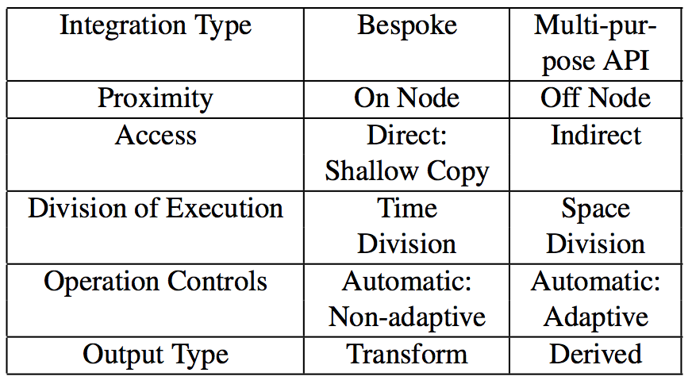
Example
The sole purpose of this system is to render isosurfaces.
Apply isosurfaces as data is produced
The resulting triangles are sent over the network to dedicated visualization nodes, using a data transfer library.
There, separate visualization software renders the data, evaluating the best camera angles for the data
The resulting images are saved to disk

Slide 28
Remaining work
Big: classify existing systems (at least some of them)
Small: take some surveys showing ineffectiveness of old terms, effectiveness of new terms
Smallest: how to pronounce? Italicize?

Slide 29
The name “in situ”
in situ: we define as “processing data as it is generated”
This is broader than “in place” / “on site” / “in position”
Alternatives, such as “concurrent,” considered
70% of group voted to stick with in situ because of inertia with stakeholders and funders

Slide 30
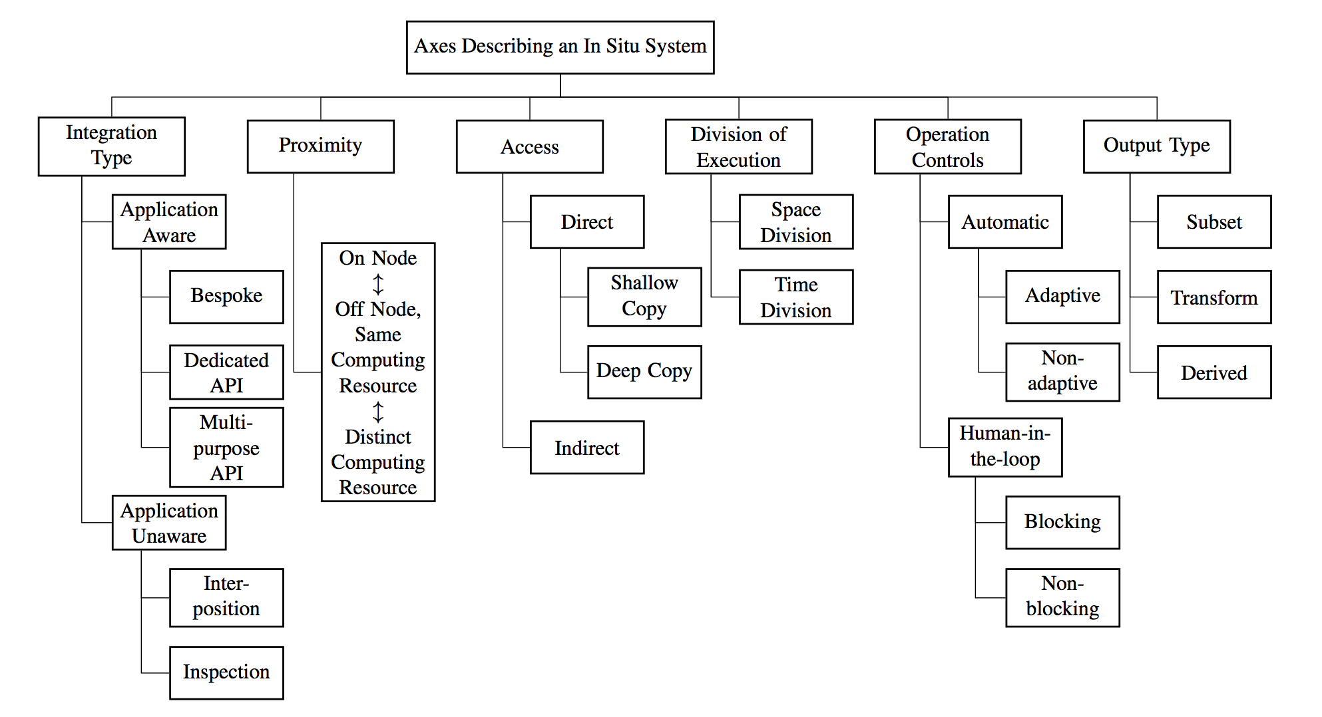
Missing Axes?
Missing Options?
Other feedback?

