Slide 1

A ToolKit for Scientific Visualization on
Many-Core Processors
Hank Childs
Kenneth Moreland
David Pugmire
Robert Maynard
University of Oregon
Sandia National Laboratories
Oak Ridge National Laboratory
Kitware, Inc.

Slide 2
State of this tutorial…

Slide 3
START SKIPPING SLIDES FOR HACK-A-THON TUTORIAL

Slide 4
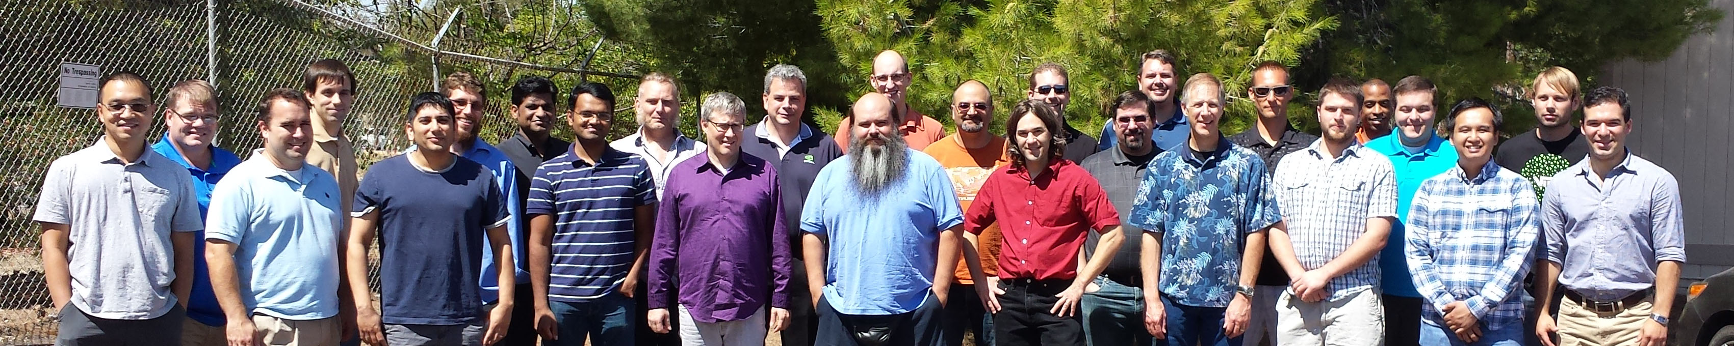
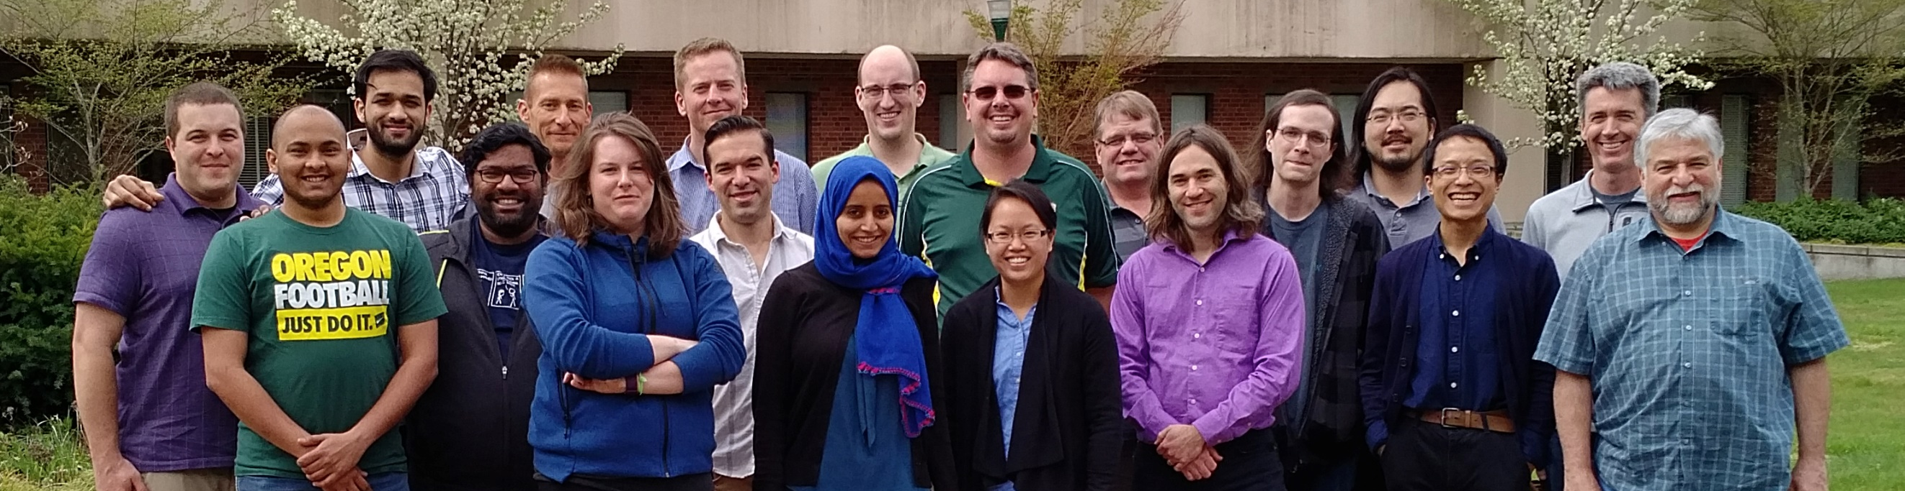
Big Picture
is a library for visualization and analysis on many-core devices
  Emphasis on platform portability: write once, use on different architectures
  Emphasis on performance: match performance of hardware-specific implementations
Who is making it?
  Developers of ParaView, VTK, and VisIt
    Will include pathways to these products
  Development hubs: Sandia, Oak Ridge, Los Alamos, Lawrence Livermore, Univ. of Oregon
  USA ”Exascale Computing Project” funding ~$2M (US) per year towards project
2015 VTK-m Code Sprint (Livermore, CA, USA)
2017 VTK-m Code Sprint (Eugene, OR, USA)

Slide 5
VTK-m: the ‘m’ is for many-core
VTK:
  popular, open source, supported by a community
  … but primarily single core only.
VTK-m:
  name chosen to evoke the positive attributes of VTK
  … but will support multi-core and many-core.

Slide 6
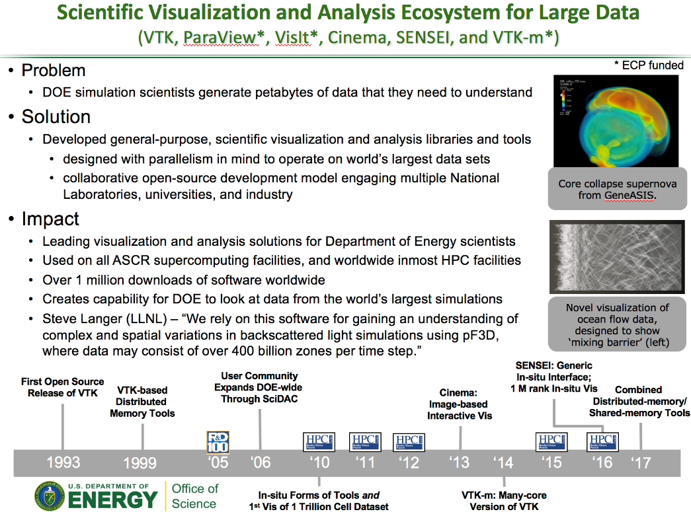
What is the problem?
(Current status of visualization and analysis for HPC)
Developed popular, open source tools (ParaView, VisIt) based on the Visualization ToolKit library (VTK)
  Widespread usage in DOE and >1 million downloads worldwide
  Hundreds of person years of effort
Three major problems for exascale:
  Many-core architectures (as current VTK-based investments are primarily only MPI parallelism)
  I/O limitations will require in situ processing
  Artifacts created will require new methods of analysis and vis
ASCR highlight slide for VTK-based tools.
ECP VTK-m project is focused on problem #1.
ECP ALPINE is focused on problem #2.
ECP ALPINE and ATDM Cinema impact #3.
Our approaches are complementary and coordinated.

Slide 7

VTK-m is a critical part of USA Department of Energy visualization strategy.
Apps
In situ
Infrastructure
In situ
Algorithms
Output/Artifacts
Post
Processing
ALPINE
New
Algorithms
ParaView
Cinema
VisIt
Libsim
Traditional
Algorithms
Traditional
Output
VisIt
Rendering
…
…
ParaView
Catalyst
Rover
VTKm

Slide 8
Tutorial Purpose
We believe VTK-m has become useful software
We are hopeful visualization researchers will considering using and perhaps even developing VTK-m
  (We would like the project to expand beyond the Department of Energy / beyond the USA, much like VTK, ParaView, and VisIt.)
At the end of this tutorial:
  Understand the design behind VTK-m
  Understand how to use VTK-m
  Understand basics of developing VTK-m

Slide 9
Tutorial Schedule
30m
35m
30m
50m
35m
30m
Introduction / software install
Concepts behind VTK-m usage
Using VTK-m (hands on)
Concepts behind VTK-m development
VTK-m example (hands on)
Discussion of upcoming activities / wrap up

Slide 10
Tutorial Team
Contributor | Hank Childs | Kenneth Moreland | David Pugmire | Robert Maynard
Affiliation
Software Projects | VTK-m, VisIt, Ascent | VTK-m (PI), ParaView, Ice-T | VTK-m (Deputy PI), VisIt, ADIOS | VTK-m (Chief Developer), ParaView, VTK

Slide 11
STOP SKIPPING SLIDES FOR HACK-A-THON TUTORIAL

Slide 12
Tutorial Schedule
30m
35m
30m
50m
35m
30m
Introduction / software install
Concepts behind VTK-m usage
Using VTK-m (hands on)
Concepts behind VTK-m development
VTK-m example (hands on)
Discussion of upcoming activities / wrap up

Slide 13
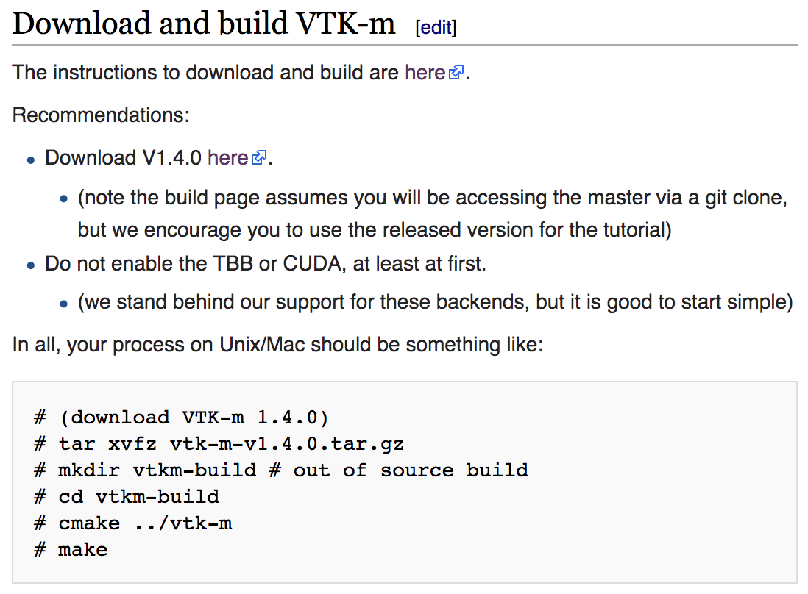
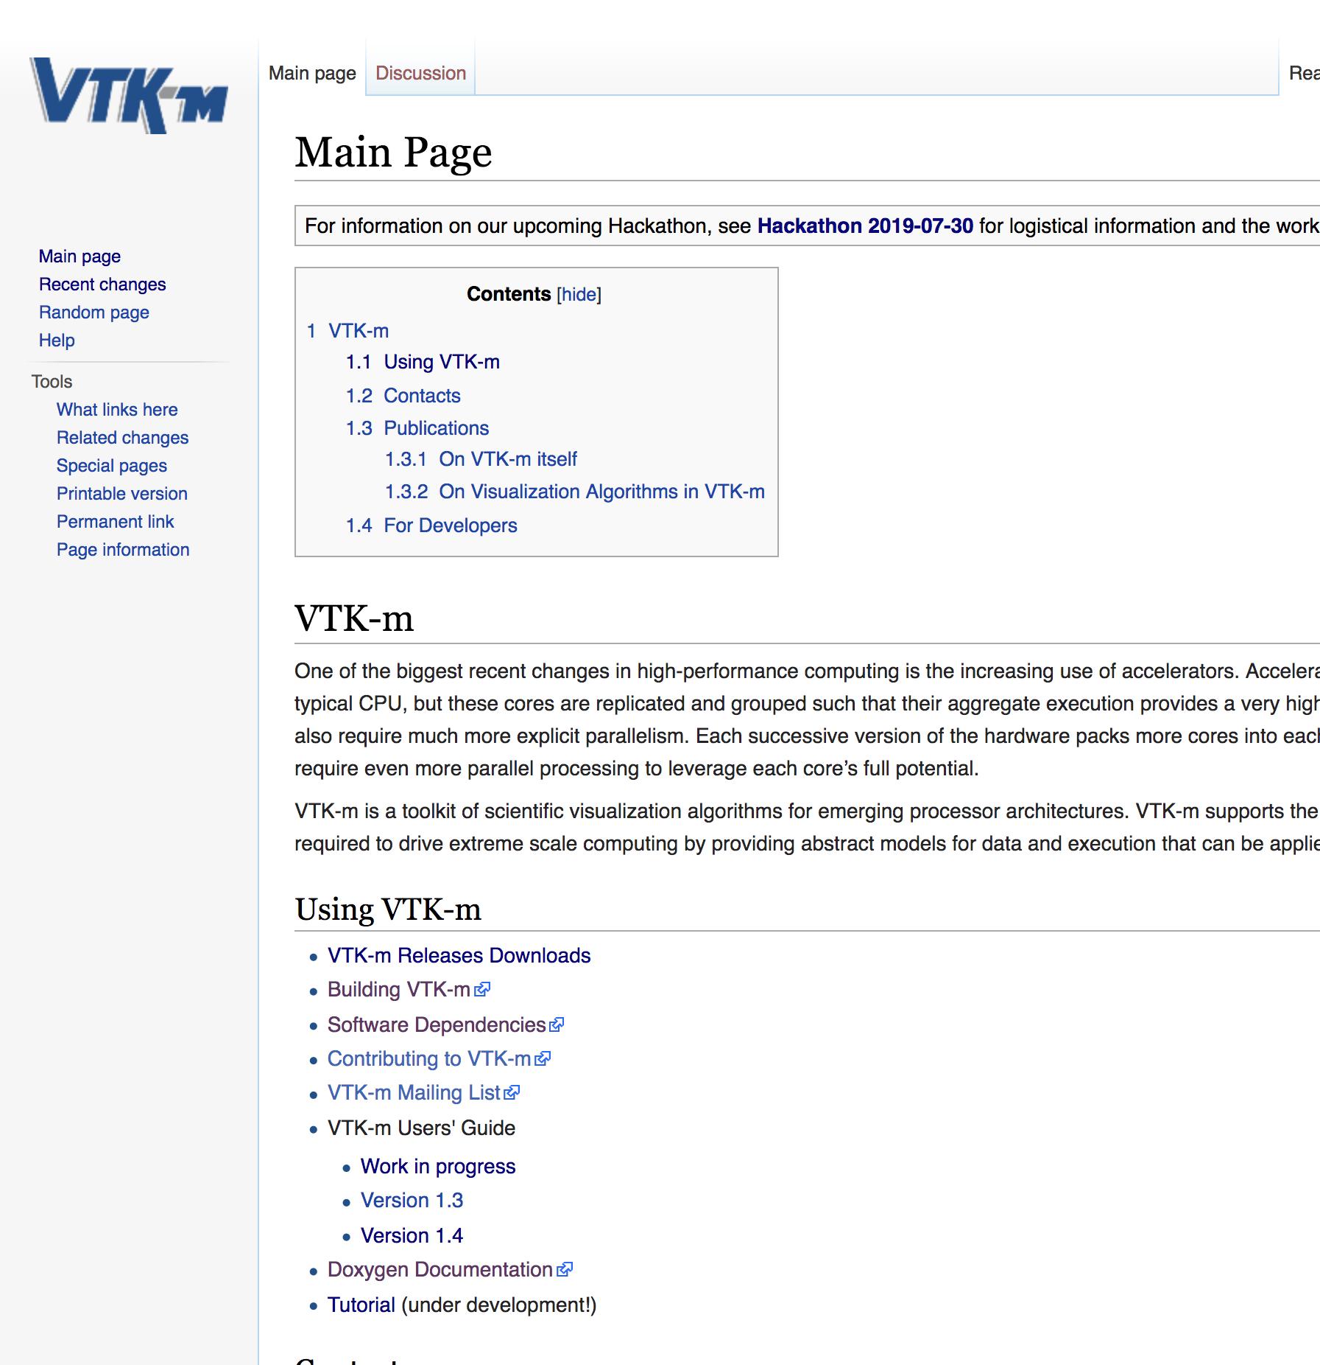
Download & build VTK-m
Find tutorial instructions:
  Go to m.vtk.org
  Click on “Tutorials” link
Follow instructions for VTK-m build:

Slide 14
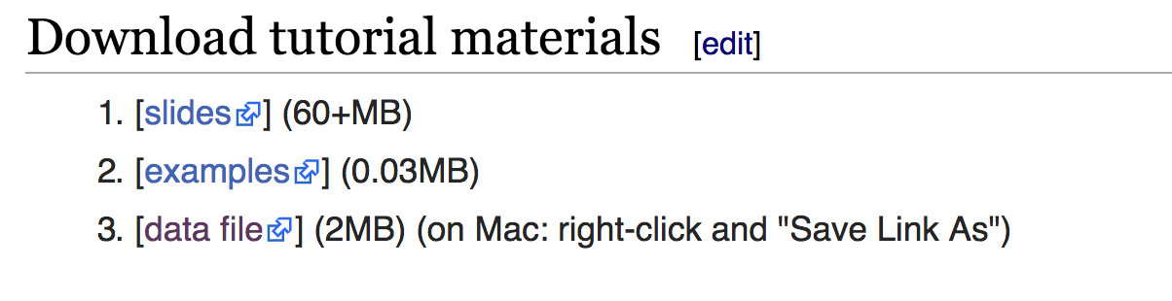
Download tutorial materials
Download these slides (VTKm_tutorial_Jul19.pptx)
Download example code (VTKm_tutorial_examples.tar)
Download data file (kitchen.vtk)
(from webpage)

Slide 15
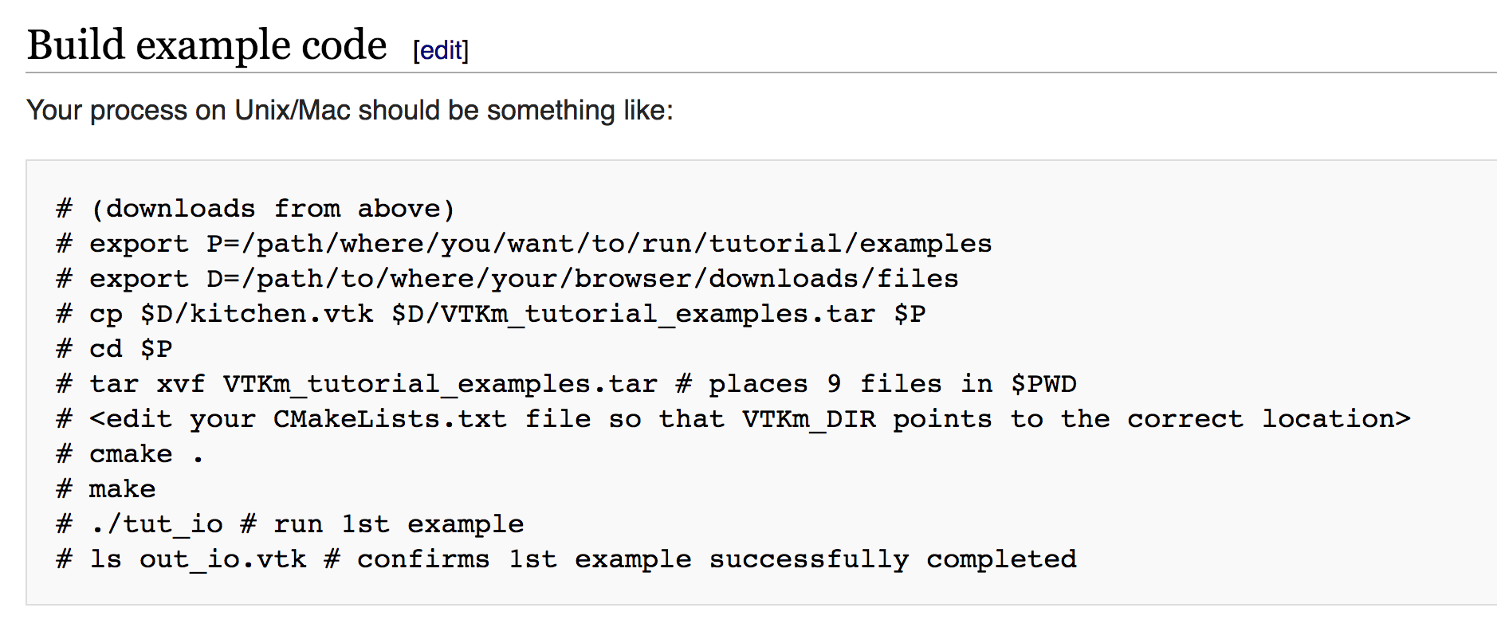
Build example code, run first project
(from webpage)

Slide 16
Introduction to VTK-m

Slide 17
START SKIPPING SLIDES FOR HACK-A-THON TUTORIAL

Slide 18
VTK-m Use Cases
Use ParaView, VisIt, Catalyst, Libsim, Ascent, etc.
Use software that uses (or will use) visualization libraries.
Develop visualization software and want to make the leap to many-core devices.

Slide 19
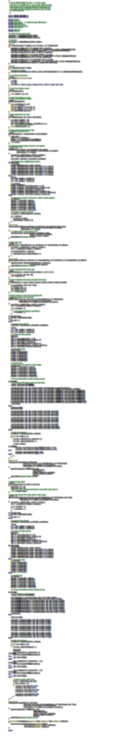

VTK-m
283 Lines
CUDA SDK
561 Lines
Notes:
The source code of Marching Cubes in three different packages. Case tables removed (all essentially the same).
CUDA SDK: marchingCubes_kernel.cu
VTK-m: IsosurfaceUniformGrid.h

Slide 20
Visualization and Analysis for HPC: Current Status
Developed popular, open source tools (ParaView, VisIt) based on the Visualization ToolKit library (VTK)
  Widespread usage in DOE and >1 million downloads worldwide
  Hundreds of person years of effort
Two major problems for exascale:
  Many-core architectures (as current VTK-based investments are primarily only MPI parallelism)
  I/O limitations will require in situ processing
ASCR highlight slide for VTK-based tools.
ECP/VTK-m project focused on problem #1.
ECP ALPINE is focused on problem #2.
Our approaches are complementary and coordinated.

Slide 21
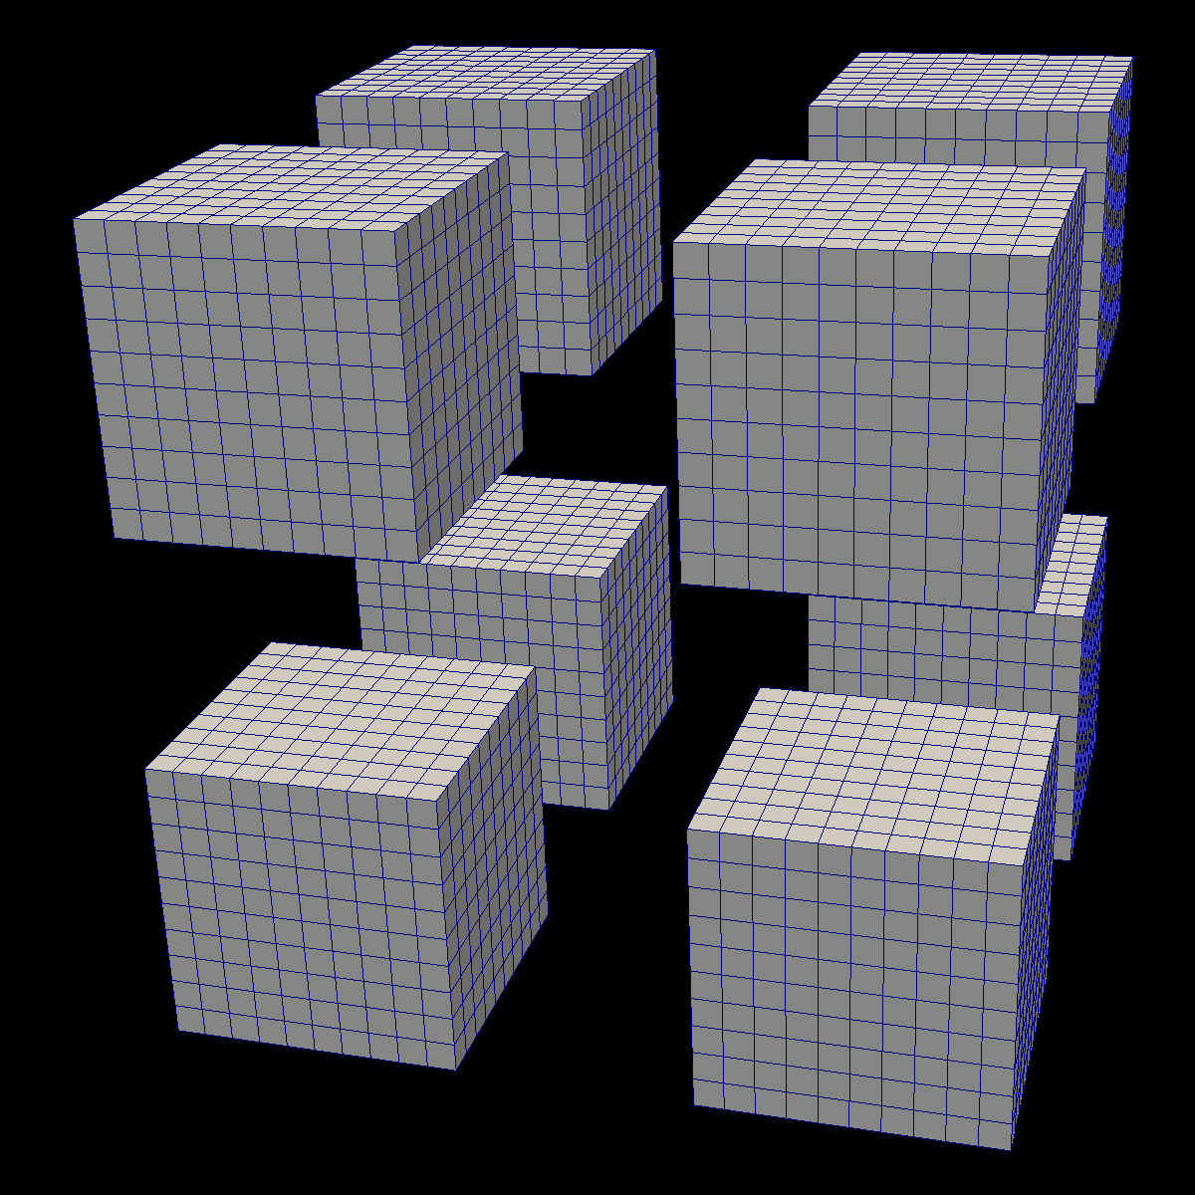
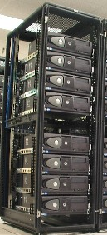



Distributed
Parallelism

Slide 22
Distributed
Parallelism
On Node
Parallelism

Slide 23

Isosurface
Streamline
Clip
Render
GPU
CPU
TBB
OpenMP

Slide 24
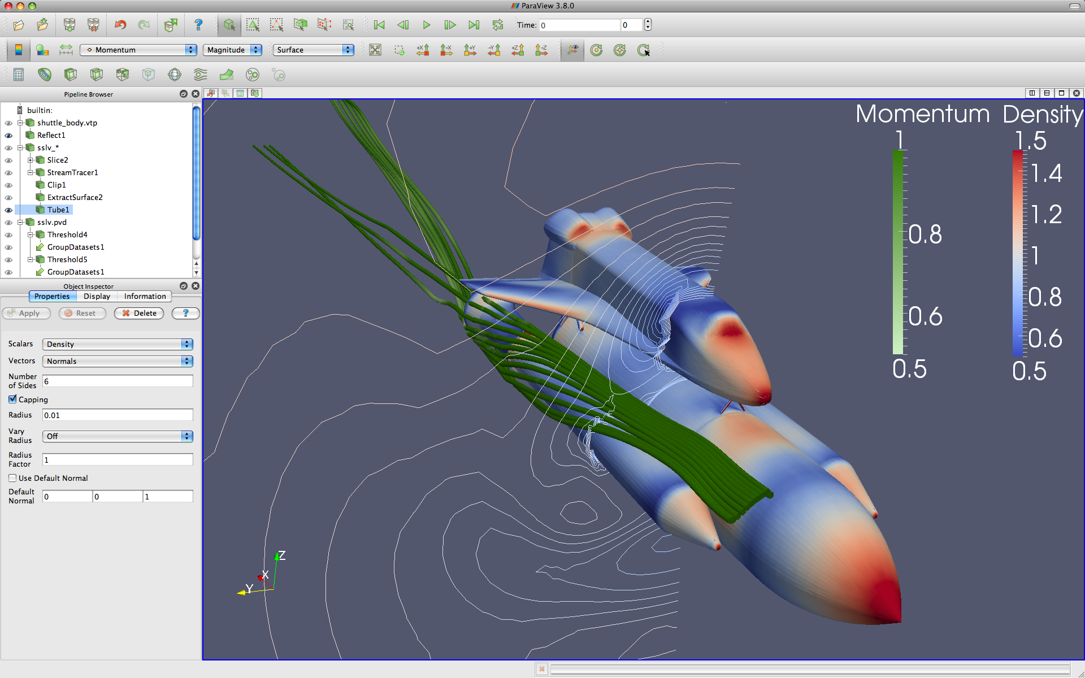



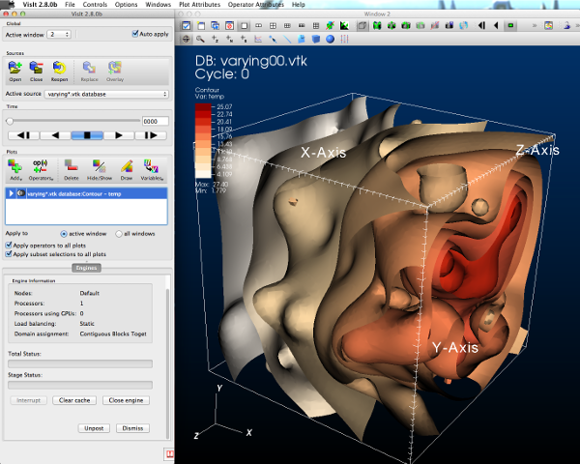



GUI / Parallel Management
In Situ Vis Library
(Integration with Sim)
Base Vis Library
(Algorithm Implementation)
Simulations
Libsim
Multithreaded Algorithms
Processor Portability

Slide 25

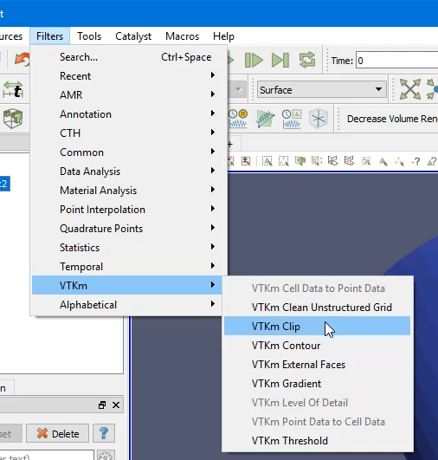
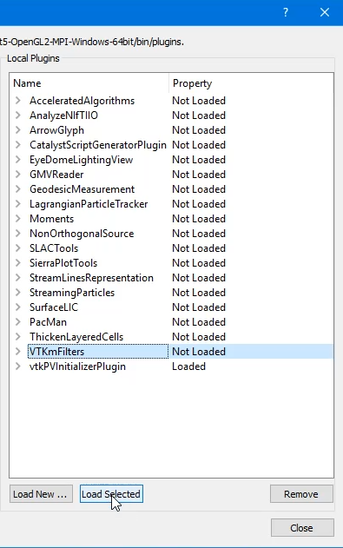
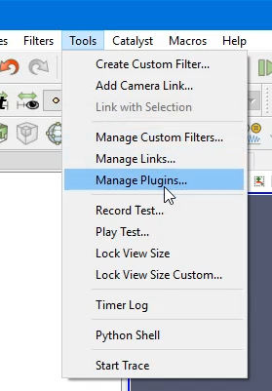
In ParaView
2. Use a VTK-m filter like any other
1. Load VTK-m Plugin
Slide Credit: Ken Moreland

Slide 26
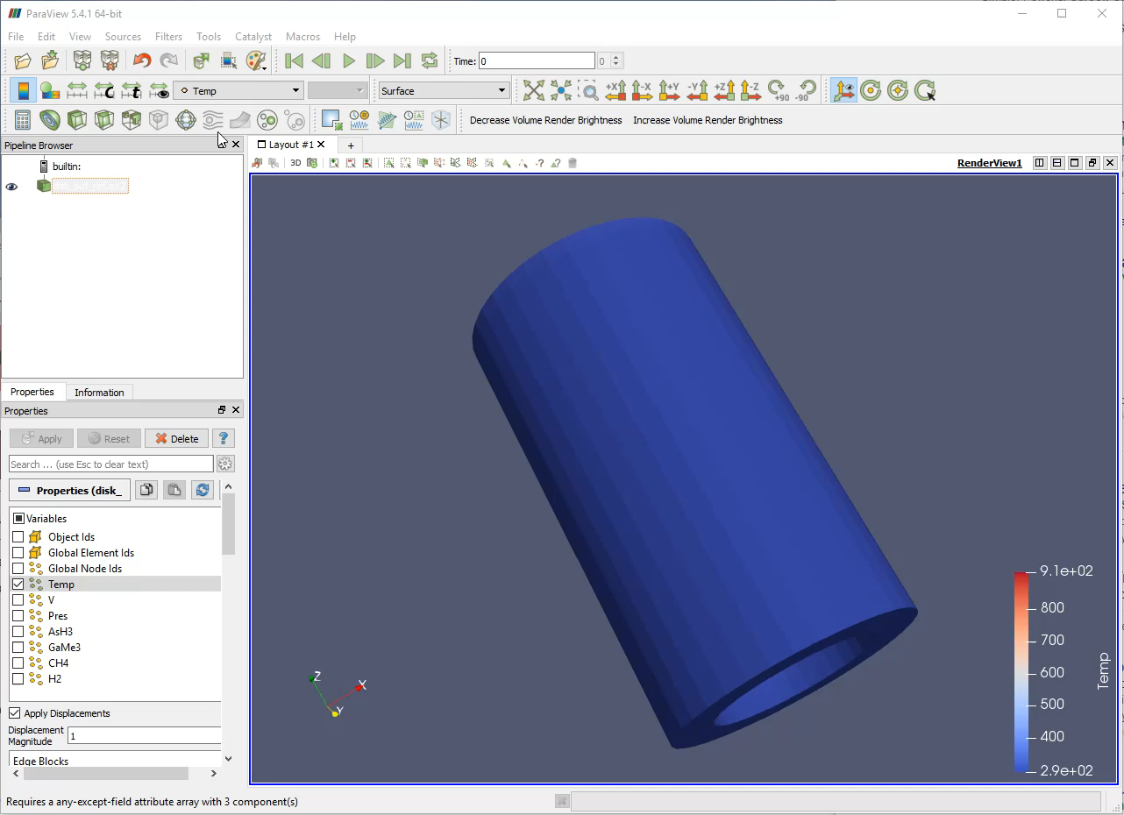
Slide Credit: Ken Moreland

Slide 27
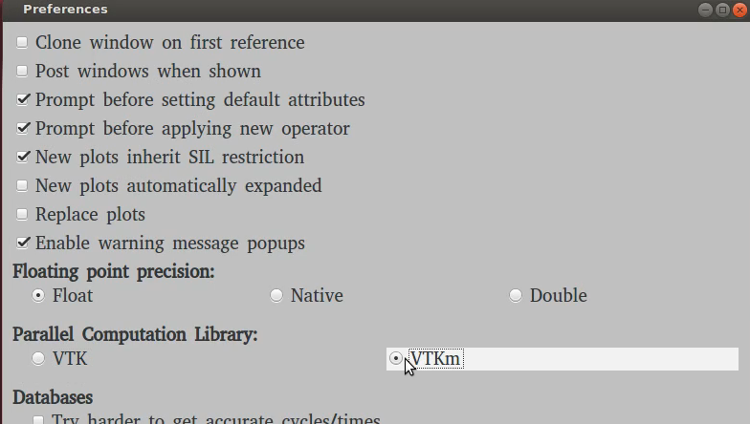
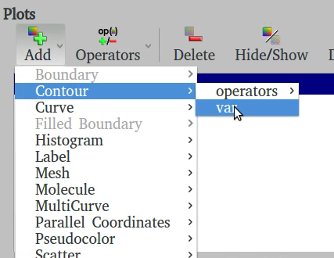
In VisIt
1. Turn on VTK-m in Preferences
2. Use VTK-m enabled plots as normal
Slide Credit: David Pugmire

Slide 28
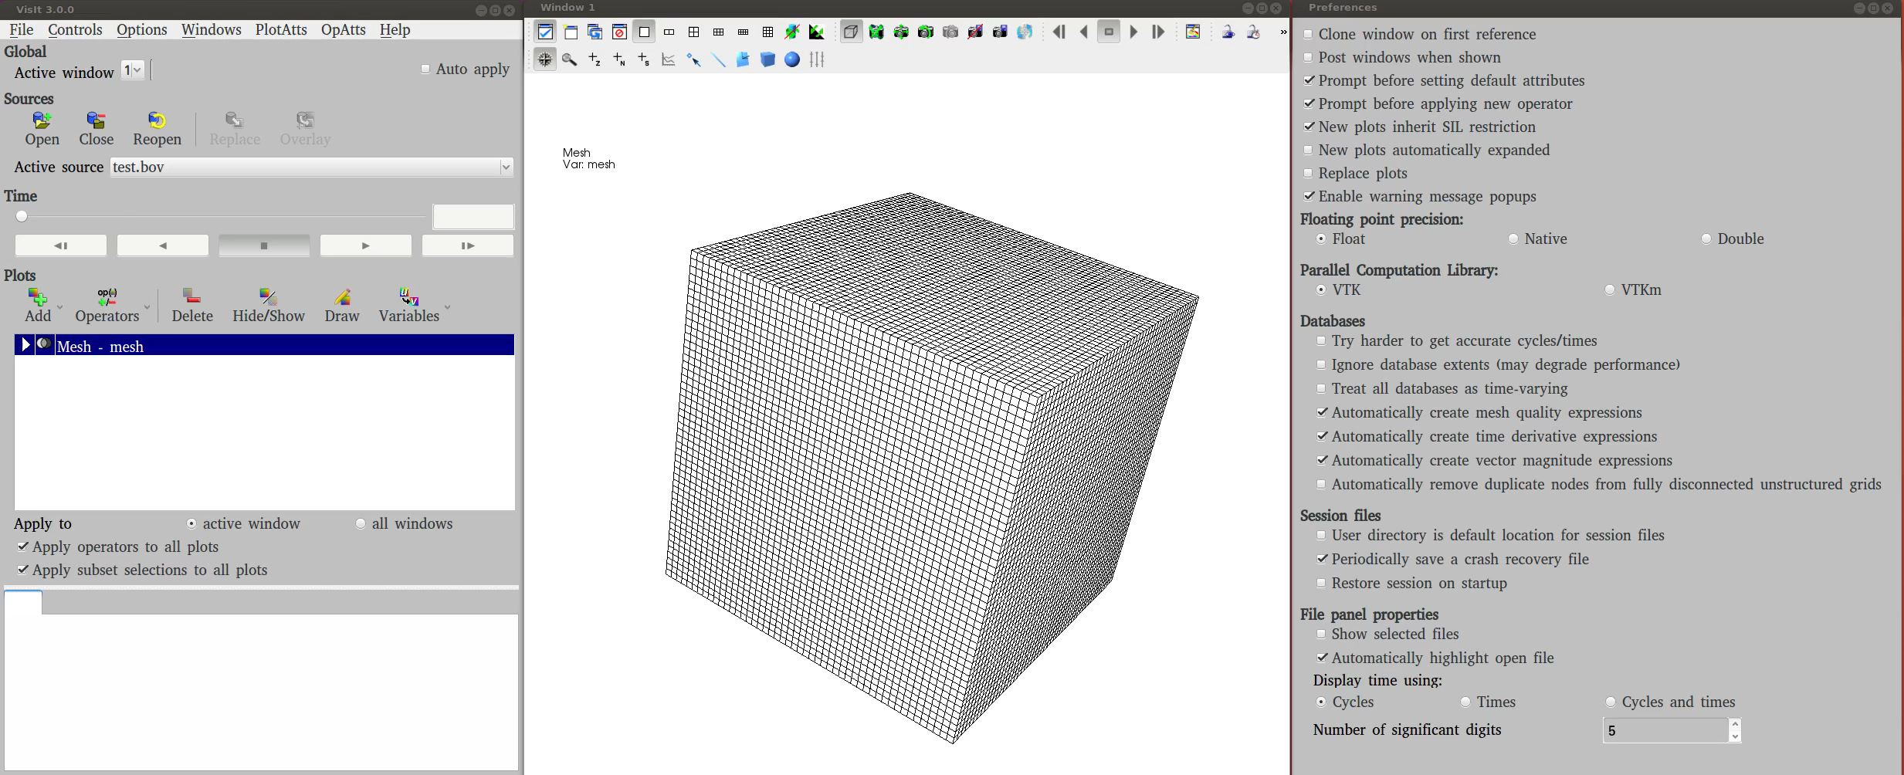
Slide Credit: David Pugmire

Slide 29
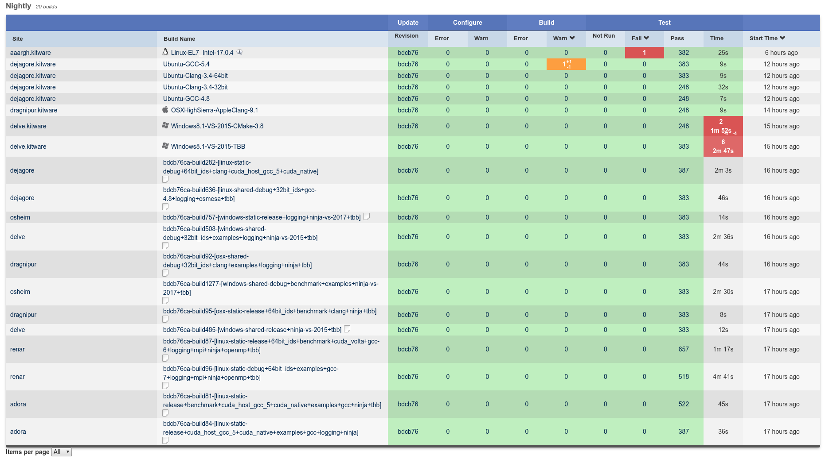
Project is serious about software engineering: revision control, documentation, testing, etc.

Slide 30
Need slide on performance!!!

Slide 31
STOP SKIPPING SLIDES FOR HACK-A-THON TUTORIAL

Slide 32
Important design stuff that even users should know about

Slide 33
Design of VTK-m
VTK-m split into two environments: control and execution
Each has its own API
Direct interaction between the environments is disallowed
Let’s learn more about control and execution environments

Slide 34
Control Environment
API is for people that want to use VTK-m’s existing functionality
Used to:
  interface with applications
  interface with I/O devices
  schedule parallel execution of the algorithms
Code for the control environment is designed to run on a single thread (or one single thread per process in an MPI job)

Slide 35
Execution Environment
Where computational portion of algorithms are executed
Code for the execution environment is designed to always execute on a very large number of threads
The execution environment depends on worklets

Slide 36
Execution Environment:
What is a worklet? (1/2)
VTK-m provides programming construct called “worklet”
  small functor or kernel designed to operate on a small element of data
The name “worklet” actually means a small amount of work
But: for VTK-m, amount of data is small, not necessarily the amount of instructions performed

Slide 37
Execution Environment:
What is a worklet? (2/2)
For VTK-m, worklets must be serial and stateless functions
Serial/stateless enables three critical goals:
  Pervasive parallelism. Allows VTK-m to schedule worklet invocations on many independent concurrent threads.
  Thread safety. By controlling the memory access the toolkit can insure that no worklet will have any memory collisions, false sharing, or other parallel programming pitfalls.
  Good programming practices. The worklet model provides a natural approach to visualization algorithm design that also has good general performance characteristics.

Slide 38
Execution Environment:
How do worklets become usable code?
Developers write worklets as serial components
VTK-m handles whatever layers of concurrency are necessary, thereby removing the onus from the visualization algorithm developer
  Concurrency within CUDA, TBB, OpenMP, etc.
Worklet operation is then wrapped into filters, which provide a simplified interface to end users

Slide 39
Bridges between control and execution environments
Data!
  Need to refer to data in control environment, but have it accessible in execution environment
  Need to get results from execution environment back to control environment
  Key concept in VTK-m: Array Handles
Many-core device:
  Need to have control environment select which architecture execution environment should run on
  Need to have control environment invoke code on execution environment
  Key concept in VTK-m: Device Adaptors

Slide 40
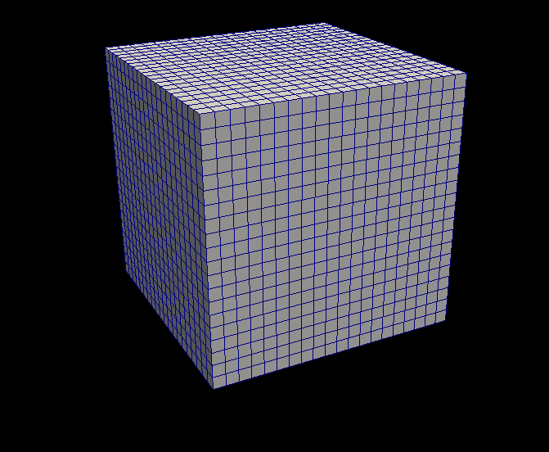
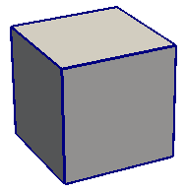
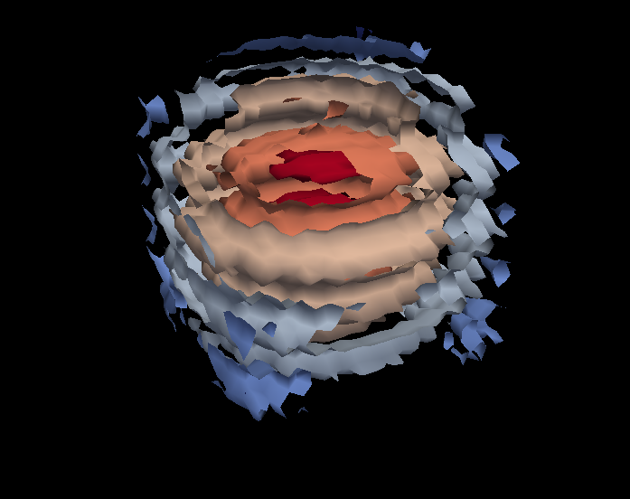
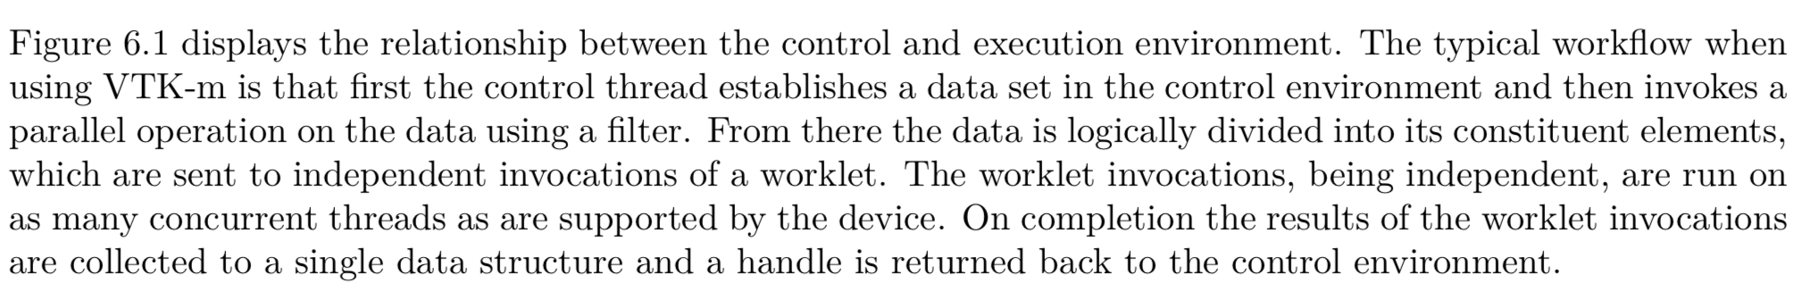
Control Environment
Grid Topology
Array Handle
Invoke
Execution Environment
Cell Operations
Field Operations
Basic Math
Make Cells
Device Adapter
Allocate
Transfer
Schedule
Sort
…
Worklet

Slide 41
Enough about execution environment … back to control environment for a while

Slide 42
Tutorial Schedule
30m
35m
30m
50m
35m
30m
Introduction / software install
Concepts behind VTK-m usage VTK-m: Control Environment
Using VTK-m (hands on)
Concepts behind VTK-m development
VTK-m example (hands on)
Discussion of upcoming activities / wrap up

Slide 43
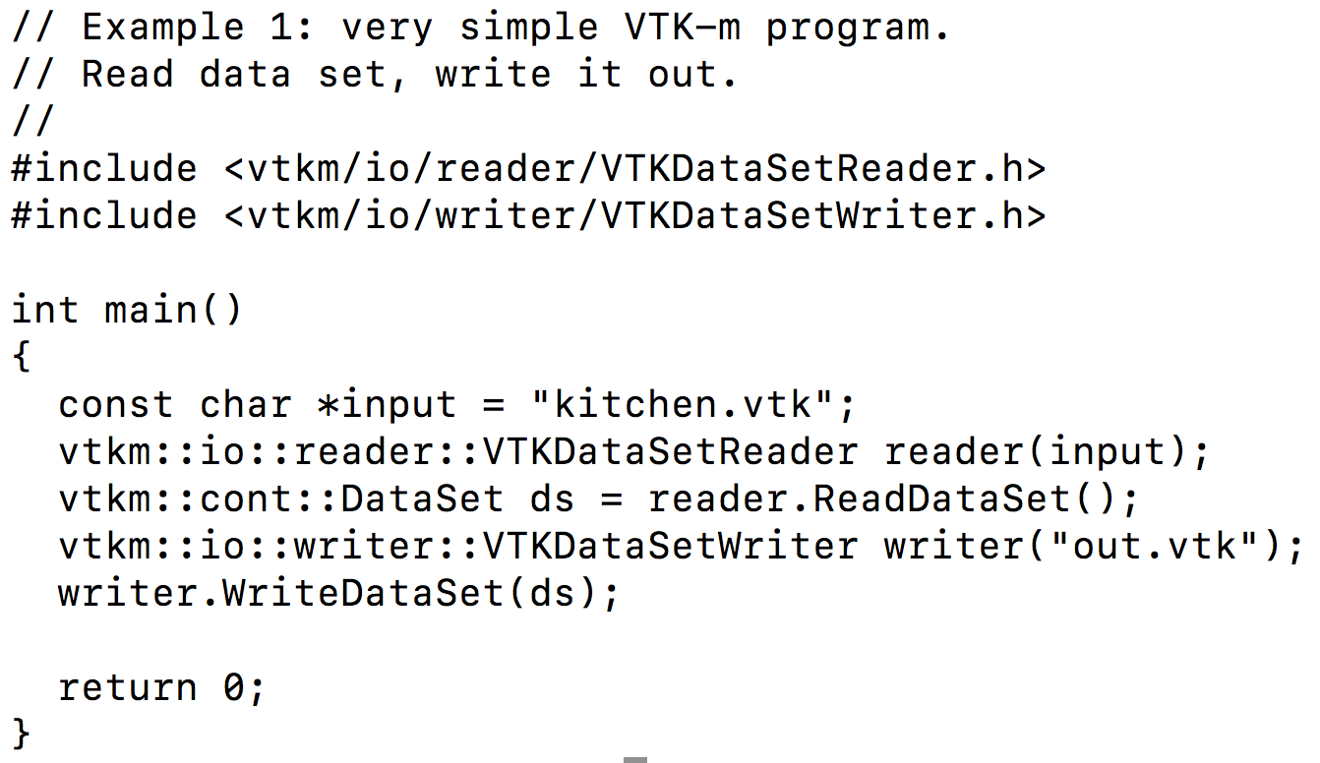
Our first program: tut_io.cxx
This is effectively a “copy” program for VTK files.
Instantiate a module that reads VTK files.
Constructor takes a file name (“kitchen.vtk”).
Instruct the reader module to read the data set from the file.
The “ReadDataSet” method returns a vtkm DataSet.
Instruct the writer module to write the data set to a file.
The “writeDataSet” method takes a vtkm DataSet.
Instantiate a module that writes VTK files.
Constructor takes a file name (“out.vtk”).
Let’s run it!

Slide 44
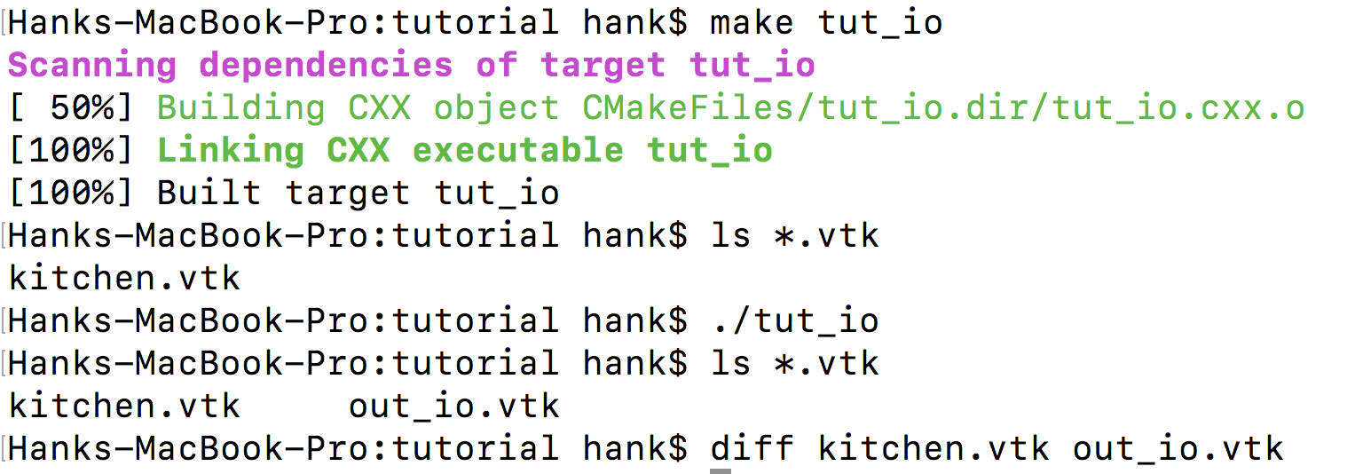
Now let’s focus on smaller details of the program.

Slide 45
Our first program: tut_io.cxx
Header files are organized hierarchically.
Let’s learn more about how the header files are organized

Slide 46
Organization of header files
Directory vtk-m-v1.4.0/vtkm has 10 subdirectories:
Directory | Theme | Type
cont/ | Control environment: base objects used to ‘cont’rol VTK-m | Beginning usage
filter/ | Contains filters | Beginning usage
io/ | I/O – readers and writers | Beginning usage
rendering/ | Rendering modules | Beginning usage
interop/ | Interoperation between GPGPU and OpenGL memory | Advanced usage
exec/ | Execution environment: “execution objects” needed for advanced development use cases for defining better data structures for worklets | Development
internal/ | Internals for VTK-m | Development
worklet/ | Worklets | Development
testing/ | Unit tests | Advanced development
thirdparty/ | Third party libraries | Advanced development

Slide 47
Our first program: tut_io.cxx
VTK-m makes heavy use of namespaces.
So what are the namespaces?
This means the type (class) VTKDataSetReader.
And VTKDataSetReader is within the “reader” namespace.
And reader is within the “io” namespace.
And io is within the “vtkm” namespace.

Slide 48
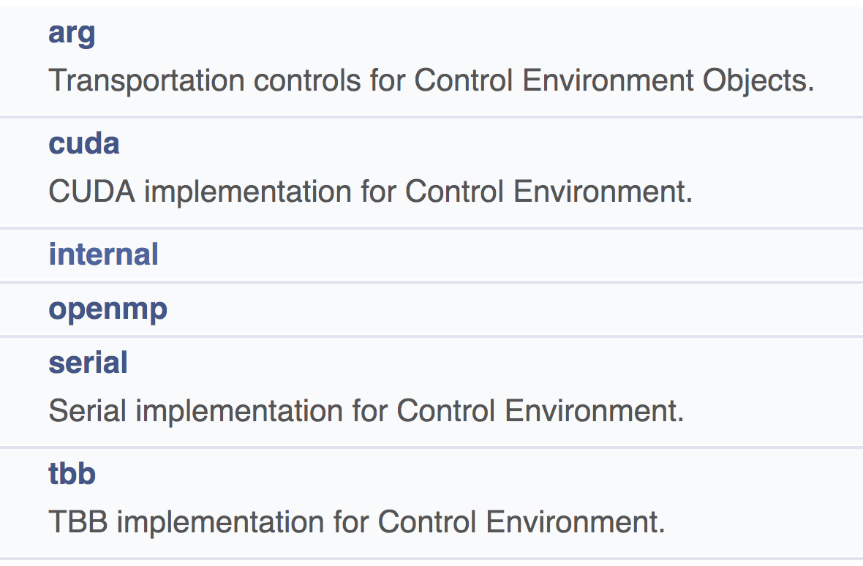
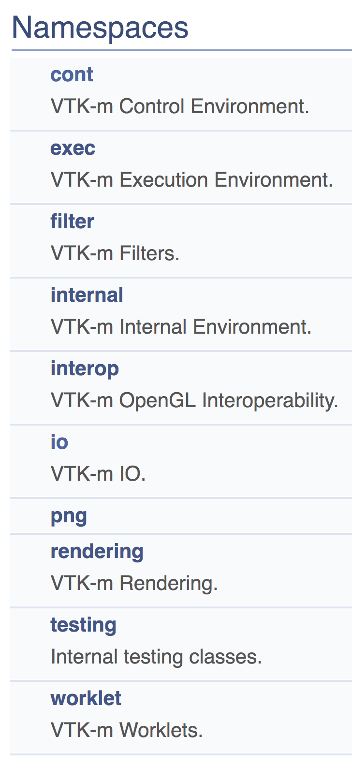
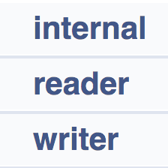
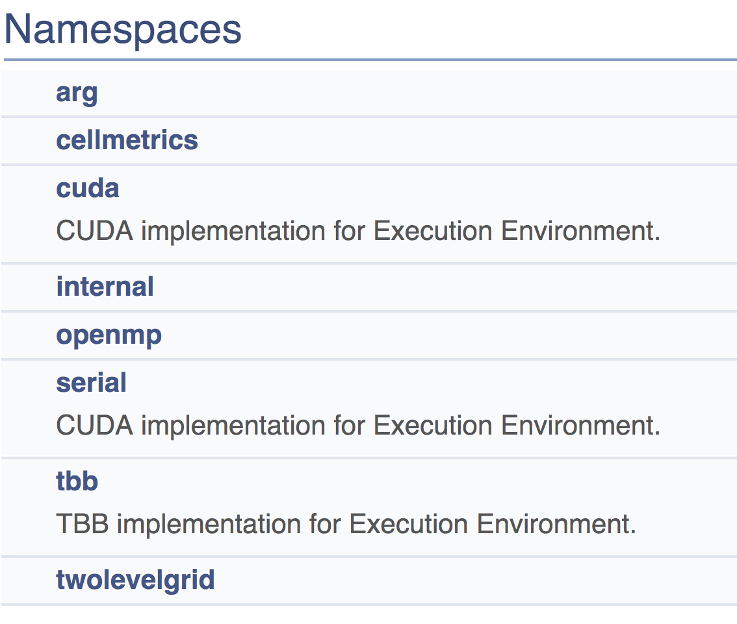
VTK-m namespaces
exec, filter, internal, interop, png, rendering, testing, and worklet contain zero or few namespaces

Slide 49
Our first program: tut_io.cxx
This execution model is different than VTK.
VTK is demand-driven: “Update()” / “Execute()”
With VTK-m, certain calls prompt modules to Execute.
The user (you!) manages when things execute.
ReadDataSet does I/O work when you call it.
DataSet ds is then resident in memory (on the execution device).
WriteDataSet does I/O work when you call it.

Slide 50
VTK-m filters
What is a filter?
  definition #1: encodes an algorithm
  definition #2: modules that take data as input and create new data as output
      Data type is always vtkm::cont::DataSet (or its cousin for “multi-block”)
Methods:
  Many methods for setting algorithm parameters (e.g., set isovalues for marching cubes)
  Execute(): input is passed as argument(s) and output is returned by function call
    Again: this is different than VTK’s Update()/Execute()
  Note: must set algorithm parameters before calling Execute()
    It does the work when Execute() is called
Let’s consider a simple example.

Slide 51
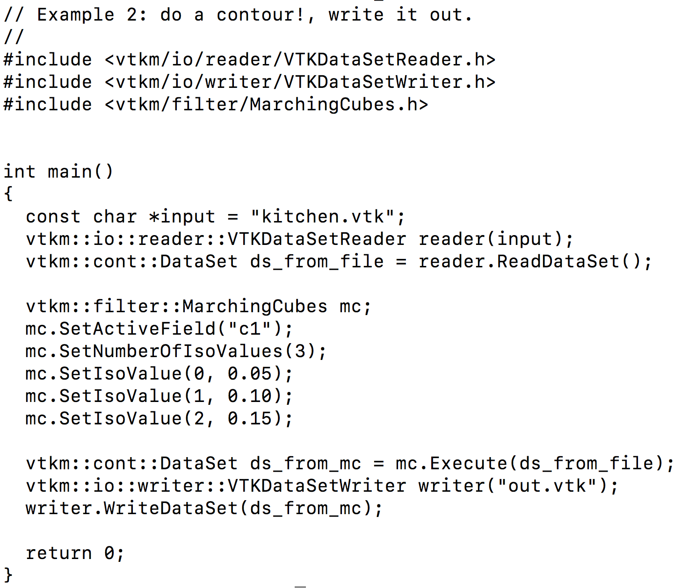
Our second program: tut_mc.cxx
Include header for MarchingCubes filter
Same as before: read from file
MarchingCubes is in the filter namespace
Set parameters: isosurface by field “c1” and use isovalues 0.05, 0.10, and 0.15.
Explicitly force execution
Same as before: write to file

Slide 52
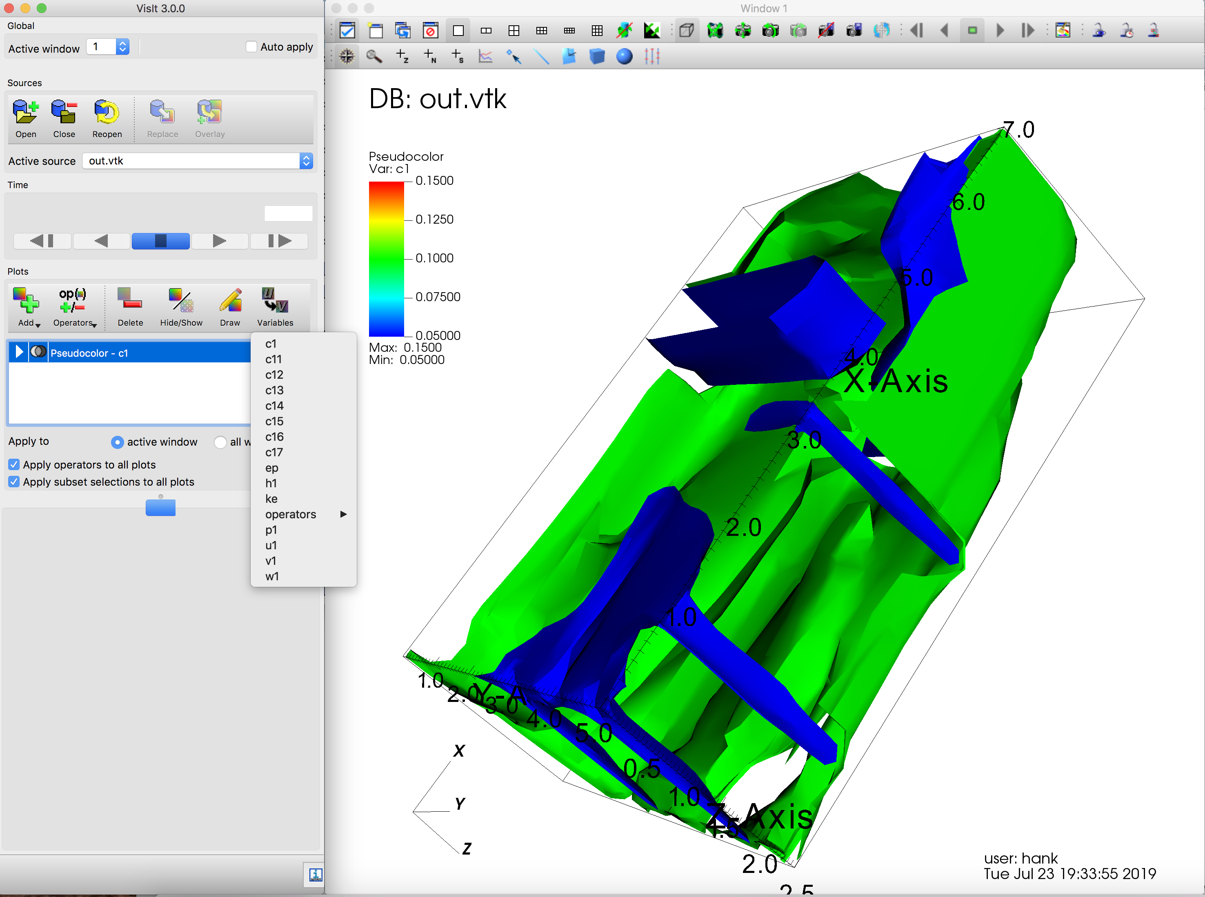
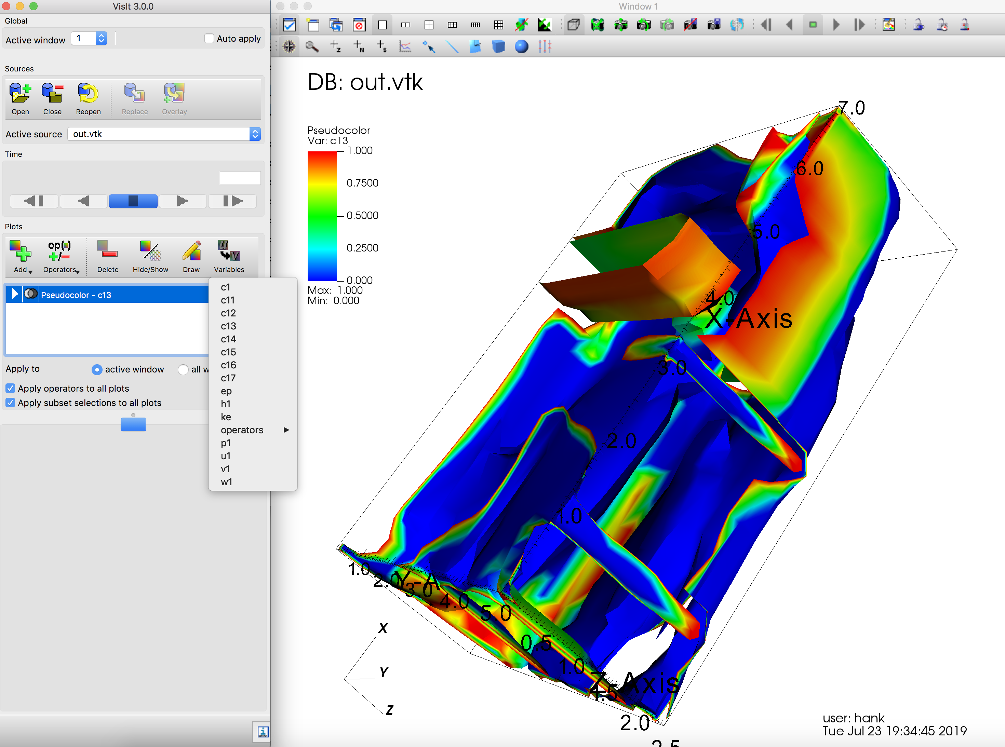
kitchen.vtk contains many fields
Each of these fields was interpolated onto the isosurface
Many fields written to out_mc.vtk
Field c1 (isosurfaces at c1 == 0.05, 0.1, 0.15)
Field c13 (isosurfaces at c1 == 0.05, 0.1, 0.15)

Slide 53
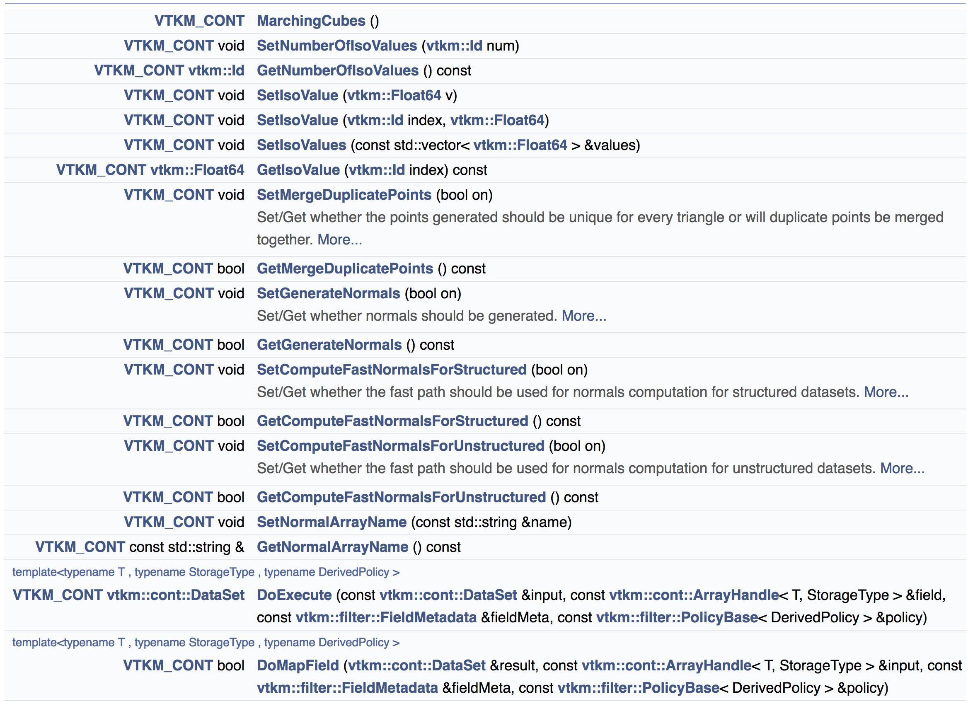
Each filter has many attributes, which can be set by calling methods before Execute()
Methods for
MarchingCubes
(1/3)

Slide 54
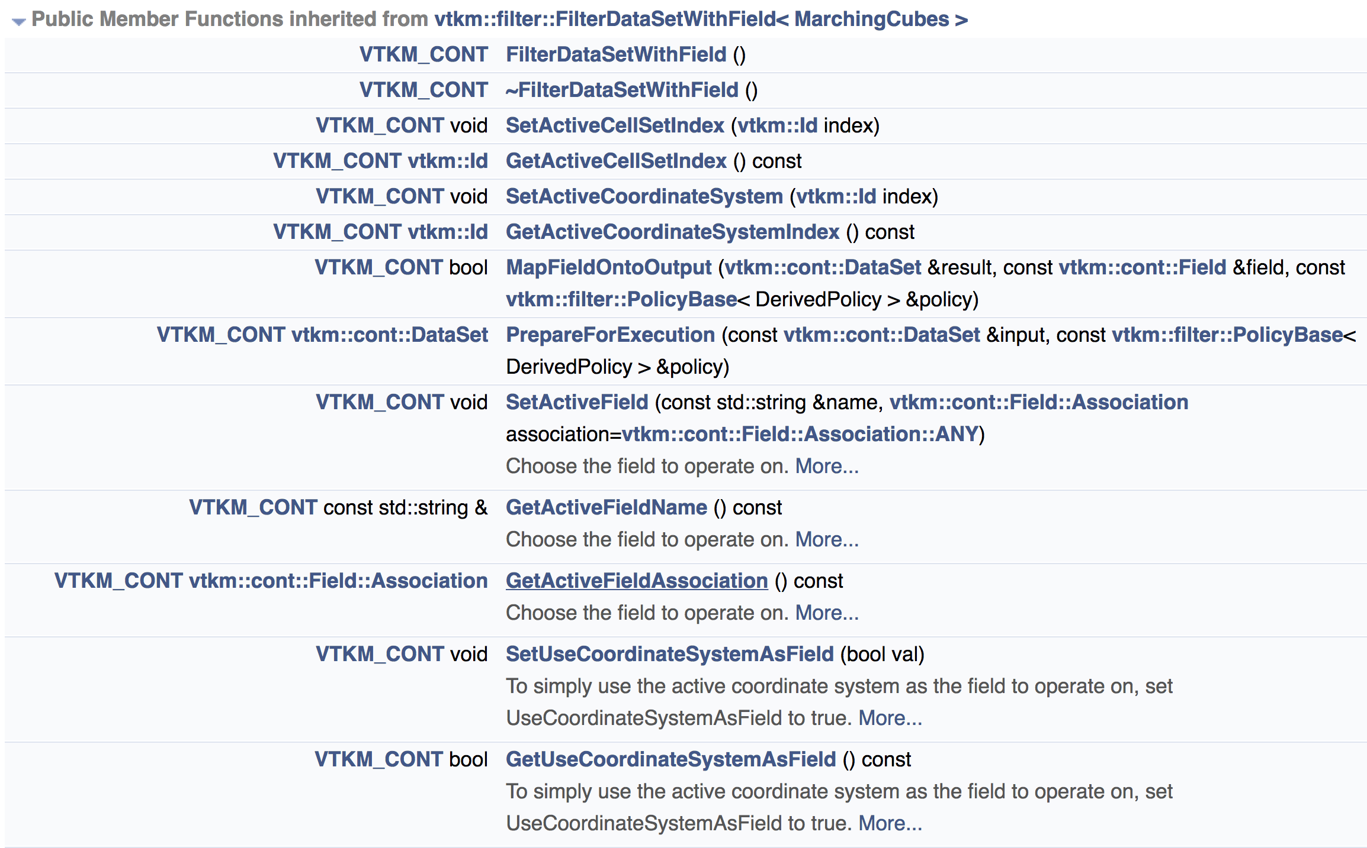
Each filter has many attributes, which can be set by calling methods before Execute()
Methods for
MarchingCubes from its base class
“FilterDataSetWithField”
(2/3)

Slide 55
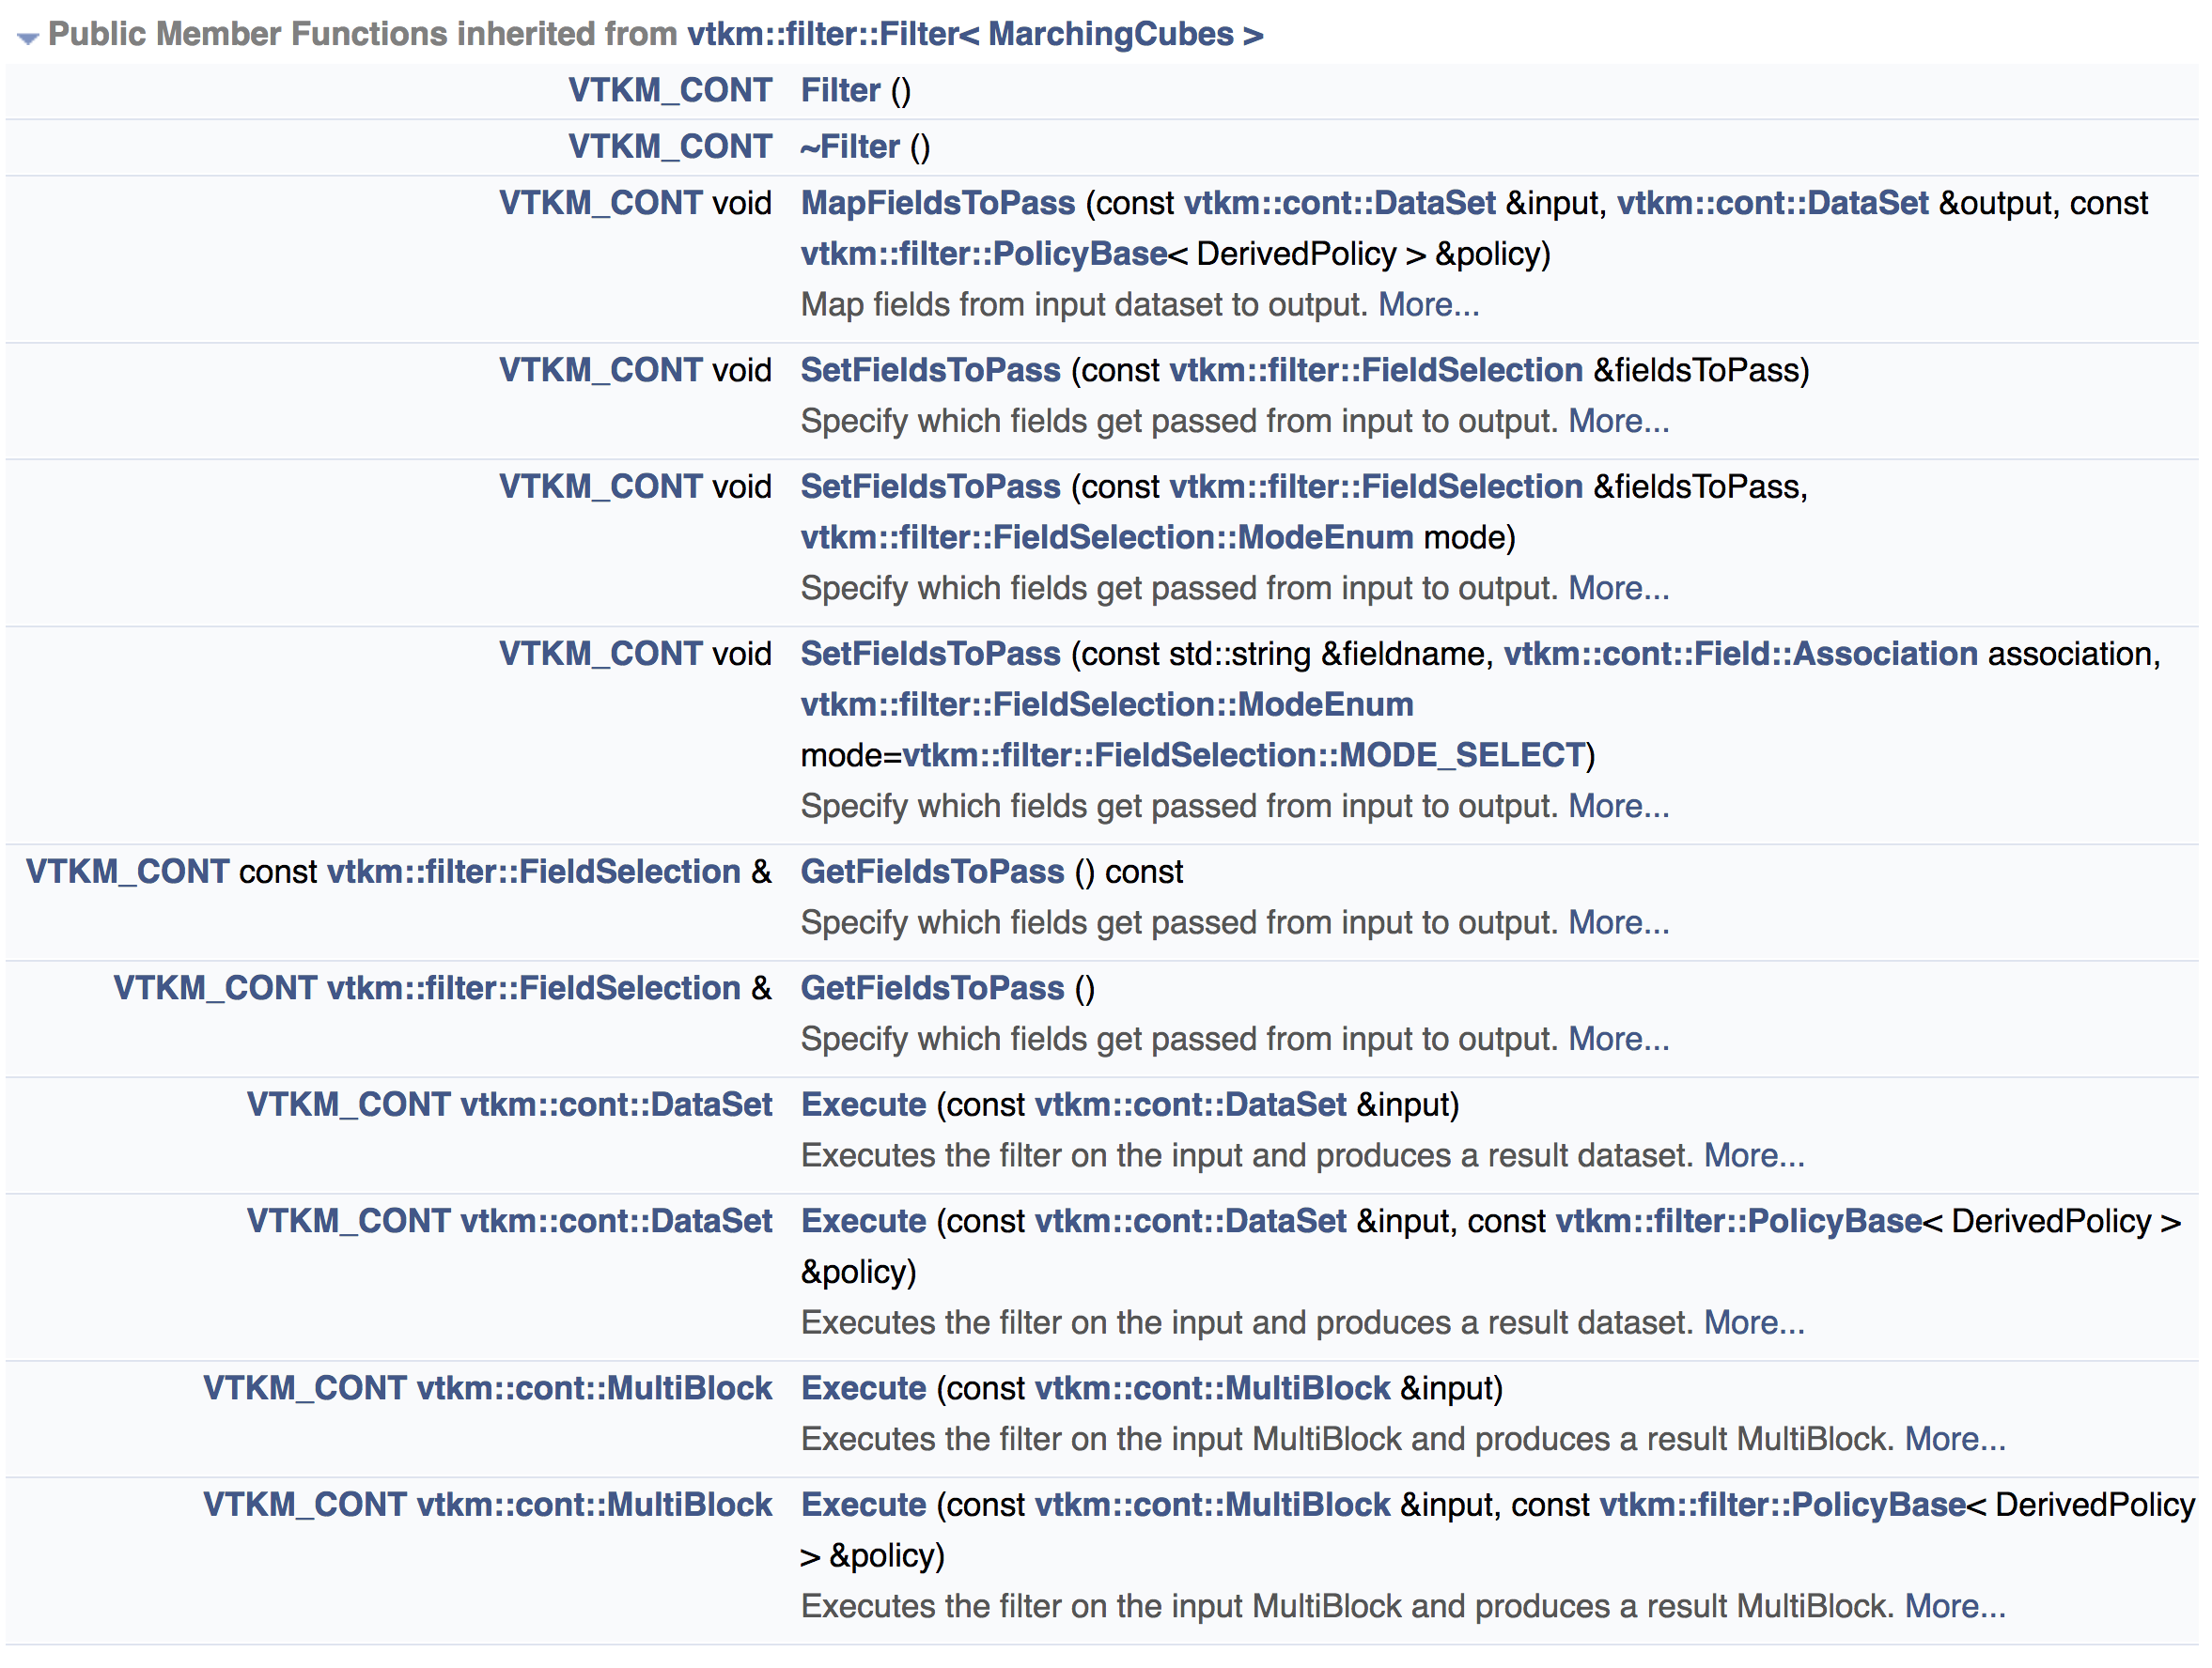
Each filter has many attributes, which can be set by calling methods before Execute()
Methods for
MarchingCubes from
“FilterDataSetWithField”’s
base class
”Filter”
(3/3)
Let’s use this
But how to learn more?

Slide 56
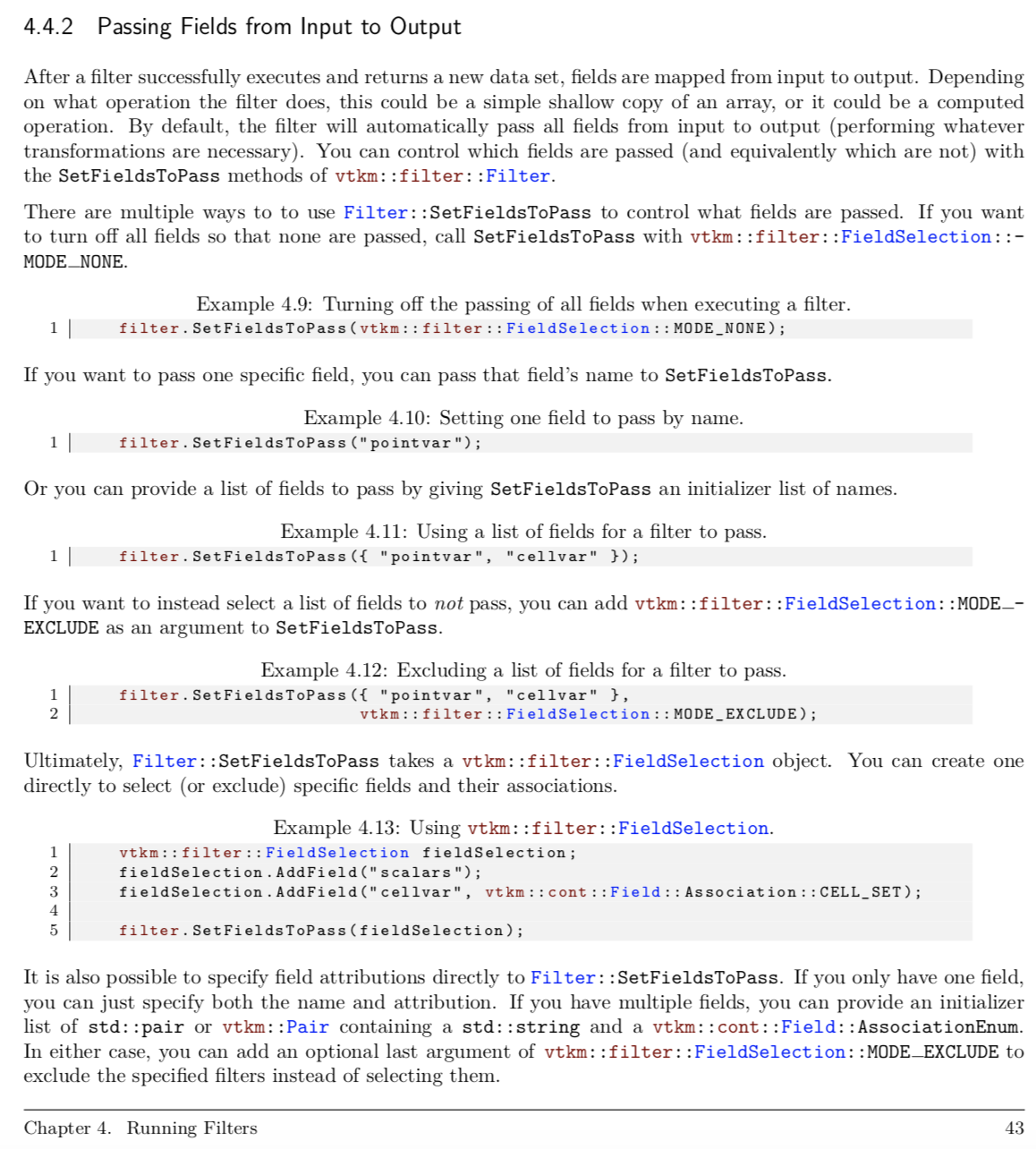
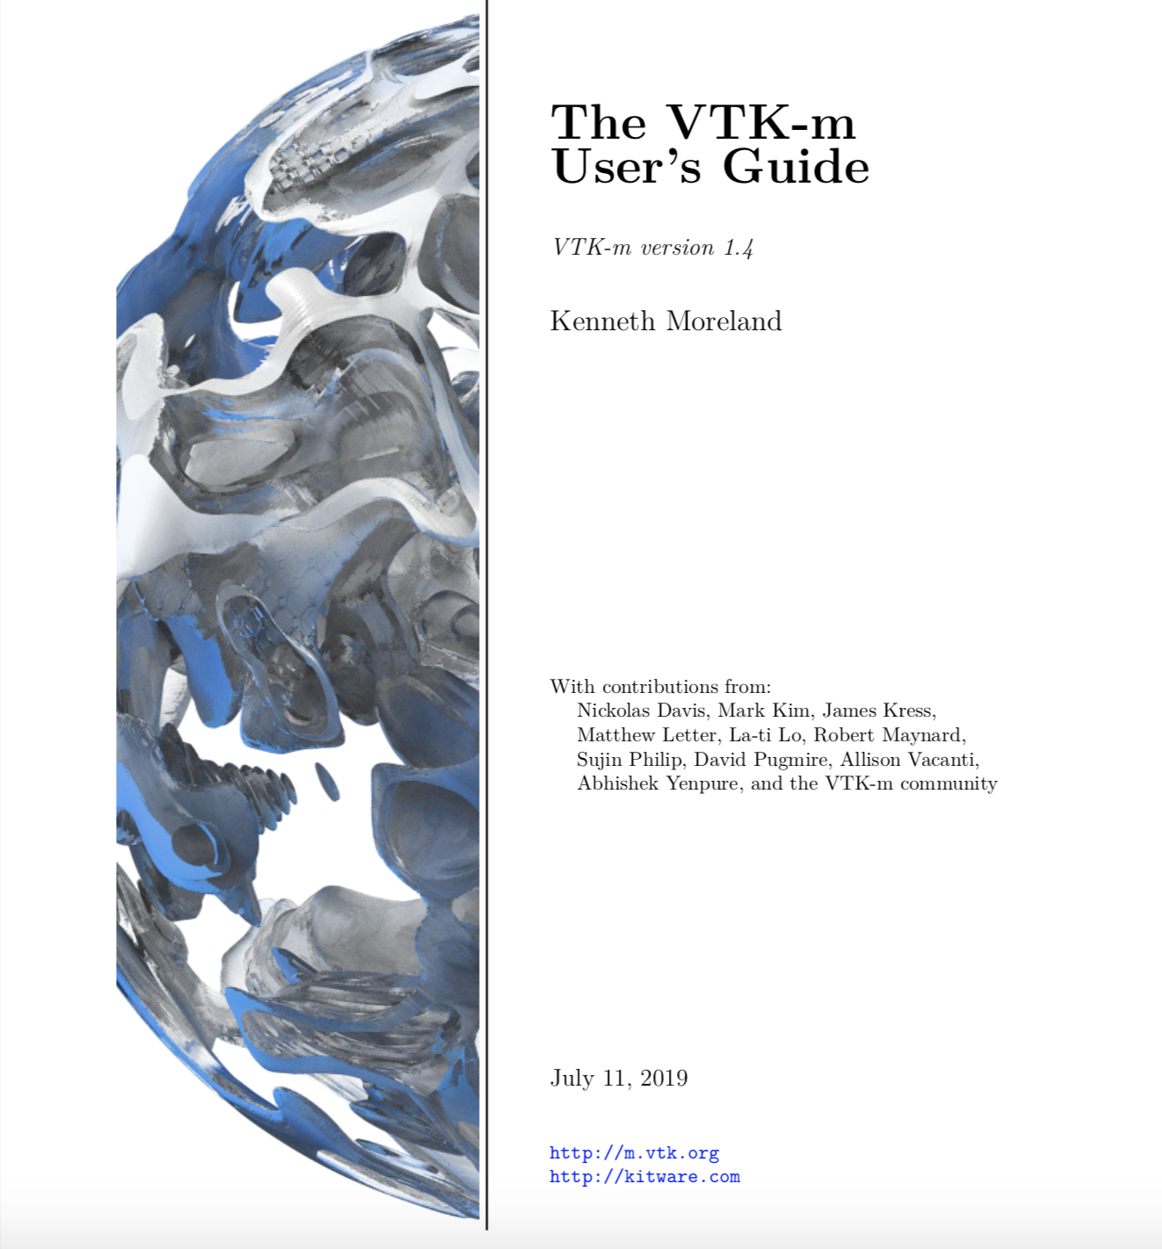
User’s Guide has extensive documentation
TOO SMALL TO READ

Slide 57
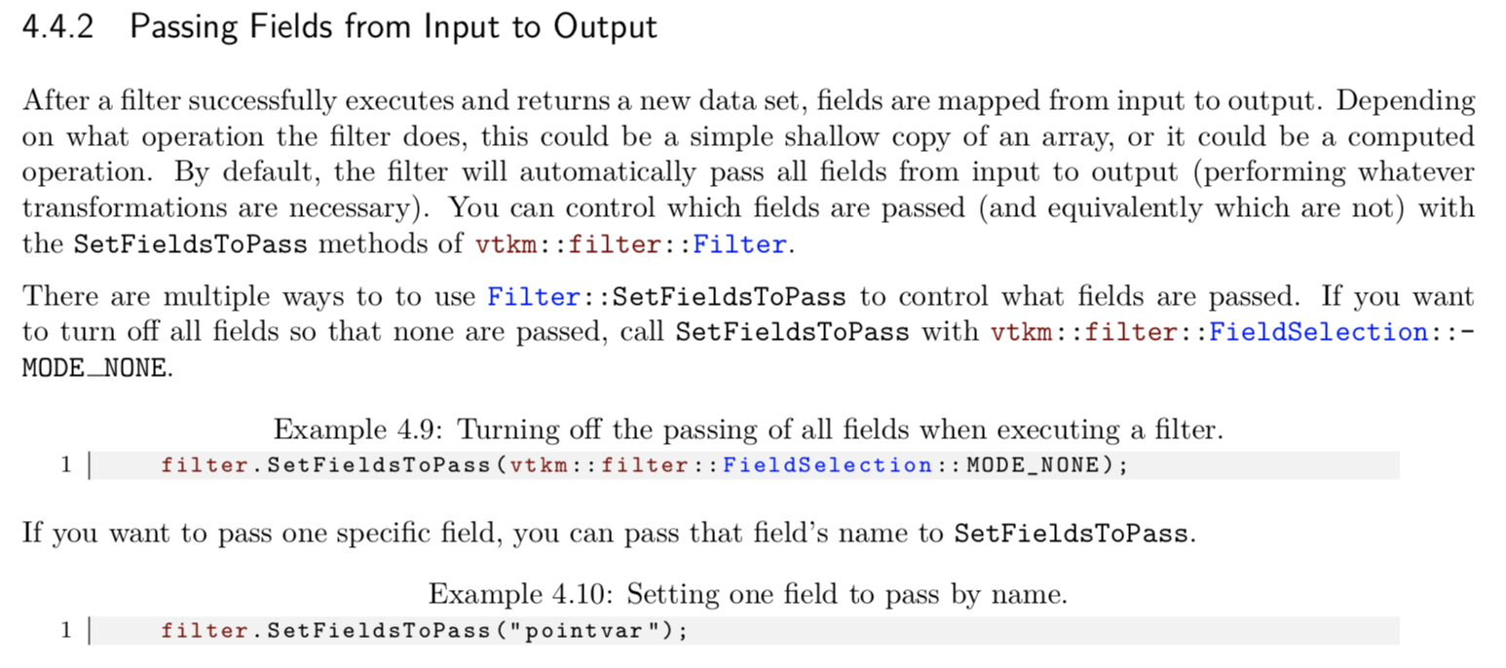
Contents of User’s Guide: Passing Fields (1/3)

Slide 58
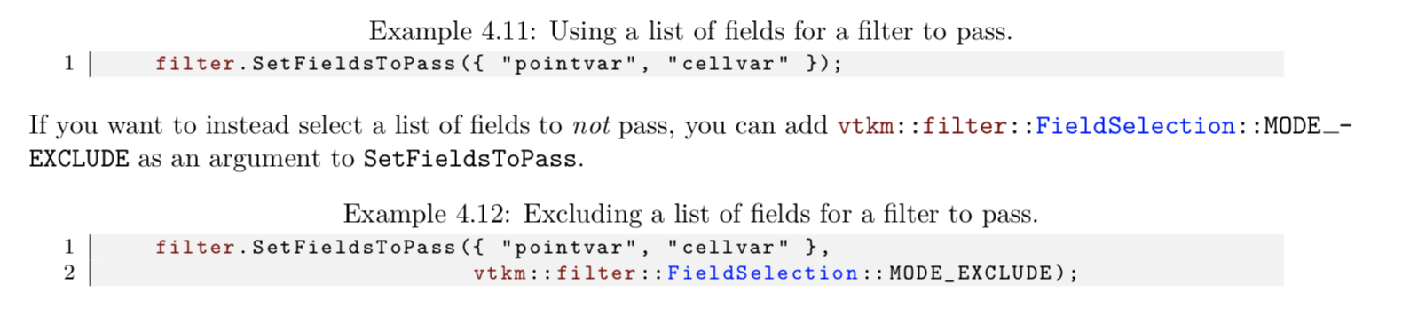
Contents of User’s Guide: Passing Fields (2/3)
We will do this one for our next example.

Slide 59
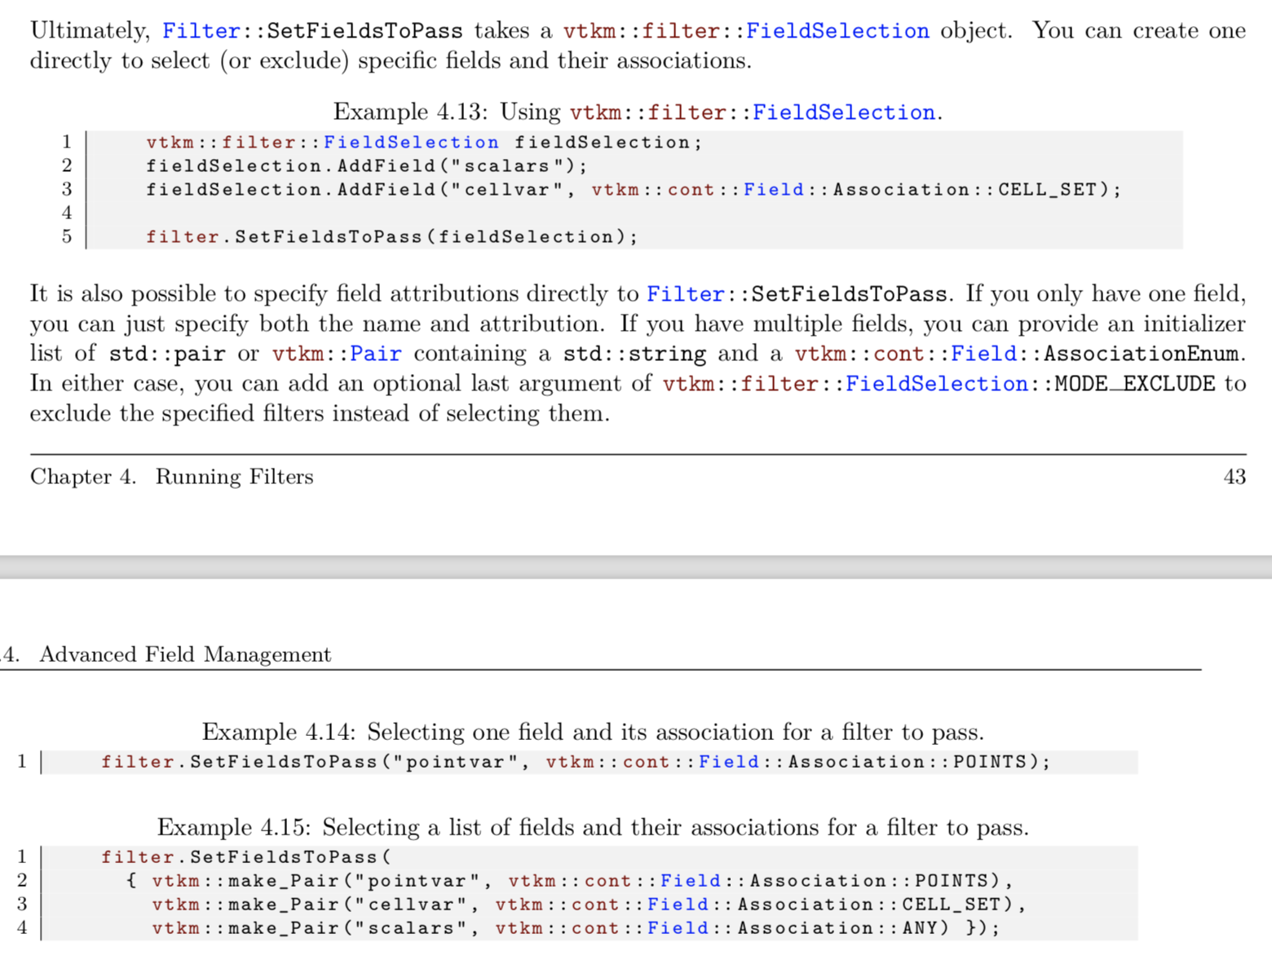
Contents of User’s Guide: Passing Fields (3/3)
Gets increasingly complex.
Let’s skip this.
(Read the manual for more.)

Slide 60
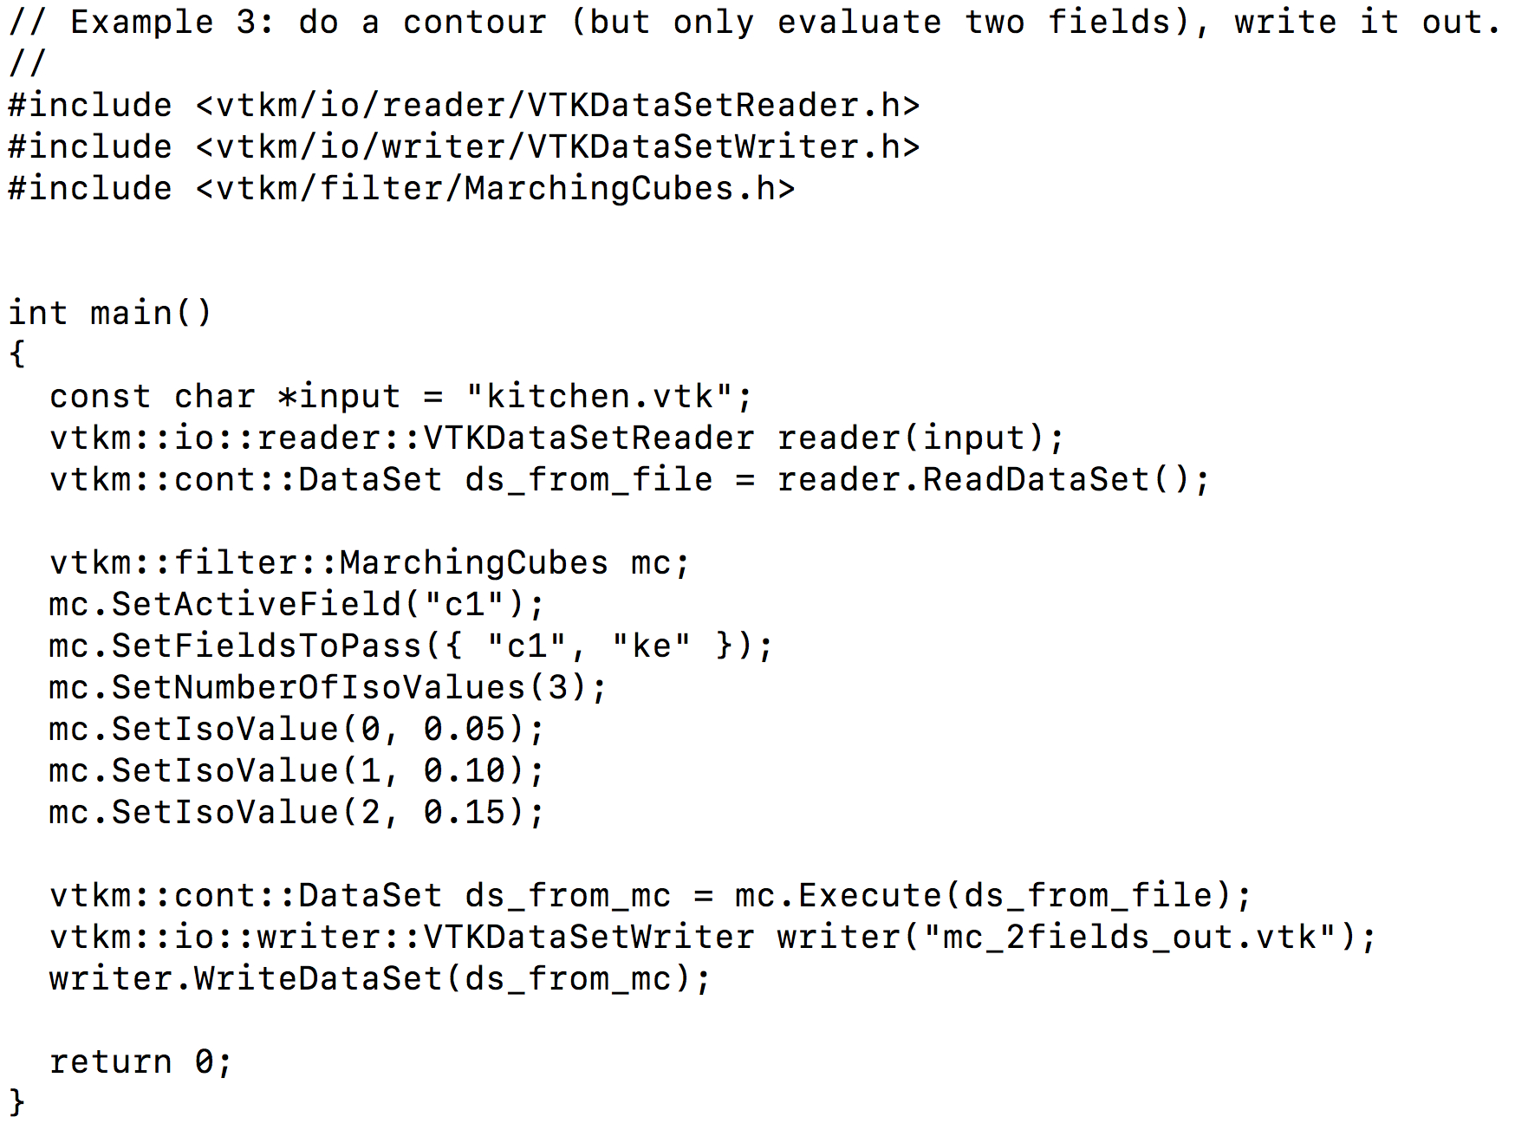
Our third program: tut_mc_2fields.cxx
New function call
(rest is the same)

Slide 61
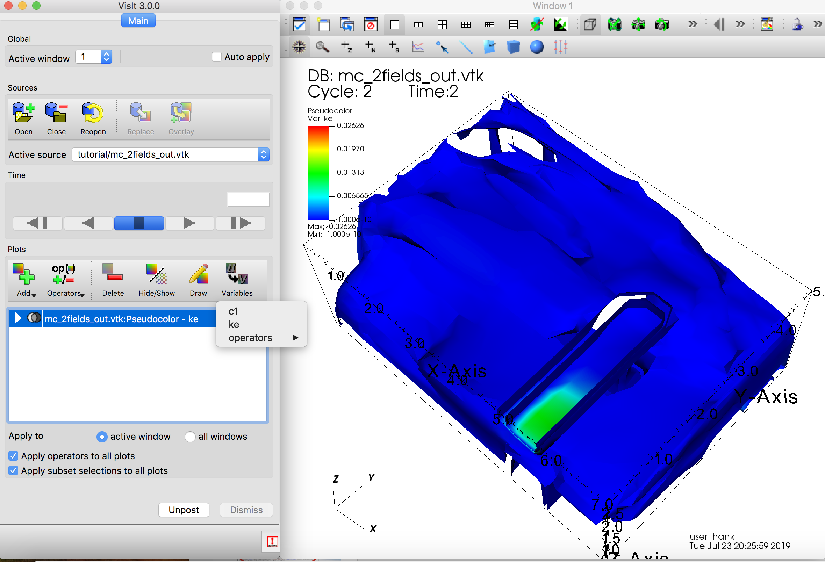
Now only two fields calculated, written out.
(operators is a VisIt thing)

Slide 62
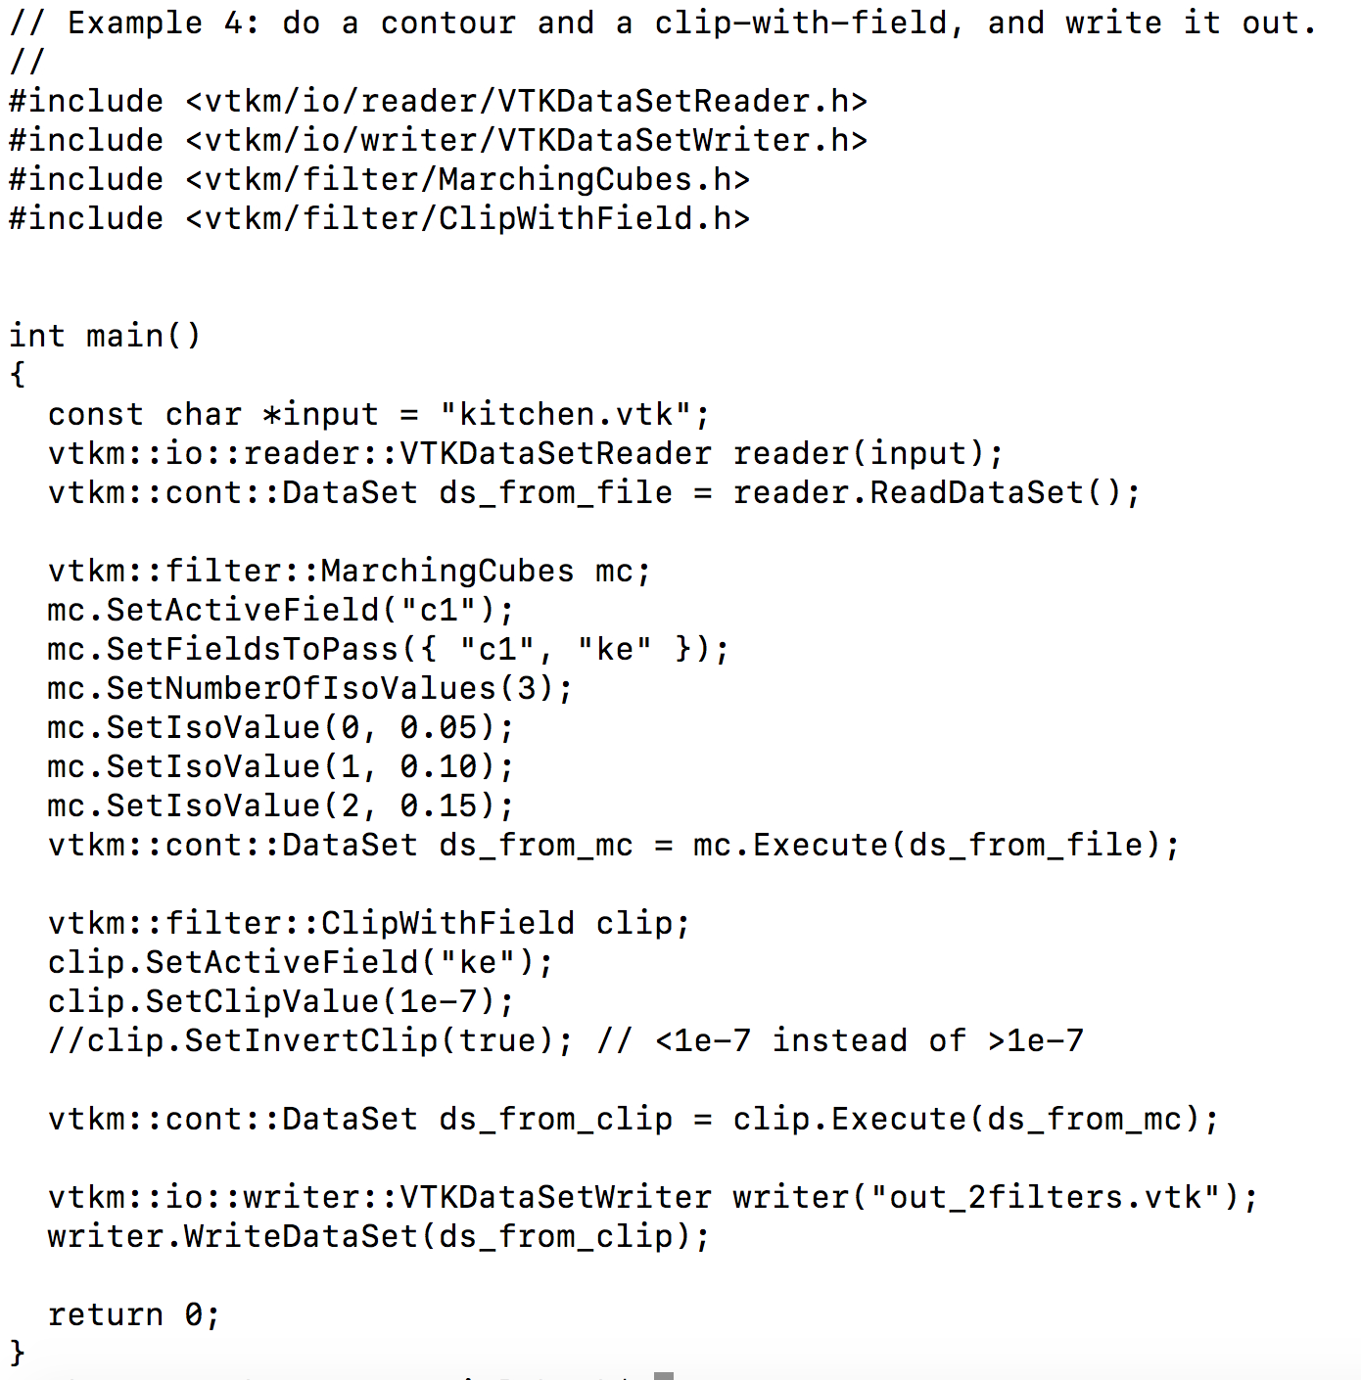
Our fourth program: tut_mc_2filters.cxx
Good thing we passed “ke”
Now do a clip-with-field
Call Execute() a second time, input to Execute() is output from MarchingCube::Execute()

Slide 63
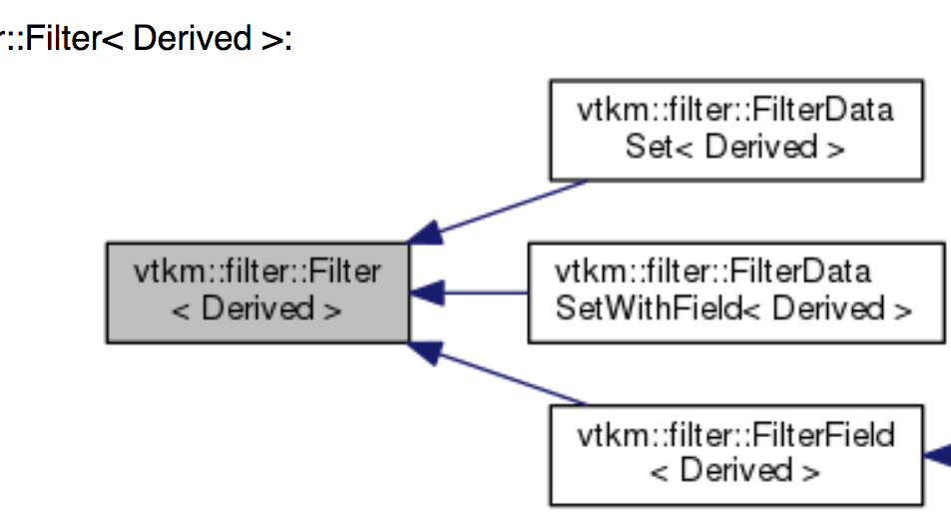
Filters in VTK-m fall into 3 classes
This inheritance hierarchy
is important!
Field Filters
Data Set Filters
Data Set With Field Filters
Consider example of vtkm::filter::MarchingCubes
5 derived types
6 derived types
including MarchingCubes
16 derived types

Slide 64
SLIDE REPEAT:
Each filter has many attributes, which can be set by calling methods before Execute()
Methods UNIQUE TO
MarchingCubes
(1/3)

Slide 65
SLIDE REPEAT:
Each filter has many attributes, which can be set by calling methods before Execute()
Methods for
MarchingCubes from its base class
“FilterDataSetWithField”
(2/3)

Slide 66
SLIDE REPEAT:
Each filter has many attributes, which can be set by calling methods before Execute()
Methods for
MarchingCubes from
“FilterDataSetWithField”’s
base class
”Filter”
(3/3)

Slide 67
Filters in VTK-m fall into 3 classes
Let’s better understand what these three base types mean.
Field Filters
Data Set Filters
Data Set With Field Filters
5 derived types
6 derived types
16 derived types

Slide 68
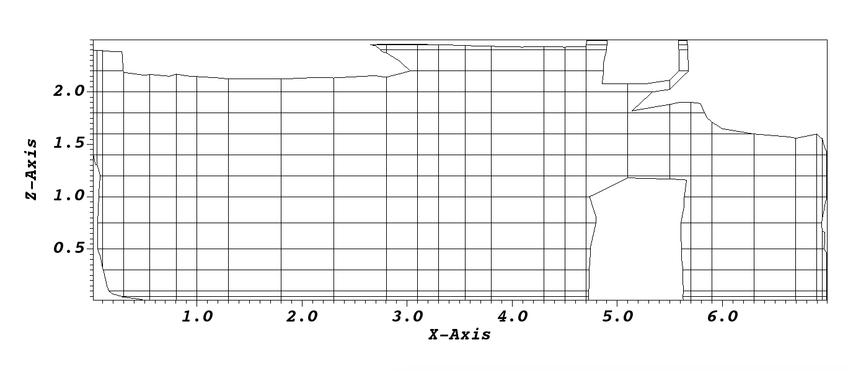
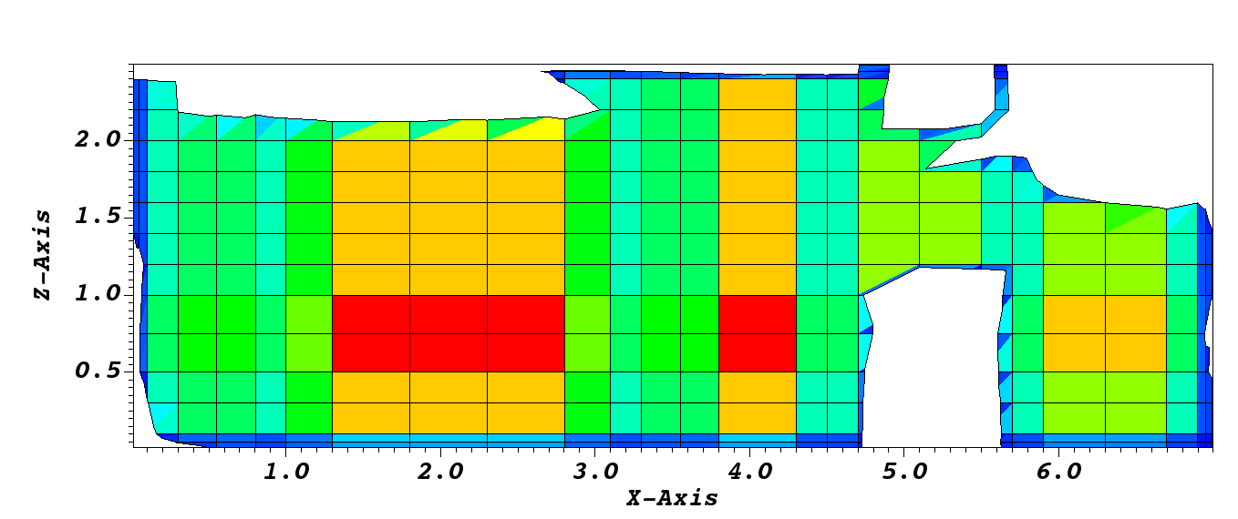
1. Field Filters (16 concrete types)
Defined: a class of filters that generate a new field. Mesh is unchanged.
  However: some seem to change vertex locations. (Hank doesn’t like this.)
Example 1: calculate density from mass and volume
Example 2: take mesh and calculate area

Slide 69
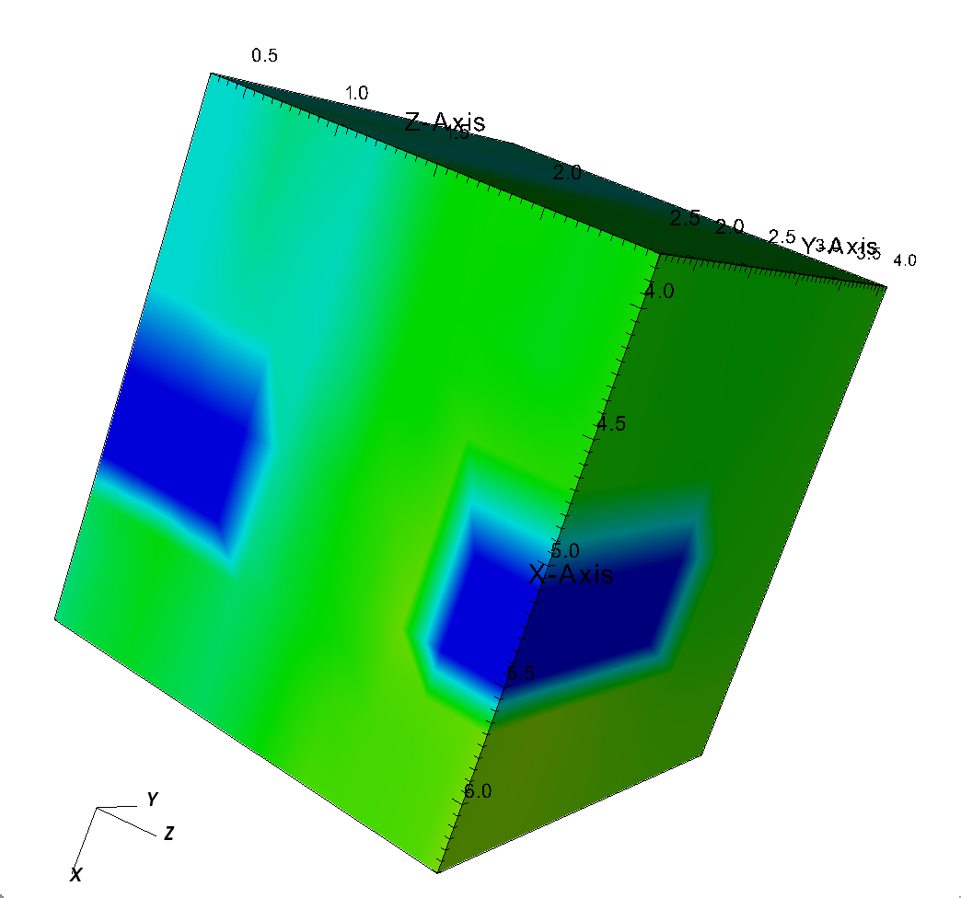
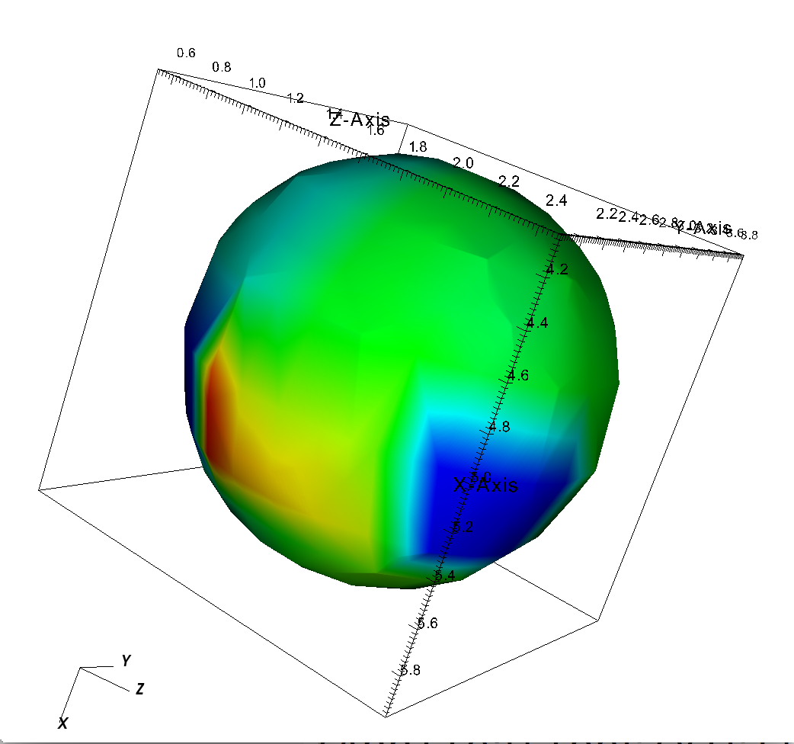
2. Data Set Filters (5 concrete types)
Defined: a class of filters that generate a new mesh && NO fields are needed to do the operation.
Example: clip based on sphere
There was a field on the input and a field on the output, but the field was not used to carry out the operation.

Slide 70
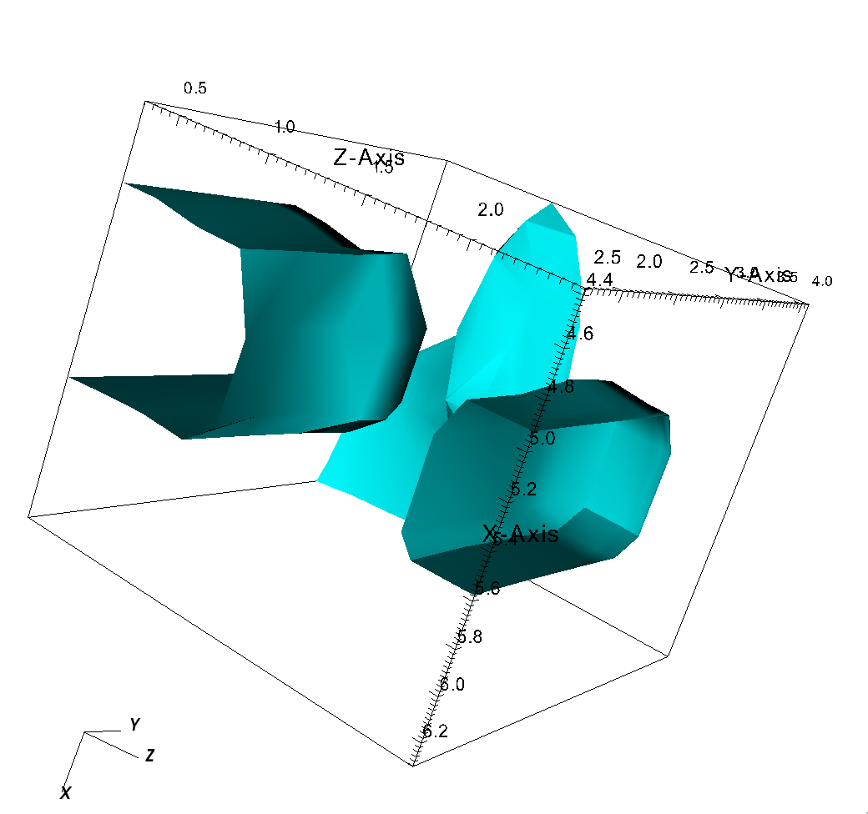
3. Data Set With Field Filters (6 concrete types)
Defined: a class of filters that generate a new mesh && fields ARE needed to do the operation.
Example: Marching Cubes (isosurface)
There was a field on the input and it was used to create the output.

Slide 71
Filters in VTK-m fall into 3 classes
OK, so what are the filters?
Field Filters
Data Set Filters
Data Set With Field Filters
5 derived types
6 derived types
16 derived types

Slide 72
1. Field Filters (16 concrete types)
Defined: a class of filters that generate a new field. Mesh is unchanged.
  However: some seem to change vertex locations. (Hank doesn’t like this.)
Cell Average
Coordinate System Transform
Cross Product
Dot Product
Connected Components
Field to Colors
Gradients
Histogram
Point Average
Point Elevation
Point Transform
Surface Normals
Vector Magnitude
Warp Scalar
Warp Vector
ZFP

Slide 73
2. Data Set Filters (5 concrete types)
Defined: a class of filters that generate a new mesh && NO fields are needed to do the operation.
Clean Grid
Clip With Implicit Function
External Faces
Ghost Cell Classification
Vertex Clustering

Slide 74
3. Data Set With Field Filters (6 concrete types)
Defined: a class of filters that generate a new mesh && fields ARE needed to do the operation.
Clip With Field
Ghost Cell Removal
Marching Cubes
Threshold
Streamlines
Pathlines

Slide 75
VTK-m data model

Slide 76
3 Fundamental Concepts for vtkm::cont::DataSet
Cell Sets: topological connections, i.e., how points connect to form cells
Fields: e.g., scalars, vectors, etc.
Coordinate System: special field that describes physical locations
Two important notes:
  Helper functions to build data sets for you
  Also a vtkm::cont::MultiBlock for multi-block data

Slide 77
How many of each type for a single vtkm::cont::DataSet?
Concept | # for a given vtkm::cont::DataSet | Explanation
Cell Set | 1 or more | Always one, and could be more (example: side sets)
Fields | Any | 0 fields means there is no data on the mesh. Can be any number of fields. (Often ten or more.)
Coordinate System | 0, 1, or more | 0: no spatial locations (infovis) 1: typical >1: (example) geospatial data has 3D position, lat-long, multiple projections, etc.

Slide 78
3 Fundamental Concepts for vtkm::cont::DataSet
Cell Sets: topological connections, i.e., how points connect to form cells
Fields: e.g., scalars, vectors, etc.
Coordinate System: special field that describes physical locations
Two important notes:
  Helper functions to build data sets for you
  Also a vtkm::cont::MultiBlock for multi-block data

Slide 79

Types of Cell Sets (1/3):
Structured Cell Sets

Slide 80

Types of Cell Sets (2.1/3):
Explicit Cell Sets

Slide 81

Types of Cell Sets (2.2/3):
Explicit Cell Sets

Slide 82
Types of Cell Sets (3/3):
Other
Additional types:
  Cell set permutations: rearranges cells (support is currently limited)
  Dynamic cell sets: needed to solve issues with typing and templates
# cell sets != 1:
  Blocks / assemblies: multiple cell sets
  Zero cell set: no cell sets

Slide 83
3 Fundamental Concepts for vtkm::cont::DataSet
Cell Sets: topological connections, i.e., how points connect to form cells
Fields: e.g., scalars, vectors, etc.
Coordinate System: special field that describes physical locations
Two important notes:
  Helper functions to build data sets for you
  Also a vtkm::cont::MultiBlock for multi-block data

Slide 84
Fields
Field: provides a value on every point in space on the mesh
  Example: temperature, pressure, density, velocity
In VTK-m, vtkm::cont::Field
Implemented with Array Handles
  Array Handles were briefly described in the intro --- mechanism to have data live in execution environment and accessible via control environment

Slide 85
3 Fundamental Concepts for vtkm::cont::DataSet
Cell Sets: topological connections, i.e., how points connect to form cells
Fields: e.g., scalars, vectors, etc.
Coordinate System: special field that describes physical locations
Two important notes:
  Helper functions to build data sets for you
  Also a vtkm::cont::MultiBlock for multi-block data

Slide 86
Coordinate Systems
Location of mesh’s elements (scivis use case)
3D vector at each point
vtkm::cont::CoordinateSystem class manages this
More details: need to know about ArrayHandles … tricks so that implicit point orderings don’t require a lot of storage

Slide 87
3 Fundamental Concepts for vtkm::cont::DataSet
Cell Sets: topological connections, i.e., how points connect to form cells
Fields: e.g., scalars, vectors, etc.
Coordinate System: special field that describes physical locations
Two important notes:
  Helper functions to build data sets for you
  Also a vtkm::cont::MultiBlock for multi-block data

Slide 88


Easiest example: create uniform grids with vtkm::cont::DataSetBuilderUniform
Origin
?
?
?
?
Spacing

Slide 89


(1/4)

Slide 90

(2/4)

Slide 91

(3/4)

Slide 92

(4/4)

Slide 93


Next easiest example: create rectilinear grids with vtkm::cont::DataSetBuilderRectilinear
?
?
?
?
?
?
?
?

Slide 94



Slide 95

Next example: create unstructured grids with vtkm::cont::
DataSetBuilderExplicit
(SEE MANUAL)

Slide 96

Create fields with vtkm::cont::DataSetFieldAdd

Slide 97
Rendering

Slide 98
“Hello World” for Rendering
int main(){
//Loading .vtk File
const char *input = "kitchen.vtk";
vtkm::io::reader::VTKDataSetReader reader(input);
vtkm::cont::DataSet ds_from_file = reader.ReadDataSet();
//Creating Actor
vtkm::cont::ColorTable colorTable("viridis");
vtkm::rendering::Actor actor(ds_from_file.GetCellSet(), ds_from_file.GetCoordinateSystem(), ds_from_file.GetField("c1"), colorTable);
//Creating Scene and adding Actor
vtkm::rendering::Scene scene;
scene.AddActor(actor);
//Creating and initializing the View using the Canvas, Ray Tracer Mappers, and Scene
vtkm::rendering::MapperRayTracer mapper;
vtkm::rendering::CanvasRayTracer canvas(1920, 1080);
vtkm::rendering::View3D view(scene, mapper, canvas);
view.Initialize();
//Setting the background and foreground colors; optional.
view.SetBackgroundColor(vtkm::rendering::Color(1.0f, 1.0f, 1.0f));
view.SetForegroundColor(vtkm::rendering::Color(0.0f, 0.0f, 0.0f));
//Painting View
view.Paint();
//Saving View
view.SaveAs("BasicRenderingVeridis.ppm");
return 0;
}

Slide 99
Rendering
Four mandatory components for each render:
Actors
Scenes
Canvas
View

Slide 100
Rendering
Four mandatory components for each render:
Actors
Scenes
Canvas
View

Slide 101
Rendering - Actors
Each vtkm::cont::DataSet usually constitutes 1 actor
Actors require a cell set, coordinate system, and scalars for each location (coloring will be based on these scalars)
Optional color mapping, with some common continuous presets included
(e.g., Viridis, Inferno)

Slide 102

Rendering - Actors

Slide 103
Rendering - Actors
#include <vtkm/cont/Initialize.h>
#include <vtkm/io/reader/VTKDataSetReader.h>
#include <vtkm/io/writer/VTKDataSetWriter.h>
#include <vtkm/cont/DataSet.h>
#include <vtkm/cont/ColorTable.h>
#include <vtkm/rendering/Actor.h>
#include <vtkm/rendering/Scene.h>
#include <vtkm/rendering/MapperRayTracer.h>
#include <vtkm/rendering/CanvasRayTracer.h>
#include <vtkm/rendering/View3D.h>
int main(){
//Loading .vtk File
const char *input = "kitchen.vtk";
vtkm::io::reader::VTKDataSetReader reader(input);
vtkm::cont::DataSet ds_from_file = reader.ReadDataSet();
//Creating Actor
vtkm::cont::ColorTable colorTable("viridis");
vtkm::rendering::Actor actor(ds_from_file.GetCellSet(), ds_from_file.GetCoordinateSystem(), ds_from_file.GetField("c1"), colorTable);
//Creating Scene and adding Actor
vtkm::rendering::Scene scene;
scene.AddActor(actor);
//Creating and initializing the View using the Canvas, Ray Tracer Mappers, and Scene
vtkm::rendering::MapperRayTracer mapper;
vtkm::rendering::CanvasRayTracer canvas(1920, 1080);
vtkm::rendering::View3D view(scene, mapper, canvas);
view.Initialize();
//Setting the background and foreground colors; optional.
view.SetBackgroundColor(vtkm::rendering::Color(1.0f, 1.0f, 1.0f));
view.SetForegroundColor(vtkm::rendering::Color(0.0f, 0.0f, 0.0f));
//Painting View
view.Paint();
//Saving View
view.SaveAs("BasicRenderingVeridis.ppm");
return 0;
}
int main(){
//Loading .vtk File
const char *input = "kitchen.vtk";
vtkm::io::reader::VTKDataSetReader reader(input);
vtkm::cont::DataSet ds_from_file = reader.ReadDataS...
//Creating Actor
vtkm::cont::ColorTable colorTable("viridis");
vtkm::rendering::Actor actor(
ds_from_file.GetCellSet(),
ds_from_file.GetCoordinateSystem(),
ds_from_file.GetField("c1"),
colorTable);

Slide 104
Rendering
Four mandatory components for each render:
Actors
Scenes
Canvas
View

Slide 105

Rendering – Scenes: a container for actors

Slide 106
Rendering - Scenes
#include <vtkm/cont/Initialize.h>
#include <vtkm/io/reader/VTKDataSetReader.h>
#include <vtkm/io/writer/VTKDataSetWriter.h>
#include <vtkm/cont/DataSet.h>
#include <vtkm/cont/ColorTable.h>
#include <vtkm/rendering/Actor.h>
#include <vtkm/rendering/Scene.h>
#include <vtkm/rendering/MapperRayTracer.h>
#include <vtkm/rendering/CanvasRayTracer.h>
#include <vtkm/rendering/View3D.h>
int main(){
//Loading .vtk File
const char *input = "kitchen.vtk";
vtkm::io::reader::VTKDataSetReader reader(input);
vtkm::cont::DataSet ds_from_file = reader.ReadDataSet();
//Creating Actor
vtkm::cont::ColorTable colorTable("viridis");
vtkm::rendering::Actor actor(ds_from_file.GetCellSet(), ds_from_file.GetCoordinateSystem(), ds_from_file.GetField("c1"), colorTable);
//Creating Scene and adding Actor
vtkm::rendering::Scene scene;
scene.AddActor(actor);
//Creating and initializing the View using the Canvas, Ray Tracer Mappers, and Scene
vtkm::rendering::MapperRayTracer mapper;
vtkm::rendering::CanvasRayTracer canvas(1920, 1080);
vtkm::rendering::View3D view(scene, mapper, canvas);
view.Initialize();
//Setting the background and foreground colors; optional.
view.SetBackgroundColor(vtkm::rendering::Color(1.0f, 1.0f, 1.0f));
view.SetForegroundColor(vtkm::rendering::Color(0.0f, 0.0f, 0.0f));
//Painting View
view.Paint();
//Saving View
view.SaveAs("BasicRenderingVeridis.ppm");
return 0;
}
//Creating Actor
vtkm::cont::ColorTable colorTable("viridis");
vtkm::rendering::Actor actor(
ds_from_file.GetCellSet(),
ds_from_file.GetCoordinateSystem(),
ds_from_file.GetField("c1"),
colorTable);
//Creating Scene and adding Actor
vtkm::rendering::Scene scene;
scene.AddActor(actor);

Slide 107
Rendering
Four mandatory components for each render:
Actors
Scenes
Canvas
View

Slide 108
Rendering - Canvas*
*CanvasRayTracer is the subclass name used for Ray Tracing based visualizations
Some settings
  Foreground and background color
  Width and height (in pixels)
Basic annotations
  Superimposed text
  Augmented lines

Slide 109

Rendering - Canvas
And Even More...

Slide 110
Rendering
Four mandatory components for each render:
Actors
Scenes
Canvas
View

Slide 111

Rendering - View
Comes in 3 flavors: 1D, 2D, 3D
Constructed with 3 things:
  A scene
  A canvas
    Currently only RayTracing canvas is supported
  A mapper

Slide 112

Rendering - View

Slide 113
Rendering - View
3 Important methods
  Paint()
    Forces rendering to occur (“Execute()”)
  SaveAs(filename)
    Saves the view as a .ppm file.
  GetCamera()
    Returns a Camera object that allows you to change the position/clipping range/zoom/roll/etc. of the view
  Also can set foreground and background colors

Slide 114

Rendering - View
And Even More...

Slide 115
Rendering - View
/*Creating and initializing the View using the Canvas, Ray Tracer Mappers, and Scene*/
vtkm::rendering::MapperRayTracer mapper;
vtkm::rendering::CanvasRayTracer canvas(1920, 1080);
vtkm::rendering::View3D view(scene, mapper, canvas);
view.Initialize();
//Setting the background and foreground colors; optional.
view.SetBackgroundColor(vtkm::rendering::Color(1.0f, 1.0f, 1.0f));
view.SetForegroundColor(vtkm::rendering::Color(0.0f, 0.0f, 0.0f));
//Painting View
view.Paint();
//Saving View
view.SaveAs("BasicRendering.ppm");
#include <vtkm/cont/Initialize.h>
#include <vtkm/io/reader/VTKDataSetReader.h>
#include <vtkm/io/writer/VTKDataSetWriter.h>
#include <vtkm/cont/DataSet.h>
#include <vtkm/cont/ColorTable.h>
#include <vtkm/rendering/Actor.h>
#include <vtkm/rendering/Scene.h>
#include <vtkm/rendering/MapperRayTracer.h>
#include <vtkm/rendering/CanvasRayTracer.h>
#include <vtkm/rendering/View3D.h>
int main(){
//Loading .vtk File
const char *input = "kitchen.vtk";
vtkm::io::reader::VTKDataSetReader reader(input);
vtkm::cont::DataSet ds_from_file = reader.ReadDataSet();
//Creating Actor
vtkm::cont::ColorTable colorTable("viridis");
vtkm::rendering::Actor actor(ds_from_file.GetCellSet(), ds_from_file.GetCoordinateSystem(), ds_from_file.GetField("c1"), colorTable);
//Creating Scene and adding Actor
vtkm::rendering::Scene scene;
scene.AddActor(actor);
//Creating and initializing the View using the Canvas, Ray Tracer Mappers, and Scene
vtkm::rendering::MapperRayTracer mapper;
vtkm::rendering::CanvasRayTracer canvas(1920, 1080);
vtkm::rendering::View3D view(scene, mapper, canvas);
view.Initialize();
//Setting the background and foreground colors; optional.
view.SetBackgroundColor(vtkm::rendering::Color(1.0f, 1.0f, 1.0f));
view.SetForegroundColor(vtkm::rendering::Color(0.0f, 0.0f, 0.0f));
//Painting View
view.Paint();
//Saving View
view.SaveAs("BasicRenderingVeridis.ppm");
return 0;
}

Slide 116

Rendering - Result
To get more interesting views, adjust Camera settings within View object
BasicRendering.ppm

Slide 117
Advanced Topics in the Control Environment

Slide 118
Advanced Topics in Control Environment
Initialization
Error handling
Logging
Timers

Slide 119
Advanced Topics in Control Environment
Initialization
Error handling
Logging
Timers

Slide 120
Initialize (1/3)
A method for initializing VTK-m
Used to set up various VTK-m facilities, including:
  Device connections
  Logging
Inputs:
  argc/arvg
  vtkm::cont::InitializeOptions
Outputs:
  vtkm::cont::InitializeResult
Syntax:
Let’s describe these objects

Slide 121


Initialize (2/3): InitializeOptions / InitializeResult
Initialize
Options
Initialize
Result

Slide 122


Initialize (3/3): Example

Slide 123
Advanced Topics in Control Environment
Initialization
Error handling
Logging
Timers

Slide 124

Error handling occurs via C++ exception handling
Code in try block
Mistake! … didn’t initialize vtkm::cont::DataSet
Error caught in catch block

Slide 125
Advanced Topics in Control Environment
Initialization
Error handling
Logging
Timers

Slide 126

Logging: tut_logging.cxx
VTKM_LOG_F/VTKM_LOG_S: macros for adding log statements

Slide 127

Logging: tut_logging.cxx
VTKM_LOG_F/VTKM_LOG_S: macros for adding log statements

Slide 128
Advanced Topics in Control Environment
Initialization
Error handling
Logging
Timers

Slide 129

Timers

Slide 130
Tutorial Schedule
30m
35m
30m
50m
35m
30m
Introduction / software install
VTK-m: Control Environment
Using VTK-m (hands on) → how do we want to use this time?
Concepts behind VTK-m development
VTK-m example (hands on)
Discussion of upcoming activities / wrap up

Slide 131
Tutorial Schedule
30m
35m
30m
50m
35m
30m
Introduction / software install
VTK-m: Control Environment
Using VTK-m (hands on)
Concepts behind VTK-m development. VTK-m: Execution Environment
VTK-m example (hands on)
Discussion of upcoming activities / wrap up

Slide 132
Control Environment
Grid Topology
Array Handle
Invoke
Execution Environment
Cell Operations
Field Operations
Basic Math
Make Cells
Device Adapter
Allocate
Transfer
Schedule
Sort
…
Worklet

Slide 133
Worklets
Worklets: simplest way to implement algorithm in VTK-m.
What is a worklet? – a functor.
What is a functor? – a C struct/class with an overloaded ::operator()
  ::operator() must be declared const for thread safety
And: significant metadata alongside functor
  How data is managed
  How execution is structured

Slide 134
Going deep on worklets
Worklet types
Dispatchers
Elements of a worklet
Example reference for one worklet type (FieldMap)

Slide 135
Going deep on worklets
Worklet types
Dispatchers
Elements of a worklet
Example reference for one worklet type (FieldMap)

Slide 136
Worklet types
Following slides are base classes for worklets
They provide patterns for accessing data
Derived types provide a functor that makes use of data
Let’s pause and consider one pattern in more depth – “map”

Slide 137
Worklet types – example on “map” pattern
Input/output
  Input: M arrays --- In_1, In_2, … In_m
  Output: N arrays --- Out_1, Out_2, … Out_n
  All arrays have same size: || In_1 || = … = || In_M || = || Out_1 || = … = || Out_n ||
How execution works
  Consider element K of Out_j.
  Out_j[K] = function(In_1[K], In_2[K], …, In_m[K])
  → key point: Out_j[K] does not depend on In_i(X) for any X != K
Why is this good?
  each element of the array can be calculated independently

Slide 138
Worklet types
(we’ve seen these three bullets before)
Following slides are base classes for worklets
They provide patterns for accessing data
Derived types provide a functor that makes use of data
Now consider map:
  VTK-m provides a base class worklet -- “WorkletMapField” -- that defines the access pattern for map
  Developers write derived type of “WorkletMapField” that defines the specific map operator
    Example: Density::operator() functor takes mass and volume as input and outputs the density as mass divided by volume
OK, so what are the worklet “base classes”?
(new)

Slide 139

WorkletMapField
Iterates over any array (Point, Cell)
  Read/Write access
  Parallel for_each

Slide 140
WorkletMapCellToPoint
Iterates over all points
  Read access to cell fields
  Read/Write access to point fields
  Point 3 has access to cells 1,3,4

Slide 141
WorkletMapPointToCell
Iterates over all cells
  Read access to point fields
  Read/Write access to cell fields
  Cell 1 has access to points 0,2,3,4

Slide 142

WorkletPointNeighborhood
Iterates over all points
  Read access to points field neighborhood
  Write access to center point

Slide 143

WorkletReduceByKey
Iterates over a key/value(s) array
  Read access to all values of a given key
  Write access for a given key

Slide 144
Going deep on worklets
Worklet types
Dispatchers
Elements of a worklet
Example reference for one worklet type (FieldMap)

Slide 145
Dispatchers (1/2)
What is the problem?:
  Worklets are instantiated in control environment
  … but need to run in execution environment
What is the solution?: … dispatchers
Dispatchers are a way to invoke worklets to start running in the execution environment
There are multiple types of dispatchers, each corresponding to a worklet type

Slide 146

Dispatchers (2/2)

Slide 147
Going deep on worklets
Worklet types
Dispatchers
Elements of a worklet
Example reference for one worklet type (FieldMap)

Slide 148

Elements of a worklet

Slide 149

Control Signature

Slide 150

Execution Signature

Slide 151
Input Domain: tells dispatcher which input array to parallelize over
(allows it to know size of data array)

Slide 152
Worklet Operator – define the functor!
?
?
?
?
Must be const for thread safety

Slide 153
VTKM_EXEC, VTKM_CONT, VTKM_EXEC_CONT
These are C macros that instruct compiler what architecture to compile for
VTKM_EXEC: execution environment
VTKM_CONT: control environment
VTKM_EXEC_CONT: both environments

Slide 154

Worklet Example

Slide 155
Going deep on worklets
Worklet types
Dispatchers
Elements of a worklet
Example reference for one worklet type (FieldMap)

Slide 156

Screenshots from users manual on reference material for
Field Map worklet
(1/2)

Slide 157

Screenshots from users manual on reference material for
Field Map worklet
(2/2)

Slide 158
Wrapping up the tutorial: let’s do a real example

Slide 159
We never discussed ArrayHandles
Reminder here since they come up in the example
REPEAT:
  Need to refer to data in control environment, but have it accessible in execution environment
  Need to get results from execution environment back to control environment
  Key concept in VTK-m: Array Handles

Slide 160
New filter that calculates magnitude of a vector field
Code: tut_mag_grad.cxx
Worklet called Magnitude
  Uses MapField pattern
Filter called FieldMagnitude
  Uses Magnitude worklet
Main function
  Uses FieldMagnitudeFilter

Slide 161
New filter that calculates magnitude of a vector field
Code: tut_mag_grad.cxx
Worklet called Magnitude
  Uses MapField pattern
Filter called FieldMagnitude
  Uses Magnitude worklet
Main function
  Uses FieldMagnitudeFilter

Slide 162


Slide 163
New filter that calculates magnitude of a vector field
Code: tut_mag_grad.cxx
Worklet called Magnitude
  Uses MapField pattern
Filter called FieldMagnitude
  Uses Magnitude worklet
Main function
  Uses FieldMagnitudeFilter

Slide 164

(1/2)

Slide 165

(2/2)

Slide 166
New filter that calculates magnitude of a vector field
Code: tut_mag_grad.cxx
Worklet called Magnitude
  Uses MapField pattern
Filter called FieldMagnitude
  Uses Magnitude worklet
Main function
  Uses FieldMagnitudeFilter

Slide 167


Slide 168

Acknowledgements
This material is based upon work supported by the U.S. Department of Energy, Office of Science, Office of Advanced Scientific Computing Research, under Award Numbers 10-014707, 12-015215, and 14-017566.
This research was supported by the Exascale Computing Project (17-SC-20-SC), a collaborative effort of two U.S. Department of Energy organizations (Office of Science and the National Nuclear Security Administration) responsible for the planning and preparation of a capable exascale ecosystem, including software, applications, hardware, advanced system engineering, and early testbed platforms, in support of the nation’s exascale computing imperative.
Sandia National Laboratories is a multimission laboratory managed and operated by National Technology and Engineering Solutions of Sandia, LLC., a wholly owned subsidiary of Honeywell International, Inc., for the U.S. Department of Energy’s National Nuclear Security Administration under contract DE-NA-0003525.
Thanks to many, many partners in labs, universities, and industry.

