Slide 1
CIS 640 Writing in Computer Science Research
“Lecture 1”:
Class Overview
March 28, 2022
Hank Childs, University of Oregon

Slide 2
Disclaimers
I love teaching this class
We have had some great groups
Enjoyed our class time
Learned a lot
Some of these slides are harsh – sorry
(“Do this or No Pass”)

Slide 3
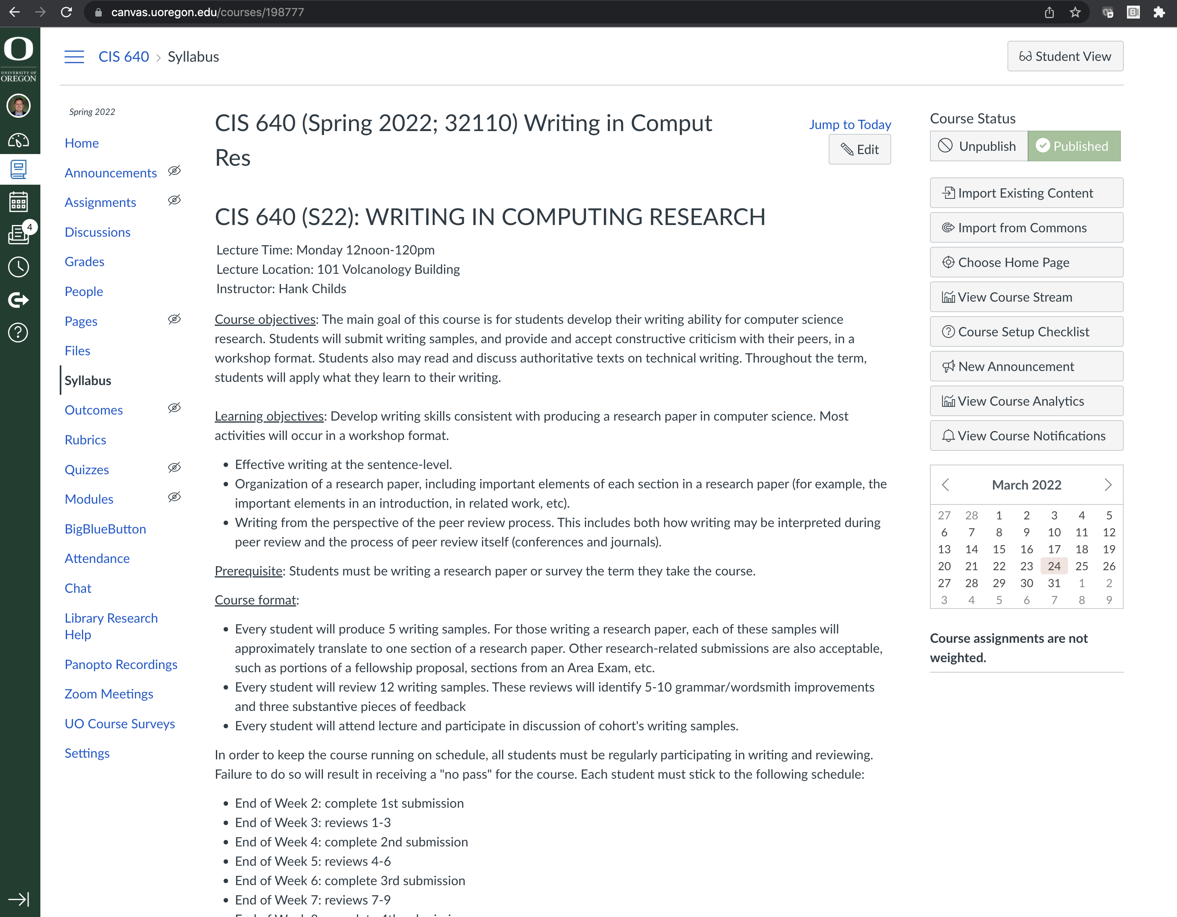
Canvas
These slides are posted on the class Canvas page
The syllabus is on Canvas
That is all we will use Canvas for

Slide 4
Course Outcomes
The main goal of this course is for students develop their writing ability for computer science research.
Students will submit writing samples, and provide and accept constructive criticism with their peers, in a workshop format.
Students also may read and discuss authoritative texts on technical writing.
Throughout the term, students will apply what they learn to their writing.

Slide 5
Course Outcomes
The main goal of this course is for students develop their writing ability for computer science research.
Students will submit writing samples, and provide and accept constructive criticism with their peers, in a workshop format.
Students also may read and discuss authoritative texts on technical writing.
Throughout the term, students will apply what they learn to their writing.

Slide 6
Course Outcomes
The main goal of this course is for students develop their writing ability for computer science research.
Students will submit writing samples, and provide and accept constructive criticism with their peers, in a workshop format.
Students also may read and discuss authoritative texts on technical writing.
Throughout the term, students will apply what they learn to their writing.

Slide 7
Course Outcomes
The main goal of this course is for students develop their writing ability for computer science research.
Students will submit writing samples, and provide and accept constructive criticism with their peers, in a workshop format.
Students also may read and discuss authoritative texts on technical writing.
Throughout the term, students will apply what they learn to their writing.

Slide 8
Learning Outcomes
Develop writing skills consistent with producing a research paper in computer science. Most activities will occur in a workshop format.
Effective writing at the sentence-level.
Organization of a research paper, including important elements of each section in a research paper (for example, the important elements in an introduction, in related work, etc.).
Writing from the perspective of the peer review process. This includes both how writing may be interpreted during peer review and the process of peer review itself (conferences and journals).

Slide 9
Learning Outcomes
Develop writing skills consistent with producing a research paper in computer science. Most activities will occur in a workshop format.
Effective writing at the sentence-level.
Organization of a research paper, including important elements of each section in a research paper (for example, the important elements in an introduction, in related work, etc.).
Writing from the perspective of the peer review process. This includes both how writing may be interpreted during peer review and the process of peer review itself (conferences and journals).

Slide 10
Learning Outcomes
Develop writing skills consistent with producing a research paper in computer science. Most activities will occur in a workshop format.
Effective writing at the sentence-level.
Organization of a research paper, including important elements of each section in a research paper (for example, the important elements in an introduction, in related work, etc.).
Writing from the perspective of the peer review process. This includes both how writing may be interpreted during peer review and the process of peer review itself (conferences and journals).

Slide 11
Learning Outcomes
Develop writing skills consistent with producing a research paper in computer science. Most activities will occur in a workshop format.
Effective writing at the sentence-level.
Organization of a research paper, including important elements of each section in a research paper (for example, the important elements in an introduction, in related work, etc.).
Writing from the perspective of the peer review process. This includes both how writing may be interpreted during peer review and the process of peer review itself (conferences and journals).

Slide 12
Course Prerequisite
Must be writing something this term
PhD students:
Typically DRP or Area Exam
Could be dissertation or a paper
Fellowship proposal
MS students:
MS thesis
Survey paper (did you do a survey for 630 or 631?)

Slide 13
What You Have To Do
1) Attend class
Approved reasons for absence will be discussed later
2) Perform course tasks
Writing, reviewing, revision
(See next slide)
3) Keep on schedule
We work as a unit, and we all must keep the schedule
Exceptions by permission only
Failure to do any of these three will result in a No Pass

Slide 14
Writing and Reviewing
Writing
5 submissions of 1-2 pages each
Final paper (6500 words)
4 revisions of writing (not collected)
Reviewing
12 reviews
→ first 4 submissions each get 3 reviews

Slide 15
Example Plan
Week 2: write “Introduction” section
Week 3: receive feedback on “Introduction”
Week 4: write “My Method” section, revise “Introduction”
Week 5: receive feedback on “My Method”
Week 6: write “Experimental Overview” section, revise “My Method”
Week 7: receive feedback on “Experimental Overview”
Week 8: write “Results” section, revise “Experimental Overview.”
Week 9, receive reviews on “Results”
Week 10: write “Related Work,” revise “Results”
Finals Week: complete Final Paper

Slide 16
Problems with Plan
When were Conclusion & Abstract written?
Answer: example plan is just a strawman
Write ~1300 words every two weeks
If you write 800 words every time (4000 words), then you will have a miserable Finals Week (2500 words)
If you write 1800 words every time (9000 words), then you will have an easy Finals Week

Slide 17
Final Paper
Length: 6500 words
This will use all the text from 1st 5 submissions
Why 6500 words? → approx. word count from IEEE 8 page paper, double column
Final paper must be submission quality
Due Weds June 8, 1015am

Slide 18
What does “submission” quality mean?
When you “submit” a paper to a conference or journal, you are expecting 100s of people to read it
The author (you) should work hard to make the paper as accessible as possible

Slide 19
Example
Assume 100 people read it
On average, spend 1h20 reading
What if?:
Author spends 20 hours improving readability
Average reading time drops to 1h5m
1.333*100 = 133 hours
1.08*100 = 108 hours
133-108 = 25 ... the world is better off

Slide 20
More on “Submission” Quality
I review a ton of papers
If someone has not done me the courtesy of making my experience as efficient as possible, then it puts me in a bad mood
This is a very different setting than writing a term paper for a class (one author, one reader)

Slide 21
4 Reviews
Each review must have the following:
5-10 grammatical / wordsmithing suggestions
If the writing is great, then 5
If the paper is rough, you stop at 10
3 “big picture” suggestions on how to improve

Slide 22
Revisions
Each revision should take into account reviews and fix all problems
We will not collect revisions
... but your final paper should reflect fixes that came from your reviews

Slide 23
Participation
Every student will attend lecture and participate in peer review of cohort's writing samples
Every student will offer up text for group review

Slide 24
Logistics (1/2)
Will be run through EasyChair
EasyChair link on class website
(I know Canvas is beloved)
Reviews must be completed 5 days after assignment
Can go “on vacation”

Slide 25
Logistics (2/2)
If you fall behind the minimums at any of these weeks,
then you will receive a “NP” in the course
(This class only works if everyone is making steady progress)

Slide 26
How Will We Spend Class Time?
Look at writing examples and collectively edit
While this seems like it might be uncomfortable, it has been OK so far
We are each on a personal journey to become our best writing self
Also, I can talk about topics as needed
How papers are accepted?
What should go in each section?
Other?

Slide 27
My Own Personal Writing Story
Summary:
poor writer as a PhD student, good writer now
Observations:
writing improves and is easier as you practice
I used to hate writing and now _enjoy_ it
students often put way too little time into writing
since they hate doing it
coding is more fun

Slide 28
Anna Karenina Principle
“All happy families are alike; each unhappy family is unhappy in its own way”
While each problematic paper is uniquely unhappy, there are common themes
We will be collectively identifying “unhappy families” themes throughout the term

Slide 29
“Unhappy Families” From Hank (1/3)
(1) every sentence reads well, but the whole is a jumbled mess
No sense of purpose per paragraph / section
Facts appear in random places
(2) only makes sense if the reader already knows what you are talking about
(3) procrastinate, procrastinate, procrastinate, write hastily and declare done and then get co-authors to fix

Slide 30
“Unhappy Families” From Hank (1/3)
(1) every sentence reads well, but the whole is a jumbled mess
No sense of purpose per paragraph / section
Facts appear in random places
(2) only makes sense if the reader already knows what you are talking about
(3) procrastinate, procrastinate, procrastinate, write hastily and declare done and then get co-authors to fix

Slide 31
“Unhappy Families” From Hank (1/3)
(1) every sentence reads well, but the whole is a jumbled mess
No sense of purpose per paragraph / section
Facts appear in random places
(2) only makes sense if the reader already knows what you are talking about
(3) procrastinate, procrastinate, procrastinate, write hastily and declare done and then get co-authors to fix

Slide 32
“Unhappy Families” from Hank (2/3)
(4) Writing is overly complicated
Example:
lots and lots of clauses,
Clauses are not well connected
leave it to the reader to figure out how they relate
say what the subject is at the end of the sentence
(5) Writer assumes the reader is as fascinated by the topic as the author and will endure endless details because of their mutual shared fascination

Slide 33
“Unhappy Families” from Hank (2/3)
(4) Writing is overly complicated
Example:
lots and lots of clauses,
Clauses are not well connected
leave it to the reader to figure out how they relate
say what the subject is at the end of the sentence
(5) Writer assumes the reader is as fascinated by the topic as the author and will endure endless details because of their mutual shared fascination

Slide 34
“Unhappy Families” from Hank (3/3)
(6) Writer assumes too much knowledge
(7) Writer assumes too little knowledge
(8) Writer has not properly digested/synthesized their own work, and expects reader to be excited about learning details and also expect the reader to do this digesting/synthesis on their behalf

Slide 35
“Unhappy Families” from Hank (3/3)
(6) Writer assumes too much knowledge
(7) Writer assumes too little knowledge
(8) Writer has not properly digested/synthesized their own work, and expects reader to be excited about learning details and also expect the reader to do this digesting/synthesis on their behalf

Slide 36
“Unhappy Families” from Hank (3/3)
(6) Writer assumes too much knowledge
(7) Writer assumes too little knowledge
(8) Writer has not properly digested/synthesized their own work, and expects reader to so excited about that their work that the reader will do this digesting/synthesis on their behalf

Slide 37
Non-Native Speakers
You may consider typing in MS-Word (or similar)
This way MS-Word will catch many problems before they make it to your reviews

Slide 38
Pitfalls: Area Exam
This class has worked well when Area Exam document is already in progress
Not as good for those just starting, unless you can really really devote yourself
Typical Area Exam: 20 pages, 6 months of 30 hours/week
→ ~40 hours of effort per page
This class: 8 pages, 10 weeks of 8 hours/week (for 640)
→ 10 hours of effort per page (???)

Slide 39
Pitfalls: DRP / Research Paper
Can be harrowing if results are coming “just in time” for paper writing
Remediation:
focus on what you can do
write good sentences that are factually wrong and revise when the real results come
Deliver ~6500 words of mashup: 6 pages of DRP, 2 pages of Area Exam

Slide 40
Pitfalls: MS
If you are doing a thesis or research paper, then this will be like PhD students
If not, then you should do a survey
Perhaps you join forces on what to survey?
Softer than other tracks
softer on “submission quality” standards here – this is an 8 hour / week course
number of references per page will be much less than Area Exam
That said, it must be 6500 words

Slide 41
How to Begin?
For you doing your writing?
Pick a section and write it
by Thursday in Week2
Note: there are often slight variations in how papers are organized between fields
For this class?
Two volunteers who can be ready by Apr 4?

Slide 42
COVID!
We will all not wear masks the whole term for now
If you have a concern about spreading COVID, then skip class
But email me BEFOREHAND
More info on syllabus

Slide 43
Attendance is Mandatory, Except When...
A student is concerned about spreading illness, in which case they should contact the instructor before class begins and stay home.
A student has received permission from the instructor ahead of time to miss the course. Such reasons should be significant (attending a conference or wedding) and not insignificant (need to be home to receive a package).
An unforeseeable event, such as a flat tire or the public bus fails to run. In this case, the student should do their best to contact the instructor.

Slide 44
Let’s Introduce Ourselves

Slide 45
My Random Writing Facts (1/2)
Adjectives have an ordering

Slide 46
My Random Writing Facts (2/2)
Punctuation inside quotes? … not always.

