Slide 1
CIS 607:
_ _ _ _ ______ _ _____
/ / / /___ (_) __ ____ _____ ____/ / / ____/ _/_/ ____/__ __
/ / / / __ \/ / |/_/ / __ `/ __ \/ __ / / / _/_// / __/ /___/ /_
/ /_/ / / / / /> < / /_/ / / / / /_/ / / /____/_/ / /__/_ __/_ __/
\____/_/ /_/_/_/|_| \__,_/_/ /_/\__,_/ \____/_/ \____//_/ /_/
Lecture 1.1:
Course Overview &
Introduction to Unix
October 3, 2022
Hank Childs, University of Oregon

Slide 2
Outline
Class Overview
Getting Started With Unix
  Unix History
  Shell Prompts
  Files
  File Editors
Project 1

Slide 3
COVID / Illness
If you have to quarantine or feel sick, then:
  (1) email me ahead of time
  (2) call in to the Zoom
    Zoom listed on Canvas site
  (3) you will be credited with attending
Please, please stay home if there is a possibility of spreading COVID

Slide 4
Why Does This Seminar Exist?
Some schools make their undergraduate students do a lot of Unix/C/C++ preparation.
Some do not.
At UO, we assume our grad students know Unix/C/C++.
If you didn’t get a lot of preparation, this is a chance to do it now.
(Also a good refresher for those interviewing for jobs)
Note: this course draws a lot of material from previous courses. Apologies in advance.
Note #2: material is pretty basic this week. Will get more advanced.

Slide 5
Course Derived from CIS 330
330 Goals: excellence in C, C++, and Unix
Why 607?
  Many of our grad-level classes require strong knowledge in C, C++, and Unix
  Critical for success after graduation
Programming Languages Beacon: http://www.lextrait.com/vincent/implementations.html

Slide 6
Grading For This Course (1/2)
Will assign ~18 projects
Only 2 will be graded: 3H and 4B
→ these two depend on 3A-3G
The rest of the projects are to prepare you to do 3H and 4B

Slide 7
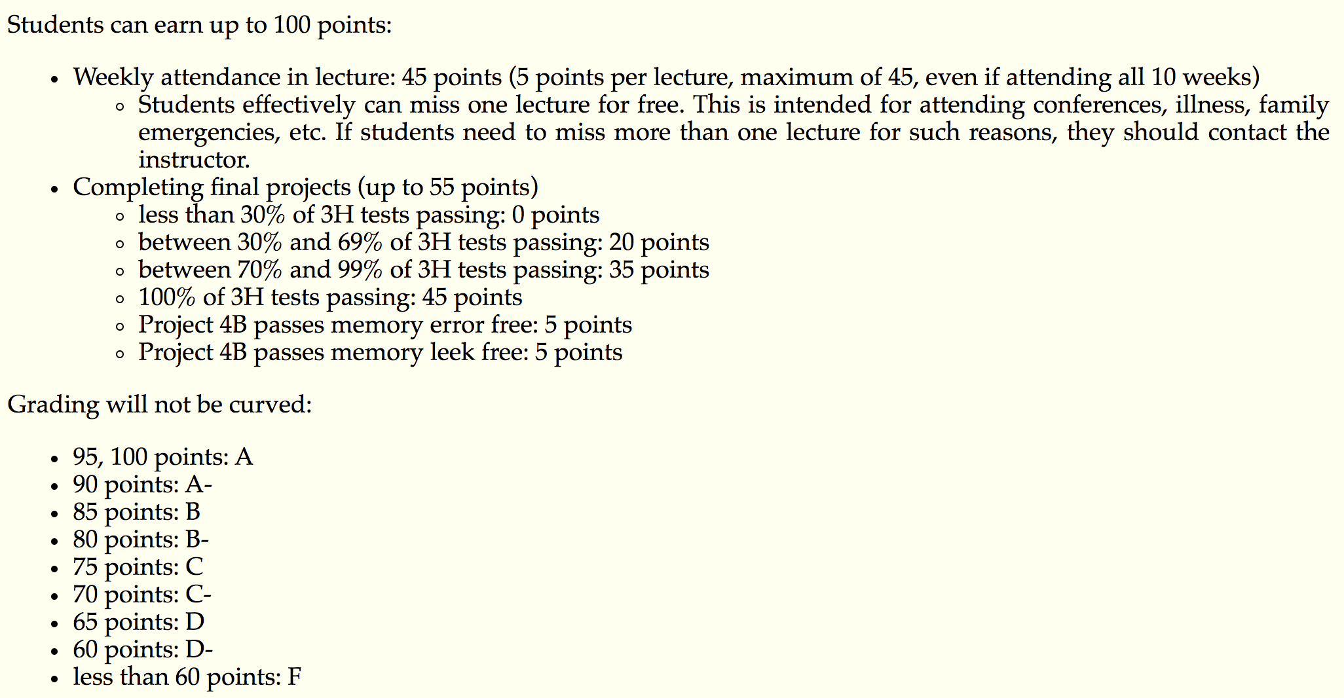
Grading For This Course (2/2)

Slide 8
Norms for this class
Please ask questions
Please ask me to slow down
Please give feedback
Quiet classroom greatly valued
Please do not arrive late

Slide 9
Course Materials
PowerPoint lectures will be posted online.
I will “live code” frequently.
Textbook:
  Past terms: none
  This term: incorporating “C and Data Structures” by Sventek
    On Canvas (legal statement next slide)

Slide 10
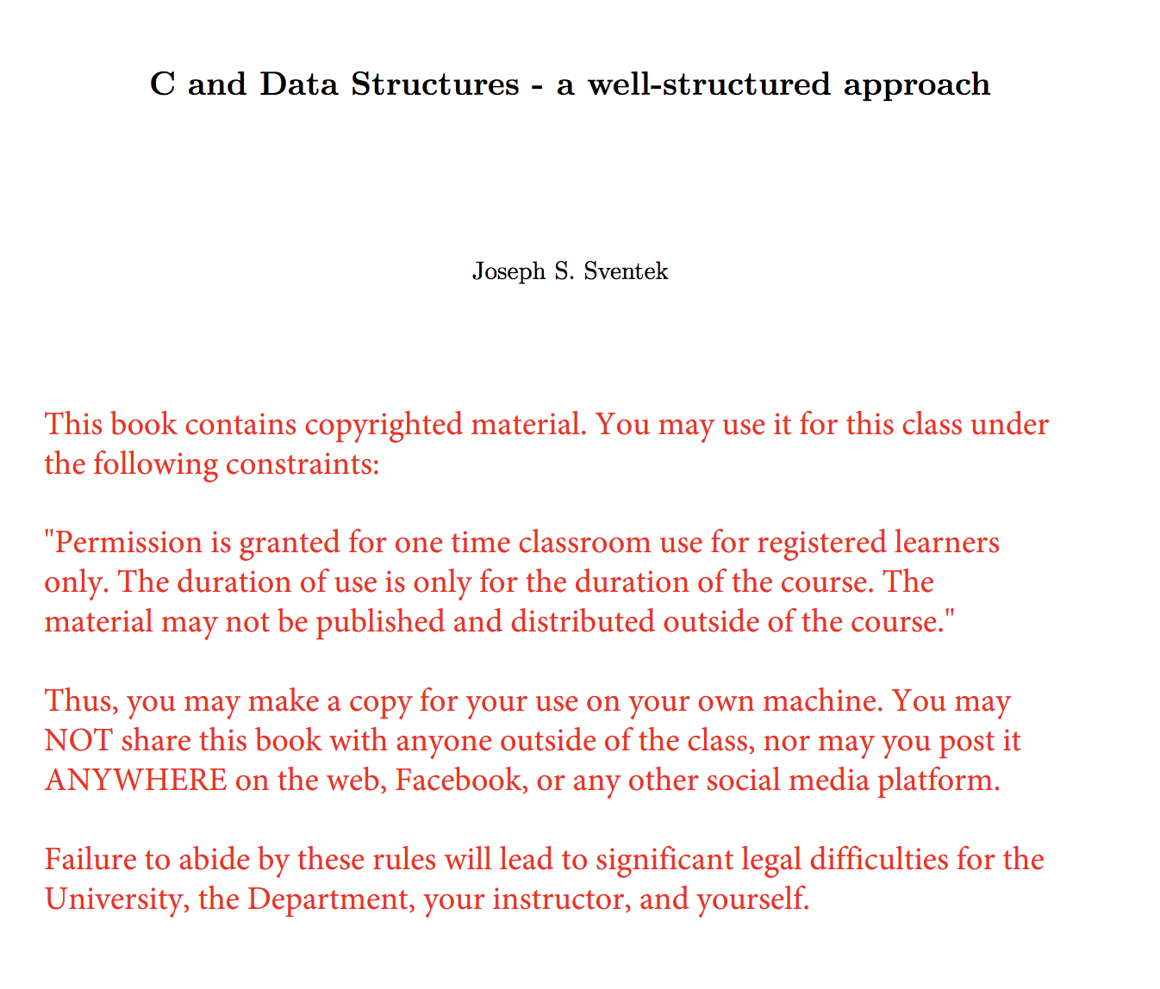

Slide 11
Academic Misconduct (1 of 2)
The programming projects are individual efforts
  You may discuss the projects with your classmates.
  Do not let someone look at your code on your screen. (BUT: helper can look at helpee’s code)
  Absolutely, positively do not email code.
  Do not search the internet for previous implementations (includes github)

Slide 12
Academic Misconduct (2 of 2)
If I detect collusion, all individuals involved will receive an F in the course immediately
  I choose to not enumerate cases that involve collusion. Whiteboard conversations are fine. If appropriate, the helper can look at the helpee’s code. If you feel you are in a gray area, then you should email me.
  Please note that if you are the one providing too much help, then you will also get an F

Slide 13
IDEs
IDEs are great
  … but in this class, we will learn how to get by without them
Many, many Unix-based projects don’t use IDEs
  The skills you are using will be useful going forward in your careers

Slide 14
Accessing a Unix environment
Rm 100, Deschutes
Remote logins (ssh, scp)
Windows options
  Cygwin / MSYS
  Virtual machines
Who has home access to a Unix environment?
Who has Windows?

Slide 15
Missed Class on Week 1 Is an Opportunity??
This class: do 3A-3H, 4B
But: need to get through a lot of lecture before you can begin
Ends up being crowded at the end
Different idea?
  More lectures early in the term
  Skip lectures later in the term

Slide 16
Outline
Class Overview
Getting Started With Unix
  Unix History
  Shells
  Files
  File Editors
Project 1

Slide 17
Reading
C and Data Structures:
  Chapter 2.1, 2.2, 2.3, 2.4., 2.5, and 2.6.1.

Slide 18
Outline
Class Overview
Getting Started With Unix
  Unix History
  Shells
  Files
  File Editors
Project 1

Slide 19
What is Unix?
Operating system
  Multi-tasking
  Multi-user
Started at AT&T Bell Labs in late ’60s, early ‘70s
First release in 1973

Slide 20
What is Unix?
80s & 90s: many competing versions, all conforming to same standard
  AIX (IBM), Solaris (Sun), HP-UX (Hewlett-Packard)
1990s: Linux takes off
  Open source
2000s: commercial Unixes abandoned, companies use Linux, back Linux
  Several variants of Linux
OS X: used on Macs since 2002
  Meets Unix standard

Slide 21
Outline
Class Overview
Getting Started With Unix
  Unix History
  Shells
  Files
  File Editors
Project 1

Slide 22

Shells
Shells are accessed through a terminal program
  Typically exposed on all Linux
  Mac: Applications->Utilities->Terminal
    (I always post this on the dock immediately upon getting a new Mac)

Slide 23
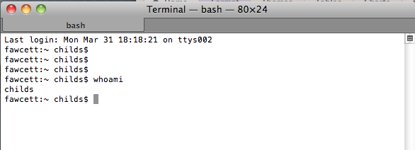
Shells
Shells are interpreters
  Like Python
You type a command, it carries out the command

Slide 24
Shells
There are many types of shells
Two most popular:
  sh (= bash & ksh)
  csh (= tcsh)
They differ in syntax, particularly for
  Environment variables
  Iteration / loops / conditionals
The examples in this course will use syntax for sh

Slide 25
Environment Variables
Environment variables: variables stored by shell interpreter
Some environment variables create side effects in the shell
Other environment variables can be just for your own private purposes

Slide 26
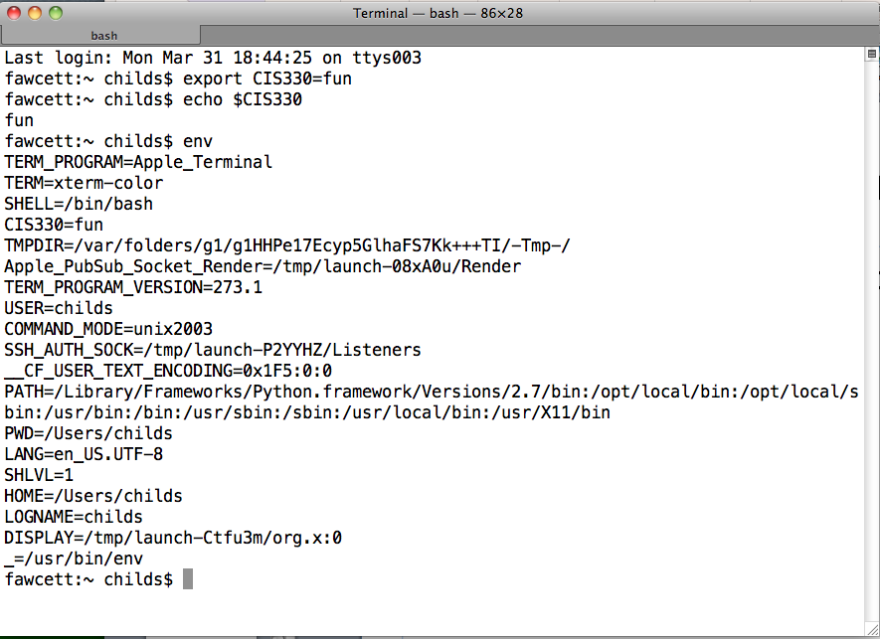
Environment Variables
New commands: export, echo, env

Slide 27
Shells
There is lots more to shells … we will learn about them as we go through the quarter

Slide 28
Outline
Class Overview
Getting Started With Unix
  Unix History
  Shells
  Files
  File Editors
Project 1

Slide 29
Files
Unix maintains a file system
  File system controls how data is stored and retrieved
Primary abstractions:
  Directories
  Files
Files are contained within directories

Slide 30
Directories are hierarchical
Directories can be placed within other directories
“/” -- The root directory
  Note “/”, where Windows uses “\”
“/dir1/dir2/file1”
  What does this mean?
File file1 is contained in directory dir2,
which is contained in directory dir1,
which is in the root directory

Slide 31

Home directory
Unix supports multiple users
Each user has their own directory that they control
Location varies over Unix implementation, but typically something like “/home/username”
Stored in environment variables

Slide 32
Anatomy of shell formatting
Current
working
directory
Machine name
Username
“~” (tilde) is shorthand for your home directory
  You can use it when invoking commands
The shell formatting varies over Unix implementation and can be customized with environment variables. (PS1, PS2, etc)

Slide 33
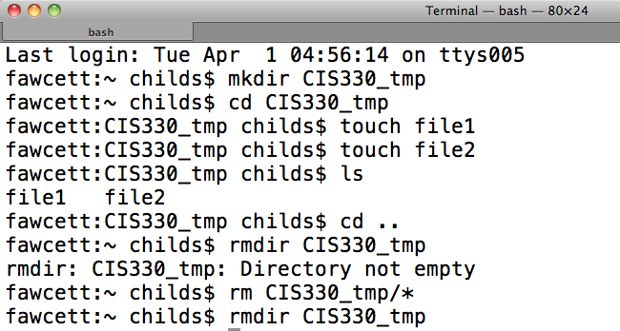
File manipulation
New commands: mkdir, cd, touch, ls, rmdir, rm
Also, “*” is a wildcard that matches any filename

Slide 34
cd: change directory
The shell always has a “present working directory”
  directory that commands are relative to
“cd” changes the present working directory
When you start a shell, the shell is in your “home” directory

Slide 35
Unix commands: mkdir
mkdir: makes a directory
  Two flavors
    Relative to current directory
      mkdir dirNew
    Relative to absolute path
      mkdir /dir1/dir2/dirNew
        (dir1 and dir2 already exist)

Slide 36
Unix commands: rmdir
rmdir: removes a directory
  Two flavors
    Relative to current directory
      rmdir badDir
    Relative to absolute path
      rmdir /dir1/dir2/badDir
        Removes badDir, leaves dir1, dir2 in place
Only works on empty directories!
  “Empty” directories are directories with no files
Most Unix commands can distinguish between absolute and relative path, via the “/” at beginning of filename.
(I’m not going to point this feature out for subsequent commands.)

Slide 37
Unix commands: touch
touch: “touch” a file
Behavior:
  If the file doesn’t exist
    → create it
  If the file does exist
    → update time stamp
Time stamps record the last modification to a file or directory
Why could time stamps be useful?

Slide 38
Unix commands: ls
ls: list the contents of a directory
  Note this is “LS”, not “is” with a capital ‘i’
Many flags, which we will discuss later
  A flag is a mechanism for modifying a Unix programs behavior.
  Convention of using hyphens to signify special status
“ls” is also useful with “*” wild cards (discussed more later)

Slide 39
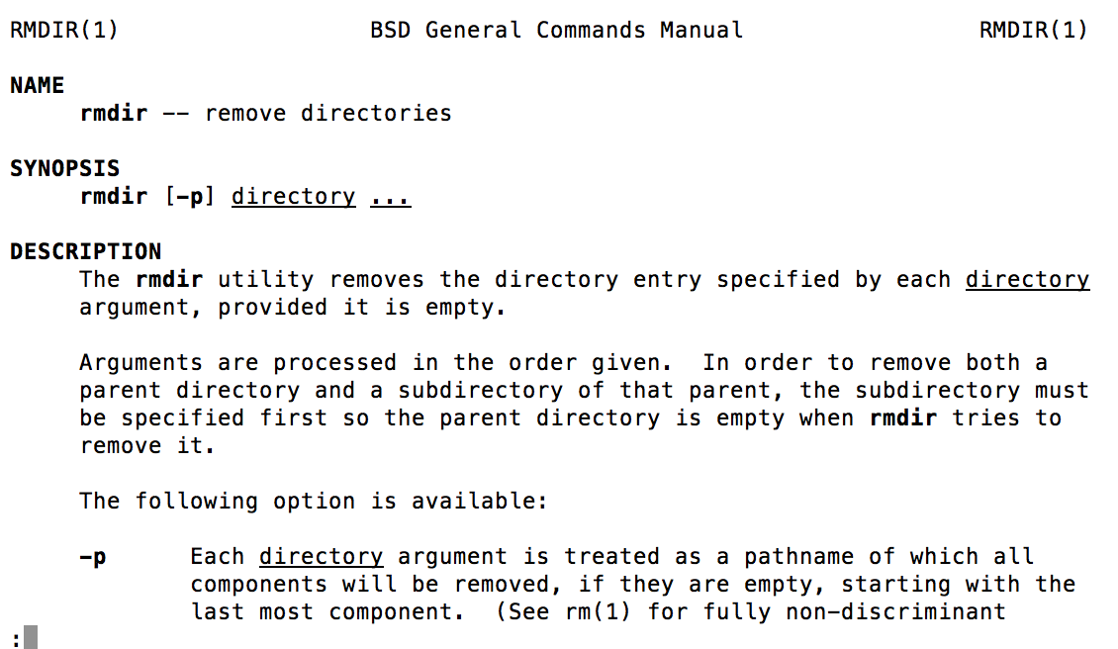
Important: “man”
Get a man page:
→ “man rmdir” gives:

Slide 40
Outline
Class Overview
Getting Started With Unix
  Unix History
  Shells
  Files
  File Editors
Project 1

Slide 41
File Editors
Existing file editors:
  Vi
  Emacs
  Two or three hot new editors that everyone loves (and ultimately fade away and die)
This has been the state of things for 25 years
I will use “vi” in this course.
You are welcome to use whatever editor you want.

Slide 42
My Mental Model for File Editors
vi
emacs
How efficient you can be after you are proficient
Everything else
Investment to be proficient with your editor

Slide 43
Vi has two modes
Command mode
  When you type keystrokes, they are telling vi a command you want to perform, and the keystrokes don’t appear in the file
Edit mode
  When you type keystrokes, they appear in the file.

Slide 44
Transitioning between modes
Command mode to edit mode
  i: enter into edit mode at the current cursor position
  a: enter into edit mode at the cursor position immediately to the right of the current position
  I: enter into edit mode at the beginning of the current line
  A: enter into edit mode at the end of the current line
There are other ways to enter edit mode as well

Slide 45
Transitioning between modes
Edit mode to command mode
  Press Escape

Slide 46
Useful commands
yy: yank the current line and put it in a buffer
  2yy: yank the current line and the line below it
p: paste the contents of the buffer
  2pp: past the contents of the buffer two times
x: delete the character at the current cursor
“:100” go to line 100 in the file
Arrows can be used to navigate the cursor position (while in command mode)
  So do h, j, k, and l
We will discuss more tips for “vi” throughout the quarter.
They will mostly be student-driven (Q&A time each class)

Slide 47
My first vi sequence
At a shell, type: “vi cis330file”
Press ‘i’ (to enter edit mode)
Type “I am using vi and it is fun” (text appears on the screen)
Press “Escape” (to enter command mode)
Press “:wq” (command mode sequence for “write and quit”)

Slide 48
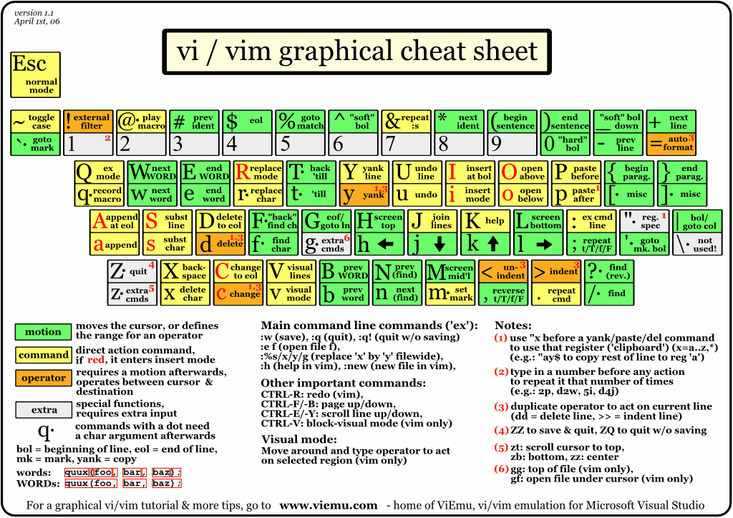
http://www.viemu.com/vi-vim-cheat-sheet.gif

Slide 49
vimtutor
Past students have liked vimtutor

Slide 50
Project 1A
Practice using an editor
Must be written using editor on Unix platform
  I realize this is unenforceable.
  If you want to do it with another mechanism, I can’t stop you
    But realize this project is simply to prepare you for later projects

Slide 51
Project 1A
Write >=300 words using editor (vi, emacs, other)
Topic: what you know about C programming language
Can’t write 300 words?
  Bonus topic: what you want from this course
How will you know if it is 300 words?
  Unix command: “wc” (word count)

Slide 52
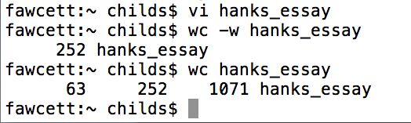
Unix command: wc (word count)
(63 = lines, 252 = words, 1071 = character)

Slide 53
Don’t forget
This lecture is available online
  http://ix.cs.uoregon.edu/~hank/607
All project prompts are available online

Slide 54
CIS 607:
_ _ _ _ ______ _ _____
/ / / /___ (_) __ ____ _____ ____/ / / ____/ _/_/ ____/__ __
/ / / / __ \/ / |/_/ / __ `/ __ \/ __ / / / _/_// / __/ /___/ /_
/ /_/ / / / / /> < / /_/ / / / / /_/ / / /____/_/ / /__/_ __/_ __/
\____/_/ /_/_/_/|_| \__,_/_/ /_/\__,_/ \____/_/ \____//_/ /_/
Lecture 1.2:
Permissions
Hank Childs, University of Oregon

Slide 56
Permissions: System Calls
System calls: a request from a program to the OS to do something on its behalf
  … including accessing files and directories
System calls:
  Typically exposed through functions in C library
  Unix utilities (cd, ls, touch) are programs that call these functions
Permissions in Unix are enforced via system calls.

Slide 57
Permissions: Unix Groups
Groups are a mechanism for saying that a subset of Unix users are related
  In 2014, we had a “330_S14” unix group on ix
  Members:
    Me
    2 TAs
CIS uses “groupctl”
The commands for creating a group tend to vary, and are often done by a system administrator

Slide 58
Permissions
Permissions are properties associated with files and directories
  System calls have built-in checks to permissions
    Only succeed if proper permissions are in place
Three classes of permissions:
  User: access for whoever owns the file
    You can prevent yourself from accessing a file!
      (But you can always change it back)
  Group: allow a Unix group to access a file
  Other: allow anyone on the system to access a file

Slide 59
Three types of permissions
Read
Write
Execute (see next slide)

Slide 60
Executable files
An executable file: a file that you can invoke from the command line
  Scripts
  Binary programs
The concept of whether a file is executable is linked with file permissions

Slide 61
There are 9 file permission attributes
Can user read?
Can user write?
Can user execute?
Can group read?
Can group write?
Can group execute?
Can other read?
Can other write?
Can other execute?
User = “owner”
Other = “not owner, not group”
A bunch of bits … we could represent this with binary

Slide 62
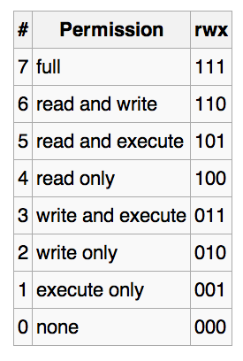
Translating R/W/E permissions to binary
Which of these modes make sense? Which don’t?
We can have separate values (0-7) for user, group, and other
Image from wikipedia

Slide 63
Unix command: chmod
chmod: change file mode
chmod 750 <filename>
  User gets 7 (rwx)
  Group gets 5 (rx)
  Other gets 0 (no access)
Lots of options to chmod
(usage shown here is most common)

Slide 64
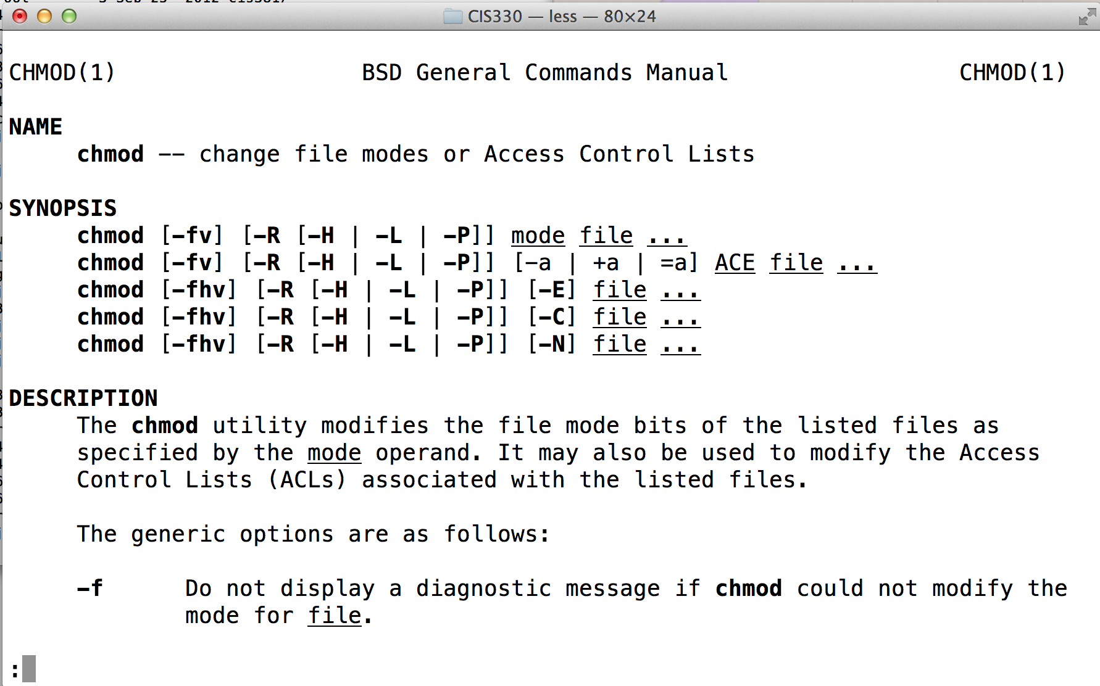
Manpage for chmod
“man chmod”

Slide 65
Unix commands for groups
chgrp: changes the group for a file or directory
  chgrp <group> <filename>
groups: lists groups you are in

Slide 66
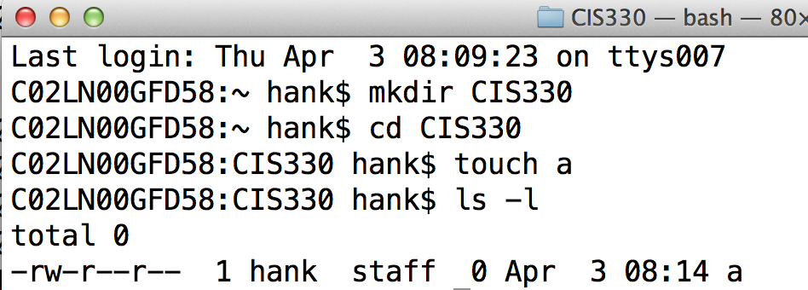
ls -l
Long listing of files
Date of
last change
Filename
Permissions
Links (*)
Owner
Group
File size
How to interpret this?

Slide 67
Permissions and Directories
You can only enter a directory if you have “execute” permissions to the directory
Quiz: a directory has permissions “400”. What can you do with this directory?
Answer: it depends on what permissions a system call requires.

Slide 68
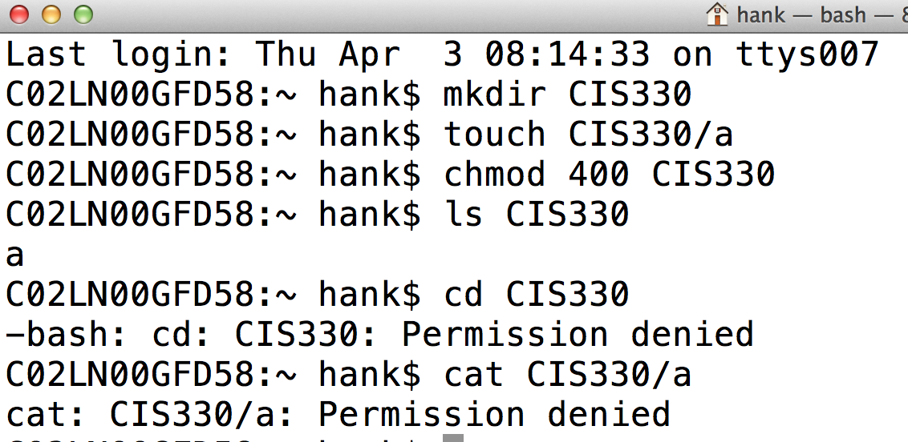
Directories with read, but no execute

Slide 69
Outline
Permissions
Project 1B Overview
More on memory / arrays / pointers

Slide 70
Unix scripts
Scripts
  Use an editor (vi/emacs/other) to create a file that contains a bunch of Unix commands
  Give the file execute permissions
  Run it like you would any program!!

Slide 71
Unix scripts
Arguments
  Assume you have a script named “myscript”
  If you invoke it as “myscript foo bar”
  Then
    $# == 2
    $1 == foo
    $2 == bar

Slide 72
Project 1B
Summary: write a script that will create a specific directory structure, with files in the directories, and specific permissions.

Slide 73
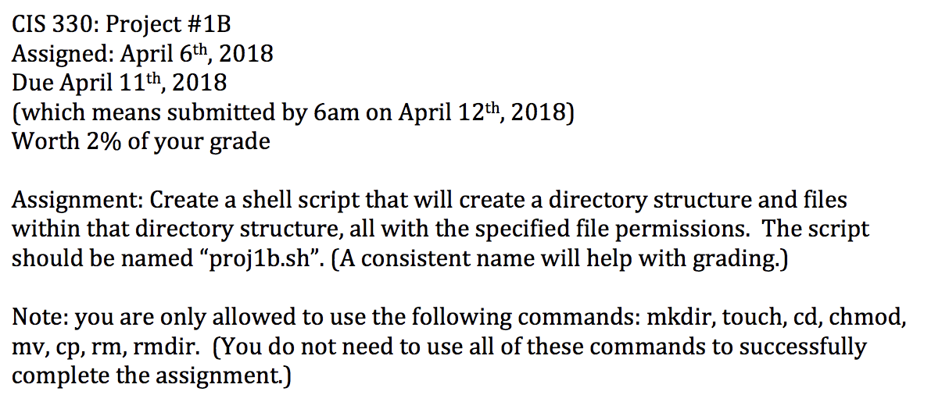
Project 1B

Slide 74
Project 1B

Slide 75
CIS 607:
_ _ _ _ ______ _ _____
/ / / /___ (_) __ ____ _____ ____/ / / ____/ _/_/ ____/__ __
/ / / / __ \/ / |/_/ / __ `/ __ \/ __ / / / _/_// / __/ /___/ /_
/ /_/ / / / / /> < / /_/ / / / / /_/ / / /____/_/ / /__/_ __/_ __/
\____/_/ /_/_/_/|_| \__,_/_/ /_/\__,_/ \____/_/ \____//_/ /_/
Lecture 1.2:
Memory in C
Oct 3rd, 2022
Hank Childs, University of Oregon

Slide 76
Plan for today
Baby steps into C and gcc
Memory

Slide 77
GNU Compilers
GNU compilers: open source
  gcc: GNU compiler for C
  g++: GNU compiler for C++

Slide 78
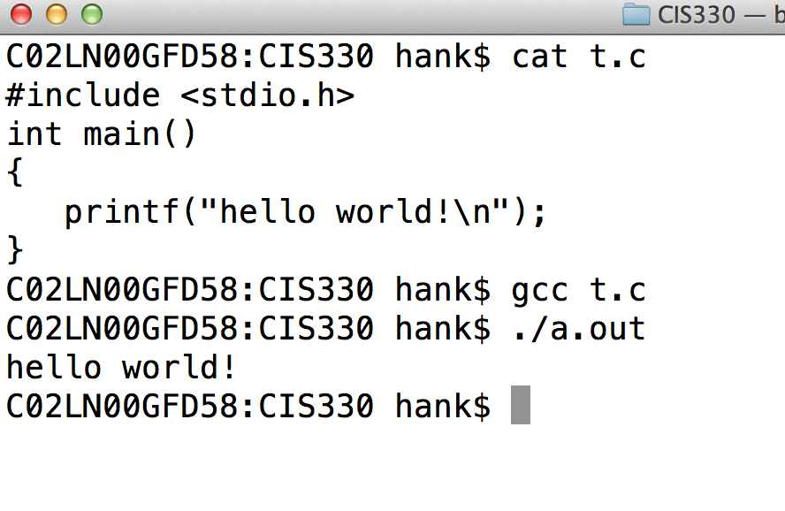
Our first gcc program
Unix command that
prints contents of a file
Invoke gcc compiler
Name of file to compile
gcc’s default name for output programs
You should use this for Proj 2A

Slide 79
Plan for today
Baby steps into C and gcc
Memory

Slide 80
Reading
4.1 (but NOT 4.1.2 … covered later)
4.2
4.3-4.5.2 (what I assume you know from 314)
  NOT 4.5.3 to 4.5.8
4.6: today’s lecture

Slide 81
Why C?
You can control the memory
That helps get good performance
If you don’t control the memory (like in other programming languages), you are likely to get poor performance
… so let’s talk about memory

Slide 82
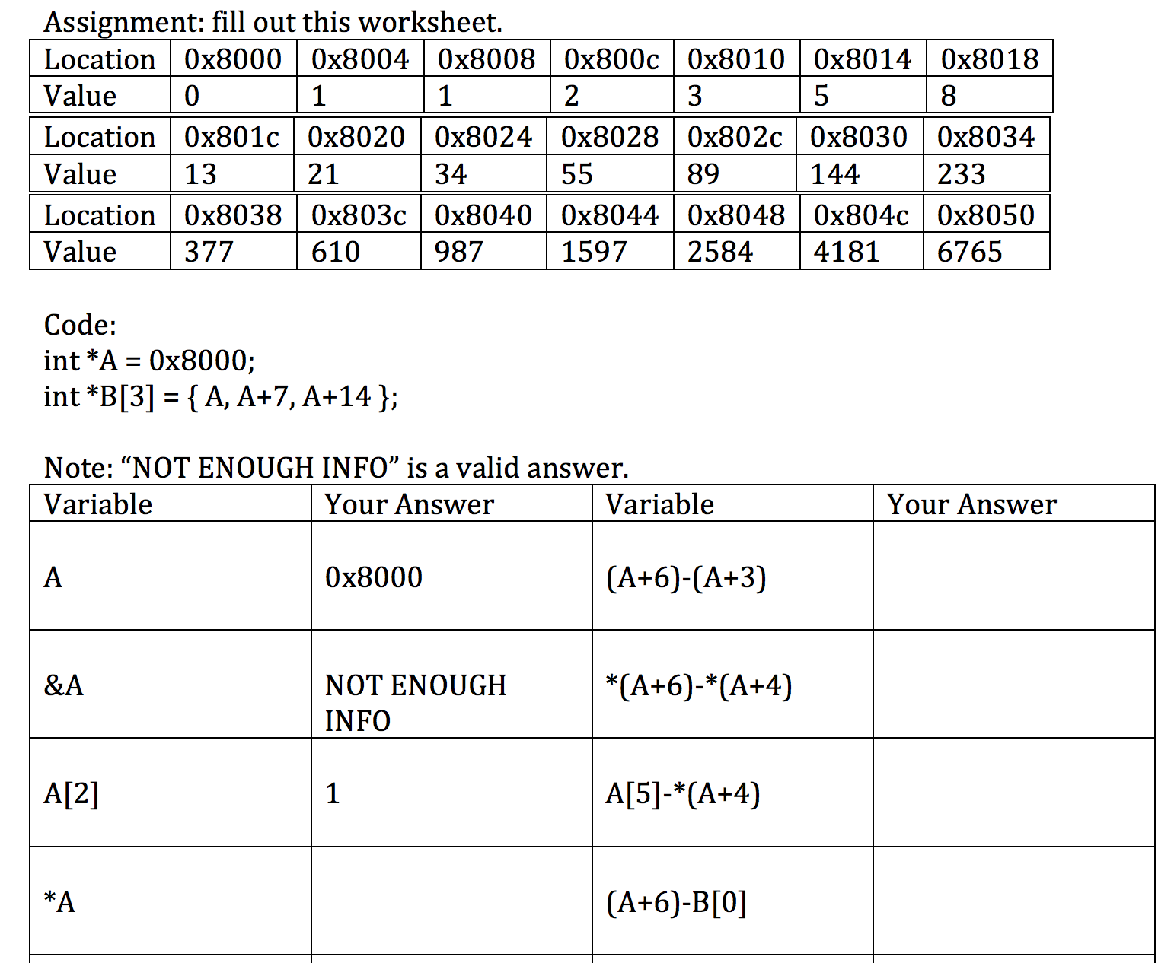
Motivation: Project 2A

Slide 83
Important Context
Different types have different sizes:
  int: 4 bytes
  float: 4 bytes
  double: 8 bytes
  char: 1 byte
  unsigned char: 1 byte

Slide 84
Important Memory Concepts in C (1/9):
Stack versus Heap
You can allocate variables that only live for the invocation of your function
  Called stack variables (will talk more about this later)
You can allocated variables that live for the whole program (or until you delete them)
  Called heap variables (will talk more about this later as well)

Slide 85
Important Memory Concepts in C (2/9):
Pointers
Pointer: points to memory location
  Denoted with ‘*’
  Example: “int *p”
    pointer to an integer
  You need pointers to get to heap memory
Address of: gets the address of memory
  Operator: ‘&’
  Example:
    int x;
    int *y = &x;

Slide 86
Important Memory Concepts in C (3/9):
Memory allocation
Special built-in function to allocate memory from heap: malloc
  Interacts with Operating System
  Argument for malloc is how many bytes you want
Also built-in function to deallocate memory: free

Slide 87
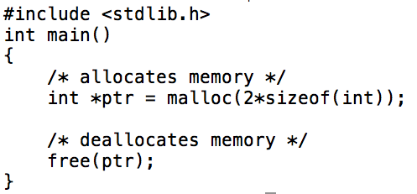
free/malloc example
Enables compiler to see functions that aren’t in this file. More on this next week.
sizeof is a built in function in C. It returns the number of bytes for a type (4 bytes for int).
don’t have to say how many bytes to free … the OS knows

Slide 88
Important Memory Concepts in C (4/9):
Arrays
Arrays lie in contiguous memory
  So if you know address to one element, you know address of the rest
int *a = malloc(sizeof(int)*1);
  a single integer
  … or an array of a single integer
int *a = malloc(sizeof(int)*2);
  an array of two integers
  first integer is at ‘a’
  second integer is at the address ‘a+4’
    Tricky point here, since C/C++ will refer to it as ‘a+1’

Slide 89
Important Memory Concepts in C (5/9):
Dereferencing
There are two operators for getting the value at a memory location: *, and []
  This is called deferencing
    * = “dereference operator”
int *p = malloc(sizeof(int)*1);
*p = 2; /* sets memory p points to to have value 2 */
p[0] = 2; /* sets memory p points to to have value 2 */

Slide 90
Important Memory Concepts in C (6/9): pointer arithmetic
int *p = malloc(sizeof(int)*5);
C/C++ allows you to modify pointer with math operations
  called pointer arithmetic
  “does the right thing” with respect to type
    int *p = malloc(sizeof(int)*5);
    p+1 is 4 bytes bigger than p!!
Then:
  “p+3” is the same as “&(p[3])” (ADDRESSES)
  “*(p+3)” is the same as “p[3]” (VALUES)

Slide 91
Important Memory Concepts in C (7/9)
Pointers to pointers
int **p = malloc(sizeof(int *)*5);
p[0] = malloc(sizeof(int)*50);
….
p[0] p[1] p[2] p[3] p[4]
p
50 integers…
p[0][0]

Slide 92
Important Memory Concepts in C (8/9):
Hexadecimal address
Addresses are in hexadecimal
int *A = 0x8000;
Then A+1 is 0x8004. (Since int is 4 bytes)

Slide 93
Important Memory Concepts in C (9/9)
NULL pointer
int *p = NULL;
often stored as address 0x0000000
used to initialize something to a known value
  And also indicate that it is uninitialized…

Slide 94
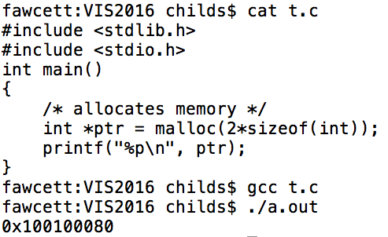
Project 2A
You now know what you need to do Project 2A
  But: practice writing C programs and testing yourself!!
  Hint: you can printf with a pointer

Slide 95
Project 2A
Assigned now
Worksheet. You print it out, complete it on your own, and bring it to class.
Due Monday 10am in class
Practice with C, vi, gcc, printf

Slide 96
Memory Segments
Von Neumann architecture: one memory space, for both instructions and data
→ so break memory into “segments”
  … creates boundaries to prevent confusion
4 segments:
  Code segment
  Data segment
  Stack segment
  Heap segment

Slide 97
Code Segment
Contains assembly code instructions
Also called text segment
This segment is modify-able, but that’s a bad idea
  “Self-modifying code”
    Typically ends in a bad state very quickly.

Slide 98
Data Segment
Contains data not associated with heap or stack
  global variables
  statics (to be discussed later)
  character strings you’ve compiled in
    char *str = “hello world\n”

Slide 99
Stack: data structure for collection
A stack contains things
It has only two methods: push and pop
  Push puts something onto the stack
  Pop returns the most recently pushed item (and removes that item from the stack)
LIFO: last in, first out
Imagine a stack of trays.
You can place on top (push).
Or take one off the top (pop).

Slide 100
Stack
Stack: memory set aside as scratch space for program execution
When a function has local variables, it uses this memory.
  When you exit the function, the memory is lost

Slide 101
Stack
The stack grows as you enter functions, and shrinks as you exit functions.
  This can be done on a per variable basis, but the compiler typically does a grouping.
    Some exceptions (discussed later)
Don’t have to manage memory: allocated and freed automatically

Slide 102
Heap
Heap (data structure): tree-based data structure
Heap (memory): area of computer memory that requires explicit management (malloc, free).
Memory from the heap is accessible any time, by any function.
  Contrasts with the stack

Slide 103
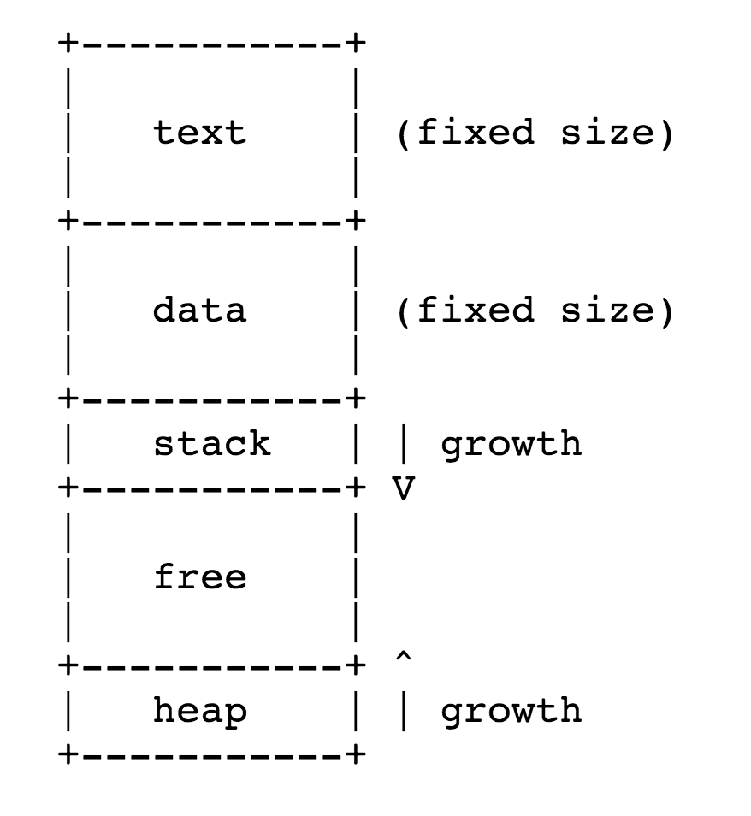
Memory Segments
Source: http://www.cs.uwm.edu/classes/cs315/Bacon/

Slide 104
Stack vs Heap: Pros and Cons
 | Stack | Heap
Allocation/Deallocation | Automatic | Explicit

Slide 105
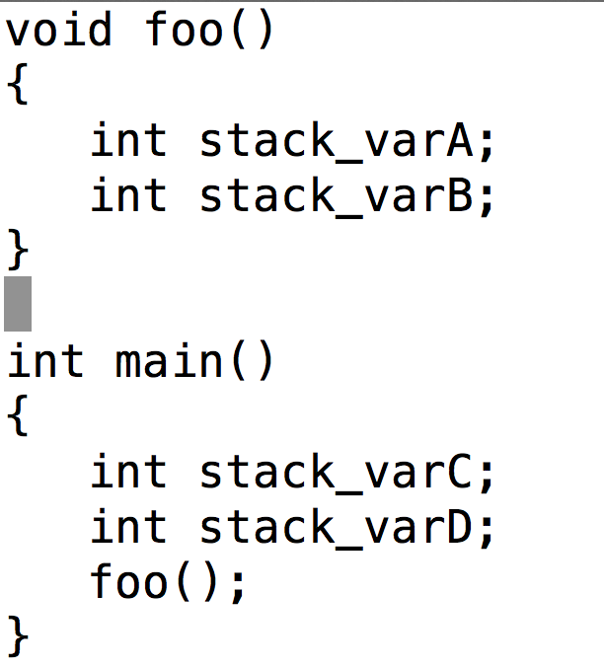
How stack memory is allocated into Stack Memory Segment
Code
Data
Stack
Free
Heap

Slide 106
How stack memory is allocated into Stack Memory Segment
Code
Data
Stack
stack_varC
stack_varD
Free
Heap

Slide 107
How stack memory is allocated into Stack Memory Segment
Code
Data
Stack
stack_varC
stack_varD
stack_varA
stack_varB
Free
Heap

Slide 108
How stack memory is allocated into Stack Memory Segment
Code
Data
Stack
stack_varC
stack_varD
Free
Heap

Slide 109
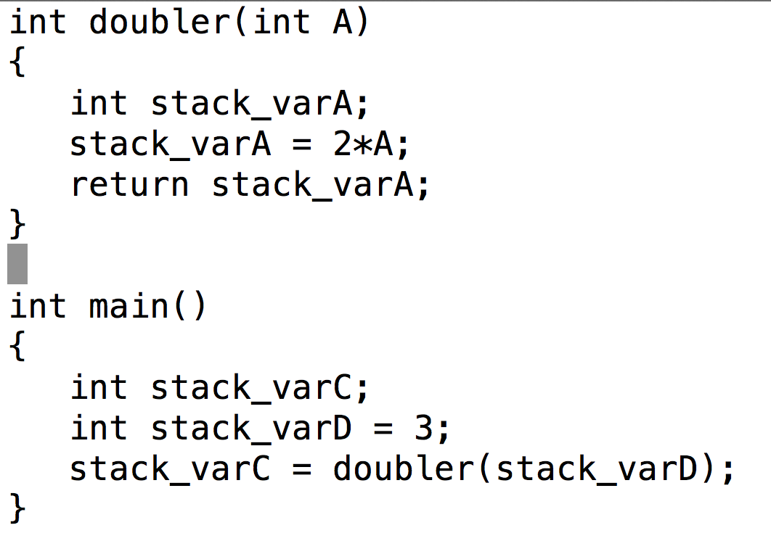
How stack memory is allocated into Stack Memory Segment
Code
Data
Stack
stack_varC
stack_varD
Free
Heap

Slide 110
How stack memory is allocated into Stack Memory Segment
Code
Data
Stack
stack_varC
stack_varD
<info for how to get back to main>
A (= 3)
<Location for RV>
Free
Heap

Slide 111
How stack memory is allocated into Stack Memory Segment
Code
Data
Stack
stack_varC
stack_varD
<info for how to get back to main>
A (= 3)
<Location for RV>
stack_varA
Free
Heap

Slide 112
How stack memory is allocated into Stack Memory Segment
Code
Data
Stack
stack_varC
stack_varD
<info for how to get back to main>
A (= 3)
<Location for RV>
stack_varA
Return copies into location specified by calling function
Free
Heap

Slide 113
How stack memory is allocated into Stack Memory Segment
Code
Data
Stack
stack_varC = 6
stack_varD = 3
Free
Heap

Slide 114
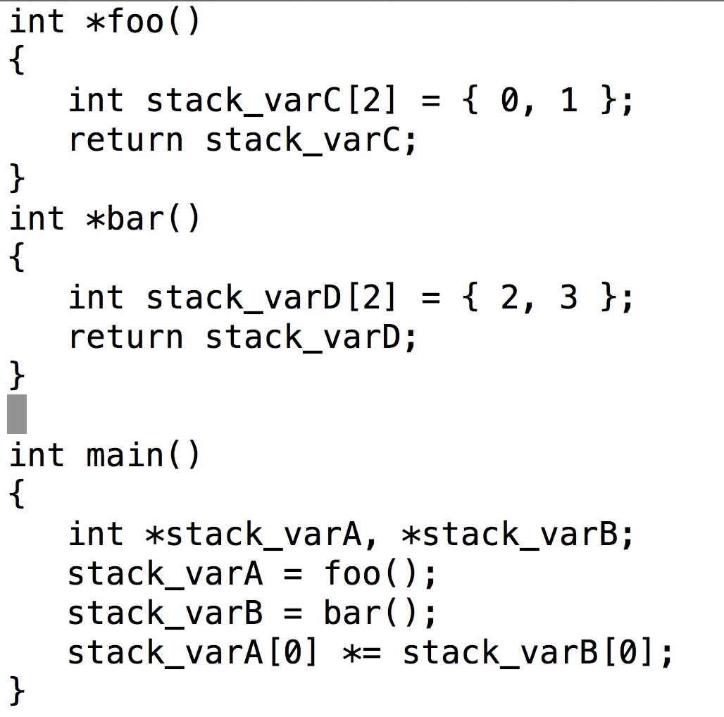
This code is very problematic … why?
foo and bar are returning addresses that are on the stack … they could easily be overwritten
(and bar’s stack_varD overwrites foo’s stack_varC in this program)

Slide 115
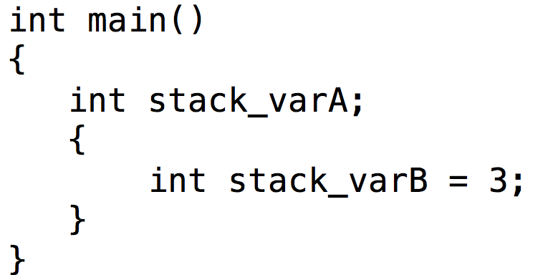
Nested Scope
Code
Data
Stack
stack_varA
Free
Heap

Slide 116
Nested Scope
Code
Data
Stack
stack_varA
stack_varB
Free
Heap

Slide 117
Nested Scope
Code
Data
Stack
stack_varA
You can create new scope within a function by adding ‘{‘ and ‘}’.
Free
Heap

Slide 118
Stack vs Heap: Pros and Cons
 | Stack | Heap
Allocation/Deallocation | Automatic | Explicit
Access | Fast | Slower
Memory pages associated with stack are almost always immediately available.
Memory pages associated with heap may be located anywhere ... may be caching effects

Slide 119
Stack vs Heap: Pros and Cons
 | Stack | Heap
Allocation/Deallocation | Automatic | Explicit
Access | Fast | Slower
Variable scope | Limited | Unlimited

Slide 120
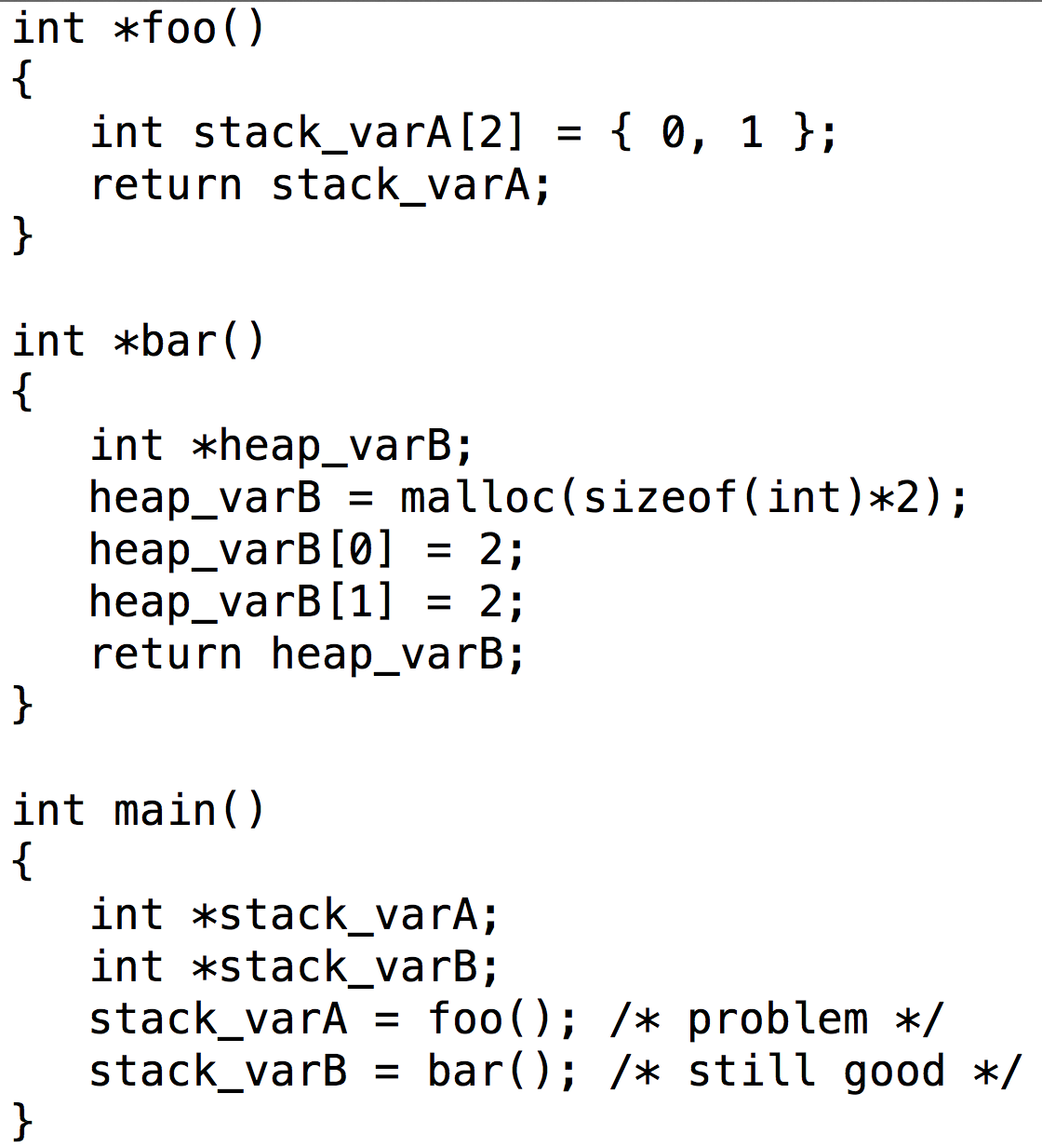
Variable scope: stack and heap
foo is bad code … never return memory on the stack from a function
bar returned memory from heap
The calling function – i.e., the function that calls bar – must understand this and take responsibility for calling free.
If it doesn’t, then this is a “memory leak”.

Slide 121
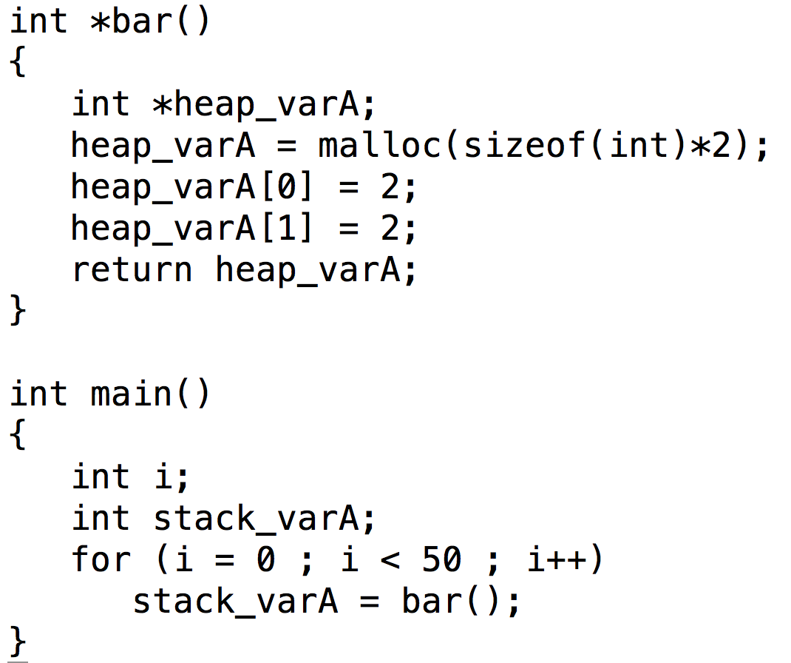
Memory leaks
It is OK that we are using the heap … that’s what it is there for
The problem is that we lost the references to the first 49 allocations on heap
The heap’s memory manager will not be able to re-claim them … we have effectively limited the memory available to the program.
Code
Data
Stack
stack_varA
Free
Heap

Slide 122
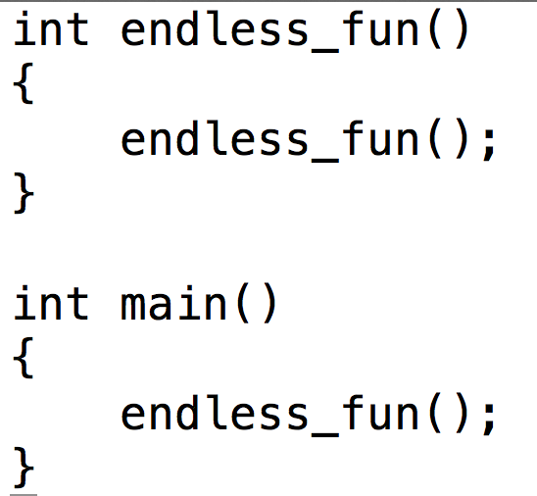
Running out of memory (stack)
Code
Data
Stack
stack overflow: when the stack runs into the heap.
There is no protection for stack overflows.
(Checking for it would require coordination with the heap’s memory manager on every function calls.)
Free
Heap

Slide 123
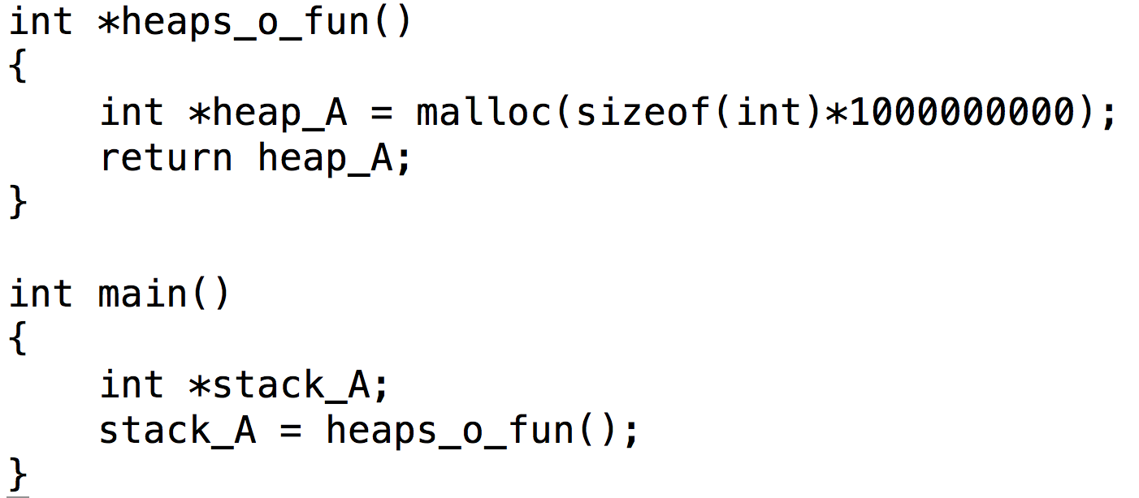
Running out of memory (heap)
Code
Data
Stack
Allocation too big … not enough free memory
If the heap memory manager doesn’t have room to make an allocation, then malloc returns NULL …. a more graceful error scenario.
Free
Heap

Slide 124
Stack vs Heap: Pros and Cons
 | Stack | Heap
Allocation/Deallocation | Automatic | Explicit
Access | Fast | Slower
Variable scope | Limited | Unlimited
Fragmentation | No | Yes

Slide 125
Memory Fragmentation
Memory fragmentation: the memory allocated on the heap is spread out of the memory space, rather than being concentrated in a certain address space.

Slide 126
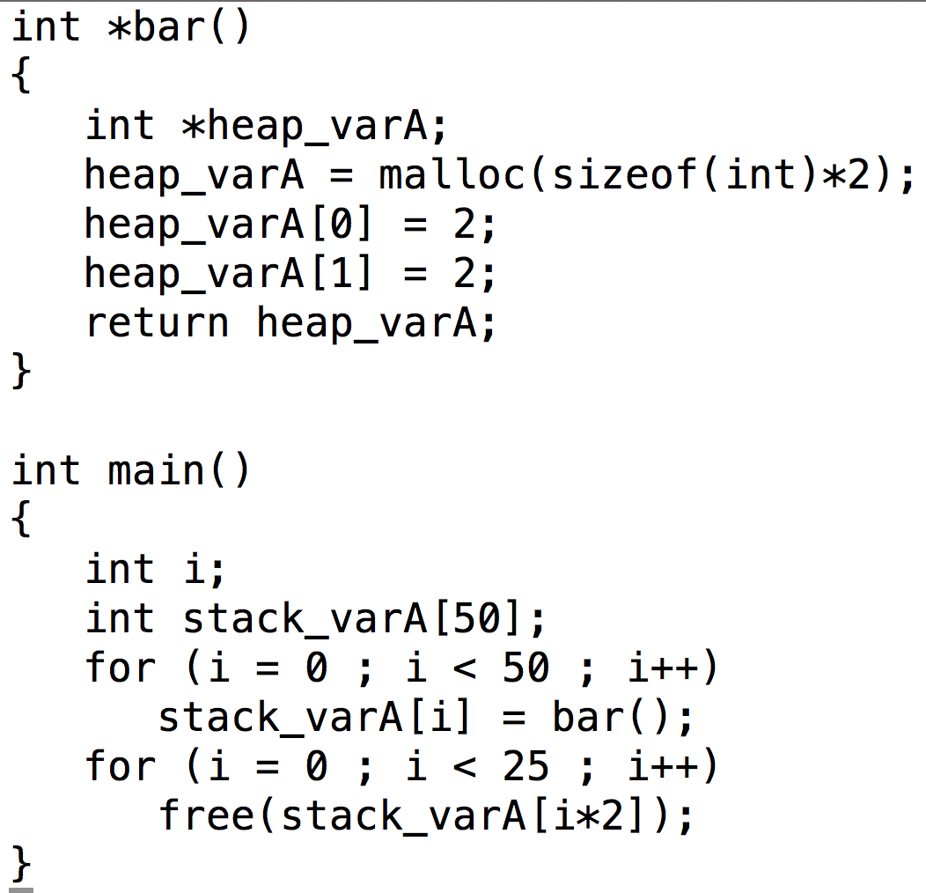
Memory Fragmentation
Code
Data
Stack
Free
Negative aspects of fragmentation?
can’t make big allocations
losing cache coherency
Heap

Slide 127
Fragmentation and Big Allocations
Even if there is lots of memory available, the memory manager can only accept your request if there is a big enough contiguous chunk.
Code
Data
Stack
Free
Heap

Slide 128
Stack vs Heap: Pros and Cons
 | Stack | Heap
Allocation/Deallocation | Automatic | Explicit
Access | Fast | Slower
Variable scope | Limited | Unlimited
Fragmentation | No | Yes

Slide 129
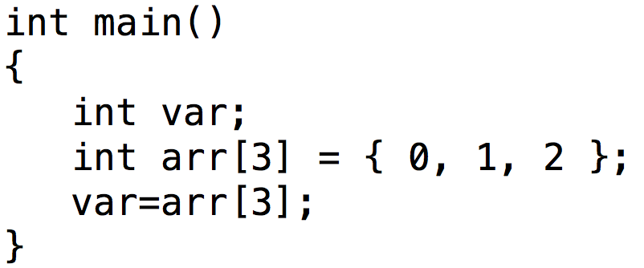
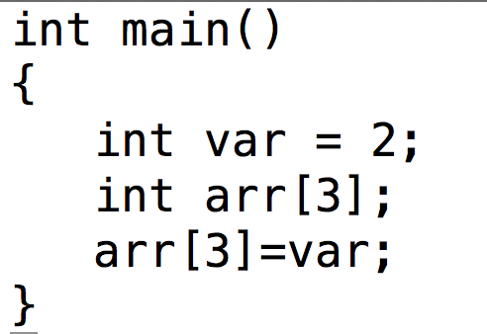
Memory Errors
Array bounds read
Array bounds write

Slide 130
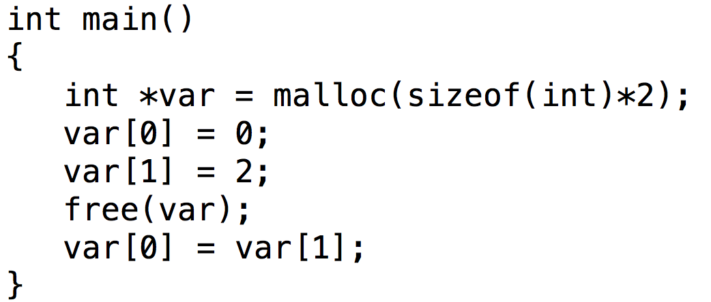
Memory Errors
Free memory read / free memory write
When does this happen in real-world scenarios?

Slide 131
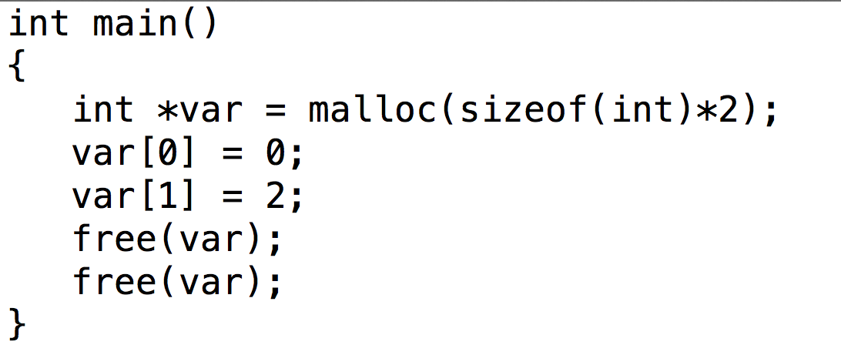
Memory Errors
Freeing unallocated memory
When does this happen in real-world scenarios?
Vocabulary: “dangling pointer”: pointer that points to memory that has already been freed.

Slide 132
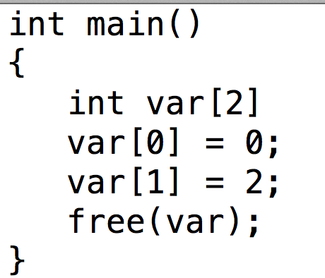
Memory Errors
Freeing non-heap memory
When does this happen in real-world scenarios?

Slide 133
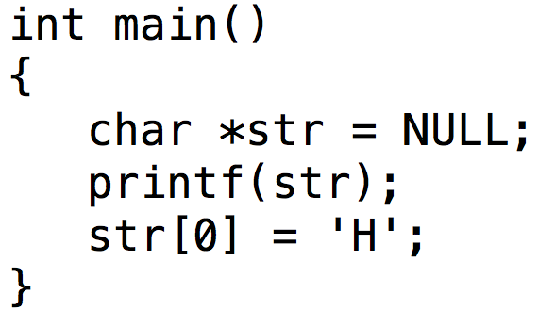
Memory Errors
NULL pointer read / write
NULL is never a valid location to read from or write to, and accessing them results in a “segmentation fault”
  …. remember those memory segments?
When does this happen in real-world scenarios?

Slide 134
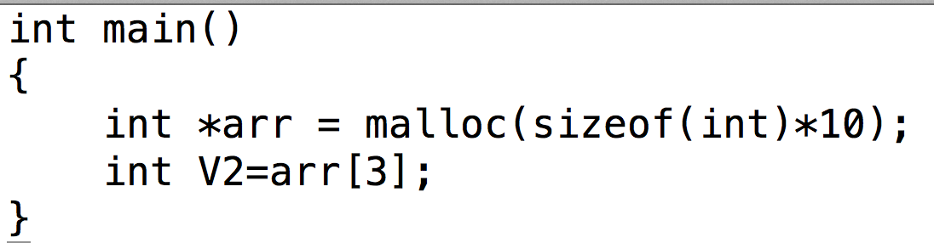
Memory Errors
Unitialized memory read
When does this happen in real-world scenarios?

