Slide 1
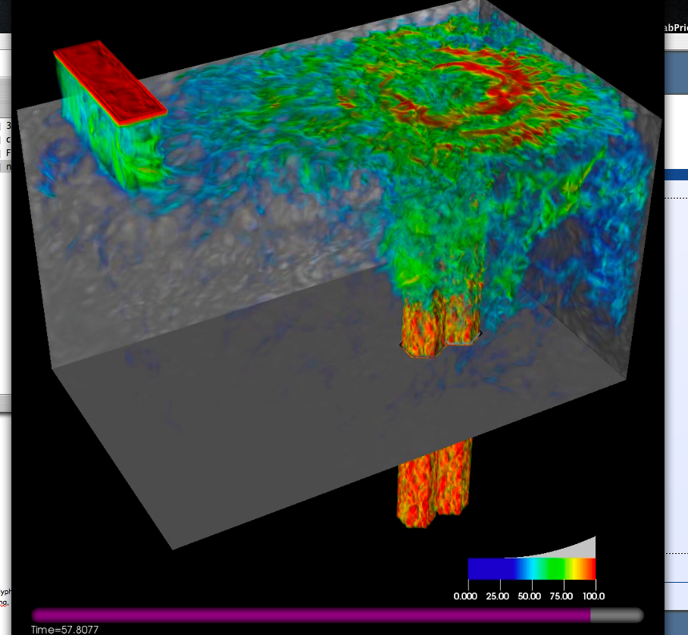
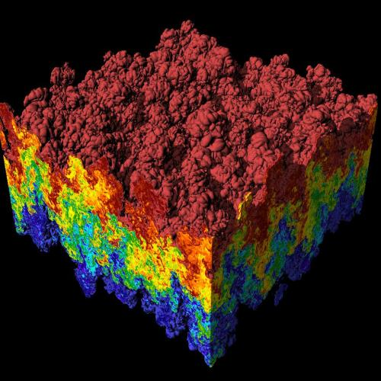
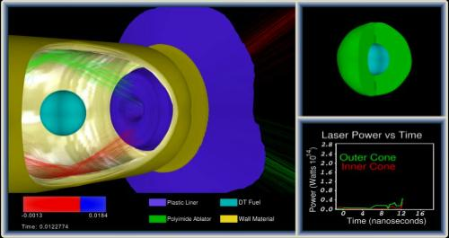
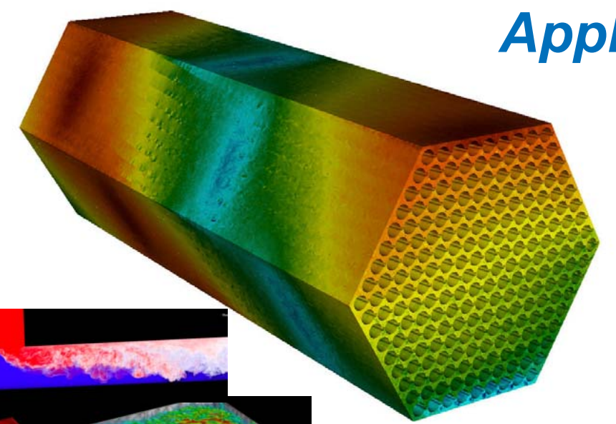
CIS 441/541: Intro to Computer Graphics Lecture 9: OpenGL
May 4, 2021
Hank Childs, University of Oregon

Slide 2
Current Plan (1/2)
Week | Sun | Mon | Tues | Weds | Thurs | Fri | Sat
5 |  |  | Lec 7 (shading), 1F assigned, 1E due |  | Lec 8 (finish shading, GL), 2A assigned 1F assigned
6 |  | 1F due | Lec 9 (GL), 2B assigned 2A assigned (sort of) | 1F due | 2B assigned Discussion of final projects / More GL Quiz 3 |  | 2A due
7 |  |  | Lec 11 – ray tracing Even more GL 2B assigned 2A due |  | More discussion of final projects Quiz 3 | 2B due

Slide 3
Quiz 3
Old: Thursday of Week 6 (in two days)
Old: on matrices
New: Thursday of Week 7 (in nine days)
New: on Phong shading

Slide 4
Current Plan (2/2)
Early part of Week 8: 2B due
Rest of Week 8 -> Week 10 → you work on final projects
Lectures will be on misc. topics in graphics, esp. in support of final projects
Quiz 3 (Week 6): likely on matrices
Quiz 3 (Week 7): Phong shading
Quiz 4 (Week 8): likely on GL
Quiz 5 (Week 10): likely on topics in final weeks

Slide 5
Office Hours

Slide 6
Project #1F (8%), Wed May 5th
Goal: add shading, movie
Extend your project1E code
Important:
add #define NORMALS
Download new file, update to new file

Slide 7
Changes to data structures
class Triangle
{
public:
double X[3], Y[3], Z[3];
double colors[3][3];
double normals[3][3];
};
reader1e.cxx will not compile (with #define NORMALS) until you make these changes
reader1e.cxx will initialize normals at each vertex

Slide 8
More comments (1/3)
This project in a nutshell:
Add method called “CalculateShading”
My version of CalculateShading is about ten lines of code.
Call CalculateShading for each vertex
This is a new field, which you will LERP
Modify RGB calculation to use shading

Slide 9
More comments (2/3)
New: more data to help debug
I will make the shading value for each pixel available
I will also make it available for ambient, diffuse, specular
Don’t forget to do two-sided lighting
REVERSAL: do one-sided lighting

Slide 10
(c_x, c_y, c_z) / camera = (0,1,0)
This example has a triangle vertex, v, at the origin, the camera one unit along the Y-axis and the light source one unit along the X-axis.
The lightDir and viewDir formulas show the conventions we should use for direction for general positions.
viewDir = normalize(c_x-v_x, c_y-v_y, c_z-v_z) = (0, 1, 0)
(0.707,0.707,0) / view normal
(l_x, l_y , l_z) / light source = (1,0,0)
(v_x, v_y, v_z)
= (0,0,0)
lightDir
= normalize(l_x-v_x, l_y-v_y, l_z-v_z)
= (1, 0, 0)

Slide 11
More comments (3/3)
I haven’t said anything about movie encoders

Slide 12
Project #1F (8%), Due Weds May 5th
Goal: add shading, movie

Slide 13
(Lecture Begins)

Slide 14
GLFW: Graphics Library FrameWork
Open Source, multi-platform library for
OpenGL,
OpenGL ES, and
Vulkan development
on the desktop
Source: https://www.glfw.org/

Slide 15
OpenGL ES?
OpenGL ES is an “embeddable subset” of OpenGL
Slims down large OpenGL API to bare essentials
Enables implementation on devices with
simpler, cheaper hardware
power requirements (runs on batteries)
Standard on smartphones running both Apple’s IOS and Google’s Android operating
Source: khronos.org

Slide 16
Vulkan?
New generation graphics and compute API
Features:
high-efficiency
cross-platform access to modern GPUs
PCs
consoles
mobile phones
embedded platforms
Source: khronos.org

Slide 17
GLFW: Graphics Library FrameWork
Written in C
Supports
Windows
macOS
two Unix (X11 and Wayland)
Source: https://www.glfw.org/

Slide 18
GLFW: Does Things We Don’t Want to Do
GLFW provides a simple API for
creating windows
receiving input and events
Source: https://www.glfw.org/

Slide 19
GLFW
Source: https://www.glfw.org/

Slide 20
Layout of Simple OpenGL Program
Set up windows
Set up things to render (VBOs)
Set up how to render (shaders)
While (1)
Accept events, make changes
New camera positions, new geometry, etc.
Render

Slide 21
Layout of Simple OpenGL Program
This is done for you in 2A
Simple through GLFW
Will talk about this first
Set up windows
Set up things to render (VBOs)
Set up how to render (shaders)
While (1)
Accept events, make changes
New camera positions, new geometry, etc.
Render

Slide 22
Layout of Simple OpenGL Program
Set up windows
Set up things to render (VBOs)
Set up how to render (shaders)
While (1)
Accept events, make changes
New camera positions, new geometry, etc.
Render
This is done for you in 2A
Simple through GLFW
Will talk about this second

Slide 23
Layout of Simple OpenGL Program
Set up windows
Set up things to render (VBOs)
Set up how to render (shaders)
While (1)
Accept events, make changes
New camera positions, new geometry, etc.
Render
This will be discussed for 2B. In 2A, renders one time and you are done.

Slide 24
Layout of Simple OpenGL Program
Set up windows
Set up things to render (VBOs)
Set up how to render (shaders)
While (1)
Accept events, make changes
New camera positions, new geometry, etc.
Render
Majority of this lecture & next.
You do both in 2A.

Slide 25
The remainder of this lecture and Thursday’s lecture are made up of 4 parts
Set up windows
Doing a render
Set up things to render (VBOs)
Set up how to render (shaders) (Thursday)

Slide 26
Part 1
This is done for you in 2A
Simple through GLFW
Will talk about this first
Set up windows
Set up things to render (VBOs)
Set up how to render (shaders)
While (1)
Accept events, make changes
New camera positions, new geometry, etc.
Render

Slide 27
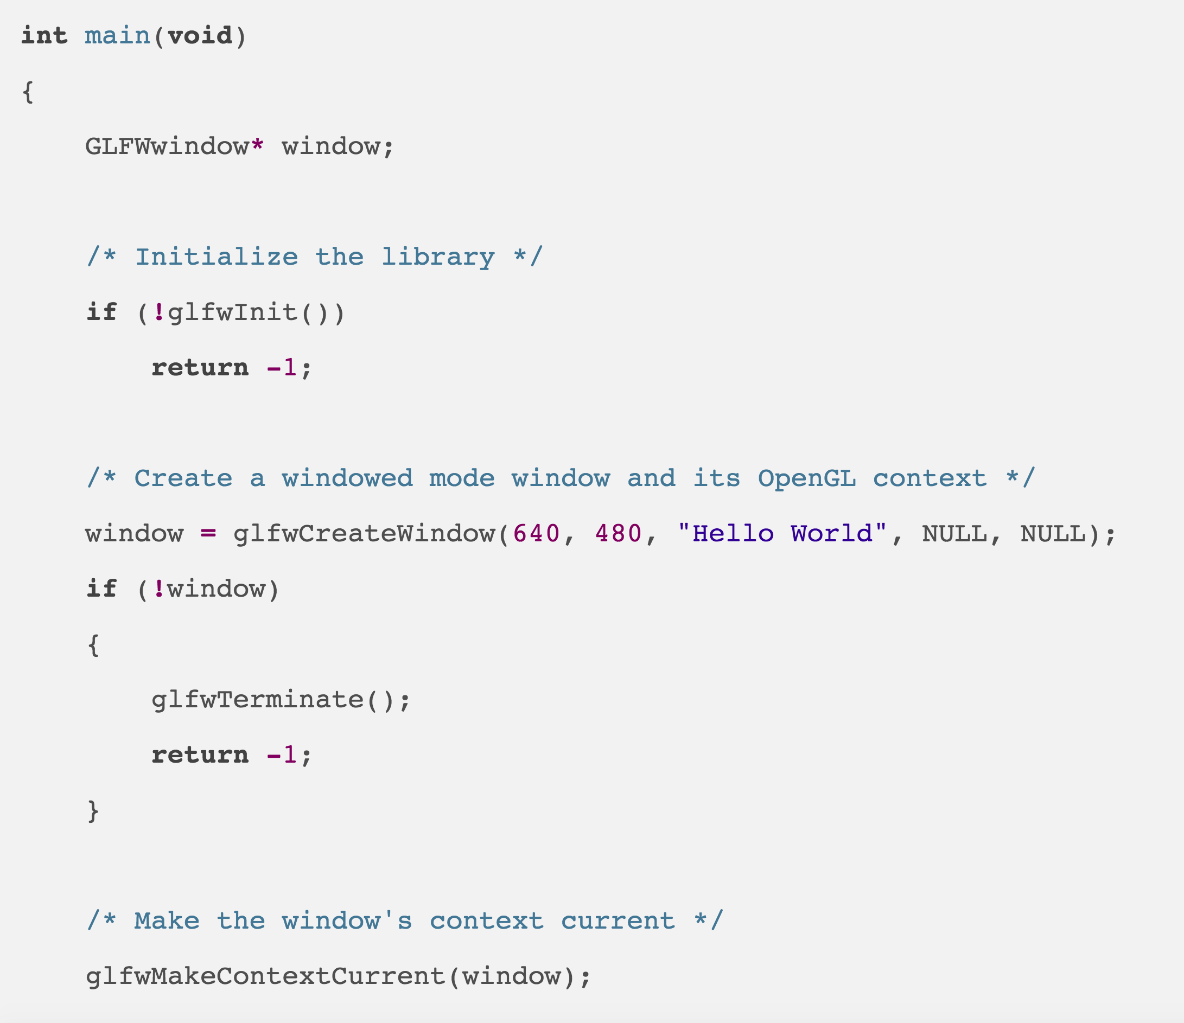
???
https://www.glfw.org/documentation.html#example-code

Slide 28
OpenGL Context
An OpenGL context represents many things
A context stores all of the state associated with this instance of OpenGL
All of your buffers are within this context
If you have two OpenGL programs running, they can co-exist since each works in its own context
(Not something you need to worry about when writing your first GL programs)
https://www.khronos.org/opengl/wiki/OpenGL_Context

Slide 29
Note: Abhishek’s program has some extra stuff – not worth worrying about
EXCEPT:
// uncomment these lines if on Apple OS X
glfwWindowHint(GLFW_CONTEXT_VERSION_MAJOR, 3);
glfwWindowHint(GLFW_CONTEXT_VERSION_MINOR, 2);
glfwWindowHint(GLFW_OPENGL_FORWARD_COMPAT, GL_TRUE);
glfwWindowHint(GLFW_OPENGL_PROFILE, GLFW_OPENGL_CORE_PROFILE);

Slide 30
Part 2
Set up windows
Set up things to render (VBOs)
Set up how to render (shaders)
While (1)
Accept events, make changes
New camera positions, new geometry, etc.
Render
This is done for you in 2A
Simple through GLFW
Will talk about this second

Slide 31
Render: 3 steps
Initialize
Perform Render Actions
Finalize

Slide 32
Rendering Step #1: Initialize (1/2)
Need to clear everything off the screen from the last render
You did this in Project 1
for (int i = 0 ; i < npixels ; i++)
{
zbuffer[i] = -1.0;
buffer[3*i+0] = 0;
buffer[3*i+1] = 0;
buffer[3*i+2] = 0;
}

Slide 33
Rendering Step #1: Initialize (2/2)
GL command: glClear
Arguments: what to clear
Color buffer
Depth buffer ⬅ ➔ Z buffer
Actual invocation:
glClear(GL_COLOR_BUFFER_BIT | GL_DEPTH_BUFFER_BIT);

Slide 34
Render Step #2: Perform Render Actions
GL needs to know:
Geometry to render
How to render that geometry
After a clear, you have to instruct GL to render geometry
You can optionally tell it how to render that geometry during a render cycle
Or you can tell it ahead of time

Slide 35
From Example Program (a little modified)
glUseProgram(shader_programme);
glBindVertexArray(vao);
while (!glfwWindowShouldClose(window)) {
// wipe the drawing surface clear
glClear(GL_COLOR_BUFFER_BIT |
GL_DEPTH_BUFFER_BIT);
// draw points 0-3 from the currently bound VAO
glDrawElements( GL_TRIANGLES, 6,
GL_UNSIGNED_INT, NULL );
…
glUseProgram, glBindVertexArray, glDrawElements will be discussed later this lecture

Slide 36
... But this works too
while (!glfwWindowShouldClose(window)) {
// wipe the drawing surface clear
glClear(GL_COLOR_BUFFER_BIT |
GL_DEPTH_BUFFER_BIT);
glUseProgram(shader_programme); // modify shader each render
glBindVertexArray(vao); // modify geometry each render
// draw points 0-3 from the currently bound VAO
glDrawElements( GL_TRIANGLES, 6,
GL_UNSIGNED_INT, NULL );
…
glUseProgram, glBindVertexArray, glDrawElements will be discussed later this lecture

Slide 37
Rendering Step #3: Finalize
Finalize means getting the image to the viewer on the display
In graphics, maintain two copies of buffers
Copy #1 (“front buffer”): given to the display for user to see
Copy #2 (“back buffer”): being generated “right now”
When rendering is done, swap “copy #2” into “copy #1” and start over
Command: glfwSwapBuffers(window);
(And there is an OpenGL equivalent)

Slide 38
Why Double Buffered?
General computer science idea: double buffering (or “multiple buffering”)
use of more than one buffer to hold a block of data
Why?
"reader" sees a complete (though perhaps old) version of the data, rather than a partially updated version of the data being created by a “writer”
In other words: if you are continuously working on something, then regularly make a copy and show that to the user, rather than risking them see incomplete/partial versions
https://en.wikipedia.org/wiki/Multiple_buffering

Slide 39
Part 3
Set up windows
Set up things to render (VBOs)
Set up how to render (shaders)
While (1)
Accept events, make changes
New camera positions, new geometry, etc.
Render
Majority of this lecture and you do both in 2A.

Slide 40
Game Plan
Plan
Set up small things
Wrap the small things up into one big thing
More detail
Small things are buffers / Vertex Buffer Objects (VBOs)
Big things are arrays of buffers / Vertex Array Object (VAOs)
Lecture
Starts with VBO and then go on to VAO
Focuses on starter code for 2A

Slide 41
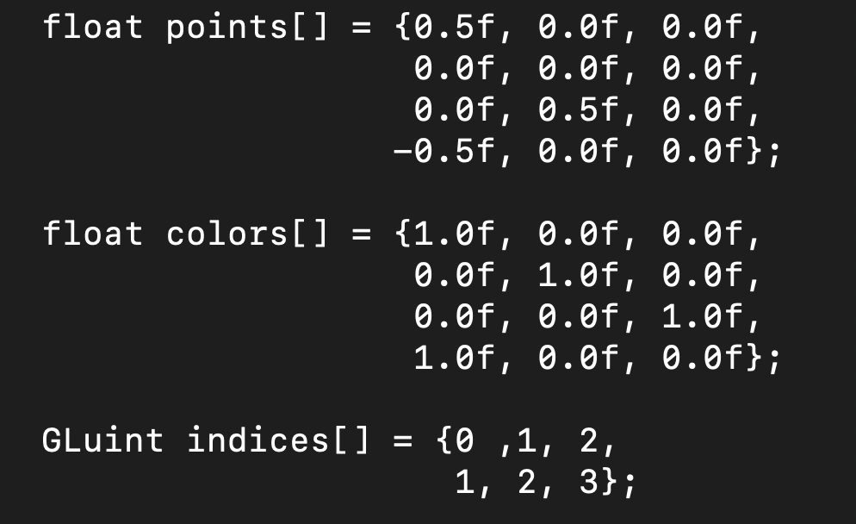
Walking Through the Starter Code
4 points:
V0 = (0.5, 0, 0), red
V1 = (0, 0, 0), green
V2 = (0, .5, 0), blue
V3 = (-0.5, 0, 0), red
6 indices for 2 triangles
Triangle 0: (V0,V1,V2)
Triangle 1: (V1,V2,V3)

Slide 42
glGenBuffers / glBindBuffers / glBufferData
GLuint: this is an unsigned integer, but OpenGL defines its own type so it can deal with portability issues (like 32 bits vs 64 bits)

Slide 43
glGenBuffers / glBindBuffers / glBufferData
glGenBuffers
Asks OpenGL to generate a new buffer for the programmer to work with
That buffer will have a unique identifier (points_vbo)
This unique identifier is useful: lets programmer tell OpenGL which buffer they want to operate on

Slide 44
glGenBuffers / glBindBuffers / glBufferData
glBindBuffer
Buffers can operate on different types of “targets”
(I think types would be a better word than targets)
glBindBuffer says what type of target a buffer will operate on
It also makes the buffer “active,” meaning subsequent GL calls will use this buffer

Slide 45
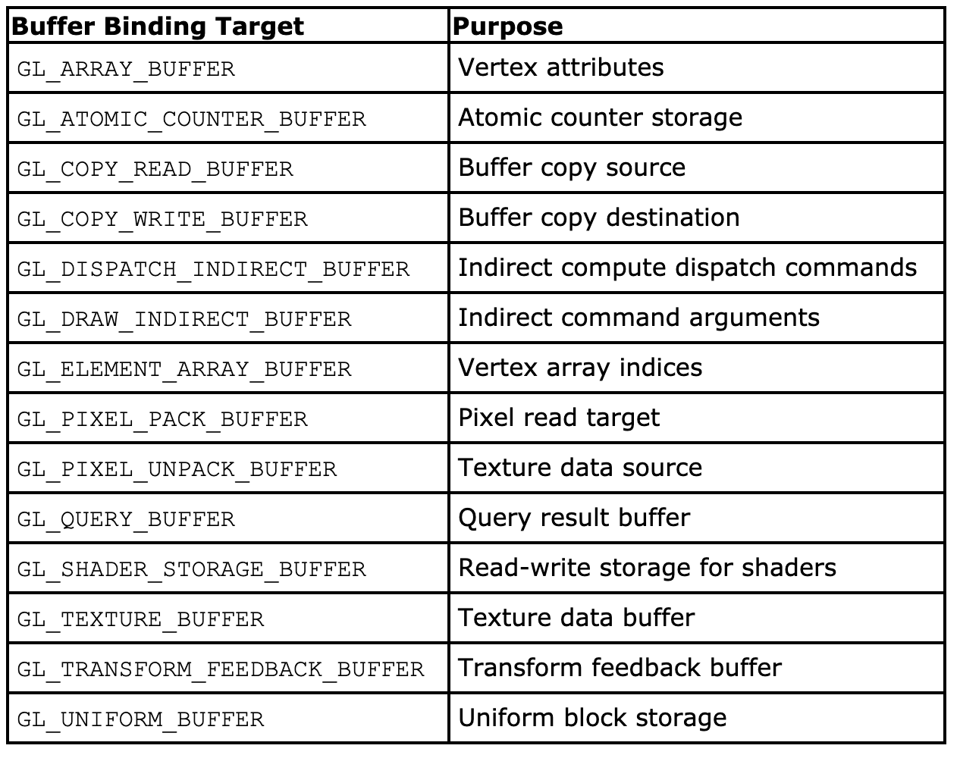
Targets for glBindBuffers
We will use the ones underlined in red
Distinction
Is this the data?
Or are these indices into existing data?
https://www.khronos.org/registry/OpenGL-Refpages/gl4/html/glBindBuffer.xhtml

Slide 46
glGenBuffers / glBindBuffers / glBufferData
glBufferData
Tells OpenGL about your actual data
Notes:
“target” (GL_ARRAY_BUFFER) is repeated
Passing 48 bytes, but not saying anything (yet) about how to interpret the data
GL_STATIC_DRAW tells OpenGL about the usage

Slide 47
glBufferData: usage types
Hint to OpenGL about how data will be used
Two parts:
Frequency
of access
Nature of
access
https://www.khronos.org/registry/OpenGL-Refpages/gl4/html/glBufferData.xhtml

Slide 48
glGenBuffers / glBindBuffers / glBufferData
So what did this code do?
1) asked GL to make a buffer
2) told GL the buffer would be used to store an array
3) told GL the actual data to put in the buffer

Slide 49
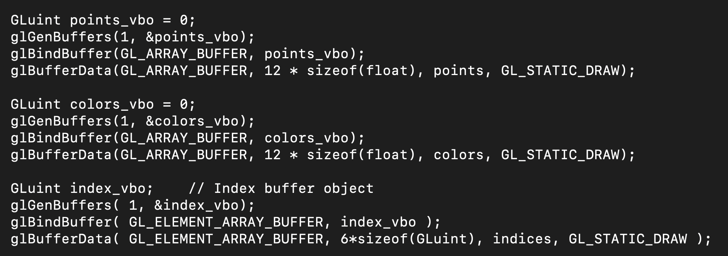
More Starter Code
This one is indices, not data

Slide 50
Vertex Buffer Object versus Vertex Array Object
Vertex Buffer Object (VBO):
Memory buffer in your GPU
Contains information about vertices
Vertex Array Object (VAO):
Contains one or more VBOs
Should contain a “complete” renderable object
Summary:
VBOs store your vertex data
VAOs wrap up VBOs into something that can be rendered

Slide 51
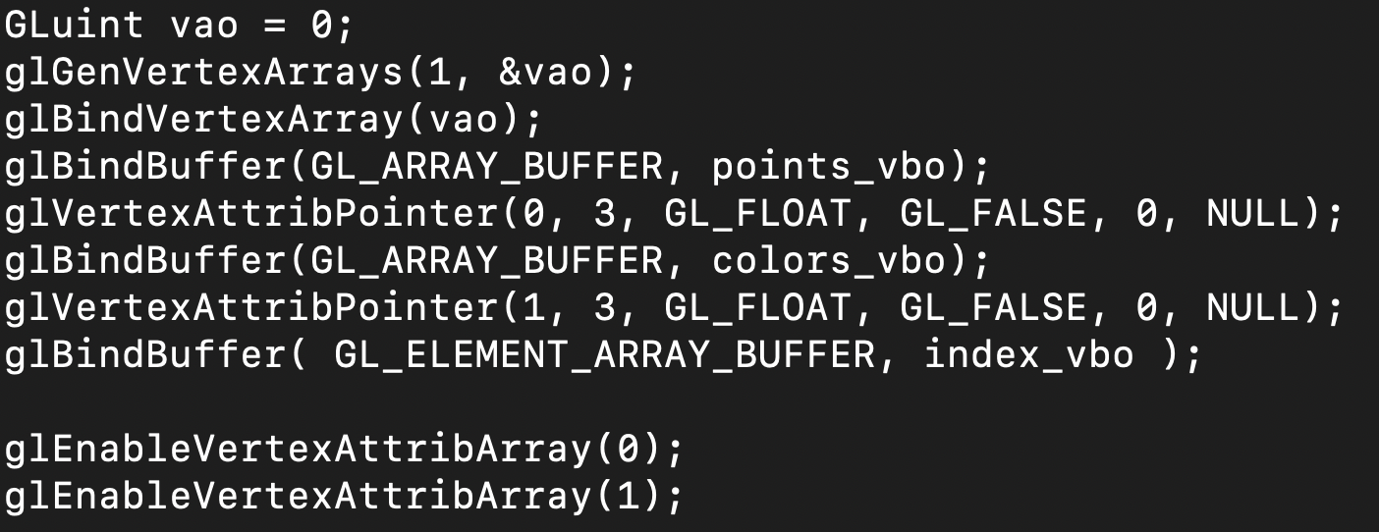
Next Step in Starter Code: Make a VAO and put VBOs into VAO
glGenVertexArrays
Just like glGenBuffers, but for VAOs
Asks OpenGL to generate a new VAO for the programmer to work with
That buffer will have a unique identifier (vao)
This unique identifier is useful: lets programmer tell OpenGL which buffer they want to operate on

Slide 52
Next Step in Starter Code: Make a VAO and put VBOs into VAO
glBindVertexArray
Just like glBindBuffer, but for VAOs
It also makes the buffer “active,” meaning subsequent GL calls will use this buffer
glBindBuffer commands will put the VBOs into this VAO

Slide 53
Next Step in Starter Code: Make a VAO and put VBOs into VAO
We’ve seen this before!
Further, this code could be tightened up
Could start by building VAO, and then build VBOs are part of the VAO building process
(Call glBindBuffer once, not twice)
I like how Abhishek set it up – easier to understand

Slide 54
Next Step in Starter Code: Make a VAO and put VBOs into VAO
Tells GL how to interpret a VBO within the VAO
This one is for the 0th VBO, which is points_vbo
Arguments:
0: the 0th VBO – goes in “location 0” of the shader program
3: there are 3 values per vertex
GL_FLOAT: they are floats
GL_FALSE: don’t normalize this data
0/NULL: deals with data layout stuff (always 0/NULL for 441)

Slide 55
Next Step in Starter Code: Make a VAO and put VBOs into VAO
Tells GL how that array 0 (i.e., points_vbo) should be enabled – it should be processed when vao is processed
We always want to enable for 441
Why disable? Improved performance if not using an array

Slide 56
(REPEAT SLIDE FROM PART 2) From Example Program
while (!glfwWindowShouldClose(window)) {
// wipe the drawing surface clear
glClear(GL_COLOR_BUFFER_BIT |
GL_DEPTH_BUFFER_BIT);
glUseProgram(shader_programme);
glBindVertexArray(vao);
// draw points 0-3 from the currently bound VAO
glDrawElements( GL_TRIANGLES, 6,
GL_UNSIGNED_INT, NULL );
…
glUseProgram, glBindVertexArray, glDrawElements will be discussed later this lecture now

Slide 57
(REPEAT SLIDE FROM PART 2) From Example Program
glBindVertexArray(vao);
// draw points 0-3 from the currently bound VAO
glDrawElements( GL_TRIANGLES, 6,
GL_UNSIGNED_INT, NULL );
…
Tells OpenGL that commands that follow will be for vertex array object “vao”

Slide 58
(REPEAT SLIDE FROM PART 2) From Example Program
glBindVertexArray(vao);
// draw points 0-3 from the currently bound VAO
glDrawElements( GL_TRIANGLES, 6,
GL_UNSIGNED_INT, NULL );
…
Tells OpenGL to draw the elements in the current VAO
And:
GL_TRIANGLES: the indices are describing triangles
6: there are 6 indices (2 triangles total)
GL_UNSIGNED_INT: the indices are unsigned int
NULL: something for fancy array layouts (we don’t need this for 441)

Slide 59
Project 2A
Assigned today, due in one week (Tuesday May 11)
Worth 8% of your grade
Implementing Project 1 within OpenGL
5 phases
Phase 1: install GLFW
Phase 2: run example program
Phase 3: modify VBO/VAO
Phases 4 & 5: shader programs
Please start ASAP on Phase 1-3
Thursday’s lecture will be on Phase 4 & 5

Slide 60
Finish lecture by talking again about compiling shaders

Slide 61
How to Use Shaders
You write a shader program: a tiny C-like program
You write C/C++ code for your application
Your application loads the shader program from a text file
Your application sends the shader program to the OpenGL library and directs the OpenGL library to compile the shader program
If successful, the resulting GPU code can be attached to your (running) application and used
It will then supplant the built-in GL operations

Slide 62
How to Use Shaders: Visual Version
sends “char *”
version of
program to GL via
function call
Project2A’
C++ code
Project2A’
binary
g++
OpenGL
library
reads
text
file
when
running
OpenGL
compiles program, binary made just for
the current
execution
Program is used
on GPU to support
Project2A’ binary
shader program is a binary
shader program

Slide 63
Compiling Shader

Slide 64
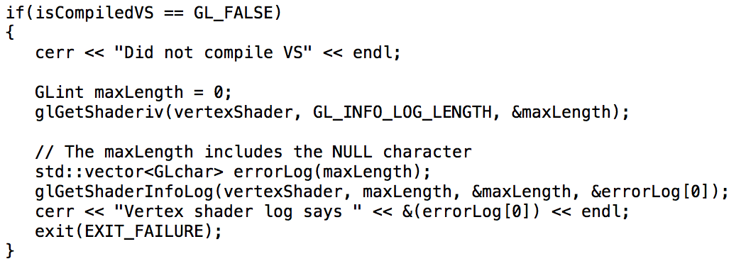
Compiling Shader: inspect if it works

Slide 65
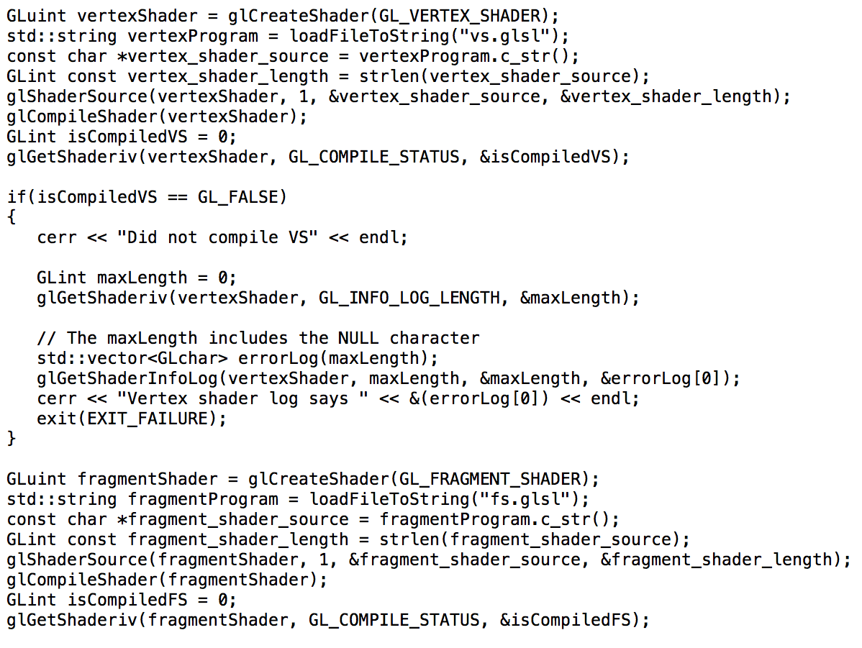
Compiling Multiple Shaders

Slide 66
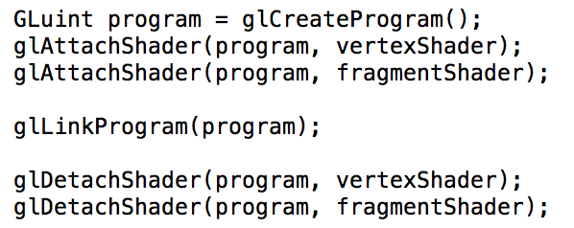
Attaching Shaders to a Program

Slide 67
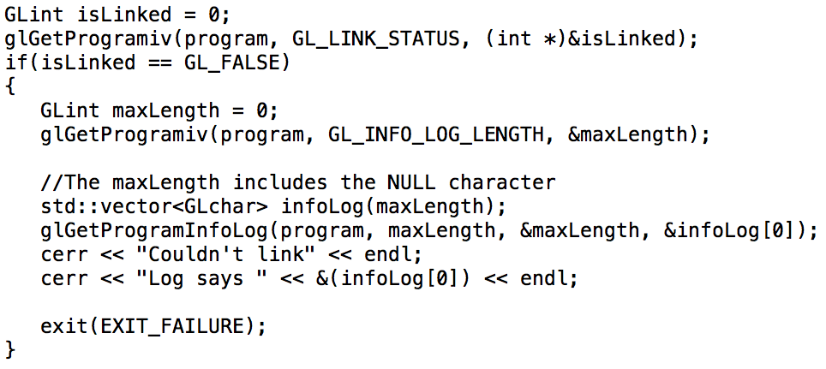
Inspecting if program link worked…

Slide 68
Simplest Vertex Shader
Many built-in variables.
Some are input.
Some are required output (gl_Position).

