Slide 1
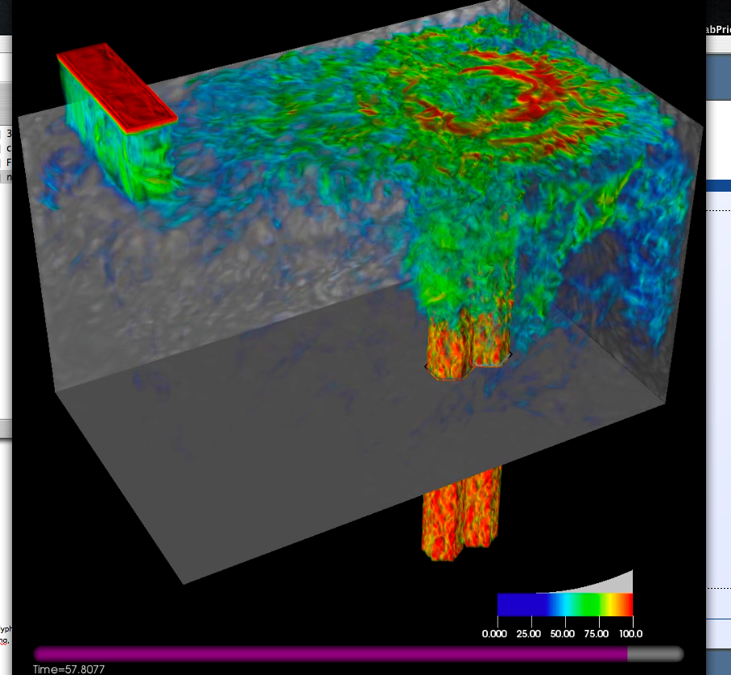
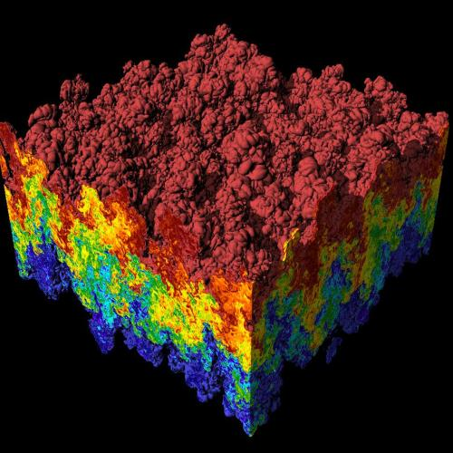
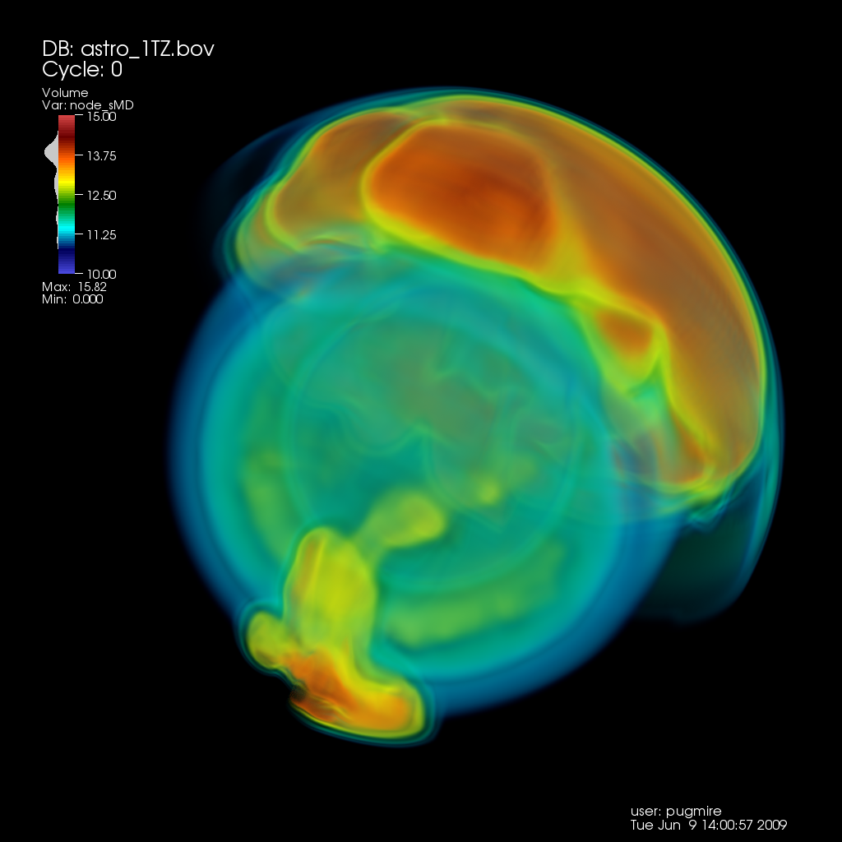
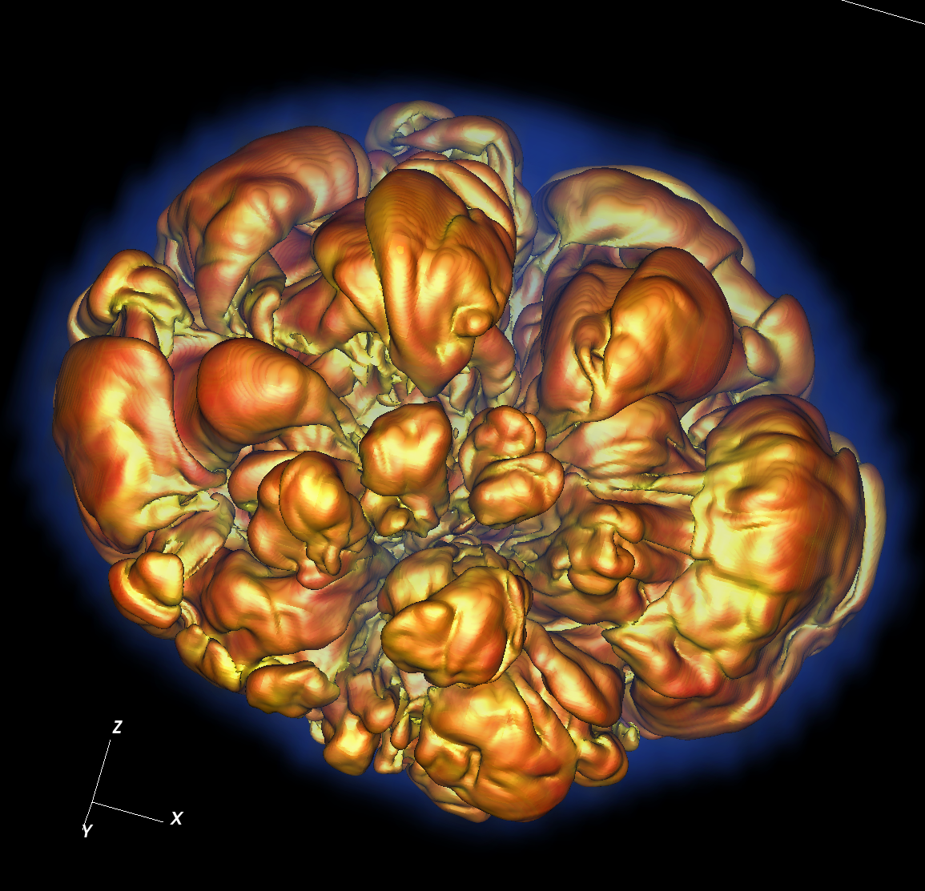
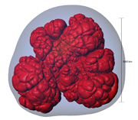
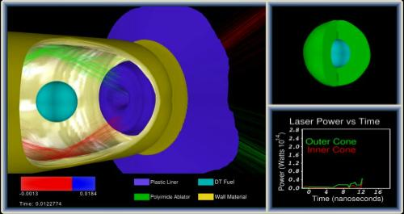
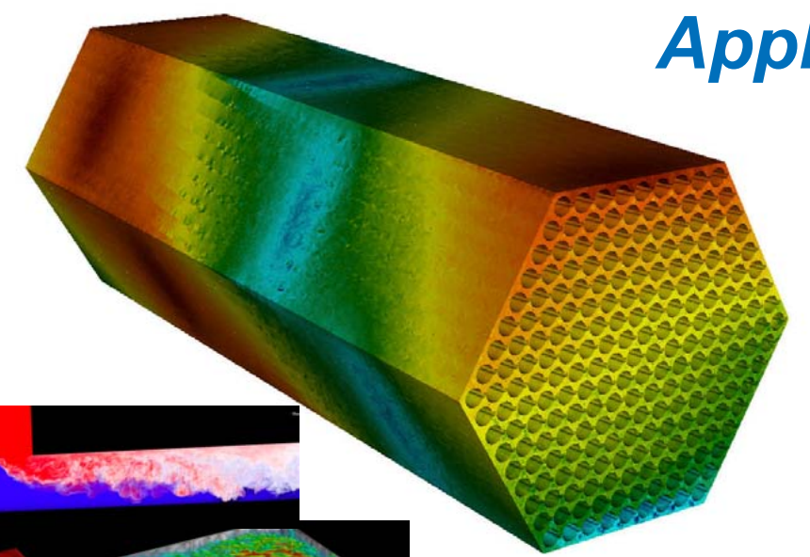
CIS 441/541: Intro to Computer Graphics Lecture 8: Finish Shading, Intro OpenGL
April 29, 2021
Hank Childs, University of Oregon

Slide 2
Class Plan
Abhishek and I are working hard on preparing Project 2 (OpenGL)
Quite frankly not going as well as we thought
Things are going better!
Grading has slowed down
Projects will start coming faster
Want there to time to do great final projects
1E, 1F: simpler coding, harder concepts

Slide 3
Class Plan (New Slide)
Option A:
Slow class down, more time on OpenGL, less time for final project
Option B:
Keep up the pace, less time on OpenGL (but make sure we do OpenGL!), more time for final project

Slide 4
Current Plan (1/2)
Week | Sun | Mon | Tues | Weds | Thurs | Fri | Sat
5 |  |  | Lec 7 (shading), 1F assigned, 1E due |  | Lec 8 (finish shading, GL), 2A assigned 1F assigned
6 |  | 1F due | Lec 9 (GL), 2B assigned 2A assigned | 1F due | 2B assigned Discussion of final projects / Quiz 3 |  | 2A due
7 |  | 2A due | Lec 11 – ray tracing |  | More discussion of final projects (?) | 2B due

Slide 5
Current Plan (2/2)
Weeks 8-10 → you work on final projects
Lectures will be on misc. topics in graphics, esp. in support of final projects
Quiz 3 (Week 6): likely on matrices
Quiz 4 (Week 8): likely on GL
Quiz 5 (Week 10): likely on topics in final weeks

Slide 6
Office Hours

Slide 7
Lecture Plan
Today:
Finish shading, 2F
Talk some about OpenGL V1
Talk about shaders (conceptual)
Tuesday: get into actual OpenGL calls
Summary: today is about concepts, Tuesday is about practical stuff

Slide 8
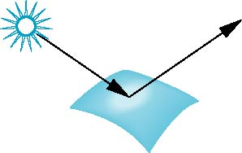
Shading
Our goal:
For each pixel, calculate a shading factor
Shading factor typically between 0 and 1, but sometimes >1
Shading >1 makes a surface more white
3 types of lighting to consider:
Ambient
Diffuse
Specular
Light everwhere
Our game plan:
Calculate all 3 and combine them.
rough surface
smooth surface

Slide 9
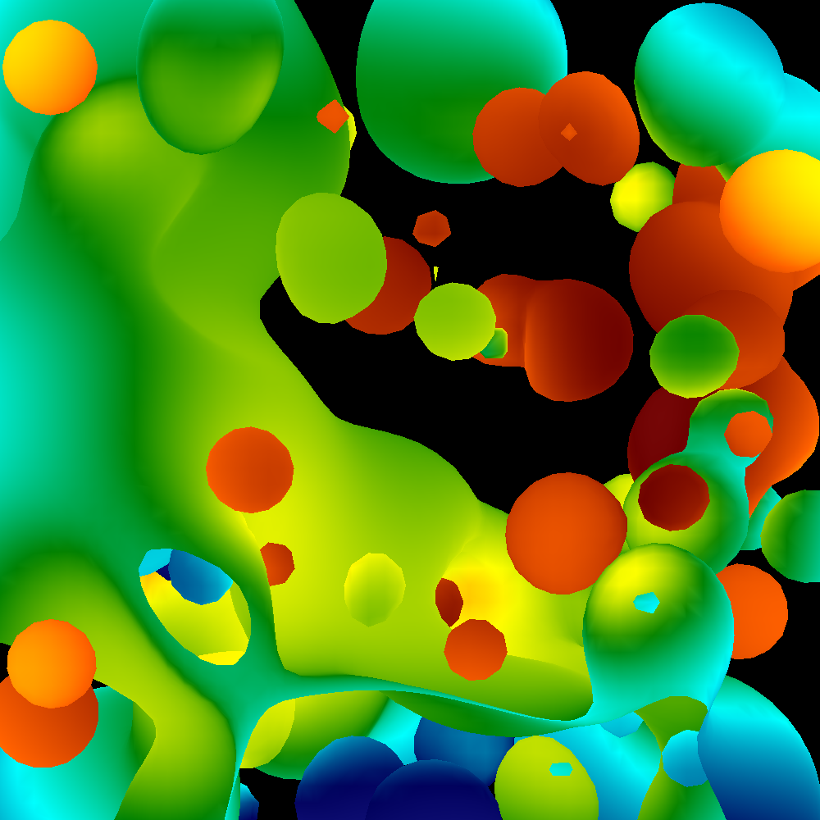
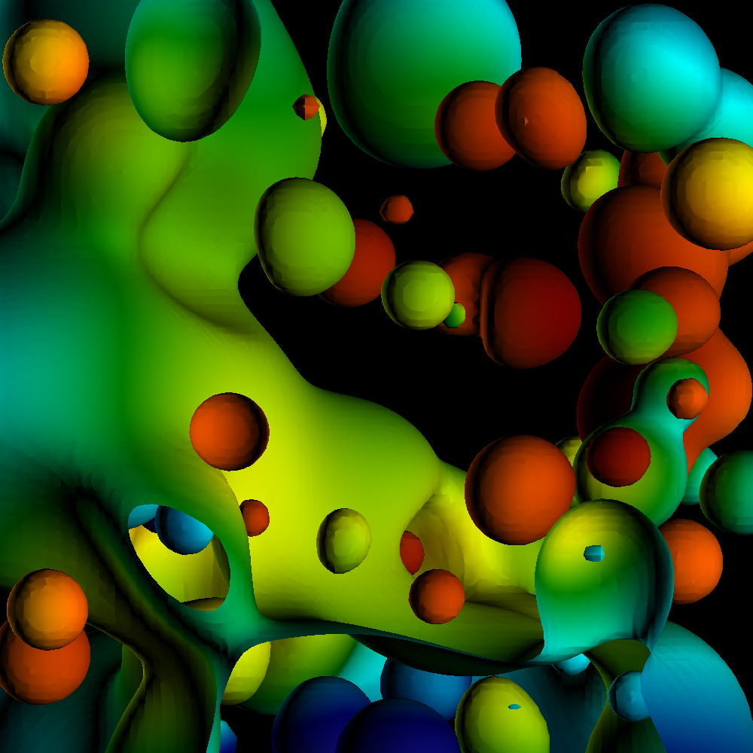
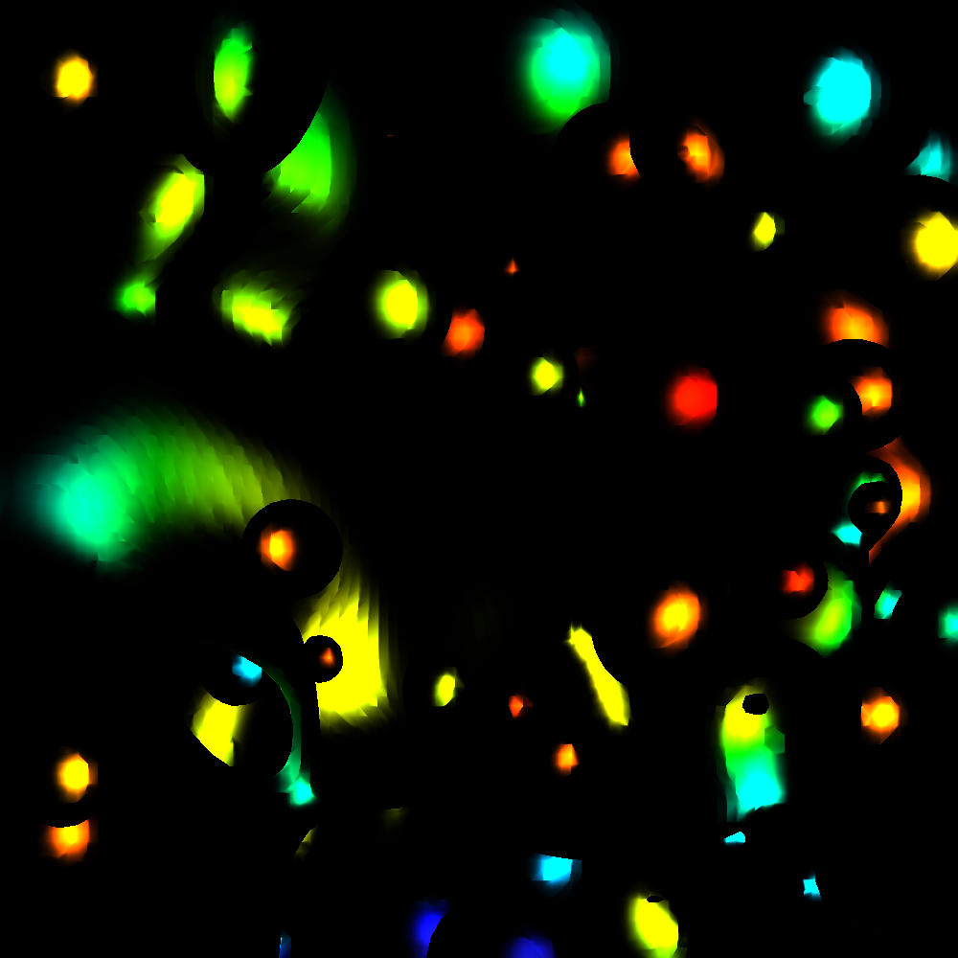
Phong Model
Combine three lighting effects: ambient, diffuse, specular

Slide 10
Phong Model
Simple version: 1 light, with “full intensity” (i.e., don’t add an intensity term)
Phong model
Shading_Amount = K_{a} + K_{d}*Diffuse + K_{s}*Specular
Signature:
double CalculatePhongShading(LightingParameters &, double *viewDirection, double *normal)
Will have to calculate viewDirection for each pixel!

Slide 11
How to handle shading values greater than 1?
Color at pixel = (1.0, 0.4, 0.8)
Shading value = 0.5
Easy!
Color = (0.5, 0.2, 0.4)→ (128, 52, 103)
Shading value = 2.0
Color = (1.0, 0.8, 1.0) → (255, 204, 255)
Color_R = 255*min(1, R*shading_value)
This is how bright lights makes things whiter and whiter.
But it won’t put in colors that aren’t there.

Slide 12
Ambient Lighting
Ambient light
Same amount of light everywhere in scene
Can model contribution of many sources and reflecting surfaces
Surface lit with ambient lighting only

Slide 13
Diffuse Lighting
Diffuse light
Light distributed evenly in all directions, but amount of light depends on orientation of triangles with respect to light source.
Different for each triangle
Surface lit with diffuse lighting only

Slide 14
Diffuse Lighting
V1
Surface Normal
V2
N
L
α
Lambertian Surface
You can calculate the diffuse contribution by taking the dot product of L and N,
Since L.N = cos(α)
(assuming L and N are normalized)

Slide 15
How much light reflects with specular lighting?
Highest proportion of light reflecting
V
Smooth Surface
How much light gets to point V?

Slide 16
How much light reflects with specular lighting?
Highest proportion of light reflecting
V
α
Smooth Surface
How much light gets to point V?
A: proportional to cos(α)

Slide 17
How much light reflects with specular lighting?
Highest proportion of light reflecting
V
α
Smooth Surface
How much light gets to point V?
A: proportional to cos(α)
(Shininess strength) * cos(α) ^ (shininess coefficient)

Slide 18
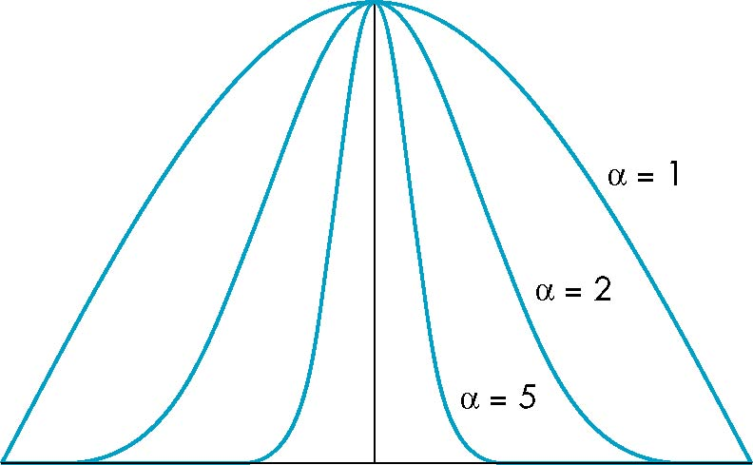
γ: The Shininess Coefficient
Values of γ between 100 and 200 correspond to metals
Values between 5 and 10 give surface that look like plastic
cos^{γ} α
γ=1
γ=2
γ=5
-90
φ
90
α

Slide 19
How much light reflects with specular lighting?
Highest proportion of light reflecting
V
α
Smooth Surface
How much light gets to point V?
A: proportional to cos(α)
(Shininess strength) * cos(α) ^ (shininess coefficient)

Slide 20
How much light reflects with specular lighting?
Highest proportion of light reflecting (R)
V
α
Smooth Surface
Great!
We know that cos(α) is V.R (provided V & R are normalized).

Slide 21
How much light reflects with specular lighting?
Highest proportion of light reflecting (R)
V
α
Smooth Surface
Great!
We know that cos(α) is V.R (provided V & R are normalized).
But what is R?
It is a formula: R = 2*(L.N)*N - L

Slide 22
Phong Model
Combine three lighting effects: ambient, diffuse, specular

Slide 23
Phong Model
Simple version: 1 light, with “full intensity” (i.e., don’t add an intensity term)
Phong model
Shading_Amount = K_{a} + K_{d}*Diffuse + K_{s}*Specular
Signature:
double CalculatePhongShading(LightingParameters &, double *viewDirection, double *normal)
Will have to calculate viewDirection for each pixel!

Slide 24
Specular Term of Phong Model
Specular part of Phong: K_{s}*Specular
and Specular is: (Shininess strength) * cos(α) ^ (shininess coefficient)
Putting it all together would be:
K_{s} * (Shininess strength) * cos(α) ^ (shininess coefficient)
But now we have two multipliers, K_{s} and (Shininess Strength). Not needed.
So: just use one. Drop Shininess Strength and only use K_{s}
K_{s} * cos(α) ^ (shininess coefficient)

Slide 25
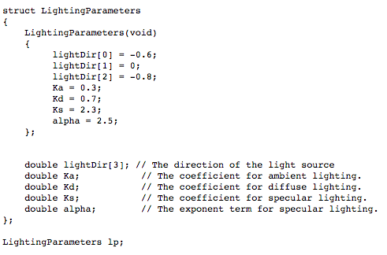
Lighting parameters

Slide 26
Project #1F (8%), Wed May 5th
Goal: add shading, movie
Extend your project1E code
Important:
add #define NORMALS
Download new file, update to new file

Slide 27
Project #1F (8%), Wed May 5th
Goal: add shading, movie
Extend your project1E code
Important:
add #define NORMALS
Download new file, update to new file

Slide 28
Changes to data structures
class Triangle
{
public:
double X[3], Y[3], Z[3];
double colors[3][3];
double normals[3][3];
};
reader1e.cxx will not compile (with #define NORMALS) until you make these changes
reader1e.cxx will initialize normals at each vertex

Slide 29
More comments (1/3)
This project in a nutshell:
Add method called “CalculateShading”
My version of CalculateShading is about ten lines of code.
Call CalculateShading for each vertex
This is a new field, which you will LERP
Modify RGB calculation to use shading

Slide 30
More comments (2/3)
New: more data to help debug
I will make the shading value for each pixel available
I will also make it available for ambient, diffuse, specular
Don’t forget to do two-sided lighting
REVERSAL: do one-sided lighting

Slide 31
(c_x, c_y, c_z) / camera = (0,1,0)
This example has a triangle vertex, v, at the origin, the camera one unit along the Y-axis and the light source one unit along the X-axis.
The lightDir and viewDir formulas show the conventions we should use for direction for general positions.
viewDir = normalize(c_x-v_x, c_y-v_y, c_z-v_z) = (0, 1, 0)
(0.707,0.707,0) / view normal
(l_x, l_y , l_z) / light source = (1,0,0)
(v_x, v_y, v_z)
= (0,0,0)
lightDir
= normalize(l_x-v_x, l_y-v_y, l_z-v_z)
= (1, 0, 0)

Slide 32
More comments (3/3)
I haven’t said anything about movie encoders

Slide 33
Project #1F (8%), Due Weds May 5th
Goal: add shading, movie

Slide 34
Lecture Plan
Today:
Finish shading, 2F
Talk some about OpenGL V1
Talk about shaders (conceptual)
Tuesday: get into actual OpenGL calls
Summary: today is about concepts, Tuesday is about practical stuff

Slide 35
Some notes about OpenGL
OpenGL has evolved a lot over 25+ years
The slides that follow and the homeworks will detail an early version of OpenGL (OpenGL V1.0)
This is the easiest version to understand and implement
It is also inefficient
Since efficiency is important, newer versions are more complex and also faster
Lecture will conclude with conceptual overview of newer OpenGL. Tuesday’s lecture will have specific details.

Slide 36
Models and Architectures
Ed Angel
Professor of Computer Science, Electrical and Computer Engineering, and Media Arts
University of New Mexico

Slide 37
Objectives
Learn the basic design of a graphics system
Introduce pipeline architecture
Examine software components for an interactive graphics system

Slide 38
Image Formation Revisited
Can we mimic the synthetic camera model to design graphics hardware software?
Application Programmer Interface (API)
Need only specify
Objects
Materials
Viewer
Lights
But how is the API implemented?

Slide 39
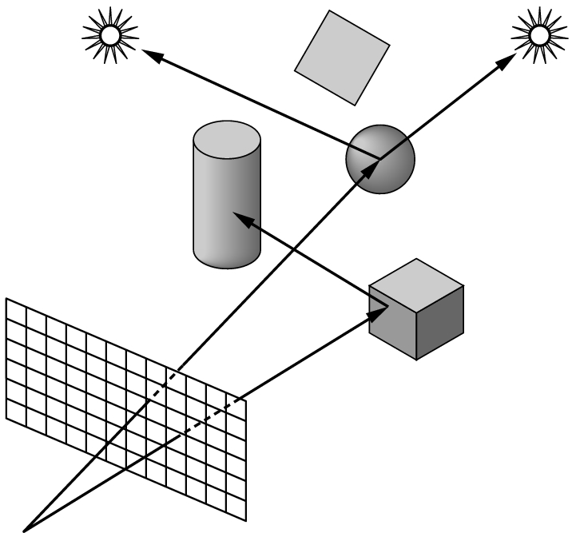
Physical Approaches
Ray tracing: follow rays of light from center of projection until they either are absorbed by objects or go off to infinity
Can handle global effects
Multiple reflections
Translucent objects
Slow
Must have whole data base
available at all times
Radiosity: Energy based approach
Very slow

Slide 40
Practical Approach
Process objects one at a time in the order they are generated by the application
Can consider only local lighting
Pipeline architecture
All steps can be implemented in hardware on the graphics card
application
program
display

Slide 41
Vertex Processing
Much of the work in the pipeline is in converting object representations from one coordinate system to another
Object coordinates
Camera (eye) coordinates
Screen coordinates
Every change of coordinates is equivalent to a matrix transformation
Vertex processor also computes vertex colors

Slide 42
Projection
Projection is the process that combines the 3D viewer with the 3D objects to produce the 2D image
Perspective projections: all projectors meet at the center of projection
Parallel projection: projectors are parallel, center of projection is replaced by a direction of projection

Slide 43
Primitive Assembly
Vertices must be collected into geometric objects before clipping and rasterization can take place
Line segments
Polygons
Curves and surfaces

Slide 44
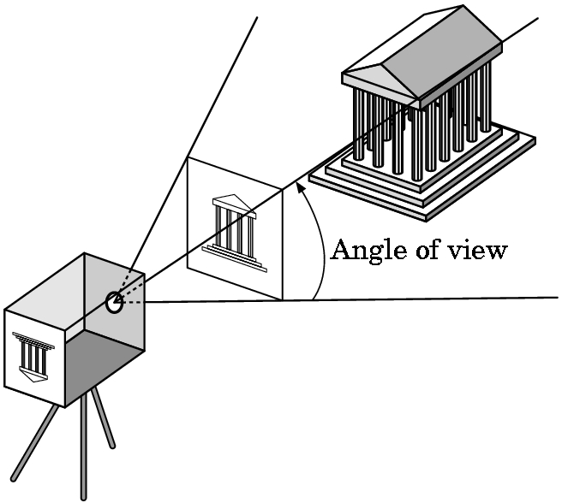
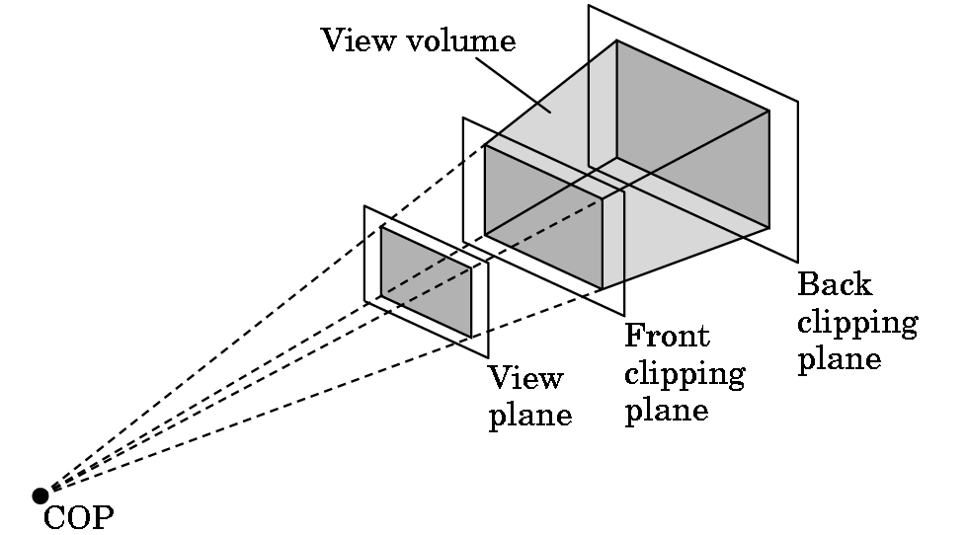
Clipping
Just as a real camera cannot “see” the whole world, the virtual camera can only see part of the world or object space
Objects that are not within this volume are said to be clipped out of the scene

Slide 45
Rasterization
If an object is not clipped out, the appropriate pixels in the frame buffer must be assigned colors
Rasterizer produces a set of fragments for each object
Fragments are “potential pixels”
Have a location in frame bufffer
Color and depth attributes
Vertex attributes are interpolated over objects by the rasterizer

Slide 46
Fragment Processing
Fragments are processed to determine the color of the corresponding pixel in the frame buffer
Colors can be determined by texture mapping or interpolation of vertex colors
Fragments may be blocked by other fragments closer to the camera
Hidden-surface removal

Slide 47
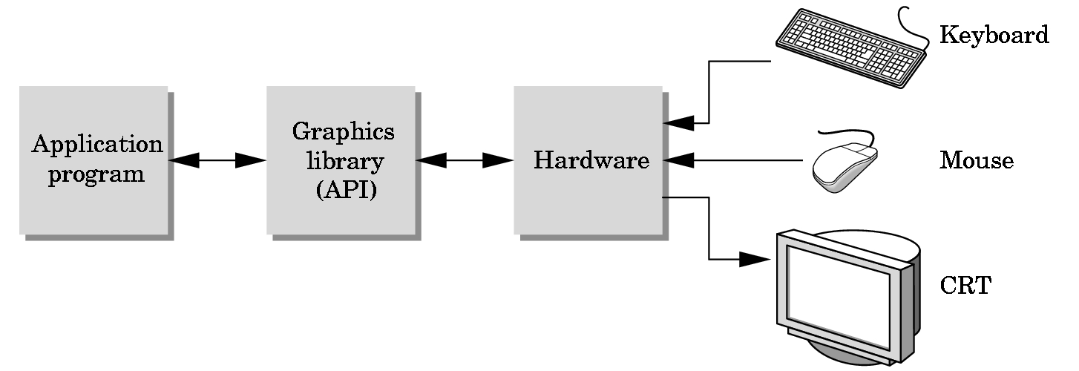
The Programmer’s Interface
Programmer sees the graphics system through a software interface: the Application Programmer Interface (API)

Slide 48
API Contents
Functions that specify what we need to form an image
Objects
Viewer
Light Source(s)
Materials
Other information
Input from devices such as mouse and keyboard
Capabilities of system

Slide 49
Object Specification
Most APIs support a limited set of primitives including
Points (0D object)
Line segments (1D objects)
Polygons (2D objects)
Some curves and surfaces
Quadrics
Parametric polynomials
All are defined through locations in space or vertices

Slide 50
Example (OLD!!)
type of object
location of vertex
glBegin(GL_POLYGON);
glVertex3f(0.0, 0.0, 0.0);
glVertex3f(0.0, 1.0, 0.0);
glVertex3f(0.0, 0.0, 1.0);
glEnd( );
end of object definition

Slide 51
Lights and Materials (OLD!!)
Types of lights
Point sources vs distributed sources
Spot lights
Near and far sources
Color properties
Material properties
Absorption: color properties
Scattering
Diffuse
Specular

Slide 52
OpenGL Architecture (OLD!!)
geometry
pipeline
Immediate Mode
Per Vertex
Operations &
Primitive
Assembly
Polynomial
Evaluator
CPU
Display List
Rasterization
Per Fragment
Operations
Frame
Buffer
Texture
Memory
Pixel
Operations

Slide 53
Lecture Plan
Today:
Finish shading, 2F
Talk some about OpenGL V1
Talk about shaders (conceptual)
Tuesday: get into actual OpenGL calls
Summary: today is about concepts, Tuesday is about practical stuff

Slide 54
Shaders

Slide 55
Shaders
Shader: computer program used to do “shading”
“Shading”: general term that covers more than just shading/lighting
Used for many special effects
Increased control over:
position, hue, saturation, brightness, contrast
For:
pixels, vertices, textures

Slide 56
Motivation: Bump Mapping
Idea:
typical rasterization, calculate fragments
fragments have normals (as per usual)
also interpolate “texture” on geometry & fragments
use texture for “bumps”
take normal for fragment and displace it by “bump” from texture
image from wikipedia

Slide 57
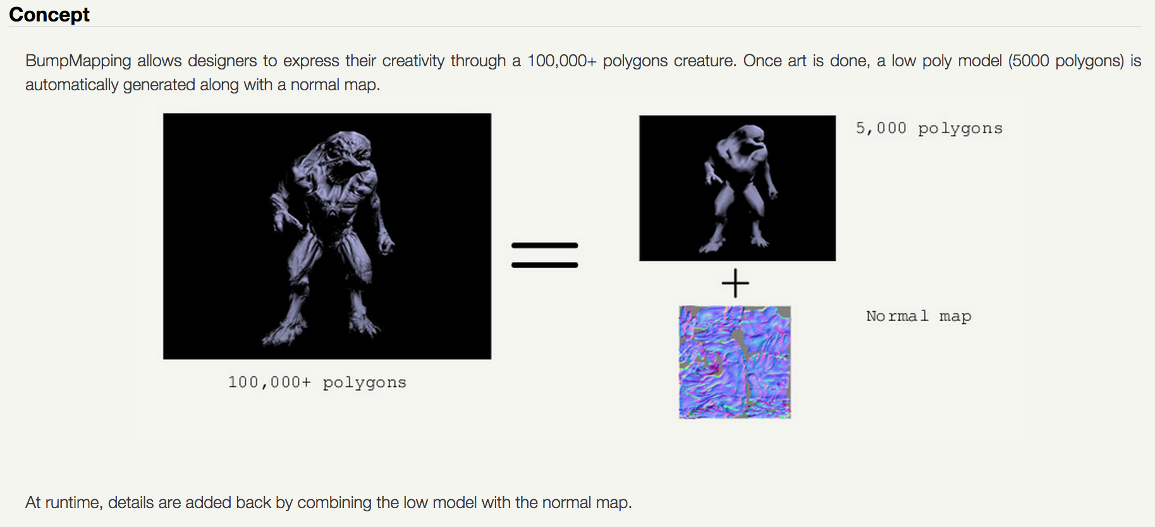
Bump Mapping Example
credit: http://www.fabiensanglard.net/bumpMapping/

Slide 58
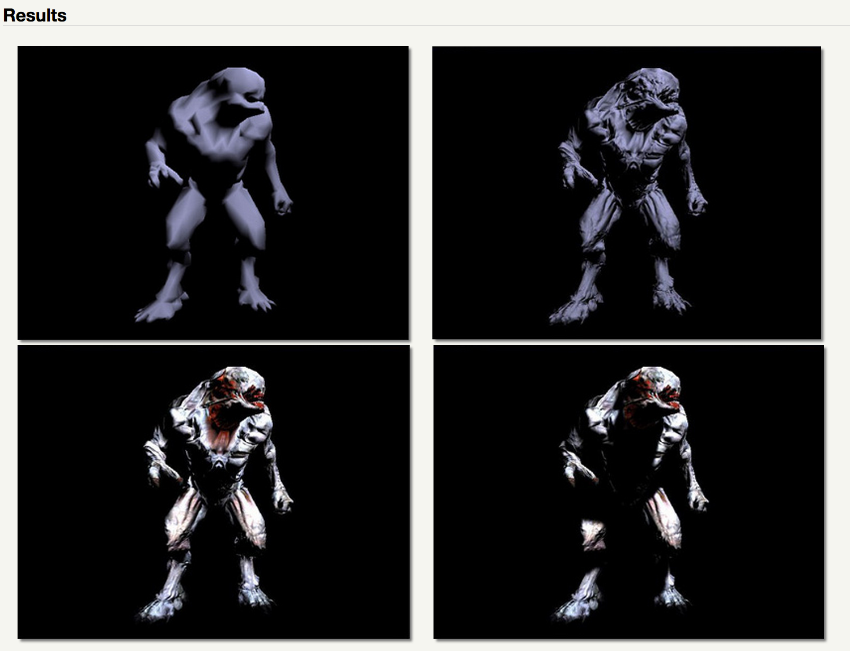
Bump Mapping Example

Slide 59
How to do Bump Mapping?
Answer: easy to imagine doing it in your Project 1A-1F infrastructure
You have total control
But what OpenGL commands would do this?
Not easy in V1 of the GL interface
Much more possible with shaders

Slide 60
Shading Languages
shading language: programming language for graphics, specifically “shader” effects
Benefits: increased flexibility with rendering
OpenGL V1: fixed transformations for color, position, of pixels, vertices, and textures.
Shader languages: custom programs, custom effects for color, position of pixels, vertices, and textures.

Slide 61
ARB assembly language
ARB: low-level shading language
at same level as assembly language
Created by OpenGL Architecture Review Board (ARB)
Goal: standardize instructions for controlling GPU
Implemented as a series of extensions to OpenGL
You don’t want to work at this level, but it was an important development in terms of establishing foundation for today’s technology

Slide 62
GLSL: OpenGL Shading Language
GLSL: high-level shading language
also called GLSLang
syntax similar to C
Purpose: increased control of graphics pipeline for developers, but easier than assembly
This is layer where developers do things like “bump mapping”
Benefits:
Benefits of GL (cross platform: Windows, Mac, Linux)
Support over GPUs (NVIDIA, ATI)
HW vendors support GLSL very well

Slide 63
Other high-level shading languages
Cg (C for Graphics)
based on C programming language
outputs DirectX or OpenGL shader programs
deprecated in 2012
HLSL (high-level shading language)
used with MicroSoft Direct3D
analogous to GLSL
similar to CG
RSL (Renderman Shading Language)
C-like syntax
for use with Renderman: Pixar’s rendering engine

Slide 64
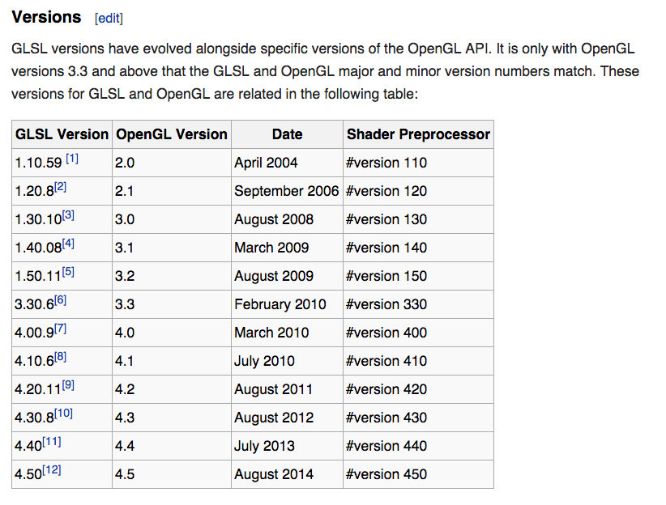
Relationship between GLSL and OpenGL
Source: wikipedia

Slide 65
4 Types of Shaders
Vertex Shaders
Fragment Shaders
Geometry Shaders
Tessellation Shaders
It is common to use multiple types of shaders in a program and have them interact.

Slide 66
How Shaders Fit Into the Graphics Pipeline
You can have 0 or 1 of each shader type
Vertex & fragment: very common
Geometry & tessellation: less common
adaptive meshing
Transform Vertices from World Space to Device Space
Rasterize
Contribute Fragments to Buffers
vertex shaders: custom implementation
fragment shaders: custom implementation
geometry & tessellation shaders: create new geometry before rasterized

Slide 67
Vertex Shader
Run once for each vertex
Can: manipulate position, color, texture
Cannot: create new vertices
Primary purpose: transform from world-space to device-space (+ depth for z-buffer).
However: A vertex shader replaces the transformation, texture coordinate generation and lighting parts of OpenGL, and it also adds texture access at the vertex level
Output goes to geometry shader or rasterizer

Slide 68
Geometry Shader
Run once for each geometry primitive
Purpose: create new geometry from existing geometry.
Output goes to rasterizer
Examples: glyphing, mesh complexity modification
Formally available in GL 3.2, but previously available in 2.0+ with extensions
Tessellation Shader: doing some of the same things
Available in GL 4.0

Slide 69
Fragment Shader
Run once for each fragment
Purpose: replaces the fixed capabilities in OpenGLV1 (texturing, color sum and fog)
Output goes to buffers
Example usages: bump mapping, shadows, specular highlights
Can be very complicated: can sample surrounding pixels and use their values (blur, edge detection)
Also called pixel shaders

Slide 70
How to Use Shaders
You write a shader program: a tiny C-like program
You write C/C++ code for your application
Your application loads the shader program from a text file
Your application sends the shader program to the OpenGL library and directs the OpenGL library to compile the shader program
If successful, the resulting GPU code can be attached to your (running) application and used
It will then supplant the built-in GL operations

Slide 71
How to Use Shaders: Visual Version
sends “char *”
version of
program to GL via
function call
Project2A’
C++ code
Project2A’
binary
g++
OpenGL
library
reads
text
file
when
running
OpenGL
compiles program, binary made just for
the current
execution
Program is used
on GPU to support
Project2A’ binary
shader program is a binary
shader program

Slide 72
Compiling Shader

Slide 73
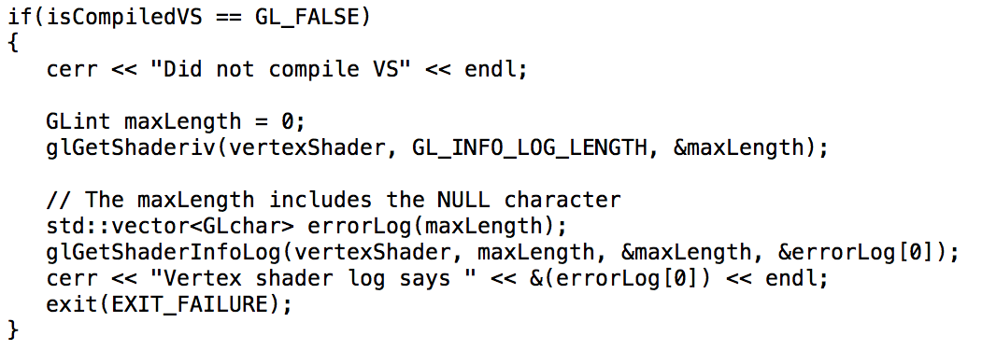
Compiling Shader: inspect if it works

Slide 74
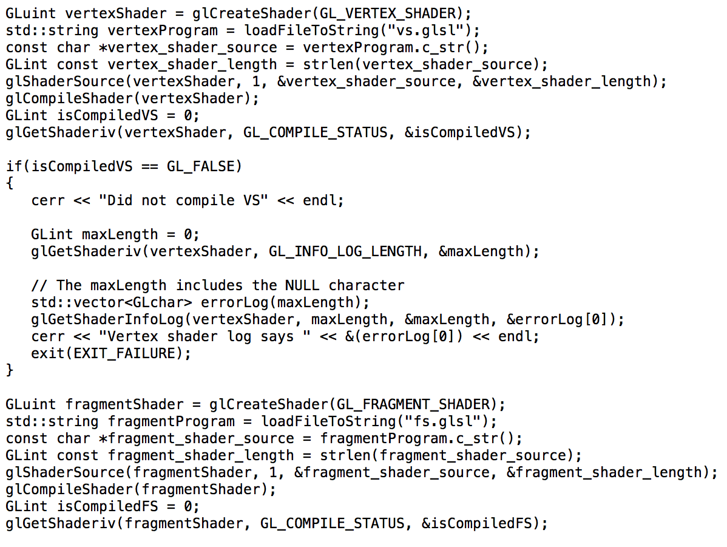
Compiling Multiple Shaders

Slide 75
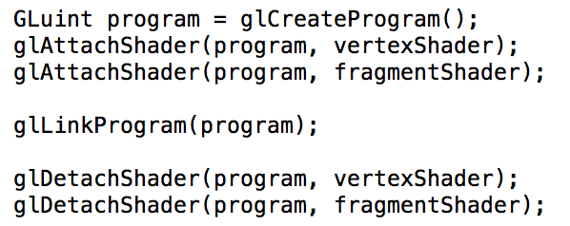
Attaching Shaders to a Program

Slide 76
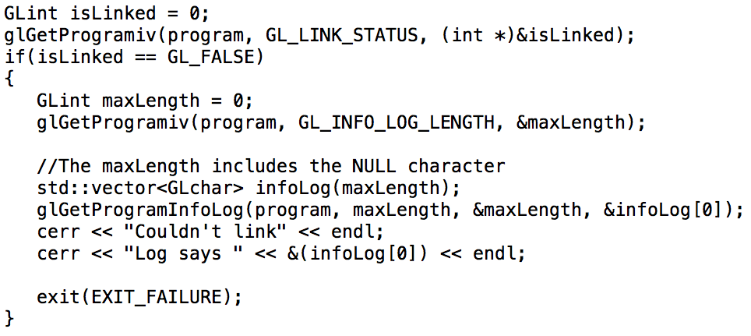
Inspecting if program link worked…

Slide 77
Simplest Vertex Shader
Many built-in variables.
Some are input.
Some are required output (gl_Position).

Slide 78
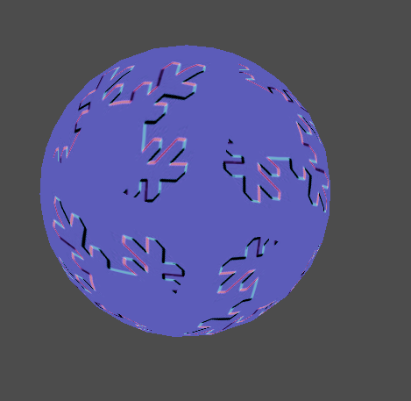
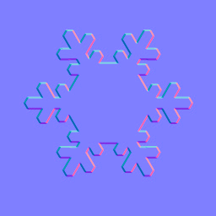
Bump-mapping with GLSL
bump map texture
output

Slide 79
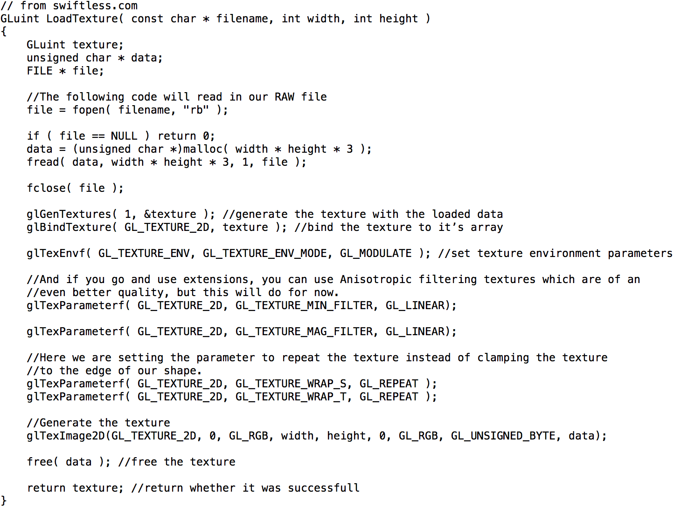
Will need to load a texture…

Slide 80
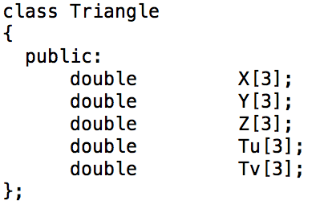
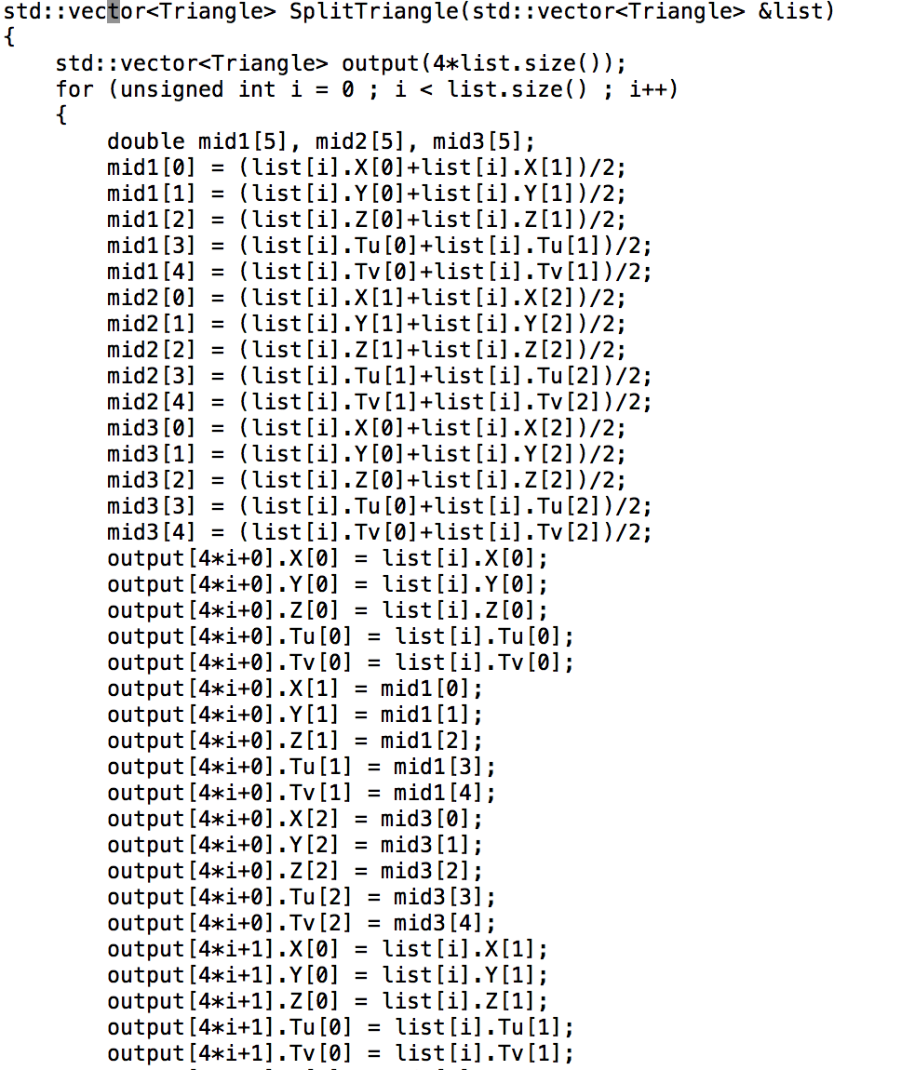
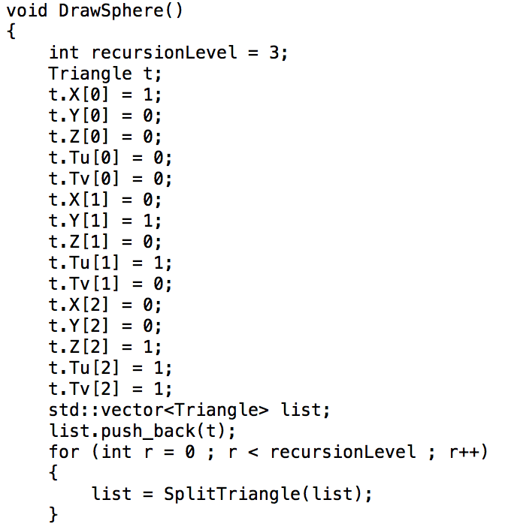
Need to put 2D textures on our triangles…

Slide 81
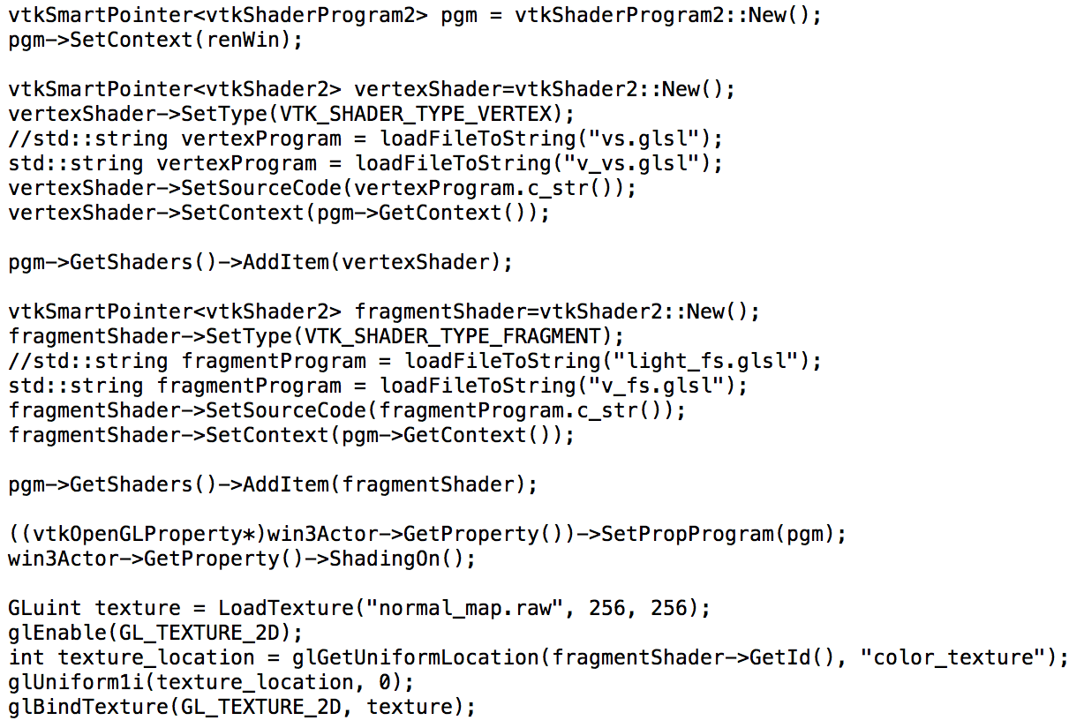
Need to set up shaders and textures…

Slide 82
So what is the vertex shader program?...

Slide 83
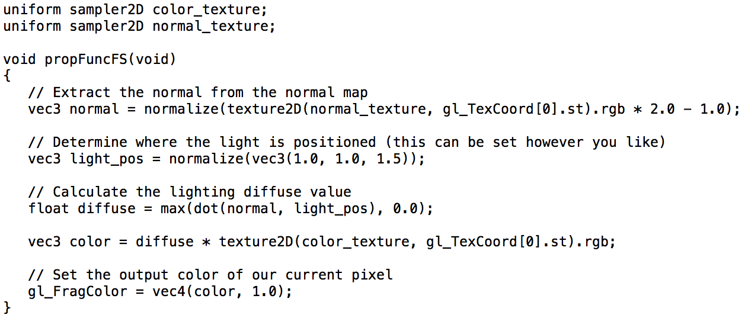
And what is the fragment shader program?...

