Slide 1
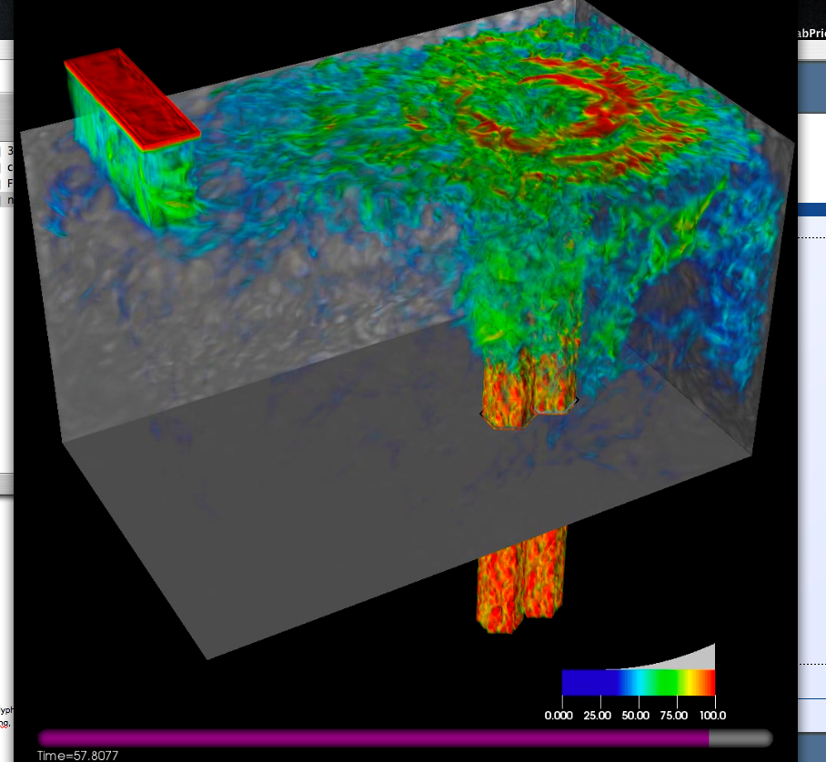
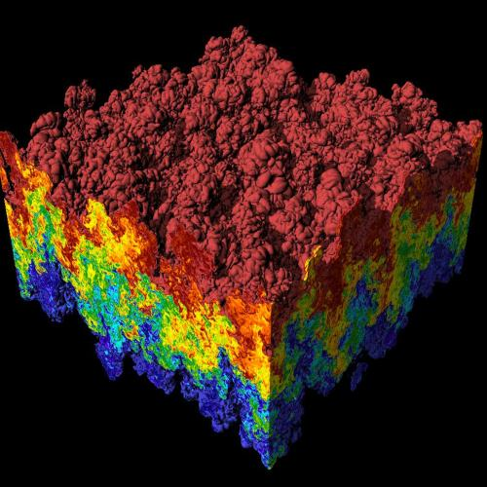
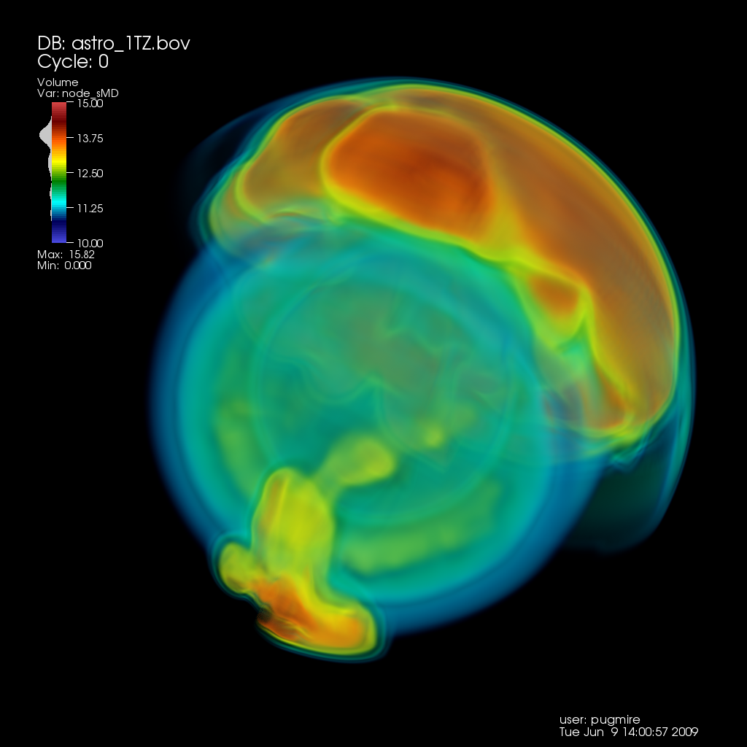
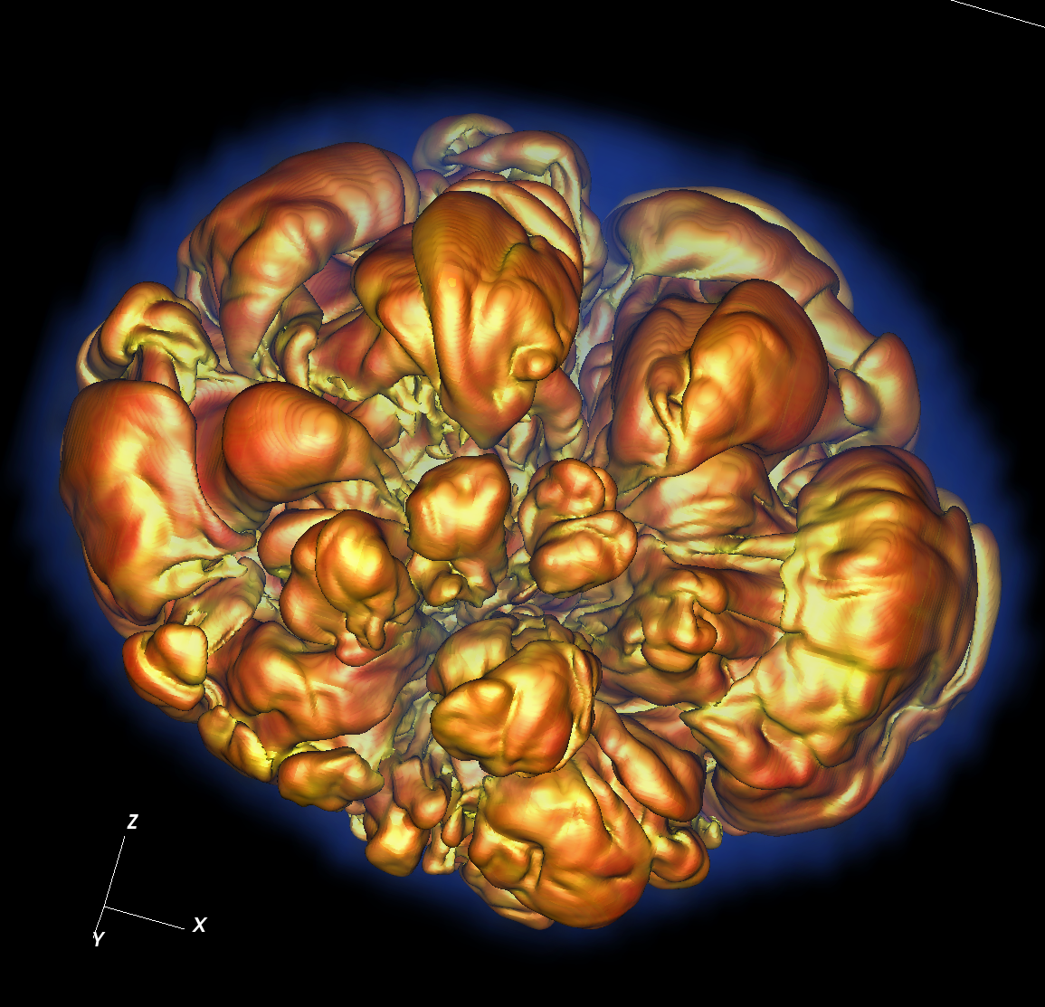
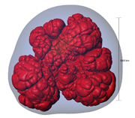
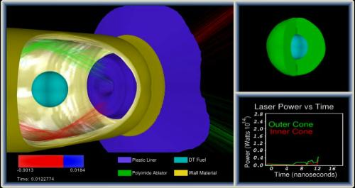
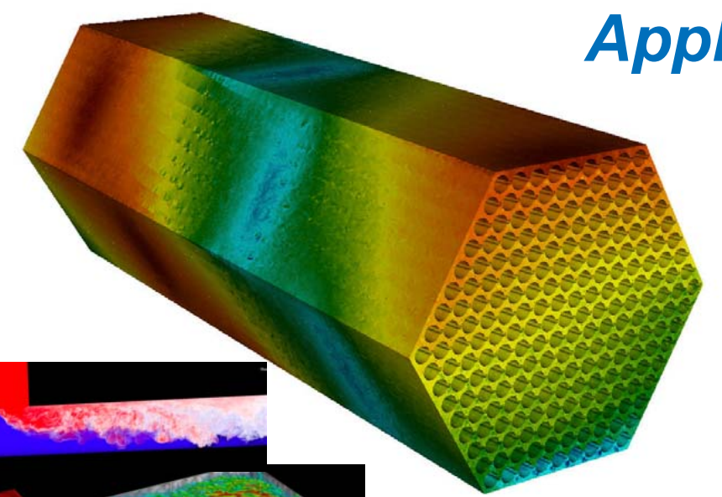
CIS 441/541: Intro to Computer Graphics Lecture 7: Math Basics, Lighting Introduction & Phong Lighting
January 31, 2019
Hank Childs, University of Oregon

Slide 2
Office Hours: Weeks 4-10
Monday: 1-2 (Roscoe)
Tuesday: 1-2 (Roscoe)
Wednesday: 1-3 (Roscoe)
Thursday: 1130-1230 (Hank)
Friday: 1130-1230 (Hank)
All normal this week!!! ☺

Slide 3
Timeline
1C: due Weds Jan 23rd
1D: assigned today (LAST TUESDAY), due Thurs Jan 31st
1E: assigned Thurs Jan 31st, due Weds Feb 6th
→ will be extra support with this. Tough project.
1F: assigned Feb 7th (probably before), due Feb 19th
→ not as tough as 1E
2A: will be assigned during week of Feb 11th (maybe before)
Sun | Mon | Tues | Weds | Thurs | Fri | Sat
Jan 20 | Jan21 | Jan 22 Lec4 | Jan 23 1C due | Lec 5 1D assigned | Jan 25 | Jan 26
Jan 27 | Jan 28 | Jan 29 (YouTube) | Jan 30 | Lec 6 1D due 1E assigned | Feb 1 | Feb 2
Feb 3 | Feb 4 | Feb 5 Lec 7 | Feb 6 1E due | Feb 7 1F assigned | Feb 8 | Feb 9
Likely: pre-SuperBowl OH

Slide 4
Sunday OH?
Sunday Feb 3rd: 1030-1145
???

Slide 5
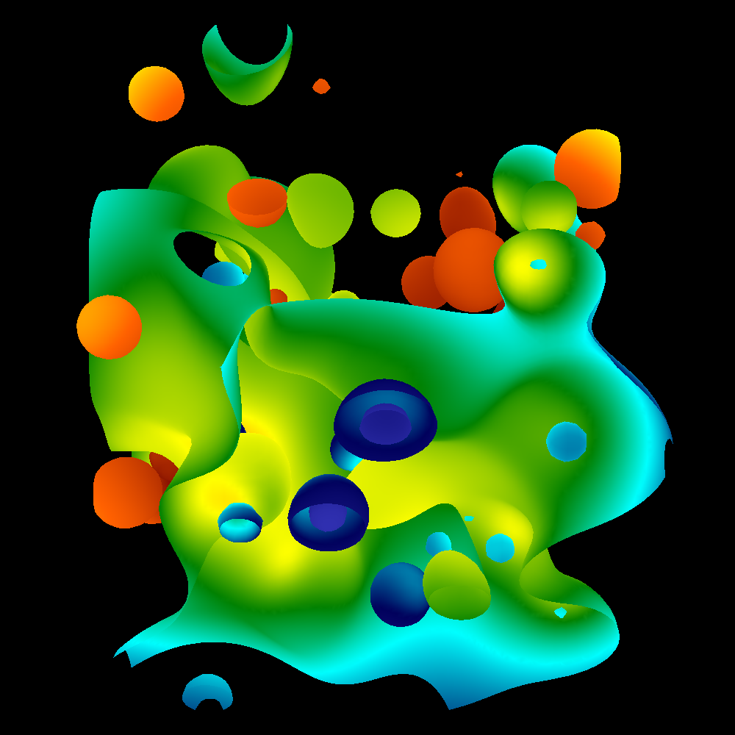
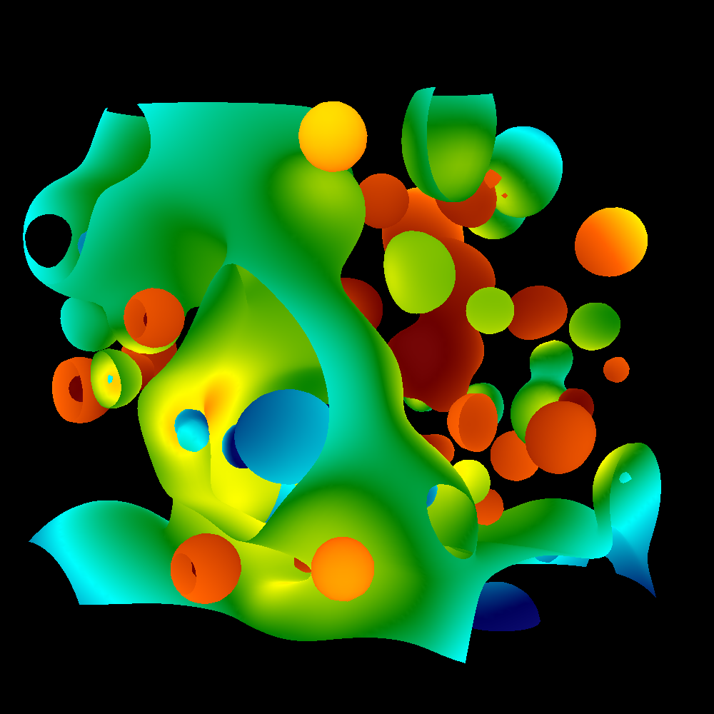
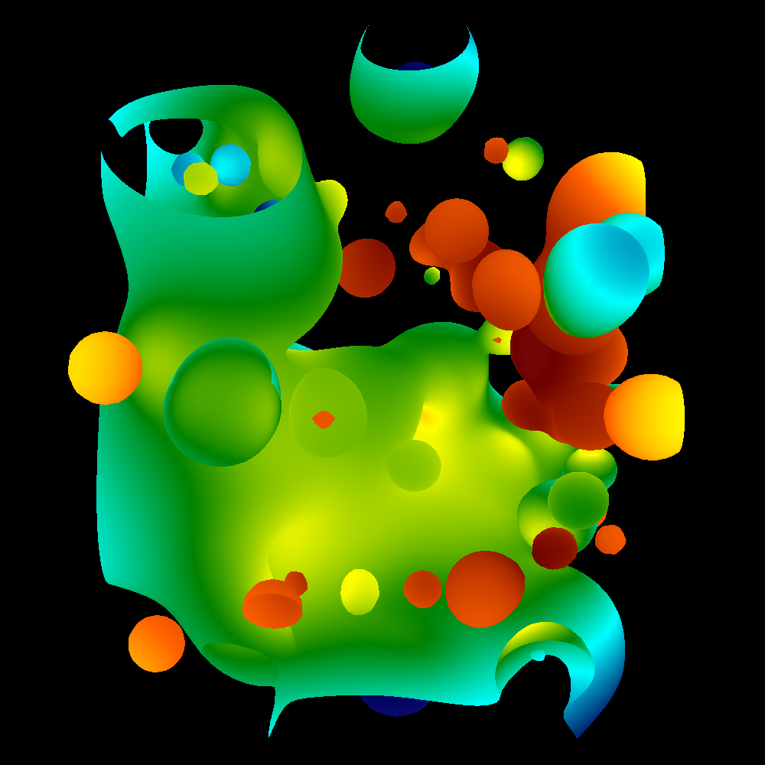
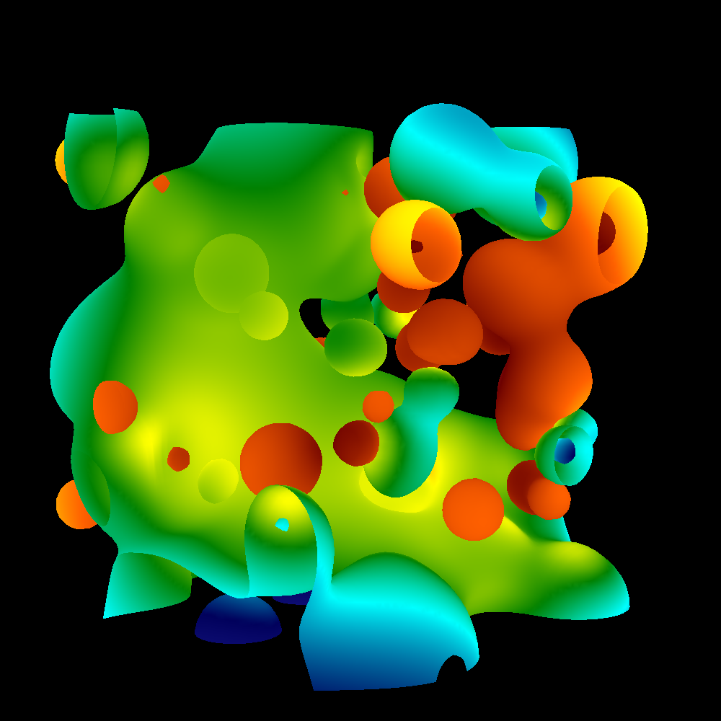
Project #1E (6%), Due Weds Feb 6th
Goal: add arbitrary camera positions
Extend your project1D code
New: proj1e_geometry.vtk available on web (9MB), “reader1e.cxx”.
New: Matrix.cxx, Camera.cxx
No Cmake, project1E.cxx
QUESTIONS ON 1E?

Slide 6
New topic: Hank’s travel

Slide 7
From Lecture #1: Planned Absences
Schedule TBD for absences

Slide 8
How should we deal with Hank’s travel?
We are halfway through my travel commitments
What should we do for the remainder?
Guest lectures
Video lectures + OH
One of each?
(Are video lectures working?)

Slide 9
Outline
Math Basics
Lighting Basics
The Phong Model

Slide 10
Outline
Math Basics
Lighting Basics
The Phong Model

Slide 11
What is the norm of a vector?
The norm of a vector is its length
Denoted with || . ||
For a vector A = (A.x, A.y),
||A|| = sqrt(A.x*A.x+A.y*A.y)
Physical interpretation:
For 3D, ||A|| = sqrt(A.x*A.x+A.y*A.y+A.z*A.z)
(A.x,A.y)
||A||
y
x

Slide 12
What does it means for a vector to be normalized?
The vector A is normalized if ||A|| = 1.
This is also called a unit vector.
To obtain a normalized vector, take A/||A||
Many of the operations we will discuss today will only work correctly with normalized vectors.
Example: A=(3,4,0). Then:
||A|| = 5
A/||A|| = (0.6, 0.8, 0)

Slide 13
What is the normal of a triangle?
A triangle coincides with a flat plane.
A triangle’s normal is the vector perpendicular to that plane.
If a triangle is on plane = Ax+By+Cz = D,
then the triangle’s normal is (A, B, C)

Slide 14
Norm, Normal, Normalize, Oh My!
Norm: the length of a vector (||A||)
Normal: a perpendicular vector to a plane coincident with geometry
Normalize: the operation to create a vector with length 1 (A/||A||)
All 3 are important for today’s lecture

Slide 15
What is a dot product?
A.B = A.x*B.x + A.y*B.y
(or A.x*B.x + A.y*B.y + A.z*B.z)
Physical interpretation:
A.B = cos(α)*(||A||*||B||)
B = (B.x, B.y)
A = (A.x,A.y)
α

Slide 16
What is the cross product?
AxB = (A.y*B.z - A.z*B.y,
B.x*A.z - A.x*B.z,
A.x*B.y - A.y*B.x)
What is the physical interpretation of a cross product?
Finds a vector perpendicular to both A and B.

Slide 17
Easy Way to Calculate Normal For a Triangle
Normal = (C-A)x(B-A)
C
A
B
Important:
(C-A)x(B-A) != (B-A)x(C-A)
… we’ll worry about this later

Slide 18
Lighting and Normals
Two ways to treat normals:
Constant over a triangle
Varying over a triangle
Constant over a triangle ←→ flat shading
Varying over a triangle ←→ smooth shading

Slide 19
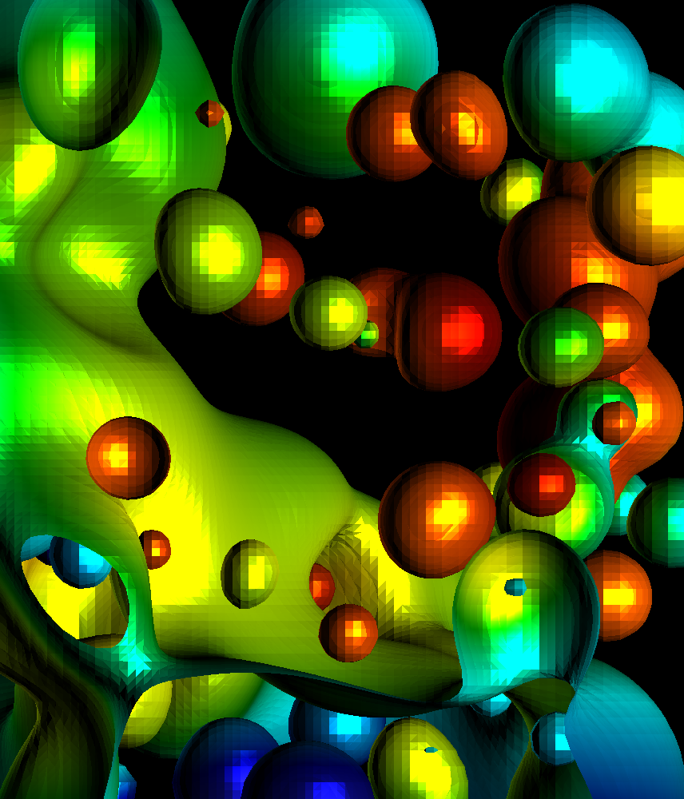
Flat vs Smooth Shading

Slide 20
Lighting and Normals
Two ways to treat normals:
Constant over a triangle
Varying over a triangle
Constant over a triangle ←→ flat shading
Take (C-A)x(B-A) as normal over whole triangle
Varying over a triangle ←→ smooth shading
Calculate normal at vertex, then calculate shading at vertex, then LERP shading
How do you calculate normal at a vertex?

Slide 21
Vertex Normals
Algorithm:
For vertex V,
Find all triangles T_{i} incident to V
Normal(V) = {0,0,0}
NumIncident = 0
For each T_{i},
calculate Normal(T_{i})
Normal(V) += Normal(T_{i})
NumIncident++
Normal(V) /= NumIncident
Note: our data structures don’t allow for “Find all triangles T_{i} incident to V” very easily.
Vertex normals are precalculated for 1F
V
N(V) = (N(T1)+N(T2)+N(T3)+N(T4)) / 4

Slide 22
Outline
Math Basics
Lighting Basics
The Phong Model

Slide 23
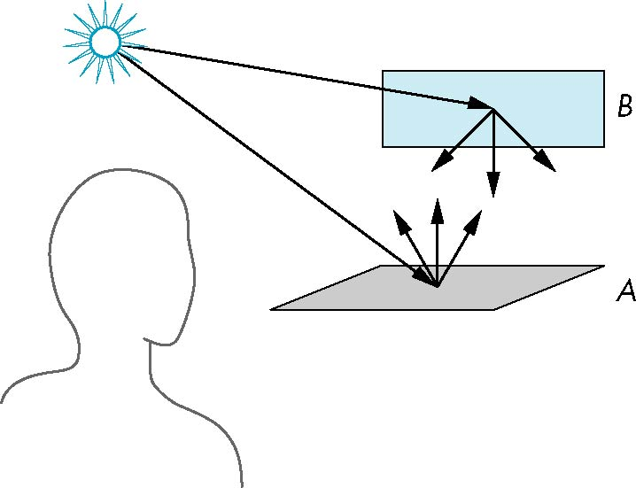
Scattering
Light strikes A
Some scattered
Some absorbed
Some of scattered light strikes B
Some scattered
Some absorbed
Some of this scattered
light strikes A
and so on

Slide 24
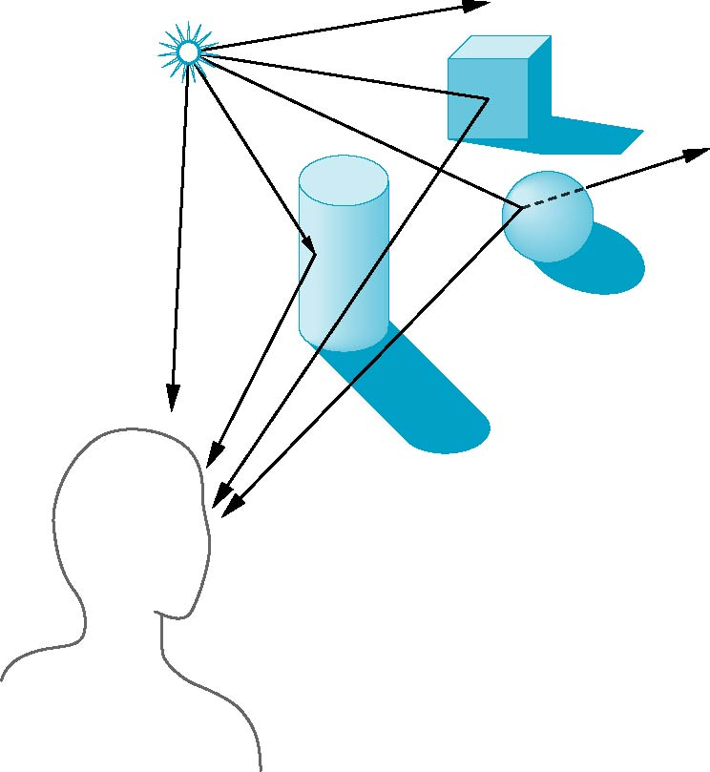
Global Effects
shadow
multiple reflection
translucent surface

Slide 25
Local vs Global Rendering (1/2)
Local rendering: when rendering one triangle, ignore the effects of other triangles
Global rendering: when rendering one triangle, consider the effects of other triangles

Slide 26
Local vs Global Rendering (2/2)
Correct shading requires a global calculation involving all objects and light sources
Incompatible with model which shades each polygon independently (local rendering)
However, in computer graphics, especially real time graphics, we are happy if things “look right”
Many techniques exist for approximating global effects
I.e., do local rendering, but bring in other knowledge to make it look like global rendering

Slide 27
Light-Material Interaction
Light that strikes an object is partially absorbed and partially scattered (reflected)
The amount reflected determines the color and brightness of the object
A surface appears red under white light because the red component of the light is reflected and the rest is absorbed
The reflected light is scattered in a manner that depends on the smoothness and orientation of the surface

Slide 28
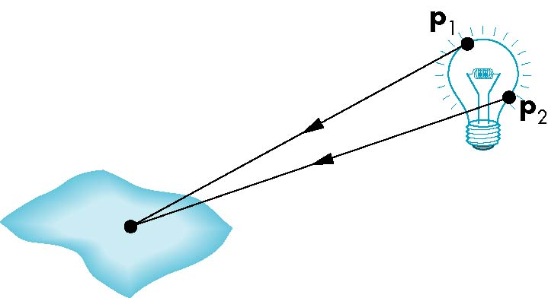
Light Sources
General light sources are difficult to work with because we must integrate light coming from all points on the source

Slide 29
Simple Light Sources
Point source
Model with position and color
Distant source = infinite distance away (parallel)
Spotlight
Restrict light from ideal point source
(We will do point sources for 1F … and this class)

Slide 30
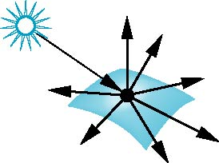
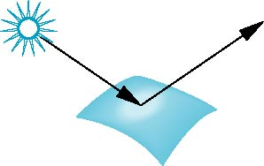
Surface Types
The smoother a surface, the more reflected light is concentrated in the direction that a perfect mirror would reflect the light
A very rough surface scatters light in all directions
smooth surface
rough surface

Slide 31
Shading
Our goal:
For each pixel, calculate a shading factor
Shading factor typically between 0 and 1, but sometimes >1
Shading >1 makes a surface more white
3 types of lighting to consider:
Ambient
Diffuse
Specular
Light everwhere
Our game plan:
Calculate all 3 and combine them.
rough surface
smooth surface

Slide 32
How to handle shading values greater than 1?
Color at pixel = (1.0, 0.4, 0.8)
Shading value = 0.5
Easy!
Color = (0.5, 0.2, 0.4)→ (128, 52, 103)
Shading value = 2.0
Color = (1.0, 0.8, 1.0) → (255, 204, 255)
Color_R = 255*min(1, R*shading_value)
This is how bright lights makes things whiter and whiter.
But it won’t put in colors that aren’t there.

Slide 33
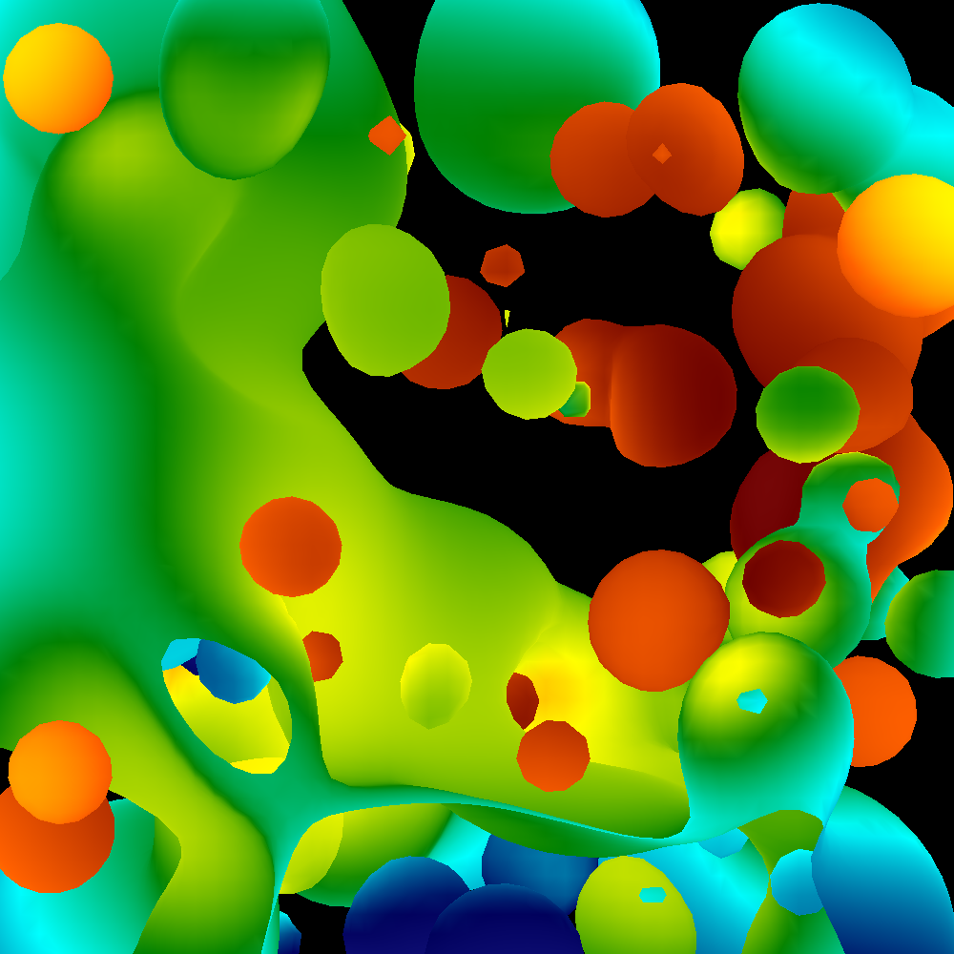
Ambient Lighting
Ambient light
Same amount of light everywhere in scene
Can model contribution of many sources and reflecting surfaces
Surface lit with ambient lighting only

Slide 34
Lambertian Surface
Perfectly diffuse reflector
Light scattered equally in all directions
Extreme zoom-in of part of a diffuse surface … light is scattered in all directions
(this image shows 5 of the directions)
Slide inspired by Ed Angel Computer Graphics Book

Slide 35
Diffuse Lighting
Surface Normal
Lambertian Surface

Slide 36
Diffuse Lighting
Surface Normal
Lambertian Surface
No light reflects off the (top) surface
(Light direction and surface normal are perpendicular)

Slide 37
Diffuse Lighting
Surface Normal
Lambertian Surface
When the light squarely hits the surface, then that’s when the most light is reflected

Slide 38
Diffuse Lighting
Surface Normal
N
L
α
Lambertian Surface
How much light should be reflected in this case?
A: cos(α)
And note that:
cos(0) = 1
cos(90) = 0

Slide 39
Diffuse Lighting
V1
Surface Normal
V2
N
L
α
Lambertian Surface
How much light makes it to viewer V1? Viewer V2?
A: cos(α) for both
Lambertian surfaces reflect light equally in all directions

Slide 40
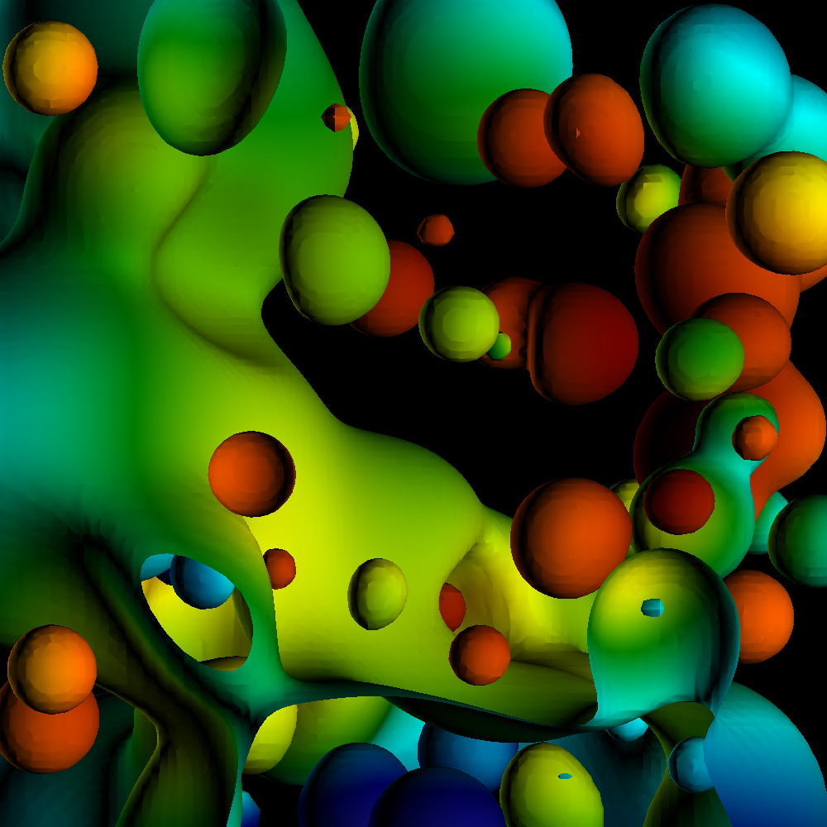
Diffuse Lighting
Diffuse light
Light distributed evenly in all directions, but amount of light depends on orientation of triangles with respect to light source.
Different for each triangle
Surface lit with diffuse lighting only

Slide 41
SLIDE REPEAT: Diffuse Lighting
V1
Surface Normal
V2
N
L
α
Lambertian Surface
How much light makes it to viewer V1? Viewer V2?
A: cos(α) for both
Lambertian surfaces reflect light equally in all directions

Slide 42
What is a dot product?
A.B = A.x*B.x + A.y*B.y
Physical interpretation:
A.B = cos(α)/(||A||*||B||)
(B.x, B.y)
(A.x,B.y)
α

Slide 43
Diffuse Lighting
V1
Surface Normal
V2
N
L
α
Lambertian Surface
You can calculate the diffuse contribution by taking the dot product of L and N,
Since L.N = cos(α)
(assuming L and N are normalized)

Slide 44
What about cases where L.N < 0?

Slide 45
What about cases where L.N < 0?
L.N = -1
Non-sensical … takes away light?
Common solution:
Diffuse light = max(0, L.N)

Slide 46
But wait…
If you have an open surface, then there is a “back face”.
The back face has the opposite normal.

Slide 47
But wait…
If you have an open surface, then there is a “back face”.
The back face has the opposite normal.
How can we deal with this case?

Slide 48
But wait…
If you have an open surface, then there is a “back face”.
The back face has the opposite normal.
How can we deal with this case?
Idea #1: encode all triangles
twice, with different normals
Idea #2: modify diffuse lighting model

Slide 49
But wait…
If you have an open surface, then there is a “back face”.
The back face has the opposite normal.
How can we deal with this case?
Idea #1: encode all triangles
twice, with different normals
Idea #2: modify diffuse lighting model
Diffuse light = abs(L.N)
This is called two-sided lighting

Slide 50
Two-sided lighting
We will use two-sided lighting for project 1F, since we have open surfaces
Note that Ed Angel book assumes closed surfaces and recommends one-sided lighting

Slide 51
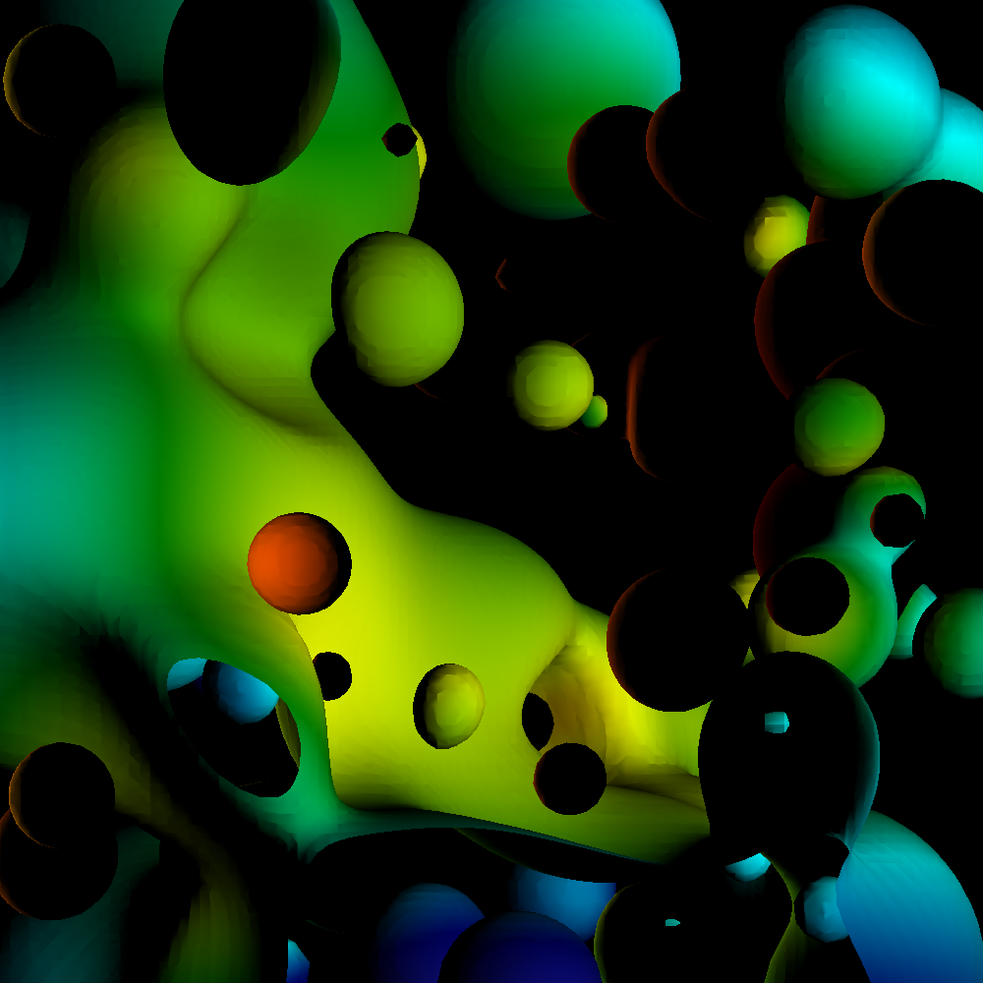
One-sided lighting with open surfaces is disappointing

Slide 52
The most valuable thing I learned in Freshman Physics
“angle in = angle out”
α

Slide 53
The most valuable thing I learned in Freshman Physics
“angle in = angle out”
α
α

Slide 54
Specular Lighting
Highest proportion of light reflecting
Smooth Surface
Light reflects in all directions.
But the surface is smooth, not Lambertian, so amount of reflected light varies.
So how much light??

Slide 55
How much light reflects with specular lighting?
Highest proportion of light reflecting
V
Smooth Surface
Consider V located along reflection ray.
Answer: most possible
Call this “1”

Slide 56
How much light reflects with specular lighting?
Highest proportion of light reflecting
V
Smooth Surface
Consider V located along perpendicular ray.
Answer: none of it
Call this “0”

Slide 57
How much light reflects with specular lighting?
Highest proportion of light reflecting
V
Smooth Surface
How much light gets to point V?

Slide 58
How much light reflects with specular lighting?
Highest proportion of light reflecting
V
α
Smooth Surface
How much light gets to point V?
A: proportional to cos(α)

Slide 59
How much light reflects with specular lighting?
Highest proportion of light reflecting
V
α
Smooth Surface
How much light gets to point V?
A: proportional to cos(α)
(Shininess strength) * cos(α) ^ (shininess coefficient)

Slide 60
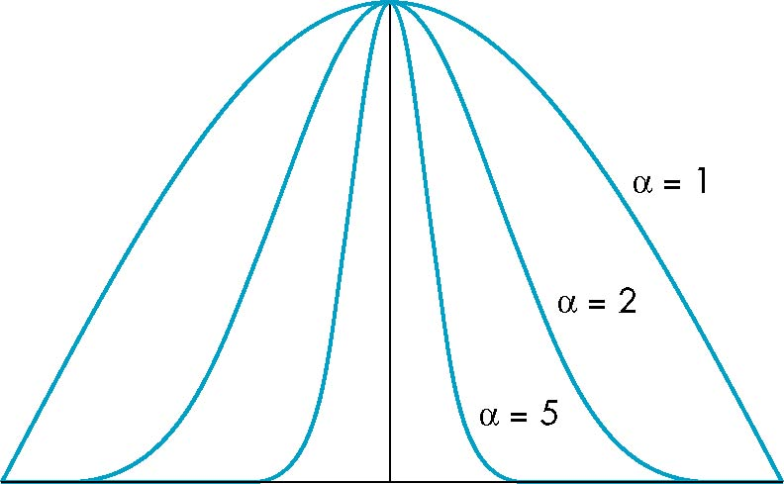
γ: The Shininess Coefficient
Values of γ between 100 and 200 correspond to metals
Values between 5 and 10 give surface that look like plastic
cos^{γ} α
γ=1
γ=2
γ=5
-90
φ
90
α

Slide 61
How much light reflects with specular lighting?
Highest proportion of light reflecting
V
α
Smooth Surface
How much light gets to point V?
A: proportional to cos(α)
(Shininess strength) * cos(α) ^ (shininess coefficient)

Slide 62
How much light reflects with specular lighting?
Highest proportion of light reflecting (R)
V
α
Smooth Surface
Great!
We know that cos(α) is V.R (provided V & R are normalized).

Slide 63
How much light reflects with specular lighting?
Highest proportion of light reflecting (R)
V
α
Smooth Surface
Great!
We know that cos(α) is V.R (provided V & R are normalized).
But what is R?
It is a formula: R = 2*(L.N)*N - L

Slide 64
Two-sided lighting
For specular lighting, we will use one-sided lighting for project 1F
It just looks better
Diffuse: abs(L.N)
Specular: max(0, S*(R.V)^{γ})

Slide 65
Outline
Math Basics
Lighting Basics
The Phong Model

Slide 66
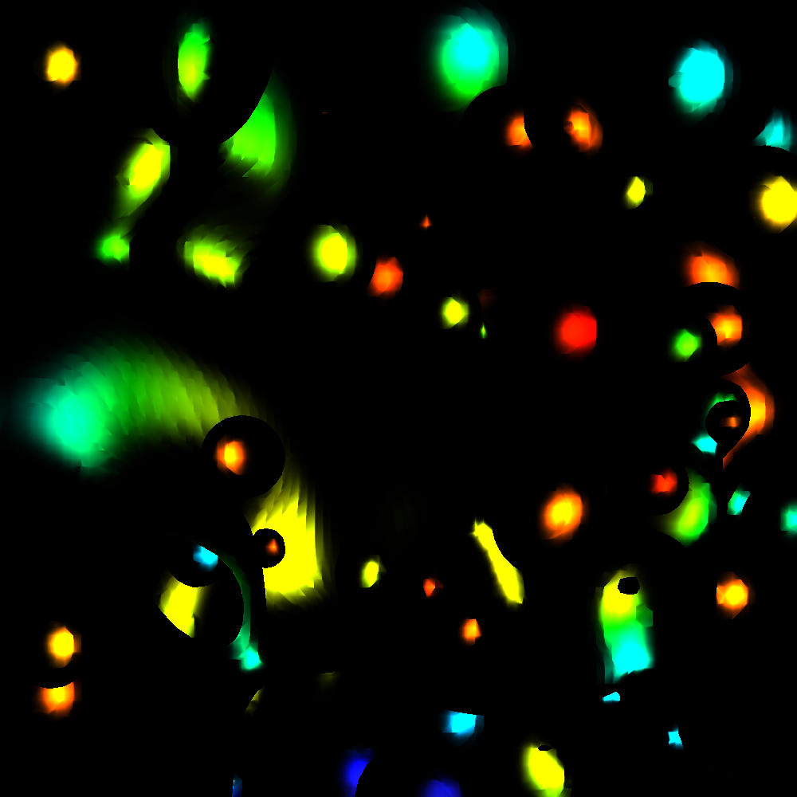
Phong Model
Combine three lighting effects: ambient, diffuse, specular

Slide 67
Phong Model
Simple version: 1 light, with “full intensity” (i.e., don’t add an intensity term)
Phong model
Shading_Amount = K_{a} + K_{d}*Diffuse + K_{s}*Specular
Signature:
double CalculatePhongShading(LightingParameters &, double *viewDirection, double *normal)
Will have to calculate viewDirection for each pixel!

Slide 68
Specular Term of Phong Model
Specular part of Phong: K_{s}*Specular
and Specular is: (Shininess strength) * cos(α) ^ (shininess coefficient)
Putting it all together would be:
K_{s} * (Shininess strength) * cos(α) ^ (shininess coefficient)
But now we have two multipliers, K_{s} and (Shininess Strength). Not needed.
So: just use one. Drop Shininess Strength and only use K_{s}
K_{s} * cos(α) ^ (shininess coefficient)

Slide 69
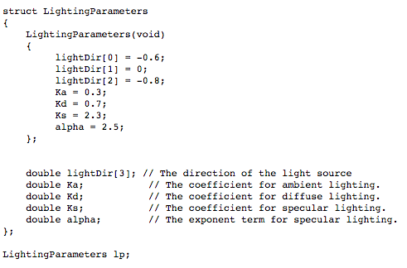
Lighting parameters

Slide 70
Project #1F (8%), Due Feb 19th
Goal: add shading, movie
Extend your project1E code
Important:
add #define NORMALS

Slide 71
Changes to data structures
class Triangle
{
public:
double X[3], Y[3], Z[3];
double colors[3][3];
double normals[3][3];
};
reader1e.cxx will not compile (with #define NORMALS) until you make these changes
reader1e.cxx will initialize normals at each vertex

Slide 72
More comments (1/3)
This project in a nutshell:
Add method called “CalculateShading”.
My version of CalculateShading is about ten lines of code.
Call CalculateShading for each vertex
This is a new field, which you will LERP.
Modify RGB calculation to use shading.

Slide 73
More comments (2/3)
New: more data to help debug
I will make the shading value for each pixel available.
I will also make it available for ambient, diffuse, specular.
Don’t forget to do two-sided lighting (for diffuse, not specular)

Slide 74
More comments (3/3)
I haven’t said anything about movie encoders

Slide 75
Where Hank spent his debugging time…
Concave surface
Convex surface
Lighting direction
Lighting direction

Slide 76
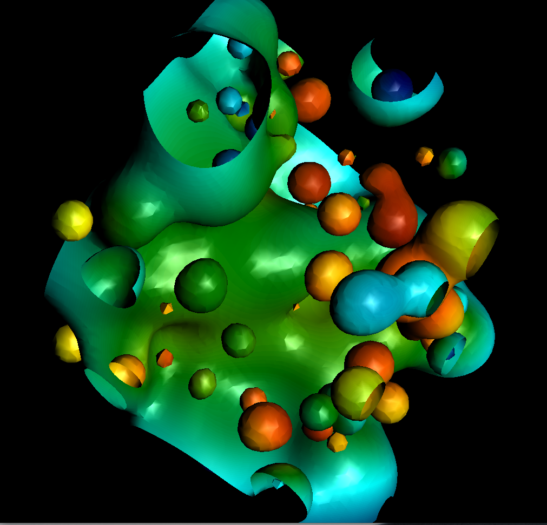
Where Hank spent his debugging time…

Slide 77
Project #1F (8%), Due Feb 19th
Goal: add shading, movie

