Slide 1
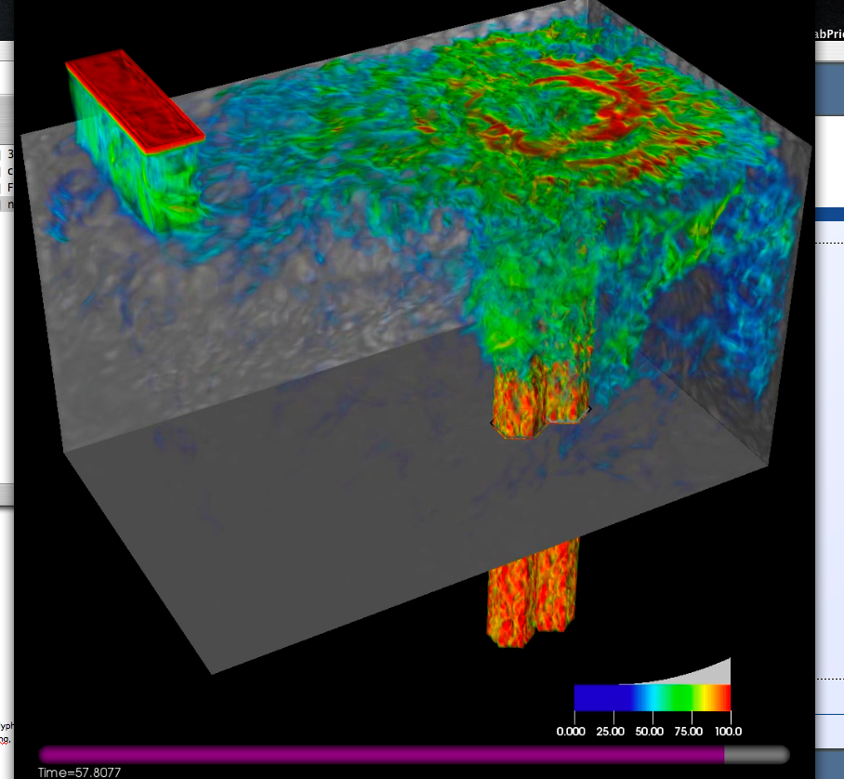
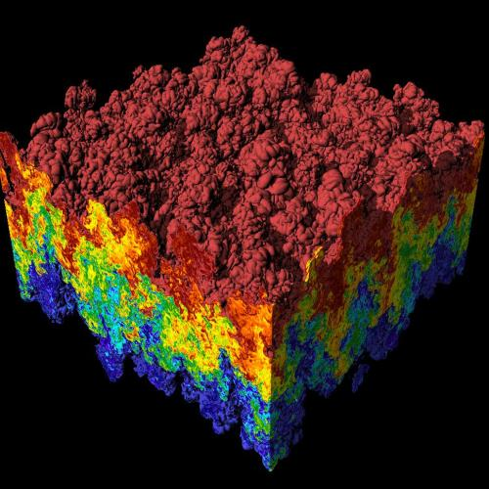
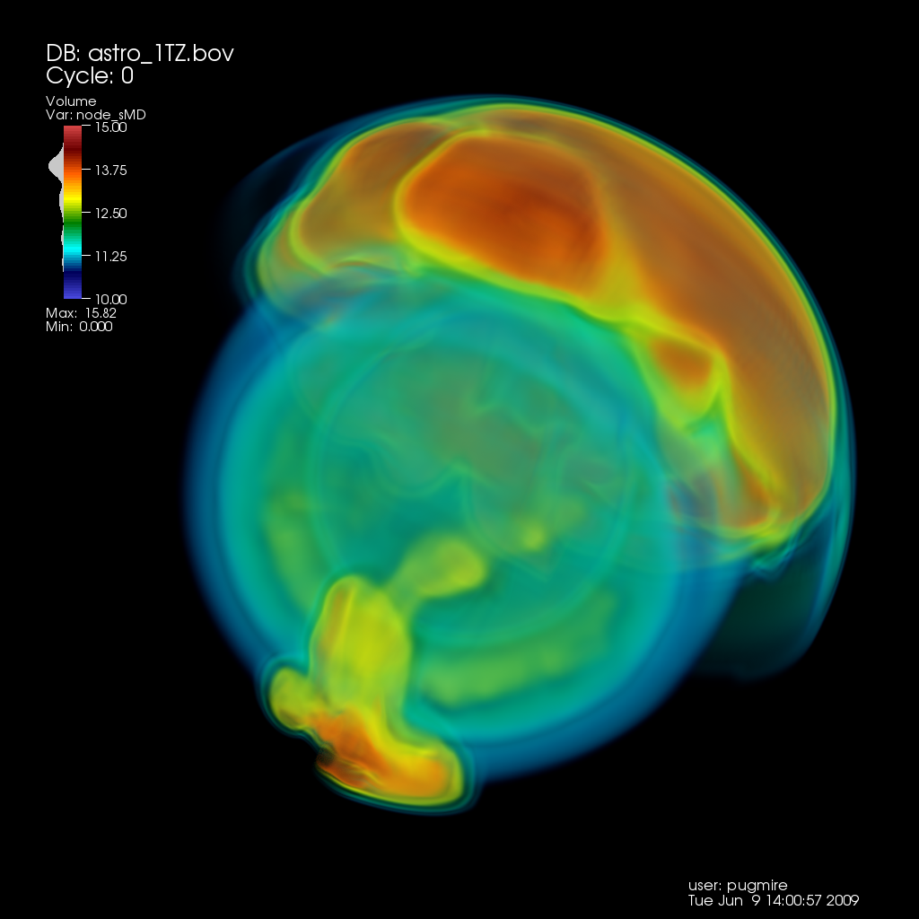
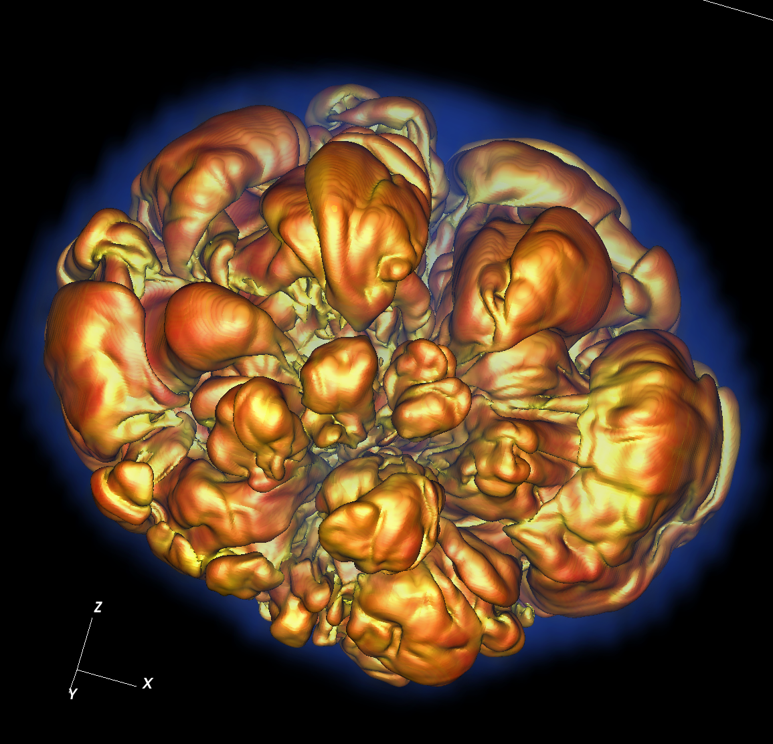
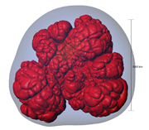
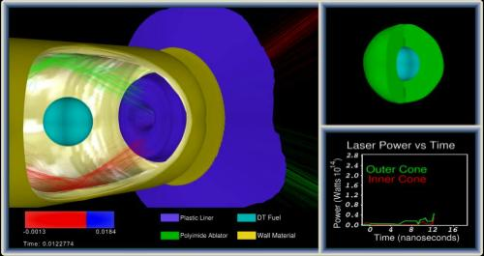
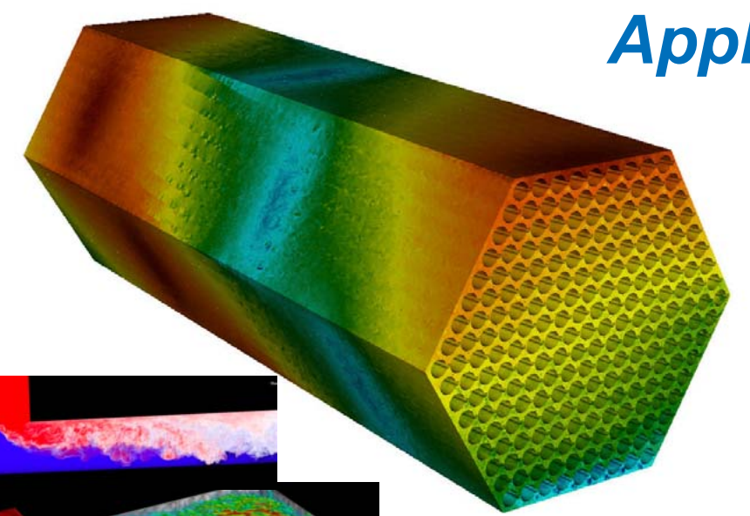
CIS 441/541: Intro to Computer Graphics Lecture 7: Math Basics, Lighting Introduction & Phong Lighting
April 27, 2021
Hank Childs, University of Oregon

Slide 2
Midway Experience: thank you to the 2 people who responded

Slide 3
Proposed Change to Syllabus/Quiz Structure: YES

Slide 4
Class Plan
Abhishek and I are working hard on preparing Project 2 (OpenGL)
Quite frankly not going as well as we thought
Projects will start coming faster
Want there to time to do great final projects
1E, 1F: simpler coding, harder concepts
Cannot finish shading today
Also have another activity

Slide 5
Class Plan (New Slide)
Option A:
Slow class down, more time on OpenGL, less time for final project
Option B:
Keep up the pace, less time on OpenGL, more time for final project

Slide 6
Current Plan (1/2)
Week | Sun | Mon | Tues | Weds | Thurs | Fri | Sat
5 |  |  | Lec 7 (shading), 1F assigned, 1E due |  | Lec 8 (finish shading, GL), 2A assigned
6 |  | 1F due | Lec 9 (GL), 2B assigned |  | Discussion of final projects / Quiz 3 |  | 2A due
7 |  |  | Lec 11 – ray tracing |  | More discussion of final projects (?) | 2B due

Slide 7
Current Plan (2/2)
Weeks 8-10 → you work on final projects
Lectures will be on misc. topics in graphics, esp. in support of final projects
Quiz 3 (Week 6): likely on matrices
Quiz 4 (Week 8): likely on GL
Quiz 5 (Week 10): likely on topics in final weeks

Slide 8
Office Hours

Slide 9
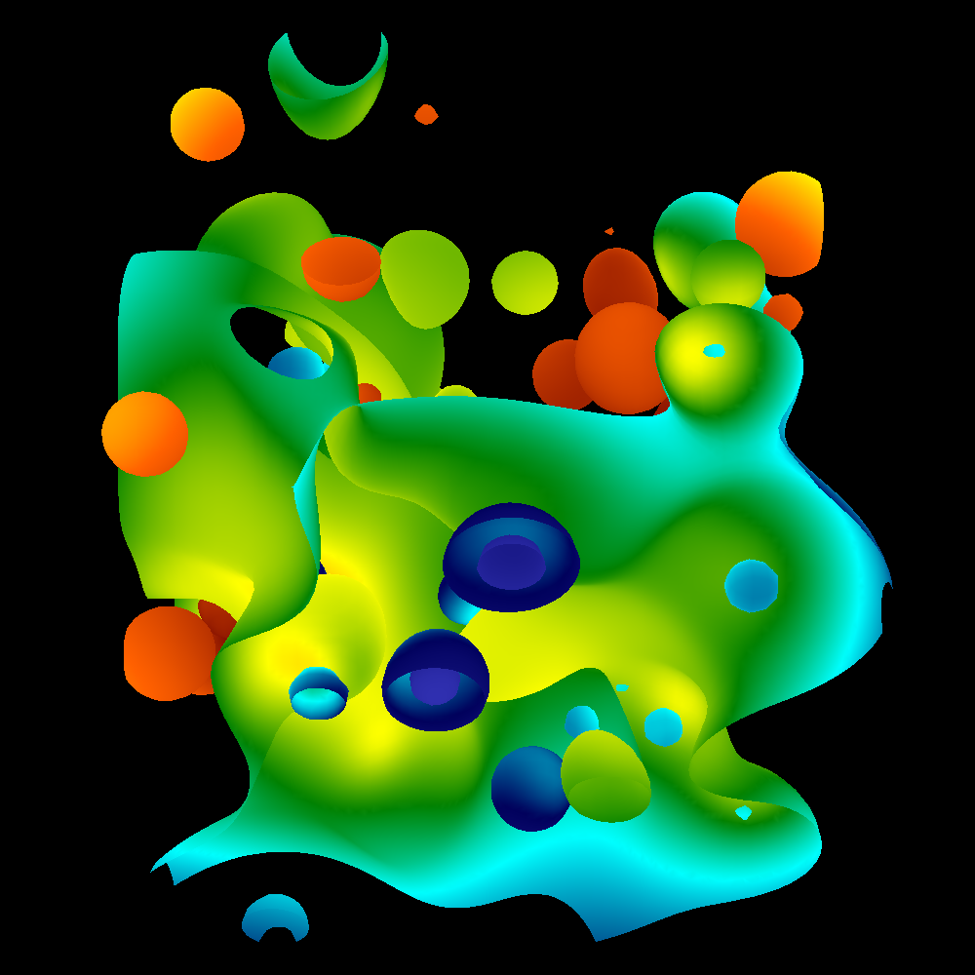
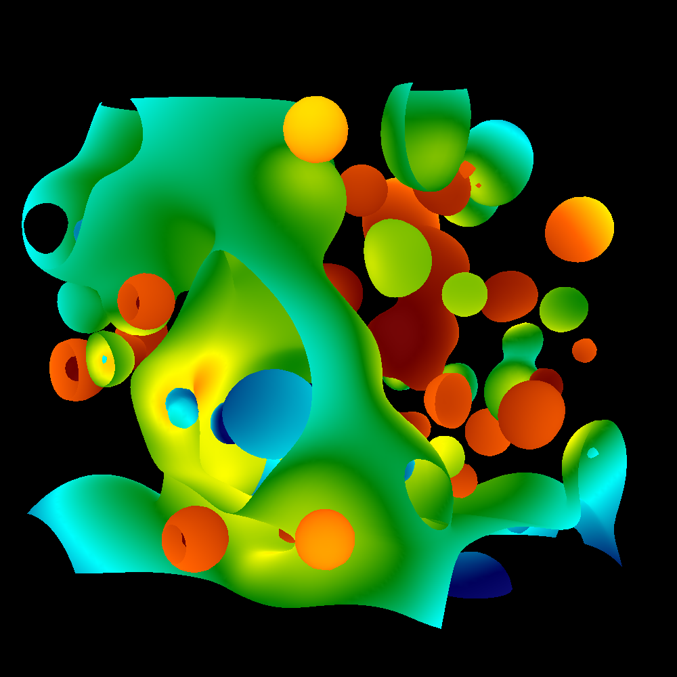
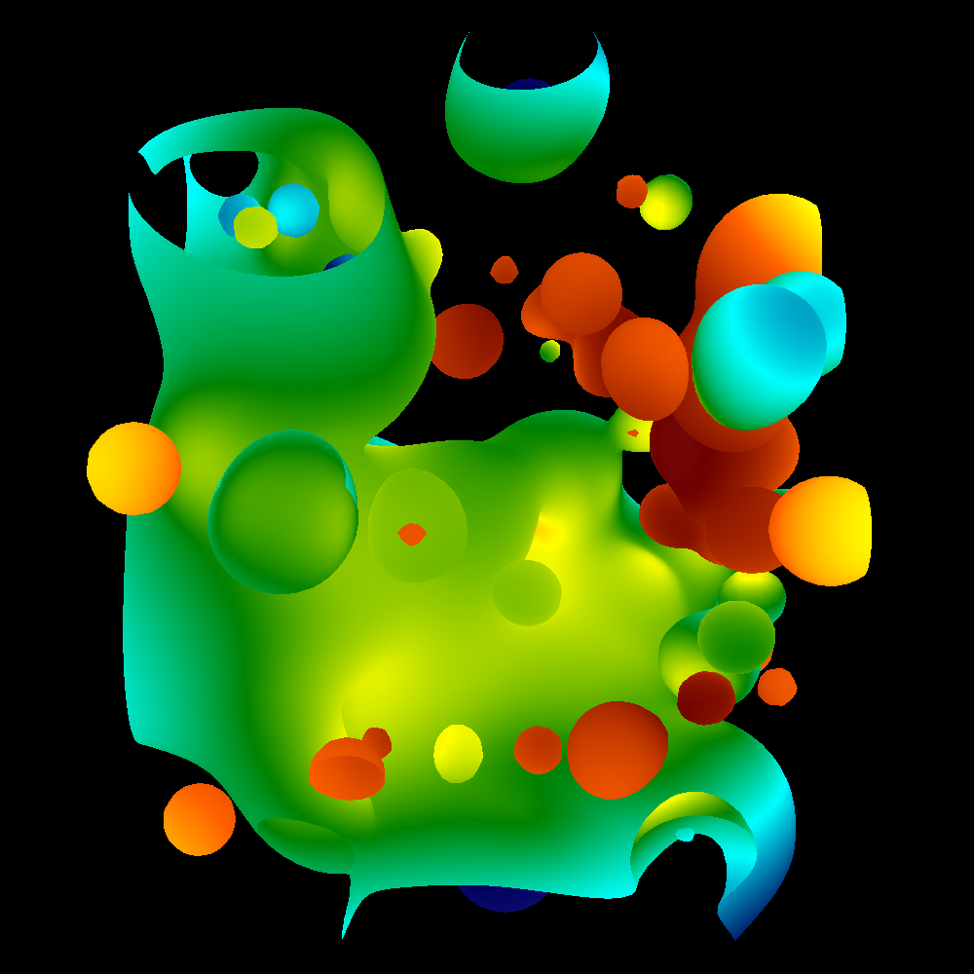
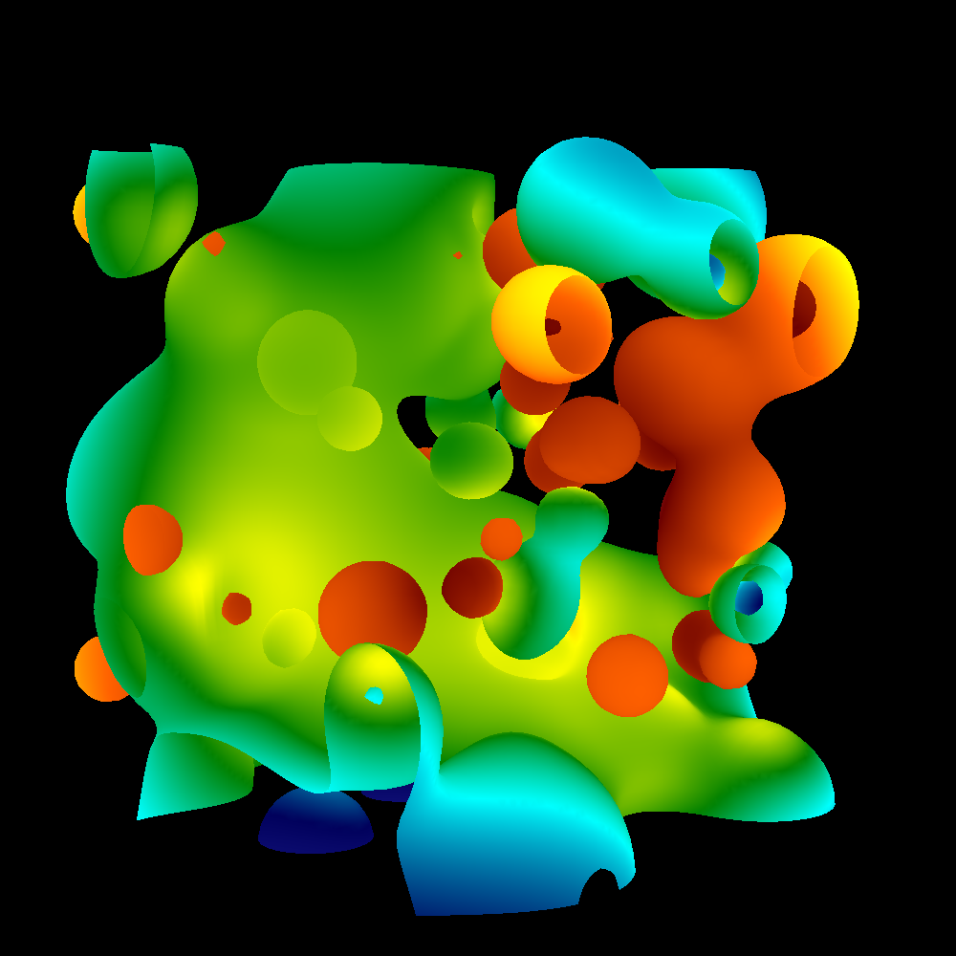
Project #1E (6%), Due Tues April 27th
Goal: add arbitrary camera positions
Extend your project1D code
New: proj1e_geometry.vtk available on web (9MB), “reader1e.cxx”.
New: Matrix.cxx, Camera.cxx
No Cmake, project1E.cxx

Slide 10
Outline
Math Basics
Lighting Basics
The Phong Model

Slide 11
Outline
Math Basics
Lighting Basics
The Phong Model

Slide 12
What is the norm of a vector?
The norm of a vector is its length
Denoted with || . ||
For a vector A = (A.x, A.y),
||A|| = sqrt(A.x*A.x+A.y*A.y)
Physical interpretation:
For 3D, ||A|| = sqrt(A.x*A.x+A.y*A.y+A.z*A.z)
(A.x,A.y)
||A||
y
x

Slide 13
What does it means for a vector to be normalized?
The vector A is normalized if ||A|| = 1.
This is also called a unit vector.
To obtain a normalized vector, take A/||A||
Many of the operations we will discuss today will only work correctly with normalized vectors.
Example: A=(3,4,0). Then:
||A|| = 5
A/||A|| = (0.6, 0.8, 0)

Slide 14
What is the normal of a triangle?
A triangle coincides with a flat plane.
A triangle’s normal is the vector perpendicular to that plane.
If a triangle is on plane = Ax+By+Cz = D,
then the triangle’s normal is (A, B, C)

Slide 15
Norm, Normal, Normalize, Oh My!
Norm: the length of a vector (||A||)
Normal: a perpendicular vector to a plane coincident with geometry
Normalize: the operation to create a vector with length 1 (A/||A||)
All 3 are important for today’s lecture

Slide 16
What is a dot product?
A.B = A.x*B.x + A.y*B.y
(or A.x*B.x + A.y*B.y + A.z*B.z)
Physical interpretation:
A.B = cos(α)*(||A||*||B||)
B = (B.x, B.y)
A = (A.x,A.y)
α

Slide 17
What is the cross product?
AxB = (A.y*B.z - A.z*B.y,
B.x*A.z - A.x*B.z,
A.x*B.y - A.y*B.x)
What is the physical interpretation of a cross product?
Finds a vector perpendicular to both A and B.

Slide 18
Easy Way to Calculate Normal For a Triangle
Normal = (C-A)x(B-A)
C
A
B
Important:
(C-A)x(B-A) != (B-A)x(C-A)
… we’ll worry about this later

Slide 19
Lighting and Normals
Two ways to treat normals:
Constant over a triangle
Varying over a triangle
Constant over a triangle ←→ flat shading
Varying over a triangle ←→ smooth shading

Slide 20
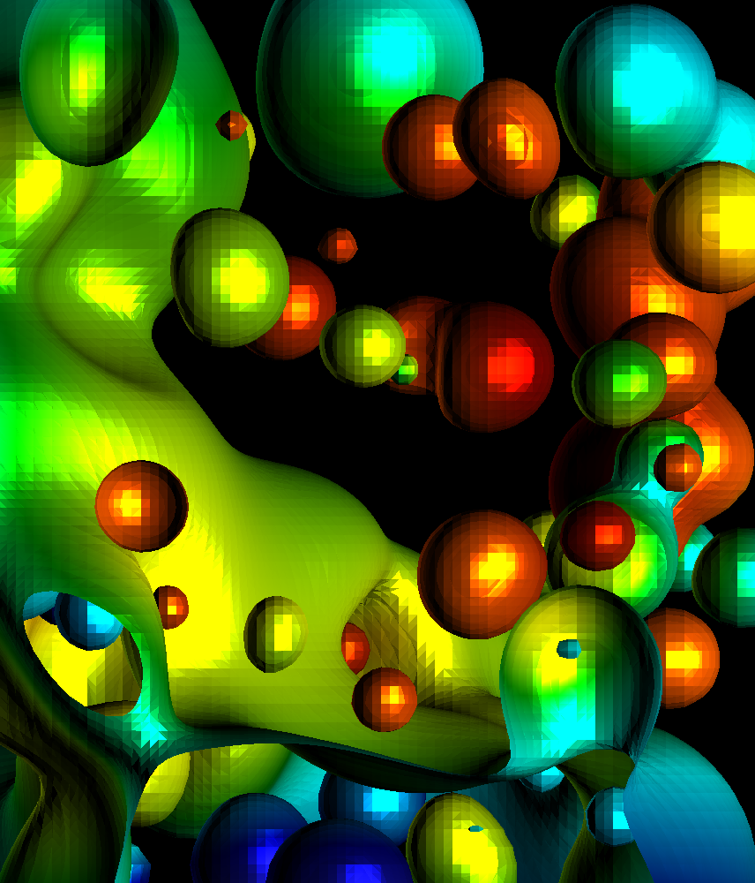
Flat vs Smooth Shading

Slide 21
Lighting and Normals
Two ways to treat normals:
Constant over a triangle
Varying over a triangle
Constant over a triangle ←→ flat shading
Take (C-A)x(B-A) as normal over whole triangle
Varying over a triangle ←→ smooth shading
Calculate normal at vertex, then calculate shading at vertex, then LERP shading
How do you calculate normal at a vertex?

Slide 22
Vertex Normals
Algorithm:
For vertex V,
Find all triangles T_{i} incident to V
Normal(V) = {0,0,0}
NumIncident = 0
For each T_{i},
calculate Normal(T_{i})
Normal(V) += Normal(T_{i})
NumIncident++
Normal(V) /= NumIncident
Note: our data structures don’t allow for “Find all triangles T_{i} incident to V” very easily.
Vertex normals are precalculated for 1F
V
N(V) = (N(T1)+N(T2)+N(T3)+N(T4)) / 4

Slide 23
Outline
Math Basics
Lighting Basics
The Phong Model

Slide 24
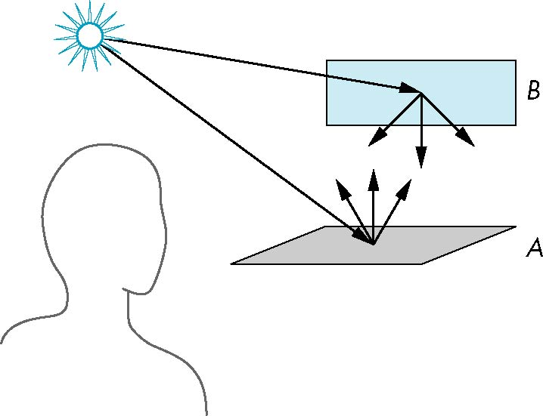
Scattering
Light strikes A
Some scattered
Some absorbed
Some of scattered light strikes B
Some scattered
Some absorbed
Some of this scattered
light strikes A
and so on

Slide 25
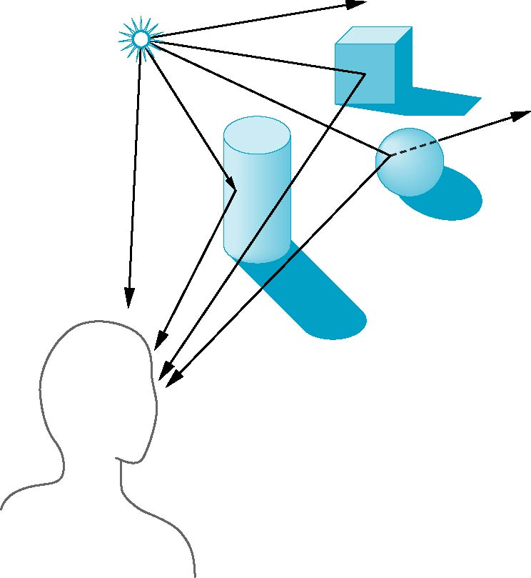
Global Effects
shadow
multiple reflection
translucent surface

Slide 26
Local vs Global Rendering (1/2)
Local rendering: when rendering one triangle, ignore the effects of other triangles
Global rendering: when rendering one triangle, consider the effects of other triangles

Slide 27
Local vs Global Rendering (2/2)
Correct shading requires a global calculation involving all objects and light sources
Incompatible with model which shades each polygon independently (local rendering)
However, in computer graphics, especially real time graphics, we are happy if things “look right”
Many techniques exist for approximating global effects
I.e., do local rendering, but bring in other knowledge to make it look like global rendering

Slide 28
Light-Material Interaction
Light that strikes an object is partially absorbed and partially scattered (reflected)
The amount reflected determines the color and brightness of the object
A surface appears red under white light because the red component of the light is reflected and the rest is absorbed
The reflected light is scattered in a manner that depends on the smoothness and orientation of the surface

Slide 29
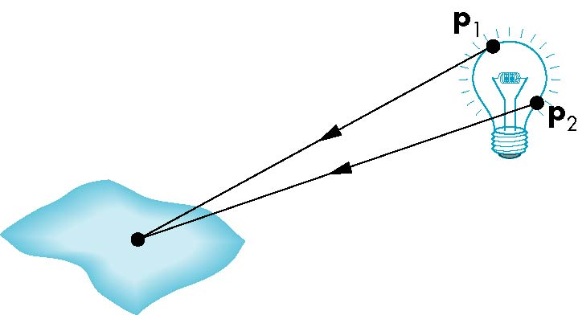
Light Sources
General light sources are difficult to work with because we must integrate light coming from all points on the source

Slide 30
Simple Light Sources
Point source
Model with position and color
Distant source = infinite distance away (parallel)
Spotlight
Restrict light from ideal point source
(We will do point sources for 1F … and this class)

Slide 31
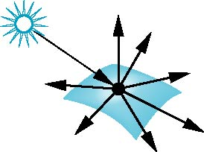
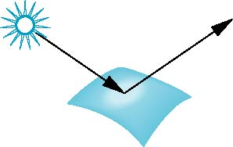
Surface Types
The smoother a surface, the more reflected light is concentrated in the direction that a perfect mirror would reflect the light
A very rough surface scatters light in all directions
smooth surface
rough surface

Slide 32
Shading
Our goal:
For each pixel, calculate a shading factor
Shading factor typically between 0 and 1, but sometimes >1
Shading >1 makes a surface more white
3 types of lighting to consider:
Ambient
Diffuse
Specular
Light everwhere
Our game plan:
Calculate all 3 and combine them.
rough surface
smooth surface

Slide 33
How to handle shading values greater than 1?
Color at pixel = (1.0, 0.4, 0.8)
Shading value = 0.5
Easy!
Color = (0.5, 0.2, 0.4)→ (128, 52, 103)
Shading value = 2.0
Color = (1.0, 0.8, 1.0) → (255, 204, 255)
Color_R = 255*min(1, R*shading_value)
This is how bright lights makes things whiter and whiter.
But it won’t put in colors that aren’t there.

Slide 34
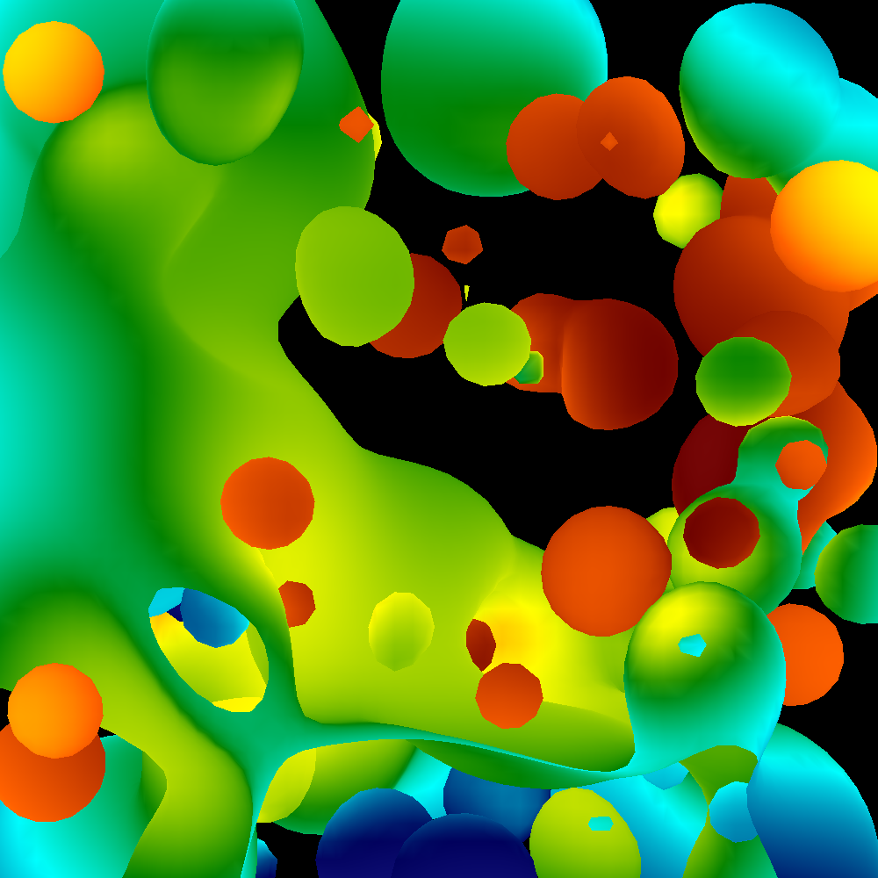
Ambient Lighting
Ambient light
Same amount of light everywhere in scene
Can model contribution of many sources and reflecting surfaces
Surface lit with ambient lighting only

Slide 35
Lambertian Surface
Perfectly diffuse reflector
Light scattered equally in all directions
Extreme zoom-in of part of a diffuse surface … light is scattered in all directions
(this image shows 5 of the directions)
Slide inspired by Ed Angel Computer Graphics Book

Slide 36
Diffuse Lighting
Surface Normal
Lambertian Surface

Slide 37
Diffuse Lighting
Surface Normal
Lambertian Surface
No light reflects off the (top) surface
(Light direction and surface normal are perpendicular)

Slide 38
Diffuse Lighting
Surface Normal
Lambertian Surface
When the light squarely hits the surface, then that’s when the most light is reflected

Slide 39
Diffuse Lighting
Surface Normal
N
L
α
Lambertian Surface
How much light should be reflected in this case?
A: cos(α)
And note that:
cos(0) = 1
cos(90) = 0

Slide 40
Diffuse Lighting
V1
Surface Normal
V2
N
L
α
Lambertian Surface
How much light makes it to viewer V1? Viewer V2?
A: cos(α) for both
Lambertian surfaces reflect light equally in all directions

Slide 41
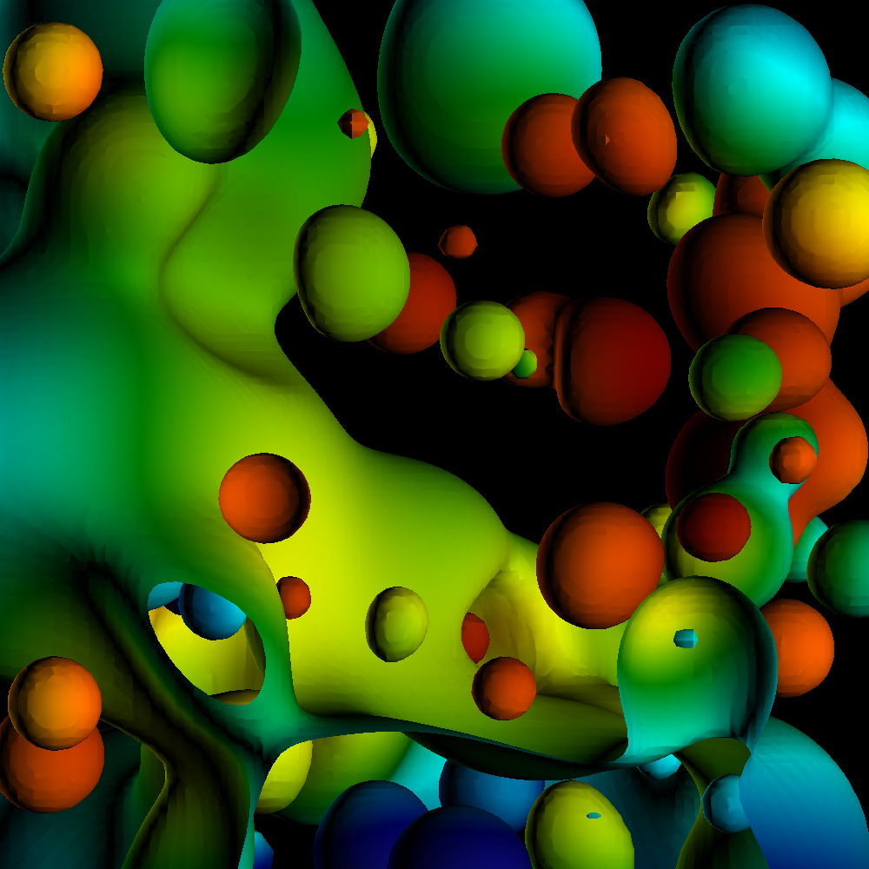
Diffuse Lighting
Diffuse light
Light distributed evenly in all directions, but amount of light depends on orientation of triangles with respect to light source.
Different for each triangle
Surface lit with diffuse lighting only

Slide 42
SLIDE REPEAT: Diffuse Lighting
V1
Surface Normal
V2
N
L
α
Lambertian Surface
How much light makes it to viewer V1? Viewer V2?
A: cos(α) for both
Lambertian surfaces reflect light equally in all directions

Slide 43
What is a dot product?
A.B = A.x*B.x + A.y*B.y
Physical interpretation:
A.B = cos(α)/(||A||*||B||)
(B.x, B.y)
(A.x,B.y)
α

Slide 44
Diffuse Lighting
V1
Surface Normal
V2
N
L
α
Lambertian Surface
You can calculate the diffuse contribution by taking the dot product of L and N,
Since L.N = cos(α)
(assuming L and N are normalized)

Slide 45
What about cases where L.N < 0?

Slide 46
What about cases where L.N < 0?
L.N = -1
Non-sensical … takes away light?
Common solution:
Diffuse light = max(0, L.N)

Slide 47
But wait…
If you have an open surface, then there is a “back face”.
The back face has the opposite normal.

Slide 48
But wait…
If you have an open surface, then there is a “back face”.
The back face has the opposite normal.
How can we deal with this case?

Slide 49
But wait…
If you have an open surface, then there is a “back face”.
The back face has the opposite normal.
How can we deal with this case?
Idea #1: encode all triangles
twice, with different normals
Idea #2: modify diffuse lighting model

Slide 50
But wait…
If you have an open surface, then there is a “back face”.
The back face has the opposite normal.
How can we deal with this case?
Idea #1: encode all triangles
twice, with different normals
Idea #2: modify diffuse lighting model
Diffuse light = abs(L.N)
This is called two-sided lighting

Slide 51
Two-sided lighting
We will use two-sided lighting for project 1F, since we have open surfaces
Note that Ed Angel book assumes closed surfaces and recommends one-sided lighting

Slide 52
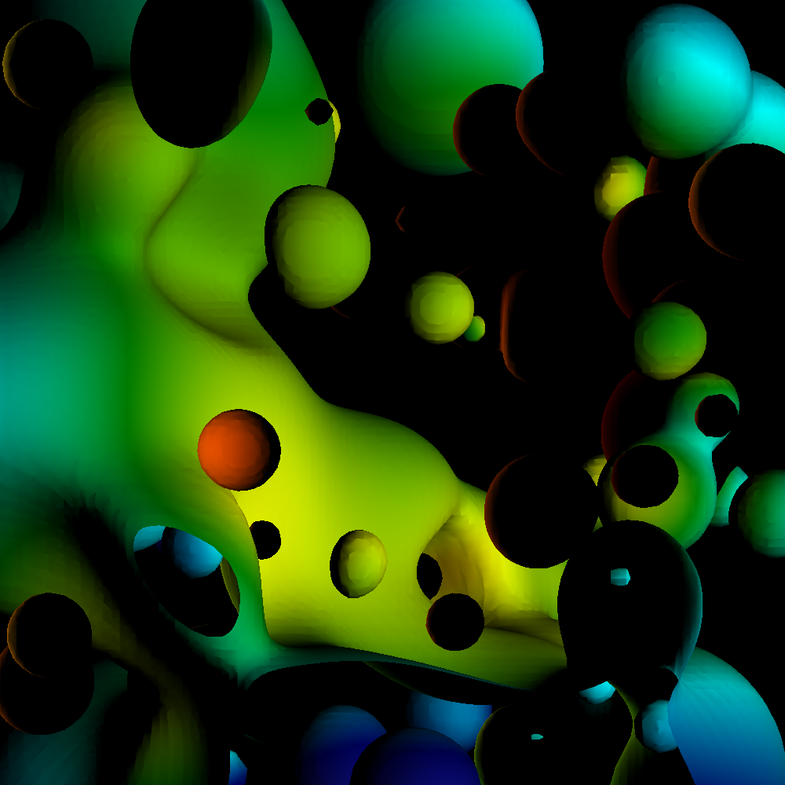
One-sided lighting with open surfaces is disappointing

Slide 53
The most valuable thing I learned in Freshman Physics
“angle in = angle out”
α

Slide 54
The most valuable thing I learned in Freshman Physics
“angle in = angle out”
α
α

Slide 55
Specular Lighting
Highest proportion of light reflecting
Smooth Surface
Light reflects in all directions.
But the surface is smooth, not Lambertian, so amount of reflected light varies.
So how much light??

Slide 56
How much light reflects with specular lighting?
Highest proportion of light reflecting
V
Smooth Surface
Consider V located along reflection ray.
Answer: most possible
Call this “1”

Slide 57
How much light reflects with specular lighting?
Highest proportion of light reflecting
V
Smooth Surface
Consider V located along perpendicular ray.
Answer: none of it
Call this “0”

Slide 58
How much light reflects with specular lighting?
Highest proportion of light reflecting
V
Smooth Surface
How much light gets to point V?

Slide 59
How much light reflects with specular lighting?
Highest proportion of light reflecting
V
α
Smooth Surface
How much light gets to point V?
A: proportional to cos(α)

Slide 60
How much light reflects with specular lighting?
Highest proportion of light reflecting
V
α
Smooth Surface
How much light gets to point V?
A: proportional to cos(α)
(Shininess strength) * cos(α) ^ (shininess coefficient)

Slide 61
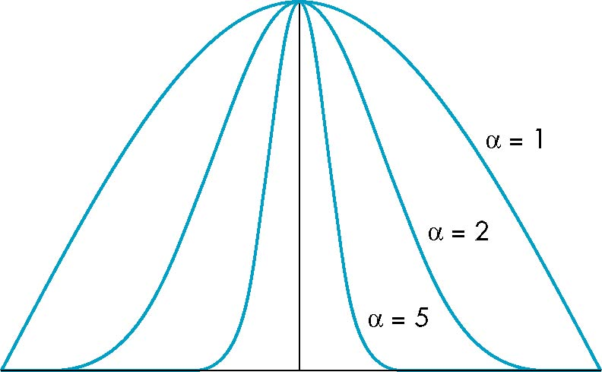
γ: The Shininess Coefficient
Values of γ between 100 and 200 correspond to metals
Values between 5 and 10 give surface that look like plastic
cos^{γ} α
γ=1
γ=2
γ=5
-90
φ
90
α

Slide 62
How much light reflects with specular lighting?
Highest proportion of light reflecting
V
α
Smooth Surface
How much light gets to point V?
A: proportional to cos(α)
(Shininess strength) * cos(α) ^ (shininess coefficient)

Slide 63
How much light reflects with specular lighting?
Highest proportion of light reflecting (R)
V
α
Smooth Surface
Great!
We know that cos(α) is V.R (provided V & R are normalized).

Slide 64
How much light reflects with specular lighting?
Highest proportion of light reflecting (R)
V
α
Smooth Surface
Great!
We know that cos(α) is V.R (provided V & R are normalized).
But what is R?
It is a formula: R = 2*(L.N)*N - L

Slide 65
Two-sided lighting
For specular lighting, we will use two-sided lighting for project 1F
Diffuse: abs(L.N)
Specular: abs(S*(R.V)^{γ})

Slide 66
Outline
Math Basics
Lighting Basics
The Phong Model

Slide 67
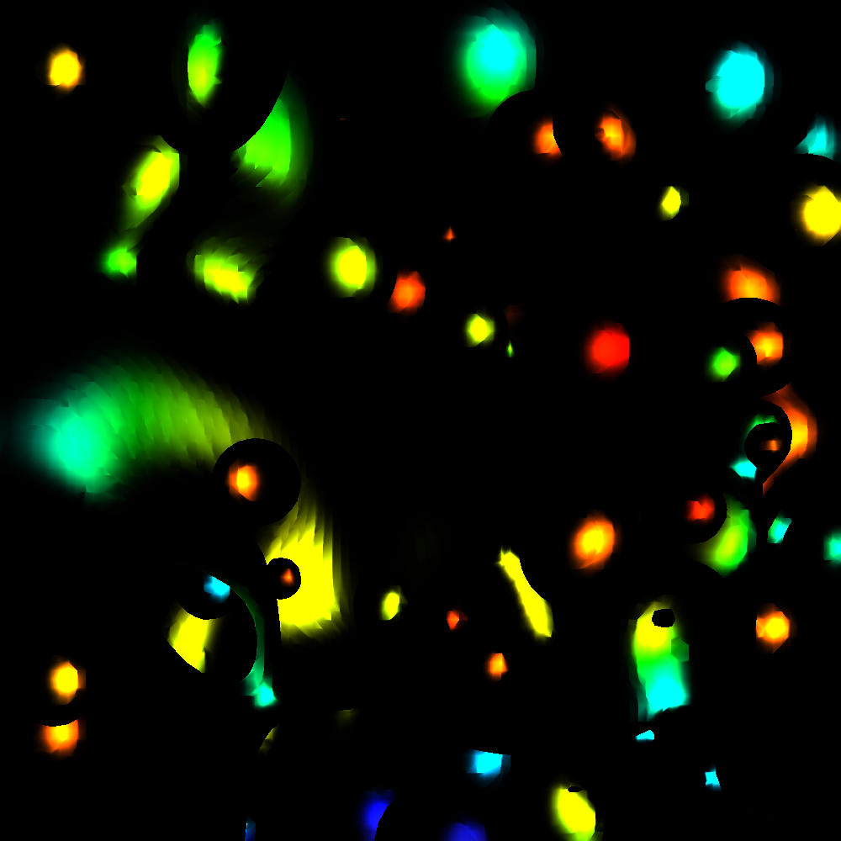
Phong Model
Combine three lighting effects: ambient, diffuse, specular

Slide 68
Phong Model
Simple version: 1 light, with “full intensity” (i.e., don’t add an intensity term)
Phong model
Shading_Amount = K_{a} + K_{d}*Diffuse + K_{s}*Specular
Signature:
double CalculatePhongShading(LightingParameters &, double *viewDirection, double *normal)
Will have to calculate viewDirection for each pixel!

Slide 69
Specular Term of Phong Model
Specular part of Phong: K_{s}*Specular
and Specular is: (Shininess strength) * cos(α) ^ (shininess coefficient)
Putting it all together would be:
K_{s} * (Shininess strength) * cos(α) ^ (shininess coefficient)
But now we have two multipliers, K_{s} and (Shininess Strength). Not needed.
So: just use one. Drop Shininess Strength and only use K_{s}
K_{s} * cos(α) ^ (shininess coefficient)

Slide 70
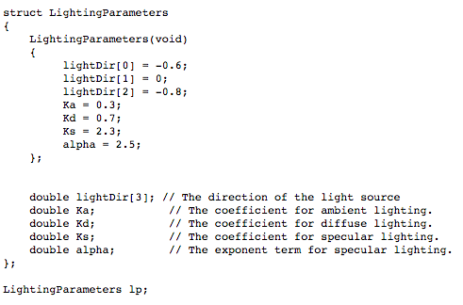
Lighting parameters

Slide 71
Project #1F (8%), Monday May 3rd
Goal: add shading, movie
Extend your project1E code
Important:
add #define NORMALS

Slide 72
Changes to data structures
class Triangle
{
public:
double X[3], Y[3], Z[3];
double colors[3][3];
double normals[3][3];
};
reader1e.cxx will not compile (with #define NORMALS) until you make these changes
reader1e.cxx will initialize normals at each vertex

Slide 73
More comments (1/3)
This project in a nutshell:
Add method called “CalculateShading”.
My version of CalculateShading is about ten lines of code.
Call CalculateShading for each vertex
This is a new field, which you will LERP.
Modify RGB calculation to use shading.

Slide 74
More comments (2/3)
New: more data to help debug
I will make the shading value for each pixel available.
I will also make it available for ambient, diffuse, specular.
Don’t forget to do two-sided lighting

Slide 75
More comments (3/3)
I haven’t said anything about movie encoders

Slide 76
Where Hank spent his debugging time…
Concave surface
Convex surface
Lighting direction
Lighting direction

Slide 77
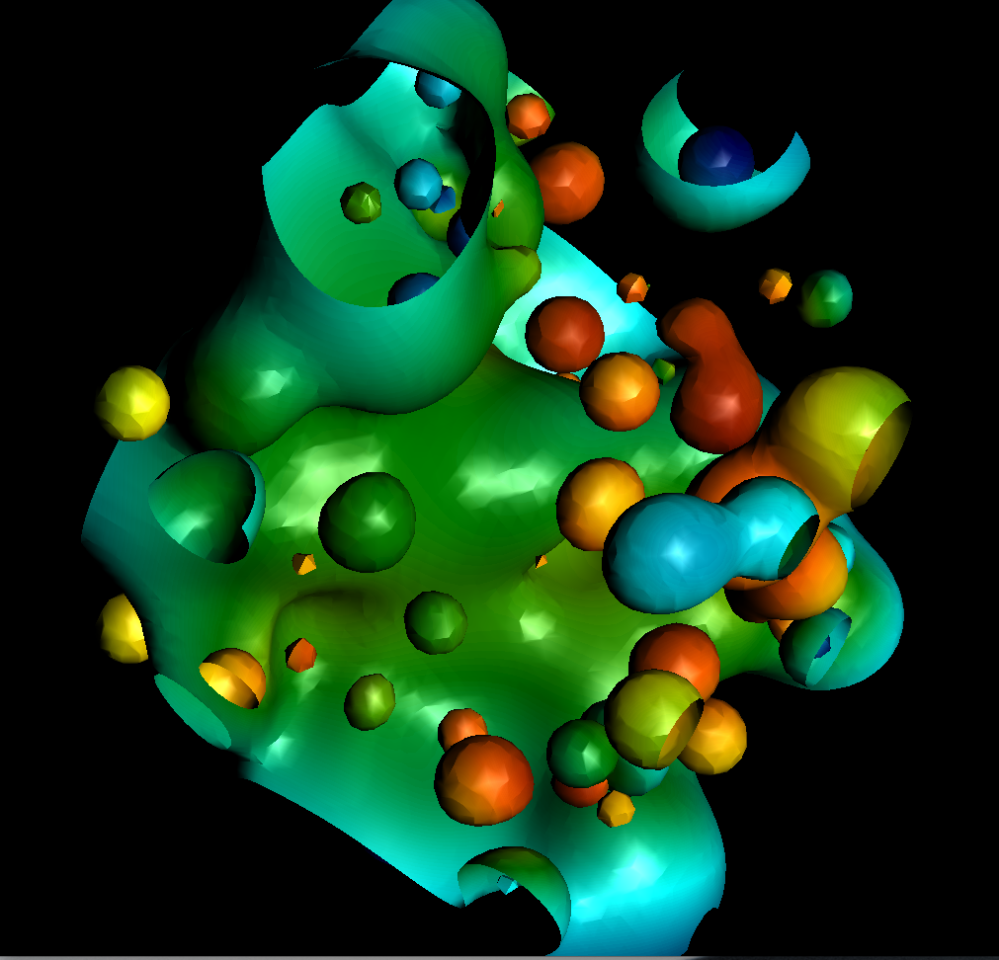
Where Hank spent his debugging time…

Slide 78
Project #1F (8%), Due Monday May 3rd
Goal: add shading, movie

Slide 79
static
static memory: third kind of memory allocation
reserved at compile time
contrasts with dynamic (heap) and automatic (stack) memory allocations
accomplished via keyword that modifies variables
There are three distinct usages of statics

Slide 80
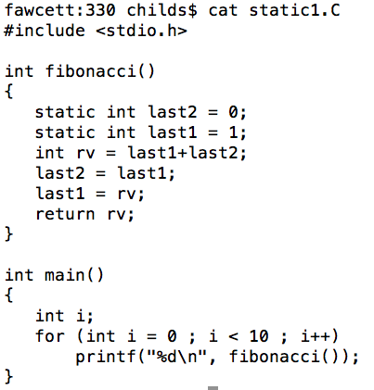
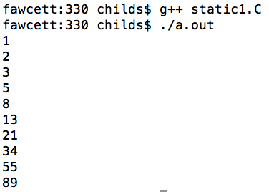
static usage #1: persistency within a function

Slide 81
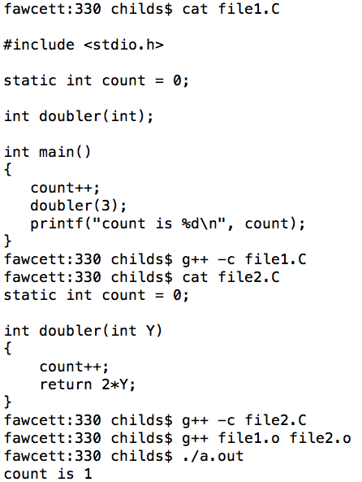
static usage #2: making global variables be local to a file
I have no idea why the static keyword is used in this way.

Slide 82
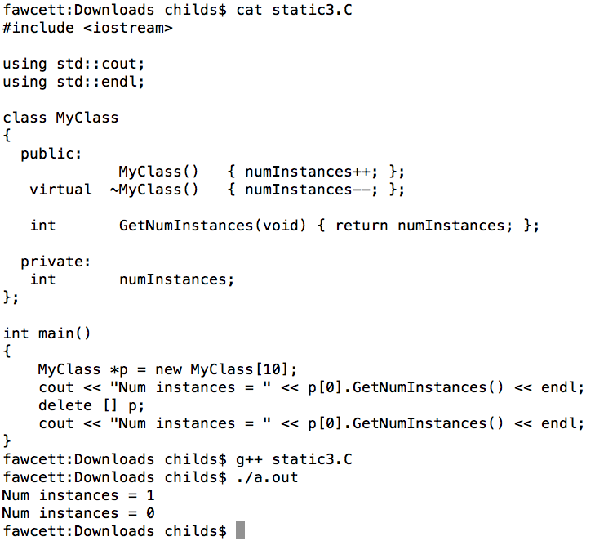
static usage #3: making a singleton for a class

Slide 83
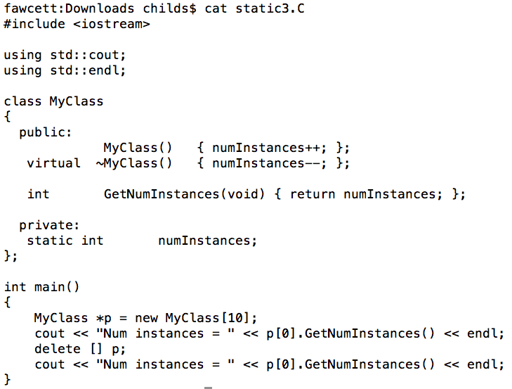
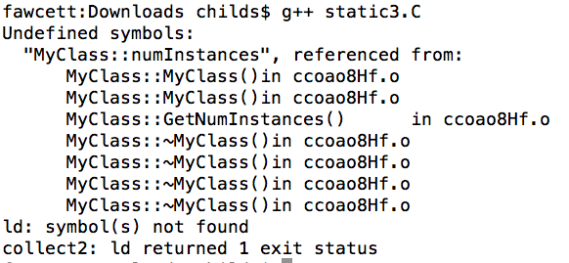
static usage #3: making a singleton for a class
We have to tell the compiler where to store this static.
What do we get?

Slide 84
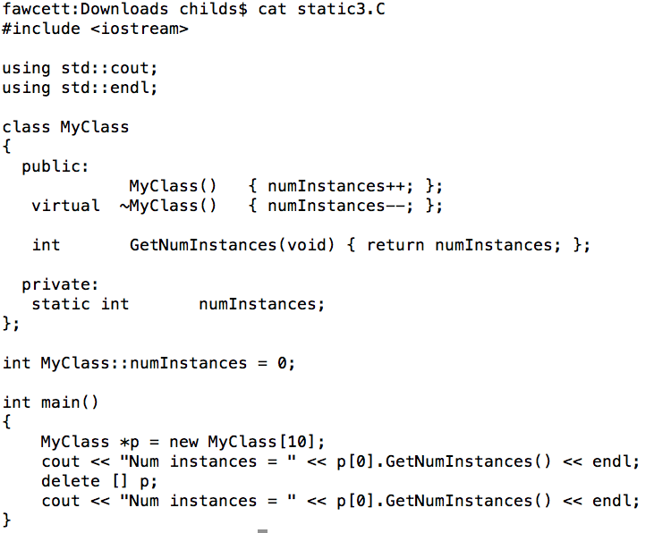
static usage #3: making a singleton for a class

Slide 85
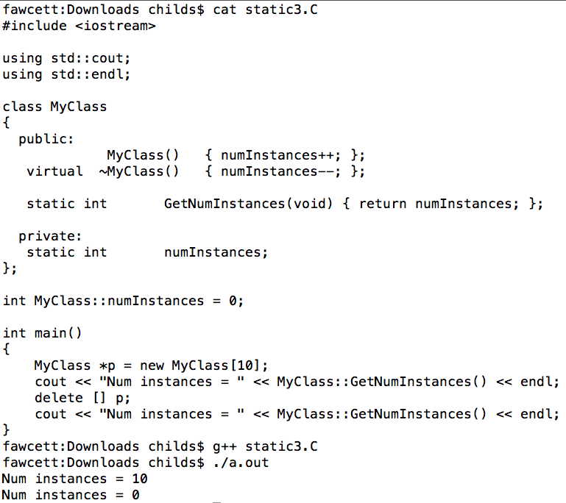
static methods
Static data members and static methods are useful and they are definitely used in practice

