Slide 1
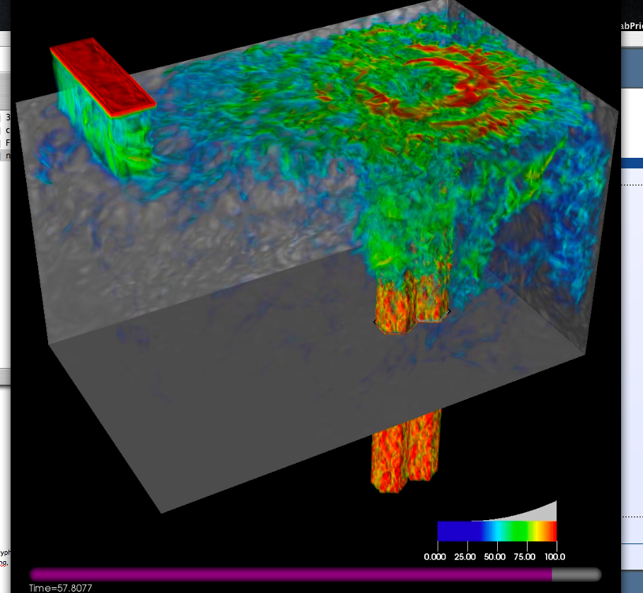
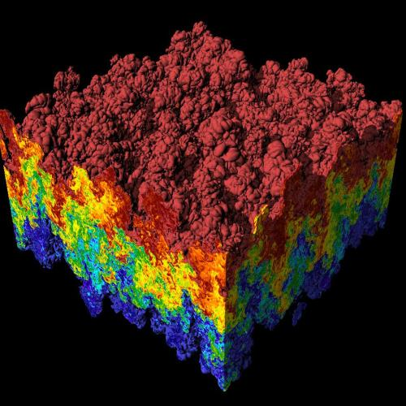
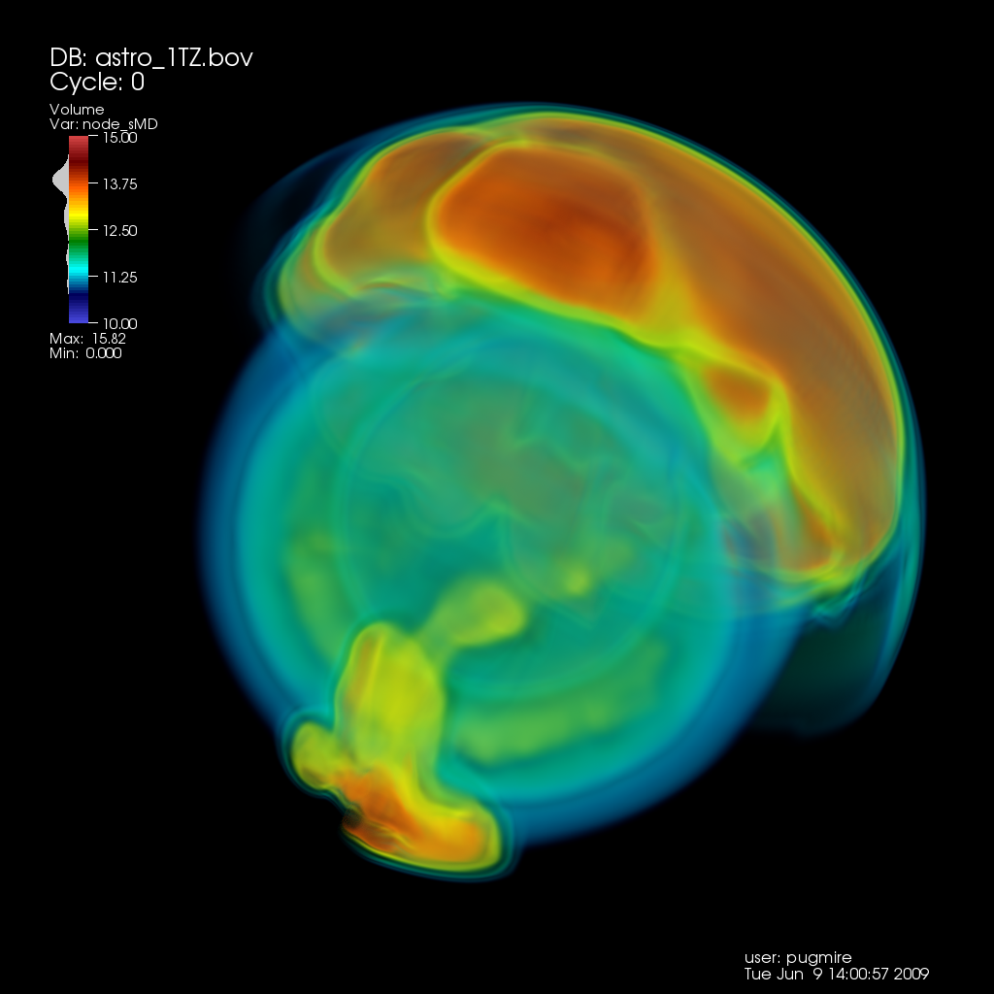
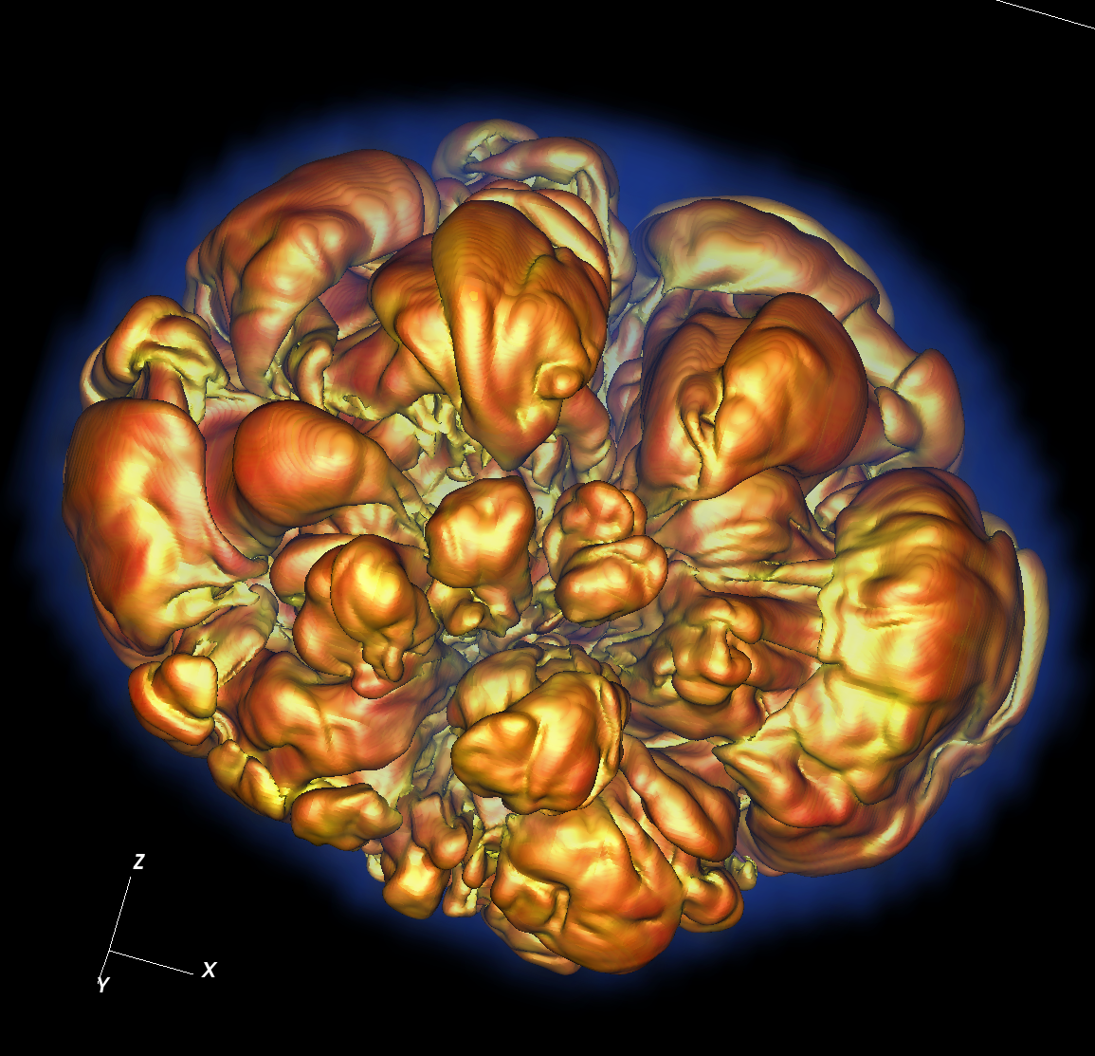
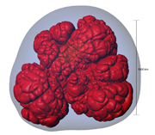
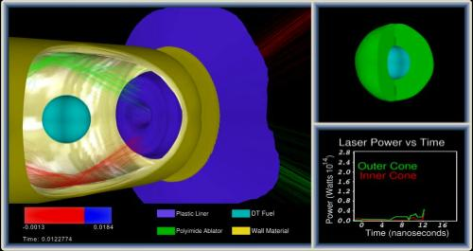
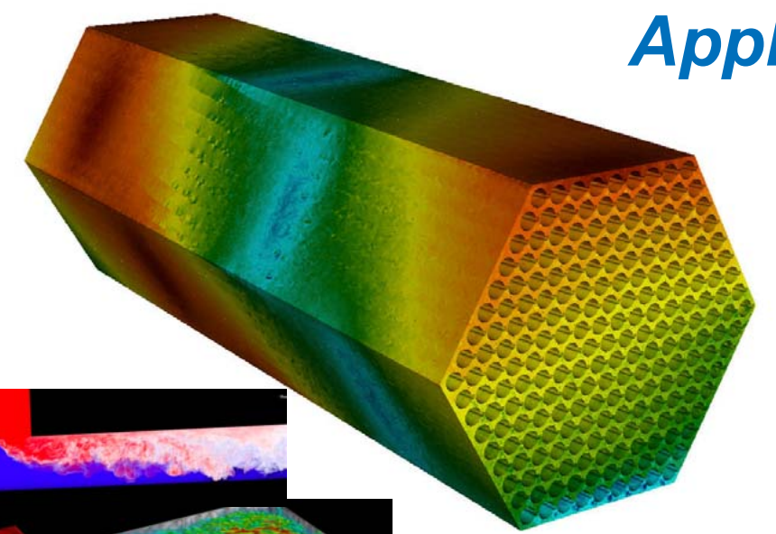
CIS 441/541: Intro to Computer Graphics Lecture 5: Cameras & Matrices, Project 1E
April 20, 2021
Hank Childs, University of Oregon

Slide 2
Midway Experience

Slide 3
Proposed Change to Syllabus/Quiz Structure

Slide 4
Thursday’s Lecture – Asynchronous (sort of)
Links are posted on class webpages to YouTube videos
These lectures are from last offering, but I rewatched them and they are still applicable
WARNING: the 1E overview video has the wrong due date – April 27th, 2021, not Feb 6th, 2019.
IMPORTANT: group discussion at 9am on Thursday

Slide 5
So What Do We Do On Thursday?
Watch YouTube videos before Thursday’s class
Call in at 9am on Thursday
Group discussion of any questions on cameras

Slide 6
Class Plan
Abhishek and I are working hard on preparing Project 2 (OpenGL)
Projects will start coming faster
Want there to time to do great final projects
1E, 1F: simpler coding, harder concepts

Slide 7
Current Plan (1/2)
Week | Sun | Mon | Tues | Weds | Thurs | Fri | Sat
4 |  |  | Lec5, 1E assigned | 1D due | Lec 6 (async / group chat)
5 |  |  | Lec 7 (shading), 1F assigned, 1E due |  | Lec 8 (GL), 2A assigned
6 |  | 1F due | Lec 9 (GL), 2B assigned |  | Discussion of final projects / Quiz 3 |  | 2A due
7 |  |  | Lec 11 – ray tracing |  | More discussion of final projects (?) | 2B due

Slide 8
Current Plan (2/2)
Weeks 8-10 → you work on final projects
Lectures will be on misc. topics in graphics, esp. in support of final projects
Quiz 3 (Week 6): likely on matrices
Quiz 4 (Week 8): likely on GL
Quiz 5 (Week 10): likely on topics in final weeks

Slide 9
Week 4 Office Hours

Slide 10
Cameras and Matrices
Note: I will be am repeating some of this content next this week.

Slide 11
Our goal
O
O
World space:
Triangles in native Cartesian coordinates
Camera located anywhere
Camera space:
Camera located at origin, looking down -Z
Triangle coordinates relative to camera frame
z
y
x
Image space:
All viewable objects within
-1 <= x,y,z <= +1
Screen space:
All viewable objects within
-1 <= x, y <= +1
Device space:
All viewable objects within
0<=x<=width, 0 <=y<=height

Slide 12
MATH!
Concepts coming:
Spaces
Basis
Coordinates
Frames
Matrices

Slide 13
MATH!
Concepts coming:
Spaces
Basis
Coordinates
Frames
Matrices

Slide 14
Space
A “space” is a set of points
Many types of spaces

Slide 15
Here is a space ‘S’: the points in the blue shape

Slide 16
We can pick an arbitrary point in S and call it our “origin.”
O

Slide 17
Consider two directions, D1 and D2.
D1
O
D2

Slide 18
Imagine you live at “O” and you want to get to “X.” Can you do it?
Rules (chess):
Bishop can only move diagonally
Rooks can only move in straight lines
X
D1
O
D2
Rules (this space):
You can only move in direction D1 or D2

Slide 19
Imagine you live at “O” and you want to get to “X.” Can you do it?
Rules (chess):
Bishop can only move diagonally
Rooks can only move in straight lines
X
D1
O
D2
Rules (this space):
You can only move in direction D1 or D2

Slide 20
Imagine you live at “O” and you want to get to “X.” Can you do it?
Rules (chess):
Bishop can only move diagonally
Rooks can only move in straight lines
X
D1
O
D2
Rules (this space):
You can only move in direction D1 or D2

Slide 21
Imagine you live at “O” and you want to get to “X.” Can you do it?
Rules (chess):
Bishop can only move diagonally
Rooks can only move in straight lines
X
D1
O
D2
Rules (this space):
You can only move in direction D1 or D2

Slide 22
Imagine you live at “O” and you want to get to “X2.” Can you do it?
Rules (chess):
Bishop can only move diagonally
Rooks can only move in straight lines
X2
D1
O
D2
Rules (this space):
You can only move in direction D1 or D2

Slide 23
Imagine you live at “O” and you want to get to “X2.” Can you do it?
Rules (chess):
Bishop can only move diagonally
Rooks can only move in straight lines
X2
D1
O
D2
Rules (this space):
You can only move in direction D1 or D2

Slide 24
Imagine you live at “O” and you want to get to “X3.” Can you do it?
Rules (chess):
Bishop can only move diagonally
Rooks can only move in straight lines
D1
O
X3
D2
Rules (this space):
You can only move in direction D1 or D2

Slide 25
Imagine you live at “O” and you want to get to “X4.” Can you do it?
Rules (chess):
Bishop can only move diagonally
Rooks can only move in straight lines
X4
D1
O
D2
Rules (this space):
You can only move in direction D1 or D2

Slide 26
Imagine you live at “O” and you want to get to “X4.” Can you do it?
Rules (chess):
Bishop can only move diagonally
Rooks can only move in straight lines
X4
D1
O
D2
Rules (this space):
You can only move in direction D1 or D2

Slide 27
Conventions!
Let (a, b) mean:
The number of steps ‘a’ in direction D1
The number of steps ‘b’ in direction D2

Slide 28
Where is (-3, 2)?
Rules (chess):
Bishop can only move diagonally
Rooks can only move in straight lines
D1
O
D2
Rules (this space):
You can only move in direction D1 or D2

Slide 29
MATH!
Concepts coming:
Spaces
Basis
Coordinates
Frames
Matrices

Slide 30
A basis
Paraphrasing Wikipedia:
Let B = { D1, D2 } (a set of two vectors, D1 & D2)
Let S be our Shape
B is a basis for S if every element of S can be written as a unique linear combination of elements of B.
The coefficients of this linear combination are referred to as components or coordinates on B of the vector.
The elements of a basis are called basis vectors.

Slide 31
Why unique?
Let (a, b, c) mean:
The number of steps ‘a’ in direction D1
The number of steps ‘b’ in direction D2
The number of steps ‘c’ in direction D3
Then there is more than one way to get to some point X in S, i.e.,
(a1, b1, c1) = X and
(a2, b2, c2) = X
D1
D3
D2

Slide 32
What does it mean to form a basis?
For any vector v, there are unique coordinates (c1, …, cn) such that
v = c1*v1 + c2*v2 + … + cn*vn
Consider some point P.
This point is relative to some origin O
There is a vector v such that O+v = P
We know we can construct v using a combination of vi’s
Therefore we can represent P using the coordinates (c1, c2, …, cn)

Slide 33
A basis
Paraphrasing Wikipedia:
Let B = { D1, D2 } (a set of two vectors, D1 & D2)
Let S be our Shape
B is a basis for S if every element of S can be written as a unique linear combination of elements of B.
The coefficients of this linear combination are referred to as components or coordinates on B of the vector.
The elements of a basis are called basis vectors.

Slide 34
Most common basis
D1 = X-axis (i.e., (1,0,0)-(0,0,0))
D2 = Y-axis (i.e., (0,1,0)-(0,0,0))
D3 = Z-axis (i.e., (0,0,1)-(0,0,0))
Then the coordinate (2, -3, 5) means
2 units along X-axis
-3 units along Y-axis
5 units along Z-axis

Slide 35
But we could have other bases
Instead of “basis 1” (B1)
D1 = X-axis (i.e., (1,0,0)-(0,0,0))
D2 = Y-axis (i.e., (0,1,0)-(0,0,0))
D3 = Z-axis (i.e., (0,0,1)-(0,0,0))
Use “basis 2” (B2)
D1 = Y-axis (i.e., (0,1,0)-(0,0,0))
D2 = X-axis (i.e., (1,0,0)-(0,0,0))
D3 = Z-axis (i.e., (0,0,1)-(0,0,0))
Then (a,b,c) in B1 is the same as (b,a,c) in B2

Slide 36
MATH!
Concepts coming:
Spaces
Basis
Coordinates
Frames
Matrices

Slide 37
Frames
Frame:
A way to place a coordinate system into a specific location in a space
Basis + reference coordinate (“the origin”)
Cartesian example: (3,4,6)
It is assumed that we are speaking in reference to the origin location (0,0,0).

Slide 38
Example of Frames
Frame F = (v1, v2, O)
v1 = (0, -1)
v2 = (1, 0)
O = (3, 4)
What are F’s coordinates for the point (6, 6)?

Slide 39
Example of Frames
Frame F = (v1, v2, O)
v1 = (0, -1)
v2 = (1, 0)
O = (3, 4)
What are F’s coordinates for the point (6, 6)?
Answer: (-2, 3)

Slide 40
Each box is a frame, and each arrow converts to the next frame
O
O
World space:
Triangles in native Cartesian coordinates
Camera located anywhere
Camera space:
Camera located at origin, looking down -Z
Triangle coordinates relative to camera frame
z
y
x
Image space:
All viewable objects within
-1 <= x,y,z <= +1
Screen space:
All viewable objects within
-1 <= x, y <= +1
Device space:
All viewable objects within
0<=x<=width, 0 <=y<=height

Slide 41
Context
Models stored in “world space” frame
Pick an origin, store all points relative to that origin
We have been rasterizing in “device space” frame
Our goal: transform from world space to device space
We will do this using matrix multiplications
Multiply point by matrix to convert coordinates from one frame into coordinates in another frame

Slide 42
(x1,y1,z1) → P1
(x2,y2,z2) → P2
(x3,y3,z3) → P3
(1 0 0)
(x1 y1 z1) X (0 1 0) = (x+dx y+dy 1)
(dx dy 1)

Slide 43
But wait! There’s more…
And matrices also useful for more than frame-to-frame conversions.
So let’s get comfy with matrices (next time).

Slide 44
THIS IS WHERE WE STOPPED LAST TIME

Slide 45
Matrix
Defined: a rectangular array of numbers (usually) arranged in rows and columns
Example
2D matrix
“two by three” (two rows, three columns)
[3 4 8]
[-1 9.2 12]

Slide 46
Matrix: wikipedia picture

Slide 47
Matrix
What do you do with matrices?
Lots of things
Transpose, invert, add, subtract
But most of all: multiply!

Slide 48
Multiplying two 2x2 matrices
(a b) (e f) (a*e+b*g a*f+b*h)
(c d) ^{X} (g h) ⁼ (c*e+d*g c*f+d*h)

Slide 49
Multiplying two 2x2 matrices
(a b) (e f) (a*e+b*g a*f+b*h)
^{X} (g h) ⁼
One usage for matrices:
Let (a, b) be the coordinates of a point
Then the 2x2 matrix can transform (a,b) to a
new location – (a*e+b*g, a*f+b*h)

Slide 50
Identity Matrix
(a b) (1 0) (a b)
^{X} (0 1) ⁼

Slide 51
(a b) (2 0) (2a b)
^{X} (0 1) ⁼
(a,b)
(2a,b)
Scale in X, not in Y

Slide 52
(a b) (s 0) (sa tb)
^{X} (0 t) ⁼
(a,b)
(sa,tb)
Scale in both dimensions

Slide 53
(a b) (0 -1) (b -a)
^{X} (1 0) ⁼
(a,b)
(b,-a)
Rotate 90 degrees clockwise

Slide 54
(a b) (0 1) (-b a)
^{X} (-1 0) ⁼
(a,b)
(-b, a)
Rotate 90 degrees counter-clockwise

Slide 55
(a b) (cos(Ω) -sin(Ω)) (cos(Ω)*a + sin(Ω)*b,
-sin(Ω)*a +cos(Ω)*b)
^{X} (sin(Ω) cos(Ω)) ⁼
(x’, y’)
(x,y)
Ω
Rotate “Ω” degrees counter-clockwise

Slide 56
Combining transformations
How do we rotate by 90 degrees clockwise and then scale X by 2?
Answer: multiply by matrix that multiplies by 90 degrees clockwise, then multiple by matrix that scales X by 2.
But can we do this efficiently?
(0 -1) (2 0) (0 -1)
(1 0) ^{X} (0 1) ⁼ (2 0)

Slide 57
Combining transformations
How do we scale X by 2 and then rotate by 90 degrees clockwise?
Answer: multiply by matrix that scales X by 2, then multiply by matrix that rotates 90 degrees clockwise.
(2 0) (0 -1) (0 -2)
(0 1) ^{X} (1 0) ⁼ (1 0)
(0 -1) (2 0) (0 -1)
(1 0) ^{X} (0 1) ⁼ (2 0)
Rotate then scale
Order matters!!

Slide 58
Translations
Translation is harder:
(a) (c) (a+c)
(b) ⁺ (d) ⁼ (b+d)
But this doesn’t fit our nice matrix multiply model…
What to do??

Slide 59
Homogeneous Coordinates
(1 0 0)
(x y 1) X (0 1 0) = (x y 1)
(0 0 1)
Add an extra dimension.
A math trick … don’t overthink it.

Slide 60
Homogeneous Coordinates
(1 0 0)
(x y 1) X (0 1 0) = (x+dx y+dy 1)
(dx dy 1)
Translation
We can now fit translation into
our matrix multiplication system.

Slide 61
Graphics
Two really important operations:
Transform from one frame to another
Transform geometry (rotate, translate, etc)
Both can be done with matrix operations
In both cases, need homogeneous coordinates
Much of graphics is accomplished via 4x4 matrices
And: you can compose the matrices and do bunches of things at once (EFFICIENCY)

Slide 63
3dfx Voodoo (source: wikipedia)

Slide 64
Early GPUs
Special hardware to do 4x4 matrix operations
A lot of them (in parallel)

Slide 65
GPUs now
Many, many, many cores
Each code less powerful than typical CPU core

Slide 66
STOP HERE – rest on YouTube
Look as a class

Slide 67
Our goal
O
O
World space:
Triangles in native Cartesian coordinates
Camera located anywhere
Camera space:
Camera located at origin, looking down -Z
Triangle coordinates relative to camera frame
z
y
x
Image space:
All viewable objects within
-1 <= x,y,z <= +1
Screen space:
All viewable objects within
-1 <= x, y <= +1
Device space:
All viewable objects within
0<=x<=width, 0 <=y<=height

Slide 68
World Space
World Space is the space defined by the user’s coordinate system.
This space contains the portion of the scene that is transformed into image space by the camera transform.
Many of the spaces have “bounds”, meaning limits on where the space is valid
With world space 2 options:
No bounds
User specifies the bound

Slide 69
Our goal
Camera Transform
O
O
World space:
Triangles in native Cartesian coordinates
Camera located anywhere
Camera space:
Camera located at origin, looking down -Z
Triangle coordinates relative to camera frame
z
y
x
Image space:
All viewable objects within
-1 <= x,y,z <= +1
Screen space:
All viewable objects within
-1 <= x, y <= +1
Device space:
All viewable objects within
0<=x<=width, 0 <=y<=height

Slide 70
Our goal
O
O
World space:
Triangles in native Cartesian coordinates
Camera located anywhere
Camera space:
Camera located at origin, looking down -Z
Triangle coordinates relative to camera frame
z
y
x
Image space:
All viewable objects within
-1 <= x,y,z <= +1
Screen space:
All viewable objects within
-1 <= x, y <= +1
Device space:
All viewable objects within
0<=x<=width, 0 <=y<=height

Slide 71
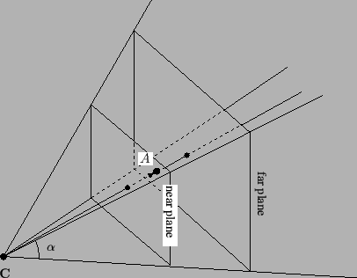
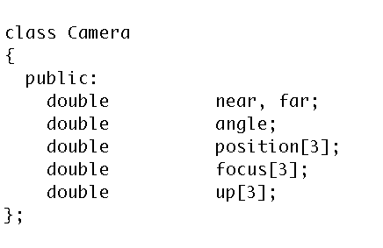
How do we specify a camera?
The “viewing pyramid” or
“view frustum”.
Frustum: In geometry, a frustum (plural: frusta or frustums) is the portion of a solid (normally a cone or pyramid) that lies between two parallel planes cutting it.

Slide 72
What is the up axis?
Up axis is the direction from the base of your nose to your forehead
Up

Slide 73
What is the up axis?
Up axis is the direction from the base of your nose to your forehead
Up
+
=

Slide 74
What is the up axis?
Up axis is the direction from the base of your nose to your forehead
(if you lie down while watching TV, the screen is sideways)
Up
+
=

Slide 75
Image Space Diagram
Up

Slide 76
Our goal
O
O
World space:
Triangles in native Cartesian coordinates
Camera located anywhere
Camera space:
Camera located at origin, looking down -Z
Triangle coordinates relative to camera frame
View Transform
z
y
x
Image space:
All viewable objects within
-1 <= x,y,z <= +1
Screen space:
All viewable objects within
-1 <= x, y <= +1
Device space:
All viewable objects within
0<=x<=width, 0 <=y<=height

Slide 77
Our goal
O
O
World space:
Triangles in native Cartesian coordinates
Camera located anywhere
Camera space:
Camera located at origin, looking down -Z
Triangle coordinates relative to camera frame
z
y
x
Image space:
All viewable objects within
-1 <= x,y,z <= +1
Screen space:
All viewable objects within
-1 <= x, y <= +1
Device space:
All viewable objects within
0<=x<=width, 0 <=y<=height

Slide 78
Image Space
Image Space is the three-dimensional coordinate system that contains screen space.
It is the space where the camera transformation directs its output.
The bounds of Image Space are 3-dimensional cube.
{(x,y,z) : −1≤x≤1,−1≤y≤1, −1≤z≤1}
(or −1≤z≤0)

Slide 79
Image Space Diagram
Up
Y=1
X = -1
Z = -1
Z=1
Y = -1
X=1

Slide 80
Our goal
O
O
World space:
Triangles in native Cartesian coordinates
Camera located anywhere
Camera space:
Camera located at origin, looking down -Z
Triangle coordinates relative to camera frame
z
y
x
Image space:
All viewable objects within
-1 <= x,y,z <= +1
Screen space:
All viewable objects within
-1 <= x, y <= +1
Device space:
All viewable objects within
0<=x<=width, 0 <=y<=height

Slide 81
Screen Space
Screen Space is the intersection of the xy-plane with Image Space.
Points in image space are mapped into screen space by projecting via a parallel projection, onto the plane z = 0 .
Example:
a point (0, 0, z) in image space will project to the center of the display screen

Slide 82
Screen Space Diagram
+1
Y
-1
-1
X
+1

Slide 83
Our goal
O
O
World space:
Triangles in native Cartesian coordinates
Camera located anywhere
Camera space:
Camera located at origin, looking down -Z
Triangle coordinates relative to camera frame
z
y
x
Image space:
All viewable objects within
-1 <= x,y,z <= +1
Screen space:
All viewable objects within
-1 <= x, y <= +1
Device space:
All viewable objects within
0<=x<=width, 0 <=y<=height

Slide 84
Device Space
Device Space is the lowest level coordinate system and is the closest to the hardware coordinate systems of the device itself.
Device space is usually defined to be the n × m array of pixels that represent the area of the screen.
A coordinate system is imposed on this space by labeling the lower-left-hand corner of the array as (0,0), with each pixel having unit length and width.

Slide 85
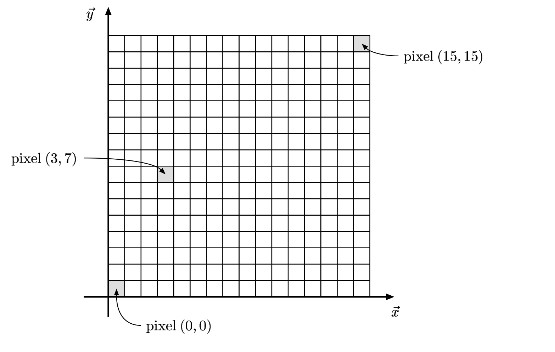
Device Space Example

Slide 86
Device Space With Depth Information
Extends Device Space to three dimensions by adding z-coordinate of image space.
Coordinates are (x, y, z) with
0 ≤ x ≤ n
0 ≤ y ≤ m
z arbitrary (but typically -1 ≤ z ≤ +1 or
-1 ≤ z ≤ 0 )

Slide 87
How do we transform?
For a camera C,
Calculate Camera Frame
From Camera Frame, calculate Camera Transform
Calculate View Transform
Calculate Device Transform
Compose 3 Matrices into 1 Matrix (M)
For each triangle T, apply M to each vertex of T, then apply rasterization/zbuffer
A
C
B

Slide 88
Easiest Transform
O
O
World space:
Triangles in native Cartesian coordinates
Camera located anywhere
Camera space:
Camera located at origin, looking down -Z
Triangle coordinates relative to camera frame
z
y
x
Image space:
All viewable objects within
-1 <= x,y,z <= +1
Screen space:
All viewable objects within
-1 <= x, y <= +1
Device space:
All viewable objects within
0<=x<=width, 0 <=y<=height

Slide 89
Image Space to Device Space
(x, y, z) → ( x’, y’, z’), where
x’ = n*(x+1)/2 = nx/2 + n/2
y’ = m*(y+1)/2 = my/2 + m/2
z’ = z = z
(for an n x m image)
Matrix:
(x y z 1) (n/2 0 0 0)
x (0 m/2 0 0)
(0 0 1 0)
(n/2 m/2 0 1)

Slide 90
More Math Prep
Note: Ken Joy’s graphics notes are fantastic
http://www.idav.ucdavis.edu/education/GraphicsNotes/homepage.html

Slide 91
What is the norm of a vector?
The norm of a vector is its length
Denoted with || . ||
For a vector A = (A.x, A.y),
||A|| = sqrt(A.x*A.x+A.y*A.y)
Physical interpretation:
For 3D, ||A|| = sqrt(A.x*A.x+A.y*A.y+A.z*A.z)
(A.x,A.y)
||A||
y
x

Slide 92
What does it means for a vector to be normalized?
The vector A is normalized if ||A|| = 1.
This is also called a unit vector.
To obtain a normalized vector, take A/||A||
Many of the operations we will discuss today will only work correctly with normalized vectors.
Example: A=(3,4,0). Then:
||A|| = 5
A/||A|| = (0.6, 0.8, 0)

Slide 93
What is a dot product?
A.B = A.x*B.x + A.y*B.y
(or A.x*B.x + A.y*B.y + A.z*B.z)
Physical interpretation:
A.B = cos(α)*(||A||*||B||)
B = (B.x, B.y)
A = (A.x,A.y)
α

Slide 94
What is the cross product?
AxB = (A.y*B.z - A.z*B.y,
B.x*A.z - A.x*B.z,
A.x*B.y - A.y*B.x)
What is the physical interpretation of a cross product?
Finds a vector perpendicular to both A and B.

Slide 95
Homogeneous Coordinates
Defined: a system of coordinates used in projective geometry, as Cartesian coordinates are used in Euclidean geometry
Primary uses:
4 × 4 matrices to represent general 3-dimensional transformations
it allows a simplified representation of mathematical functions – the rational form – in which rational polynomial functions can be simply represented
We only care about the first
I don’t really even know what the second use means

Slide 96
Interpretation of Homogeneous Coordinates
4D points: (x, y, z, w)
Our typical frame: (x, y, z, 1)

Slide 97
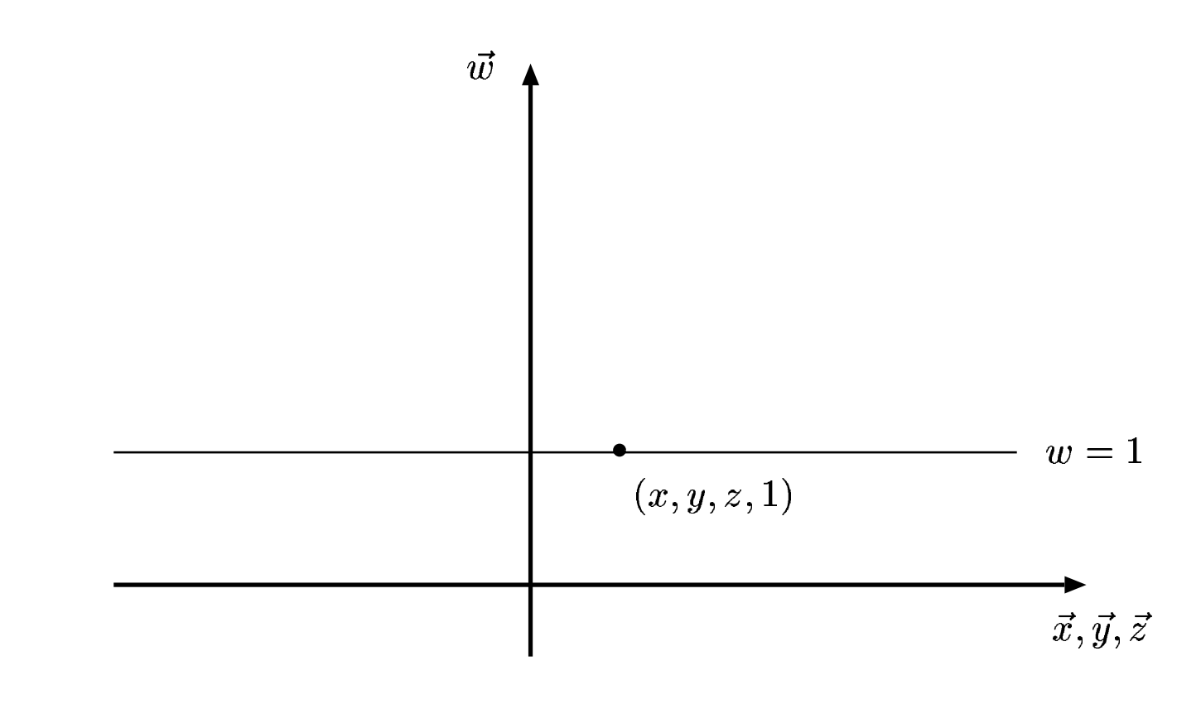
Interpretation of Homogeneous Coordinates
4D points: (x, y, z, w)
Our typical frame: (x, y, z, 1)
So how to treat points not along the w=1 line?
Our typical frame in the context of 4D points

Slide 98
Projecting back to w=1 line
Let P = (x, y, z, w) be a 4D point with w != 1
Goal: find P’ = (x’, y’, z’, 1) such P projects to P’
(We have to define what it means to project)
Idea for projection:
Draw line from P to origin.
If Q is along that line (and Q.w == 1), then Q is a projection of P

Slide 99
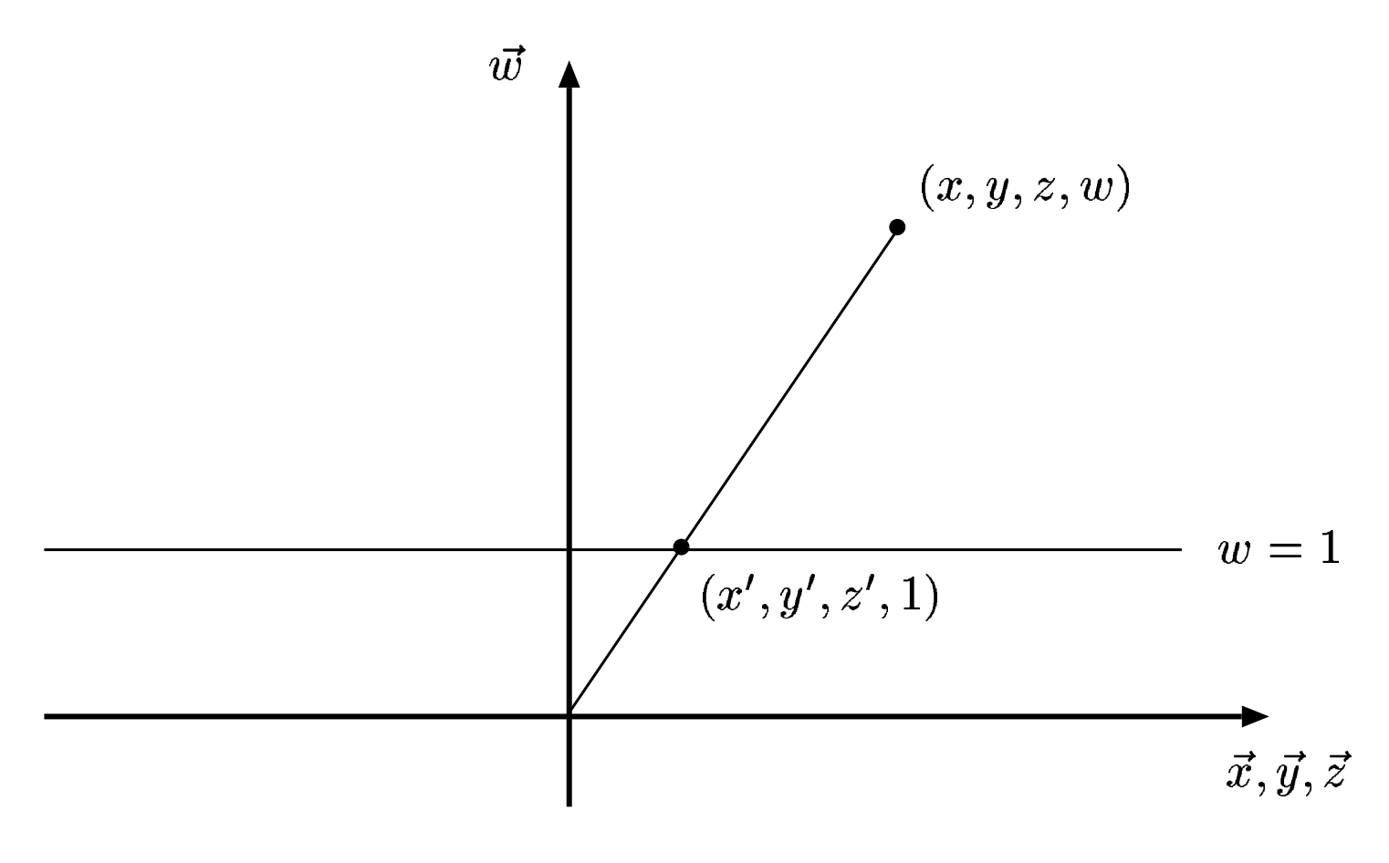
Projecting back to w==1 line
Idea for projection:
Draw line from P to origin.
If Q is along that line (and Q.w == 1), then Q is a projection of P

Slide 100
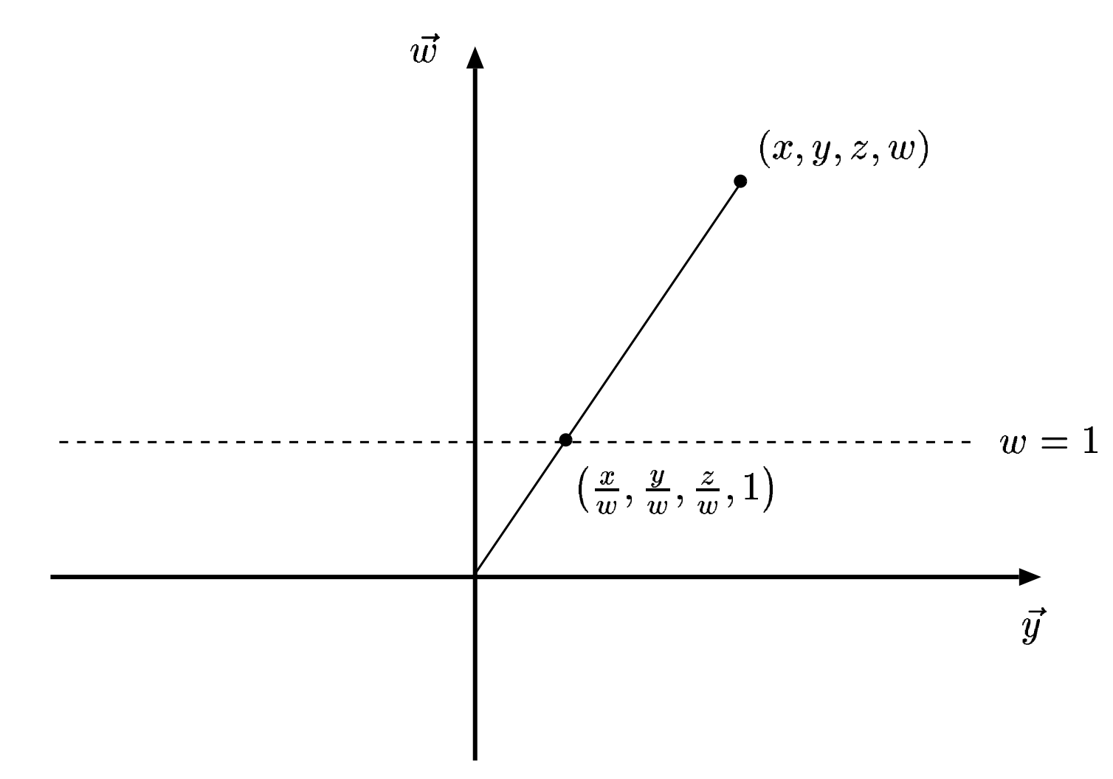
So what is Q?
Similar triangles argument:
x’ = x/w
y’ = y/w
z’ = z/w

Slide 101
Our goal
O
O
-Z
World space:
Triangles in native Cartesian coordinates
Camera located anywhere
Camera space:
Camera located at origin, looking down -Z
Triangle coordinates relative to camera frame
Need to construct a Camera Frame
Need to construct a matrix to transform points from Cartesian Frame to Camera Frame
Transform triangle by transforming its three vertices

Slide 102
Basis pt 2 (more linear algebra-y this time)
Camera frame must be a basis:
Spans space … can get any point through a linear combination of basis vectors
Every member must be linearly independent
→ we didn’t talk about this much on Thursday.
linearly independent means that no basis vector can be represented via others
Repeat slide (coming up) shows linearly *dependent* vectors

Slide 103
(REPEAT) Why unique?
Let (a, b, c) mean:
The number of steps ‘a’ in direction D1
The number of steps ‘b’ in direction D2
The number of steps ‘c’ in direction D3
Then there is more than one way to get to some point X in S, i.e.,
(a1, b1, c1) = X and
(a2, b2, c2) = X
D1
D3
D2

Slide 104
Camera frame construction
Must choose (u,v,w,O)
O = camera position
w = O-focus
Not “focus-O”, since we want to look down -Z
O
-Z
Camera space:
Camera located at origin, looking down -Z
Triangle coordinates relative to camera frame

Slide 105
Camera frame construction
Must choose (u,v,w,O)
O = camera position
w = O-focus
v = up
u = up x (O-focus)
O
-Z
Camera space:
Camera located at origin, looking down -Z
Triangle coordinates relative to camera frame

Slide 106
But wait … what if dot(v2,v3) != 0?
Up
O-focus
We can get around this with two cross products:
u = Up x (O-focus)
v = (O-focus) x u

Slide 107
Camera frame summarized
O = camera position
u = Up x (O-focus)
v = (O-focus) x u
w = O-focus
Important note: u, v, and w need to be normalized!

Slide 108
Our goal
O
O
-Z
World space:
Triangles in native Cartesian coordinates
Camera located anywhere
Camera space:
Camera located at origin, looking down -Z
Triangle coordinates relative to camera frame
Need to construct a Camera Frame ← ✔
Need to construct a matrix to transform points from Cartesian Frame to Camera Frame
Transform triangle by transforming its three vertices

Slide 109
This Will Come Up Later
Consider the meaning of Cartesian coordinates (x,y,z):
[x y z 1][<1,0,0>]
[<0,1,0>] = (x,y,z)
[<0,0,1>]
[(0,0,0)]

Slide 110
The Two Frames of the Camera Transform
Our two frames:
Cartesian:
<1,0,0>
<0,1,0>
<0,0,1>
(0,0,0)
Camera:
u = up x (O-focus)
v = (O-focus) x u
w = (O-focus)
O

Slide 111
The Two Frames of the Camera Transform
Our two frames:
Cartesian:
<1,0,0>
<0,1,0>
<0,0,1>
(0,0,0)
Camera:
u = up x (O-focus)
v = (O-focus) x u
w = (O-focus)
O
The “Camera Frame” is a Frame, so we can express any Cartesian vector as a combination of u, v, w.

Slide 112
Converting From Cartesian Frame To Camera Frame
The Cartesian vector <1,0,0> can be represented as some combination of the Camera Frame’s basis functions u, v, w:
<1,0,0> = e1,1 * u + e1,2 * v + e1,3 * w
So can the Cartesian vector <0,1,0>
<0,1,0> = e2,1 * u + e2,2 * v + e2,3 * w
So can the Cartesian vector <0,0,1>
<0,0,1> = e3,1 * u + e3,2 * v + e3,3 * w
So can the vector: Cartesian Frame origin – Camera Frame origin
(0,0,0) - O = e4,1 * u + e4,2 * v + e4,3 * w →
(0,0,0) = e4,1 * u + e4,2 * v + e4,3 * w + O

Slide 113
Putting Our Equations Into Matrix Form
<1,0,0> = e1,1 * u + e1,2 * v + e1,3 * w
<0,1,0> = e2,1 * u + e2,2 * v + e2,3 * w
<0,0,1> = e3,1 * u + e3,2 * v + e3,3 * w
(0,0,0) = e4,1 * u + e4,2 * v + e4,3 * w + O
→
[<1,0,0>] [e1,1 e1,2 e1,3 0] [u]
[<0,1,0>] [e2,1 e2,2 e2,3 0] [v]
[<0,0,1>] = [e3,1 e3,2 e3,3 0] [w]
(0,0,0) [e4,1 e4,2 e4,3 1] [O]

Slide 114
Here Comes The Trick…
Consider the meaning of Cartesian coordinates (x,y,z):
[x y z 1][<1,0,0>]
[<0,1,0>] = (x,y,z)
[<0,0,1>]
[(0,0,0)]
But:
[<1,0,0>] [e1,1 e1,2 e1,3 0] [u]
[<0,1,0>] [e2,1 e2,2 e2,3 0] [v]
[<0,0,1>] = [e3,1 e3,2 e3,3 0] [w]
(0,0,0) [e4,1 e4,2 e4,3 1] [O]

Slide 115
Here Comes The Trick…
But:
[<1,0,0>] [e1,1 e1,2 e1,3 0] [u]
[x y z 1][<0,1,0>] [x y z 1] [e2,1 e2,2 e2,3 0] [v]
[<0,0,1>] = [e3,1 e3,2 e3,3 0] [w]
[(0,0,0)] [e4,1 e4,2 e4,3 1] [O]
Coordinates of (x,y,z) with respect
to Cartesian frame.
Coordinates of (x,y,z) with respect
to Camera frame.
So this matrix is the camera transform!!

Slide 116
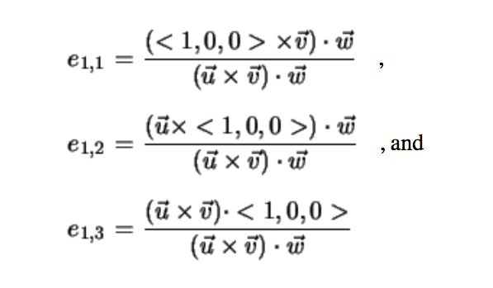
And Cramer’s Rule Can Solve This, For Example…
(u == v1, v == v2, w == v3 from previous slide)

Slide 117
Solving the Camera Transform
[e1,1 e1,2 e1,3 0] [u.x v.x w.x 0]
[e2,1 e2,2 e2,3 0] [u.y v.y w.y 0]
[e3,1 e3,2 e3,3 0] = [u.z v.z w.z 0]
[e4,1 e4,2 e4,3 1] [u.t v.t w.t 1]
Where t = (0,0,0)-O
How do we know?: Cramer’s Rule + simplifications
Want to derive?:
http://www.idav.ucdavis.edu/education/ GraphicsNotes/Camera-Transform/Camera- Transform.html

Slide 118
Our goal
O
O
World space:
Triangles in native Cartesian coordinates
Camera located anywhere
Camera space:
Camera located at origin, looking down -Z
Triangle coordinates relative to camera frame
View Transform
z
y
x
Image space:
All viewable objects within
-1 <= x,y,z <= +1
Screen space:
All viewable objects within
-1 <= x, y <= +1
Device space:
All viewable objects within
0<=x<=width, 0 <=y<=height

Slide 119
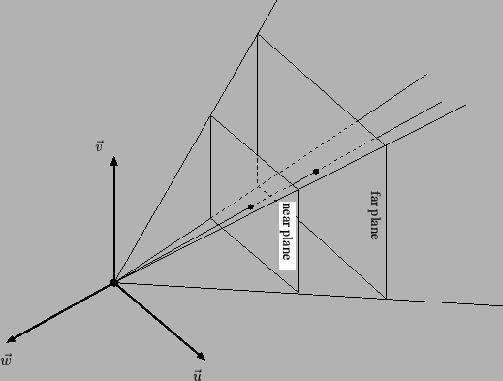
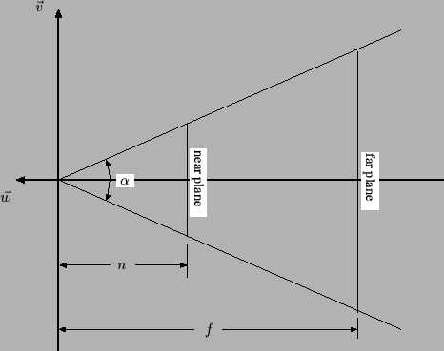

Slide 120
View Transformation
v = +1
v = -1
w = +1
w = -1
The viewing transformation is not a combination of simple translations, rotations, scales or shears: it is more complex.

Slide 121
Derivation of Viewing Transformation
I personally don’t think it is a good use of class time to derive this matrix.
Well derived at:
http://www.idav.ucdavis.edu/education/GraphicsNotes/Viewing-Transformation/Viewing-Transformation.html

Slide 122
The View Transformation
Input parameters: (α, n, f)
Transforms view frustum to image space cube
View frustum: bounded by viewing pyramid and planes z=-n and z=-f
Image space cube: -1 <= u,v,w <= 1
Cotangent = 1/tangent
[cot(α/2) 0 0 0]
[0 cot(α/2) 0 0]
[0 0 (f+n)/(f-n) -1]
[0 0 2fn/(f-n) 0]

Slide 123
Let’s do an example
Input parameters: (α, n, f) = (90, 5, 10)
f=10
n=5
α=90
[cot(α/2) 0 0 0]
[0 cot(α/2) 0 0]
[0 0 (f+n)/(f-n) -1]
[0 0 2fn/(f-n) 0]

Slide 124
Let’s do an example
Input parameters: (α, n, f) = (90, 5, 10)
f=10
n=5
α=90
[1 0 0 0]
[0 1 0 0]
[0 0 3 -1]
[0 0 20 0]

Slide 125
Let’s do an example
Input parameters: (α, n, f) = (90, 5, 10)
f=10
n=5
α=90
[1 0 0 0]
[0 1 0 0]
[0 0 3 -1]
[0 0 20 0]
Let’s multiply some points:
(0,7,-6,1)
(0,7,-8,1)

Slide 126
Let’s do an example
Input parameters: (α, n, f) = (90, 5, 10)
f=10
n=5
α=90
[1 0 0 0]
[0 1 0 0]
[0 0 3 -1]
[0 0 20 0]
Let’s multiply some points:
(0,7,-6,1) = (0,7,2,6) = (0, 1.16, 0.33)
(0,7,-8,1) = (0,7,-4,8) = (0, 0.88, -0.5)

Slide 127
Let’s do an example
Input parameters: (α, n, f) = (90, 5, 10)
f=10
n=5
α=90
[1 0 0 0]
[0 1 0 0]
[0 0 3 -1]
[0 0 20 0]
More points:
(0,7,-4,1) = (0,7,8,4) = (0, 1.75, 2)
(0,7,-5,1) = (0,7,5,5) = (0, 1.4, 1)
(0,7,-6,1) = (0,7,2,6) = (0, 1.16, 0.33)
(0,7,-8,1) = (0,7,-4,8) = (0, 0.88, -0.5)
(0,7,-10,1) = (0,7,-10,10) = (0, 0.7, -1)
(0,7,-11,1) = (0,7,-13,11) = (0, .63, -1.18)

Slide 128
View Transformation
v = +1
v = -1
w = +1
w = -1
The viewing transformation is not a combination of simple translations, rotations, scales or shears: it is more complex.

Slide 129
View Transformation
(0,1.75, 2)
(0,1.4, 1)
(0,1.16, 0.33)
v = +1
(0,0.88,-0.5)
(0,0.7,-1)
(0,0.63,-1.18)
v = -1
More points:
(0,7,-4,1) = (0,7,8,4) = (0, 1.75, 2)
(0,7,-5,1) = (0,7,5,5) = (0, 1.4, 1)
(0,7,-6,1) = (0,7,2,6) = (0, 1.16, 0.33)
(0,7,-8,1) = (0,7,-4,8) = (0, 0.88, -0.5)
(0,7,-10,1) = (0,7,-10,10) = (0, 0.7, -1)
(0,7,-11,1) = (0,7,-13,11) = (0, .63, -1.18)
w = +1
w = -1
Note there is a non-linear relationship in W (“Z”).

Slide 130
Putting It All Together

Slide 131
How do we transform?
For a camera C,
Calculate Camera Frame
From Camera Frame, calculate Camera Transform
Calculate View Transform
Calculate Device Transform
Compose 3 Matrices into 1 Matrix (M)
For each triangle T, apply M to each vertex of T, then apply rasterization/zbuffer

Slide 132
Project 1E

Slide 133
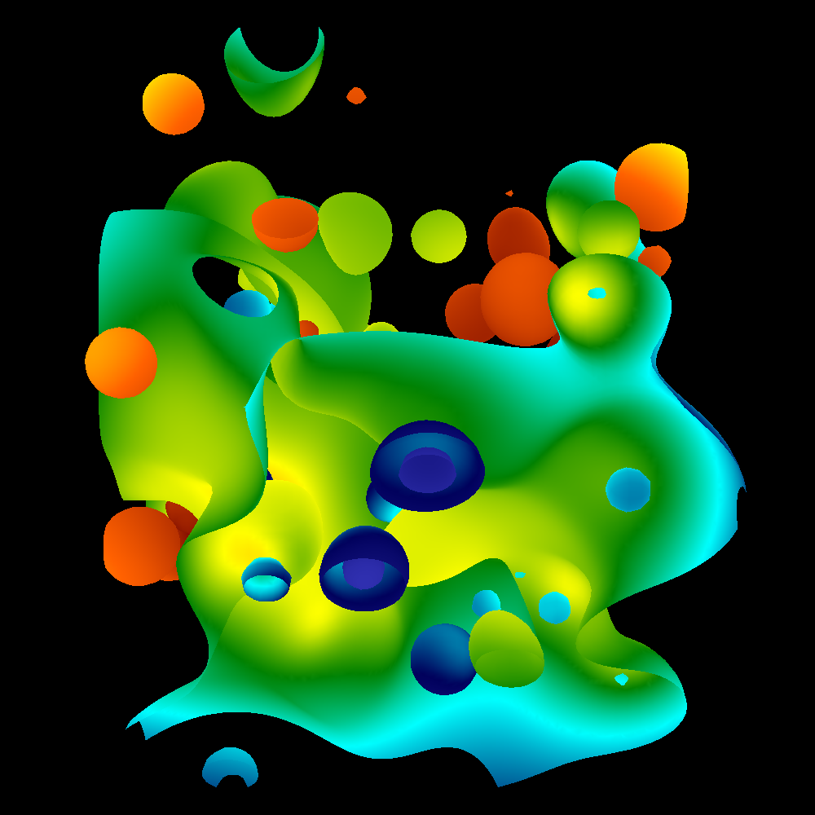
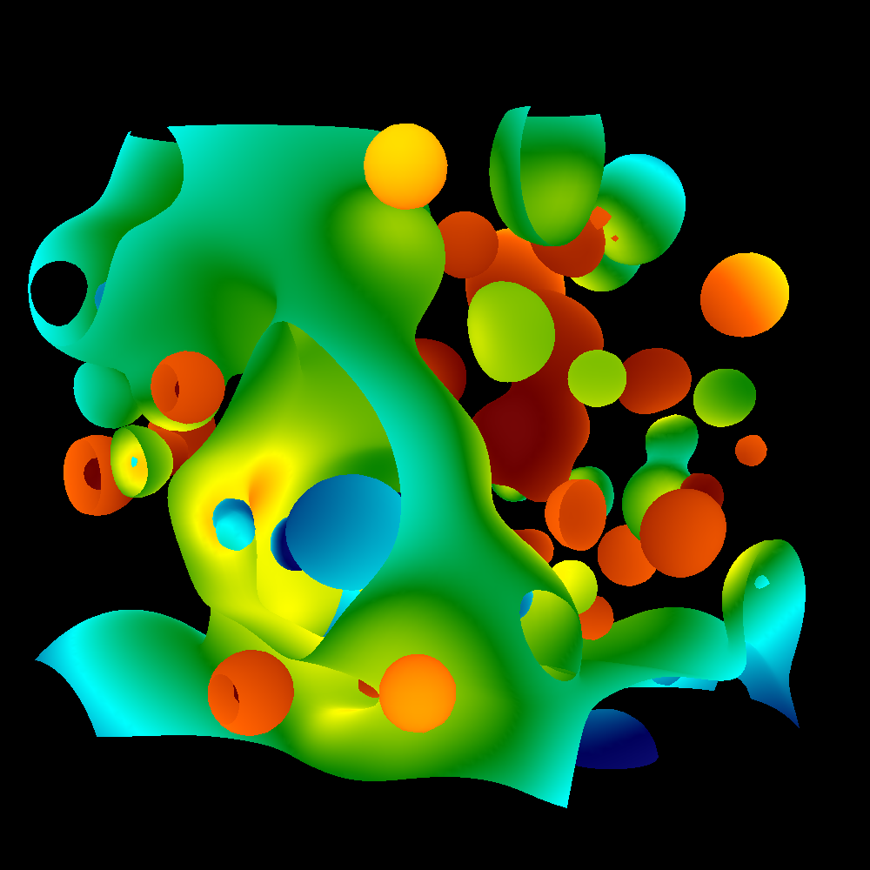
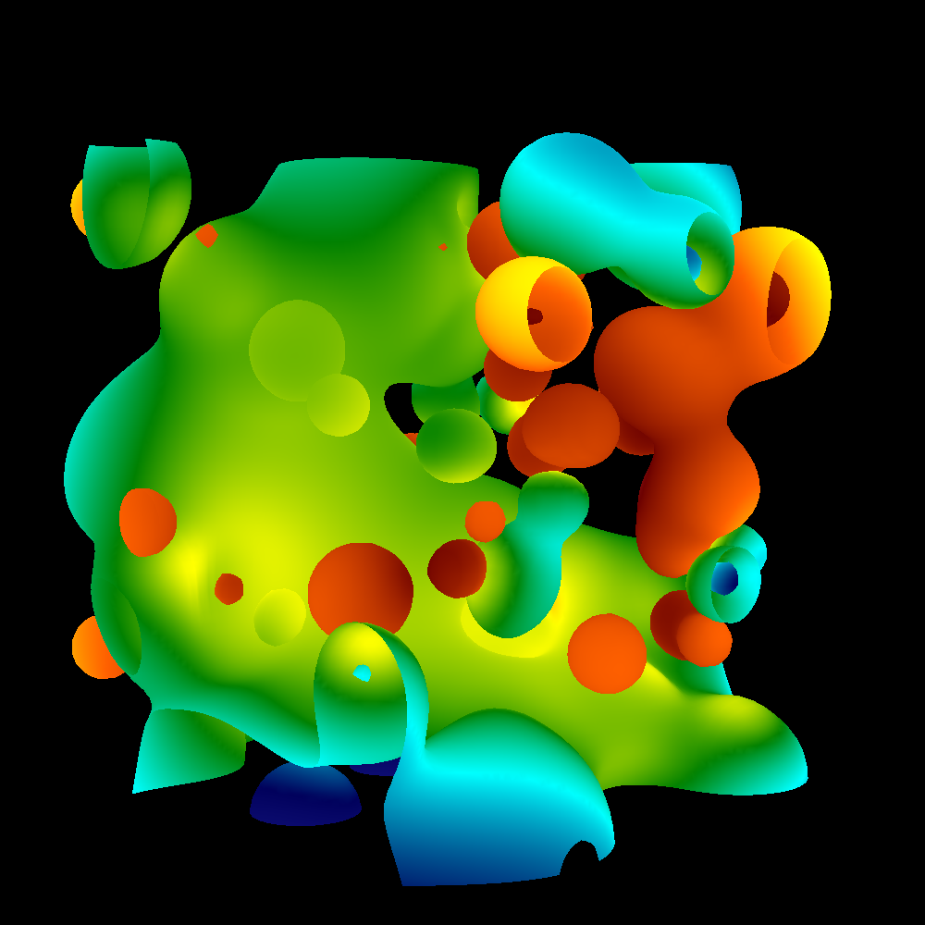
Project #1E (6%), Due Tues April 27th
Goal: add arbitrary camera positions
Extend your project1D code
New: proj1e_geometry.vtk available on web (9MB), “reader1e.cxx”.
New: Matrix.cxx, Camera.cxx
No Cmake, project1E.cxx

Slide 134
Project #1E, expanded
Matrix.cxx: complete
Methods:
class Matrix
{
public:
double A[4][4];
void TransformPoint(const double *ptIn, double *ptOut);
static Matrix ComposeMatrices(const Matrix &, const Matrix &);
void Print(ostream &o);
};

Slide 135
Project #1E, expanded
Camera.cxx: you work on this
class Camera
{
public:
double near, far;
double angle;
double position[3];
double focus[3];
double up[3];
Matrix ViewTransform(void) {;};
Matrix CameraTransform(void) {;};
Matrix DeviceTransform(void) {;};
// Will probably need something for calculating Camera Frame as well
};
Also: GetCamera(int frame, int nFrames)

Slide 136
Project #1E, deliverables
Same as usual, but times 4
4 images, corresponding to
GetCamera(0, 1000)
GetCamera(250,1000)
GetCamera(500,1000)
GetCamera(750,1000)
If you want:
Generate all thousand images, make a movie
Then you should wait for 1F. Then we will have shading too.

Slide 137
Project #1E, game plan
vector<Triangle> t = GetTriangles();
AllocateScreen();
for (int i = 0 ; i < 4 ; i++)
{ int f = 250*i;
InitializeScreen();
Camera c = GetCamera(f, 1000);
TransformTrianglesToDeviceSpace(); // involves setting up and applying matrices
//… if you modify vector<Triangle> t,
// remember to undo it later
RenderTriangles();
SaveImage();
}

Slide 138
Correct answers given for GetCamera(0, 1000)
Camera Frame: U = 0, 0.707107, -0.707107
Camera Frame: V = -0.816497, 0.408248, 0.408248
Camera Frame: W = 0.57735, 0.57735, 0.57735
Camera Frame: O = 40, 40, 40
Camera Transform
(0.0000000 -0.8164966 0.5773503 0.0000000)
(0.7071068 0.4082483 0.5773503 0.0000000)
(-0.7071068 0.4082483 0.5773503 0.0000000)
(0.0000000 0.0000000 -69.2820323 1.0000000)
View Transform
(3.7320508 0.0000000 0.0000000 0.0000000)
(0.0000000 3.7320508 0.0000000 0.0000000)
(0.0000000 0.0000000 1.0512821 -1.0000000)
(0.0000000 0.0000000 10.2564103 0.0000000)
Transformed 37.1132, 37.1132,37.1132, 1 to 0, 0,1
Transformed -75.4701, -75.4701,-75.4701, 1 to 0, 0,-1

Slide 139
Project #1E pitfalls
All vertex multiplications use 4D points. Make sure you send in 4D points for input and output, or you will get weird memory errors.
Make sure you divide by w.

Slide 140
Project #1E, pitfalls
People often get a matrix confused with its transpose. Use the method Matrix::Print() to make sure the matrix you are setting up is what you think it should be. Also, remember the points are left multiplied, not right multiplied.
Regarding multiple renderings:
Don’t forget to initialize the screen between each render
If you modify the triangle in place to render, don’t forget to switch it back at the end of the render

Slide 141
Project #1F (8%), Due Monday May 3rd
Goal: add shading, movie

