Slide 1
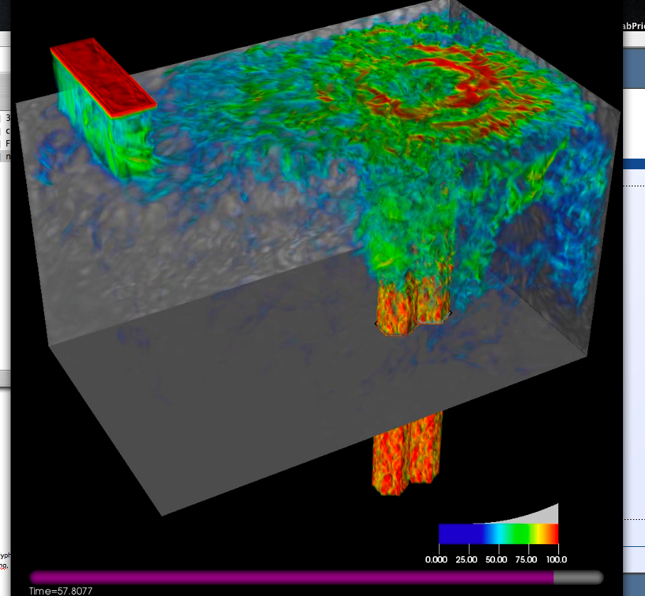
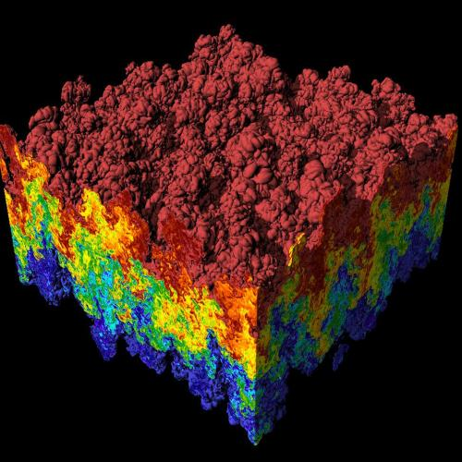
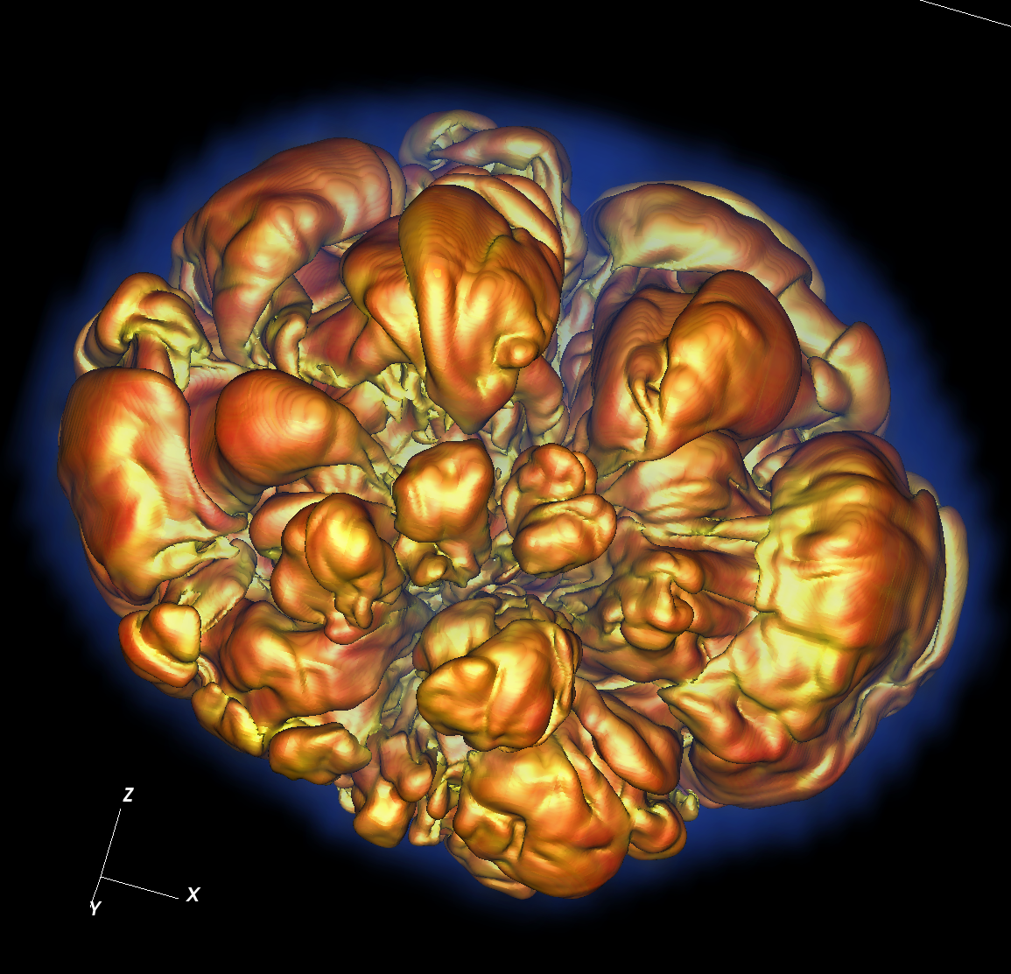
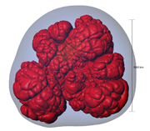
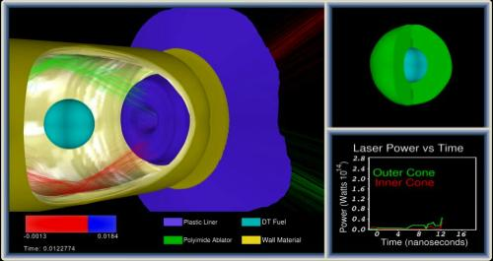
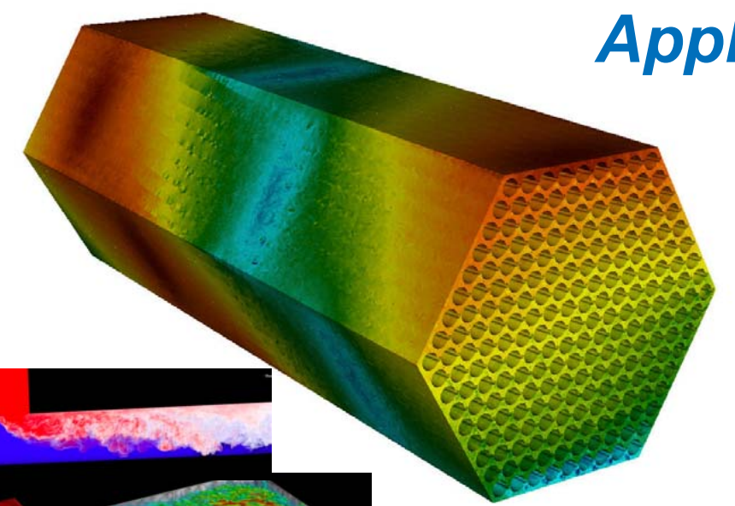
CIS 441/541: Intro to Computer Graphics Lecture 4: Z-Buffer, Project 1D, Cameras & Matrices
April 13, 2021
Hank Childs, University of Oregon

Slide 2
Class Thursday – Quiz #2
Starts at 9am
9am-915am: Q&A / group OH on topics related to project 1, graphics
915am-945am: quiz (be here at 910)
You must be present for these 30 minutes to take the quiz
If you cannot be present, you must (1) contact me by 12noon on Weds or (2) be in an emergency situation
Have a friend to text for internet issues
Know your UO ID
Have a camera
This “lecture” will not be recorded

Slide 3
Midway Experience

Slide 4
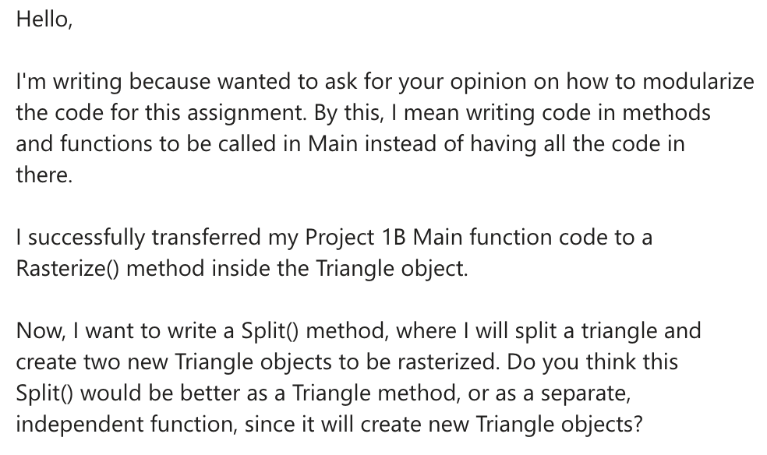
Question

Slide 5
Week 3 Office Hours

Slide 6
Feeling a little tired...

Slide 7
Where we are…
We haven’t talked about how to get triangles into position.
Arbitrary camera positions through linear algebra
We haven’t talked about shading
On Thursday, we tackled this problem:
How to deposit triangle colors onto an image?
Still don’t know how to:
Vary colors (easy)
Deal with triangles that overlap
Today’s lecture will go over the key operation to do #2. Last week was #1.

Slide 8
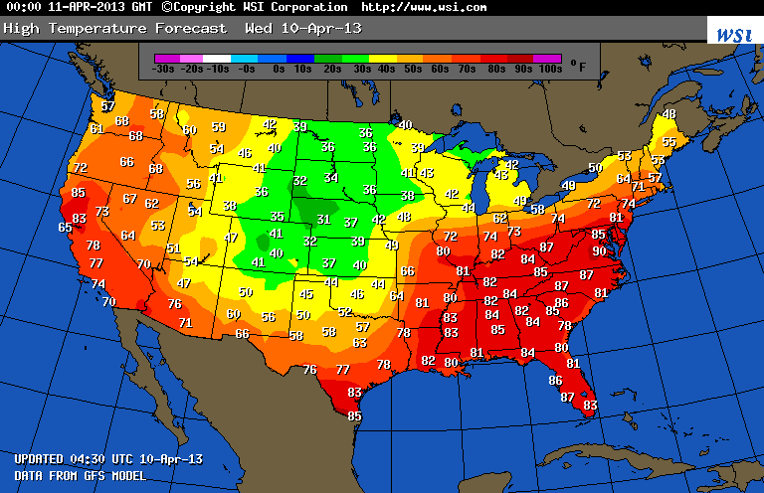
What is a field?
Example field (2D): temperature over the United States

Slide 9
Linear Interpolation for Scalar Field F
General equation to interpolate:
F(X) = F(A) + t*(F(B)-F(A))
t is proportion of X between A and B
t = (X-A)/(B-A)
F(A)
F(X)
F(B)
A
X
B

Slide 10
Consider a single scalar field defined on a triangle.
Y-axis
Y=1
Y=0.5
X-axis
Y=0
X=0
X=0.5
X=1
X=1.5
X=2

Slide 11
Consider a single scalar field defined on a triangle.
Y-axis
V2
Y=1
F(V2) = 2
Y=0.5
V1
V3
F(V1) = 10
F(V3) = -2
X-axis
Y=0
X=0
X=0.5
X=1
X=1.5
X=2

Slide 12
What is F(V4)?
Y-axis
V2
Y=1
F(V2) = 2
Y=0.5
V4, at (0.5, 0.25)
V1
V3
F(V1) = 10
F(V3) = -2
X-axis
Y=0
X=0
X=0.5
X=1
X=1.5
X=2

Slide 13
What is F(V4)?
Y-axis
V2
Y=1
F(V2) = 2
Y=0.5
V5
V4, at (0.5, 0.25)
V6
V1
V3
F(V1) = 10
F(V3) = -2
X-axis
Y=0
X=0
X=0.5
X=1
X=1.5
X=2

Slide 14
Steps to follow:
Calculate V5, the left intercept for Y=0.25
Calculate V6, the right intercept for Y=0.25
Calculate V4, which is between V5 and V6
Note: when you implement this, you will be doing vertical scanlines, so doing it for X=0.5

Slide 15
Online Lecture B
Link posted on class webpage.
Also: https://www.youtube.com/watch?v=8IkioJrMiSs

Slide 16
New Vocab Term: a “Fragment”
When rasterizing a triangle
When doing a scanline for that triangle
When that scanline finds a pixel to deposit colors for
→ that contribution is called a fragment

Slide 17
Now We Understand Interpolation Let’s Use It For Two New Ideas: Color Interpolation & Z-buffer Interpolation

Slide 18
How To Resolve When Triangles Overlap: The Z-Buffer

Slide 19
Imagine you have a cube where each face has its own color….
Face | Color
Front | Blue
Right | Green
Top | Red
Back | Yellow
Left | Purple
Bottom | Cyan
View from “front/top/right” side

Slide 20
Imagine you have a cube where each face has its own color….
How do we render the pixels that we want and ignore the pixels from faces that are obscured?
View from “front/top/right” side
View from “back/bottom/left” side

Slide 21
Consider a scene from the right side
Face | Color
Front | Blue
Right | Green
Top | Red
Back | Yellow
Left | Purple
Bottom | Cyan
Camera/eyeball
Camera oriented directly at Front face,
seen from the Right side

Slide 22
Consider the scene from the top side
Face | Color
Front | Blue
Right | Green
Top | Red
Back | Yellow
Left | Purple
Bottom | Cyan
Camera/eyeball
Camera oriented directly at Front face,
seen from the Top side

Slide 23
What do we render?
Green, Red, Purple, and Cyan all “flat” to camera. Only need to render Blue and Yellow faces (*).
Face | Color
Front | Blue
Right | Green
Top | Red
Back | Yellow
Left | Purple
Bottom | Cyan
Camera/eyeball
Camera oriented directly at Front face,
seen from the Top side

Slide 24
What do we render?
What should the picture look like?
What’s visible? What’s obscured?
Face | Color
Front | Blue
Right | Green
Top | Red
Back | Yellow
Left | Purple
Bottom | Cyan
Camera/eyeball
Camera oriented directly at Front face,
seen from the Top side

Slide 25
New field associated with each triangle: depth
Project 1B,1C:
class Triangle
{
public:
Double X[3];
Double Y[3];
…
};
Now…
Double Z[3];

Slide 26
What do we render?
Z=0
Z=-1
Face | Color
Front | Blue
Right | Green
Top | Red
Back | Yellow
Left | Purple
Bottom | Cyan
Camera/eyeball
Camera oriented directly at Front face,
seen from the Top side

Slide 27
Using depth when rendering
Use Z values to guide which geometry is displayed and which is obscured.
Example….

Slide 28
Consider 4 triangles with constant Z values
Z=-0.35
Z=-0.5
Z=-0.65
Z=-0.8

Slide 29
Consider 4 triangles with constant Z values
How do we make this picture?
Z=-0.35
Z=-0.5
Z=-0.65
Z=-0.8

Slide 30
Idea #1
Sort triangles “back to front” (based on Z)
Render triangles in back to front order
Overwrite existing pixels

Slide 31
Idea #2
Sort triangles “front to back” (based on Z)
Render triangles in front to back order
Do not overwrite existing pixels.

Slide 32
But there is a problem…
(0, 1, -0.4)
(0, 1.5, -0.4)
(-1, -1, -0.3)
(1, -1, -0.5)
(-2, -1.5, -0.5)
(2, -1.5, -0.3)

Slide 33
The Z-Buffer Algorithm
The preceding 10 slides were designed to get you comfortable with the notion of depth/Z.
The Z-Buffer algorithm is the way to deal with overlapping triangles when doing rasterization.
It is the technique that GPUs use.
It works with opaque triangles, but not transparent geometry, which requires special handling
Transparent geometry discussed week 7.
Uses the front-to-back or back-to-front sortings just discussed.

Slide 34
The Z-Buffer Algorithm: Data Structure
Existing: for every pixel, we store 3 bytes:
Red channel, green channel, blue channel
New: for every pixel, we store a floating point value:
Depth buffer (also called “Z value”)
Now 7 bytes per pixel (*)
(*): 8 with RGBA

Slide 35
The Z-Buffer Algorithm: Initialization
Existing:
For each pixel, set R/G/B to 0.
New:
For each pixel, set depth value to -1.
Valid depth values go from -1 (back) to 0 (front)
This is partly convention and partly because it “makes the math easy” when doing transformations.

Slide 36
Scanline algorithm for one triangle
Determine columns of pixels the triangle can possibly intersect
Call them columnMin to columnMax
columnMin: ceiling of smallest X value
columnMax: floor of biggest X value
For c in [columnMin → columnMax] ; do
Find end points of c intersected with triangle
Call them bottomEnd and topEnd
For r in [ceiling(bottomEnd) → floor(topEnd) ] ; do
ImageColor(r, c) ← triangle color

Slide 37
Scanline algorithm w/ Z-Buffer
Determine columns of pixels the triangle can possibly intersect
Call them columnMin to columnMax
columnMin: ceiling of smallest X value
columnMax: floor of biggest X value
For c in [columnMin → columnMax] ; do
Find end points of c intersected with triangle
Call them bottomEnd and topEnd
Interpolate z(bottomEnd) and z(topEnd) from triangle vertices
For r in [ceiling(bottomEnd) → floor(topEnd) ] ; do
Interpolate z(c,r) from z(bottomEnd) and z(topEnd)
If (z(c,r) > depthBuffer(c,r))
ImageColor(r, c) ← triangle color
depthBuffer(c,r) = z(c,r)

Slide 38
The Z-Buffer Algorithm: Example
X=5
(0,12)
(12,12)
(2.5,10.5, -0.25)
(2.5,2.5, -0.5)
(10.5,2.5, -1)
(0,0)
(12,0)

Slide 39
Interpolation and Triangles
We introduced the notion of interpolating a field on a triangle
We used the interpolation in two settings:
1) to interpolate colors
2) to interpolate depths for z-buffer algorithm
Project 1D: you will be adding color interpolation and the z-buffer algorithm to your programs.

Slide 40
Project #1D (5%), Due Weds April 21
Goal: interpolation of color and zbuffer
Extend your project1C code
File proj1d_geometry.vtk available on web (1.4MB)
File “reader1d.cxx” has code to read triangles from file.
No Cmake, project1d.cxx

Slide 41
Color is now floating-point
We will be interpolating colors, so please use floating point (0 → 1)
Keep colors in floating point until you assign them to a pixel
Fractional colors? → use ceil__441…
As in: ceil__441(value*255)

Slide 42
Changes to data structures
class Triangle
{
public:
double X[3], Y[3], Z[3];
double colors[3][3];
};
→ reader1d.cxx will not compile until you make these changes

Slide 43
Cameras and Matrices

Slide 44
Our goal
O
O
World space:
Triangles in native Cartesian coordinates
Camera located anywhere
Camera space:
Camera located at origin, looking down -Z
Triangle coordinates relative to camera frame
z
y
x
Image space:
All viewable objects within
-1 <= x,y,z <= +1
Screen space:
All viewable objects within
-1 <= x, y <= +1
Device space:
All viewable objects within
0<=x<=width, 0 <=y<=height

Slide 45
MATH!

Slide 46
Space
A “space” is a set of points
Many types of spaces

Slide 47
Here is a space ‘S’: the points in the blue shape

Slide 48
We can pick an arbitrary point in S and call it our “origin.”
O

Slide 49
Consider two directions, D1 and D2.
D1
O
D2

Slide 50
Imagine you live at “O” and you want to get to “X.” Can you do it?
Rules (chess):
Bishop can only move diagonally
Rooks can only move in straight lines
X
D1
O
D2
Rules (this space):
You can only move in direction D1 or D2

Slide 51
Imagine you live at “O” and you want to get to “X.” Can you do it?
Rules (chess):
Bishop can only move diagonally
Rooks can only move in straight lines
X
D1
O
D2
Rules (this space):
You can only move in direction D1 or D2

Slide 52
Imagine you live at “O” and you want to get to “X.” Can you do it?
Rules (chess):
Bishop can only move diagonally
Rooks can only move in straight lines
X
D1
O
D2
Rules (this space):
You can only move in direction D1 or D2

Slide 53
Imagine you live at “O” and you want to get to “X.” Can you do it?
Rules (chess):
Bishop can only move diagonally
Rooks can only move in straight lines
X
D1
O
D2
Rules (this space):
You can only move in direction D1 or D2

Slide 54
Imagine you live at “O” and you want to get to “X2.” Can you do it?
Rules (chess):
Bishop can only move diagonally
Rooks can only move in straight lines
X2
D1
O
D2
Rules (this space):
You can only move in direction D1 or D2

Slide 55
Imagine you live at “O” and you want to get to “X2.” Can you do it?
Rules (chess):
Bishop can only move diagonally
Rooks can only move in straight lines
X2
D1
O
D2
Rules (this space):
You can only move in direction D1 or D2

Slide 56
Imagine you live at “O” and you want to get to “X3.” Can you do it?
Rules (chess):
Bishop can only move diagonally
Rooks can only move in straight lines
D1
O
X3
D2
Rules (this space):
You can only move in direction D1 or D2

Slide 57
Imagine you live at “O” and you want to get to “X4.” Can you do it?
Rules (chess):
Bishop can only move diagonally
Rooks can only move in straight lines
X4
D1
O
D2
Rules (this space):
You can only move in direction D1 or D2

Slide 58
Imagine you live at “O” and you want to get to “X4.” Can you do it?
Rules (chess):
Bishop can only move diagonally
Rooks can only move in straight lines
X4
D1
O
D2
Rules (this space):
You can only move in direction D1 or D2

Slide 59
Conventions!
Let (a, b) mean:
The number of steps ‘a’ in direction D1
The number of steps ‘b’ in direction D2

Slide 60
Where is (-3, 2)?
Rules (chess):
Bishop can only move diagonally
Rooks can only move in straight lines
D1
O
D2
Rules (this space):
You can only move in direction D1 or D2

Slide 61
A basis
Paraphrasing Wikipedia:
Let B = { D1, D2 } (a set of two vectors, D1 & D2)
Let S be our Shape
B is a basis for S if every element of S can be written as a unique linear combination of elements of B.
The coefficients of this linear combination are referred to as components or coordinates on B of the vector.
The elements of a basis are called basis vectors.

Slide 62
Why unique?
Let (a, b, c) mean:
The number of steps ‘a’ in direction D1
The number of steps ‘b’ in direction D2
The number of steps ‘c’ in direction D3
Then there is more than one way to get to some point X in S, i.e.,
(a1, b1, c1) = X and
(a2, b2, c2) = X
D1
D3
D2

Slide 63
What does it mean to form a basis?
For any vector v, there are unique coordinates (c1, …, cn) such that
v = c1*v1 + c2*v2 + … + cn*vn
Consider some point P.
The basis has an origin O
There is a vector v such that O+v = P
We know we can construct v using a combination of vi’s
Therefore we can represent P in our frame using the coordinates (c1, c2, …, cn)

Slide 64
A basis
Paraphrasing Wikipedia:
Let B = { D1, D2 } (a set of two vectors, D1 & D2)
Let S be our Shape
B is a basis for S if every element of S can be written as a unique linear combination of elements of B.
The coefficients of this linear combination are referred to as components or coordinates on B of the vector.
The elements of a basis are called basis vectors.

Slide 65
Most common basis
D1 = X-axis (i.e., (1,0,0)-(0,0,0))
D2 = Y-axis (i.e., (0,1,0)-(0,0,0))
D3 = Z-axis (i.e., (0,0,1)-(0,0,0))
Then the coordinate (2, -3, 5) means
2 units along X-axis
-3 units along Y-axis
5 units along Z-axis

Slide 66
But we could have other bases
Instead of “basis 1” (B1)
D1 = X-axis (i.e., (1,0,0)-(0,0,0))
D2 = Y-axis (i.e., (0,1,0)-(0,0,0))
D3 = Z-axis (i.e., (0,0,1)-(0,0,0))
Use “basis 2” (B2)
D1 = Y-axis (i.e., (0,1,0)-(0,0,0))
D2 = X-axis (i.e., (1,0,0)-(0,0,0))
D3 = Z-axis (i.e., (0,0,1)-(0,0,0))
Then (a,b,c) in B1 is the same as (b,a,c) in B2

Slide 67
Last vocab term for a few slides: frame
Frame:
A way to place a coordinate system into a specific location in a space
Basis + reference coordinate (“the origin”)
Cartesian example: (3,4,6)
It is assumed that we are speaking in reference to the origin location (0,0,0).

Slide 68
Example of Frames
Frame F = (v1, v2, O)
v1 = (0, -1)
v2 = (1, 0)
O = (3, 4)
What are F’s coordinates for the point (6, 6)?

Slide 69
Example of Frames
Frame F = (v1, v2, O)
v1 = (0, -1)
v2 = (1, 0)
O = (3, 4)
What are F’s coordinates for the point (6, 6)?
Answer: (-2, 3)

Slide 70
Each box is a frame, and each arrow converts to the next frame
O
O
World space:
Triangles in native Cartesian coordinates
Camera located anywhere
Camera space:
Camera located at origin, looking down -Z
Triangle coordinates relative to camera frame
z
y
x
Image space:
All viewable objects within
-1 <= x,y,z <= +1
Screen space:
All viewable objects within
-1 <= x, y <= +1
Device space:
All viewable objects within
0<=x<=width, 0 <=y<=height

Slide 71
Context
Models stored in “world space” frame
Pick an origin, store all points relative to that origin
We have been rasterizing in “device space” frame
Our goal: transform from world space to device space
We will do this using matrix multiplications
Multiply point by matrix to convert coordinates from one frame into coordinates in another frame

Slide 72
But wait! There’s more…
And matrices also useful for more than frame-to-frame conversions.
So let’s get comfy with matrices (next time).

Slide 73
STOP HERE

Slide 74
Matrix
Defined: a rectangular array of numbers (usually) arranged in rows and columns
Example
2D matrix
“two by three” (two rows, three columns)
[3 4 8]
[-1 9.2 12]

Slide 75
Matrix: wikipedia picture

Slide 76
Matrix
What do you do with matrices?
Lots of things
Transpose, invert, add, subtract
But most of all: multiply!

Slide 77
Multiplying two 2x2 matrices
(a b) (e f) (a*e+b*g a*f+b*h)
(c d) ^{X} (g h) ⁼ (c*e+d*g c*f+d*h)

Slide 78
Multiplying two 2x2 matrices
(a b) (e f) (a*e+b*g a*f+b*h)
^{X} (g h) ⁼
One usage for matrices:
Let (a, b) be the coordinates of a point
Then the 2x2 matrix can transform (a,b) to a
new location – (a*e+b*g, a*f+b*h)

Slide 79
Identity Matrix
(a b) (1 0) (a b)
^{X} (0 1) ⁼

Slide 80
(a b) (2 0) (2a b)
^{X} (0 1) ⁼
(a,b)
(2a,b)
Scale in X, not in Y

Slide 81
(a b) (s 0) (sa tb)
^{X} (0 t) ⁼
(a,b)
(sa,t)
Scale in both dimensions

Slide 82
(a b) (0 -1) (b -a)
^{X} (1 0) ⁼
(a,b)
(b,-a)
Rotate 90 degrees counter-clockwise

Slide 83
(a b) (0 1) (-b a)
^{X} (-1 0) ⁼
(a,b)
(-b, a)
Rotate 90 degrees counter-clockwise

Slide 84
(a b) (cos(Ω) -sin(Ω)) (cos(Ω)*a + sin(Ω)*b,
-sin(Ω)*a +cos(Ω)*b)
^{X} (sin(Ω) cos(Ω)) ⁼
(x’, y’)
(x,y)
Ω
Rotate “Ω” degrees counter-clockwise

Slide 85
Combining transformations
How do we rotate by 90 degrees clockwise and then scale X by 2?
Answer: multiply by matrix that multiplies by 90 degrees clockwise, then multiple by matrix that scales X by 2.
But can we do this efficiently?
(0 -1) (2 0) (0 -1)
(1 0) ^{X} (0 1) ⁼ (2 0)

Slide 86
Combining transformations
How do we scale X by 2 and then rotate by 90 degrees clockwise?
Answer: multiply by matrix that scales X by 2, then multiply by matrix that rotates 90 degrees clockwise.
(2 0) (0 -1) (0 -2)
(0 1) ^{X} (1 0) ⁼ (1 0)
(0 -1) (2 0) (0 -1)
(1 0) ^{X} (0 1) ⁼ (2 0)
Rotate then scale
Order matters!!

Slide 87
Translations
Translation is harder:
(a) (c) (a+c)
(b) ⁺ (d) ⁼ (b+d)
But this doesn’t fit our nice matrix multiply model…
What to do??

Slide 88
Homogeneous Coordinates
(1 0 0)
(x y 1) X (0 1 0) = (x y 1)
(0 0 1)
Add an extra dimension.
A math trick … don’t overthink it.

Slide 89
Homogeneous Coordinates
(1 0 0)
(x y 1) X (0 1 0) = (x+dx y+dy 1)
(dx dy 1)
Translation
We can now fit translation into
our matrix multiplication system.

Slide 90
Graphics
Two really important operations:
Transform from one frame to another
Transform geometry (rotate, translate, etc)
Both can be done with matrix operations
In both cases, need homogeneous coordinates
Much of graphics is accomplished via 4x4 matrices
And: you can compose the matrices and do bunches of things at once (EFFICIENCY)

Slide 92
3dfx Voodoo (source: wikipedia)

Slide 93
Early GPUs
Special hardware to do 4x4 matrix operations
A lot of them (in parallel)

Slide 94
GPUs now
Many, many, many cores
Each code less powerful than typical CPU core

Slide 95
Our goal
O
O
World space:
Triangles in native Cartesian coordinates
Camera located anywhere
Camera space:
Camera located at origin, looking down -Z
Triangle coordinates relative to camera frame
z
y
x
Image space:
All viewable objects within
-1 <= x,y,z <= +1
Screen space:
All viewable objects within
-1 <= x, y <= +1
Device space:
All viewable objects within
0<=x<=width, 0 <=y<=height

Slide 96
World Space
World Space is the space defined by the user’s coordinate system.
This space contains the portion of the scene that is transformed into image space by the camera transform.
Many of the spaces have “bounds”, meaning limits on where the space is valid
With world space 2 options:
No bounds
User specifies the bound

Slide 97
Our goal
Camera Transform
O
O
World space:
Triangles in native Cartesian coordinates
Camera located anywhere
Camera space:
Camera located at origin, looking down -Z
Triangle coordinates relative to camera frame
z
y
x
Image space:
All viewable objects within
-1 <= x,y,z <= +1
Screen space:
All viewable objects within
-1 <= x, y <= +1
Device space:
All viewable objects within
0<=x<=width, 0 <=y<=height

Slide 98
Our goal
O
O
World space:
Triangles in native Cartesian coordinates
Camera located anywhere
Camera space:
Camera located at origin, looking down -Z
Triangle coordinates relative to camera frame
z
y
x
Image space:
All viewable objects within
-1 <= x,y,z <= +1
Screen space:
All viewable objects within
-1 <= x, y <= +1
Device space:
All viewable objects within
0<=x<=width, 0 <=y<=height

Slide 99
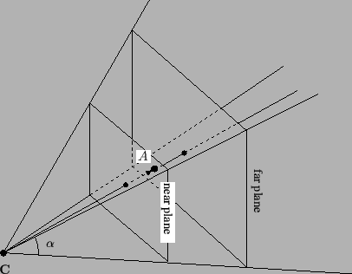
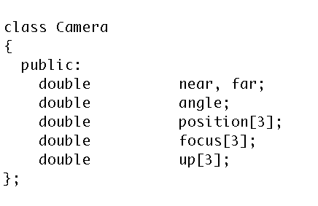
How do we specify a camera?
The “viewing pyramid” or
“view frustum”.
Frustum: In geometry, a frustum (plural: frusta or frustums) is the portion of a solid (normally a cone or pyramid) that lies between two parallel planes cutting it.

Slide 100
Our goal
O
O
World space:
Triangles in native Cartesian coordinates
Camera located anywhere
Camera space:
Camera located at origin, looking down -Z
Triangle coordinates relative to camera frame
View Transform
z
y
x
Image space:
All viewable objects within
-1 <= x,y,z <= +1
Screen space:
All viewable objects within
-1 <= x, y <= +1
Device space:
All viewable objects within
0<=x<=width, 0 <=y<=height

Slide 101
Our goal
O
O
World space:
Triangles in native Cartesian coordinates
Camera located anywhere
Camera space:
Camera located at origin, looking down -Z
Triangle coordinates relative to camera frame
z
y
x
Image space:
All viewable objects within
-1 <= x,y,z <= +1
Screen space:
All viewable objects within
-1 <= x, y <= +1
Device space:
All viewable objects within
0<=x<=width, 0 <=y<=height

Slide 102
Image Space
Image Space is the three-dimensional coordinate system that contains screen space.
It is the space where the camera transformation directs its output.
The bounds of Image Space are 3-dimensional cube.
{(x,y,z) : −1≤x≤1,−1≤y≤1, −1≤z≤1}
(or −1≤z≤0)

Slide 103
Image Space Diagram
Up
Y=1
X = -1
Z = -1
Z=1
Y = -1
X=1

Slide 104
Our goal
O
O
World space:
Triangles in native Cartesian coordinates
Camera located anywhere
Camera space:
Camera located at origin, looking down -Z
Triangle coordinates relative to camera frame
z
y
x
Image space:
All viewable objects within
-1 <= x,y,z <= +1
Screen space:
All viewable objects within
-1 <= x, y <= +1
Device space:
All viewable objects within
0<=x<=width, 0 <=y<=height

Slide 105
Screen Space
Screen Space is the intersection of the xy-plane with Image Space.
Points in image space are mapped into screen space by projecting via a parallel projection, onto the plane z = 0 .
Example:
a point (0, 0, z) in image space will project to the center of the display screen

Slide 106
Screen Space Diagram
+1
Y
-1
-1
X
+1

Slide 107
Our goal
O
O
World space:
Triangles in native Cartesian coordinates
Camera located anywhere
Camera space:
Camera located at origin, looking down -Z
Triangle coordinates relative to camera frame
z
y
x
Image space:
All viewable objects within
-1 <= x,y,z <= +1
Screen space:
All viewable objects within
-1 <= x, y <= +1
Device space:
All viewable objects within
0<=x<=width, 0 <=y<=height

Slide 108
Device Space
Device Space is the lowest level coordinate system and is the closest to the hardware coordinate systems of the device itself.
Device space is usually defined to be the n × m array of pixels that represent the area of the screen.
A coordinate system is imposed on this space by labeling the lower-left-hand corner of the array as (0,0), with each pixel having unit length and width.

Slide 109
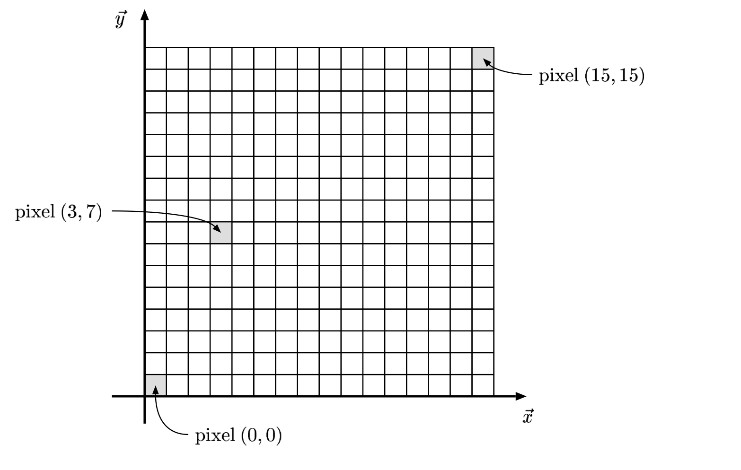
Device Space Example

Slide 110
Device Space With Depth Information
Extends Device Space to three dimensions by adding z-coordinate of image space.
Coordinates are (x, y, z) with
0 ≤ x ≤ n
0 ≤ y ≤ m
z arbitrary (but typically -1 ≤ z ≤ +1 or
-1 ≤ z ≤ 0 )

Slide 111
Easiest Transform
O
O
World space:
Triangles in native Cartesian coordinates
Camera located anywhere
Camera space:
Camera located at origin, looking down -Z
Triangle coordinates relative to camera frame
z
y
x
Image space:
All viewable objects within
-1 <= x,y,z <= +1
Screen space:
All viewable objects within
-1 <= x, y <= +1
Device space:
All viewable objects within
0<=x<=width, 0 <=y<=height

Slide 112
Image Space to Device Space
(x, y, z) → ( x’, y’, z’), where
x’ = n*(x+1)/2
y’ = m*(y+1)/2
z’ = z
(for an n x m image)
Matrix:
(x’ 0 0 0)
(0 y’ 0 0)
(0 0 z’ 0)
(0 0 0 1)

Slide 113
Coming Up on YouTube Lecture
O
O
-Z
World space:
Triangles in native Cartesian coordinates
Camera located anywhere
Camera space:
Camera located at origin, looking down -Z
Triangle coordinates relative to camera frame
Need to construct a Camera Frame
Need to construct a matrix to transform points from Cartesian Frame to Camera Frame
Transform triangle by transforming its three vertices

