Slide 1
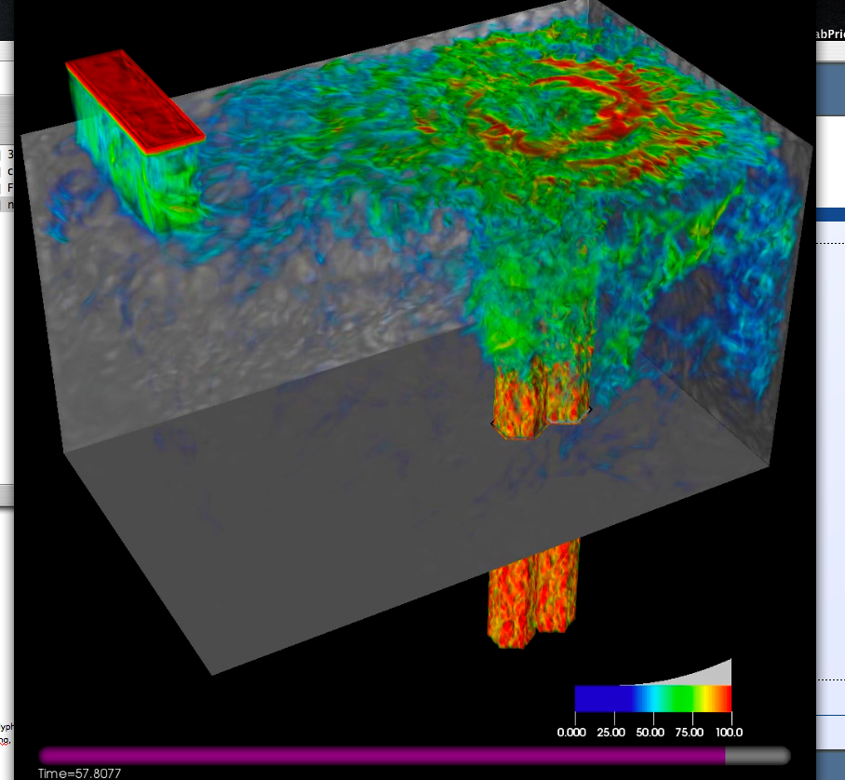
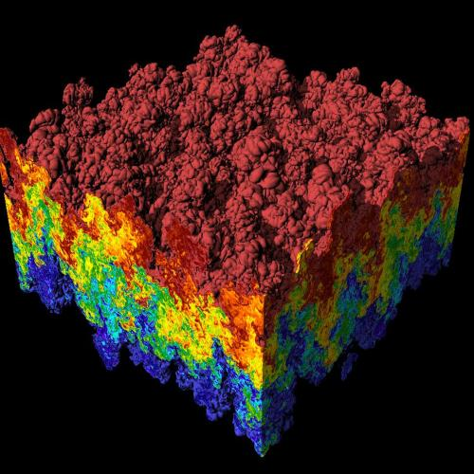
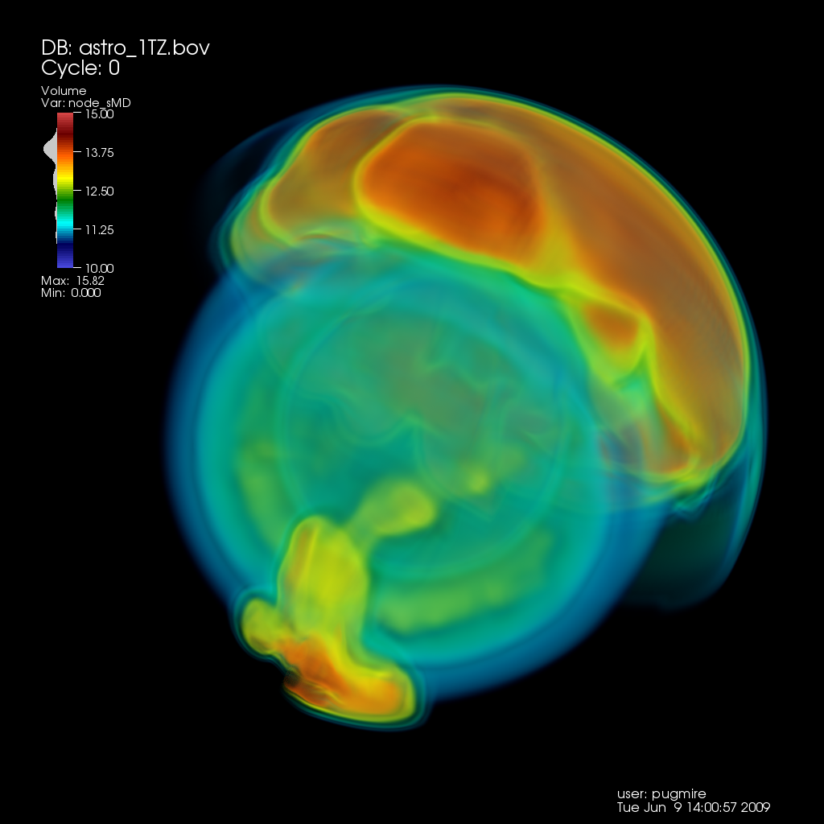
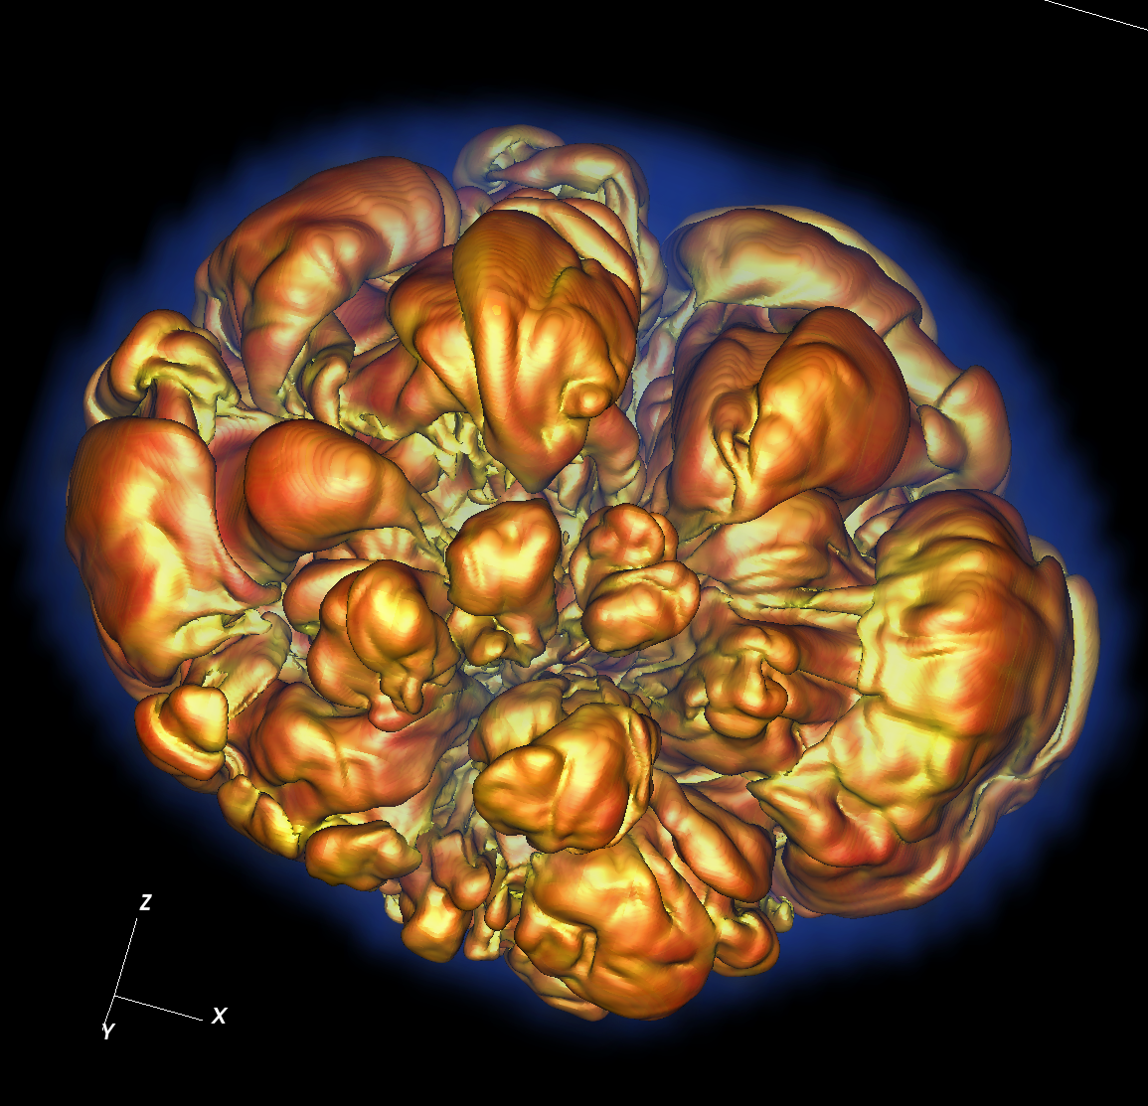
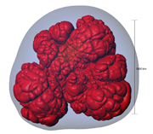
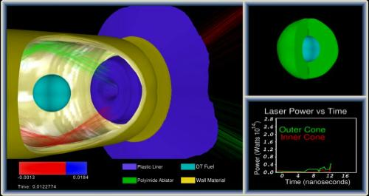
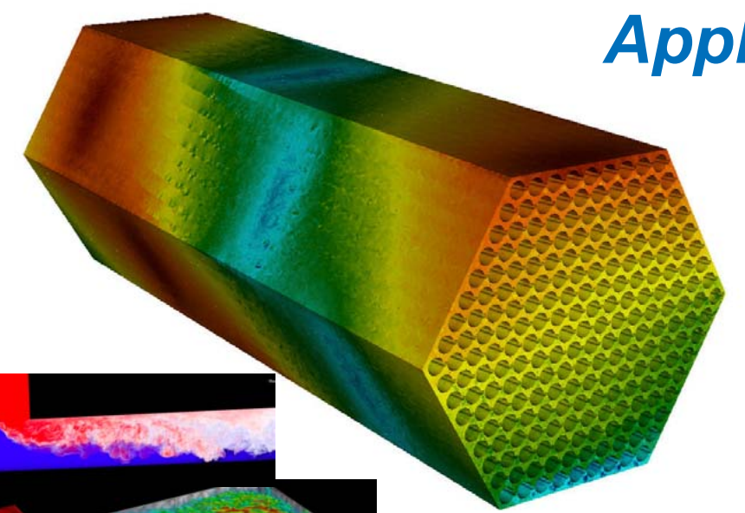
CIS 441/541: Intro to Computer Graphics Lecture 3: Interpolation
April 6, 2021
Hank Childs, University of Oregon

Slide 2
Class Thursday
Starts at 9am
9am-930am: Q&A / group OH on topics related to project 1, graphics
930am-940am: quiz
You must be present for these 10 minutes to take the quiz
If you cannot be present, you must (1) contact me by 12noon on Weds or (2) be in an emergency situation
Still determining how to make custom quizzes – know your UO ID
This “lecture” will not be recorded

Slide 3
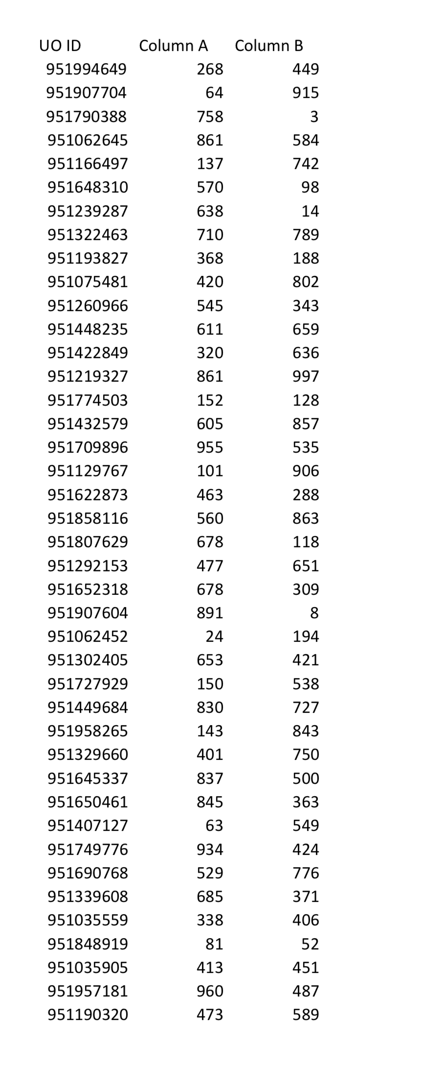
Let’s do a practice quiz
Note: all of these UO IDs are fake

Slide 4
Virtual Delivery is Changing How This Class is Delivered
Despite my best efforts, I have done a lot of repetition in previous offerings
In this setting, repeating myself seems like a waste of your time
Borderline disrespectful
We will figure this issue out as we go
Positive aspect: I was already considering using Thursdays in non-lecture format

Slide 5
May Have Too Much Lecture Today
We will get as far as we can

Slide 6
Week 2 Office Hours

Slide 7
Quick Review

Slide 8
What Are We Rendering?
Models made up of polygons
Usually triangles
Lighting tricks make surfaces look non-faceted
More on this later…

Slide 9
NEW Slide
Multiple coordinate spaces
“World space”
Specify an origin and locations with respect to that origin
(x,y,z)
“Screen space”
Everything relative to pixels on the screen
Triangle vertex (10.5, 20.5) lies in pixel (10, 20)

Slide 10
NEW Slide
Later, we will figure out how to:
Define a camera position
Transform triangle vertices from world space to screen space
Currently: assuming the transform has happened, and operating on triangle vertices already in screen space

Slide 11
These are REPEAT slides I traditionally have repeated this lecture (although quickly)

Slide 12
Project #1B (due tomorrow): Questions?
Goal: apply the scanline algorithm to “going right” triangles and output an image
File “project1B.cxx” has triangles defined in it
Due: Weds April 7
% of grade: 3%

Slide 13
Arbitrary Triangles
The description of the scanline algorithm in the preceding slides is general.
But the implementation for these three triangles vary:

Slide 14
Arbitrary Triangles
Project #1B: implement the scanline algorithm for “going right” triangles
Project #1C: arbitrary triangles

Slide 15
Arbitrary Triangles
Function: RasterizeGoingRightTriangle
(You have this from 1B)
Function: RasterizeGoingLeftTriangle
(You can write this by modifying RasterizeGoingRightTriangle)
Function: RasterizeArbitraryTriangle
Split into two triangles
Call RasterizeGoingRightTriangle and RasterizeGoingLeftTriangle

Slide 16
Project #1C (6%), Due (April 14th)
Goal: apply the scanline algorithm to arbitrary triangles and output an image.
Extend your project1B code
File proj1c_geometry.vtk available on web (80MB)
File “reader.cxx” has code to read triangles from file.
No Cmake, project1c.cxx
POSTED SOON

Slide 17
Where we are…
We haven’t talked about how to get triangles into position.
Arbitrary camera positions through linear algebra
We haven’t talked about shading
On Thursday, we tackled this problem:
How to deposit triangle colors onto an image?
Still don’t know how to:
Vary colors (easy)
Deal with triangles that overlap
Today’s lecture will go over the key operation to do these two.

Slide 18
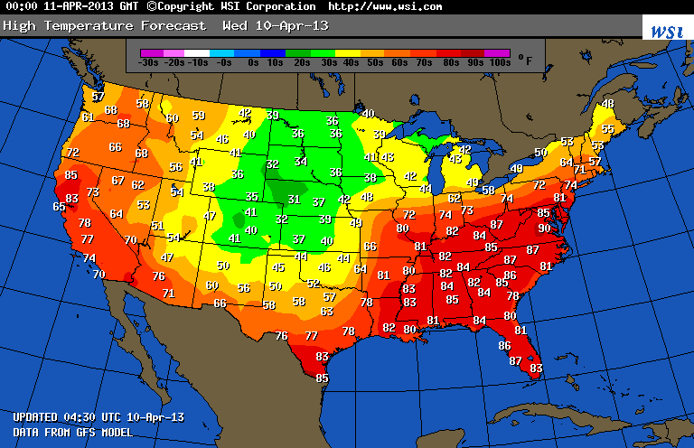
What is a field?
Example field (2D): temperature over the United States

Slide 19
How much data is needed to make this picture?
Example field (2D): temperature over the United States

Slide 20
Linear Interpolation for Scalar Field F
F(A)
F(X)
F(B)
A
X
B

Slide 21
Linear Interpolation for Scalar Field F
General equation to interpolate:
F(X) = F(A) + t*(F(B)-F(A))
t is proportion of X between A and B
t = (X-A)/(B-A)
F(A)
F(X)
F(B)
A
X
B

Slide 22
Quiz Time
F(3) = 5, F(6) = 11
What is F(4)?
= 5 + (4-3)/(6-3)*(11-5) = 7
General equation to interpolate:
F(X) = F(A) + t*(F(B)-F(A))
t is proportion of X between A and B
t = (X-A)/(B-A)

Slide 23
Consider a single scalar field defined on a triangle.
Y-axis
Y=1
Y=0.5
X-axis
Y=0
X=0
X=0.5
X=1
X=1.5
X=2

Slide 24
Consider a single scalar field defined on a triangle.
Y-axis
V2
Y=1
F(V2) = 2
Y=0.5
V1
V3
F(V1) = 10
F(V3) = -2
X-axis
Y=0
X=0
X=0.5
X=1
X=1.5
X=2

Slide 25
What is F(V4)?
Y-axis
V2
Y=1
F(V2) = 2
Y=0.5
V4, at (0.5, 0.25)
V1
V3
F(V1) = 10
F(V3) = -2
X-axis
Y=0
X=0
X=0.5
X=1
X=1.5
X=2

Slide 26
What is F(V4)?
Y-axis
V2
Y=1
F(V2) = 2
Y=0.5
V5
V4, at (0.5, 0.25)
V6
V1
V3
F(V1) = 10
F(V3) = -2
X-axis
Y=0
X=0
X=0.5
X=1
X=1.5
X=2

Slide 27
Steps to follow:
Calculate V5, the left intercept for Y=0.25
Calculate V6, the right intercept for Y=0.25
Calculate V4, which is between V5 and V6
Note: when you implement this, you will be doing vertical scanlines, so doing it for X=0.5

Slide 28
What is the X-location of V5?
Y-axis
V2
Y=1
F(V2) = 2
F(v1) = A → F(0) = 0
F(v2) = B → F(1) = 1
F(v) = A + ((v-v1)/(v2-v1))*(B-A):
F(v) = 0.25, find v
0.25 = 0 + ((v-0)/(1-0)*(1-0)
v = 0.25
Y=0.5
V5
V4, at (0.5, 0.25)
V6
V1
V3
F(V1) = 10
F(V3) = -2
X-axis
Y=0
X=0
X=0.5
X=1
X=1.5
X=2

Slide 29
What is the F-value of V5?
Y-axis
V2
Y=1
F(V2) = 2
F(v1) = A → F(0) = 10
F(v2) = B → F(1) = 2
F(v) = A + ((v-v1)/(v2-v1))*(B-A):
v = 0.25, find F(v)
F(v) = 10 + ((0.25-0)/(1-0))*(2-10)
= 10 + 0.25*-8 = 10 -2 = 8
Y=0.5
V5
V4, at (0.5, 0.25)
V6
V1
V3
F(V1) = 10
F(V3) = -2
X-axis
Y=0
X=0
X=0.5
X=1
X=1.5
X=2

Slide 30
What is the X-location of V6?
Y-axis
V2
Y=1
F(V2) = 2
F(v1) = A → F(1) = 1
F(v2) = B → F(2) = 0
F(v) = A + ((v-v1)/(v2-v1))*(B-A):
F(v) = 0.25, find v
0.25 = 1 + ((v-1)/(2-1)*(0-1)
= 1 + (v-1)*(-1)
0.25 = 2 - v
v = 1.75
Y=0.5
V5
V4, at (0.5, 0.25)
V6
V1
V3
F(V1) = 10
F(V3) = -2
X-axis
Y=0
X=0
X=0.5
X=1
X=1.5
X=2

Slide 31
What is the F-value of V6?
Y-axis
V2
Y=1
F(V2) = 2
F(v1) = A → F(1) = 2
F(v2) = B → F(2) = -2
F(v) = A + ((v-v1)/(v2-v1))*(B-A):
v = 1.75, find F(v)
F(v) = 2 + ((1.75-1)/(2-1)*(-2 - +2)
= 2 + (.75)*(-4)
= 2 - 3
= -1
Y=0.5
V5
V4, at (0.5, 0.25)
V6
V1
V3
F(V1) = 10
F(V3) = -2
X-axis
Y=0
X=0
X=0.5
X=1
X=1.5
X=2

Slide 32
What is the F-value of V5?
Y-axis
V2
Y=1
Y=0.5
L(V5) = (0.25, 0.25)
F(V5) = 8
L(V6) = (1.75, 0.25)
F(V6) = -1
V5
V4, at (0.5, 0.25)
V6
V1
V3
F(V1) = 10
F(V3) = -2
X-axis
Y=0
X=0
X=0.5
X=1
X=1.5
X=2

Slide 33
What is the F-value of V5?
F(v1) = A → F(0.25) = 8
F(v2) = B → F(1.75) = -1
F(v) = A + ((v-v1)/(v2-v1))*(B-A):
v = 0.5, find F(v)
F(v) = 8 + ((0.5-0.25)/(1.75-0.25))*(-1-8)
= 8 + (0.25/1.5)*9 = 8-1.5 = 6.5
Y-axis
V2
Y=1
Y=0.5
L(V5) = (0.25, 0.25)
F(V5) = 8
L(V6) = (1.75, 0.25)
F(V6) = -1
V5
V4, at (0.5, 0.25)
V6
V1
V3
F(V1) = 10
F(V3) = -2
X-axis
Y=0
X=0
X=0.5
X=1
X=1.5
X=2

Slide 34
Visualization of F
F=10
F=-2
Not defined
How do you think this picture was made?

Slide 35
Now We Understand Interpolation Let’s Use It For Two New Ideas: Color Interpolation & Z-buffer Interpolation

Slide 36
Colors

Slide 37
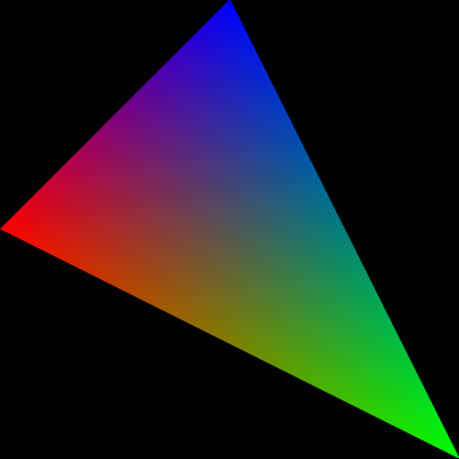
What about triangles that have more than one color?

Slide 38
The color is in three channels, hence three scalar fields defined on the triangle.
Red channel
Green channel
Blue channel

Slide 39
Scanline algorithm for one triangle
Determine columns of pixels the triangle can possibly intersect
Call them columnMin to columnMax
columnMin: ceiling of smallest X value
columnMax: floor of biggest X value
For c in [columnMin → columnMax] ; do
Find end points of c intersected with triangle
Call them bottomEnd and topEnd
For r in [ceiling(bottomEnd) → floor(topEnd) ] ; do
ImageColor(r, c) ← triangle color

Slide 40
Scanline Algorithm w/ Color
Determine columns of pixels the triangle can possibly intersect
Call them columnMin to columnMax
columnMin: ceiling of smallest X value
columnMax: floor of biggest X value
For c in [columnMin → columnMax] ; do
Find end points of c intersected with triangle
Call them bottomEnd and topEnd
Calculate Color(bottomEnd) and Color(topEnd) using interpolation from triangle vertices
For r in [ceiling(bottomEnd) → floor(topEnd) ] ; do
Calculate Color(r, c) using Color(bottomEnd) and Color(topEnd)
ImageColor(r, c) ← Color(r, c)

Slide 41
Simple Example
V(2,2)
RGB = (0,1,0)
V(2,1)
RGB = (0.25,0.5,0.25)
V(0,0)
V(2,0)
RGB = (0.5,0.,0.5)
V(4,0)
RGB = (1,0,0)
What is the color at (2, 1)?
RGB = (0,0,1)

Slide 42
Scanline algorithm w/ Color
Determine rows of pixels triangles can possibly intersect
Call them rowMin to rowMax
rowMin: ceiling of smallest Y value
rowMax: floor of biggest Y value
For r in [rowMin → rowMax] ; do
Find end points of r intersected with triangle
Call them leftEnd and rightEnd
Calculate Color(leftEnd) and Color(rightEnd) using interpolation from triangle vertices
For c in [ceiling(leftEnd) → floor(rightEnd) ] ; do
Calculate Color(r, c) using Color(leftEnd) and Color(rightEnd)
ImageColor(r, c) ← Color(r, c)
Calculating multiple color channels here!

Slide 43
Important
ceiling / floor: needed to decide which pixels to deposit colors to
used: rowMin / rowMax, leftEnd / rightEnd
not used: when doing interpolation
Color(leftEnd) and Color(rightEnd) should be at the intersection locations … no ceiling/floor.

Slide 44
How To Resolve When Triangles Overlap: The Z-Buffer

Slide 45
Imagine you have a cube where each face has its own color….
Face | Color
Front | Blue
Right | Green
Top | Red
Back | Yellow
Left | Purple
Bottom | Cyan
View from “front/top/right” side

Slide 46
Imagine you have a cube where each face has its own color….
How do we render the pixels that we want and ignore the pixels from faces that are obscured?
View from “front/top/right” side
View from “back/bottom/left” side

Slide 47
Consider a scene from the right side
Face | Color
Front | Blue
Right | Green
Top | Red
Back | Yellow
Left | Purple
Bottom | Cyan
Camera/eyeball
Camera oriented directly at Front face,
seen from the Right side

Slide 48
Consider the scene from the top side
Face | Color
Front | Blue
Right | Green
Top | Red
Back | Yellow
Left | Purple
Bottom | Cyan
Camera/eyeball
Camera oriented directly at Front face,
seen from the Top side

Slide 49
What do we render?
Green, Red, Purple, and Cyan all “flat” to camera. Only need to render Blue and Yellow faces (*).
Face | Color
Front | Blue
Right | Green
Top | Red
Back | Yellow
Left | Purple
Bottom | Cyan
Camera/eyeball
Camera oriented directly at Front face,
seen from the Top side

Slide 50
What do we render?
What should the picture look like?
What’s visible? What’s obscured?
Face | Color
Front | Blue
Right | Green
Top | Red
Back | Yellow
Left | Purple
Bottom | Cyan
Camera/eyeball
Camera oriented directly at Front face,
seen from the Top side

Slide 51
New field associated with each triangle: depth
Project 1B,1C:
class Triangle
{
public:
Double X[3];
Double Y[3];
…
};
Now…
Double Z[3];

Slide 52
What do we render?
Z=0
Z=-1
Face | Color
Front | Blue
Right | Green
Top | Red
Back | Yellow
Left | Purple
Bottom | Cyan
Camera/eyeball
Camera oriented directly at Front face,
seen from the Top side

Slide 53
Using depth when rendering
Use Z values to guide which geometry is displayed and which is obscured.
Example….

Slide 54
Consider 4 triangles with constant Z values
Z=-0.35
Z=-0.5
Z=-0.65
Z=-0.8

Slide 55
Consider 4 triangles with constant Z values
How do we make this picture?
Z=-0.35
Z=-0.5
Z=-0.65
Z=-0.8

Slide 56
Idea #1
Sort triangles “back to front” (based on Z)
Render triangles in back to front order
Overwrite existing pixels

Slide 57
Idea #2
Sort triangles “front to back” (based on Z)
Render triangles in front to back order
Do not overwrite existing pixels.

Slide 58
But there is a problem…
(0, 1, -0.4)
(0, 1.5, -0.4)
(-1, -1, -0.3)
(1, -1, -0.5)
(-2, -1.5, -0.5)
(2, -1.5, -0.3)

Slide 59
The Z-Buffer Algorithm
The preceding 10 slides were designed to get you comfortable with the notion of depth/Z.
The Z-Buffer algorithm is the way to deal with overlapping triangles when doing rasterization.
It is the technique that GPUs use.
It works with opaque triangles, but not transparent geometry, which requires special handling
Transparent geometry discussed week 7.
Uses the front-to-back or back-to-front sortings just discussed.

Slide 60
The Z-Buffer Algorithm: Data Structure
Existing: for every pixel, we store 3 bytes:
Red channel, green channel, blue channel
New: for every pixel, we store a floating point value:
Depth buffer (also called “Z value”)
Now 7 bytes per pixel (*)
(*): 8 with RGBA

Slide 61
The Z-Buffer Algorithm: Initialization
Existing:
For each pixel, set R/G/B to 0.
New:
For each pixel, set depth value to -1.
Valid depth values go from -1 (back) to 0 (front)
This is partly convention and partly because it “makes the math easy” when doing transformations.

Slide 62
Scanline algorithm for one triangle
Determine columns of pixels the triangle can possibly intersect
Call them columnMin to columnMax
columnMin: ceiling of smallest X value
columnMax: floor of biggest X value
For c in [columnMin → columnMax] ; do
Find end points of c intersected with triangle
Call them bottomEnd and topEnd
For r in [ceiling(bottomEnd) → floor(topEnd) ] ; do
ImageColor(r, c) ← triangle color

Slide 63
Scanline algorithm w/ Z-Buffer
Determine columns of pixels the triangle can possibly intersect
Call them columnMin to columnMax
columnMin: ceiling of smallest X value
columnMax: floor of biggest X value
For c in [columnMin → columnMax] ; do
Find end points of c intersected with triangle
Call them bottomEnd and topEnd
Interpolate z(bottomEnd) and z(topEnd) from triangle vertices
For r in [ceiling(bottomEnd) → floor(topEnd) ] ; do
Interpolate z(c,r) from z(bottomEnd) and z(topEnd)
If (z(c,r) > depthBuffer(c,r))
ImageColor(r, c) ← triangle color
depthBuffer(c,r) = z(c,r)

Slide 64
The Z-Buffer Algorithm: Example
X=5
(0,12)
(12,12)
(2.5,10.5, -0.25)
(2.5,2.5, -0.5)
(10.5,2.5, -1)
(0,0)
(12,0)

Slide 65
Interpolation and Triangles
We introduced the notion of interpolating a field on a triangle
We used the interpolation in two settings:
1) to interpolate colors
2) to interpolate depths for z-buffer algorithm
Project 1D: you will be adding color interpolation and the z-buffer algorithm to your programs.

