Slide 1
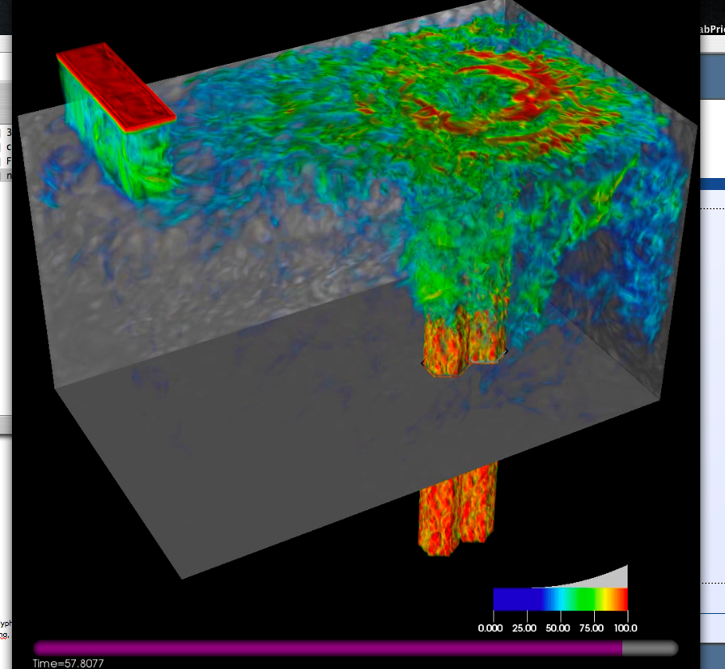
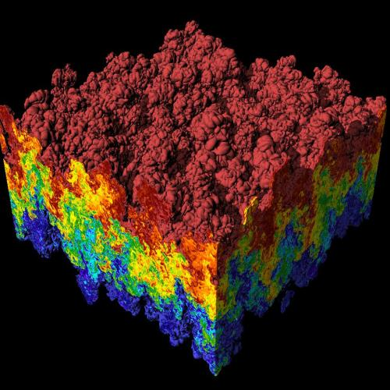
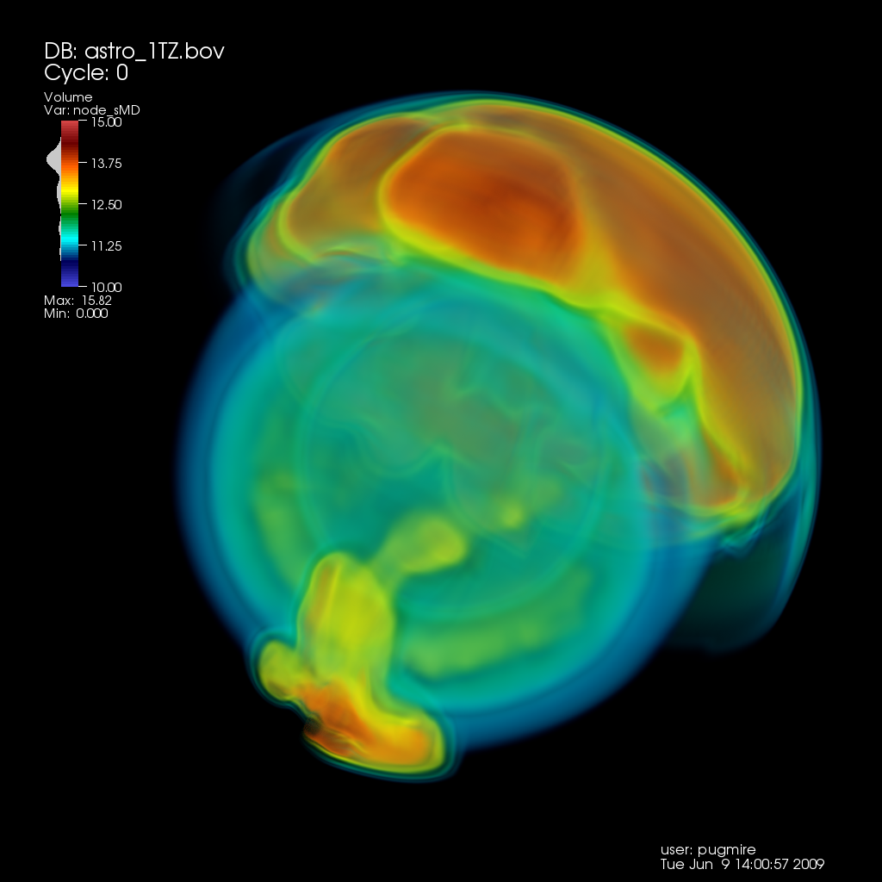
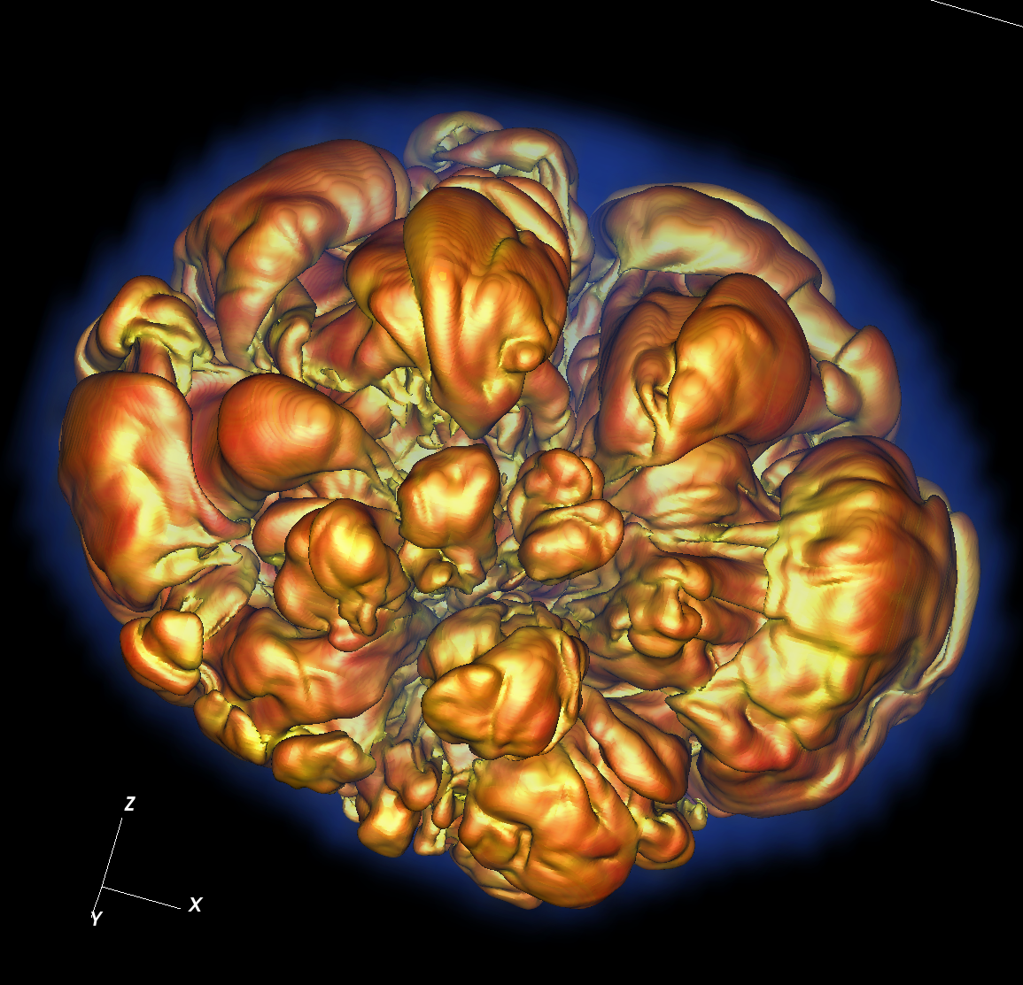
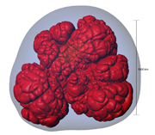
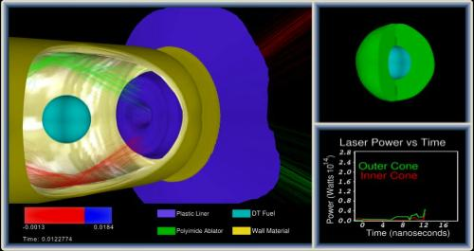
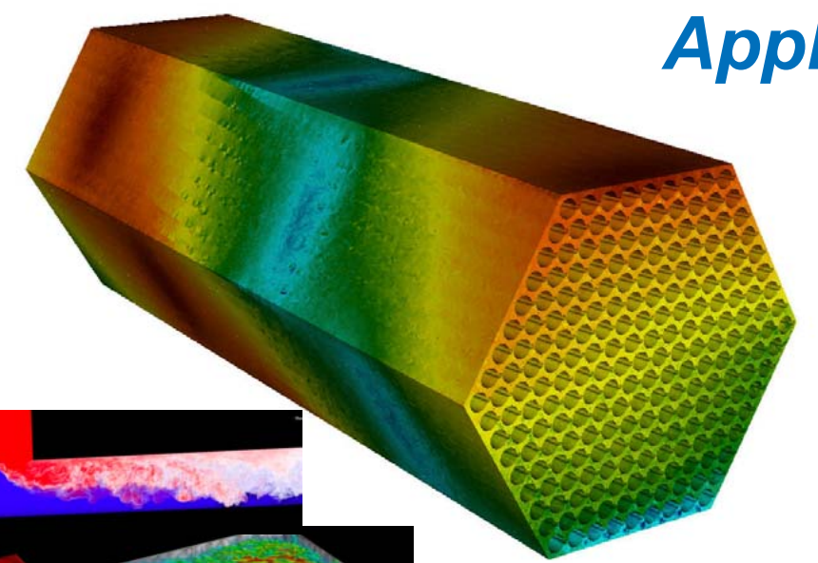
CIS 441/541: Intro to Computer Graphics Lecture 2: The Scanline Algorithm
April 1, 2021
Hank Childs, University of Oregon

Slide 2
Duo Two-Step

Slide 3
Projects
1A: due Saturday
1B: assigned today, due Wednesday (4/7)
1C: assigned Tuesday (4/6), due following Wednesday (4/14)

Slide 4
Office Hours This Week
Hank: Thursday 1-2pm
Zoom link: check Canvas
Abhishek: Fri 8-11, 2-5

Slide 5
Office Hours Weeks 2-10
Abhishek:
Monday 10-11
Tuesday 945-1045 (partial overlap with 422)
Thursday 945-1045 (partial overlap with 422)
Hank
Weds 230-330

Slide 6
Project #1A

Slide 7
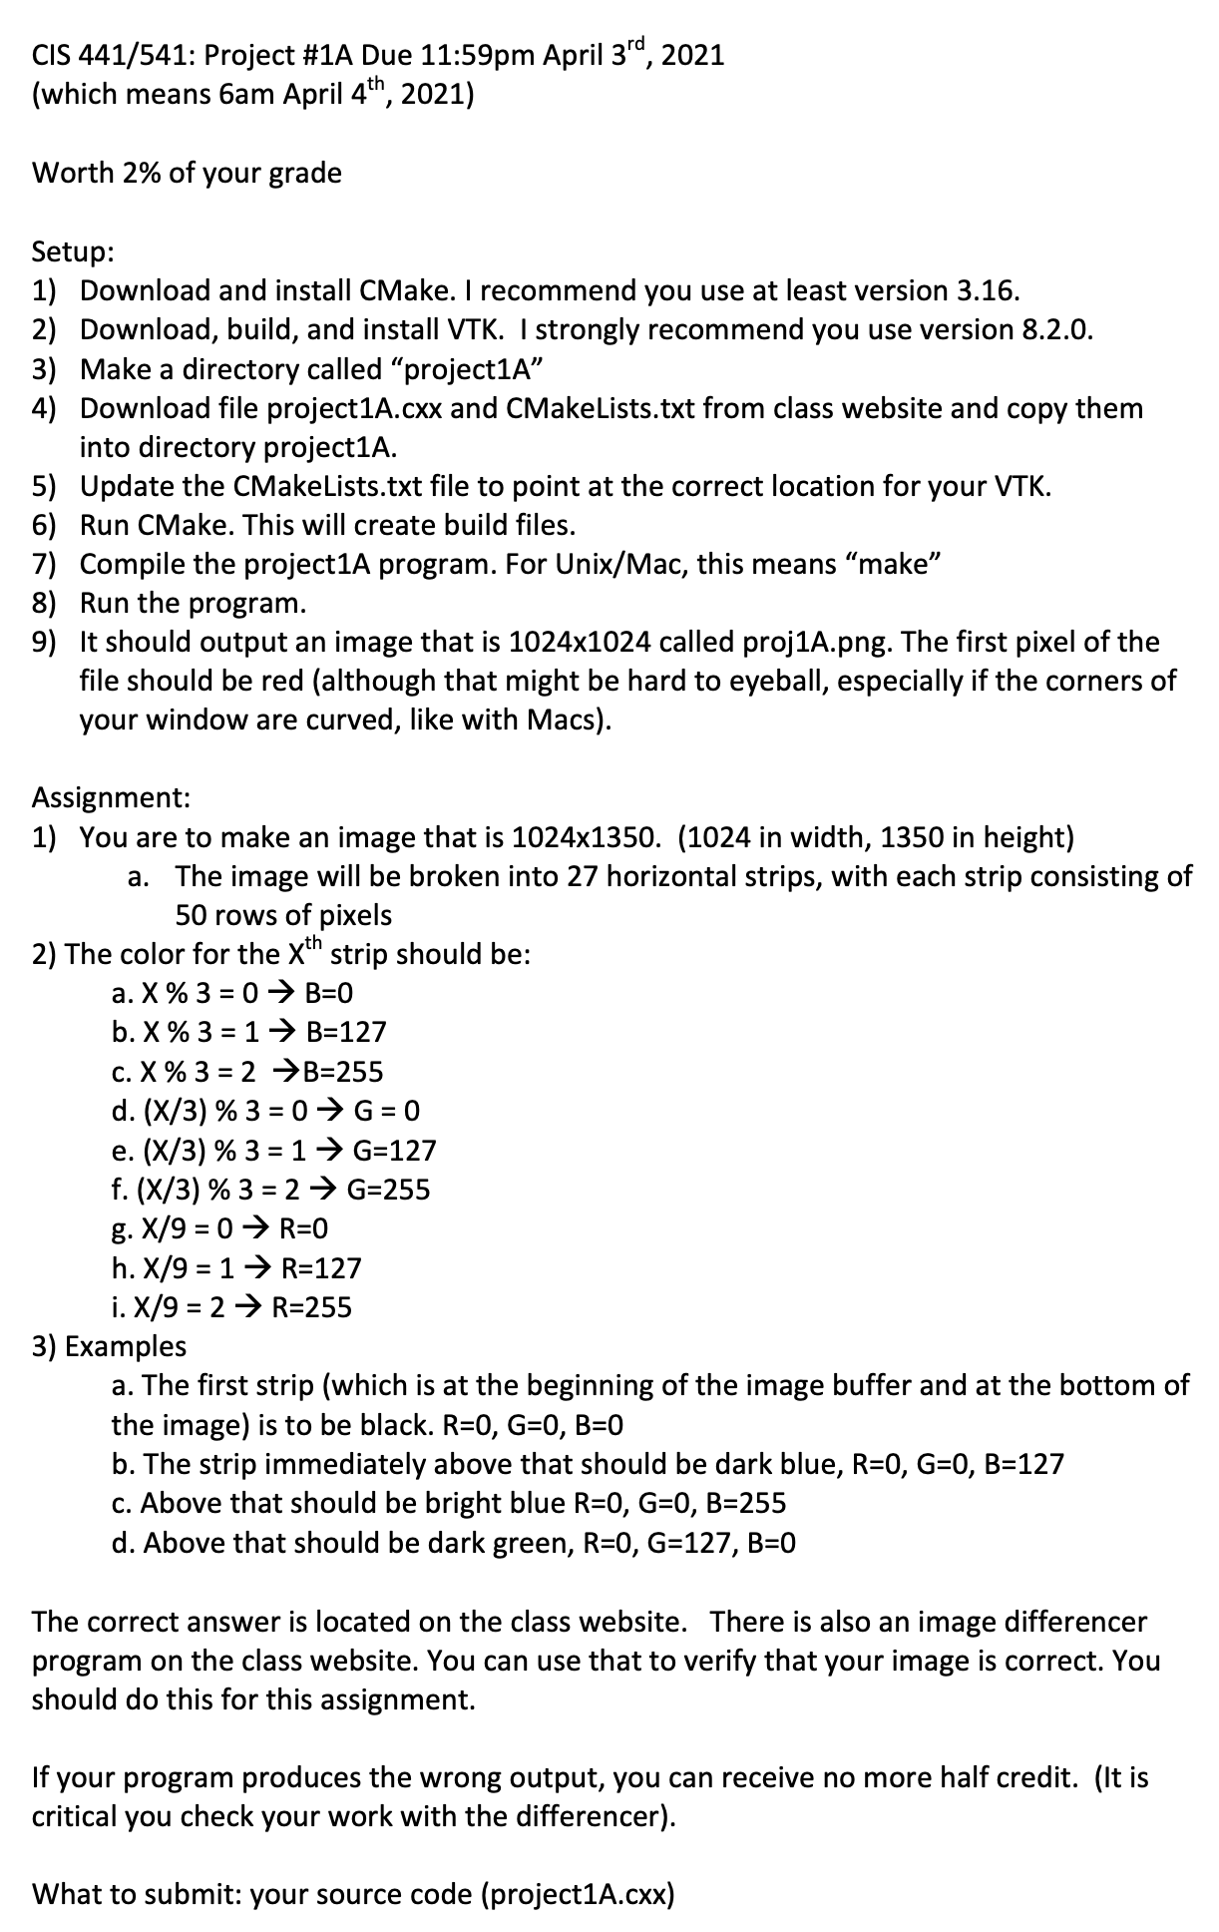
Project #1A
Goal: write a specific image
Due: Sat April 3rd
% of grade: 2%
May be a little painful

Slide 8
Project #1A: background
Definitions:
Image: 2D array of pixels
Pixel: A minute area of illumination on a display screen, one of many from which an image is composed.
Pixels are made up of three colors: Red, Green, Blue (RGB)
Amount of each color scored from 0 to 1
100% Red + 100% Green + 0% Blue = Yellow
100% Red + 0% Green + 100 %Blue = Purple
0% Red + 100% Green + 0% Blue = Cyan
100% Red + 100% Blue + 100% Green = White

Slide 9
Project #1A: background
Colors are 0->1, but how much resolution is needed? How many bits should you use to represent the color?
Can your eye tell the difference between 8 bits and 32 bits?
→ No. Human eye can distinguish ~10M colors.
8bits * 3 colors = 24 bits = ~16M colors.
Red = (255,0,0)
Green = (0,255,0)
Blue = (0,0,255)

Slide 10
Project #1A: background
An “M by N” 8 bit image consists of MxNx3 bytes.
It is stored as:
P0/R, P0/G, P0/B, P1/R, P1/G, P1/B, … P(MxN)/R, P(MxN)/G, P(MxN)/B
P0 is the top, left pixel
P(M-1) is the top, right pixel
P((MxN)-M) is the bottom, left pixel
P(MxN-1) is the bottom, right pixel

Slide 11
Project #1A: background
The red contributions are called the “red channel”
Ditto blue & green
There are 3 channels in the image described above
There is sometimes a fourth channel, called “alpha”
It is used for transparency
→ Images are either RGB or RGBA

Slide 12
Project #1A in a nutshell
Assignment:
Install CMake
Install VTK
Modify template program to output specific image

Slide 13
What is ?
Cmake is a cross-platform, open-source build system.
CMake is a family of tools designed to build, test and package software.
CMake is used to control the software compilation process using simple platform and compiler independent configuration files.
CMake generates native makefiles and workspaces that can be used in the compiler environment of your choice.

Slide 14
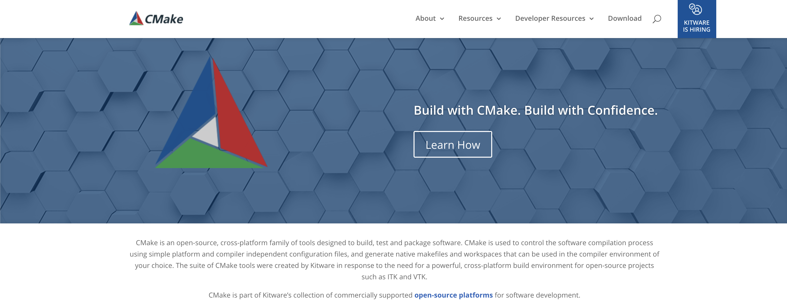
How do you install CMake?
Go to www.cmake.org & follow the directions

Slide 15
What is the ?
The Visualization Toolkit (VTK) is an open-source, freely available software system for 3D computer graphics, image processing and visualization.
VTK consists of a C++ class library and several interpreted interface layers including Tcl/Tk, Java, and Python.
VTK is cross-platform and runs on Linux, Windows, Mac and Unix platforms.

Slide 16
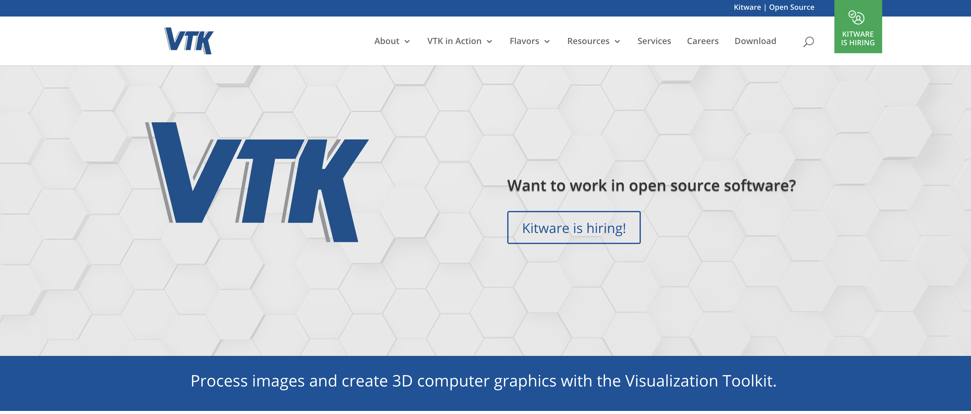
How do you install VTK?
Go to www.vtk.org , go to Download and follow the directions

Slide 17
What is the image I’m supposed to make?
(255,255,255)
R=255
(255, 0, 0)
(127,255,255)
R=127
(127,0,127)
(127, 0, 0)
(0,255,255)
(0, 255, 127)
(0, 255, 0)
(0,127,255)
R=0
(0,127,127)
(0,127,0)
(0,0,255)
(0,0,127)
(0,0,0)

Slide 18
What do I do again?
Install CMake & VTK.
Download “project1A.cxx” from class website
Download “CMakeLists.txt” from class website
Run CMake
Modify project1A.cxx to complete the assignment
And…
Submit to Canvas the source by Saturday midnight

Slide 19
Computer Graphics Models
Usually made up of triangles
+ tricks for shading
Picture credit: wikipedia, cs.mun.ca

Slide 20
The Scanline Algorithm

Slide 21
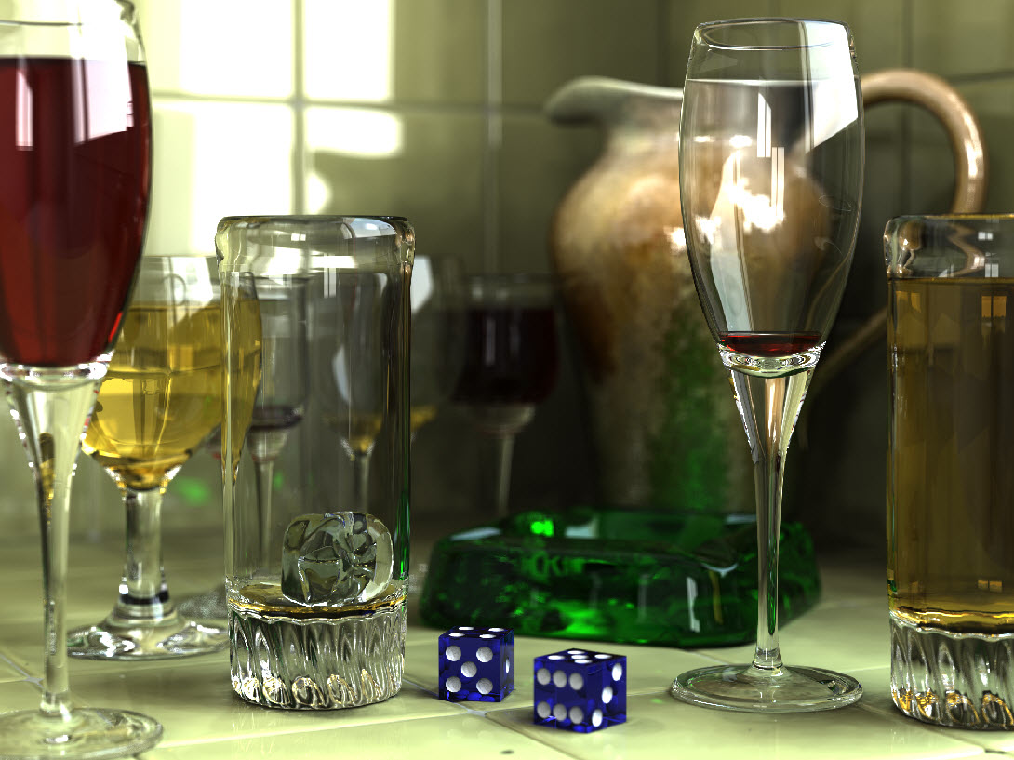
Reminder: ray-tracing vs rasterization
Two basic ideas for rendering: rasterization and ray-tracing
Ray-tracing: cast a ray for every pixel and see what geometry it intersects.
O(nPixels)
(actually, additional computational
complexity for geometry searches)
Allows for beautiful rendering
effects (reflections, etc)
Will discuss later in
the quarter

Slide 22
Reminder: ray-tracing vs rasterization
Two basic ideas for rendering: rasterization and ray-tracing
Rasterization: examine every triangle and see what pixels it covers.
O(nTriangles)
(actually, additional computational complexity for painting in pixels)
GPUs do rasterization very quickly
Our focus for the next 5 weeks

Slide 23
What color should we choose for each of these four pixels?

Slide 24
What color should we choose for each of these four pixels?
Most dominant triangle

Slide 25
What color should we choose for each of these four pixels?
Average

Slide 26
What color should we choose for each of these four pixels?
Pixel center

Slide 27
What color should we choose for each of these four pixels?
Lower left of pixel

Slide 28
The middle and lower-left variants are half-pixel translations of the other
We will use the lower-left convention for the projects.
Pixel center
Lower left of pixel

Slide 29
Where we are…
We haven’t talked about how to get triangles in position.
Arbitrary camera positions through linear algebra
We haven’t talked about shading
Today, we are tackling this problem:
How to deposit triangle colors onto an image?

Slide 30
Problem: how to deposit triangle colors onto an image?
Let’s take an example:
12x12 image
Red triangle
Vertex 1: (2.5, 1.5)
Vertex 2: (2.5, 10.5)
Vertex 3: (10.5, 1.5)
Vertex coordinates are with respect to pixel locations

Slide 31
(0,12)
(12,12)
(2.5,10.5)
(2.5,1.5)
(10.8,1.5)
(0,0)
(12,0)

Slide 32
Our desired output
How do we make this output? Efficiently?

Slide 33
Don’t need to consider any
Pixels outside these lines

Slide 34
Scanline algorithm: consider all rows columns that can possibly overlap

Slide 35
We will extract a “scanline,” i.e., calculate the intersections for one column of pixels
X=5
X
X
X
X
X
X

Slide 36
Red triangle
Vertex 1: (2.5, 1.5)
Vertex 2: (2.5, 10.5)
Vertex 3: (10.5, 1.5)

Slide 37
X=5
Red triangle
Vertex 1: (2.5, 1.5)
Vertex 2: (2.5, 10.5)
Vertex 3: (10.5, 1.5)
What are the end points?

Slide 38
X=5
Red triangle
Vertex 1: (2.5, 1.5)
Vertex 2: (2.5, 10.5)
Vertex 3: (10.5, 1.5)
What are the end points?
(5, 1.5)

Slide 39
X=5
Red triangle
Vertex 1: (2.5, 1.5)
Vertex 2: (2.5, 10.5)
Vertex 3: (10.5, 1.5)
What are the end points?
Algebra!
(5, 1.5)

Slide 40
X=5
Red triangle
Vertex 1: (2.5, 1.5)
Vertex 2: (2.5, 10.5)
Vertex 3: (10.5, 1.5)
y = mx+b
m=(1.5-10.5)/(10.5-2.5) = -9/8
b=y-mx = 1.5-10.5*-9/8 = 13.3125
→
y = -9/8x + 13.3125
@ X==5 → y = -9/8*5 + 13.3125 = 7.6875
What are the end points?
Algebra!
(5, 1.5)

Slide 41
We will extract a “scanline,” i.e., calculate the intersections for one column pixels
X=5
Y=7.6875
X
X
X
X
X
X

Slide 42
We will extract a “scanline,” i.e., calculate the intersections for one column pixels
If (r, c) is pixel at row r and column c, then scanline for X=5 leads to colors deposited at:
(2,5), (3,5), (4,5), (5,5), (6, 5), (7, 5)
X=5
Y=7.6875
X
X
X
X
X
X

Slide 43
Scanline algorithm for one triangle
Determine columns of pixels the triangle can possibly intersect
Call them columnMin to columnMax
columnMin: ceiling of smallest X value
columnMax: floor of biggest X value
For c in [columnMin → columnMax] ; do
Find end points of c intersected with triangle
Call them bottomEnd and topEnd
For r in [ceiling(bottomEnd) → floor(topEnd) ] ; do
ImageColor(r, c) ← triangle color

Slide 44
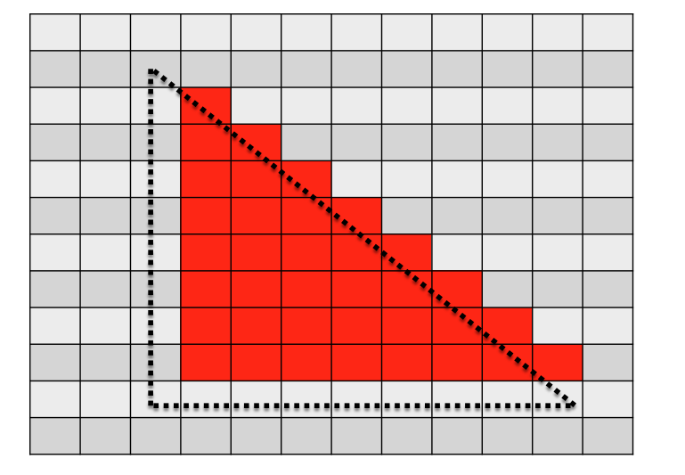
Scanline algorithm
Determine columns of pixels triangles can possibly intersect
Call them columnMin to columnMax
columnMin: ceiling of smallest X value
columnMax: floor of biggest X value
For c in [columnMin → columnMax] ; do
Find end points of c intersected with triangle
Call them bottomEnd and topEnd
For r in [ceiling(bottomEnd) → floor(topEnd) ] ; do
ImageColor(r, c) ← triangle color
Y values from 2.5 to 10.5
means rows 3 through 10
For c==5, bottomEnd = 1.5,
topEnd = 7.6875
For c = 5, we call ImageColor with
(2,5), (3,5), (4,5), (5,5), (6, 5), (7, 5)

Slide 45
Arbitrary Triangles
The description of the scanline algorithm in the preceding slides is general.
But the implementation for these three triangles vary:

Slide 46
Supersampling: use the scanline algorithm a bunch of times to converge on the “average” picture.

Slide 47
Where we are…
We haven’t talked about how to get triangles into position.
Arbitrary camera positions through linear algebra
We haven’t talked about shading
Today, we tackled this problem:
How to deposit triangle colors onto an image?
Still don’t know how to:
Vary colors (easy)
Deal with triangles that overlap

Slide 48
Project 1B

Slide 49
Arbitrary Triangles
You will implement the scanline algorithm for “going right” triangles

Slide 50
Project #1B
Goal: apply the scanline algorithm to “going right” triangles and output an image
File “project1B.cxx” has triangles defined in it
Due: Weds April 7
% of grade: 3%

Slide 51
Project #1C
You will implement the scanline algorithm for arbitrary triangles … plan ahead

Slide 52
Tips On Floating Point Precision

Slide 53
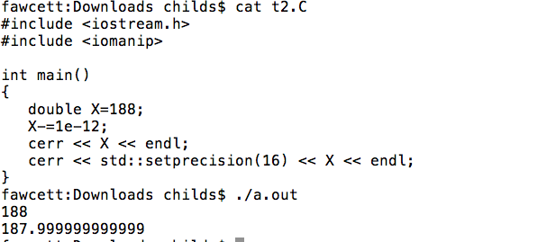
Project 1B
Cout/cerr can be misleading:

Slide 54
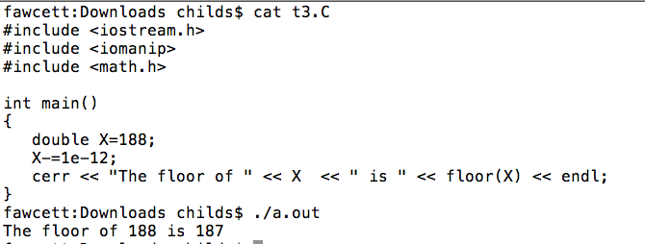
Project 1B
The limited accuracy of cerr/cout can cause other functions to be appear to be wrong:

Slide 55
Project 1B
Floating point precision is an approximation of the problem you are trying to solve
Tiny errors are introduced in nearly every operation you perform
Exceptions for integers and denominators that are a power of two
Fundamental problem:
Changing the sequence of these operations leads to *different* errors.
Example: (A+B)+C ≠ A+(B+C)

Slide 56
Project 1B
For project 1B, we are making a binary decision for each pixel: should it be colored or not?
Consider when a triangle vertex coincides with the bottom left of a pixel:
We all do different variations on how to solve for the endpoints of a line, so we all get slightly different errors.

Slide 57
Project 1B
Our algorithm incorporates floor and ceiling functions.
This is the right place to bypass the precision problem.
I have included “floor__441” and “ceil__441” in project prompt. You need to use them, or you will get one pixel differences.

Slide 58
Project 1B: other thoughts
You will be building on this project …
think about magic numbers (e.g. screen size of 1000)
add safeguards against cases that haven’t shown up yet
Assume nothing!

