Slide 1
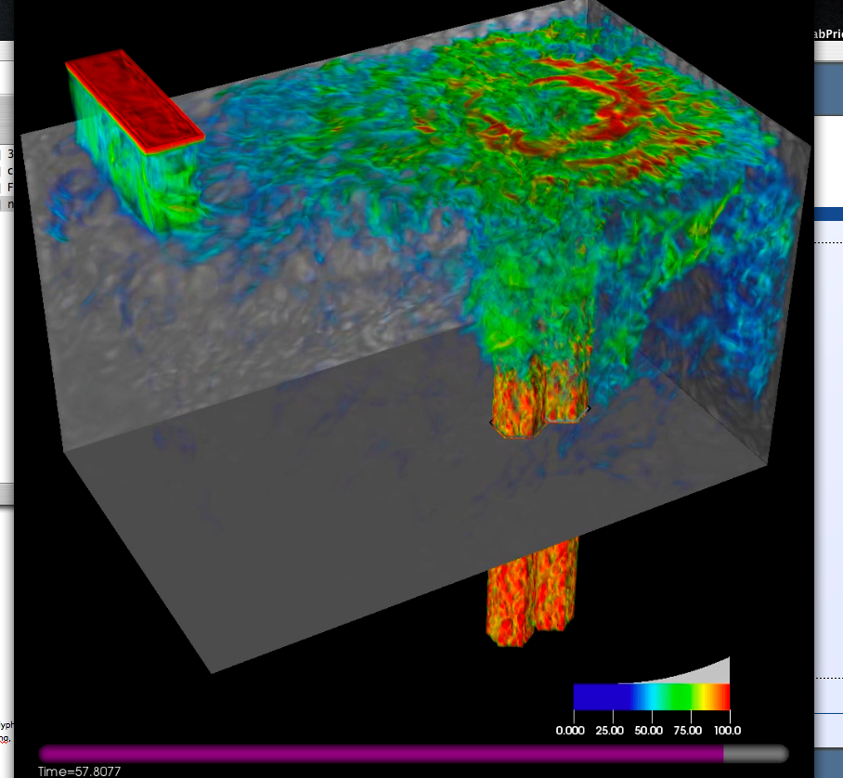
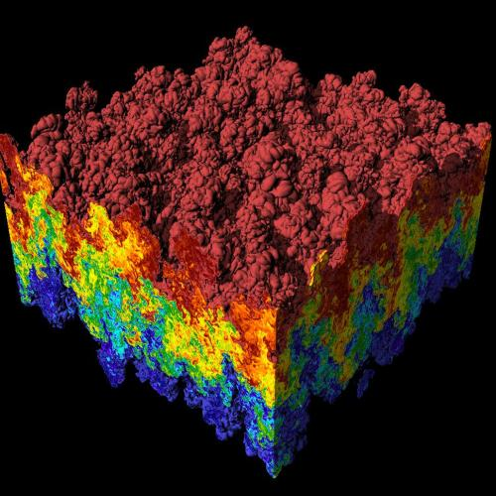
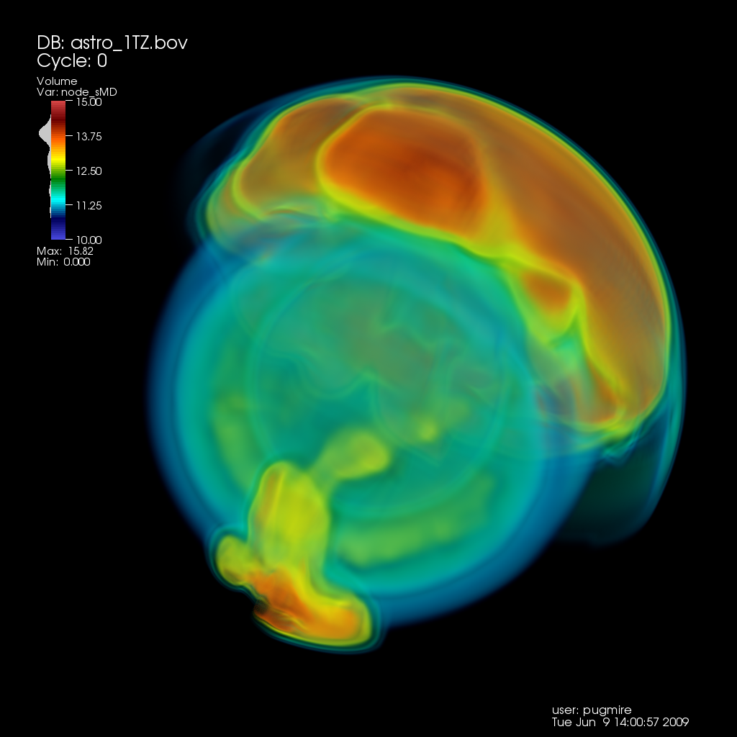
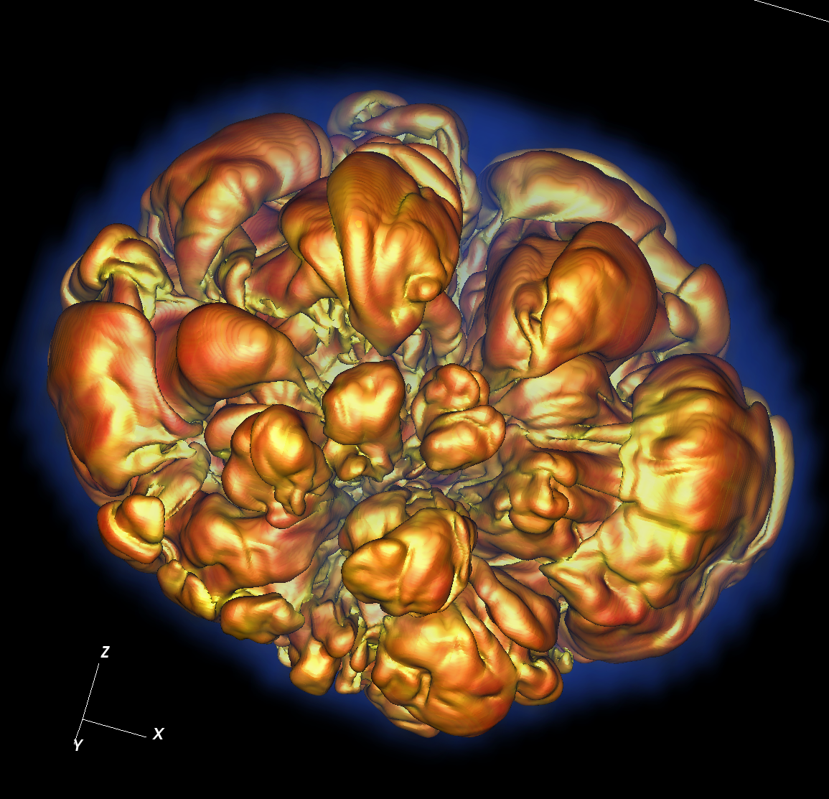
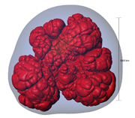
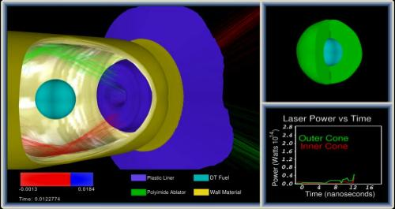
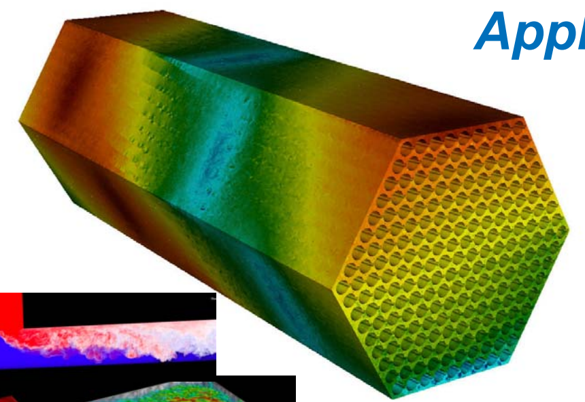
CIS 441/541: Intro to Computer Graphics Lecture 15: Mirrors
June 1, 2021
Hank Childs, University of Oregon

Slide 2
Office Hours
Now only 1 OH per week
Hank, Weds 230-330
Abhishek still doing a lot...

Slide 3
Plan for Thursday
830-910am: group Q&A on final projects
910-915: discuss how makeup quiz works
915-945: makeup quiz
Don’t want group Q&A?: just call in at 910am
Don’t want makeup quiz?: drop off at 910am
Don’t want either?: just skip on Thursday

Slide 4
Makeup Quiz
Can re-take any of previous quizzes
Score can replace previous score
New score is higher: use new score
Old score is higher: use old score
Will not be on Canvas – just email Hank
Probably will not be graded until after Tuesday June 8th

Slide 5
3.X
3A: 1D textures
3B: collisions
3C: level of detail
3D: mirrors (worth double)
3E: physically-based rendering (worth double)
Plans to get 3 projects:
3A+3B+3C
3A+3D
3B+3E
Etc.

Slide 6
Final Projects
Tuesday June 8th @8am, 2021
→ We will start at 8am, not 815am
Via class Zoom
-4 points if you do not attend (presenting or not)
Presentations: 3 minutes

Slide 7
What to Turn In: Custom Projects
Tarball/zip
“README” is appreciated
Where you spent your time
What you are proud of
What files to look at
Evidence of your efforts
Code you wrote
For art assets, it may be screenshots and not digital uploads
PowerPoints from your presentations
I do not plan to compile/run these

Slide 8
What to Turn In: Project 3.X
Tarball/zip
One directory per project
Example:
Directories for 3A, 3B, 3C
Each directory should contain your source code
In some cases, a report
I do plan to compile/run these

Slide 9
Submission Details
Canvas entry called “Final Project”
Due at 8am Tuesday June 8th
Should be submitted before the presentations start
I disabled submissions after 8am
I do not want to deal with situations where people upload them late and pretend they were not late

Slide 10
End-of-Course Student Experience Surveys
Long, but important

Slide 11
(Slide I presented last week) Grading
Generally doing good
2A graded yesterday
1A-1E, Quiz1 – Quiz4 all graded
To do
1F: hoping for this weekend
2B: next few days
Quiz 5: by Tuesday for sure

Slide 12
Late Passes
I will apply them, and connect with those who have decisions
(Still haven’t done this yet)
(Need to get 1F graded)

Slide 13
Github
I know many of you want to put these on github
No 1A-1E – what’s the point?
1F: please remove phrases like CIS441, ceil__441, floor__441, etc.
Description:
A software-based computer graphics system that renders imagery via rasterization, including Phong shading, hidden surface remove, and arbitrary camera positions .

Slide 14
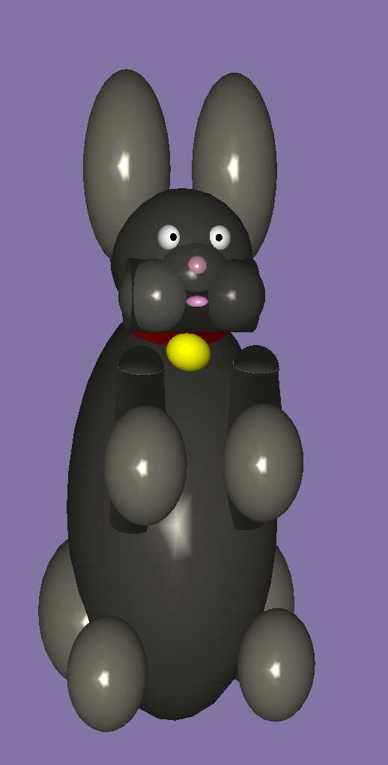
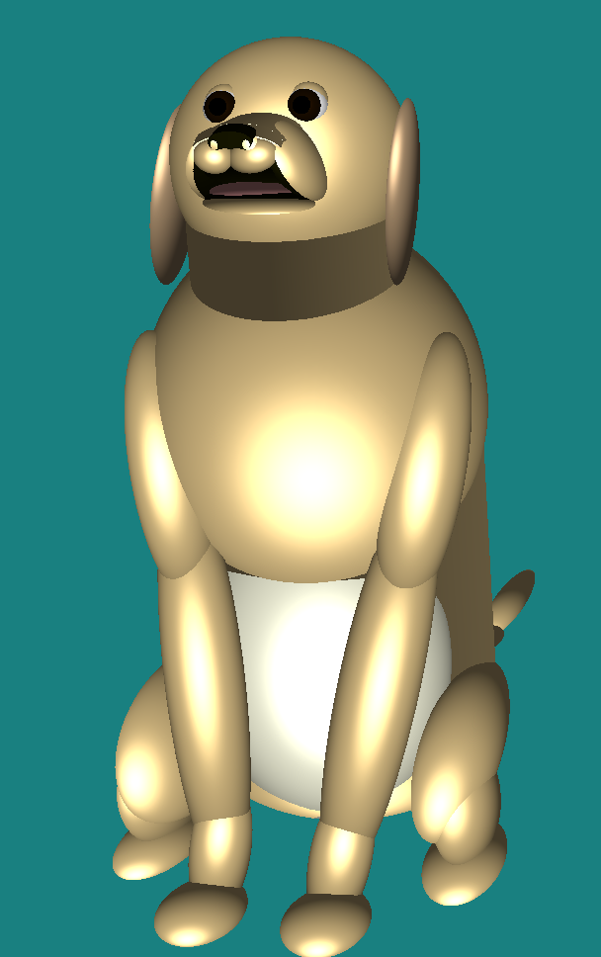
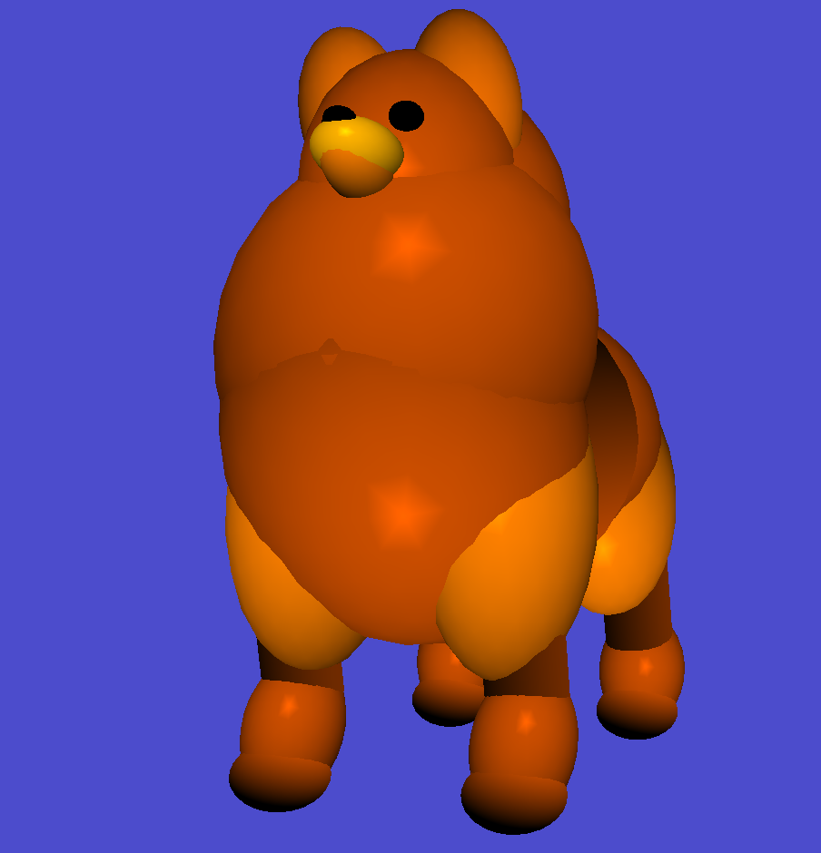
My Favorite 2B’s
Brian Gunnarson
Seth Tal
Joe Johnson
Simon Rosenthal

Slide 15
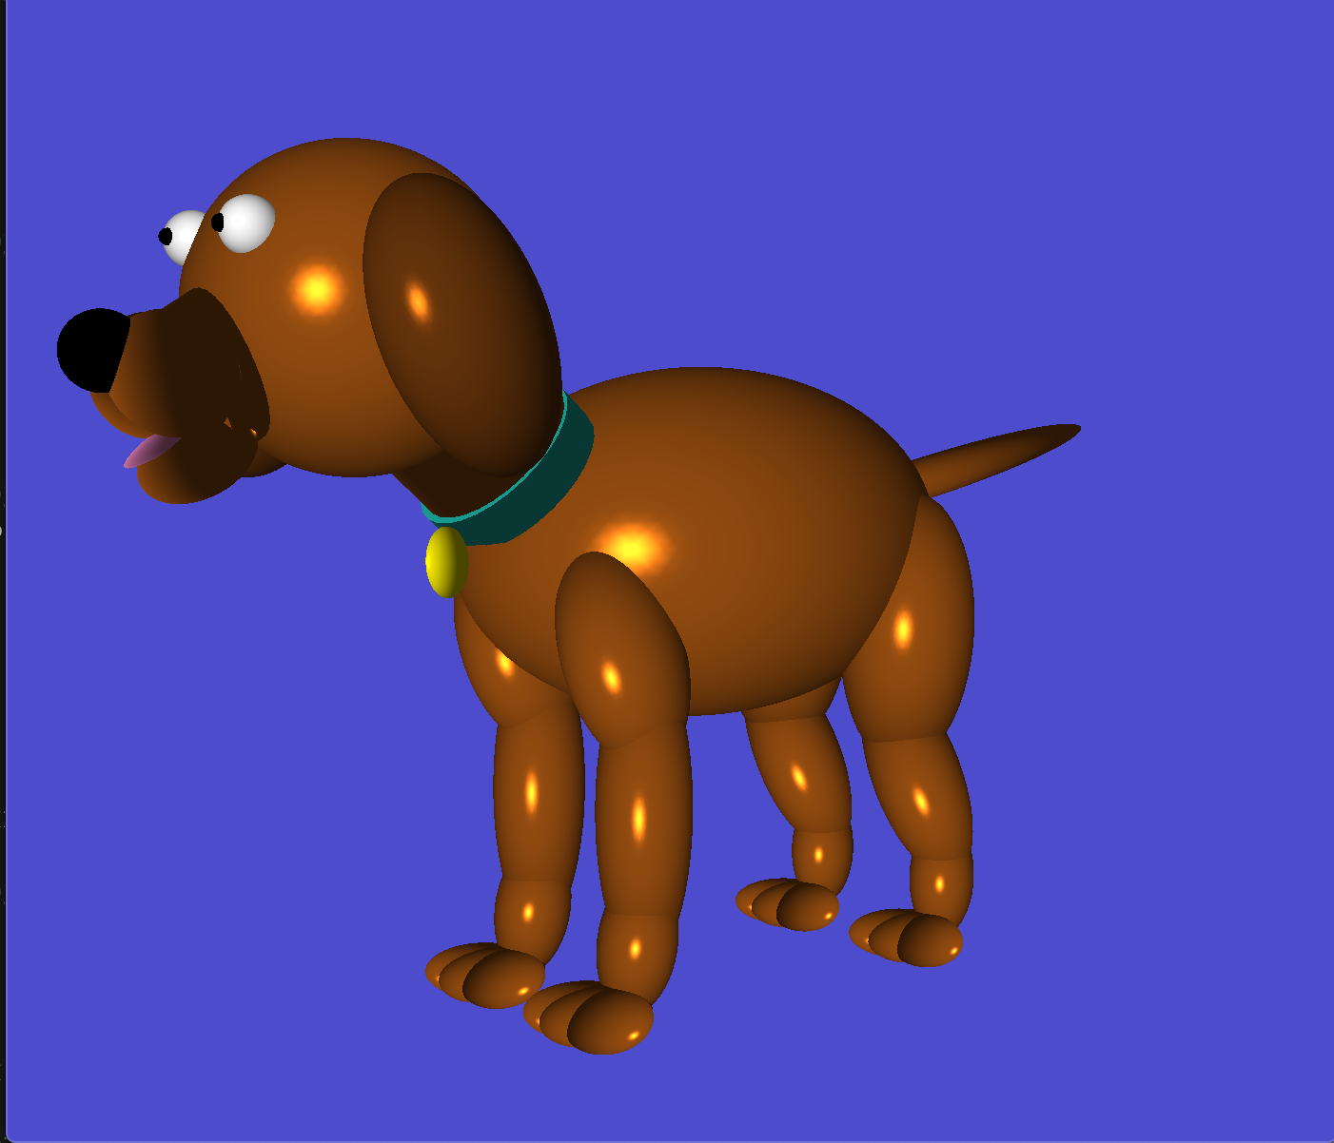
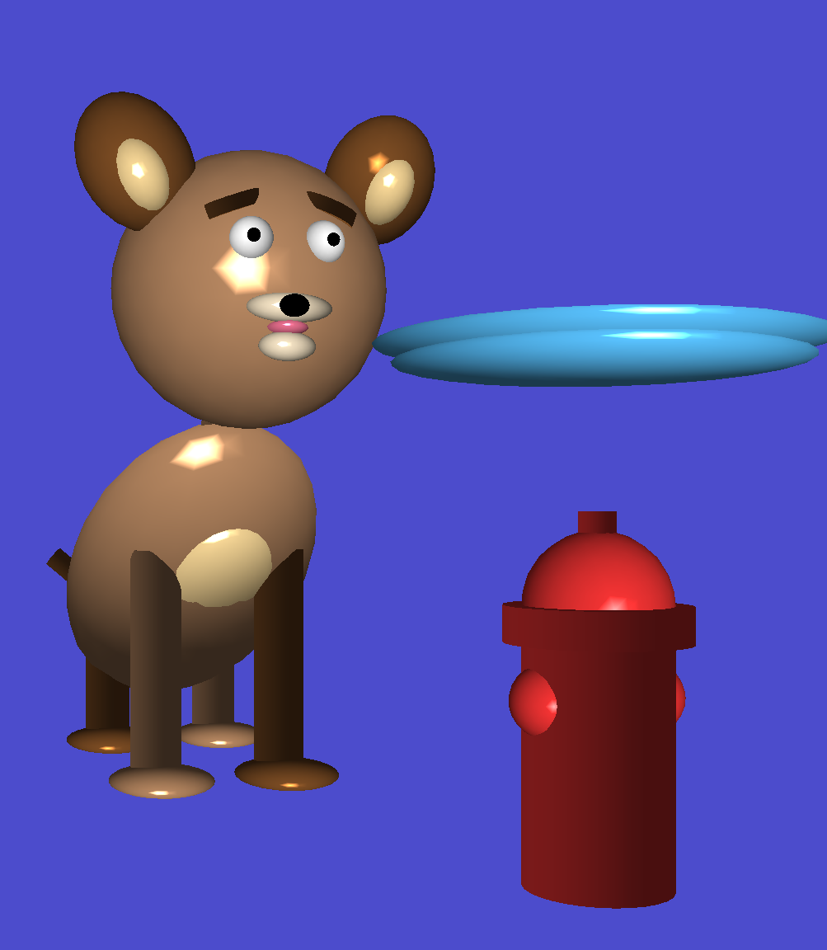
My Favorite 2B’s
Stephen Leveckis
Evan Podrabsky
Max Terry

Slide 16
My Favorite 2B’s
Raul Patel
Brandon Bower

Slide 17
Problem with 2B – Whoops!
Lighting was wrong in some cases
Why?...

Slide 18
Problem with 2B
Model
Transform
A cube object.
Normals for each face shown with an arrow.
A cube object after a rotation.
Normals correctly rotated with faces
Assume the left is a “source” object and the right is the source object being transformed for a scene

Slide 19
Reminder: Lighting Calculation Happens in World Space
(c_x, c_y, c_z) / camera = (0,1,0)
This example has a triangle vertex, v, at the origin, the camera one unit along the Y-axis and the light source one unit along the X-axis.
The lightDir and viewDir formulas show the conventions we should use for direction for general positions.
viewDir = normalize(c_x-v_x, c_y-v_y, c_z-v_z) = (0, 1, 0)
(0.707,0.707,0) / view normal
(l_x, l_y , l_z) / light source = (1,0,0)
(v_x, v_y, v_z)
= (0,0,0)
lightDir
= normalize(l_x-v_x, l_y-v_y, l_z-v_z)
= (1, 0, 0)

Slide 20
So Which Cube Is In World Space?
Model
Transform
A cube object.
Normals for each face shown with an arrow.
A cube object after a rotation.
Normals correctly rotated with faces
Answer: the right one. It represents how we want the object to appear in world space.

Slide 21
When Do We Do Lighting?
Vertex Shader
Model
Transform
View
Transform
points
gl_position
normals
Phong
shading
This is bad. Model is changing points, but not normals (see next slide)

Slide 22
So Which Cube Is In World Space?
Model
Transform
A cube object.
Normals for each face shown with an arrow.
A cube object after a rotation.
Normals correctly rotated with faces
We are doing Phong shading on these normals

Slide 23
Idea: Separate Model and View
New Idea for Vertex Shader
Model
Transform
View
Transform
points
gl_position
normals
Phong
shading
Now need to send in model and view separately.
And modify vertex shader to transform normals
But there is another problem

Slide 24
Transforms and Normals
Can a normal be rotated: yes
Can a normal be scaled: yes
Can a normal be translated: no
Example:
Normal: (1,0,0)
Translation: (0,1,0)
Normal after translation: (1,1,0)
But still want it to be (1,0,0)
So separating model and view (idea from last slide) would work except translation

Slide 25
Idea #2: Generate Transform for Just Models
New Idea for Vertex Shader
Model
Transform
View
Transform
points
gl_position
Model Normal
Transform
normals
Phong
shading
Now can send in modelview as one matrix.
But need a second matrix for normal transforms
Second matrix much like model transform, but without translations.

Slide 26
Notes
There is more to this topic:
Apparently there are tricks where you can multiple by the upper left 3x3 of a 4x4 matrix and it will discard translation
Some folks do lighting calculations in “eye space” and this allows for different formulations

Slide 27
Mirrors
Two big ideas:
Reflecting geometry across plane
Limiting rendering of reflections to be only within mirror
Mirror

Slide 28
Mirrors
Two big ideas:
Reflecting geometry across plane
Limiting rendering of reflections to be only within mirror
Mirror

Slide 29
Reflecting Geometry Across a Plane
Assume there is a 4x4 matrix that does reflections (there is)
Then reflecting geometry looks like:
glm::mat4 identity(1.0f);
RenderScene(identify);
Glm::mat4 reflection = ...;
RenderScene(reflection);

Slide 30
What About Two Mirrors?
glm::mat4 identity(1.0f);
RenderScene(identify);
glm::mat4 reflection1 = ...;
RenderScene(reflection1);
glm::mat4 reflection2 = ...;
RenderScene(reflection2);
But what about objects reflection off both mirrors?

Slide 31
What About Two Mirrors?
glm::mat4 identity(1.0f);
RenderScene(identify);
glm::mat4 reflection1 = ...;
glm::mat4 reflection2 = ...;
RenderScene(reflection1);
RenderScene(reflection2);
RenderScene(reflection2*reflection1);
RenderScene(reflection1*reflection2);
And three mirrors?

Slide 32
The Mirror Problem
One idea: use ray tracing
Another idea: just limit the number of mirrors
Common in practice!
Another idea:
Limit the number of reflections

Slide 33
So What Is the Reflection Matrix?
Easiest reflection: across plane Z=0
(or plane X=0 or plane Y=0)
(1 0 0 0)
M= (0 1 0 0)
(0 0 -1 0)
(0 0 0 1)
And: M*(x y z 1) = (x y –z 1)

Slide 34
What If I Don’t Want to Reflect Across XY, YZ, or XZ?
Answer: use more matrices to transform the problem to the simple one
Example:
Want to transform across plane Z=4
Three steps:
Translate by (0,0,-4)
Reflect across plane Z=0
Translate by (0,0,4)
This is three matrices. Compose them.

Slide 35
Making a Combined Matrix
(1 0 0 0) (1 0 0 0) (1 0 0 0) (1 0 0 0)
(0 1 0 0)*(0 1 0 0) * (0 1 0 0) = (0 1 0 0)
(0 0 1 4) (0 0 -1 0) (0 0 1 -4) (0 0 -1 8)
(0 0 0 1) (0 0 0 1) (0 0 0 1) (0 0 0 1)
Step 3: translate by Z=4
Step 1: translate by Z=-4
Step 2: reflect across Z=0

Slide 36
Transforming Point (3,3,2)
(1 0 0 0) * (3 3 2 1) = (3 3 6 1)
(0 1 0 0)
(0 0 -1 8)
(0 0 0 1)

Slide 37
Normals
Will need to reflect normals as well
Plays well with previous discussion
(and normals can be reflected)

Slide 38
Mirrors
Two big ideas:
Reflecting geometry across plane
Limiting rendering of reflections to be only within mirror
Mirror

Slide 39
The Big Idea
(1) render the geometry for the mirror
(2) take note of which pixels the mirror overlaps with
(3) when rendering reflected geometry, only accept the fragment if it overlaps with the mirror (consulting with data from (2))

Slide 40
Mirrors
The mirror overlaps with some list of pixels,
P1, P2, P3, ..., PN.
Calculate this list by rendering mirror first.
When rendering reflection of dog, accept this fragment since it is on the list (i.e., is some P_i).
Mirror
When rendering reflection of dog, reject this fragment since it is not on the list (i.e., not any of the P_i).
OK, this plan (sort of) makes sense.
But how do we instruct GPU to do this?

Slide 41
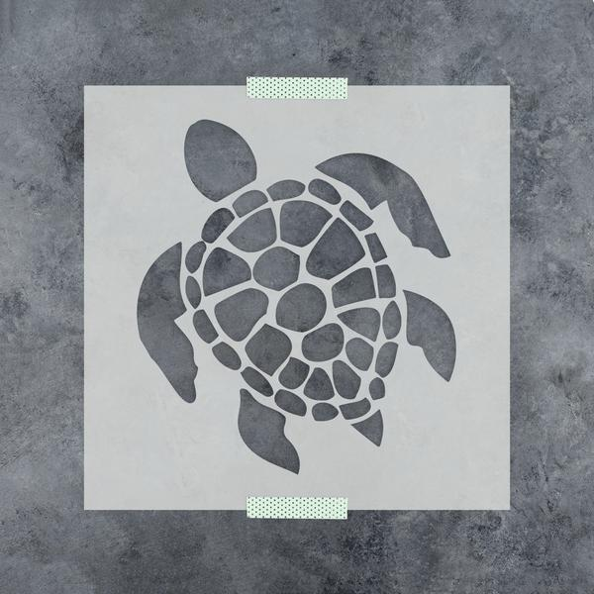
New Idea: Stenciling
Definition from the internet:
1: a piece of material (as a sheet of paper or plastic) that has lettering or a design cut out and is used as a guide (as in painting or drawing)
2: a pattern, design, or print produced with a stencil.
Image credit: stencilrevolution.com

Slide 42
New Concept in GPU: Stencil Buffer
Stores a byte for every pixel
Can be used in many ways
For this use case:
Let 1 mean that the pixel overlaps with the mirror
Let 0 mean that the pixel does not overlap with the mirror

Slide 43
Using the Stencil Buffer for Mirrors
Render mirror and store the stencil buffer
Render reflections and consult the stencil buffer
For each fragment, if corresponding pixel in buffer is 1, then accept, else reject
Notes:
We need to modify our fragment shaders
Different than my conceptual slide – not a list of pixels that are covered, but rather a 0/1 for every pixel

Slide 44
Oh. There Is a Simpler Way When Walls Are Involved.
What if the mirror is on a wall?
Mirror
Wall
Z-buffer algorithm will put wall in the image,
and reflection is removed since it is behind
the wall

Slide 45
Project 3D
This is a double project
Worth two projects to do it
Extend 2B
Place dog in room
Room has 4 mirrors
Do reflections
just one level – don’t need reflections of reflections
Modify shaders to get normals right
No starter code

Slide 46
Pizza
Looking promising, but I need to get final approval from CIS
Hoping for an announcement soon

