Slide 1
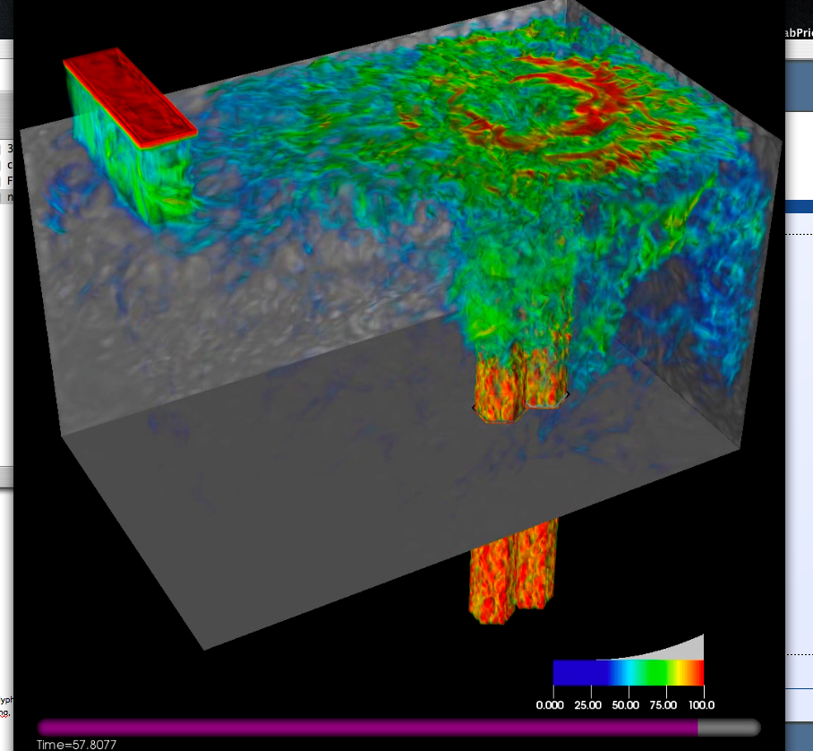
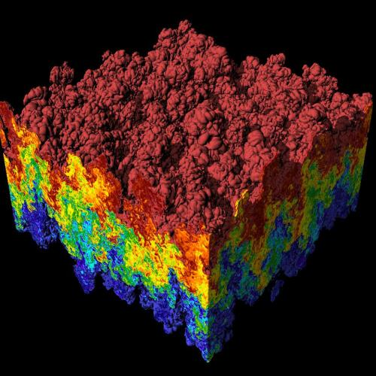
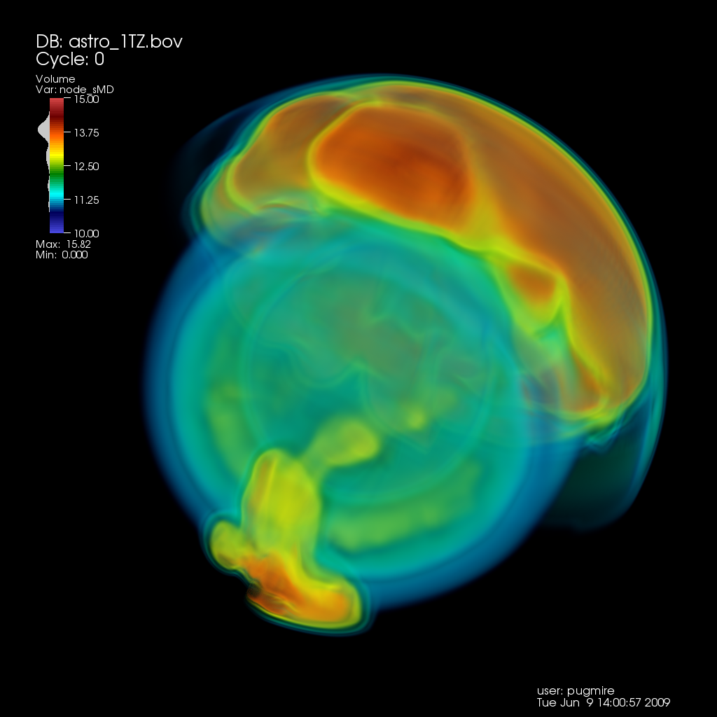
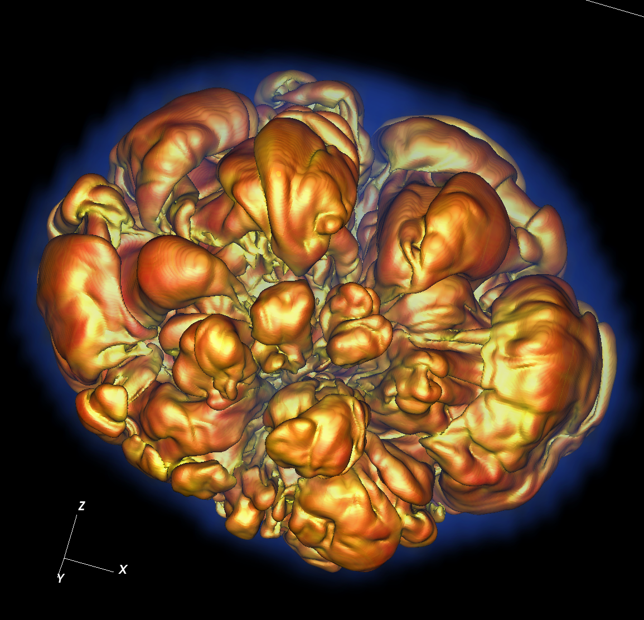
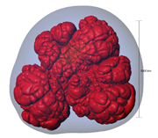
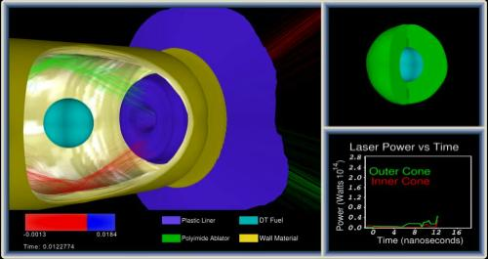
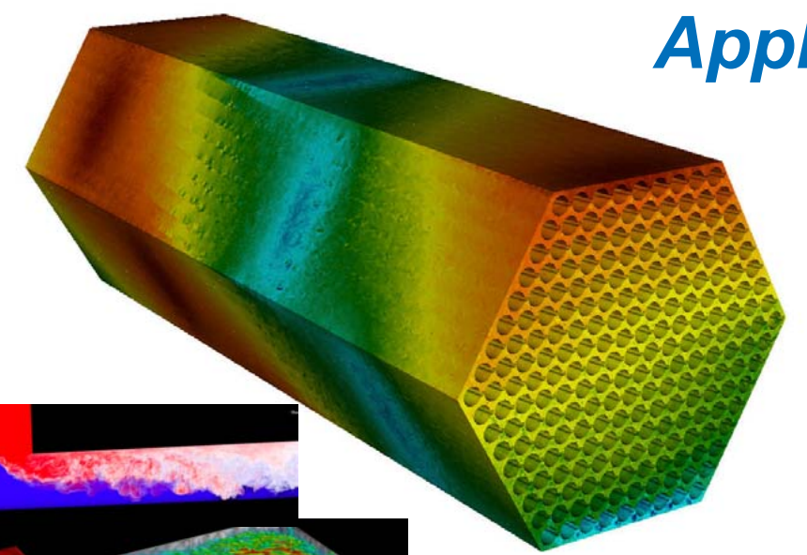
CIS 441/541: Intro to Computer Graphics Lecture 14: Collisions and Level-of-Detail
May 25, 2021
Hank Childs, University of Oregon

Slide 2
Office Hours
Now only 1 OH per week
Hank, Weds 230-330
Abhishek still doing a lot...

Slide 3
3A
If you make mistakes uploading textures, OpenGL often just defaults to the first texture
Wanted: colored by texture1 and tiger striped by texture 2
Got: colored by texture1 and tiger striped by texture 1

Slide 4
Project 3.X
3B (collisions) and 3C (level-of-detail) will be released today
Other projects are in progress

Slide 5
Plan – Parentheticals Are Likely to Change
This went well before, let’s do it again
Week | Sun | Mon | Tues | Weds | Thurs | Fri | Sat
8 |  | 2B due | Lec13 (mouse+camera) (textures) 3A avail Proposals due |  | Lec14 (ray tracing) Quiz 4 (GL)
9 |  |  | Lec15 (textures) Live code 3B, 3C, ... avail |  | Quiz 5 (project 1D)
10 |  |  | More lecture |  | Quiz makeup
Finals Week |  |  | Final Projects due All other work due: 1A-1F, 2A-2B not accepted after this point

Slide 6
Plan for Thursday
Start at 9am
9am-915am: Q&A on miscellaneous topics
915am-945am: Quiz 4
Arrive no later than 910am

Slide 7
Quiz 4
This quiz will test what you learned in Project 1D.
Sorry to be reaching back to a project from a month ago, but there is a concept there I want to do the quiz on

Slide 8
3.X
3B: collisions
3C: level of detail

Slide 9
Collision Detection

Slide 10
Collision Detection
Collision detection: as objects in the scene move, figure out when they collide and perform appropriate action (typically bouncing)
Game setting: 30 FPS, meaning 0.033s to figure out what to render and render it.
→Need to do this quickly!

Slide 11
Collision Detection
Two flavors:
A priori
before the collision occurs
calculate the trajectory of each object and put in collision events right before they occur
A posteriori
after the collision occurs
with each advance, see if anything has hit or gotten close

Slide 12
How to Do Collision Detection: Brute Force
For each object X
For each other object Y
Check if X and Y collide
→ O(n^2)

Slide 13
How to Do Collision Detection: Spatial Search Structures
Divide volume into many cubes
Place each object into its cube
For each cube
Check to see if objects in cube have collided
→ O(n)
... Sort of / kind of / not really
How many cubes?
What is they all end up in the same cube
So maybe expected run time is O(n).

Slide 14
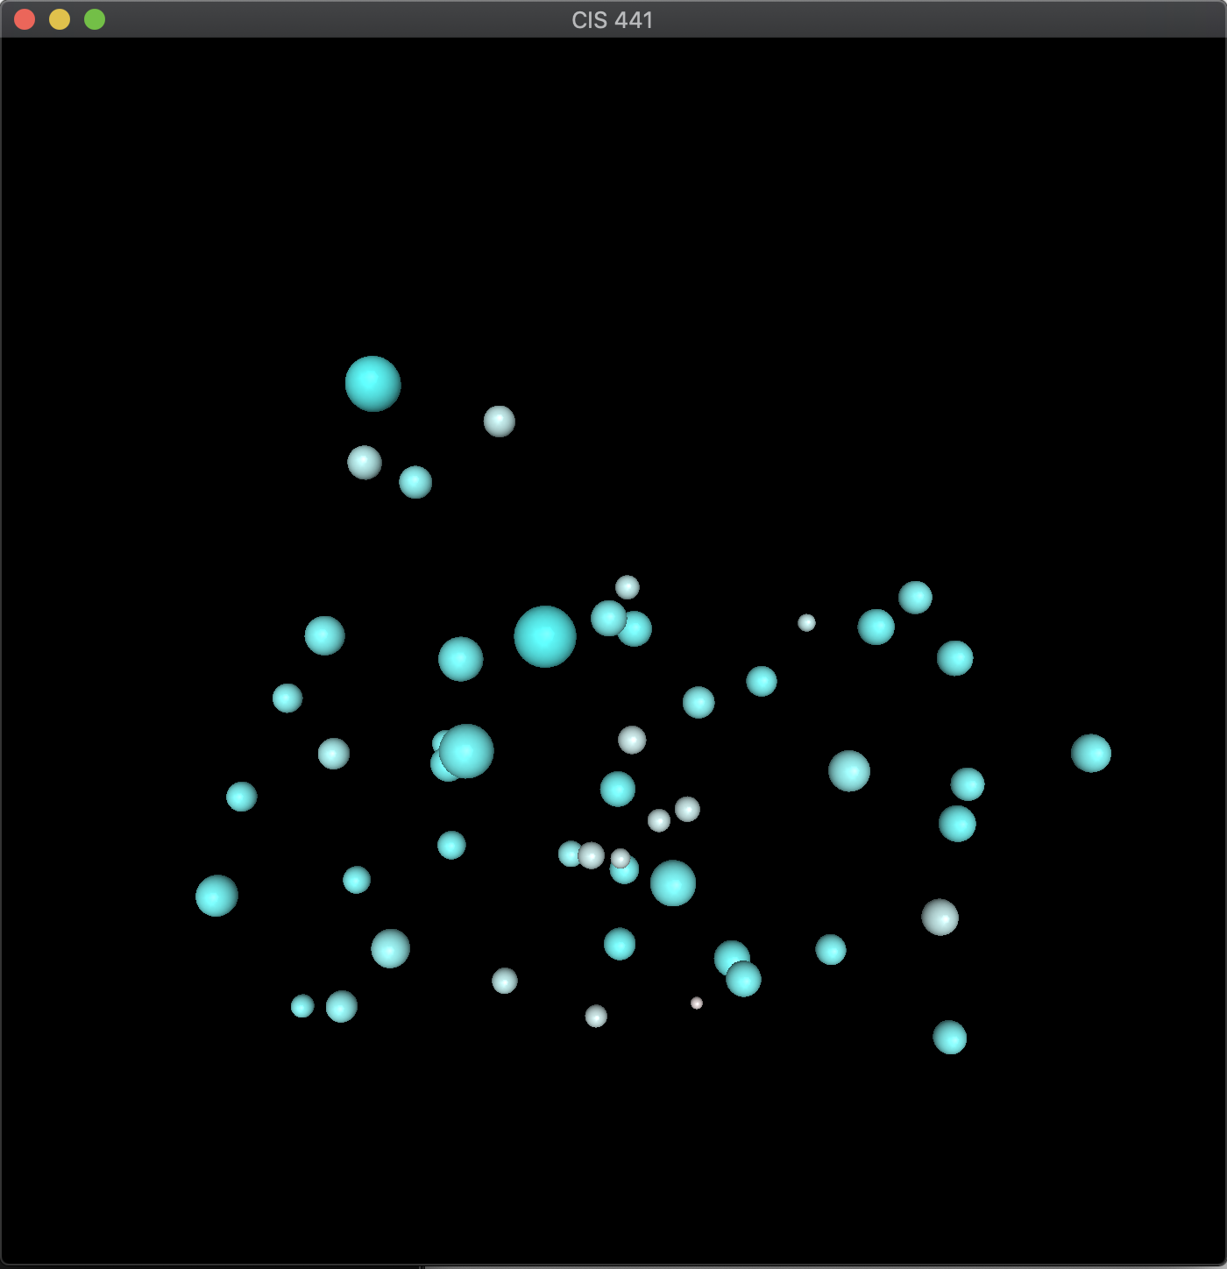
3B
Brute force on collision detection
Few enough objects that spatial search structures are not needed
But nice effects for colliding balls

Slide 15
Level of detail (LOD) techniques
level of detail: decreasing the complexity of some 3D object representations, because they
are far away
are moving fast
are not important
increases the efficiency of rendering by decreasing the workload on graphics pipeline stages
reduced visual quality of the model is often unnoticed because of the small effect on object appearance when distant or moving fast

Slide 16
Types of LOD
Two types:
Discrete LoD (DLoD)
Continuous LoD (CLoD)

Slide 17
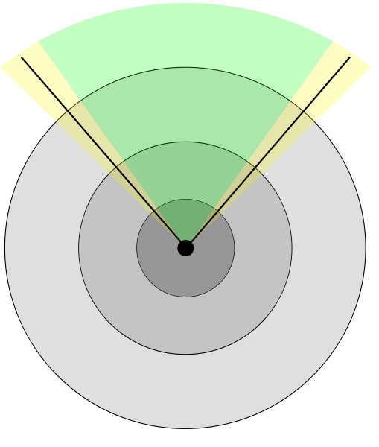
Discrete LoD (DLOD)
Discrete LoD (DLoD)
Make a fixed amount of models, ranging from highest quality to coarse approximation & render appropriate one based on importance factor
Fastest in practice, but leads to “popping”

Slide 18
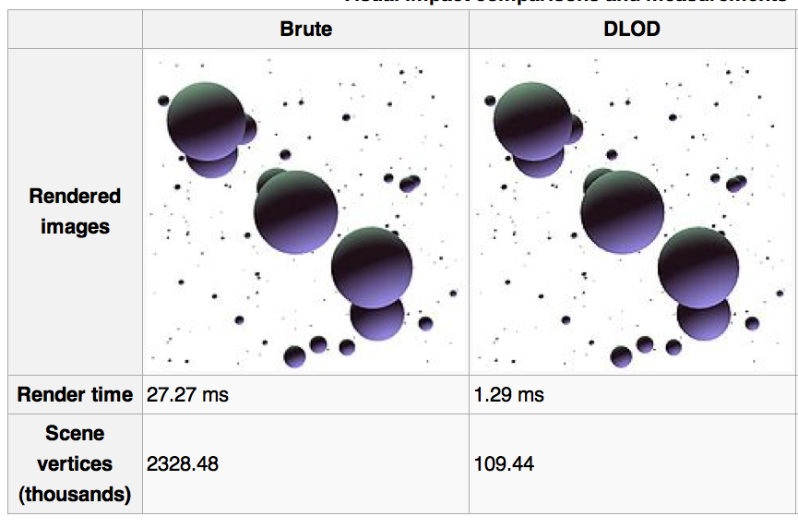
Discrete LoD example

Slide 19
OK, how do we create coarse versions?
How do we take and make these?
Answer: surface decimation (can lecture on this later)

Slide 20
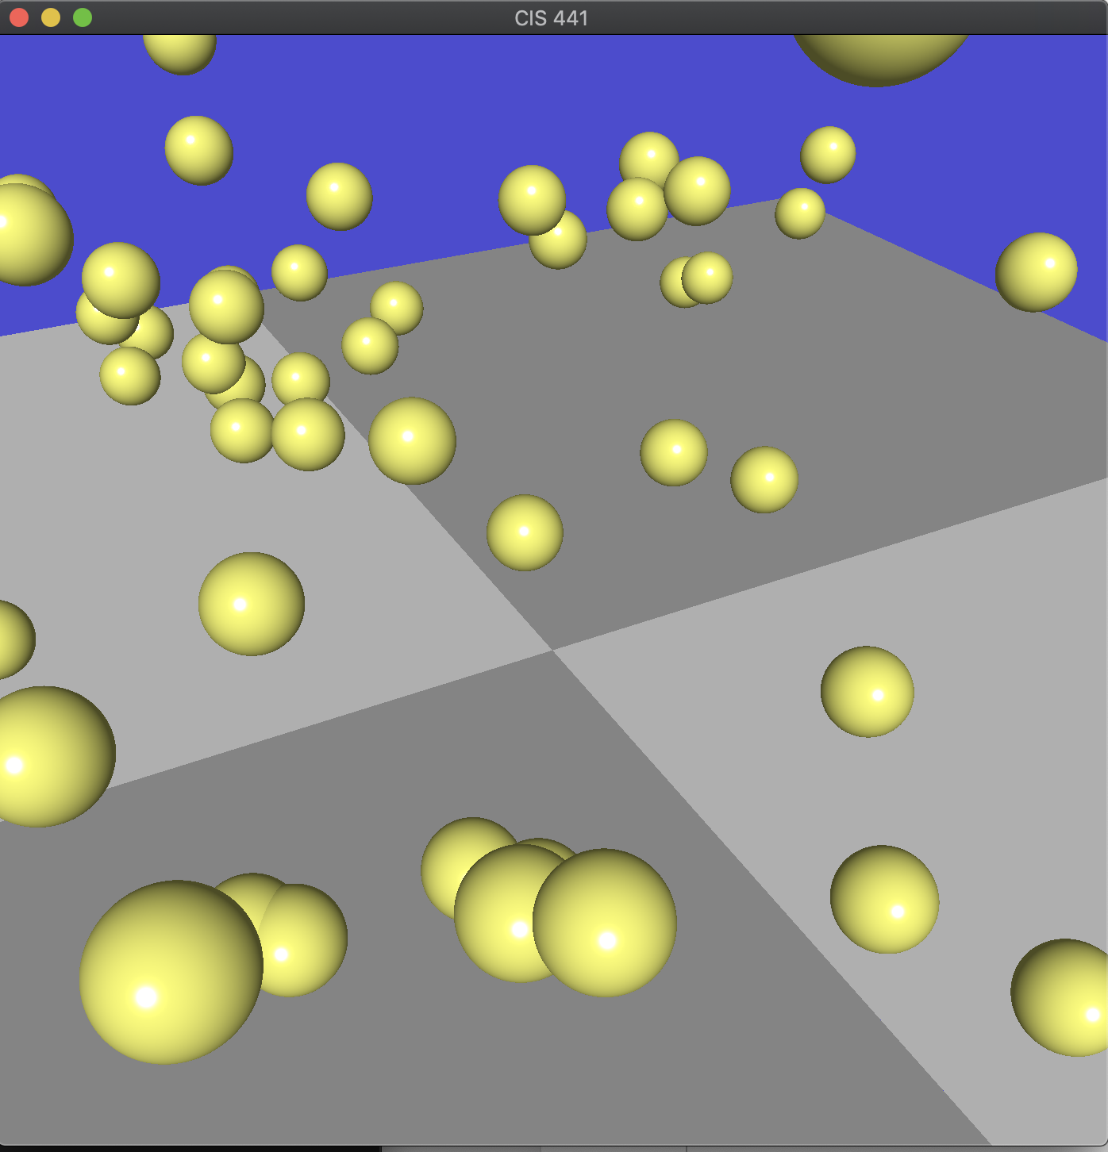
3C
Have 3 levels of details for spheres
Render closer spheres at high LOD, further away at low LOD

