Slide 1
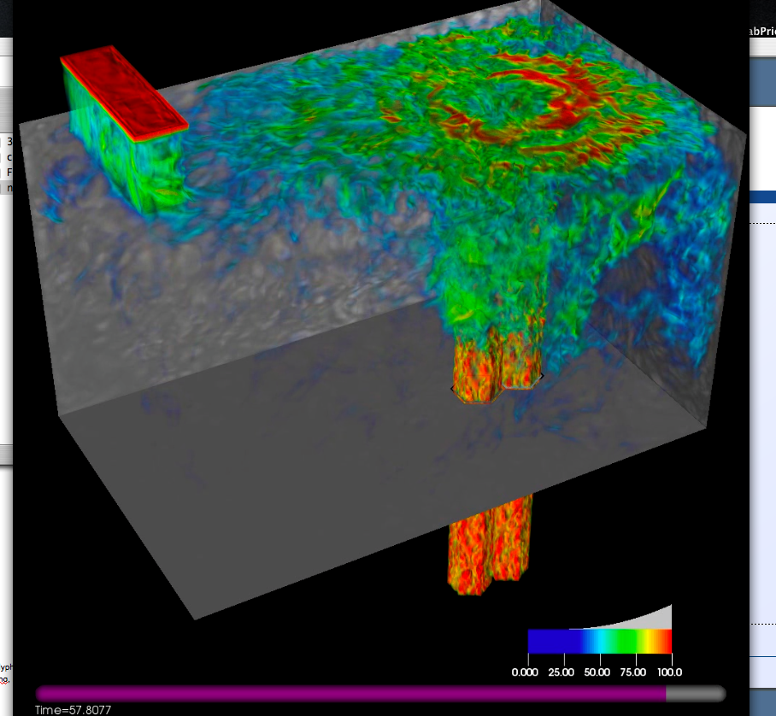
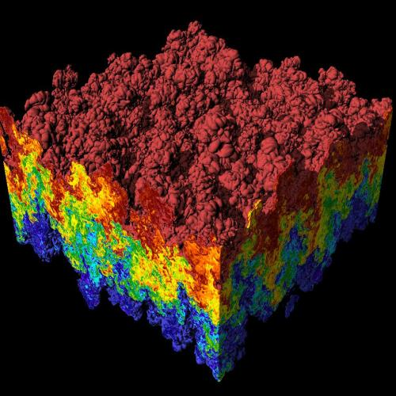
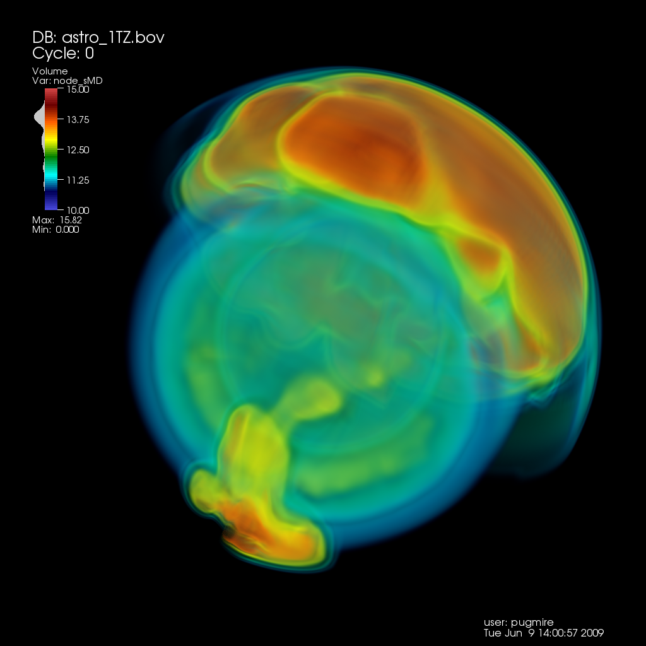
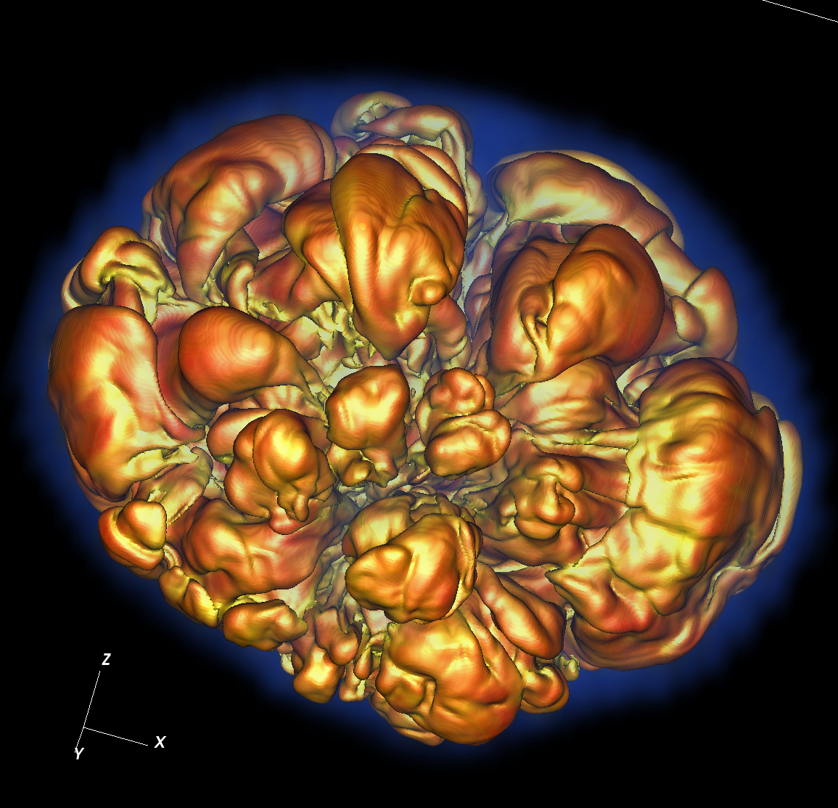
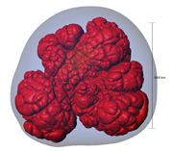
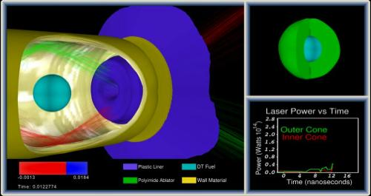
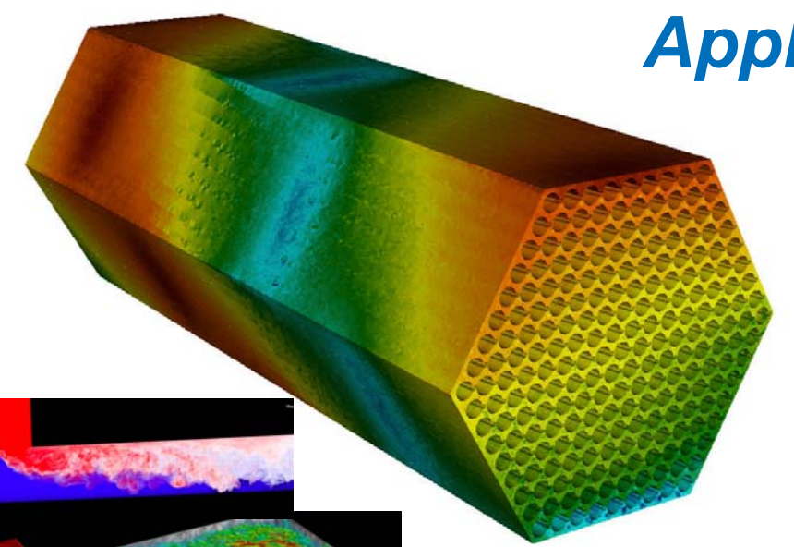
CIS 441/541: Intro to Computer Graphics
Lecture 12: Textures and Ray Tracing
May 18, 2021
Hank Childs, University of Oregon

Slide 2

Office Hours

Slide 3
Discuss Quiz 3

Slide 4
Two Choices for Final Project
Custom final project
  You define the project, should be ~25 hours of work
  Present project to class/judges on Finals Week
Pre-defined projects
  Pick three 8-hour projects from a menu of 4-6 projects
Whether you do custom or pre-defined, you must attend the final period and watch the presentations
  -4 points if you skip

Slide 5
Pre-Defined Projects
Planning on having 4-6 pre-defined projects
You choose 3
On Tuesday May 18th, we will release project 2C 3A
  Likely: view manipulation from keyboard events
On Tuesday May 25th, we will release the rest of the projects
  (possibly called 2D, 2E, 2F, etc.) (called 3B, 3C, 3D, etc.)
  These projects are TBD, but likely to include topics such as: texturing, physically based rendering, mirrors

Slide 6
Custom Project Ideas
Implement a game
Implement a screen saver
Build a model of something
Implement a neat rendering effect
  Many folks try ray tracing (will discuss this later this lecture)
... Will show examples in a few slides

Slide 7
Custom Project Proposals
If you want to do a custom project, please send me a proposal
“Deadline”: ideally Tuesday May 18th (today)
Why?
  Get the scope right
  Make an agreement early on
    Protects you and me
Important concept: minimum viable deliverable
Proposal can be whatever length you see fit
  One paragraph is fine

Slide 8
Remaining Lectures
In support of project 3A/3B/3C/...
In support of custom projects
  (Ray tracing lecture)

Slide 9
Plan – Parentheticals Are Likely to Change
This went well before, let’s do it again
Week | Sun | Mon | Tues | Weds | Thurs | Fri | Sat
8 |  | 2B due | Lec13 (mouse+camera) (textures) 3A avail Proposals due |  | Lec14 (ray tracing) Quiz 4 (GL)
9 |  |  | Lec15 (textures) 3B, 3C, ... avail |  | Lec16 Quiz 5 (rasterization)
10 |  |  | Live code |  | Quiz makeup
Finals Week |  |  | Final Projects due All other work due: 1A-1F, 2A-2B not accepted after this point

Slide 10
Plan for Thursday
830-900: 541 students only (discussion of project G)
900am-915am: general class discussion
915am: Quiz 4 starts
Note: 441 students join at 9am

Slide 11
Textures

Slide 12
Textures
“Textures” are a mechanism in OpenGL
Mechanism is useful for many things
  One of these is add “texture” to a surface, hence the name
There are “1D”, “2D”, and “3D” textures
  Most common is 2D, and placing “texture” on surfaces

Slide 13
Motivation
Making a video game
Have a brick wall in the background
Want it to look like a brick wall
But do not want to make a huge amount of geometry
  Why not?
Textures can help
Value proposition: better look with less geometry

Slide 14
How Do Textures Work?
Step 1: new fields on your geometry
Called “texture coordinates”
Step 2: textures are loaded onto
GPU
(0,1.0)
(0.3,1.0)
(1.0,1.0)
GPU memory
(0,0)
(0.7,0)
(1.0,1.0)
Step 3: texture coordinates and texture data are available during rasterization
Lots of ways to make graphics effects
Most common: use texture coordinates to look up pixel color in texture data and then assign fragment that color

Slide 15
Textures for Fragment Color
(0,1.0)
(0.3,1.0)
(1.0,1.0)
(0,0)
(0.7,0)
(1.0,1.0)
A fragment shader can then go to the image and find the corresponding color
Assume a fragment lies here
Texture coordinates are a field and will be LERP’ed like any other field
→ (0.3, 0.45)
The color at that pixel becomes the color of the fragment

Slide 16
Observation #1
Did not use top 20% of the texture.
No problem. Maybe other triangles will. Maybe not. Not an issue either way.
(0,0.8)
(0.3,0.8)
(1.0,0.8)
(0,0)
(0.7,0)
(1.0,1.0)
A fragment shader can then go to the image and find the corresponding color
Assume a fragment lies here
Texture coordinates are a field and will be LERP’ed like any other field
→ (0.3, 0.35)
The color at that pixel becomes the color of the fragment

Slide 17
Observation #2
Camera zoomed in one triangle? No problem. Just get lots of fragments, which means lots of nearby pixels in the texture image
(0,1.0)
(0.3,1.0)
(1.0,1.0)
(0,0)
(0.7,0)
(1.0,1.0)
A fragment shader can then go to the image and find the corresponding color
Assume a fragment lies here
Texture coordinates are a field and will be LERP’ed like any other field
→ (0.3, 0.45)
The color at that pixel becomes the color of the fragment

Slide 18
Actual OpenGL Code
Step 1: new fields on your geometry
Called “texture coordinates”
Step 2: textures are loaded onto
GPU
(0,1.0)
(0.3,1.0)
(1.0,1.0)
GPU memory
(0,0)
(0.7,0)
(1.0,1.0)
Step 3: texture coordinates and texture data are available during rasterization
Lots of ways to make graphics effects
Most common: use texture coordinates to look up pixel color in texture data and then assign fragment that color

Slide 19

Step 1: New Fields on Your Geometry
OpenGL is all set up for texture coordinates
Just another VBO that goes within a VAO
(This is an image from Lecture 9 about making a VBO for points)
(With textures, there are 2 floats per vertex for 2D textures,
1 float per vertex for 1D textures, etc.)

Slide 20
Actual OpenGL Code
Step 1: new fields on your geometry
Called “texture coordinates”
Step 2: textures are loaded onto
GPU
(0,1.0)
(0.3,1.0)
(1.0,1.0)
GPU memory
(0,0)
(0.7,0)
(1.0,1.0)
Step 3: texture coordinates and texture data are available during rasterization
Lots of ways to make graphics effects
Most common: use texture coordinates to look up pixel color in texture data and then assign fragment that color

Slide 21
Steps for Loading Texture to GPU
1) Generate the texture
2) Tell the shader program how to access the texture

Slide 22
Steps for Loading Texture to GPU
1) Generate the texture
2) Tell the shader program how to access the texture

Slide 23
Generating a Texture
Very similar to VBOs
Now:
  glGenTextures
  glBindTexture
  glTexImage2D (like glBufferData)
With 2 extra steps

Slide 24
Generating a Texture
glGenTextures
glActiveTexture
glBindTexture
glTexImage2D
glGenerateMipmap

Slide 25
Generating a Texture
glGenTextures
glActiveTexture
glBindTexture
glTexImage2D
glGenerateMipmap

Slide 26
glGenTextures
Generates a handle.
  You to OpenGL: I want to make some textures
  OpenGL: let’s refer to your textures using the following numbers
Note: can generate multiple handles
If you are doing multiple textures, then you call glGenTextures one time total
  The rest of the calls are once per texture
Example:
  GLuint textures[2]; glGenTextures(2, textures);

Slide 27
Generating a Texture
glGenTextures
glActiveTexture
glBindTexture
glTexImage2D
glGenerateMipmap

Slide 28
glActiveTexture
The GPU can support many textures
Each texture is given an ID (texture0, texture1, etc.)
This call tells the GPU which texture you will be referring to
Example:
  glActiveTexture(GL_TEXTURE0);
  Also:
    glActiveTexture(GL_TEXTURE1);
    glActiveTexture(GL_TEXTURE0+1);

Slide 29
Generating a Texture
glGenTextures
glActiveTexture
glBindTexture
glTexImage2D
glGenerateMipmap

Slide 30
glBindTexture
Two purposes:
  (1) make this texture be current
    Meaning subsequent calls refer to this texture
  (2) specify the texture type (1D, 2D, 3D)
Example:
  glBindTexture(GL_TEXTURE_1D, textures[0]);

Slide 31
Generating a Texture
glGenTextures
glActiveTexture
glBindTexture
glTexImage2D
glGenerateMipmap

Slide 32
glTexImage1D
Sends texture data to GPU
Example:
  glTexImage1D(GL_TEXTURE_1D, 0, GL_RGB, num, 0, GL_RGB, GL_UNSIGNED_BYTE, data);
  This example: 256 colors
    num is 256
    data: array of size 256*3 bytes
    GL_RGB means colors
      GL_RED when just a single value
  Other values are for data layouts we are not using
    Example: load one giant buffer with vertex position, normals, texture coordinates, etc., and use offsets

Slide 33
Generating a Texture
glGenTextures
glActiveTexture
glBindTexture
glTexImage2D
glGenerateMipmap

Slide 34
Mipmaps
Mipmaps: pre-calculated, optimized collections of images that accompany a main texture, intended to increase rendering speed and reduce aliasing artifacts
Widely used in 3D computer games, flight simulators and other 3D imaging systems
In use, it is called “mipmapping”
The letters "MIP" in the name are an acronym of the Latin phrase multum in parvo, meaning "much in little”

Slide 35
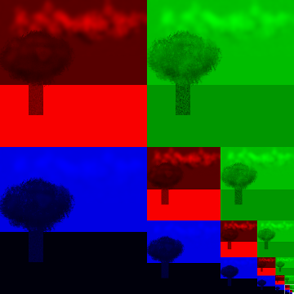
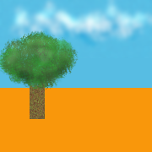
Mipmaps

Slide 36
glGenerateMipMap
glGenerateMipmap(GL_TEXTURE_1D);

Slide 37
Steps for Loading Texture to GPU
1) Generate the texture <-- We just finished this part
2) Tell the shader program how to access the texture

Slide 38
Tell the Shader Program How to Access the Texture
GLuint texture1Location = glGetUniformLocation(shader_program, "texture1");
glUniform1i(texture1Location, 0);
The texture referred to as “texture1” is located in the first texture location (i.e., GL_TEXTURE0)

Slide 39
Tell the Shader Program How to Access the Texture
GLuint texture1Location = glGetUniformLocation(shader_program, ”random_name");
glUniform1i(texture1Location, 5);
The texture referred to as “random_name” is located in the sixth texture location (i.e., GL_TEXTURE0+5)

Slide 40
Actual OpenGL Code
Step 1: new fields on your geometry
Called “texture coordinates”
Step 2: textures are loaded onto
GPU
(0,1.0)
(0.3,1.0)
(1.0,1.0)
GPU memory
(0,0)
(0.7,0)
(1.0,1.0)
Step 3: texture coordinates and texture data are available during rasterization
Lots of ways to make graphics effects
Most common: use texture coordinates to look up pixel color in texture data and then assign fragment that color

Slide 41
Two New GLSL Constructs for Shaders
1) Textures have their own type: sampler1D, sampler2D, sampler3D
  Other types we know: float, vec4, etc.
2) There is a special function that does texture lookups, called “texture”
Example fragment shader:
  in float tex_coord;
  uniform sampler1D random_name;
  void main() {
    frag_color = texture(random_name, tex_coord);
  }

Slide 42
Project 3A: 1D Textures
Will use two 1D textures

Slide 43
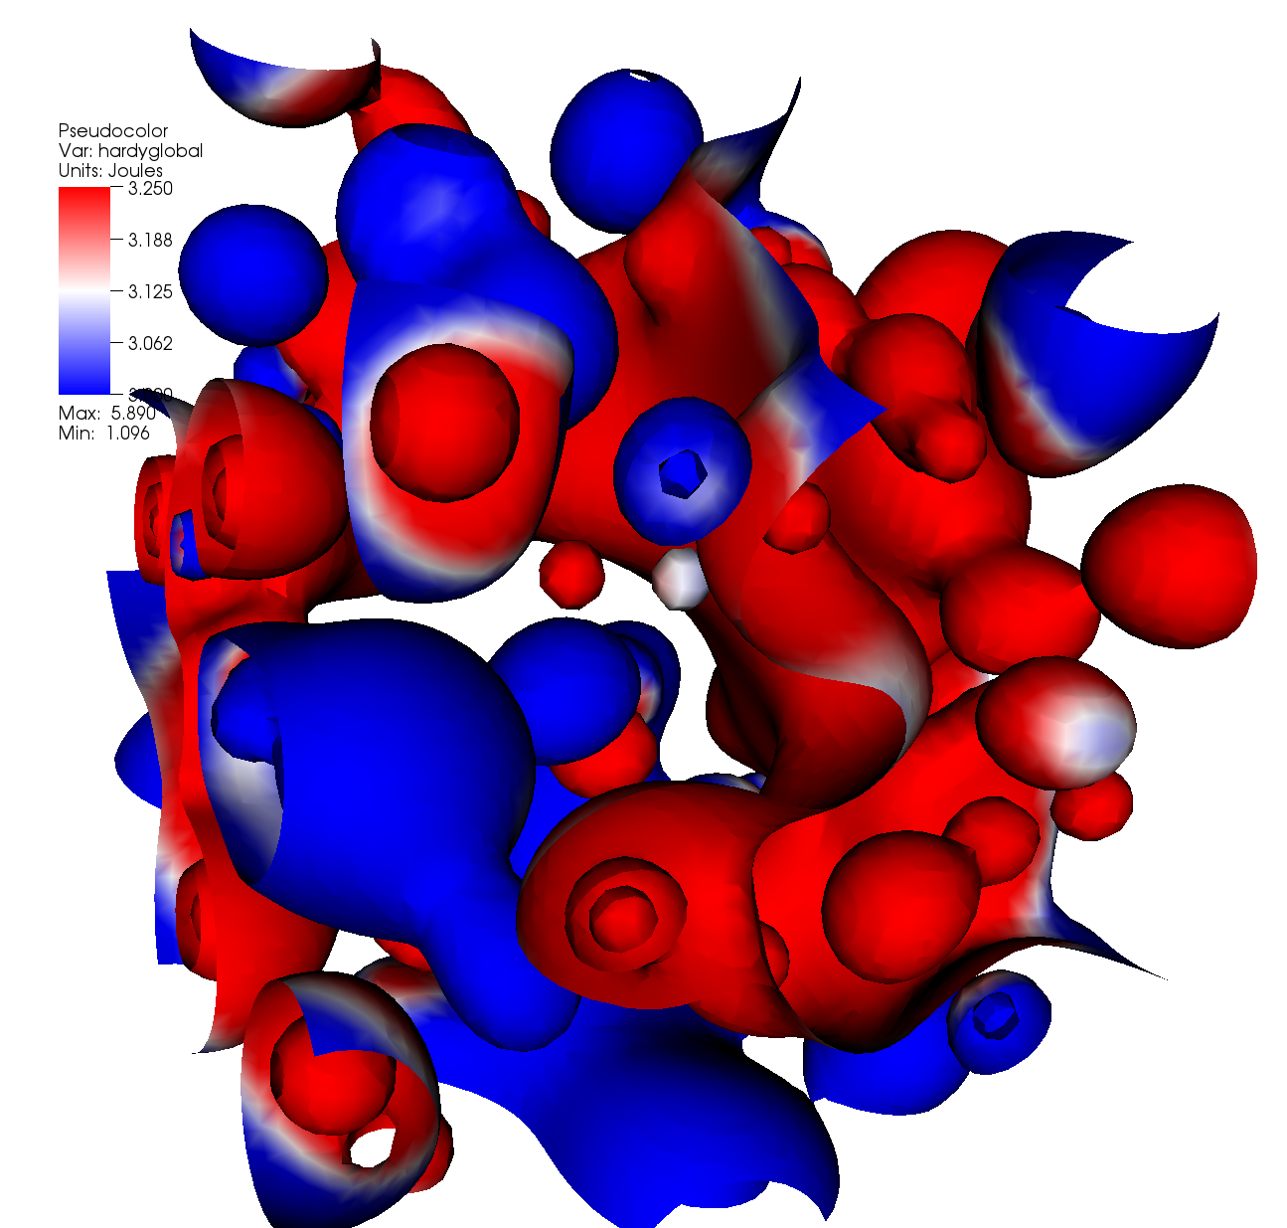
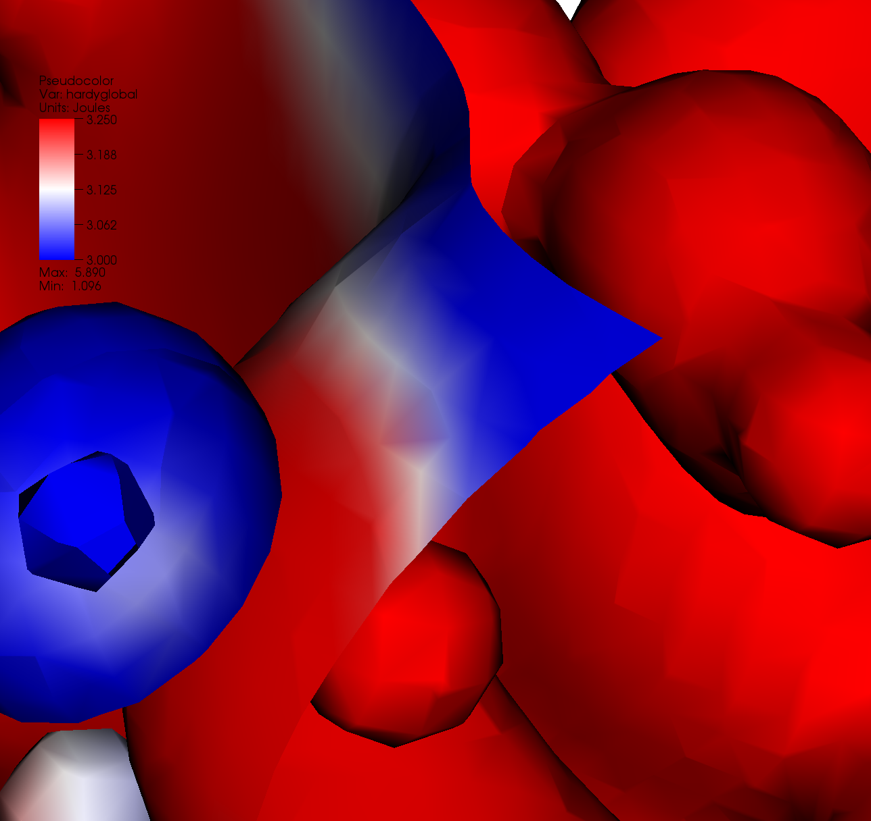
Visualization use case
Why is there purple in this picture?

Slide 44
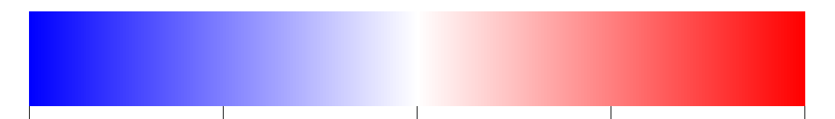
Two Ideas
Plan #1: send colors through rasterization
  Problem: get “purple”
Plan #2: send data values through rasterization
  Fragment shader map data value to texture coordinate, then uses texture coordinate to look up color in 1D texture
0.0
0.5
1.0

Slide 45
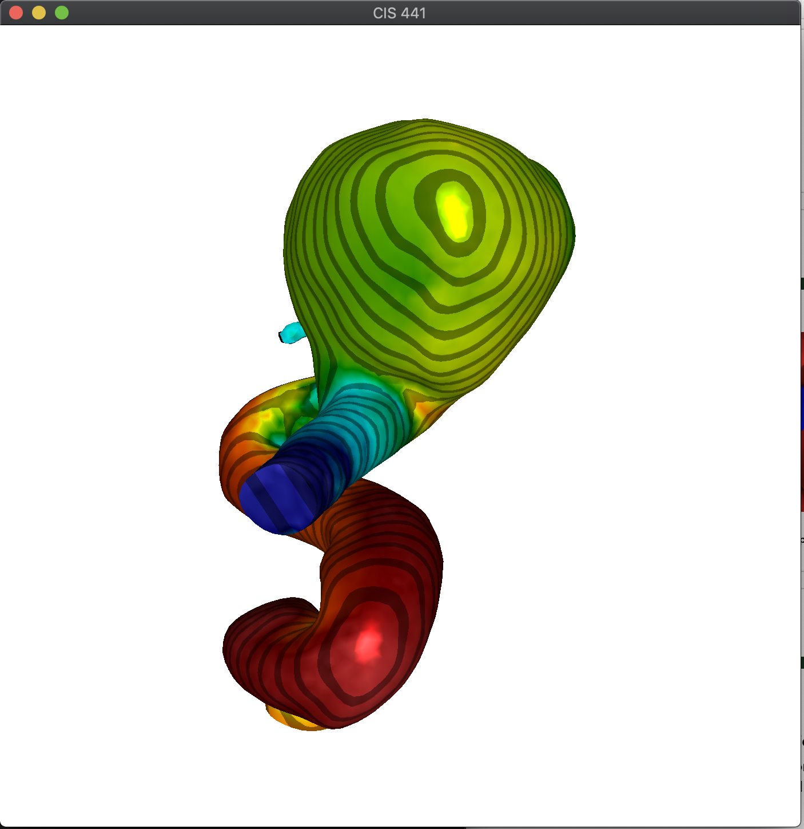
3A: why *two* 1D textures?
One texture creates colors
Second texture creates “tiger stripe” effect
Practice using multiple textures

Slide 46
Introduction to Ray Tracing
Dr. Xiaoyu Zhang
Cal State U., San Marcos

Slide 47
Classifying Rendering Algorithms
One way to classify rendering algorithms is according to the type of light interactions they capture
For example: The OpenGL lighting model captures:
  Direct light to surface to eye light transport
  Diffuse and rough specular surface reflectance
  It actually doesn’t do light to surface transport correctly, because it doesn’t do shadows
We would like a way of classifying interactions: light paths

Slide 48
Classifying Light Paths
Classify light paths according to where they come from, where they go to, and what they do along the way
Assume only two types of surface interactions:
  Pure diffuse, D
  Pure specular, S
Assume all paths of interest:
  Start at a light source, L
  End at the eye, E
Use regular expressions on the letters D, S, L and E to describe light paths
  Valid paths are L(D|S)*E

Slide 49
Simple Light Path Examples
LE
  The light goes straight from the source to the viewer
LDE
  The light goes from the light to a diffuse surface that the viewer can see
LSE
  The light is reflected off a mirror into the viewer’s eyes
L(S|D)E
  The light is reflected off either a diffuse surface or a specular surface toward the viewer
Which do OpenGL (approximately) support?

Slide 50
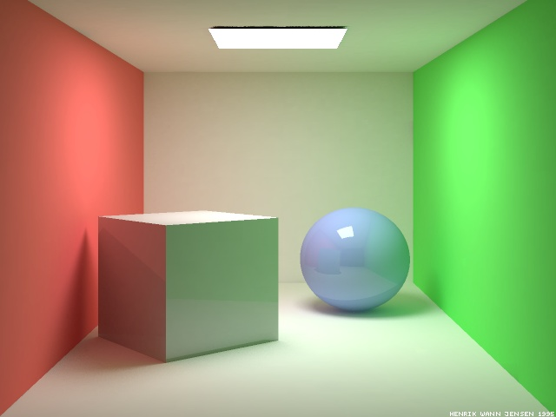
More Complex Light Paths
Find the following:
  LE
  LDE
  LSE
  LDDE
  LDSE
  LSDE
Radiosity Cornell box, due to Henrik wann Jensen,
http://www.gk.dtu.dk/~hwj, rendered with ray tracer

Slide 51
More Complex Light Paths
LE
LDDE
LSDE
LSE
LDSE
LDE

Slide 52
The OpenGL Model
The “standard” graphics lighting model captures only L(D|S)E
It is missing:
  Light taking more than one diffuse bounce: LD*E
    Should produce an effect called color bleeding, among other things
    Approximated, grossly, by ambient light
  Light refracted through curved glass
    Consider the refraction as a “mirror” bounce: LDSE
  Light bouncing off a mirror to illuminate a diffuse surface: LS+D+E
  Many others
  Not sufficient for photo-realistic rendering

Slide 53

Raytraced Images
PCKTWTCH by Kevin Odhner, POV-Ray

Slide 54
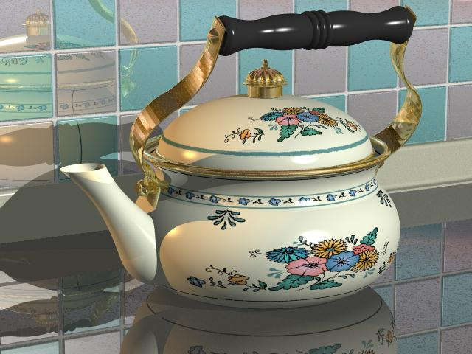
Kettle, Mike Miller, POV-Ray

Slide 55
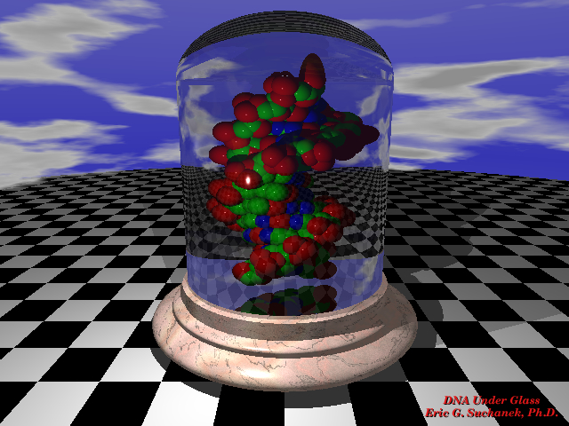

Slide 56
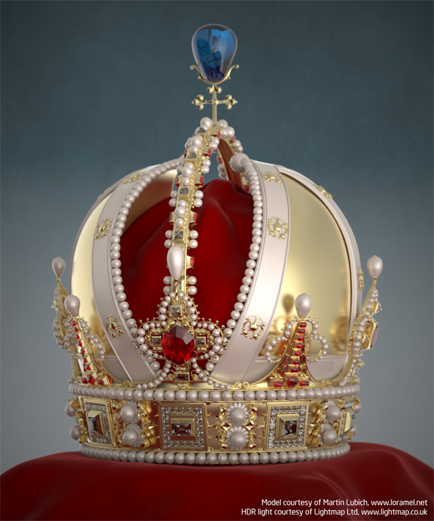
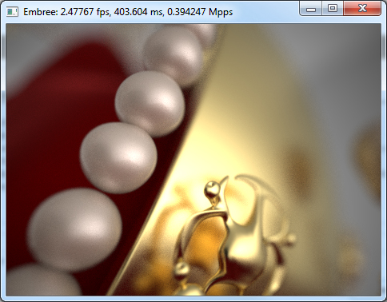
The previous slides now look like amateur hour…

Slide 57
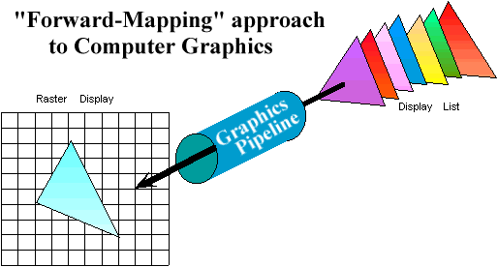
Graphics Pipeline Review
Properties of the Graphics Pipeline
  Primitives are transformed and projected (not depending on display resolution)
  Primitives are processed one at a time
  Forward-mapping from geometrical space to image space

Slide 58
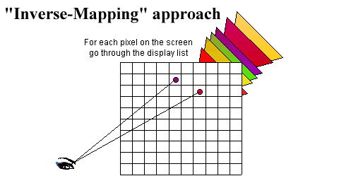
Alternative Approaches: Ray CASTING (not Ray TRACING)
Ray-casting searches along lines of sight, or rays, to determine the primitive that is visible along it.
Properties of ray-casting:
Go through all primitives at each pixel
Image space sample first
Analytic processing afterwards

Slide 59
Ray Casting Overview
For every pixel shoot a ray from the eye through the pixel.
For every object in the scene
  Find the point of intersection with the ray closest to (and in front of) the eye
  Compute normal at point of intersection
Compute color for pixel based on point and normal at intersection closest to the eye (e.g. by Phong illumination model).
t₀

Slide 60
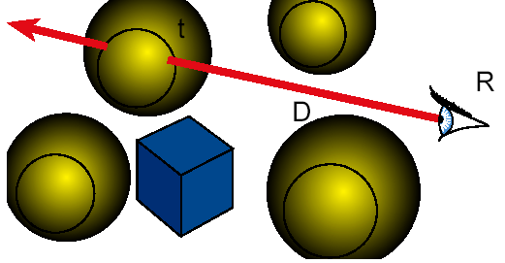
Ray Casting
Ray Cast ( Point R, Ray D ) {
  foreach object in the scene
  find minimum t>0 such that R + t D hits object
  if ( object hit )
  return object
  else return background object
}

Slide 61
Raytracing
Cast rays from the eye point the same way as ray casting
  Builds the image pixel by pixel, one at a time
Cast additional rays from the hit point to determine the pixel color
  Shoot rays toward each light. If they hit something, then the object is shadowed from that light, otherwise use “standard” model for the light
  Reflection rays for mirror surfaces, to see what should be reflected in the mirror
  Refraction rays to see what can be seen through transparent objects
  Sum all the contributions to get the pixel color

Slide 62
Raytracing
Shadow rays
Reflection ray
refracted ray

Slide 63
Recursive Ray Tracing
When a reflected or refracted ray hits a surface, repeat the whole process from that point
  Send out more shadow rays
  Send out new reflected ray (if required)
  Send out a new refracted ray (if required)
  Generally, reduce the weight of each additional ray when computing the contributions to surface color
  Stop when the contribution from a ray is too small to notice or maximum recursion level has been reached

Slide 64
Raytracing Implementation
Raytracing breaks down into two tasks:
  Constructing the rays to cast
  Intersecting rays with geometry
The former problem is simple vector arithmetic
Intersection is essentially root finding (as we will see)
  Any root finding technique can be applied
Intersection calculation can be done in world coordinates or model coordinates

Slide 65
Constructing Rays
Define rays by an initial point and a direction: x(t)=x₀+td
Eye rays: Rays from the eye through a pixel
  Construct using the eye location and the pixel’s location on the image plane. X₀ = eye
Shadow rays: Rays from a point on a surface to the light.
  X₀ = point on surface
Reflection rays: Rays from a point on a surface in the reflection direction
  Construct using laws of reflection. X₀ = surface point
Transmitted rays: Rays from a point on a transparent surface through the surface
  Construct using laws of refraction. X₀ = surface point

Slide 66
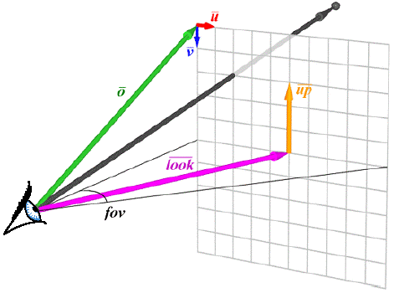
From Pixels to Rays

Slide 67
Ray Tracing Illumination
Recursive
Check for shadowing (intersection with object along ray (P,L))

Slide 68
The Ray Tree
N₃
T₃
R₂
Viewpoint
N₂
T₁
R₃
R₁
L₁
L₂
N₁
L₃
L₁
R₁
T₁
L₂
L₃
Eye
N_{i} surface normal
R_{i} reflected ray
L_{i} shadow ray
T_{i} transmitted (refracted) ray
Psuedo-code
R₂
R₃
T₃

Slide 69
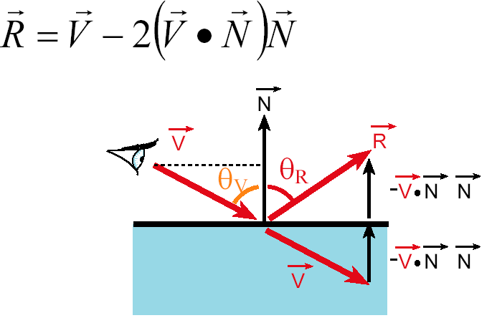
Reflection
Reflection angle = view angle

Slide 70
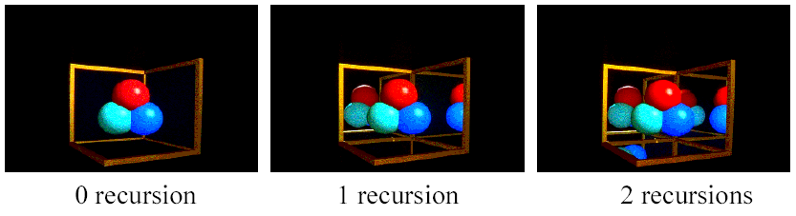
Reflection
The maximum depth of the tree affects the handling of refraction
If we send another reflected ray from here, when do we stop? 2 solutions (complementary)
  Answer 1: Stop at a fixed depth.
  Answer 2: Accumulate product of reflection coefficients and stop when this product is too small.

Slide 71
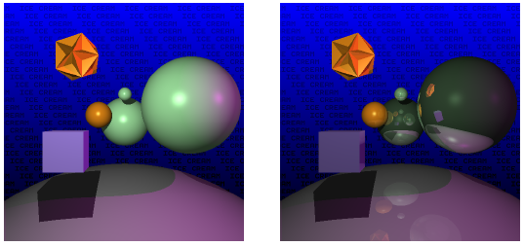
Reflection

Slide 72
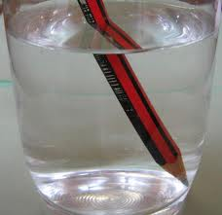
Refraction
Snell’s Law
Note that I is the negative of the incoming ray

Slide 73
Pseudo Code for Ray Tracing
rgb lsou; // intensity of light source
rgb back; // background intensity
rgb ambi; // ambient light intensity
Vector L // vector pointing to light source
Vector N // surface normal
Object objects [n] //list of n objects in scene
float Ks [n] // specular reflectivity factor for each object
float Kr [n] // refractivity index for each object
float Kd [n] // diffuse reflectivity factor for each object
Ray r;
void raytrace() {
for (each pixel P of projection viewport in raster order) {
r = ray emanating from viewer through P
int depth = 1; // depth of ray tree consisting of multiple paths
the pixel color at P = intensity(r, depth)
}
}

Slide 74
rgb intensity (Ray r, int depth) {
Ray flec, frac;
rgb spec, refr, dull, intensity;
if (depth >= 5) intensity = back;
else {
find the closest intersection of r with all objects in scene
if (no intersection) {
intensity =back;
} else {
Take closest intersection which is object[j]
compute normal N at the intersection point
if (Ks[j] >0) { // non-zero specular reflectivity
compute reflection ray flec;
refl = Ks[j]*intensity(flec, depth+1);
} else refl =0;
if (Kr[j]>0) { // non-zero refractivity
compute refraction ray frac;
refr = Kr[j]*intensity(frac, depth+1);
} else refr =0;
check for shadow;
if (shadow) direct = Kd[j]*ambi
else direct = Phong illumination computation;
intensity = direct + refl +refr;
} }
return intensity; }

Slide 75
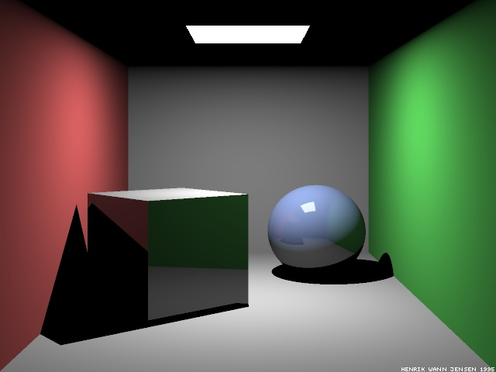
Raytraced Cornell Box
Which paths are missing?
Ray-traced Cornell box, due to Henrik Jensen,
http://www.gk.dtu.dk/~hwj

Slide 76
Paths in RayTracing
Ray Tracing
  Captures LDS*E paths: Start at the eye, any number of specular bounces before ending at a diffuse surface and going to the light
Raytracing cannot do:
  LS*D⁺E: Light bouncing off a shiny surface like a mirror and illuminating a diffuse surface
  LD⁺E: Light bouncing off one diffuse surface to illuminate others
Basic problem: The raytracer doesn’t know where to send rays out of the diffuse surface to capture the incoming light
Also a problem for rough specular reflection
  Fuzzy reflections in rough shiny objects
Need other rendering algorithms that get more paths

Slide 77
A Better Rendered Cornell Box

