Slide 1
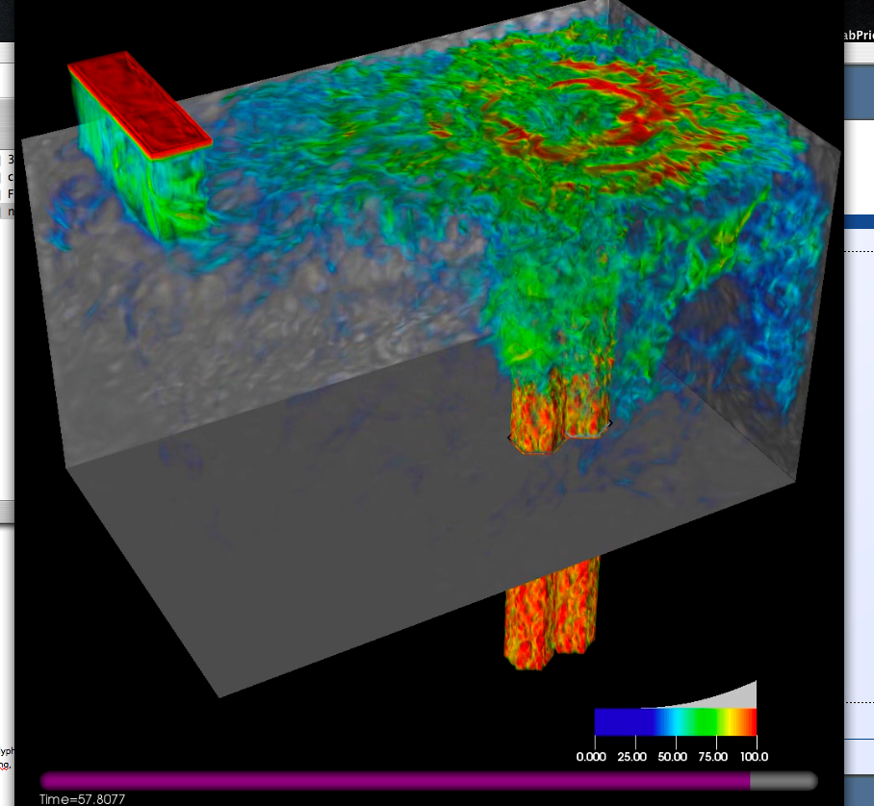
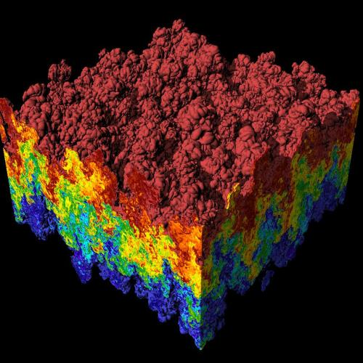
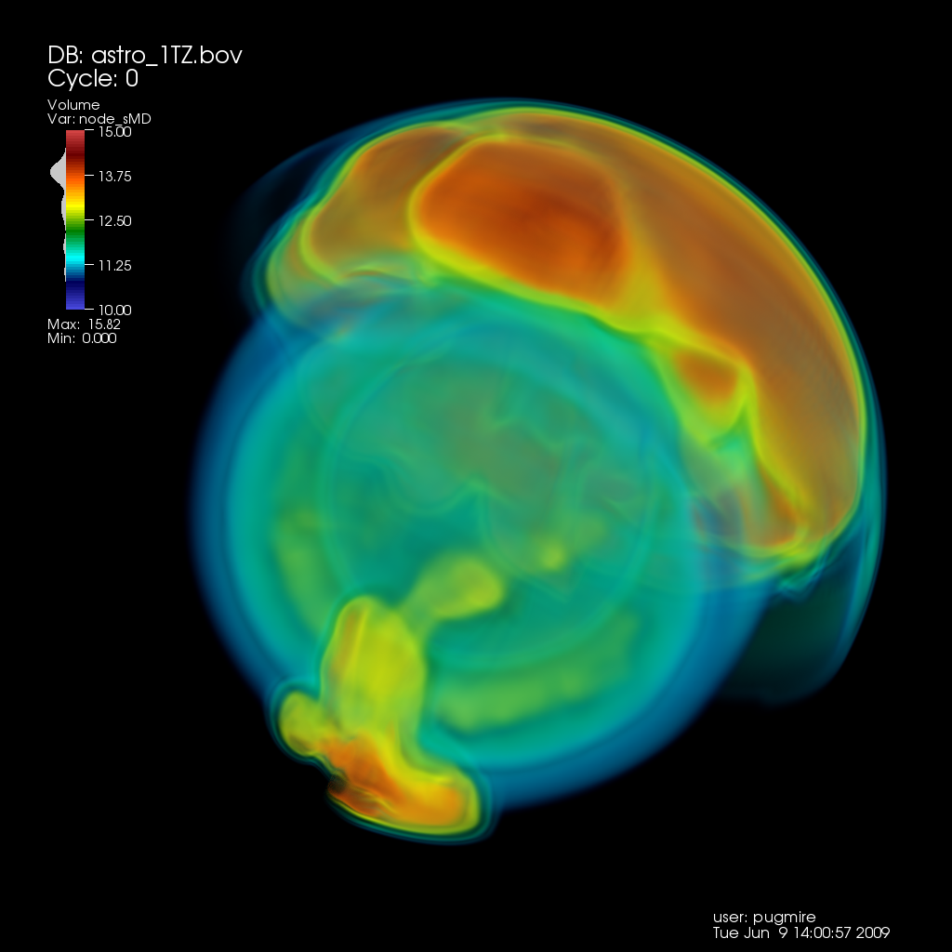
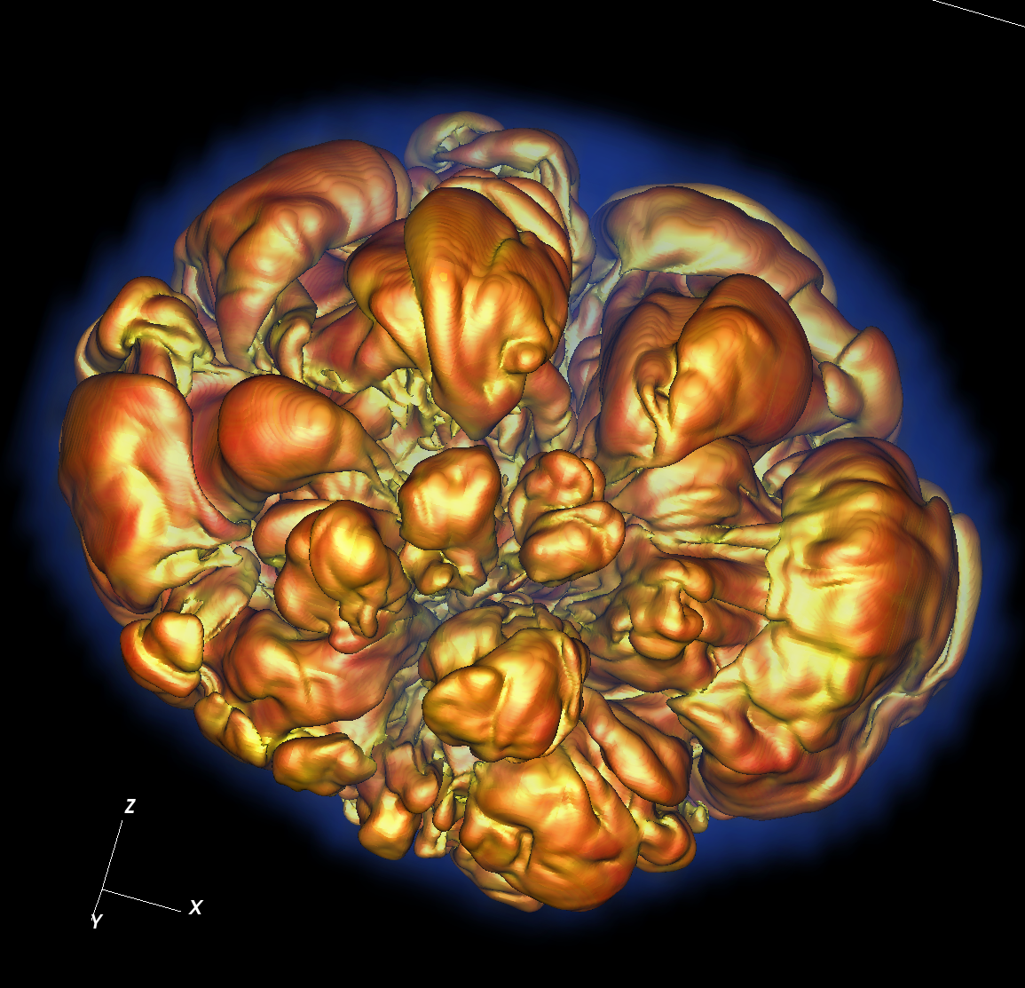
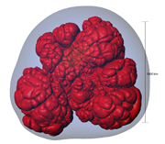
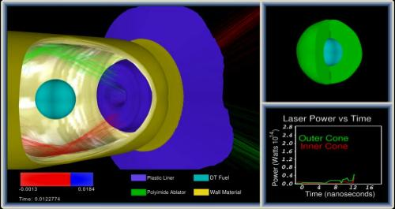
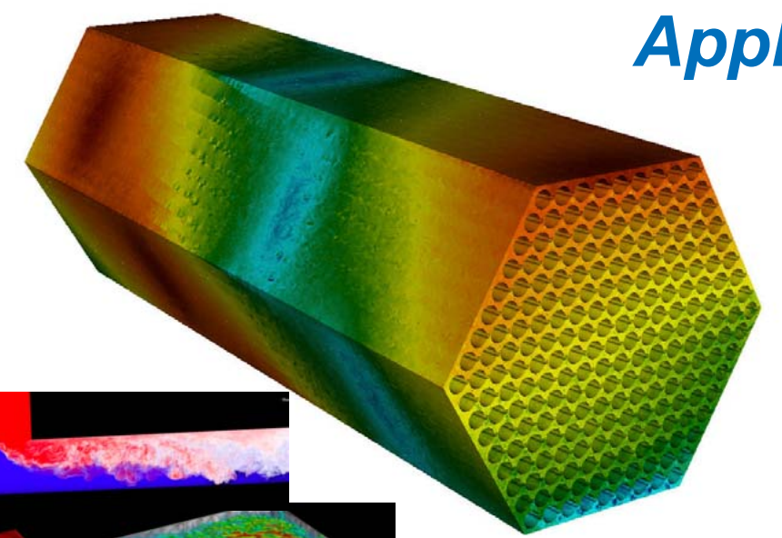
CIS 441/541: Intro to Computer Graphics Lecture 12: Final Projects
May 13, 2021
Hank Childs, University of Oregon

Slide 2
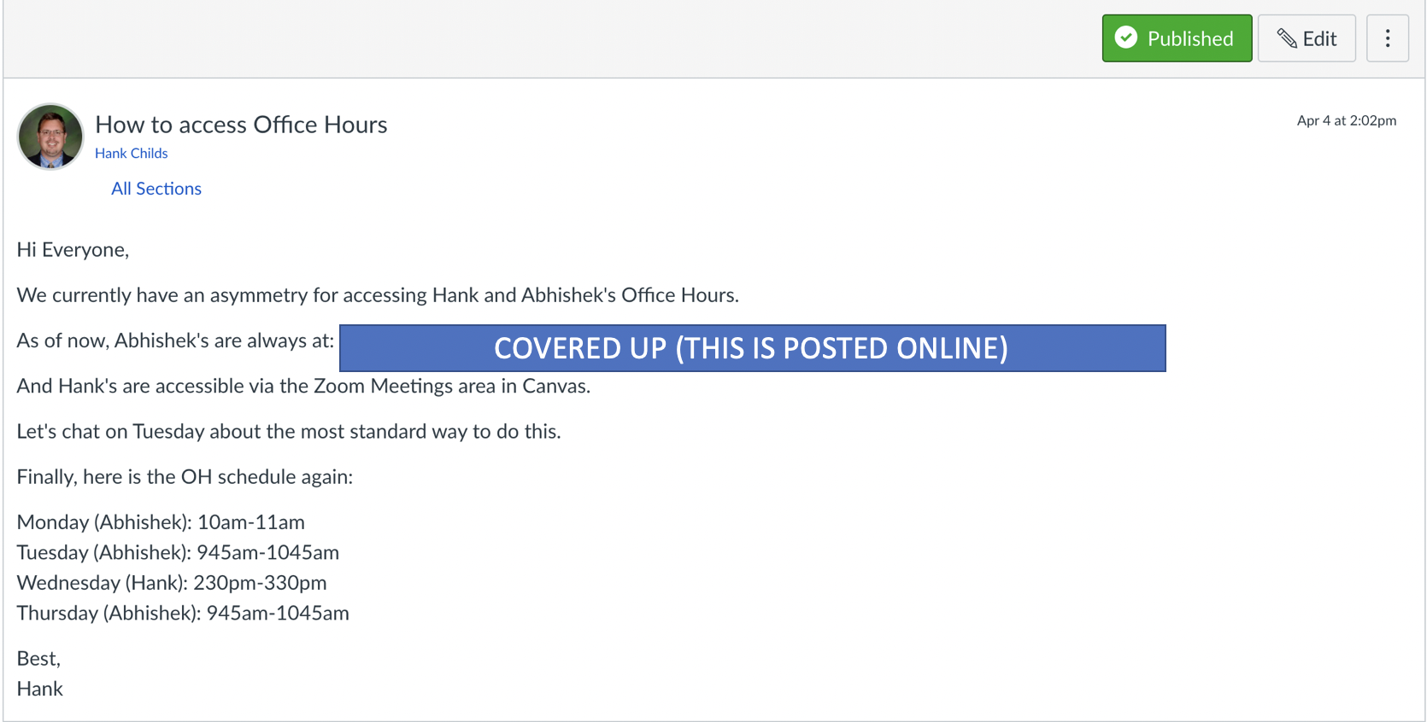
Office Hours

Slide 3
Questions on 2B

Slide 4
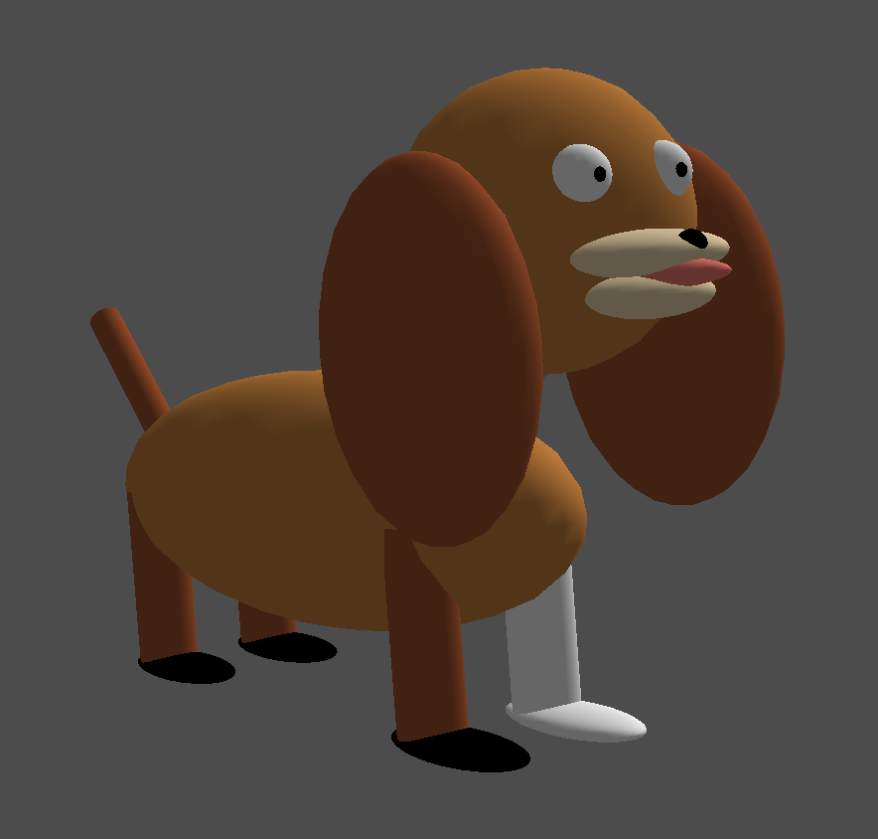
Project #2B (7%), Due Monday May 17th
Goal: modify ModelView matrix to create dog out of spheres and cylinders
New code skeleton: “project2B.cxx”
No geometry file needed
You will be able to do this by rendering ~20 spheres and cylinders, each with their own transform

Slide 5
What Is the Correct Answer?
The correct answer is:
Something that looks like a dog
No obvious problems with output geometry
Something that uses the sphere and cylinder classes
If you use something else, please clear it with me first
I may reject your submission if I think you are using outside resources that make the project too easy
Something that uses rotation
For me: the neck and tail
Something that animates
Aside from that, feel free to be as creative as you want … color, breed, etc.

Slide 6
Final Projects

Slide 7
Two Choices for Final Project
Custom final project
You define the project, should be ~25 hours of work
Present project to class/judges on Finals Week
Pre-defined projects
Pick three 8-hour projects from a menu of 4-6 projects
Whether you do custom or pre-defined, you must attend the final period and watch the presentations
-4 points if you skip

Slide 8
Final Project: 30 Points
Pre-defined: 25/30 points
No option to do extra and get 30/30
Custom:
Project type | Score | Historical trend
Excellent | 30 | ~1/3rd
Very good | 25.5-29.5 | ~1/6th
OK | 25 | ~1/6th
Problem | 16-25 | ~1/3rd

Slide 9
Pre-Defined Projects
Planning on having 4-6 pre-defined projects
You choose 3
On Tuesday May 18th, we will release project 2C
Likely: view manipulation from keyboard events
On Tuesday May 25th, we will release the rest of the projects
(possibly called 2D, 2E, 2F, etc.)
These projects are TBD, but likely to include topics such as: texturing, physically based rendering, mirrors

Slide 10
Custom Project Ideas
Implement a game
Implement a screen saver
Build a model of something
Implement a neat rendering effect
Many folks try ray tracing
... Will show examples in a few slides

Slide 11
Custom Project Proposals
If you want to do a custom project, please send me a proposal
“Deadline”: ideally Tuesday May 18th
Why?
Get the scope right
Make an agreement early on
Protects you and me
Important concept: minimum viable deliverable
Proposal can be whatever length you see fit
One paragraph is fine

Slide 12
Remaining Lectures
In support of project 2C/2D/2E/...
In support of custom projects
(Ray tracing lecture)

Slide 13
Plan – Parentheticals Are Likely to Change
This went well before, let’s do it again
Week | Sun | Mon | Tues | Weds | Thurs | Fri | Sat
8 |  | 2B due | Lec13 (mouse+camera) 2C avail Proposals due |  | Lec14 (ray tracing) Quiz 4 (GL)
9 |  |  | Lec15 (textures) 2D, ... avail |  | Lec16 Quiz 5 (rasterization)
10 |  |  | Live code |  | Quiz makeup
Finals Week |  |  | Final Projects due All other work due: 1A-1F, 2A-2B not accepted after this point

Slide 14
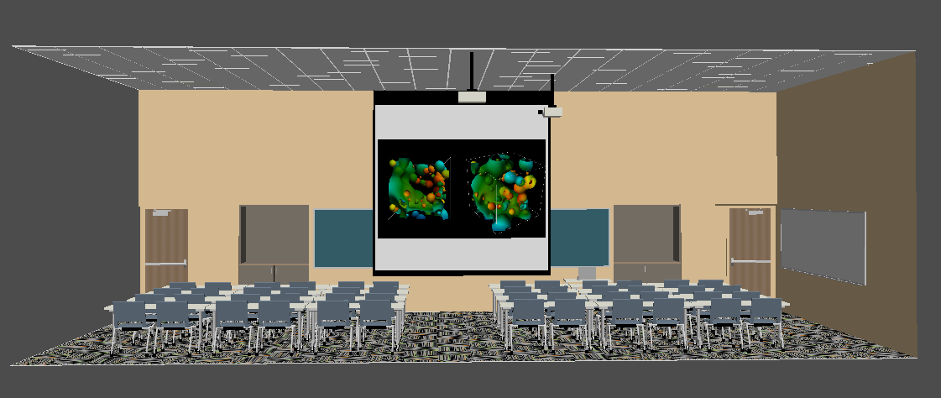
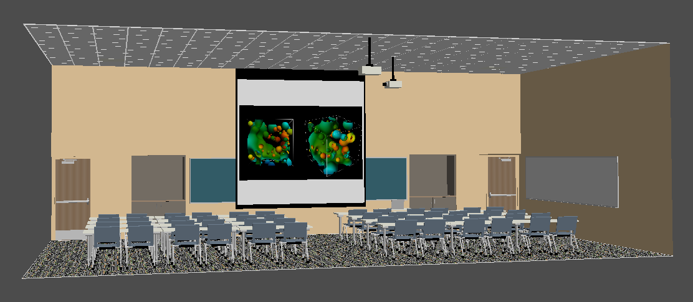
Jordan Weiler

Slide 15
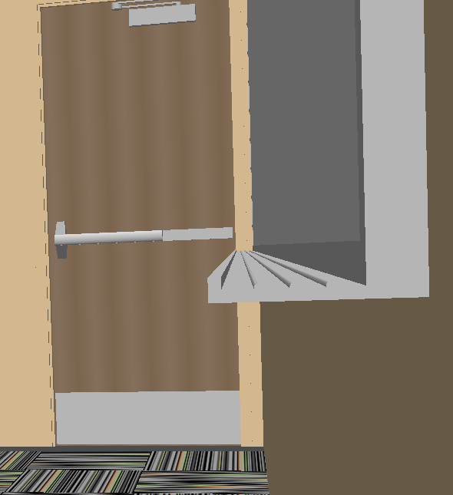
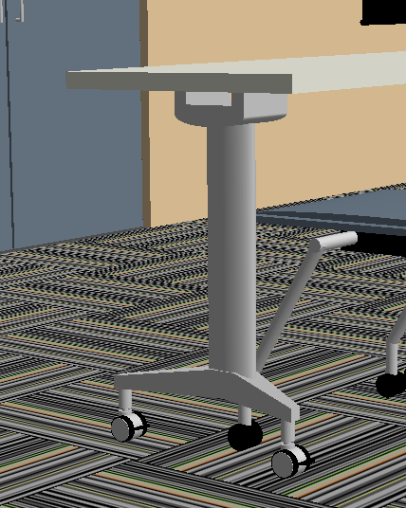

Slide 16
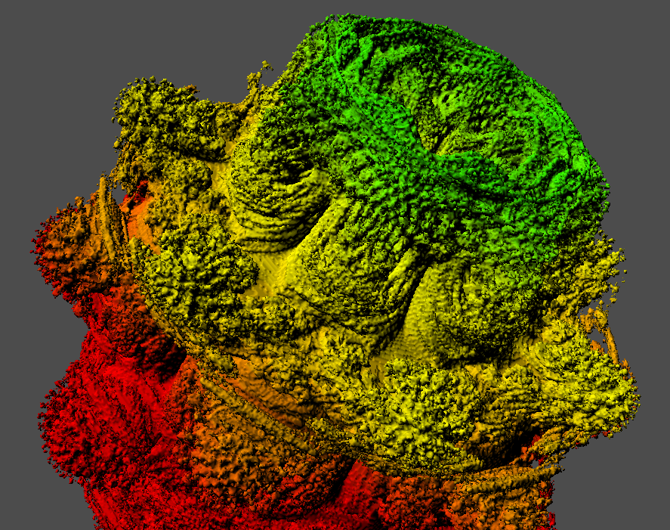
Charles Markello

Slide 17
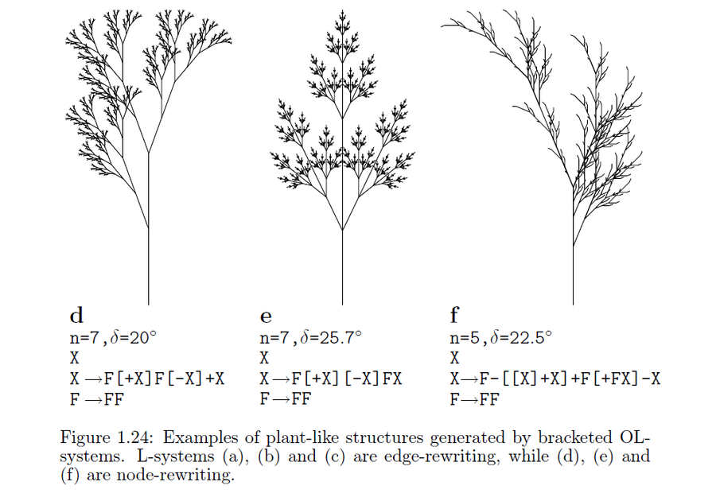
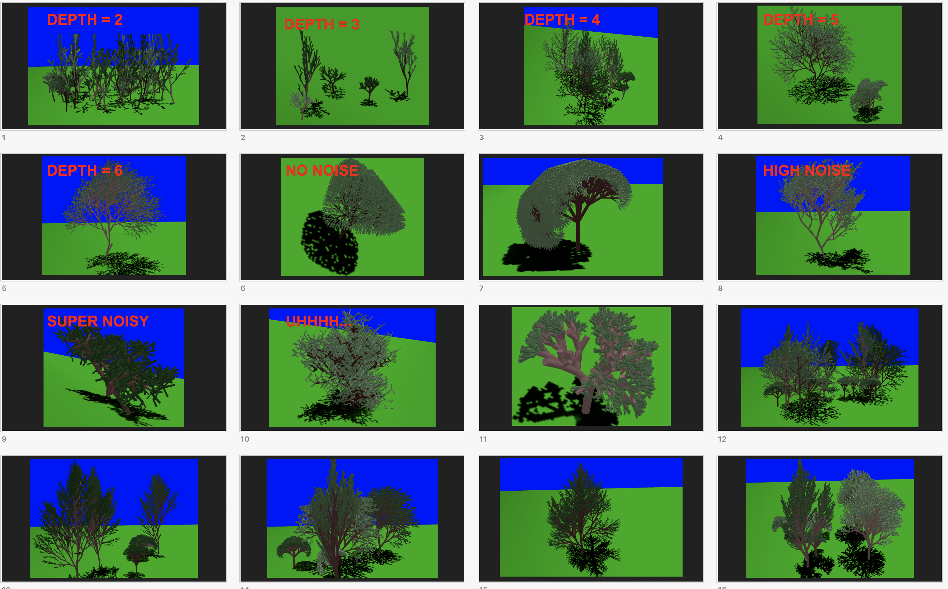
Andrew Cvitanovich -Lindenmeyer Systems

Slide 18
Max Kohl Movie
https://www.youtube.com/watch?v=AT8x7UWxVtg

Slide 19
Willem Jager Movie
http://youtu.be/pGImBA0l2Ko

Slide 20
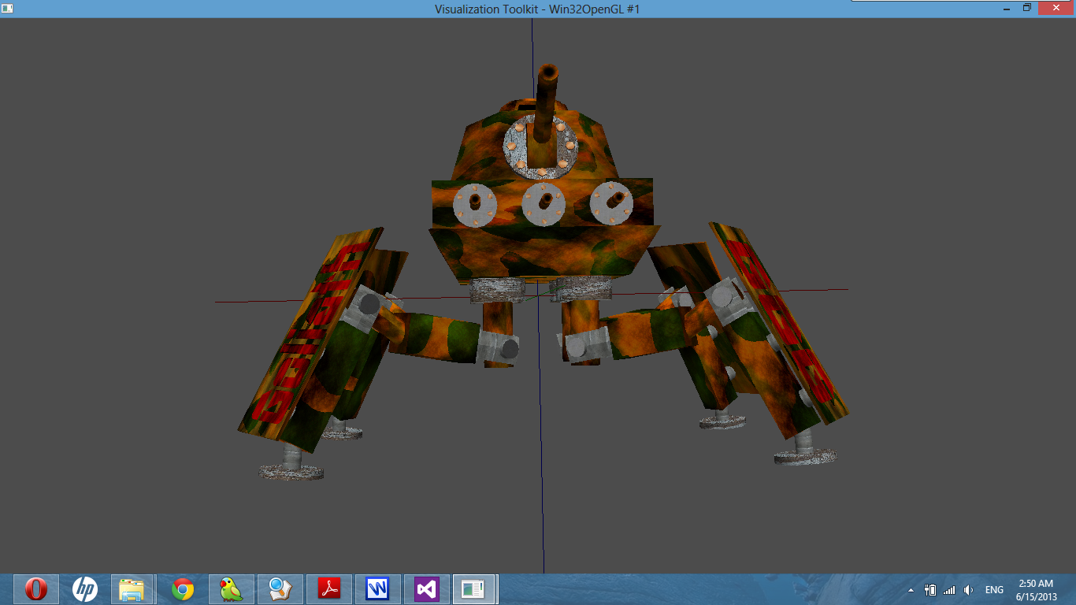
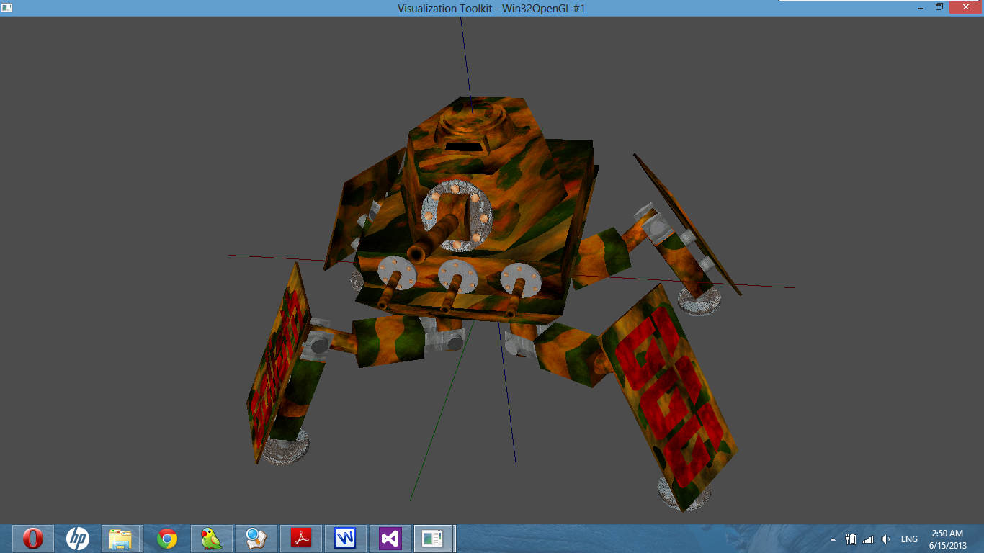
Mingyao Liu

Slide 21
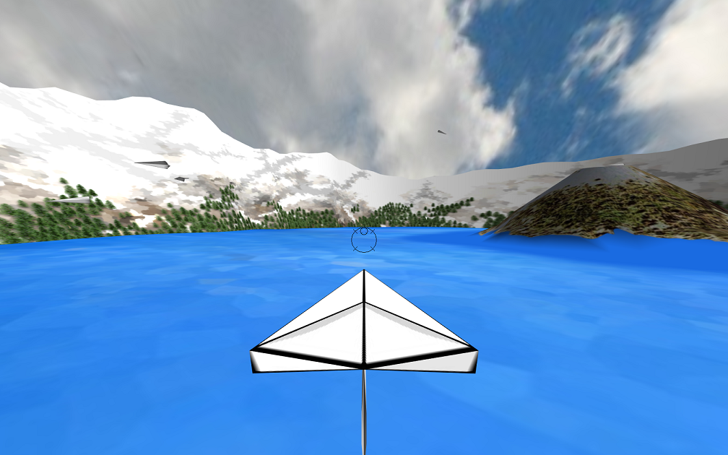
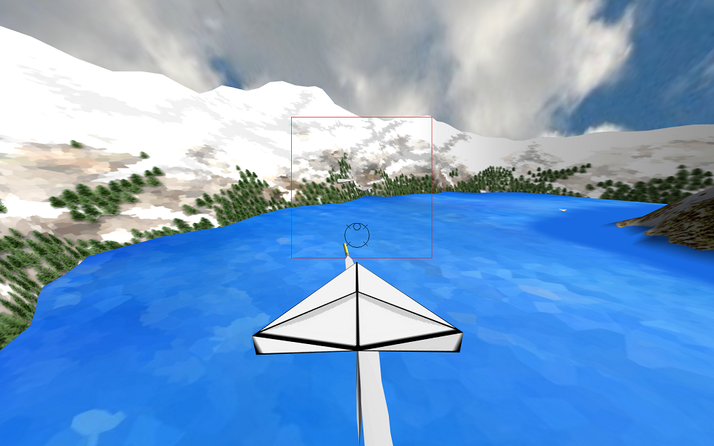
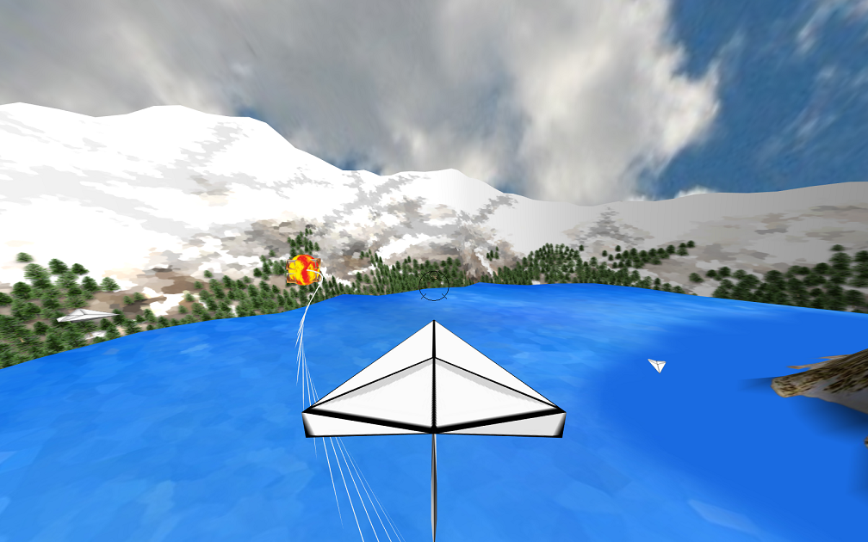
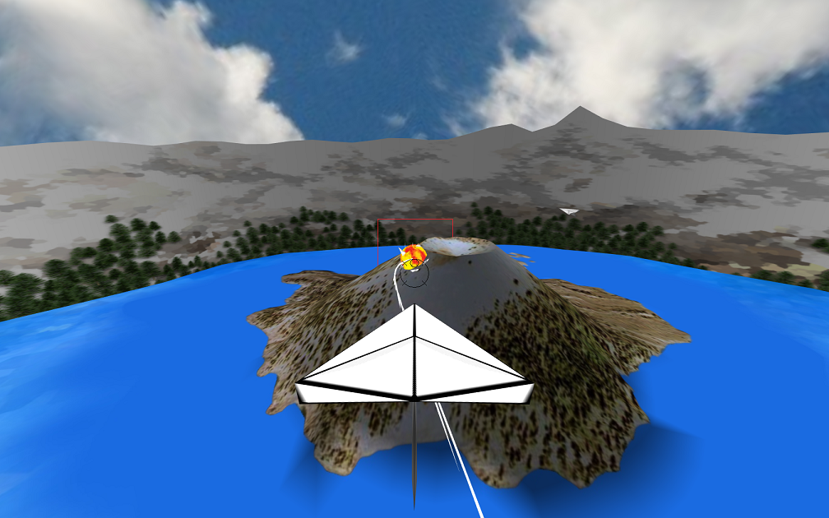
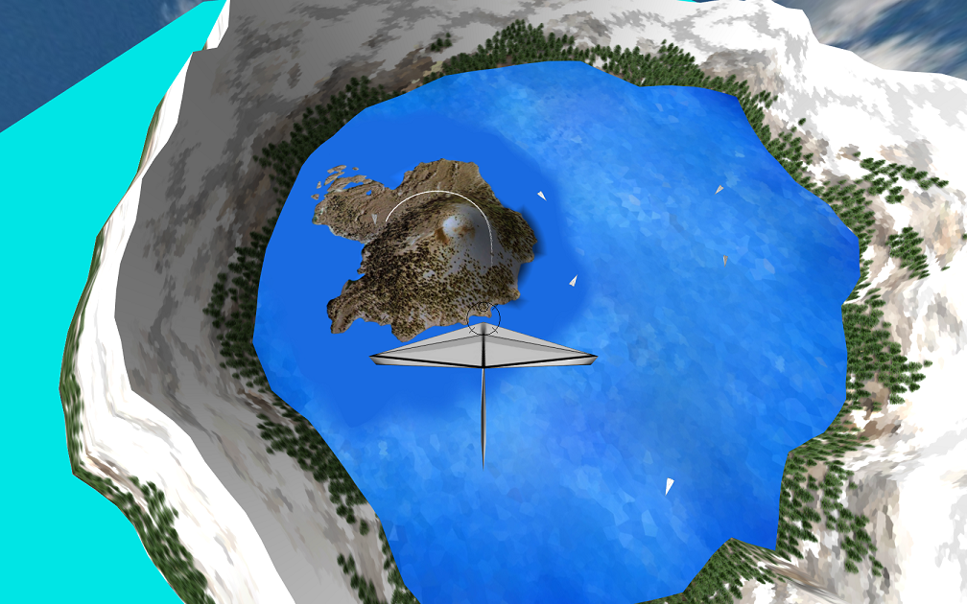
Brad Syrie

