Slide 1
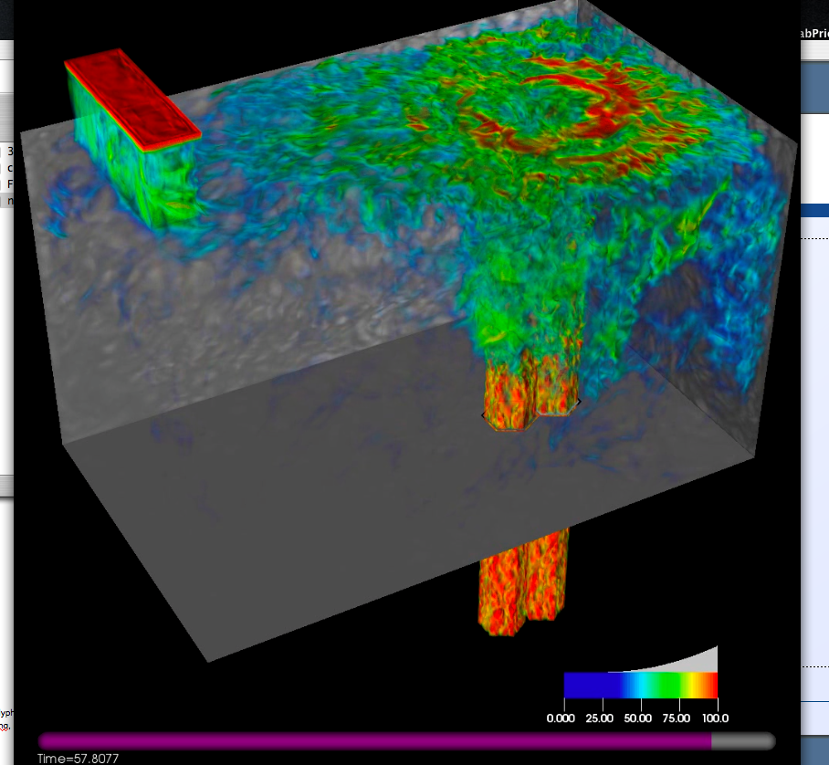
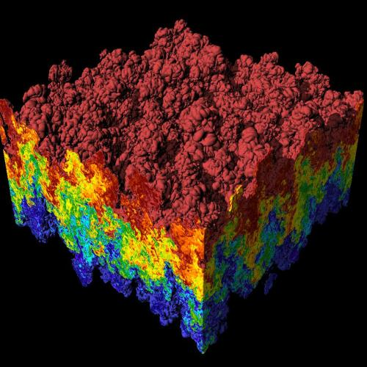
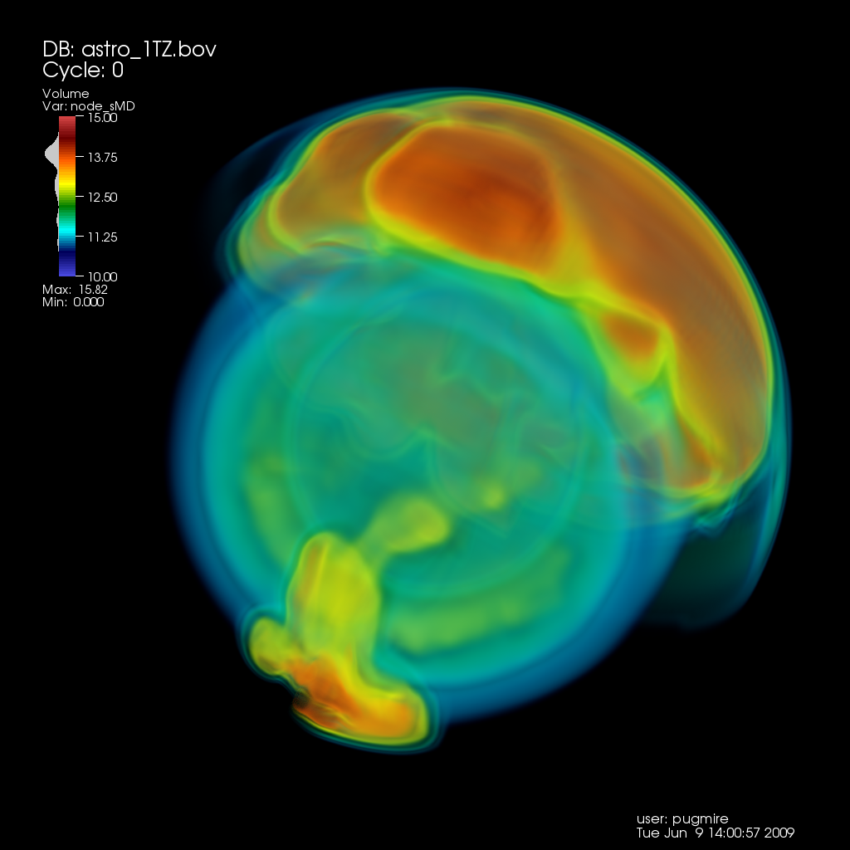
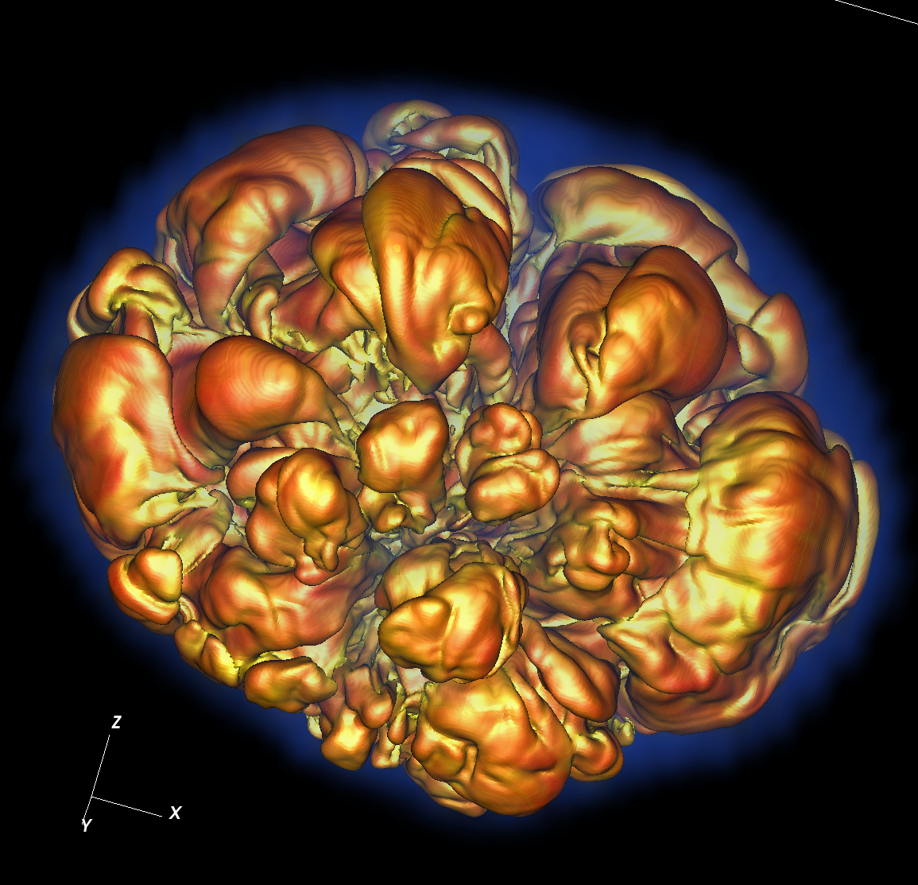
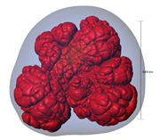
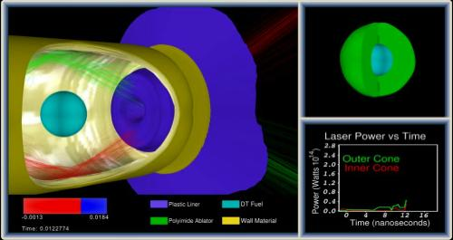
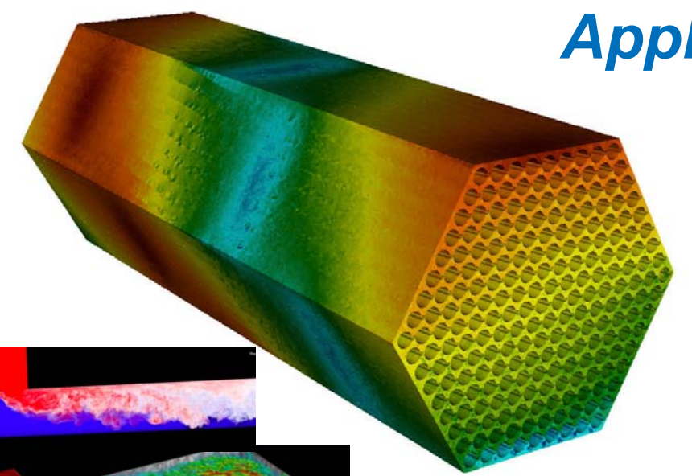
CIS 441/541: Intro to Computer Graphics
Lecture 11: ModelView
May 11, 2021
Hank Childs, University of Oregon

Slide 2

Office Hours

Slide 3
Quiz Thursday
Phong shading
Personalized quiz
Open book, open notes
Calculator OK

Slide 4
Questions on 2A?

Slide 5
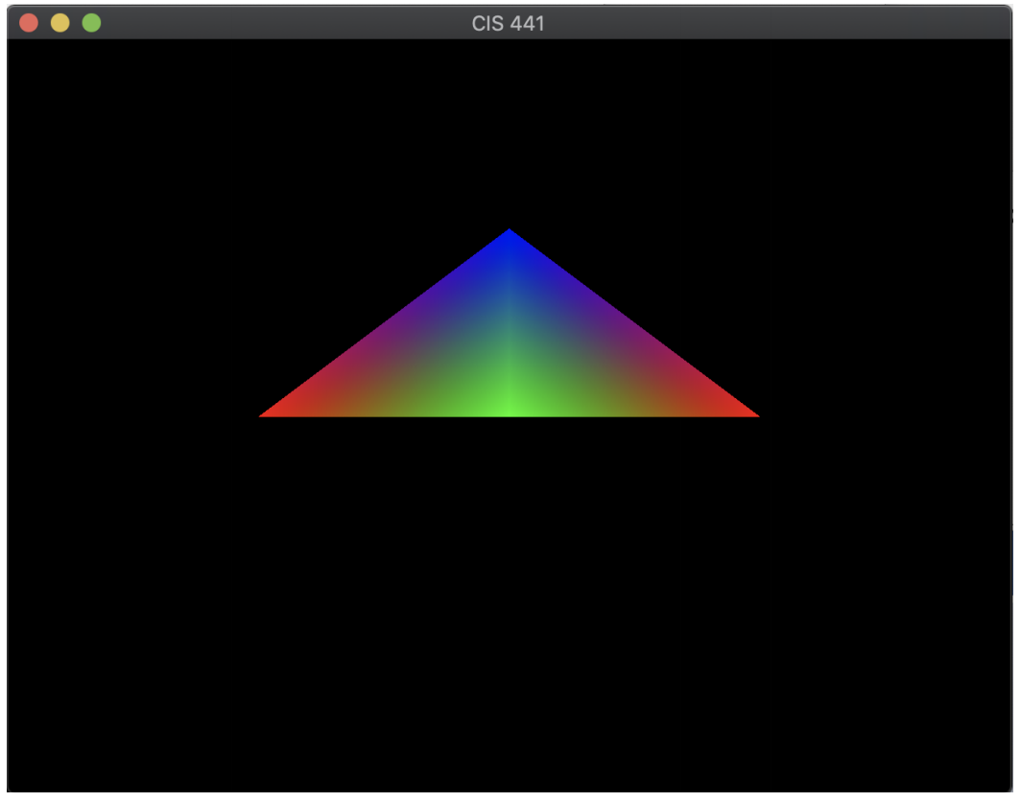

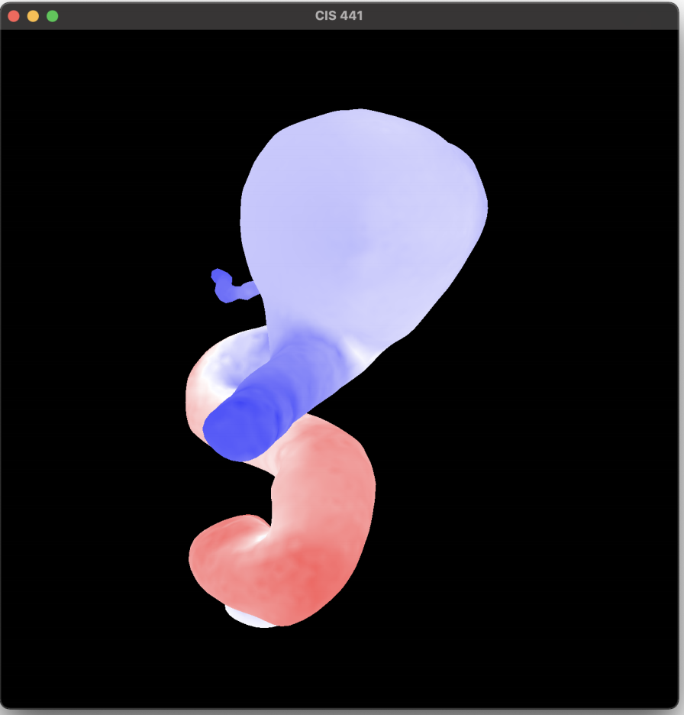
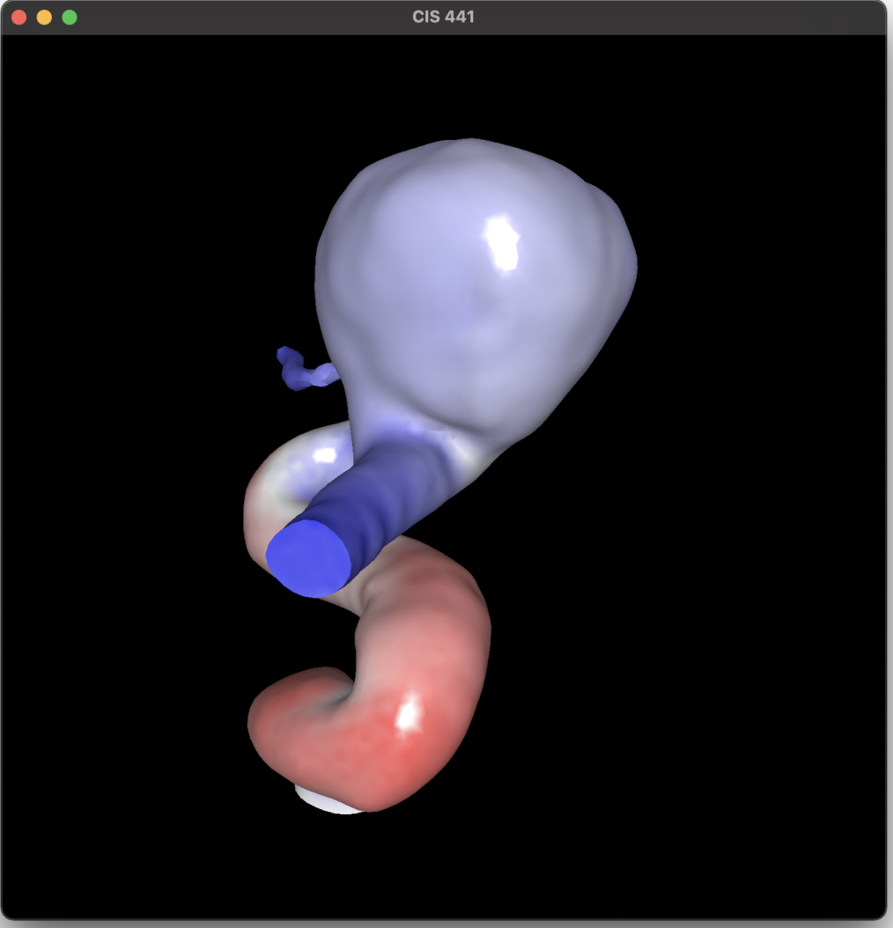
Project 2A
Assigned Tuesday, due in 5 days (Tuesday May 11)
Worth 8% of your grade
Implementing Project 1 within OpenGL
5 phases
  Phase 1: install GLFW
  Phase 2: run example program
  Phase 3: modify VBO/VAO
  Phases 4 & 5: shader programs
Please start ASAP on Phase 1-3
Thursday’s lecture will be on Phase 4 & 5

Slide 6
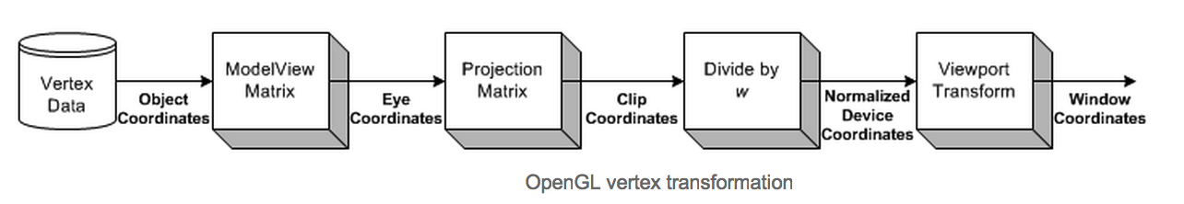
ModelView and Projection Matrices
New for us
Familiar for us
ModelView idea: two purposes … model and view
  Model: extra matrix, just for rotating, scaling, and translating geometry.
    How could this be useful?
  View: Cartesian to Camera transform

Slide 7
“Model” Part of ModelView
Add additional transforms here….
O
O
World space:
Triangles in native Cartesian coordinates
Camera located anywhere
Camera space:
Camera located at origin, looking down -Z
Triangle coordinates relative to camera frame
z
y
x
Image space:
All viewable objects within
-1 <= x,y,z <= +1
Screen space:
All viewable objects within
-1 <= x, y <= +1
Device space:
All viewable objects within
0<=x<=width, 0 <=y<=height

Slide 8
How does ModelView work in GL?
Determine the matrix
  Determine model part
  Determine view part
  Combine them
Tell OpenGL about the matrix
Vertex shader uses the matrix

Slide 9
How does ModelView work in GL?
Determine the matrix
  Determine model part
  Determine view part
  Combine them
Tell OpenGL about the matrix
Vertex shader uses the matrix

Slide 10
Determining the Model Transform
Typical plan:
  Have geometric model
    Came from a file, centered at origin
  Need to “move” it into position
    Done with a 4x4 matrix
  Specifics are the focus of today’s lecture

Slide 11
How does ModelView work in GL?
Determine the matrix
  Determine model part
  Determine view part
  Combine them
Tell OpenGL about the matrix
Vertex shader uses the matrix

Slide 12
Determining the View Transform
Set up same matrices we did for 1E
Now we use “glm” – a library for OpenGL matrices

Slide 13
How does ModelView work in GL?
Determine the matrix
  Determine model part
  Determine view part
  Combine them
Tell OpenGL about the matrix
Vertex shader uses the matrix

Slide 14
Combining Model and View
(4x4 matrix) times (4x4 matrix) → 4x4 matrix

Slide 15
Combining Model and View: Conventions
For a vertex P
For a model transformation M
For a view transformation V
Two conventions
  P*M*V = P’
  V*M*P = P’
We are using the second convention
  This is important, more detail later

Slide 16
How does ModelView work in GL?
Determine the matrix
  Determine model part
  Determine view part
  Combine them
Tell OpenGL about the matrix
Vertex shader uses the matrix

Slide 17
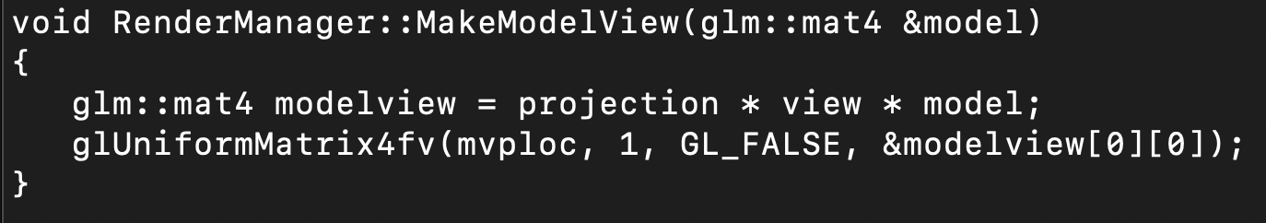
Game Plan
Make a uniform for the ModelView
OpenGL does not know this matrix is “special”
Set the uniform every time time ModelView changes
Vertex shader knows to look for the uniform and use it

Slide 18
How does ModelView work in GL?
Determine the matrix
  Determine model part
  Determine view part
  Combine them
Tell OpenGL about the matrix
Vertex shader uses the matrix

Slide 19
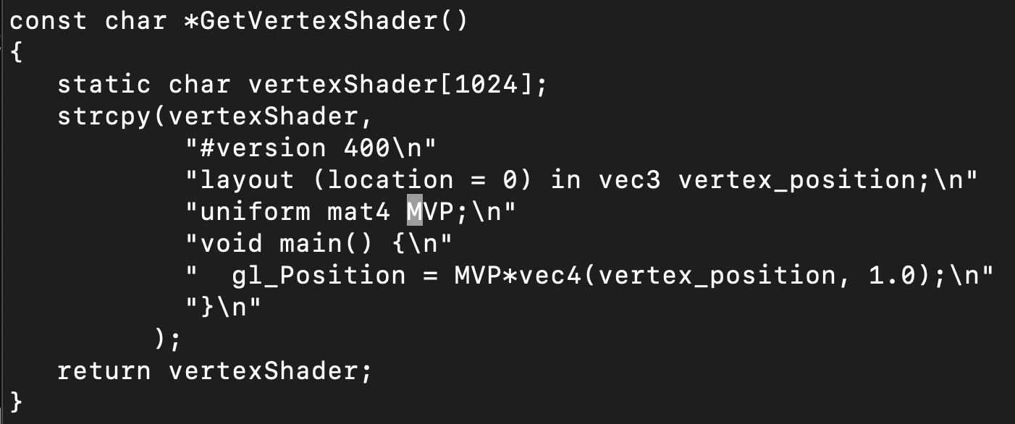
Vertex Shader Uses the Matrix

Slide 20
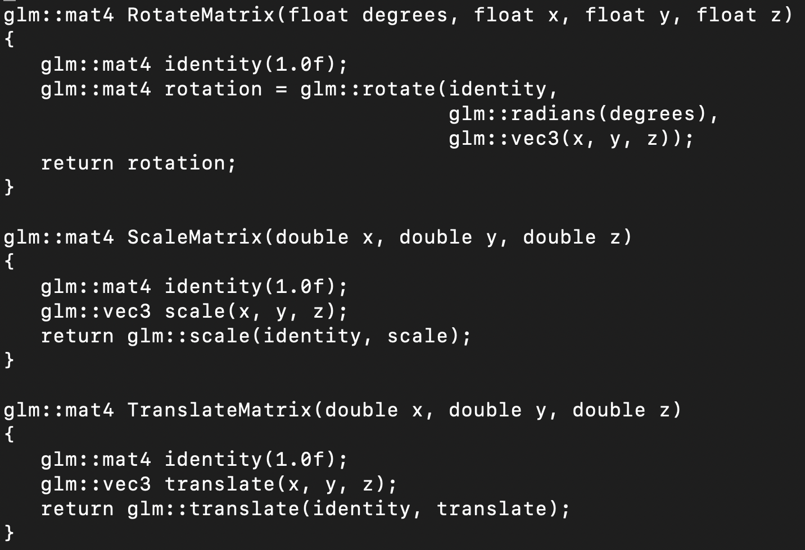
New Topic:
Types of Model Transforms
Three main types
  Rotate
  Translate
  Scale
Each can be represented as a 4x4 matrix
Convenience routines in 2B
(which use convenience routines from glm)

Slide 21
Combining Model Transforms
You don’t have to choose just 1
Assume you have a model for a chess rook
  Possibly need to scale it
  Almost certainly need to translate it
  Likely don’t need to rotate it
And: a different transform for each chess piece
Game plan: use multiple matrices, combine to make one big operation
But: order matters

Slide 22
Which of two of these three are the same?
Choice A:
  Scale(2, 2, 2);
  Translate(1, 0, 0);
Choice B:
  Translate(1, 0, 0);
  Scale(2, 2, 2);
Choice C:
  Translate(2, 0, 0);
  Scale(2, 2, 2);

Slide 23
SLIDE REPEAT:
Combining Model and View: Conventions
For a vertex P
For a model transformation M
For a view transformation V
Two conventions
  P*M*V = P’
  V*M*P = P’
We are using the second convention
  This is important, more detail later

Slide 24
Multiple Model Transforms
Let M1 be the first transform
Let M2 be the second transform
Then the combined model transform should be M2*M1
  And not M1*M2
In all:
  V * M2 * M1 * P → P’
Make sure you think about order when you do 2B!

Slide 25
Project 2B

Slide 26
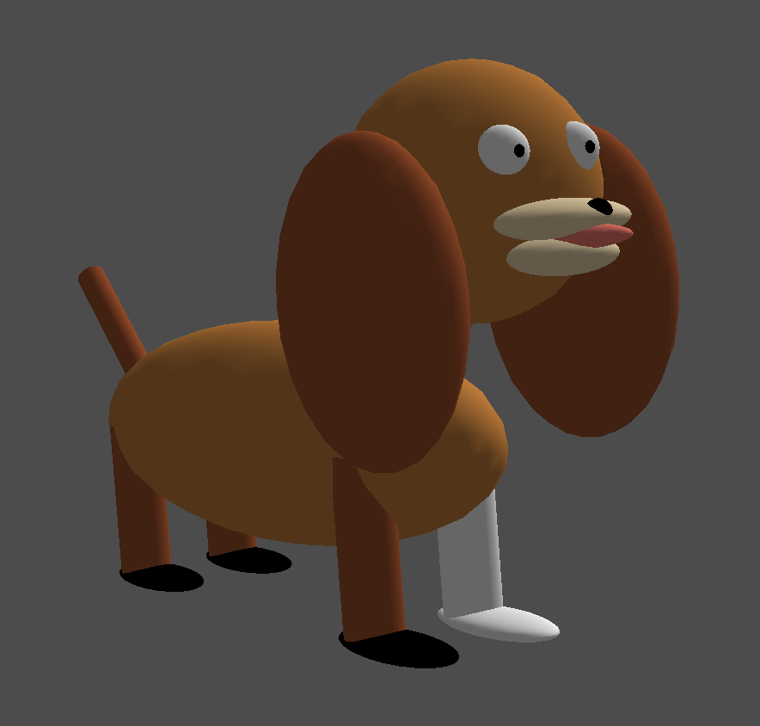
Project #2B (7%), Due Monday May 17th
Goal: modify ModelView matrix to create dog out of spheres and cylinders
New code skeleton: “project2B.cxx”
No geometry file needed
You will be able to do this by rendering ~20 spheres and cylinders, each with their own transform

Slide 27
What is the correct answer?
The correct answer is:
  Something that looks like a dog
    No obvious problems with output geometry
  Something that uses the sphere and cylinder classes
    If you use something else, please clear it with me first
      I may reject your submission if I think you are using outside resources that make the project too easy
  Something that uses rotation
    For me: the neck and tail
  Something that animates
Aside from that, feel free to be as creative as you want … color, breed, etc.

Slide 28
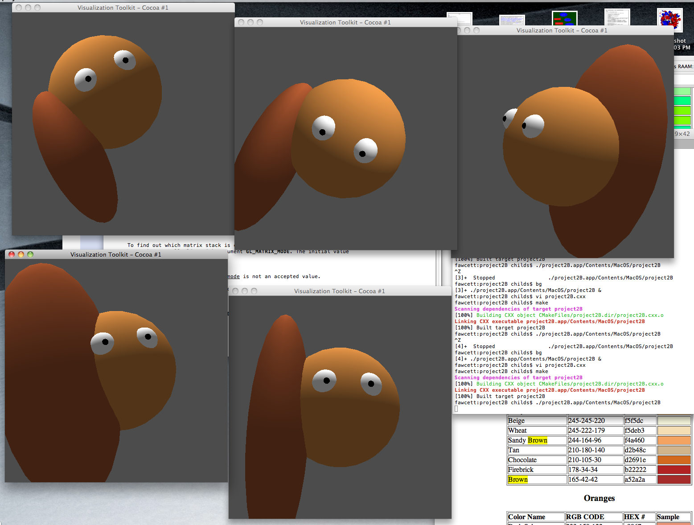

Slide 29
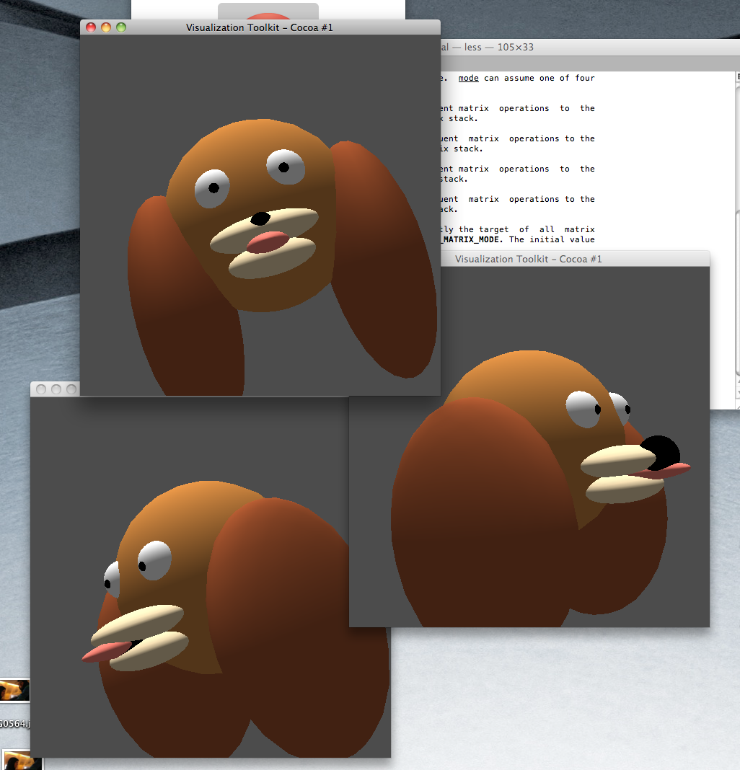

Slide 30
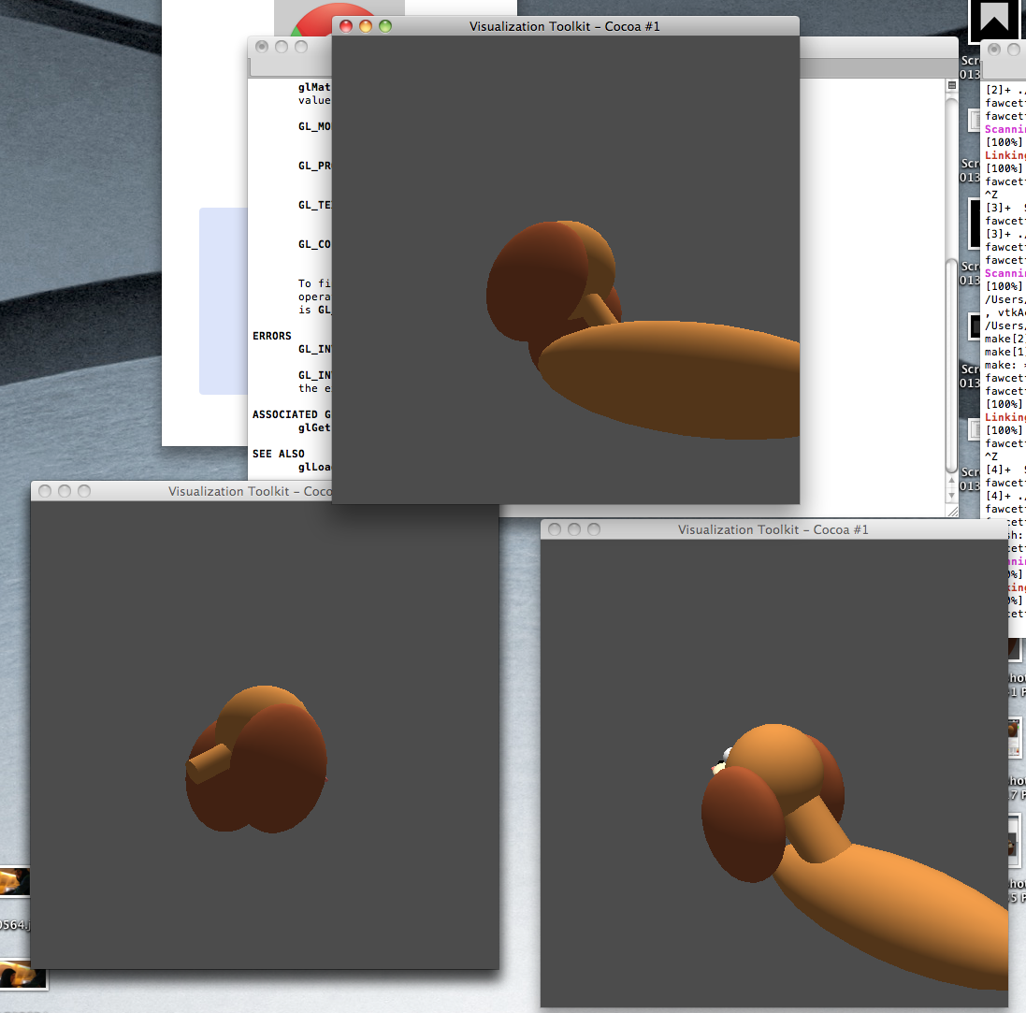

Slide 31
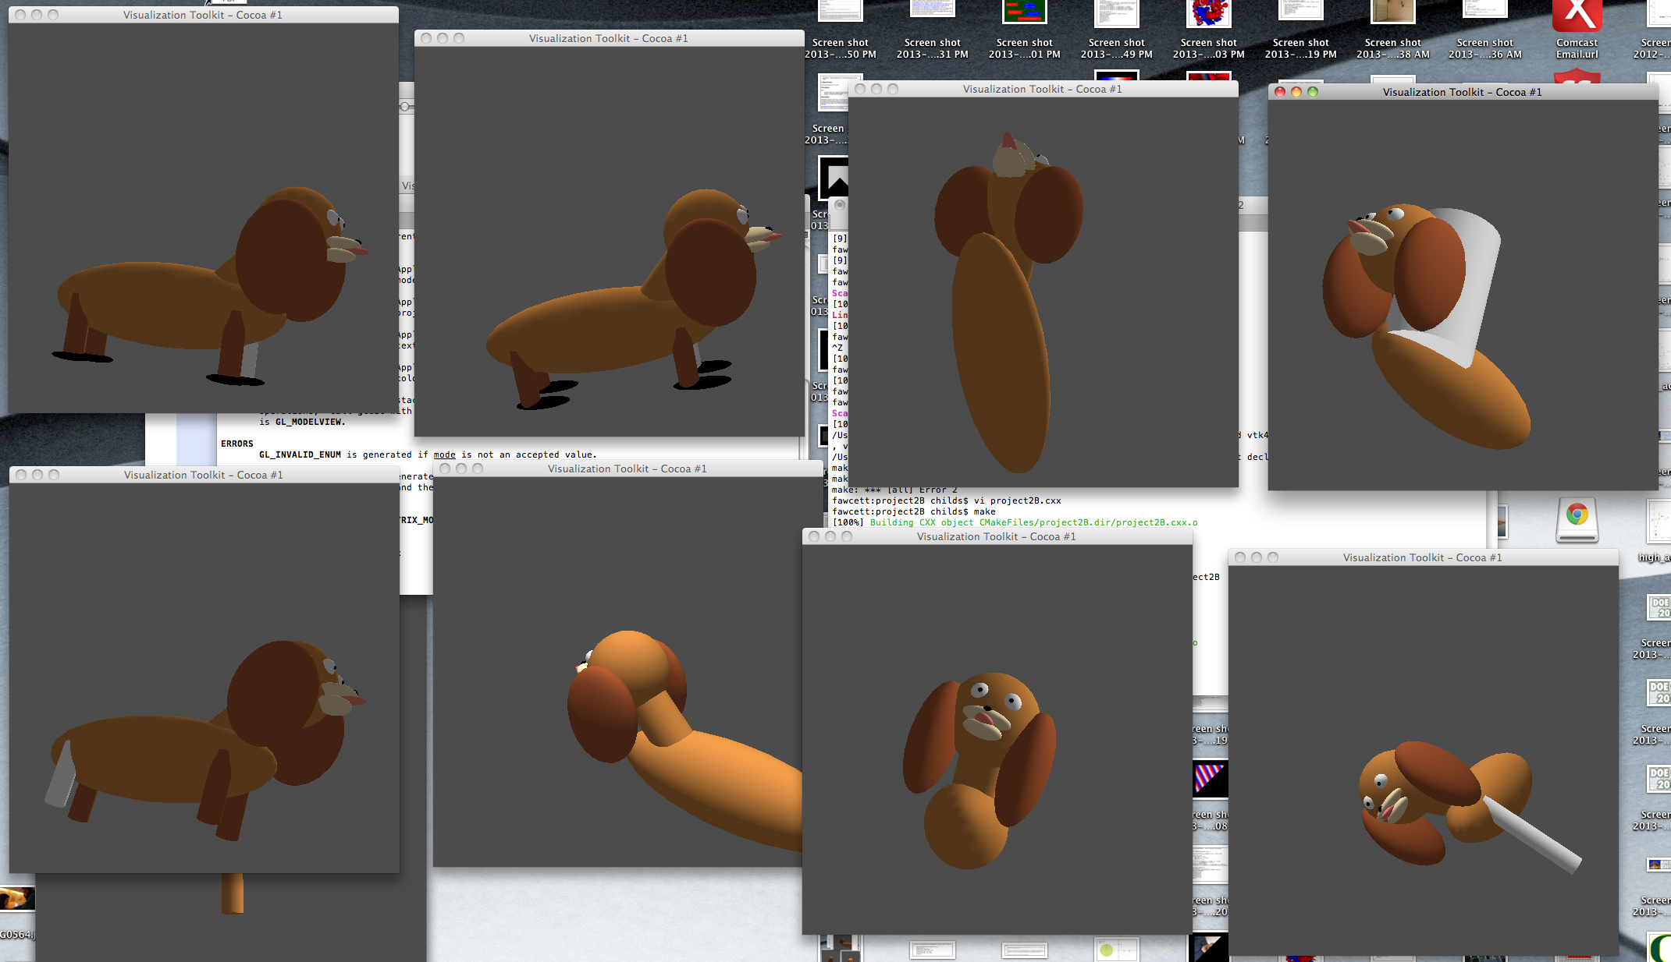

Slide 32
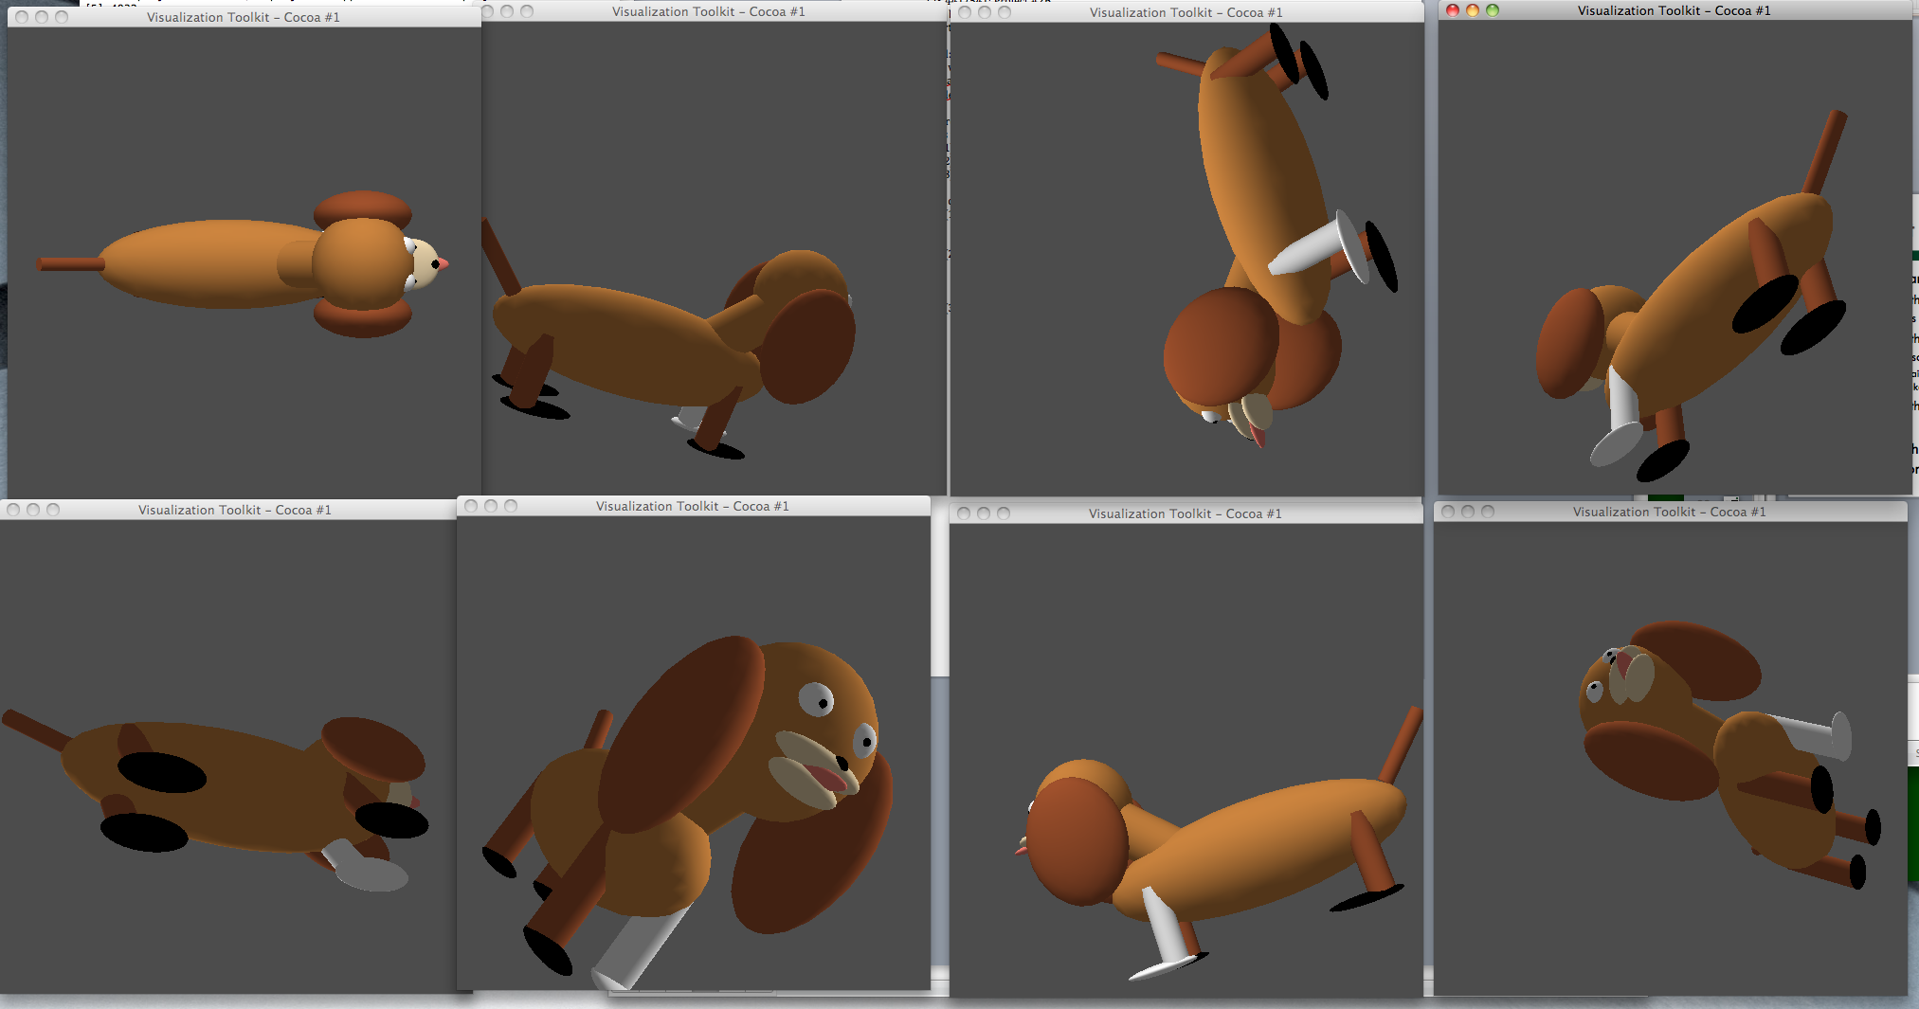
For your reference: my dog

Slide 33
Something I learned in 2B
VAOs must be allocated together to be used together

Slide 34
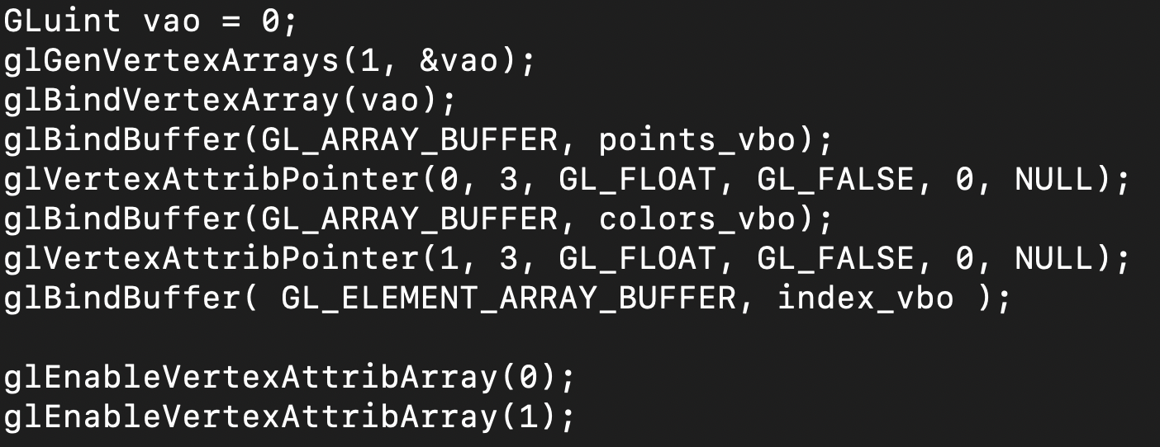
Next Step in Starter Code:
Make a VAO and put VBOs into VAO
glGenVertexArrays
  Just like glGenBuffers, but for VAOs
  Asks OpenGL to generate a new VAO for the programmer to work with
  That buffer will have a unique identifier (vao)
  This unique identifier is useful: lets programmer tell OpenGL which buffer they want to operate on

Slide 35
Something I learned in 2B
VAOs must be allocated together to be used together
Want two VAOs?
  Do:
    GLuint vao[2];
    glGenVertexArrays(2, vao);
  Not:
    Gluint vao[2];
    glGenVertexArrays(1, vao);
    gGenVertexArrays(1, vao+1)

Slide 36
New Topic: the Amazing GPU

Slide 37
“First” computer: ENIAC
Year: 1946
Location: Pennsylvania
Purpose: military
Cost: $487K
  ($6.9M today)
Technology:
  very different than today
  … but still the same

Slide 38
Vacuum Tubes
Vacuum tubes:
  Glass tubes with no gas
  Used to control electron flow in early computers
Occasionally, a bug would get stuck in the tube and cause the program to malfunction
We no longer have vacuum tubes, but the term bug has remained with us…
Vacuum tubes in ENIAC
Image source: wikipedia

Slide 39
An ENIAC Computation
Used for military calculations:
  A-bomb design
  Missile delivery
ENIAC could do ~5000 calculations in one minute
In one case:
  ENIAC did a calculation in 30 seconds
  Human being took 20 hours
  2400x increase in speed
source: wikipedia

Slide 40
Hertz (Hz) = unit of measurement for how fast you do something
1 Hertz = do something once per second
KHz = 1024 Hz
MHz = 1024 KHz
GHz = 1024 MHz
The ENIAC machine ran at 5000Hertz, or about 5KHz.
  Vocab term: “clock speed” → the number of cycles per second
    the clock speed of the ENIAC was 5KHz

Slide 41

Today’s Desktop Computers Are Fast!
Most computers run at ~1-3 GHz
i.e., operates billions of instructions each second
This is about one million times faster than the ENIAC
  … and the ENIAC was 2400X faster than humans
  (at least at tasks computers are good at)

Slide 42
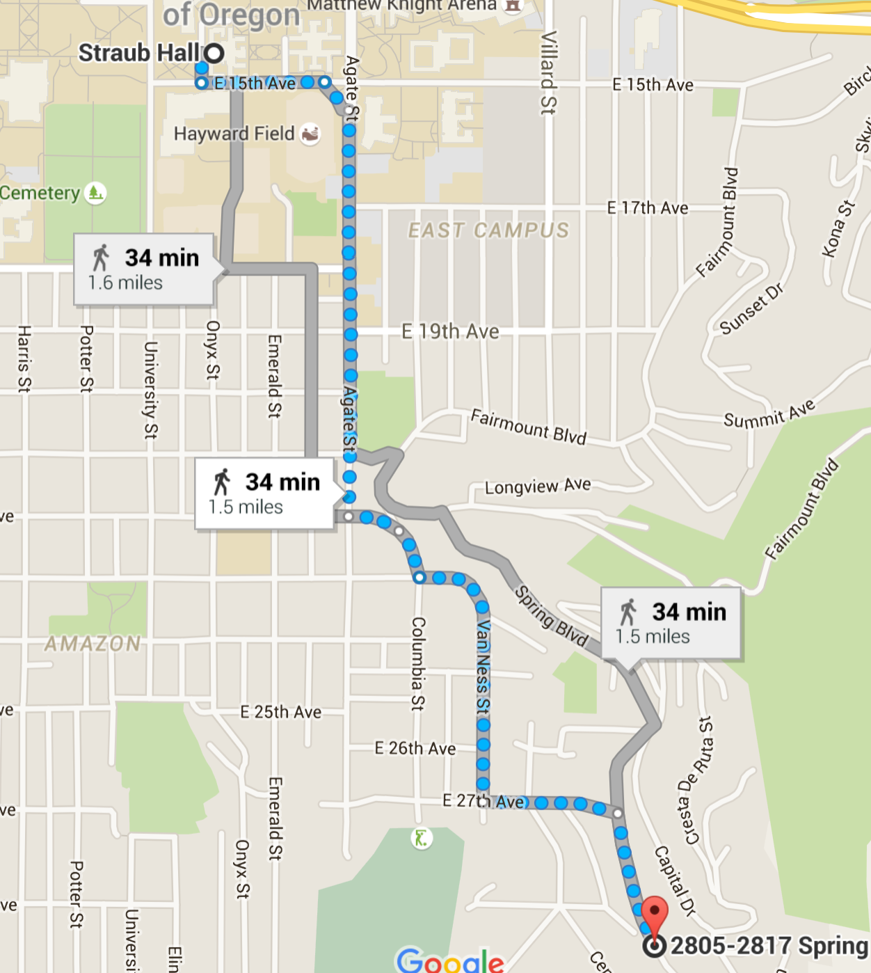
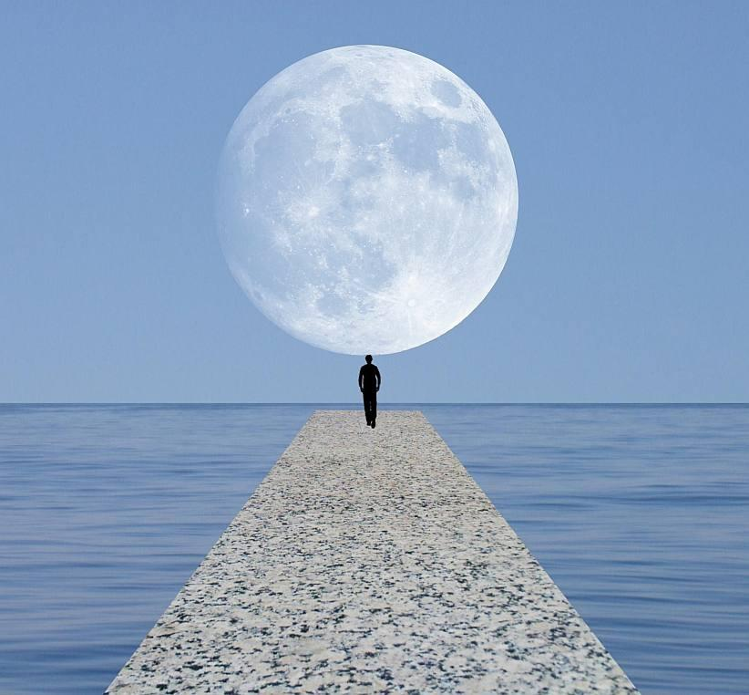
What does a million-fold increase mean?
and back
Distance: a 2” map of Oregon is 1:1,000,000 scale
Time: 1 second to 277 hours is 1:1,000,000 scale
Time: 1 minute to 694 days is 1:1,000,000 scale
Time: 1 hour to 114 years is 1:1,000,000 scale
Time: 1 day to 2738 years is 1:1,000,000 scale
10X

Slide 43
1 million-fold increase!
How does this happen?
Moore’s Law (old timer’s version)
  Clock speed doubles every 18 months
Moore’s Law (newer version but still for old timers)
  Clock speed doubles every 24 months

Slide 44
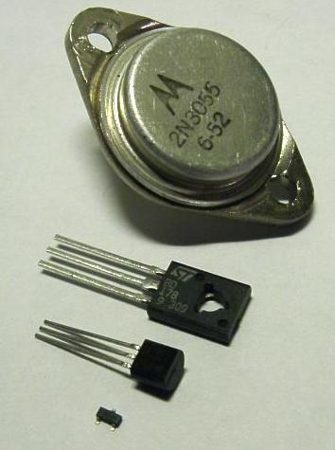
Moore’s Law
Moore’s Law (actual version)
  Number of transistors doubles every 24 months
  And clock speed is a reflection of number of transistors
So what is a transistor?
  Semiconductor device for amplifying or switching electronic signals/power
  Fundamental building block of modern electronics
  Replacement for vacuum tube

Slide 45
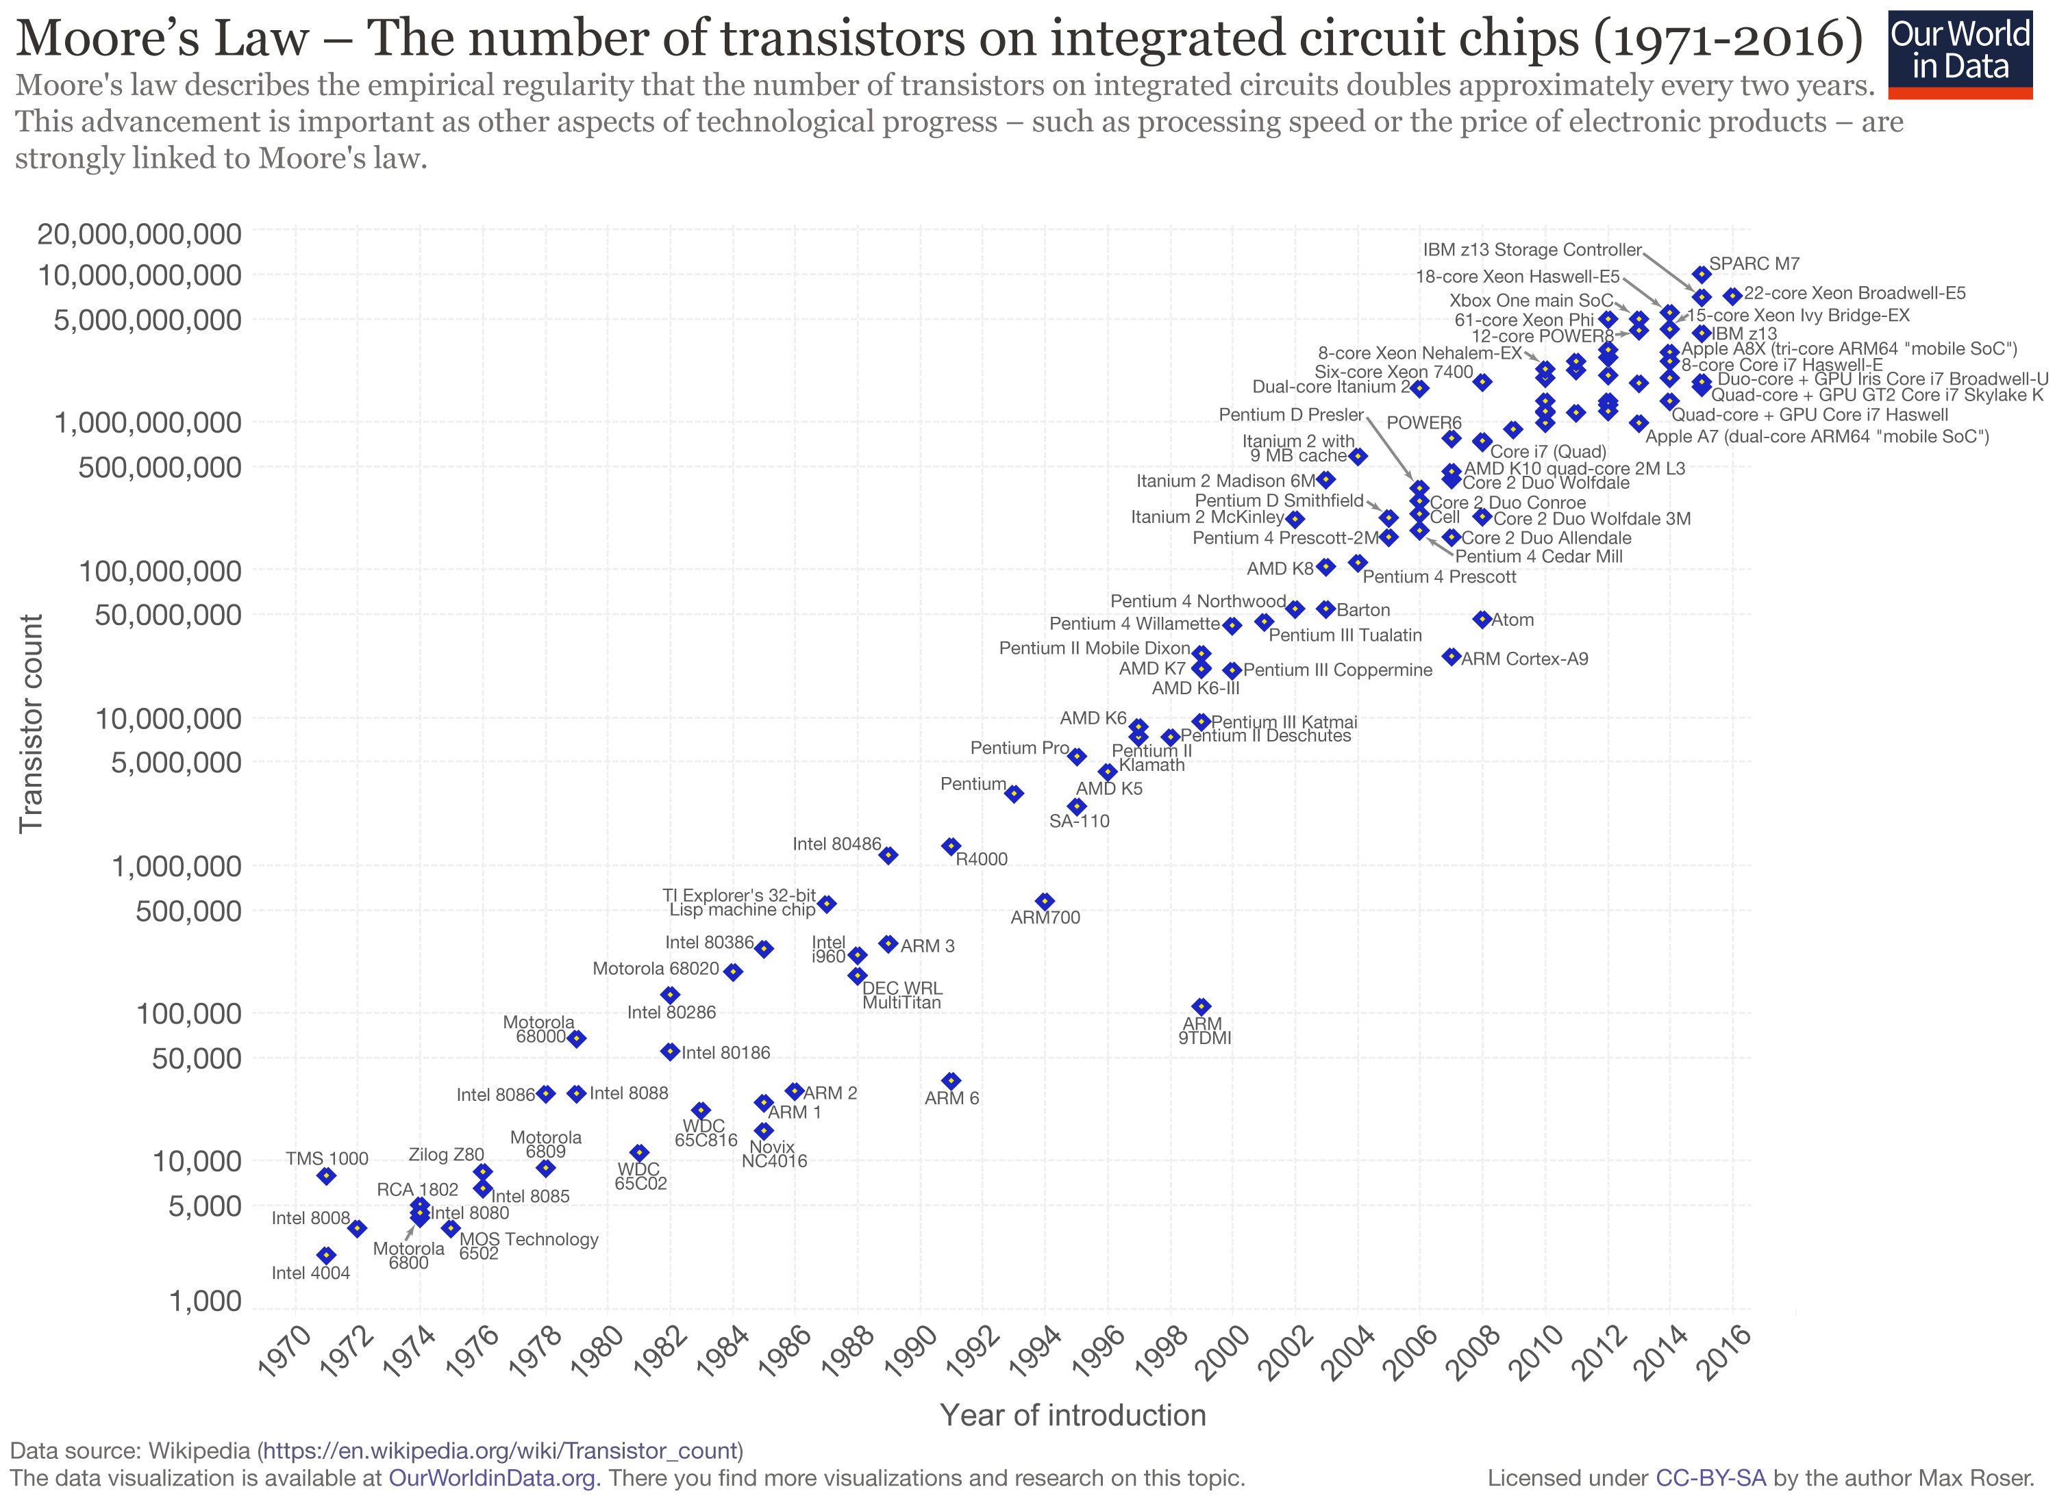

Slide 46
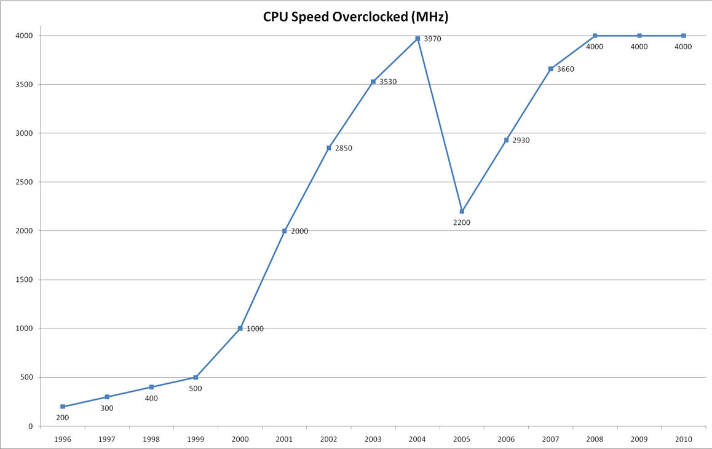
But actually…
The part about clock speed increasing with # of transistors stopped about fifteen years ago
Source: maximumpc.com

Slide 47
The reason is power
Desktop computer takes ~200W
  There are multiple components that consume the power:
    CPU
    Monitor
    Disk
    Memory
200W * 1 year → ~$70

Slide 48
Relationship Between
Power and Clock Speed
Clock goes twice as fast → Power goes up by factor of 8
  (Increase of X in clock speed → Increase of X³ in power)
Clock speeds haven’t changed in 12 years
What if they had doubled every 2 years?
Then 64X faster
  → 262144X more power (for the CPU)
  → power bill now $18M

Slide 49
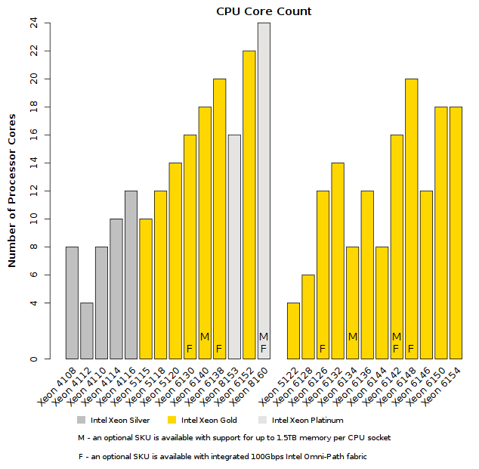
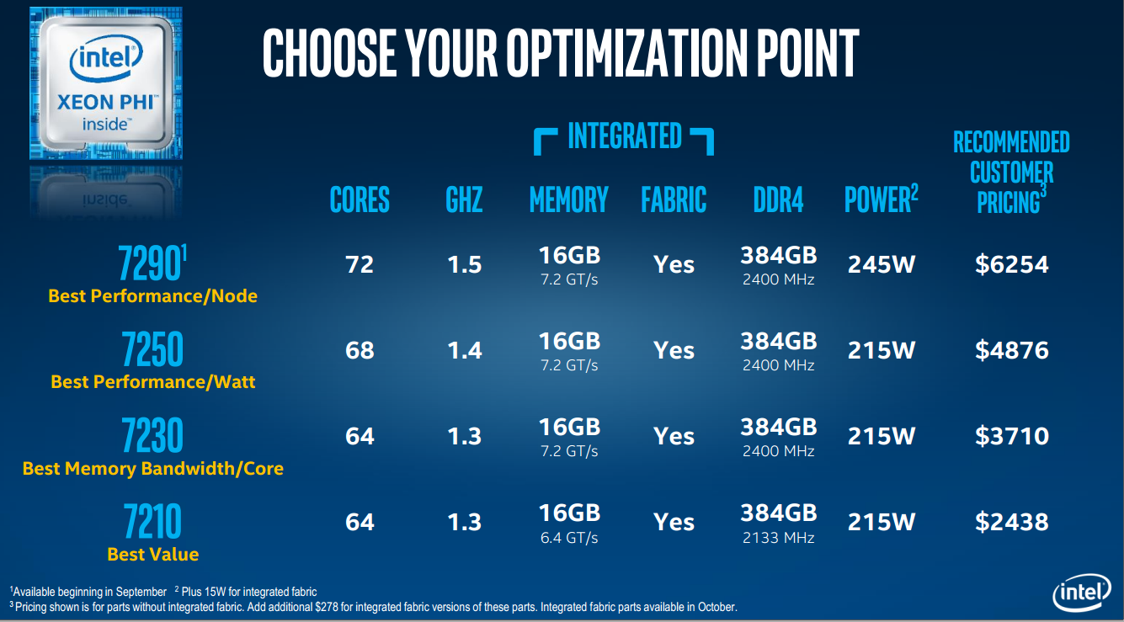

What Changed?
We are getting double the transistors every two years
… but clock speed is the same
… so what is changing?
New vocab term: “core” → lightweight version of a CPU

Slide 50
How To Use Multiple Cores?
Answer: parallel programming
  Write computer programs that use all the cores
  Ideally the coordination between the cores is minimal

Slide 51
Parallel Programming Concepts
Usual goal:
  if program takes N seconds to run with one core
  then take N/2 seconds to run with two cores
  and N/M seconds to run with M cores
Let’s consider an example outside of computers

Slide 52
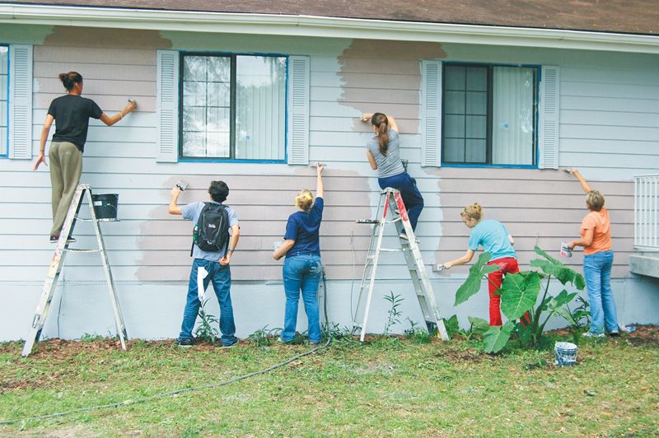
Example: paint a house
One person: 6 days (1 day = 10 hours)
Two people: 3 days
Three people: 2 days
Six people: 1 day
Sixty people: 1 hour?
Six hundred people: 6 minutes?

Slide 53
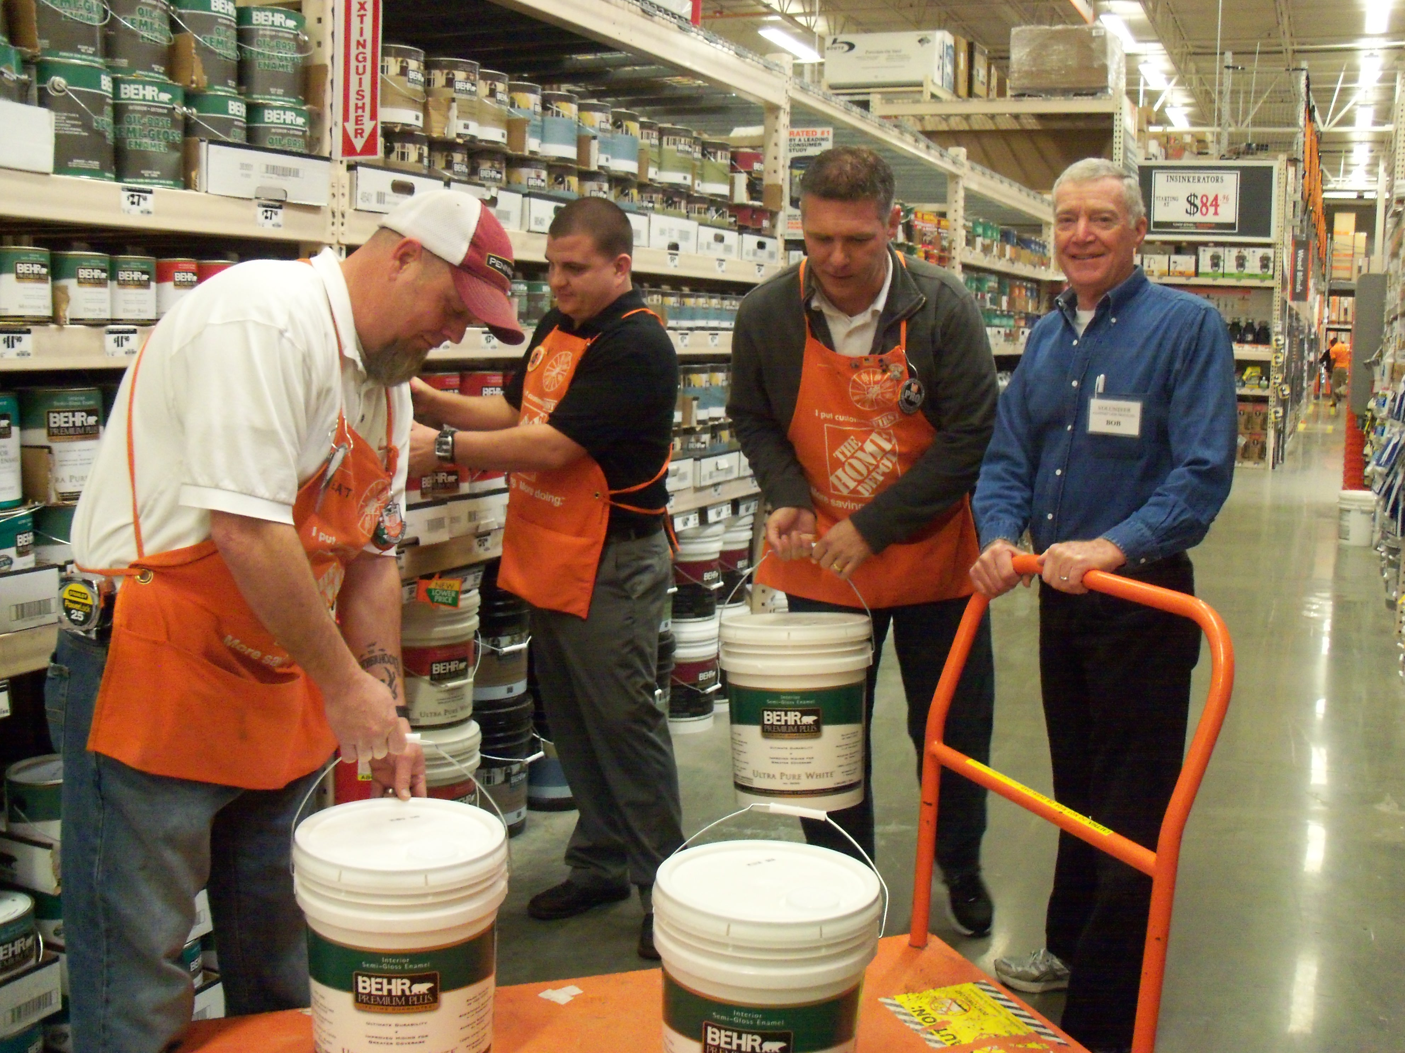
Example: paint a house, plan #2
One person: paint one house in 6 days
Two people: paint two houses in 6 days
Three people: paint three houses in 6 days
One thousand people: paint 1000 houses in 6 days?
Parallel programming is hard, and smart people spend their whole careers figuring out how to make parallel programs be efficient

Slide 54

GPUs: Graphical Processing Units (graphics cards)
Historical:
  Introduced to accelerate graphics (gaming!)
  Boom with desktop PCs – late 90s onward
  Mid-2000’s: people start “hacking” interface to program a GPU to make it do things besides graphics
  Late 2000’s: GPU makers jump on board and start encouraging folks to program GPUs directly
    GPGPU: General-purpose GPU programming
  Mid 2010’s: GPUs used for *lots* of computing problems.
    Machine learning workhorse!

Slide 55
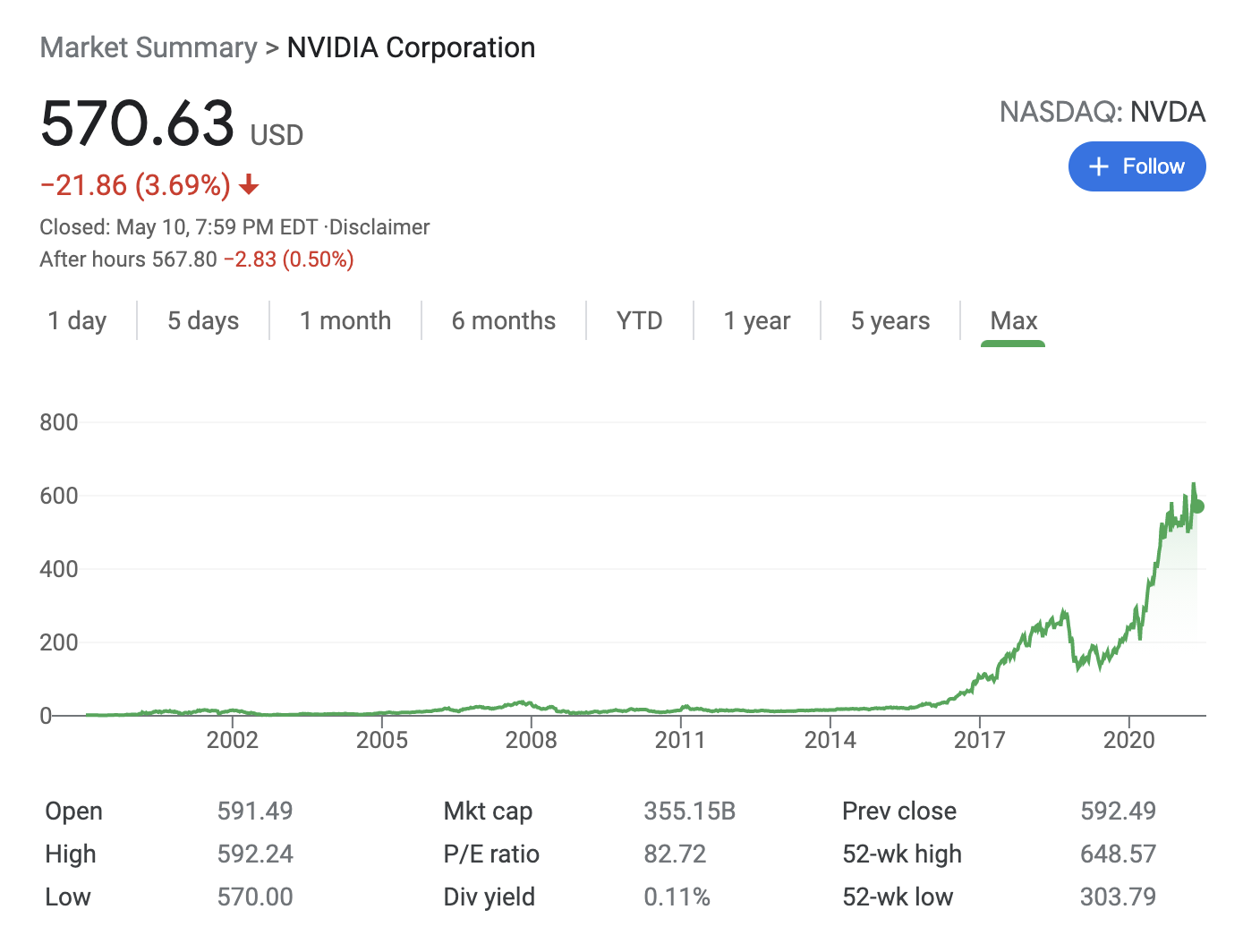
Why Are GPUs So Good?
NVIDIA: company that makes GPUs
NVIDIA Volta: latest type of NVIDIA GPU
Volta facts:
  5120 cores
  1200MHz clock speed
  → can do 2000X more operations than my laptop
  Price on Amazon: $3,999.00
This level of increase in computation is not just a quantitative change, it is a qualitative one too.

Slide 56
Graphics and GPUs
Graphics are very parallelizable
  How many people can paint a house? <100
  How many cores can paint a screen? >5000
GPUs have special support for graphics
  (Of course they do! ... Graphics processing units!)
GPUs also have support for general programming
  Example: Nvidia CUDA

Slide 57
Introduction to Ray Tracing
Dr. Xiaoyu Zhang
Cal State U., San Marcos

Slide 58
Classifying Rendering Algorithms
One way to classify rendering algorithms is according to the type of light interactions they capture
For example: The OpenGL lighting model captures:
  Direct light to surface to eye light transport
  Diffuse and rough specular surface reflectance
  It actually doesn’t do light to surface transport correctly, because it doesn’t do shadows
We would like a way of classifying interactions: light paths

Slide 59
Classifying Light Paths
Classify light paths according to where they come from, where they go to, and what they do along the way
Assume only two types of surface interactions:
  Pure diffuse, D
  Pure specular, S
Assume all paths of interest:
  Start at a light source, L
  End at the eye, E
Use regular expressions on the letters D, S, L and E to describe light paths
  Valid paths are L(D|S)*E

Slide 60
Simple Light Path Examples
LE
  The light goes straight from the source to the viewer
LDE
  The light goes from the light to a diffuse surface that the viewer can see
LSE
  The light is reflected off a mirror into the viewer’s eyes
L(S|D)E
  The light is reflected off either a diffuse surface or a specular surface toward the viewer
Which do OpenGL (approximately) support?

Slide 61
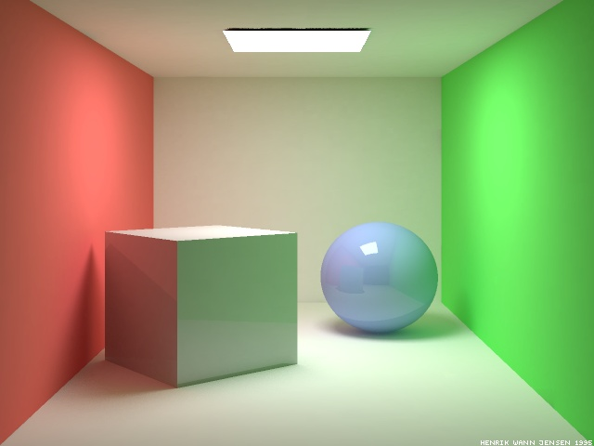
More Complex Light Paths
Find the following:
  LE
  LDE
  LSE
  LDDE
  LDSE
  LSDE
Radiosity Cornell box, due to Henrik wann Jensen,
http://www.gk.dtu.dk/~hwj, rendered with ray tracer

Slide 62
More Complex Light Paths
LE
LDDE
LSDE
LSE
LDSE
LDE

Slide 63
The OpenGL Model
The “standard” graphics lighting model captures only L(D|S)E
It is missing:
  Light taking more than one diffuse bounce: LD*E
    Should produce an effect called color bleeding, among other things
    Approximated, grossly, by ambient light
  Light refracted through curved glass
    Consider the refraction as a “mirror” bounce: LDSE
  Light bouncing off a mirror to illuminate a diffuse surface: LS+D+E
  Many others
  Not sufficient for photo-realistic rendering

Slide 64

Raytraced Images
PCKTWTCH by Kevin Odhner, POV-Ray

Slide 65
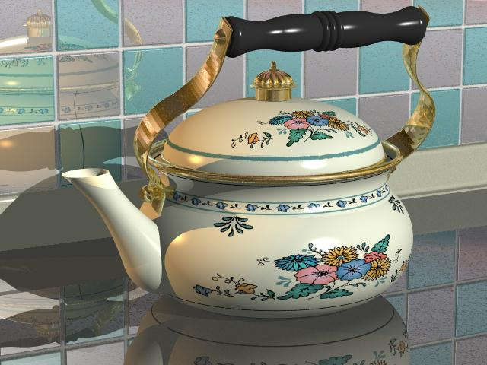
Kettle, Mike Miller, POV-Ray

Slide 66
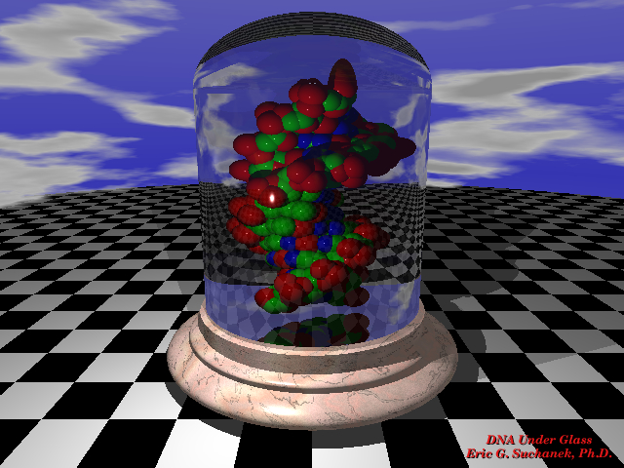

Slide 67
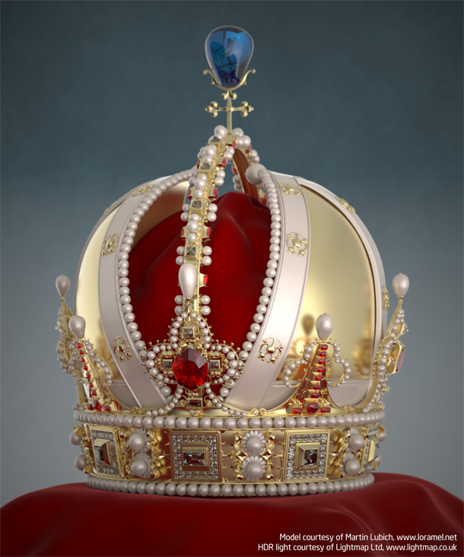
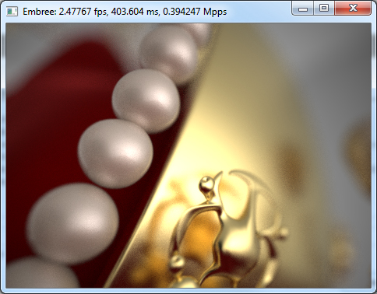
The previous slides now look like amateur hour…

Slide 68
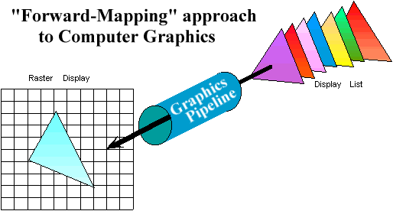
Graphics Pipeline Review
Properties of the Graphics Pipeline
  Primitives are transformed and projected (not depending on display resolution)
  Primitives are processed one at a time
  Forward-mapping from geometrical space to image space

Slide 69
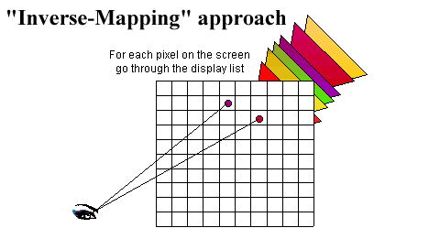
Alternative Approaches: Ray CASTING (not Ray TRACING)
Ray-casting searches along lines of sight, or rays, to determine the primitive that is visible along it.
Properties of ray-casting:
Go through all primitives at each pixel
Image space sample first
Analytic processing afterwards

Slide 70
Ray Casting Overview
For every pixel shoot a ray from the eye through the pixel.
For every object in the scene
  Find the point of intersection with the ray closest to (and in front of) the eye
  Compute normal at point of intersection
Compute color for pixel based on point and normal at intersection closest to the eye (e.g. by Phong illumination model).
t₀

Slide 71
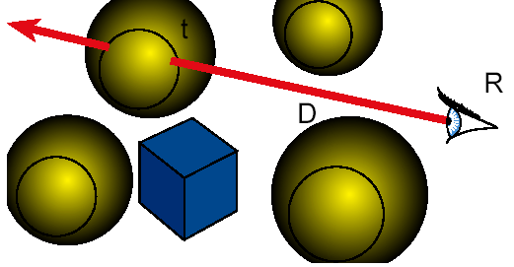
Ray Casting
Ray Cast ( Point R, Ray D ) {
  foreach object in the scene
  find minimum t>0 such that R + t D hits object
  if ( object hit )
  return object
  else return background object
}

Slide 72
Raytracing
Cast rays from the eye point the same way as ray casting
  Builds the image pixel by pixel, one at a time
Cast additional rays from the hit point to determine the pixel color
  Shoot rays toward each light. If they hit something, then the object is shadowed from that light, otherwise use “standard” model for the light
  Reflection rays for mirror surfaces, to see what should be reflected in the mirror
  Refraction rays to see what can be seen through transparent objects
  Sum all the contributions to get the pixel color

Slide 73
Raytracing
Shadow rays
Reflection ray
refracted ray

Slide 74
Recursive Ray Tracing
When a reflected or refracted ray hits a surface, repeat the whole process from that point
  Send out more shadow rays
  Send out new reflected ray (if required)
  Send out a new refracted ray (if required)
  Generally, reduce the weight of each additional ray when computing the contributions to surface color
  Stop when the contribution from a ray is too small to notice or maximum recursion level has been reached

Slide 75
Raytracing Implementation
Raytracing breaks down into two tasks:
  Constructing the rays to cast
  Intersecting rays with geometry
The former problem is simple vector arithmetic
Intersection is essentially root finding (as we will see)
  Any root finding technique can be applied
Intersection calculation can be done in world coordinates or model coordinates

Slide 76
Constructing Rays
Define rays by an initial point and a direction: x(t)=x₀+td
Eye rays: Rays from the eye through a pixel
  Construct using the eye location and the pixel’s location on the image plane. X₀ = eye
Shadow rays: Rays from a point on a surface to the light.
  X₀ = point on surface
Reflection rays: Rays from a point on a surface in the reflection direction
  Construct using laws of reflection. X₀ = surface point
Transmitted rays: Rays from a point on a transparent surface through the surface
  Construct using laws of refraction. X₀ = surface point

Slide 77
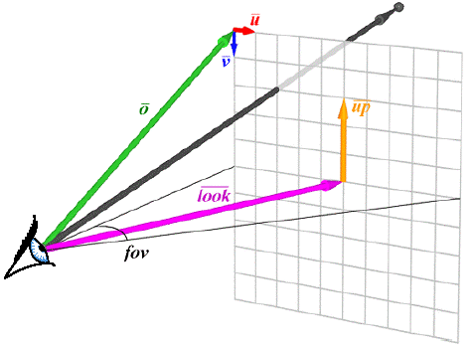
From Pixels to Rays

Slide 78
Ray Tracing Illumination
Recursive
Check for shadowing (intersection with object along ray (P,L))

Slide 79
The Ray Tree
N₃
T₃
R₂
Viewpoint
N₂
T₁
R₃
R₁
L₁
L₂
N₁
L₃
L₁
R₁
T₁
L₂
L₃
Eye
N_{i} surface normal
R_{i} reflected ray
L_{i} shadow ray
T_{i} transmitted (refracted) ray
Psuedo-code
R₂
R₃
T₃

Slide 80
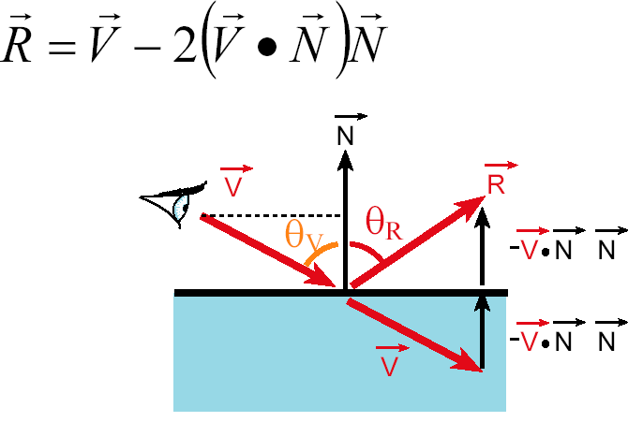
Reflection
Reflection angle = view angle

Slide 81
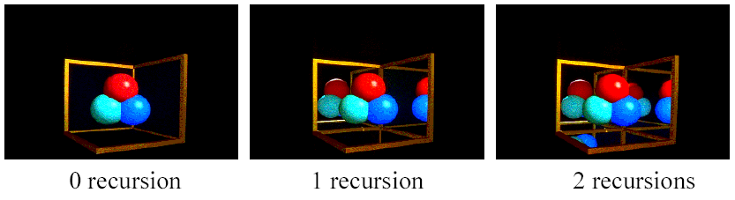
Reflection
The maximum depth of the tree affects the handling of refraction
If we send another reflected ray from here, when do we stop? 2 solutions (complementary)
  Answer 1: Stop at a fixed depth.
  Answer 2: Accumulate product of reflection coefficients and stop when this product is too small.

Slide 82
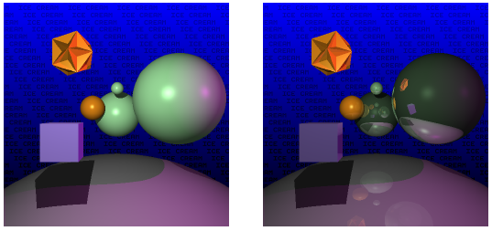
Reflection

Slide 83
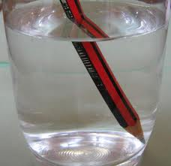
Refraction
Snell’s Law
Note that I is the negative of the incoming ray

Slide 84
Pseudo Code for Ray Tracing
rgb lsou; // intensity of light source
rgb back; // background intensity
rgb ambi; // ambient light intensity
Vector L // vector pointing to light source
Vector N // surface normal
Object objects [n] //list of n objects in scene
float Ks [n] // specular reflectivity factor for each object
float Kr [n] // refractivity index for each object
float Kd [n] // diffuse reflectivity factor for each object
Ray r;
void raytrace() {
for (each pixel P of projection viewport in raster order) {
r = ray emanating from viewer through P
int depth = 1; // depth of ray tree consisting of multiple paths
the pixel color at P = intensity(r, depth)
}
}

Slide 85
rgb intensity (Ray r, int depth) {
Ray flec, frac;
rgb spec, refr, dull, intensity;
if (depth >= 5) intensity = back;
else {
find the closest intersection of r with all objects in scene
if (no intersection) {
intensity =back;
} else {
Take closest intersection which is object[j]
compute normal N at the intersection point
if (Ks[j] >0) { // non-zero specular reflectivity
compute reflection ray flec;
refl = Ks[j]*intensity(flec, depth+1);
} else refl =0;
if (Kr[j]>0) { // non-zero refractivity
compute refraction ray frac;
refr = Kr[j]*intensity(frac, depth+1);
} else refr =0;
check for shadow;
if (shadow) direct = Kd[j]*ambi
else direct = Phong illumination computation;
intensity = direct + refl +refr;
} }
return intensity; }

Slide 86
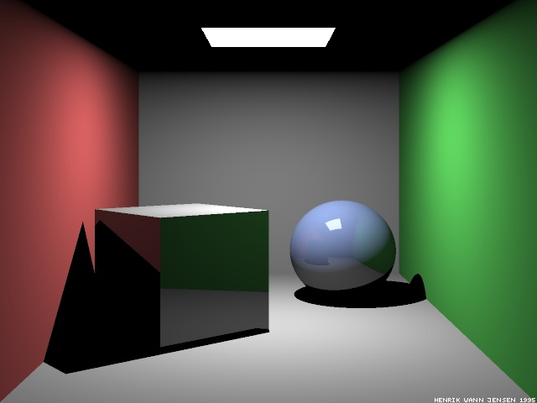
Raytraced Cornell Box
Which paths are missing?
Ray-traced Cornell box, due to Henrik Jensen,
http://www.gk.dtu.dk/~hwj

Slide 87
Paths in RayTracing
Ray Tracing
  Captures LDS*E paths: Start at the eye, any number of specular bounces before ending at a diffuse surface and going to the light
Raytracing cannot do:
  LS*D⁺E: Light bouncing off a shiny surface like a mirror and illuminating a diffuse surface
  LD⁺E: Light bouncing off one diffuse surface to illuminate others
Basic problem: The raytracer doesn’t know where to send rays out of the diffuse surface to capture the incoming light
Also a problem for rough specular reflection
  Fuzzy reflections in rough shiny objects
Need other rendering algorithms that get more paths

Slide 88
A Better Rendered Cornell Box

