Slide 1
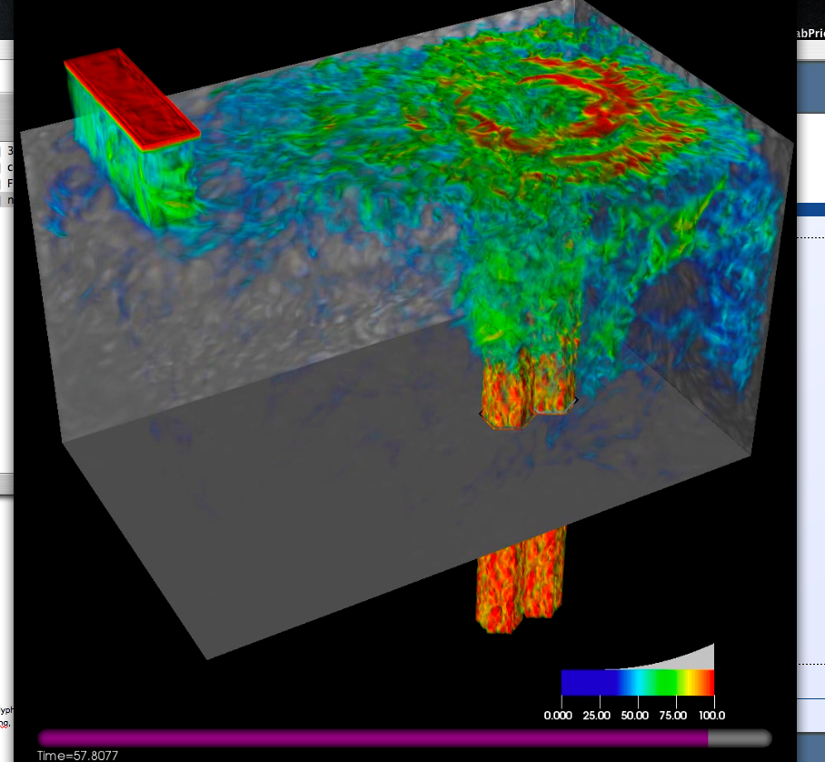
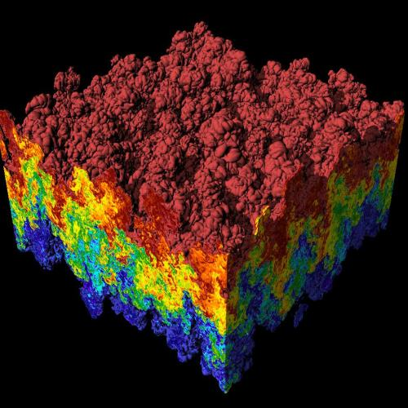
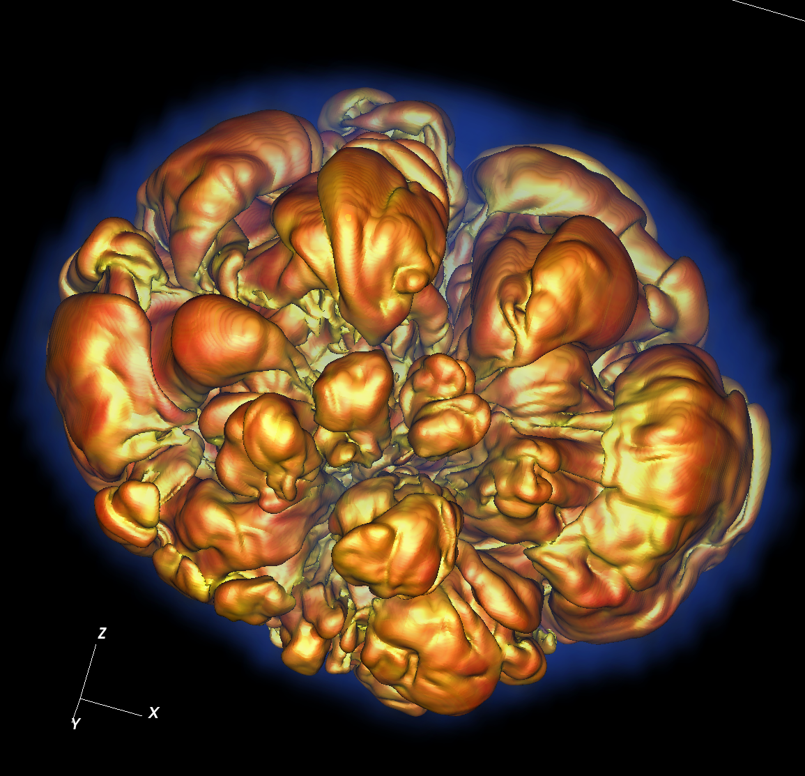
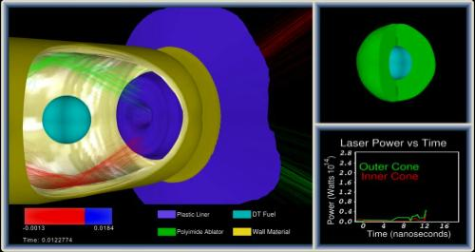
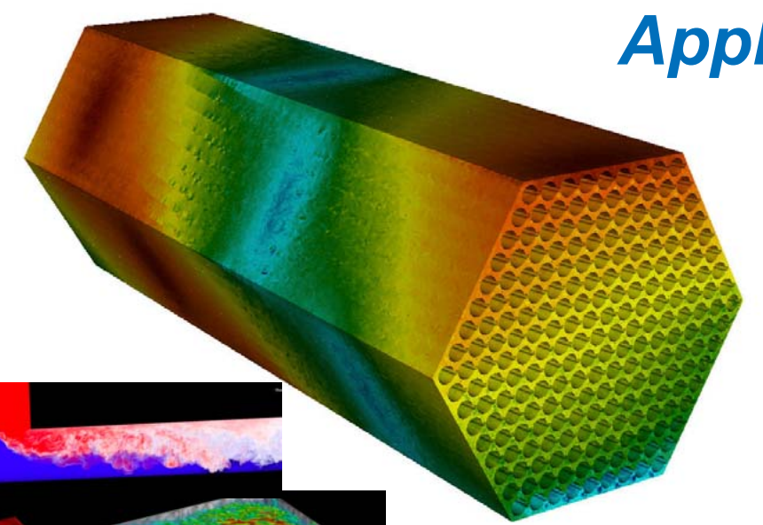
CIS 441/541: Intro to Computer Graphics Lecture 10: OpenGL - Shaders
May 6, 2021
Hank Childs, University of Oregon

Slide 2
Office Hours

Slide 3
Layout of Simple OpenGL Program
Set up windows
Set up things to render (VBOs)
Set up how to render (shaders)
While (1)
Accept events, make changes
New camera positions, new geometry, etc.
Render

Slide 4
The remainder of this lecture and Thursday’s lecture are made up of 4 parts
Set up windows
Doing a render
Set up things to render (VBOs)
Set up how to render (shaders) (Thursday)

Slide 5
The remainder of this lecture and Thursday’s lecture are made up of 4 parts
Set up windows
Doing a render
Set up things to render (VBOs)
Set up how to render (shaders) (Thursday)

Slide 6
How to Use Shaders
You write a shader program: a tiny C-like program
You write C/C++ code for your application
Your application loads the shader program from a text file (or just contains it as a string)
Your application sends the shader program to the OpenGL library and directs the OpenGL library to compile the shader program
If successful, the resulting GPU code can be attached to your (running) application and used
It will then supplant the built-in GL operations

Slide 7
How to Use Shaders: Visual Version
sends “char *”
version of
program to GL via
function call
Project2A’
C++ code
Project2A’
binary
g++
OpenGL
library
reads
text
file
when
running
OpenGL
compiles program, binary made just for
the current
execution
Program is used
on GPU to support
Project2A’ binary
shader program is a binary
shader program

Slide 8
Compiling Shader

Slide 9
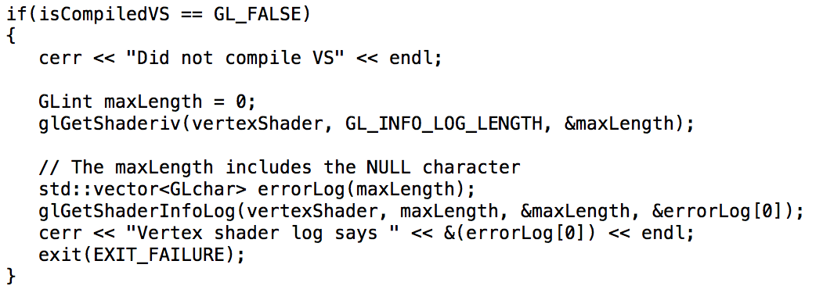
Compiling Shader: inspect if it works

Slide 10
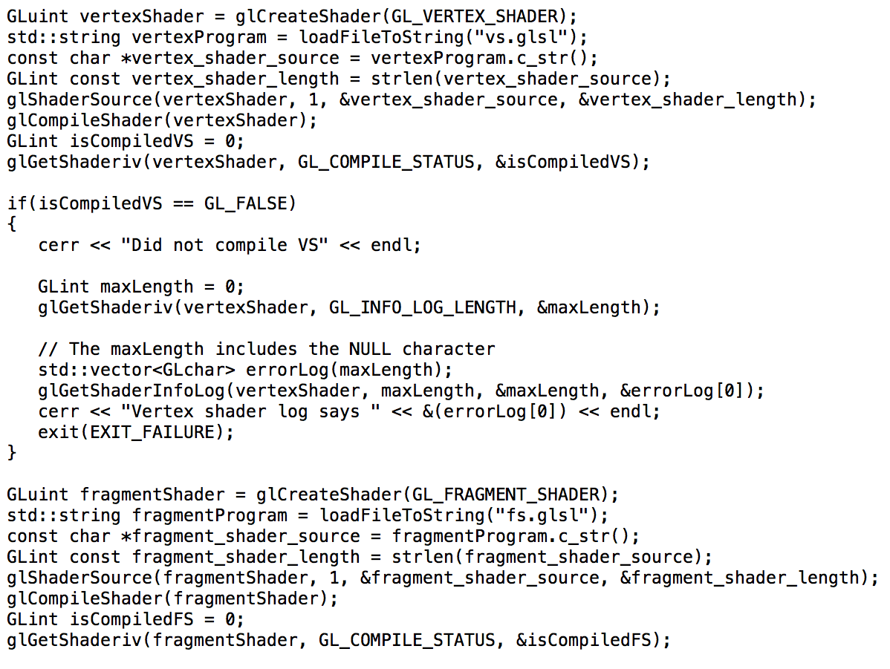
Compiling Multiple Shaders

Slide 11
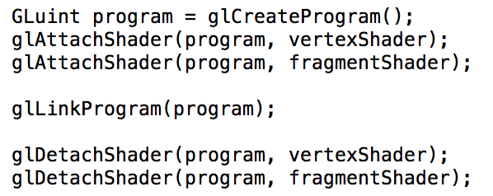
Attaching Shaders to a Program

Slide 12
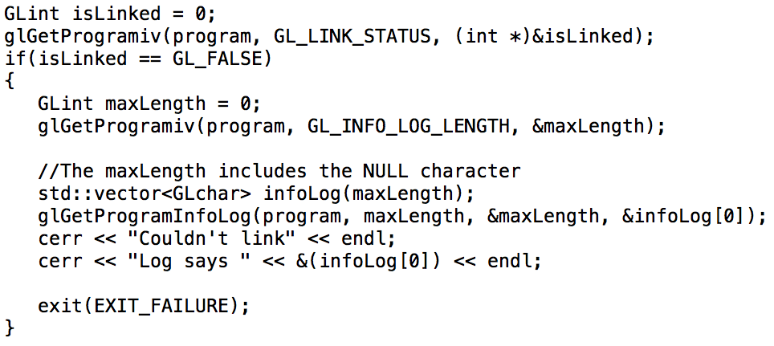
Inspecting if program link worked…

Slide 13
Starter Code Has 4 Shaders
phase2VertexShader
phase2FragmentShader
phase345VertexShader
phase345FragmentShader
Phase 2 variants are complete and work
Phase 345 variants are what you will implement

Slide 14
Reminder: How Shaders Fit Into the Graphics Pipeline
You can have 0 or 1 of each shader type
Vertex & fragment: very common (2A)
Geometry & tessellation: less common
adaptive meshing
Transform Vertices from World Space to Device Space
Rasterize
Contribute Fragments to Buffers
vertex shaders: custom implementation
fragment shaders: custom implementation
geometry & tessellation shaders: create new geometry before rasterized

Slide 15
4 Elements to a Shader Program
Declare GLSL version (GL Shader Language)
Declare inputs to program
Declare outputs of program
void main() {
C-like code that operates
on inputs to make outputs
}

Slide 16
4 Elements to a Shader Program
Declare GLSL version (GL Shader Language)
Declare inputs to program
Declare outputs of program
void main() {
C-like code that operates
on inputs to make outputs
}

Slide 17
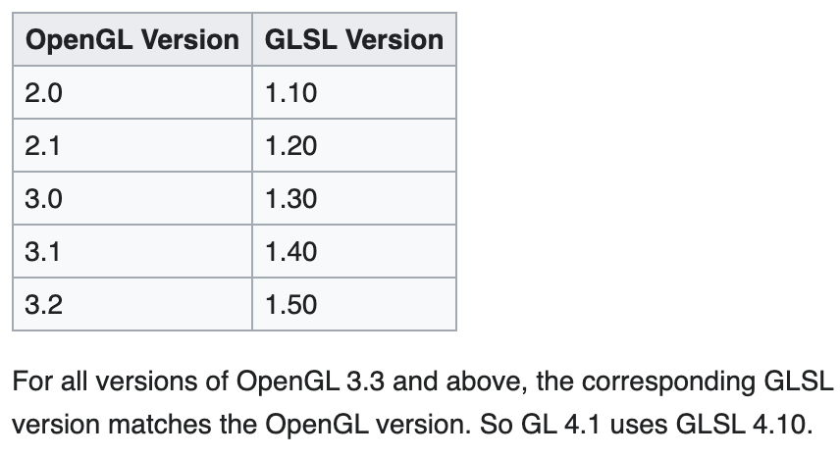
Declare GLSL version
Syntax: #version 400
Old versions: may be deprecated
New versions: may not be available
400 is a good choice – works everywhere
And what we use for this class
From: Khronos.org

Slide 18
4 Elements to a Shader Program
Declare GLSL version (GL Shader Language)
Declare inputs to program
Declare outputs of program
void main() {
C-like code that operates
on inputs to make outputs
}

Slide 19
Declare Inputs to Program
layout (location = 0) in vec3 vertex_position;
In words:
The array that was placed in location 0 is a vector of 3 floats
In my code, I will refer to this array as vertex_position
Regarding placement:
The placement was already done before the shader program executes
The program must accept the placement made by the VAO or shader program that proceeded it

Slide 20
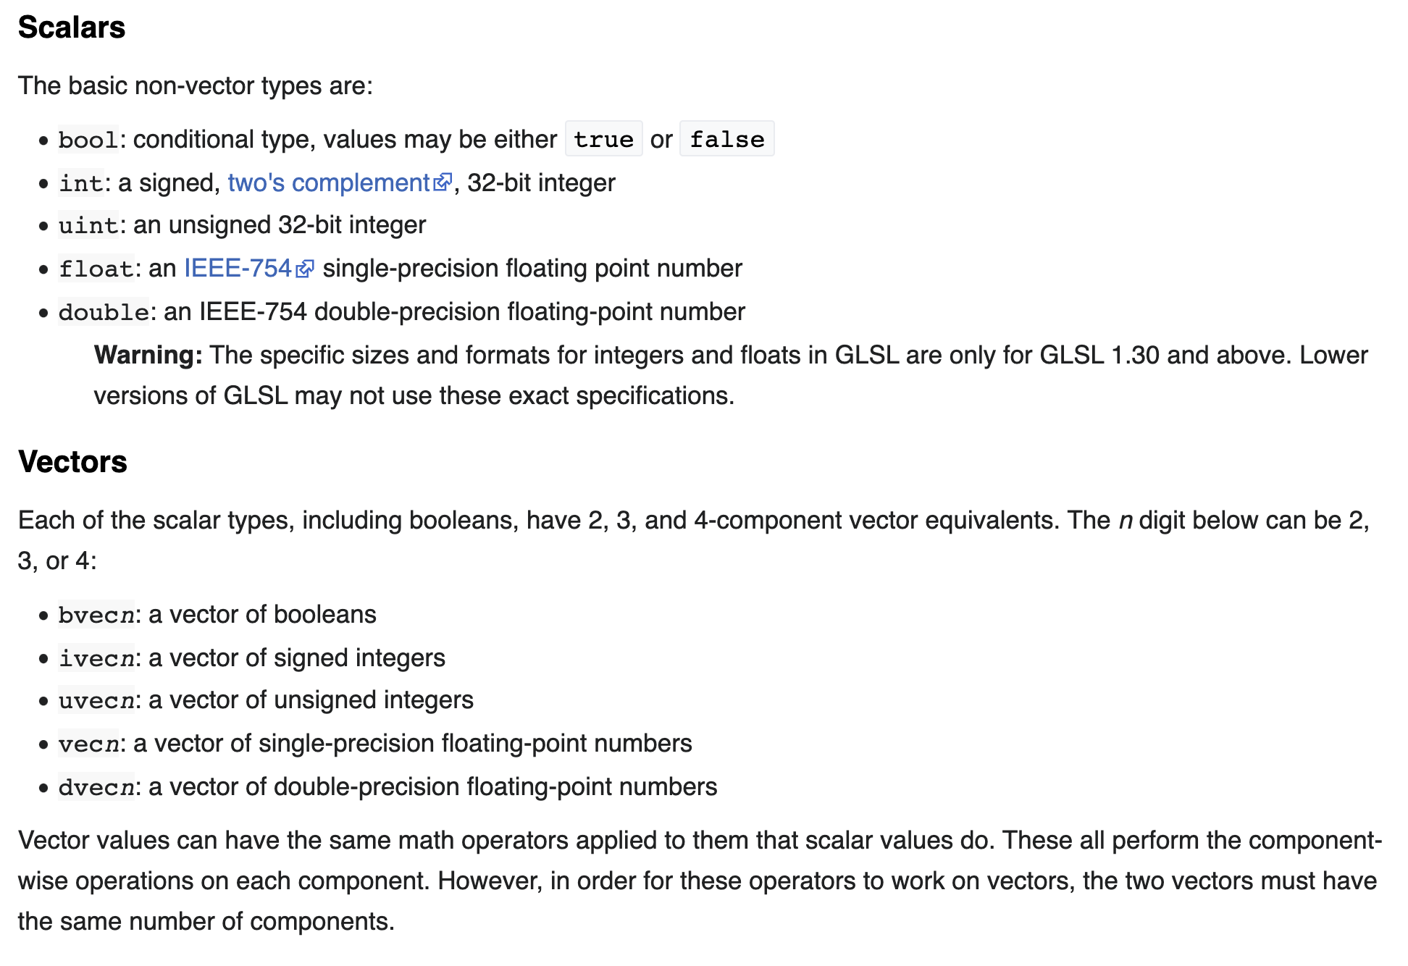
Type Names
From: Khronos.org

Slide 21
Declare Inputs to Program
layout (location = 0) in vec3 vertex_position;
layout (location = 1) in vec3 vertex_color;
In words:
The array that was placed in location 0 is a vector of 3 floats
In my code, I will refer to this array as vertex_position
The array that was placed in location 1 is also a vector of 3 floats
In my code, I will refer to this array as vertex_color

Slide 22
Declare Outputs of Program
out vec3 color;
In words:
My program will create a vector of3 floats
I will refer to this vector as color
It is at location 0, since I declared this first
The next shader program needs to know that color is placed in location 0 and is a vec3

Slide 23
4 Elements to a Shader Program
Declare GLSL version (GL Shader Language)
Declare inputs to program
Declare outputs of program
void main() {
C-like code that operates
on inputs to make outputs
}

Slide 24
C-like code
void main() {
color = vertex_color;
gl_Position = vec4(vertex_position, 1.0);
}
gl_Position is a mandatory output of a vertex shader
And this did a bad job! – should have done matrix transform and did not
Had to make a variable called color to send color info along to fragment shader

Slide 25
Vertex Shader From Starter Code
#version 400
layout (location = 0) in vec3 vertex_position;
layout (location = 1) in vec3 vertex_color;
out vec3 color;
void main() {
color = vertex_color;
gl_Position = vec4(vertex_position, 1.0);
}

Slide 26
Shader Overview
Rasterizer
VAO
Vertex Shader
Fragment Shader
VBO1
gl_Position
frag_color
L0
N0
Code
N0
Code
VBO2
L1
N1
N1
VBO3
L2
N2
N2
VBO4
L3
U6
U1
Uniforms
U4
U1
U2
U3
U4
U5
U6

Slide 27
Shader Overview
Rasterizer
VAO
Vertex Shader
Fragment Shader
VBO1
gl_Position
frag_color
L0
N0
Code
N0
Code
VBO2
L1
N1
N1
VBO3
L2
N2
N2
VBO4
L3
U6
U1
Uniforms
U4
U1
U2
U3
U4
U5
U6

Slide 28
Vertex Shader From Starter Code
#version 400
layout (location = 0) in vec3 vertex_position;
layout (location = 1) in vec3 vertex_color;
out vec3 color;
void main() {
color = vertex_color;
gl_Position = vec4(vertex_position, 1.0);
}
These must match up. VAO is putting arrays in “locations.” Shader program must honor the VAO’s ordering.
Location 0 contains “points_vbo” no matter what name it is given.

Slide 29
Shader Overview
Rasterizer
VAO
Vertex Shader
Fragment Shader
VBO1
gl_Position
frag_color
L0
N0
Code
N0
Code
VBO2
L1
N1
N1
VBO3
L2
N2
N2
VBO4
L3
U6
U1
Uniforms
U4
U1
U2
U3
U4
U5
U6

Slide 30
“Uniform” Means “Constant”
You can set constants in your GL code
You set the name
You set the type
You set the value
The shader program can then access those constants

Slide 31
Syntax for creating a uniform (in main GL code)
GLuint param = glGetUniformLocation(
shader_programme, "cis441”
);
glUniform1f(param, 0.5);
“Get Uniform Location” means “make a new uniform”
glUniform1f: the value of the constant will be a single float

Slide 32
Syntax for using a uniform
#version 400
layout (location = 0) in vec3 vertex_position;
layout (location = 1) in vec3 vertex_color;
uniform float cis441;
out vec3 color;
void main() {
color = vertex_color;
// gl_Position = vec4(vertex_position, 1.0);
gl_Position = vec4(vertex_position.x, vertex_position.y-cis441, vertex_position.z, 1.0);
}

Slide 33
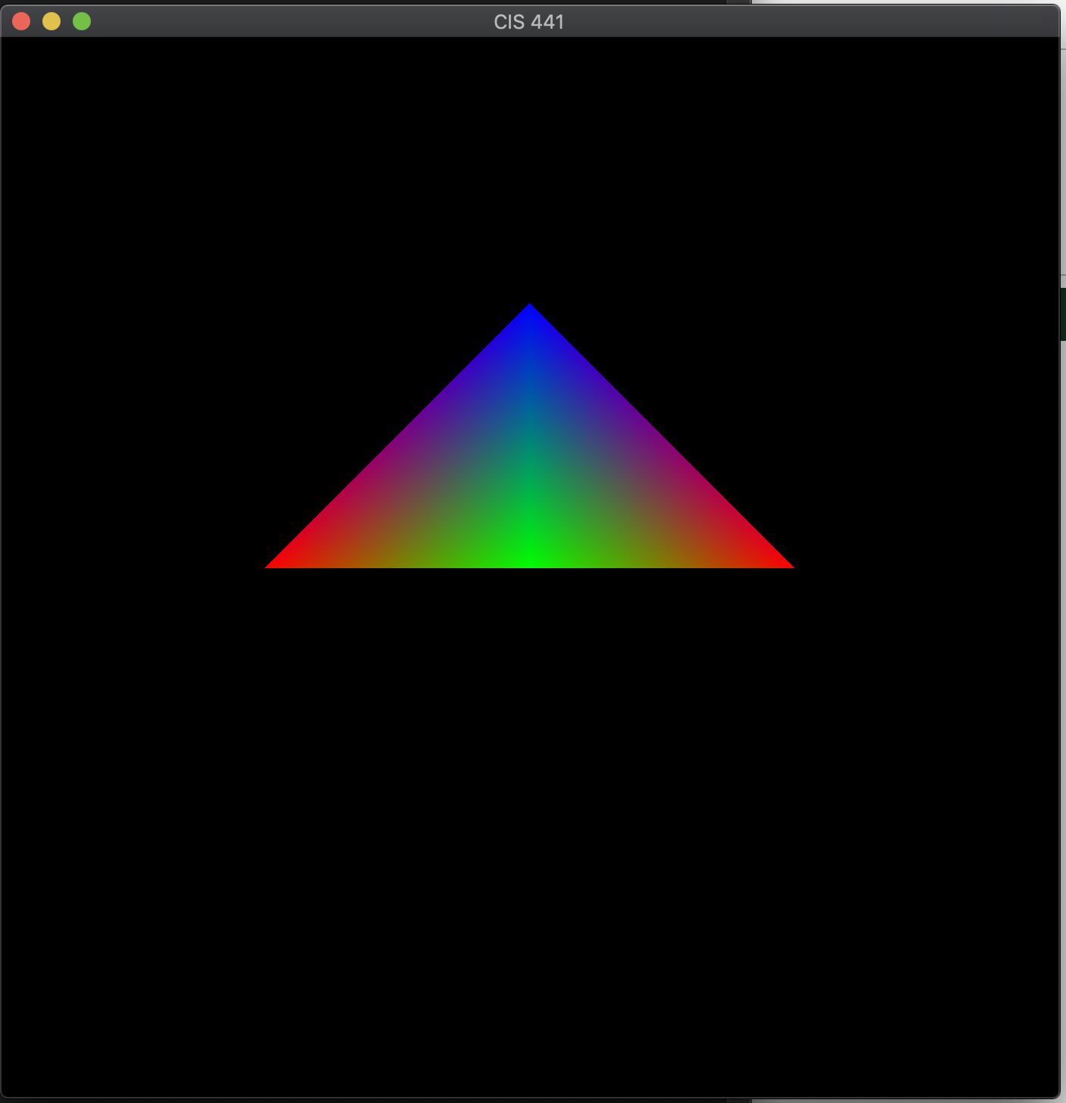
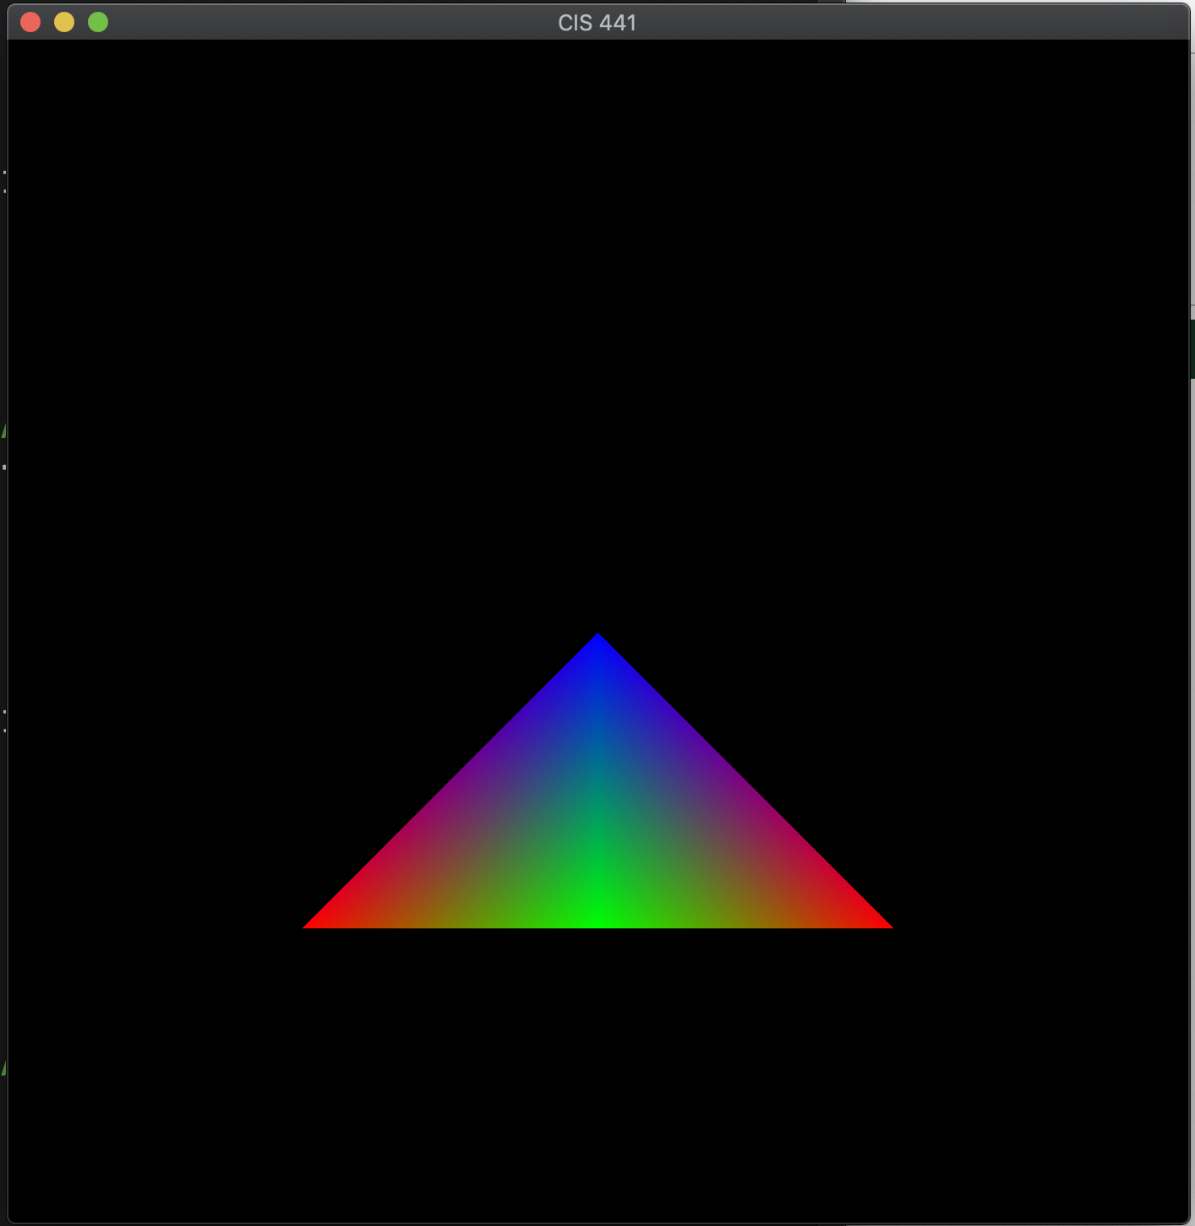
Original
New
Note: this vertex shading is not typical.
Normal vertex shader: transform points from world space to image space
This vertex shader: assume they are already in image space

Slide 34
Shader Overview
Rasterizer
VAO
Vertex Shader
Fragment Shader
VBO1
gl_Position
frag_color
L0
N0
Code
N0
Code
VBO2
L1
N1
N1
VBO3
L2
N2
N2
VBO4
L3
U6
U1
Uniforms
U4
U1
U2
U3
U4
U5
U6

Slide 35
This picture is misleading
Vertex shader called once per vertex
Fragment shader called once per fragment
One triangle has 3 vertices, but may have thousands of fragments
Not one-to-one!

Slide 36
Shader Overview
Rasterizer
VAO
Vertex Shader
Fragment Shader
VBO1
gl_Position
frag_color
L0
N0
Code
N0
Code
VBO2
L1
N1
N1
VBO3
L2
N2
N2
VBO4
L3
U6
U1
Uniforms
U4
U1
U2
U3
U4
U5
U6

Slide 37
One Shader’s Output Is Another Shader’s Input
It is your job to arrange the output’s of one shader to be the input’s to the next
Output of vertex shader is input to fragment shader
If VAO sends in arrays that you want in the fragment shader, then the vertex shader needs to do work to pass them through (see next slide)

Slide 38
Vertex Shader → Fragment Shader
#version 400
layout (location = 0) in vec3 vertex_position;
layout (location = 1) in vec3 vertex_color;
out vec3 color;
void main() {
color = vertex_color;
gl_Position = vec4(vertex_position, 1.0);
}
#version 400
in vec3 color;
out vec4 frag_color;
void main() {
frag_color = vec4(color, 1.0);
}

Slide 39
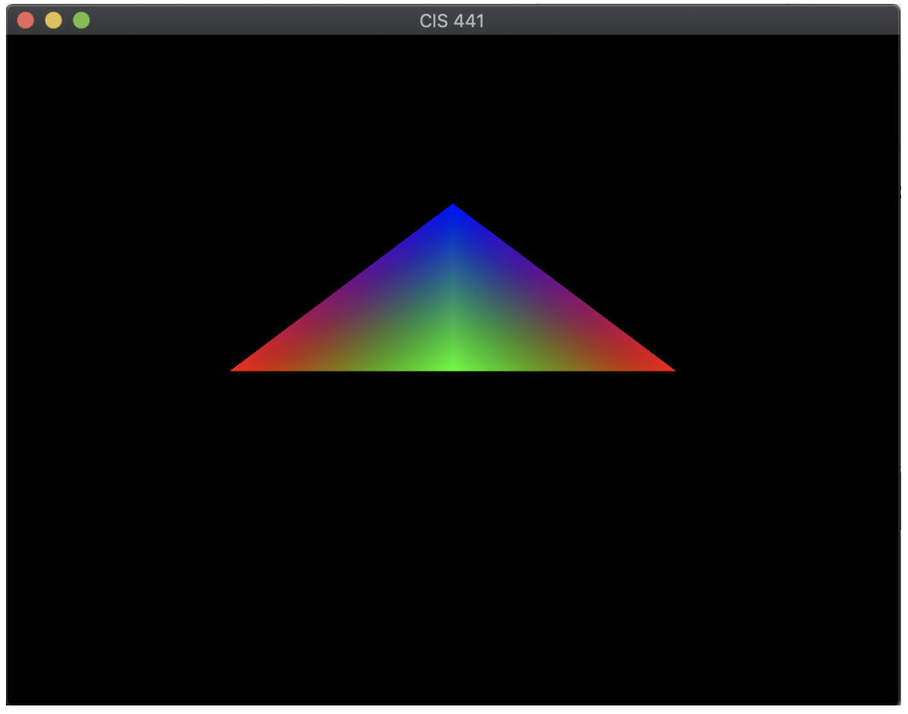
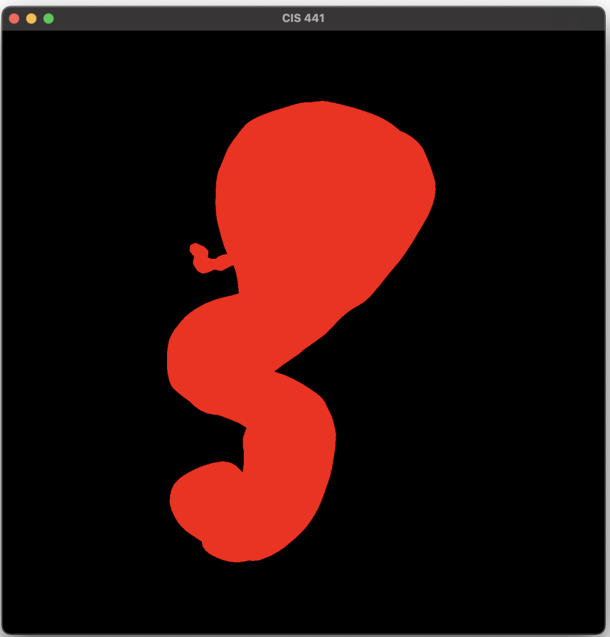
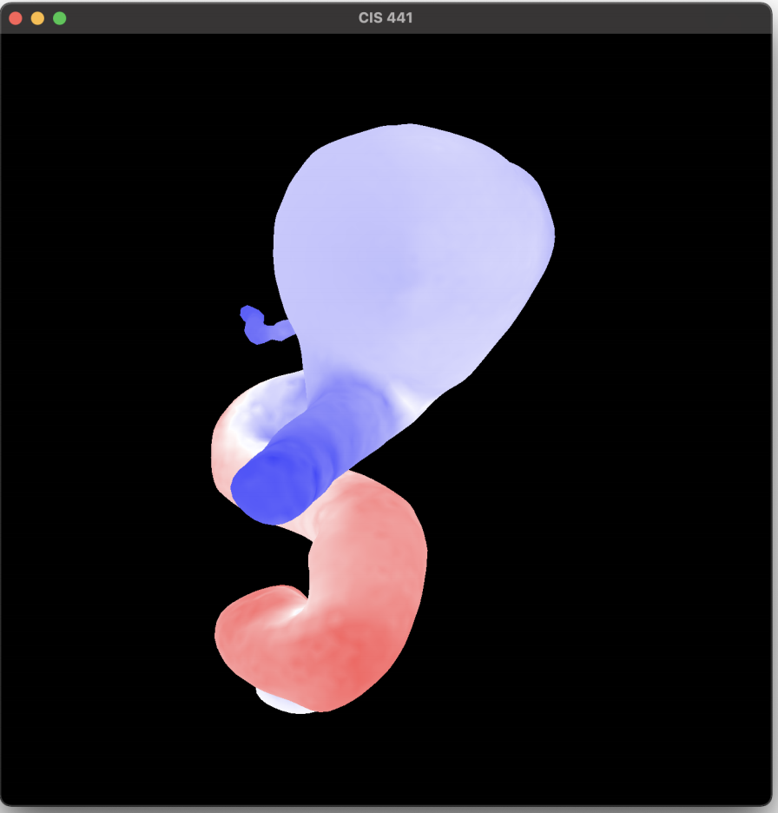
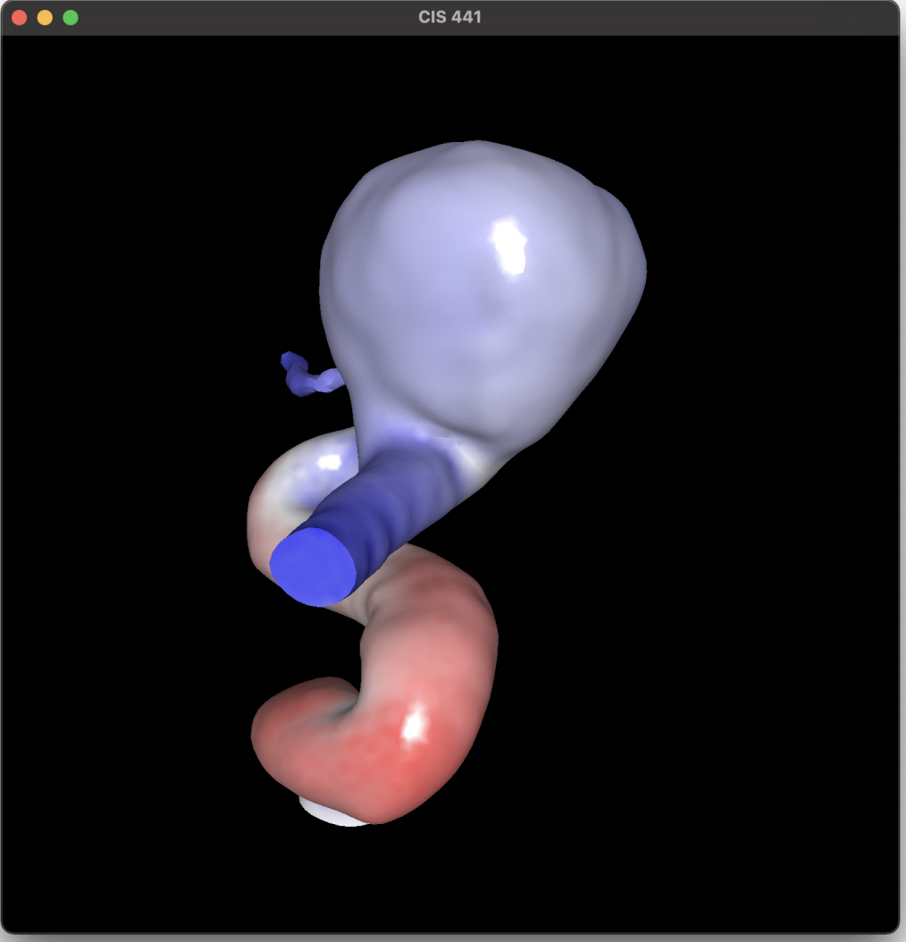
Project 2A
Assigned today, due in one week (Tuesday May 11)
Worth 8% of your grade
Implementing Project 1 within OpenGL
5 phases
Phase 1: install GLFW
Phase 2: run example program
Phase 3: modify VBO/VAO
Phases 4 & 5: shader programs
Please start ASAP on Phase 1-3
Thursday’s lecture will be on Phase 4 & 5

Slide 40
Rest of This Lecture
Have fun with shaders
Look at project 2A

Slide 42
RED
GREEN
BLUE

Slide 43
1
y
x

