Slide 1
CIS 330: _ _ _ _ ______ _ _____ / / / /___ (_) __ ____ _____ ____/ / / ____/ _/_/ ____/__ __ / / / / __ \/ / |/_/ / __ `/ __ \/ __ / / / _/_// / __/ /___/ /_ / /_/ / / / / /> < / /_/ / / / / /_/ / / /____/_/ / /__/_ __/_ __/ \____/_/ /_/_/_/|_| \__,_/_/ /_/\__,_/ \____/_/ \____//_/ /_/
Lecture 8: enum, structs, and unions
April 23rd, 2018
Hank Childs, University of Oregon

Slide 2
Announcements: Plan This Week (1/2)
Hank out of town: Monday night->Thursday night
Brent covers Hank’s OH on Tuesday
Wednesday class is ON.
Brent does lab #2, which includes parts of lecture 7
Hank does lecture on Friday

Slide 3
Announcements: Plan This Week (2/2)
2B: due today
2C: assigned today, due Saturday, 4/28/18
3A: assigned today due Tuesday, 5/1/18
NOTE: Lecture 9 is online
Corrections on Piazza

Slide 4
Outline
Review
Project 2B
Enum
Struct
Unions
Project 2C

Slide 5
File I/O: streams and file descriptors
Two ways to access files:
File descriptors:
Lower level interface to files and devices
Provides controls to specific devices
Type: small integers (typically 20 total)
Streams:
Higher level interface to files and devices
Provides uniform interface; easy to deal with, but less powerful
Type: FILE *
Streams are more portable, and more accessible
to beginning programmers. (I teach streams here.)

Slide 6
File I/O
Process for reading or writing
Open a file
Tells Unix you intend to do file I/O
Function returns a “FILE *
Used to identify the file from this point forward
Checks to see if permissions are valid
Read from the file / write to the file
Close the file

Slide 7
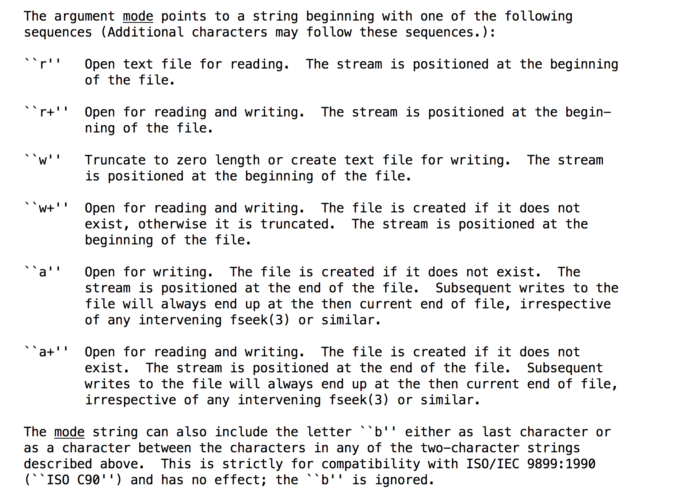
Opening a file
FILE *handle = fopen(filename, mode);
Example: FILE *h = fopen(“/tmp/330”, “wb”);
Close when you are done with “fclose”
Note: #include <stdio.h>

Slide 8
Unix and Windows difference
Unix:
“\n”: goes to next line, and sets cursor to far left
Windows:
“\n”: goes to next line (cursor does not go to left)
“\m”: sets cursor to far left
Text files written in Windows often don’t run well on Unix, and vice-versa
There are more differences than just newlines
vi: “set ff=unix” solves this

Slide 9
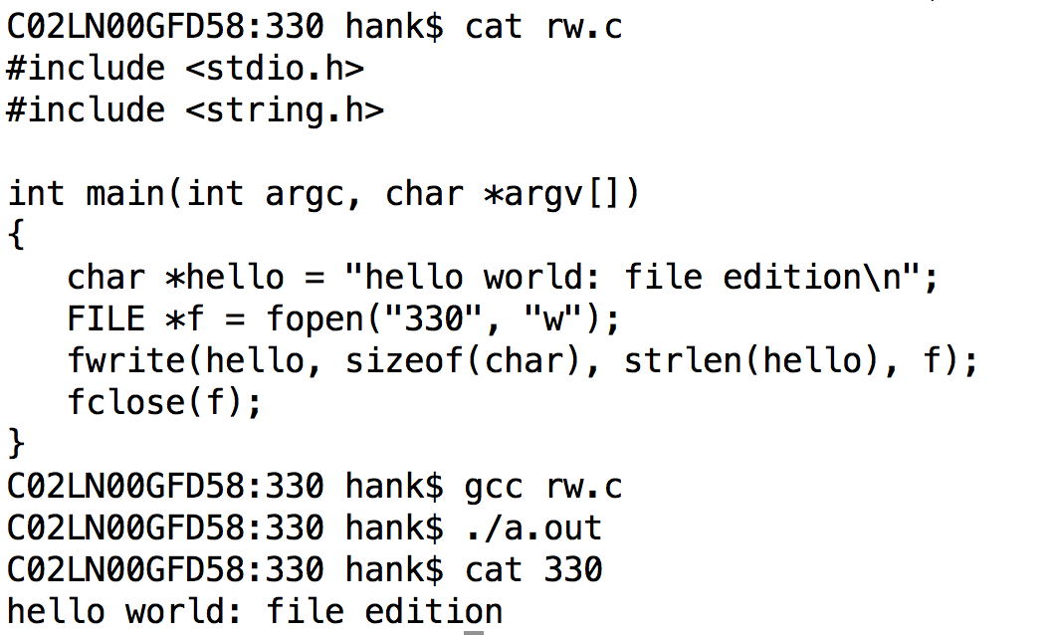
Example

Slide 10
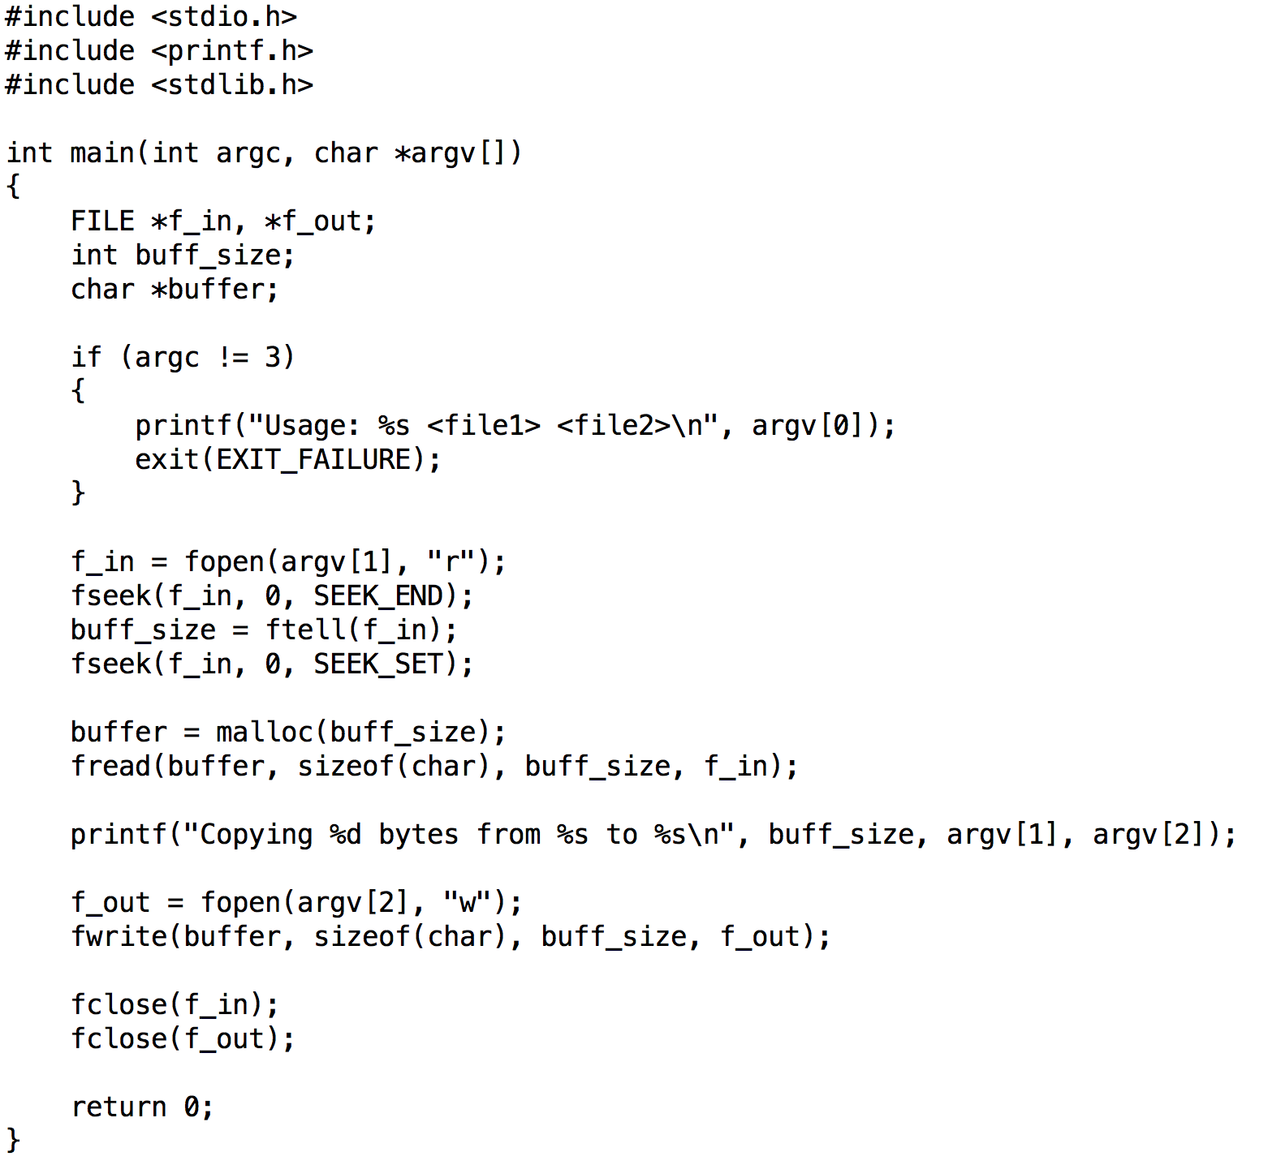

Slide 11
Printing to terminal and reading from terminal
In Unix, printing to terminal and reading from terminal is done with file I/O
Keyboard and screen are files in the file system!
(at least they were …)

Slide 12
Standard Streams
Wikipedia: “preconnected input and output channels between a computer program and its environment (typically a text terminal) when it begins execution”
Three standard streams:
stdin (standard input)
stdout (standard output)
stderr (standard error)
What mechanisms in C allow you to access standard streams?

Slide 13
printf
Print to stdout
printf(“hello world\n”);
printf(“Integers are like this %d\n”, 6);
printf(“Two floats: %f, %f”, 3.5, 7.0);

Slide 14
fprintf
Just like printf, but to streams
fprintf(stdout, “helloworld\n”);
→ same as printf
fprintf(stderr, “helloworld\n”);
prints to “standard error”
fprintf(f_out, “helloworld\n”);
prints to the file pointed to by FILE *f_out.

Slide 15
buffering and printf
Important: printf is buffered
So:
printf puts string in buffer
other things happen
buffer is eventually printed
But what about a crash?
printf puts string in buffer
other things happen … including a crash
buffer is never printed!
Solutions: (1) fflush, (2) fprintf(stderr) always flushed

Slide 16
Outline
Review
Project 2B
Enum
Struct
Unions
Project 2C

Slide 17
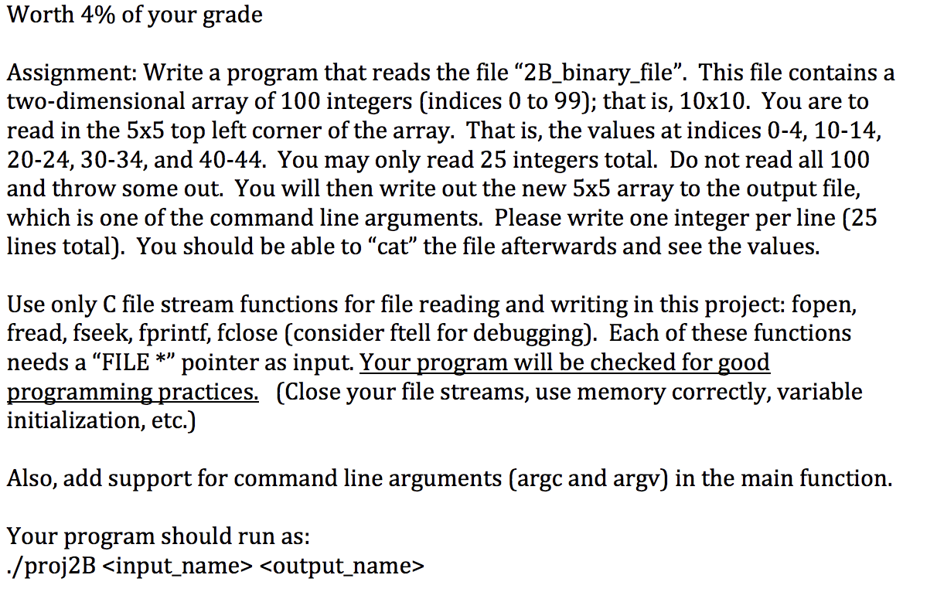
Project 2B

Slide 18
Outline
Review
Project 2B
Enum
Struct
Unions
Project 2C

Slide 19
Enums
Enums make your own type
Type is “list of key words”
Enums are useful for code clarity
Always possible to do the same thing with integers
Be careful with enums
… you can “contaminate” a bunch of useful words

Slide 20
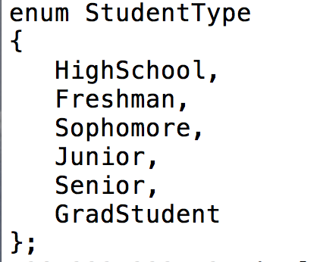
enum example
C keyword “enum” – means enum definition is coming
This enum contains 6 different student types
semi-colon!!!

Slide 21
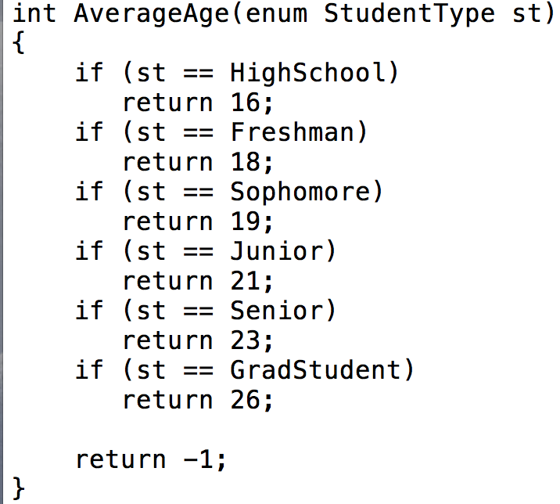
enum example

Slide 22
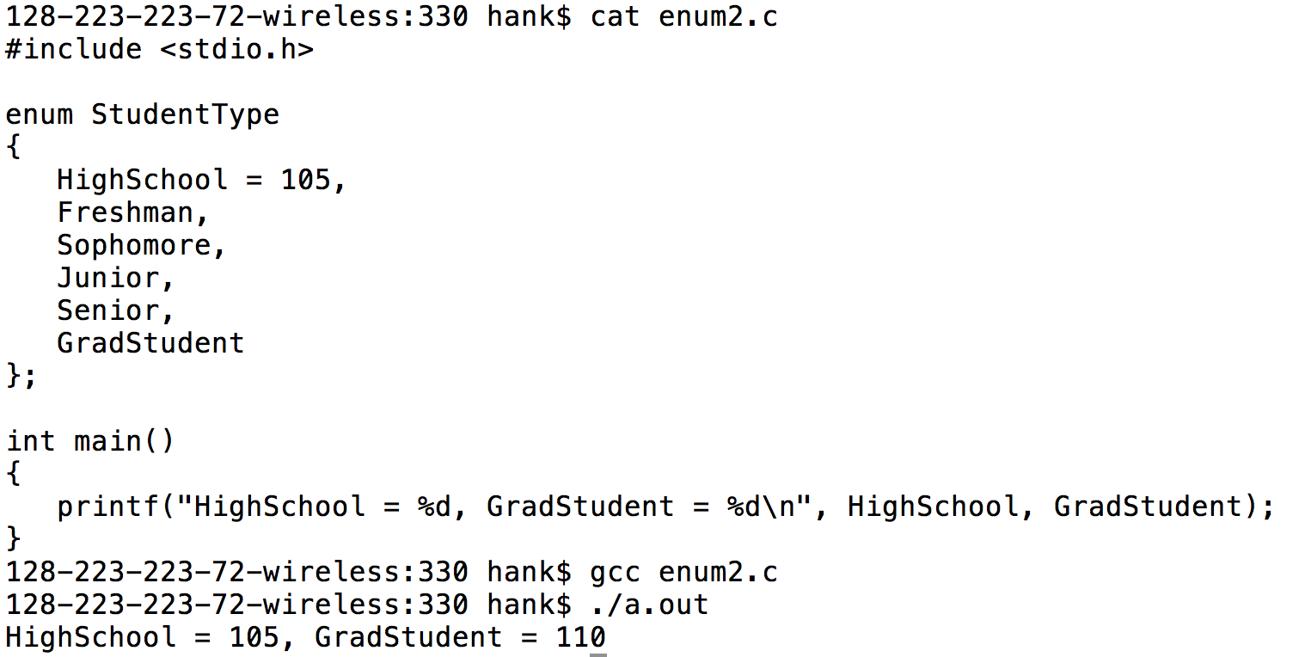
enums translate to integers … and you can set their range

Slide 23
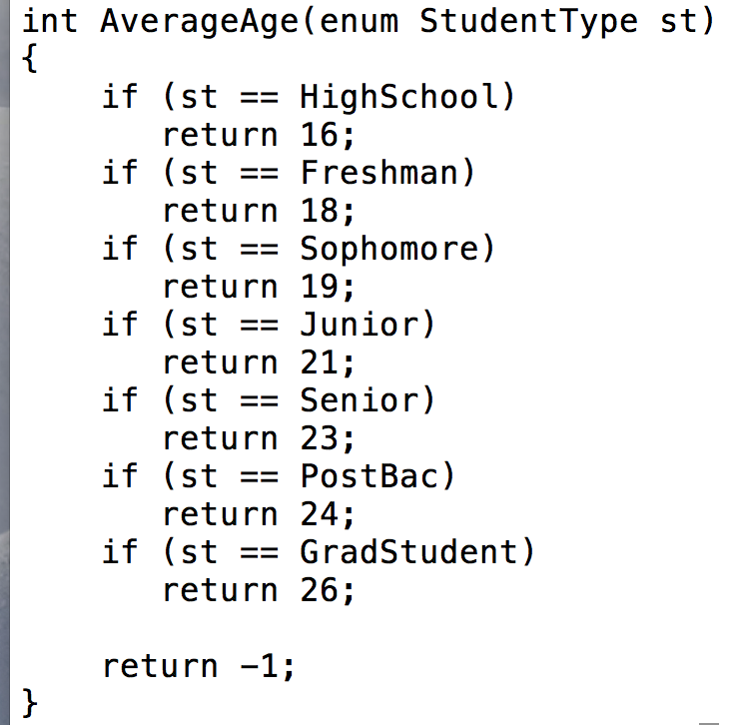
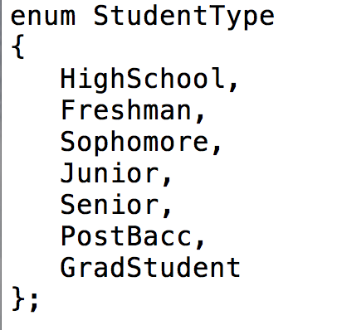
But enums can be easier to maintain than integers
If you had used integers, then this is a bigger change and likely to lead to bugs.

Slide 24
Outline
Grade 4A
Review
Project 2B
Enum
Struct
Unions
Project 2C

Slide 25
Data types
float
double
int
char
unsigned char
All of these are simple data types

Slide 26
Structs: a complex data type
Structs: mechanism provided by C programming language to define a group of variables
Variables must be grouped together in contiguous memory
Also makes accessing variables easier … they are all part of the same grouping (the struct)

Slide 27
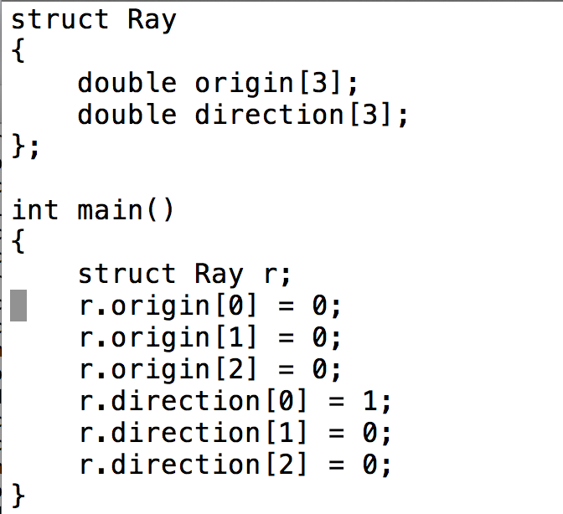
struct syntax
C keyword “struct” – means struct definition is coming
This struct contains 6 doubles, meaning it is 48 bytes
semi-colon!!!
Declaring an instance
“.” accesses data members for a struct

Slide 28
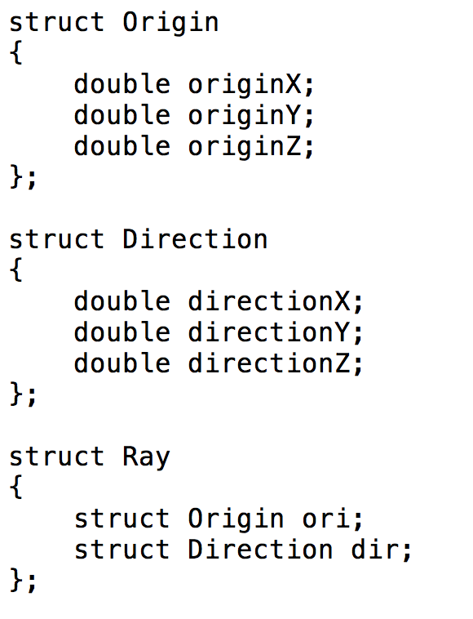
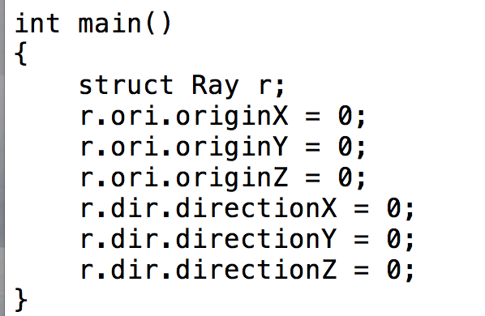
Nested structs
accesses dir
part of Ray
accesses directionZ
part of Direction
(part of Ray)

Slide 29
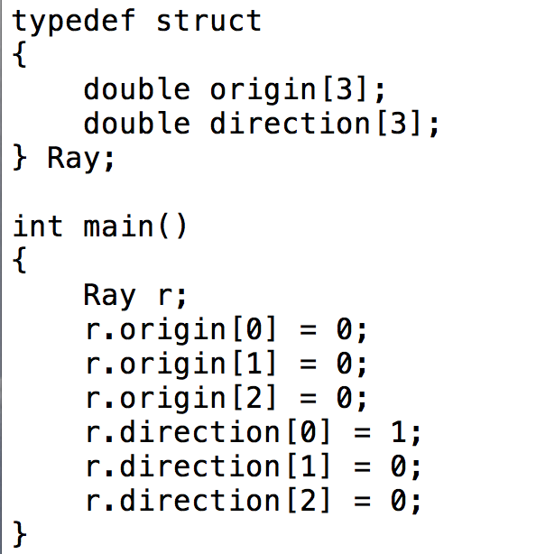
typedef
typedef: tell compiler you want to define a new type
saves you from having to type “struct” every time you declare a struct.

Slide 30
Other uses for typedef
Declare a new type for code clarity
typedef int MilesPerHour;
Makes a new type called MilesPerHour.
MilesPerHour works exactly like an int.
Also used for enums & unions
same trick as for structs … typedef saves you a word

Slide 31
Outline
Grade 4A
Review
Project 2B
Enum
Struct
Union
Project 2C

Slide 32
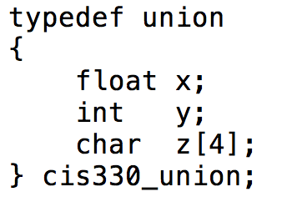
Unions
Union: special data type
store many different memory types in one memory location
When dealing with this union, you can treat it as a float, as an int, or as 4 characters.
This data structure has 4 bytes

Slide 33
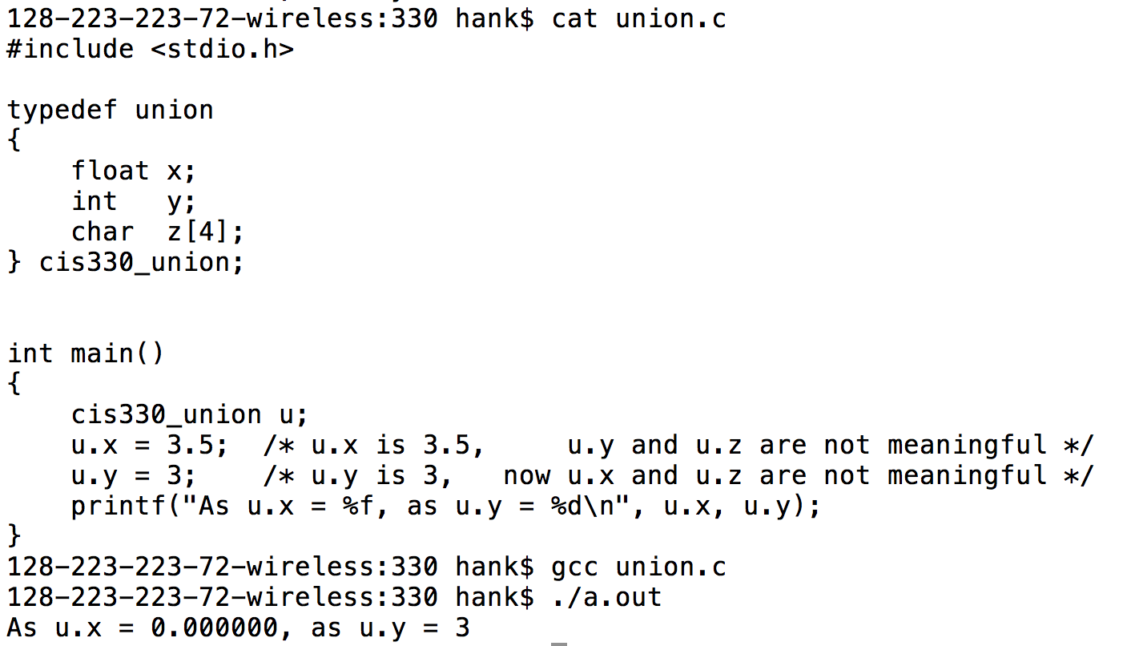
Unions
Why are unions useful?

Slide 34
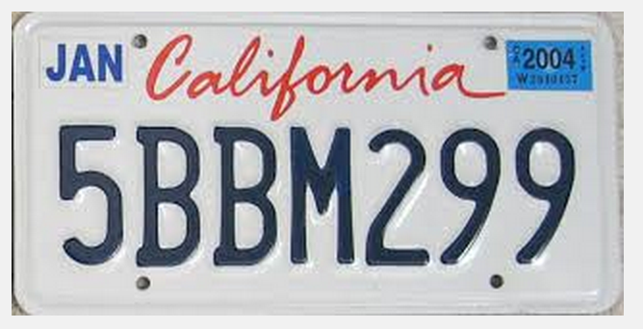
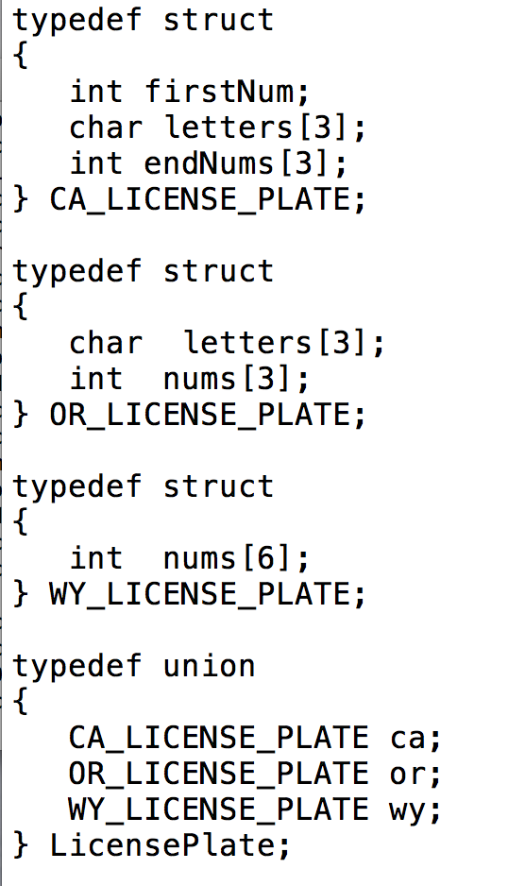
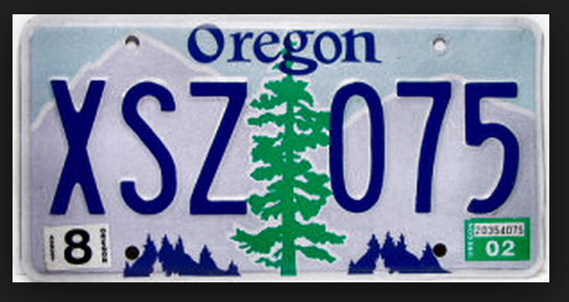
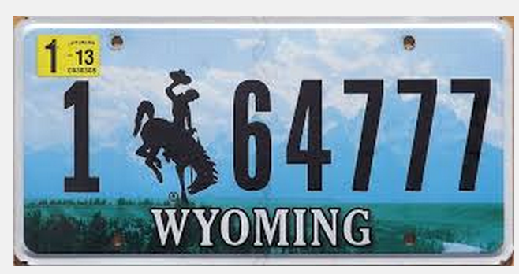
Unions Example

Slide 35
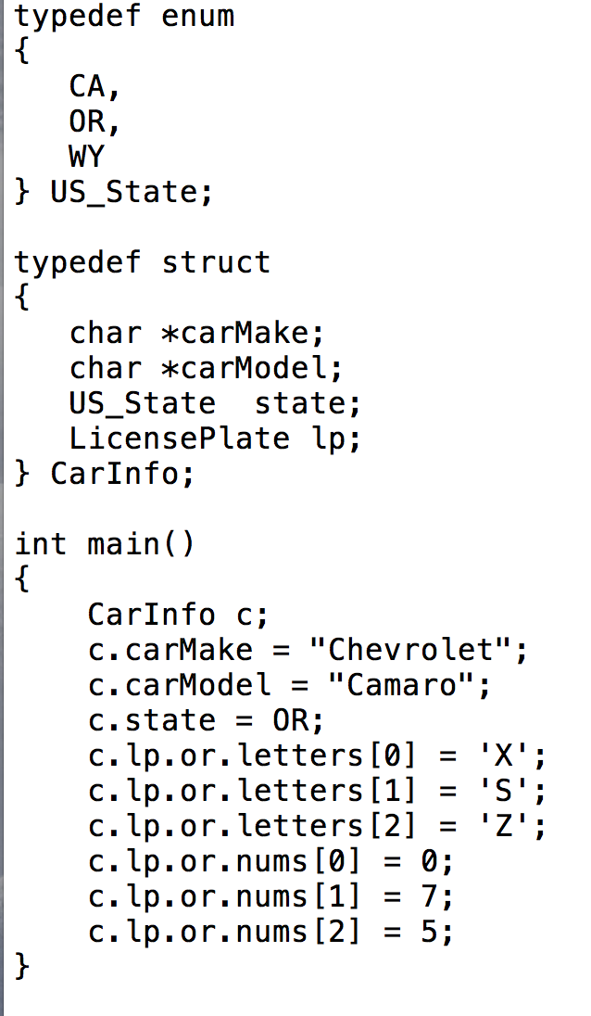
Unions Example

Slide 36
Outline
Grade 4A
Review
Project 2B
Enum
Struct
Unions
Project 2C

Slide 37
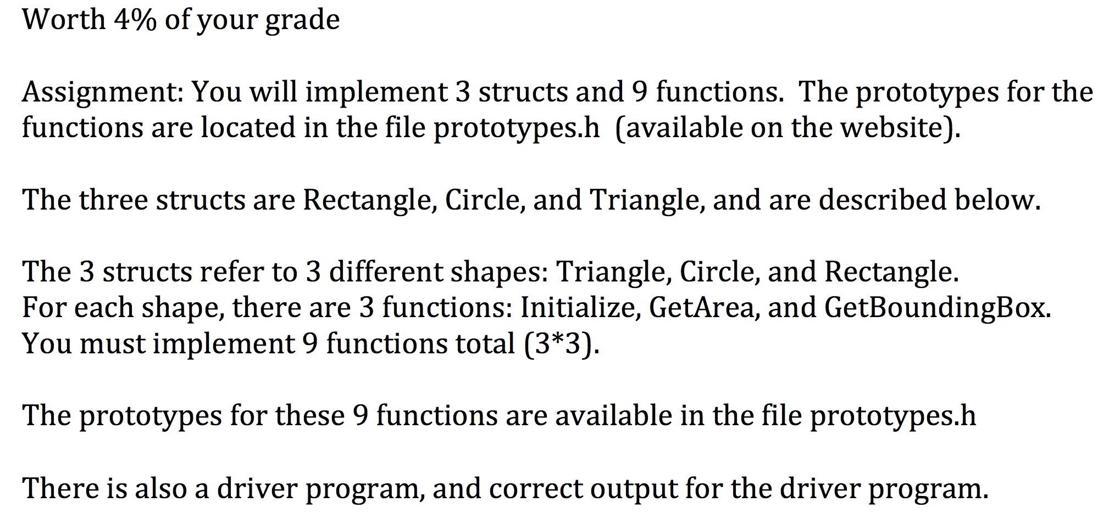
Project 2C

Slide 38
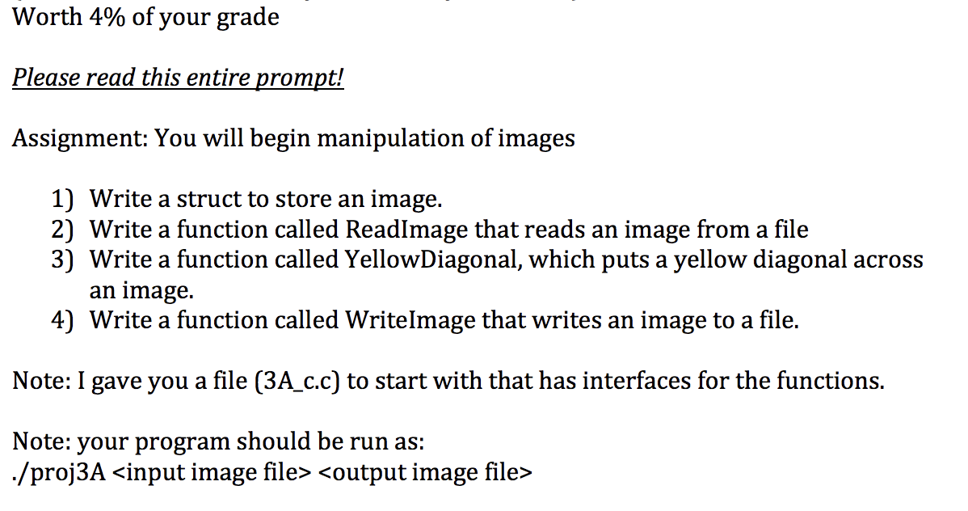
Project 3A

Slide 39
Function Pointers

Slide 40
Function Pointers
Idea:
You have a pointer to a function
This pointer can change based on circumstance
When you call the function pointer, it is like calling a known function

Slide 41
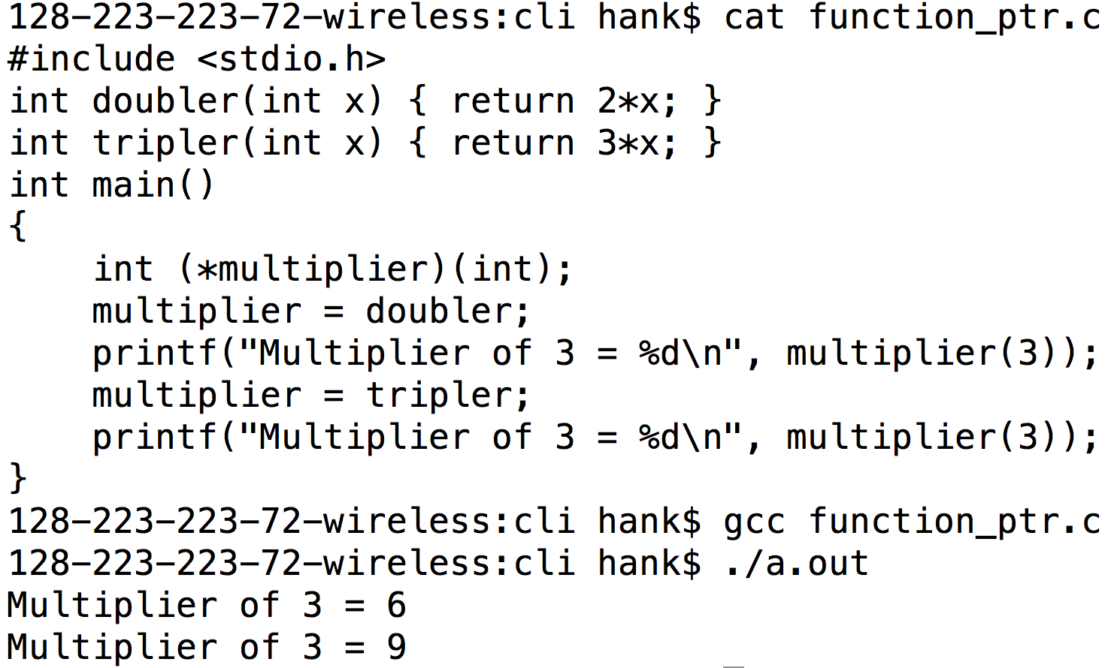
Function Pointer Example

Slide 42
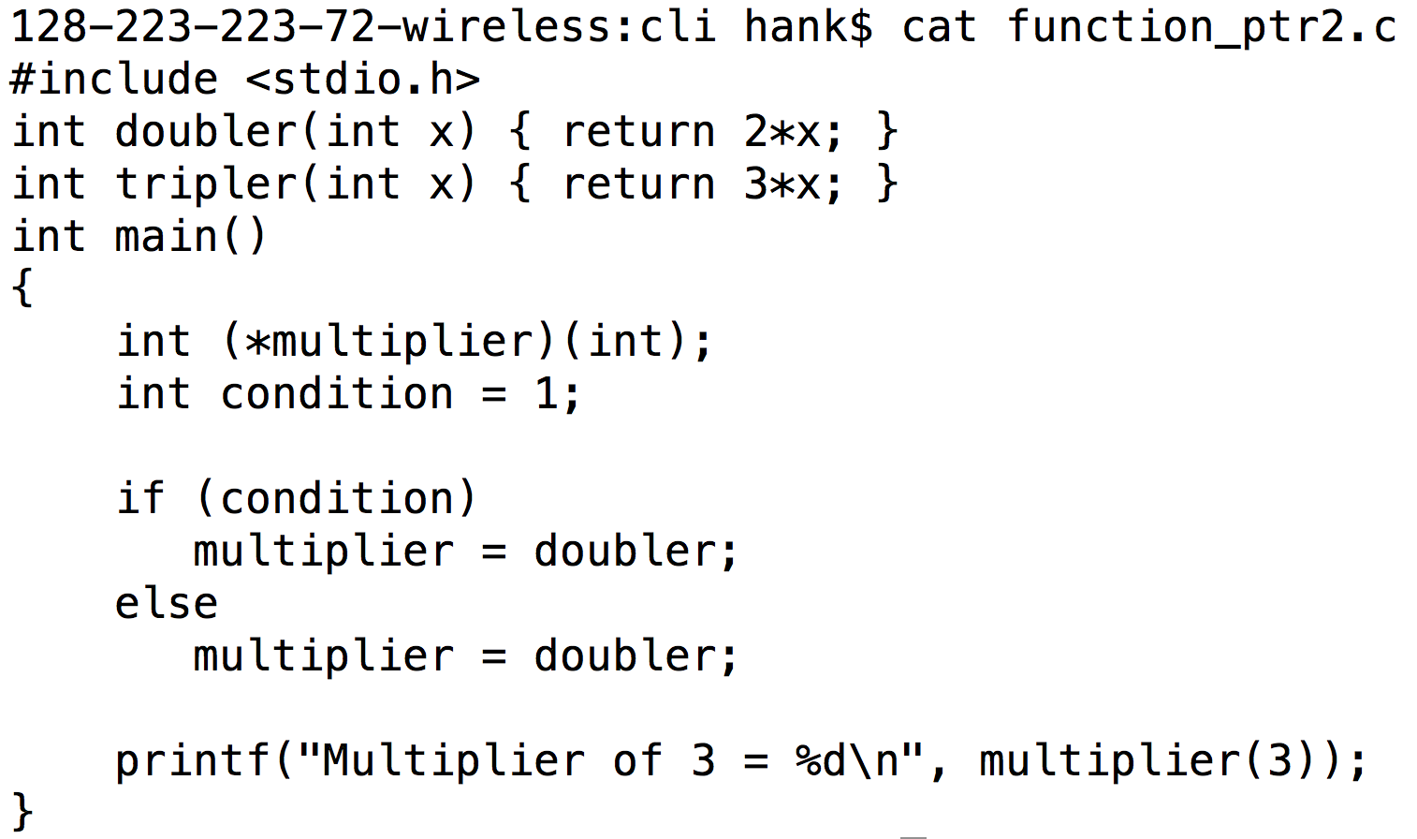
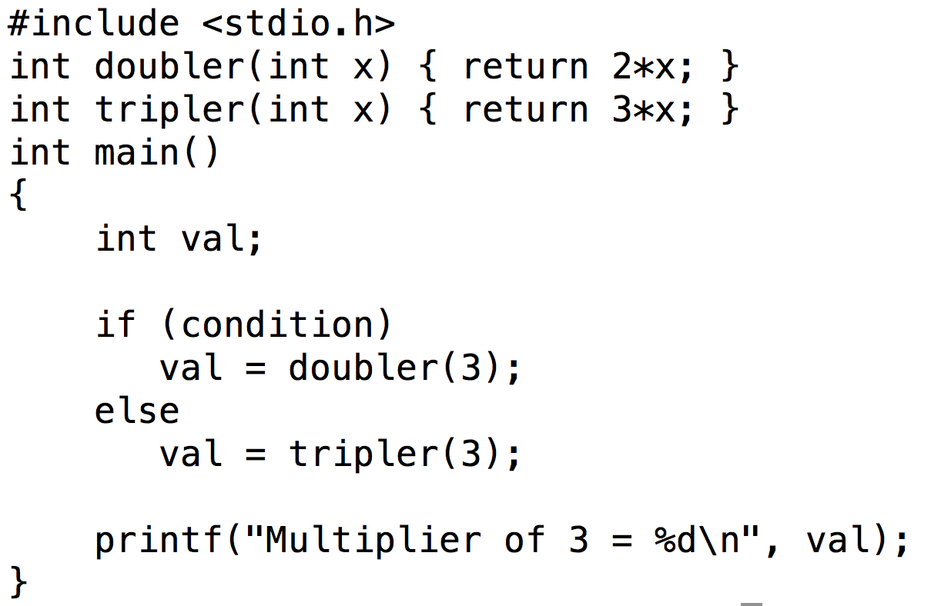
Function Pointers vs Conditionals
What are the pros and cons of each approach?

Slide 43
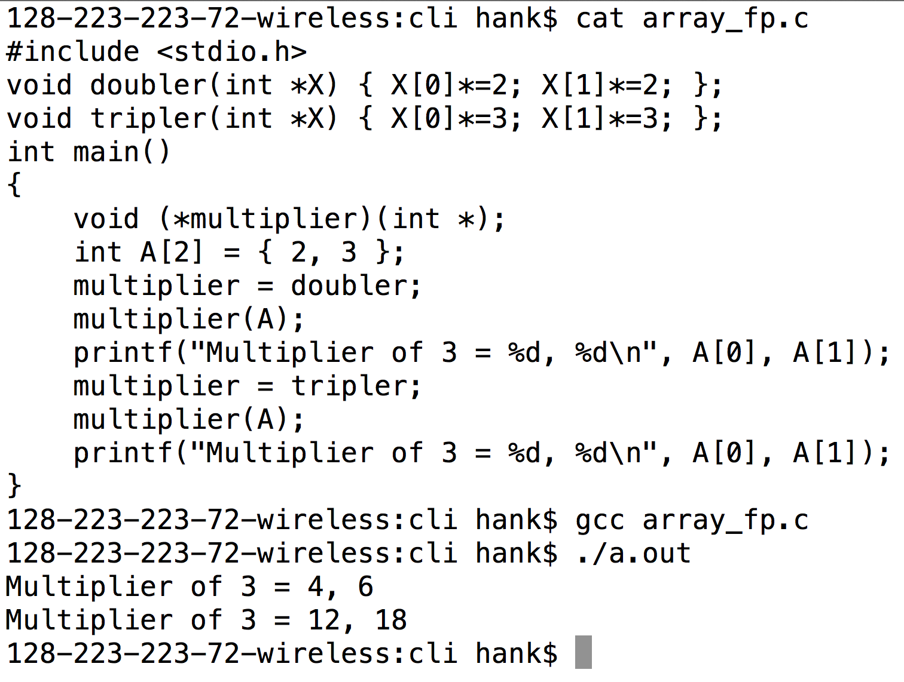
Function Pointer Example #2
Function pointer
Part of function signature
Don’t be scared of extra ‘*’s … they just come about because of pointers in the arguments or return values.

Slide 44
Simple-to-Exotic Function Pointer Declarations
void (*foo)(void);
void (*foo)(int **, char ***);
char ** (*foo)(int **, void (*)(int));
These sometimes come up on interviews.

Slide 45
Callbacks
Callbacks: function that is called when a condition is met
Commonly used when interfacing between modules that were developed separately.
… libraries use callbacks and developers who use the libraries “register” callbacks.

Slide 46
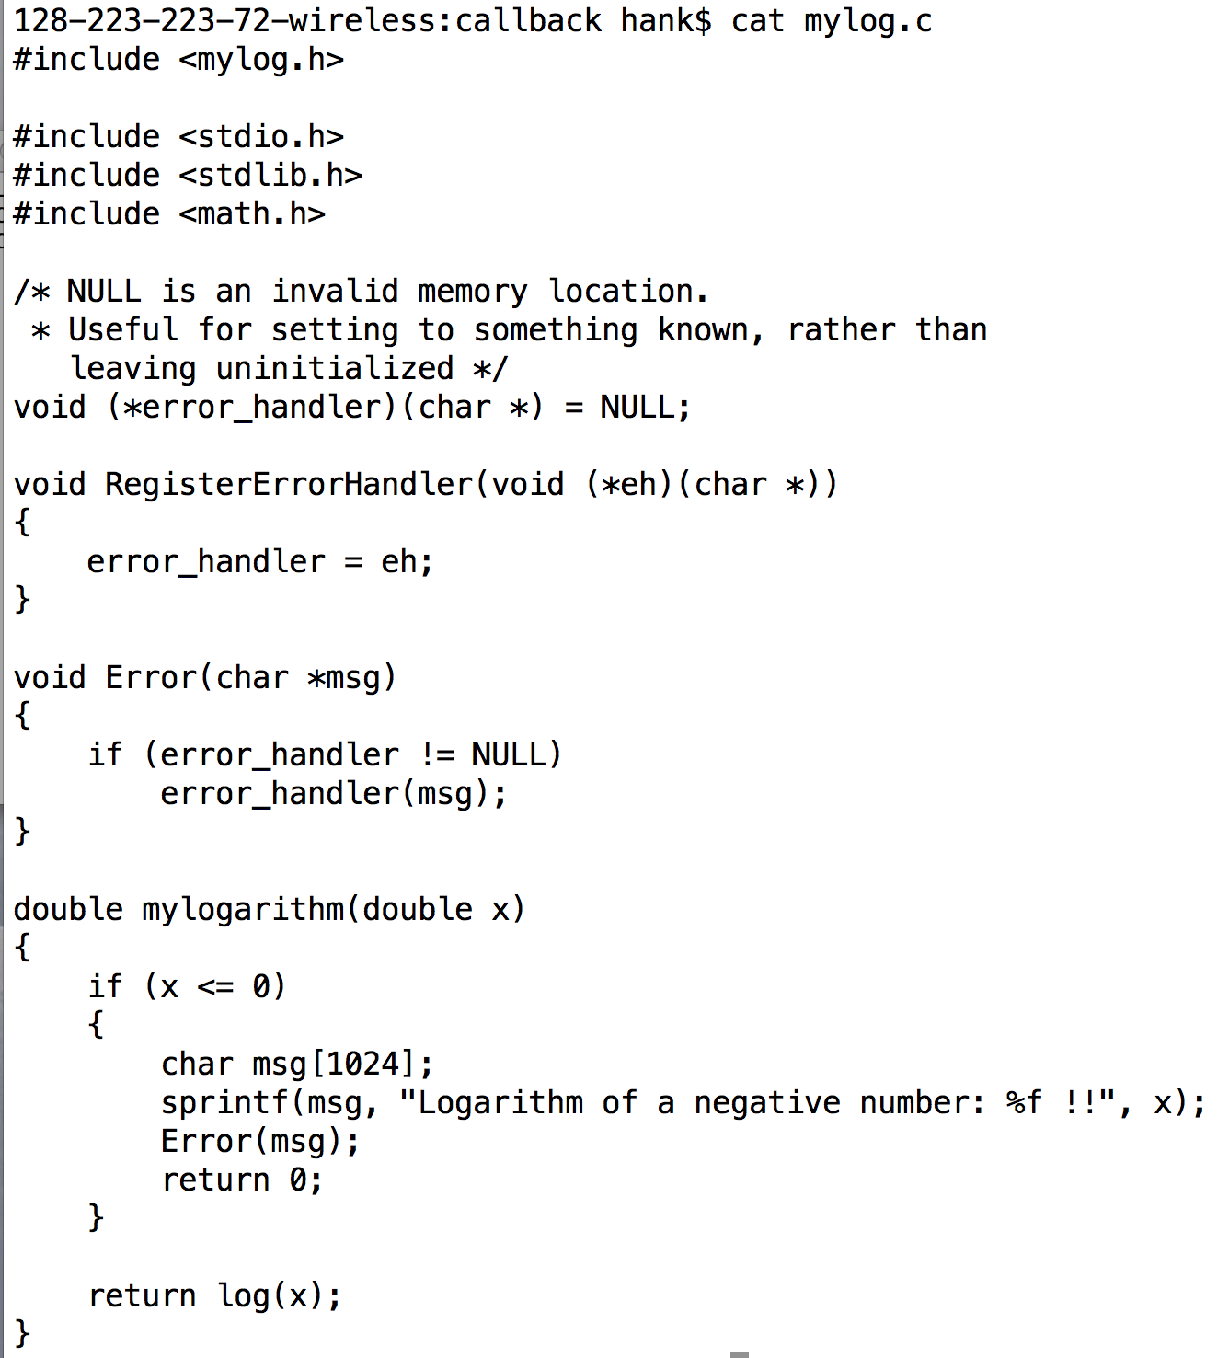
Callback example

Slide 47
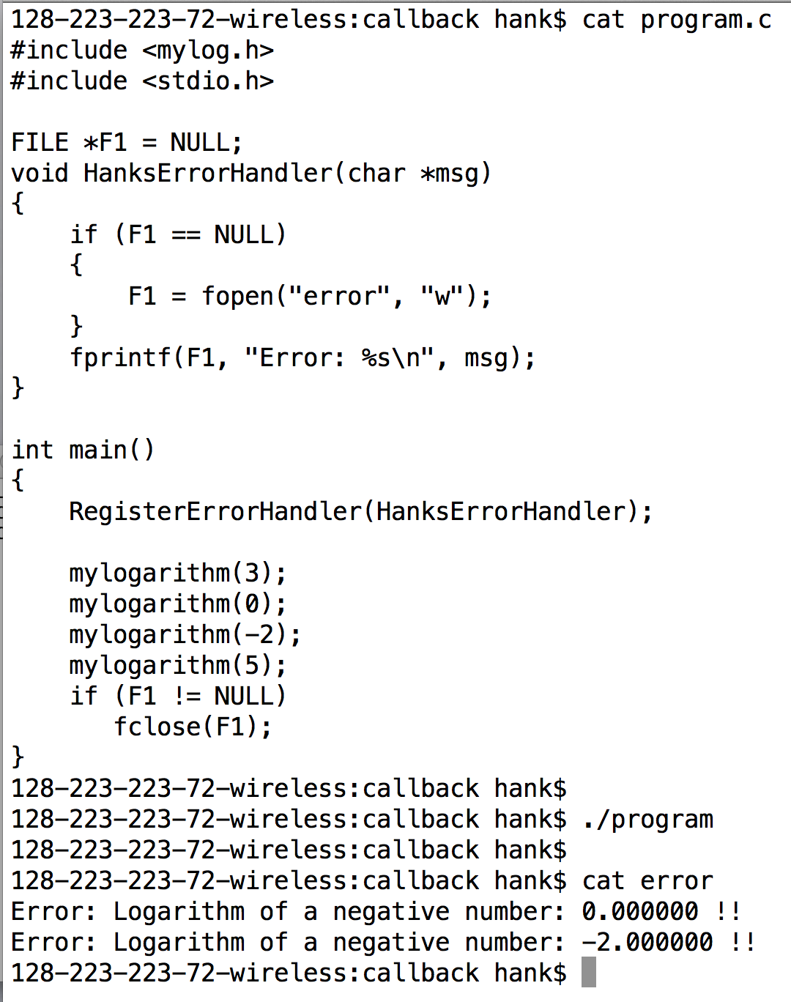
Callback example

Slide 48
Function Pointers
We are going to use function pointers to accomplish “sub-typing” in Project 2D.

Slide 49
Subtyping

Slide 50
Subtyping
Type: a data type (int, float, structs)
Subtype / supertype:
Supertype: the abstraction of a type
(not specific)
Subtype: a concrete implementation of the supertype
(specific)
The fancy term for this is “subtype polymorphism”

Slide 51
Subtyping: example
Supertype: Shape
Subtypes:
Circle
Rectangle
Triangle

Slide 52
Subtyping works via interfaces
Must define an interface for supertype/subtypes
Interfaces are the functions you can call on the supertype/subtypes
The set of functions is fixed
Every subtype must define all functions

Slide 53
Subtyping
I write my routines to the supertype interface
All subtypes can automatically use this code
Don’t have to modify code when new supertypes are added
Example:
I wrote code about Shapes.
I don’t care about details of subtypes (Triangle, Rectangle, Circle)
When new subtypes are added (Square), my code doesn’t change

Slide 54
More Unix

Slide 55
“.” and “..”
Unix convention:
“.” : the current directory
“..” : the parent directory
Quiz: you in /path/to/dir and issue “cd ./.././..”.
Where do you end up?
Answer: “/path”

Slide 56
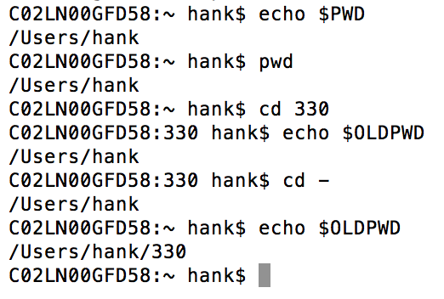
pwd and $PWD
pwd: unix command that returns the “present working directory”
$PWD : environment variable that contains the present working directory
$OLDPWD : environment variable that contains the previous present working directory
“-” : shortcut for the previous PWD

Slide 57
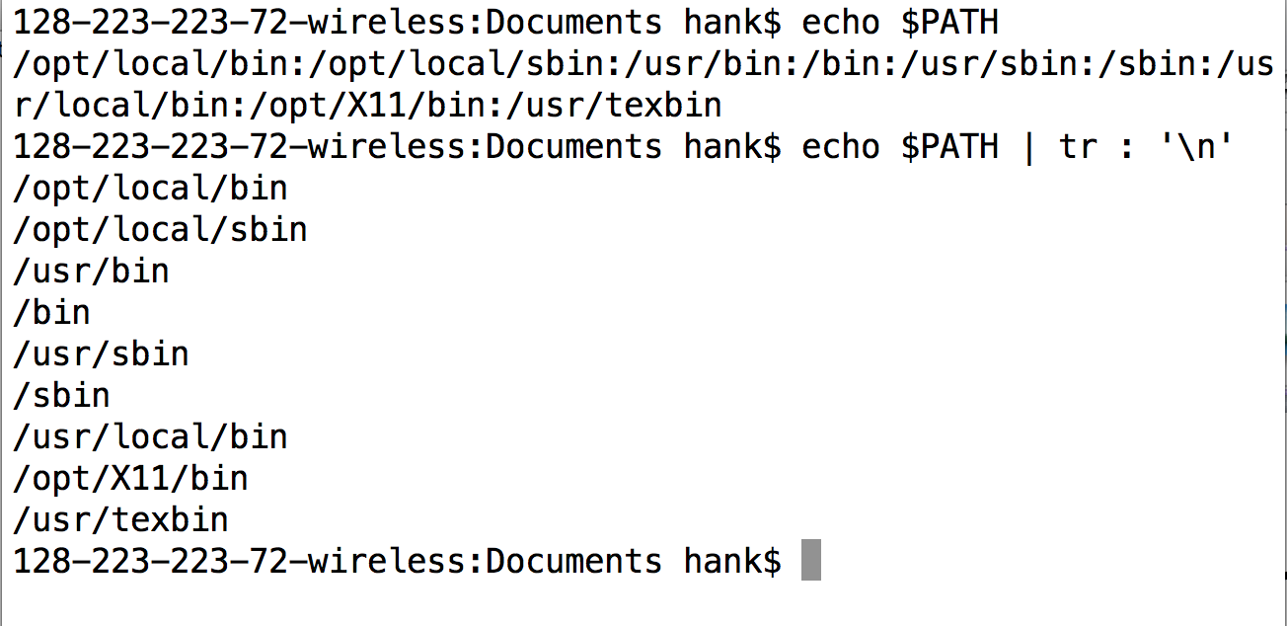
PATH environment variable
“tr”: Unix command for replacing characters (translating characters).
When the shell wants to invoke a command, it searches for the command in the path

Slide 58
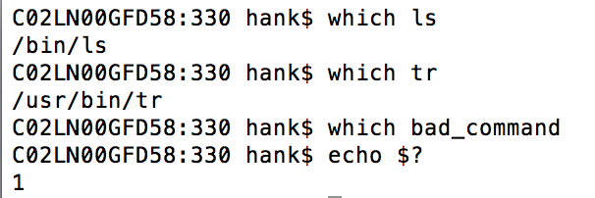
which
which: tells you the directory the shell is finding a command in.

Slide 59
Invoking programs in current directory
shell works with ./prog_name since it views this as a path. Hence $PATH is ignored.

Slide 60
Invoking programs in current directory

Slide 61
Trojan Horse Attack
export PATH=.:$PATH
why is this a terrible idea?

Slide 62
Wild Cards
‘*’ (asterisk) serves as a wild card that does pattern matching

Slide 63
Wild Cards
You can use multiple asterisks for complex patterns

Slide 64
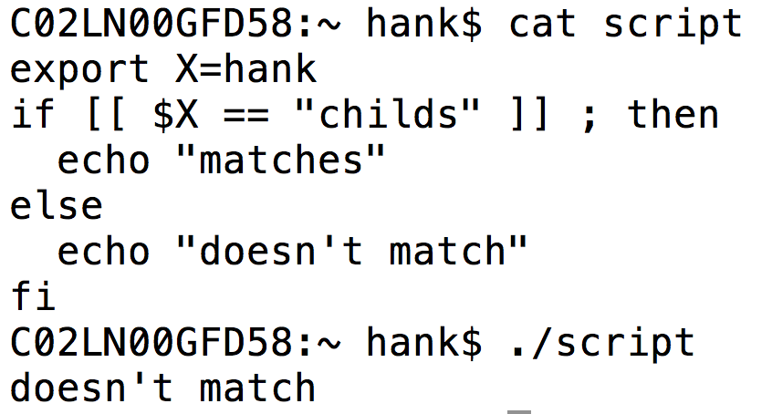
if / then / else / fi
Advanced constructs:

Slide 65
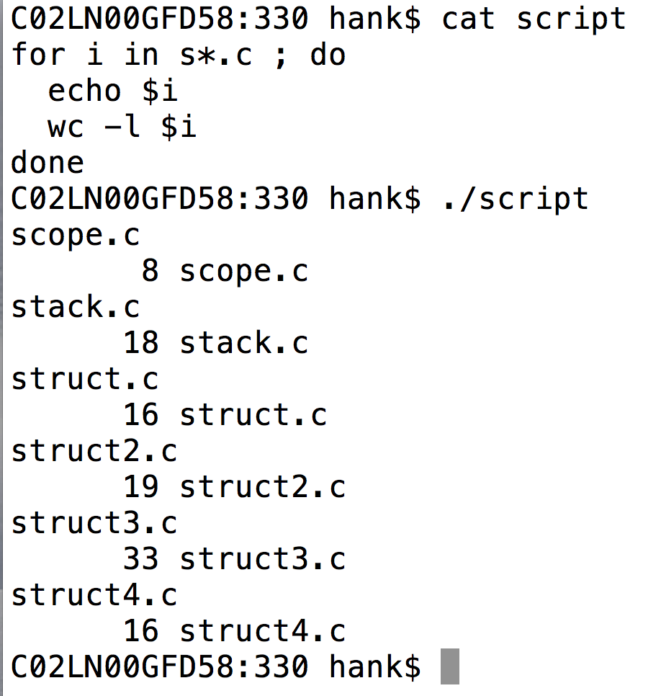
for / do / done

Slide 66
-f and -d
-f : does a file exist?
-d : does a directory exist?
example:
if [[ ! -d include ]] ; then mkdir include ; fi

Slide 67
Why are Unions useful?
Allows you to represent multiple data types simultaneously
But only if you know you want exactly one of them
Benefit is space efficiency, which leads to performance efficiency
Unions are also useful for abstracting type.
We will re-visit this when we talk about C++’s templates.

Slide 68
Bonus Material

Slide 69
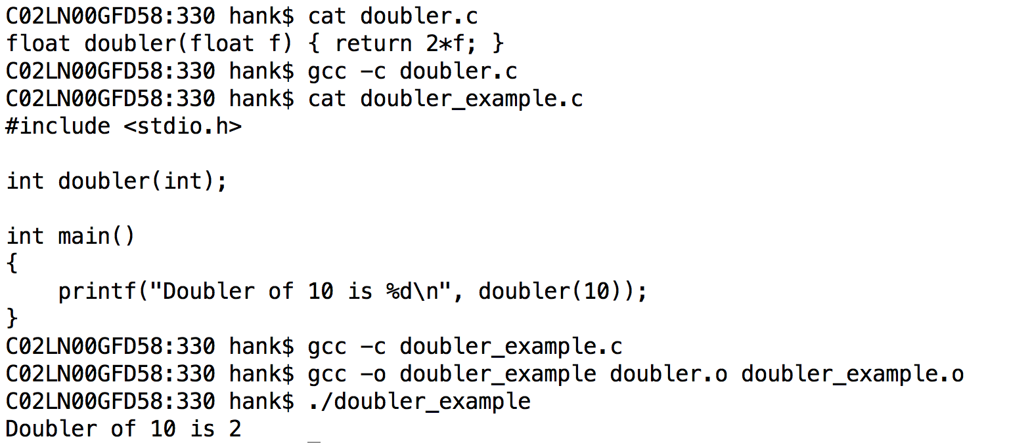
Problem with C…

Slide 70
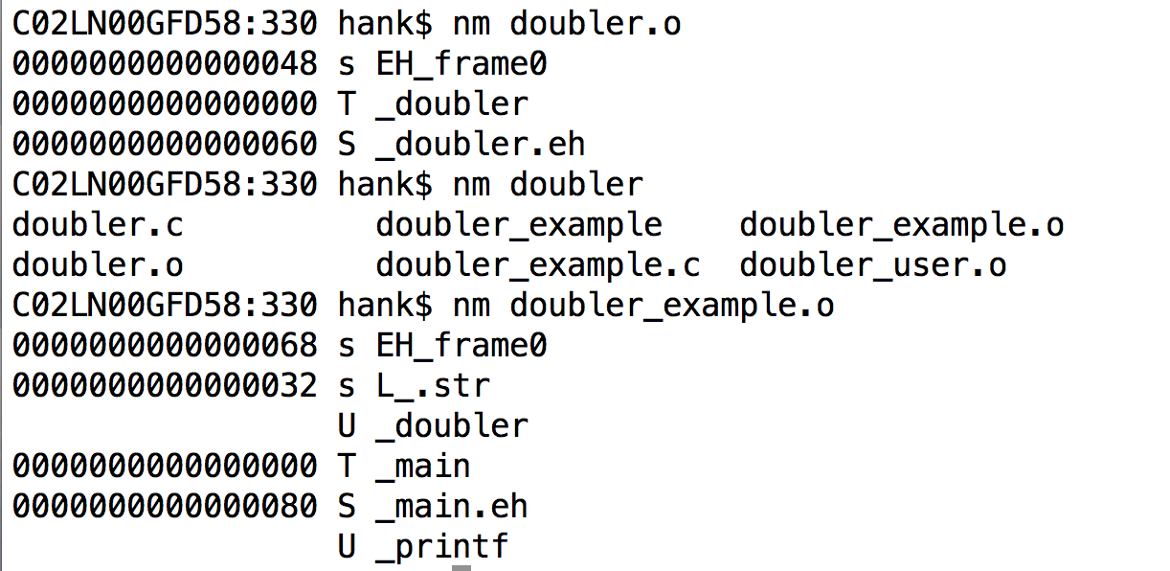
Problem with C…
No checking of type…

Slide 71
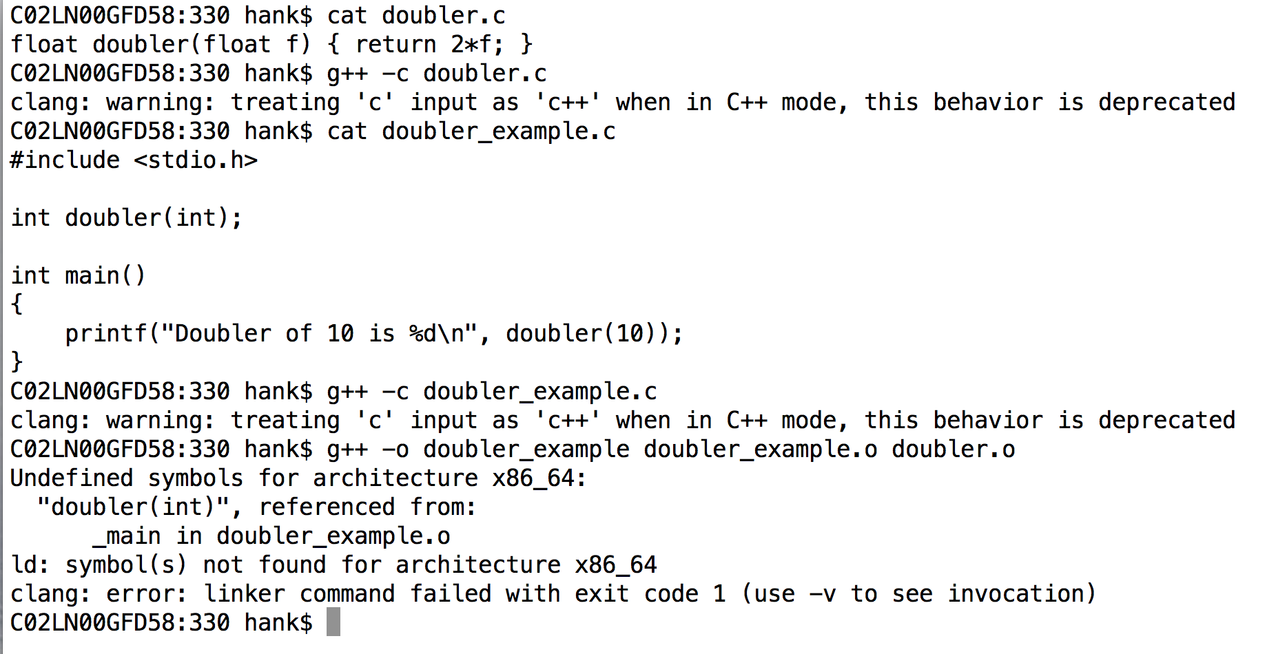
Problem is fixed with C++…

Slide 72
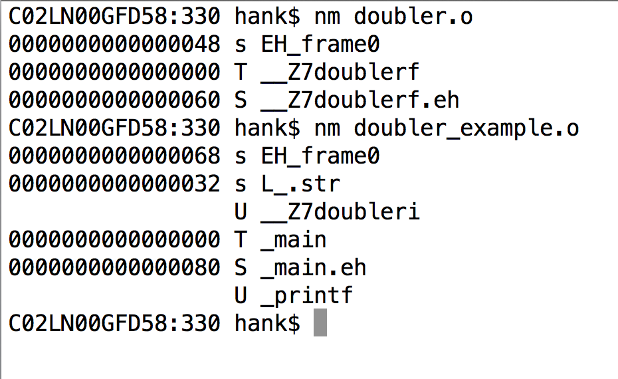
Problem is fixed with C++…

Slide 73
Mangling
Mangling refers to combing information about the return type and arguments and “mangling” it with function name.
Way of ensuring that you don’t mix up functions.
Causes problems with compiler mismatches
C++ compilers haven’t standardized.
Can’t take library from icpc and combine it with g++.

Slide 74
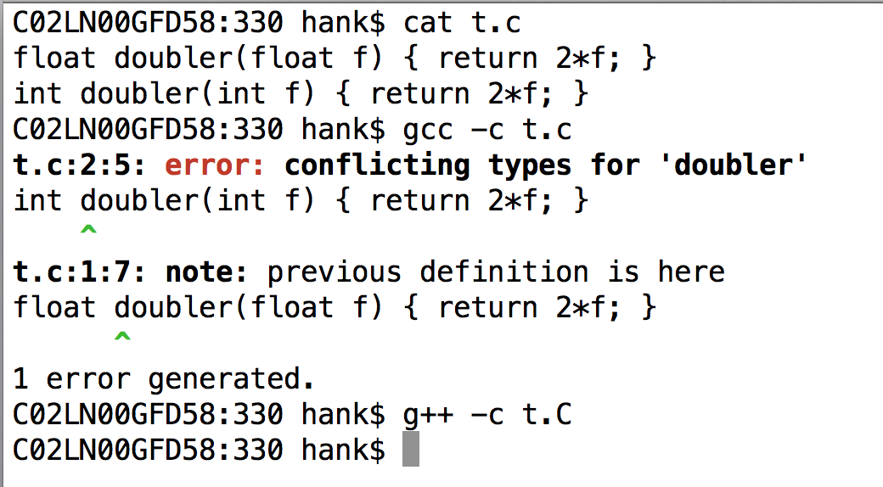
C++ will let you overload functions with different types

Slide 75
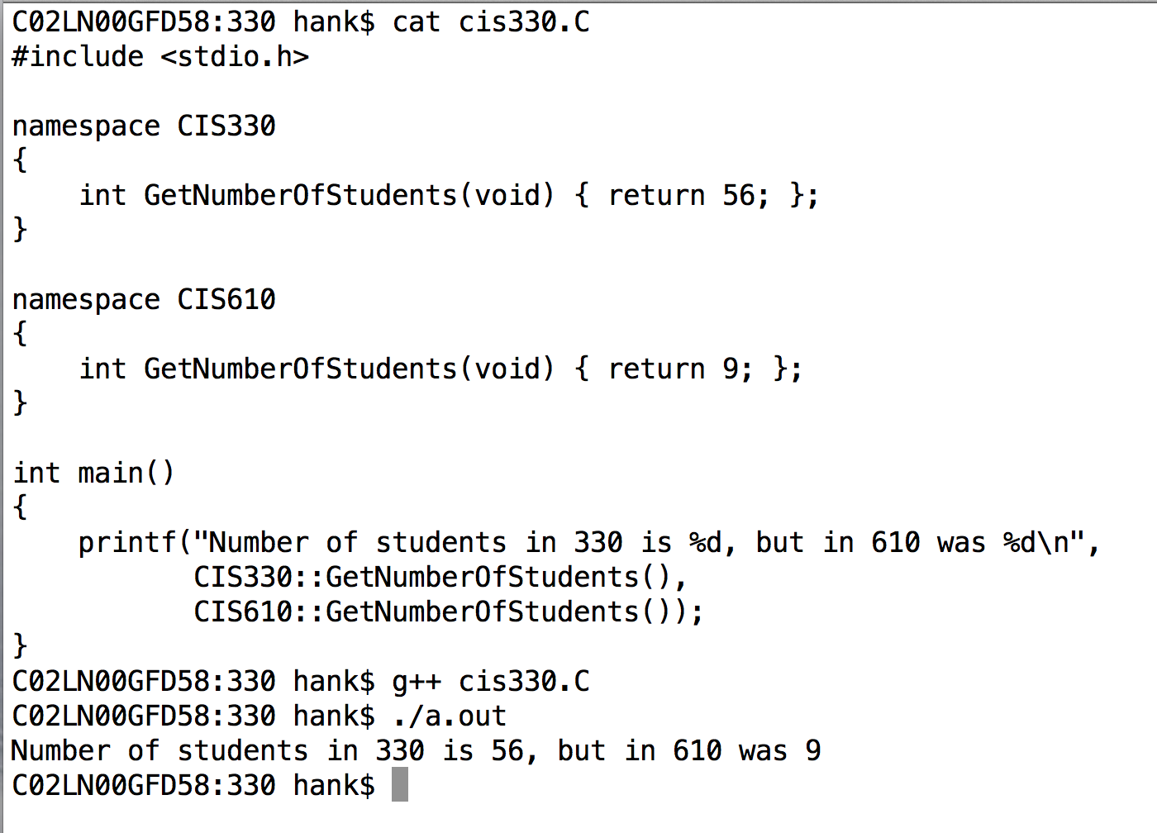
C++ also gives you access to mangling via “namespaces”
Functions or variables within a namespace are accessed with “::”

Slide 76
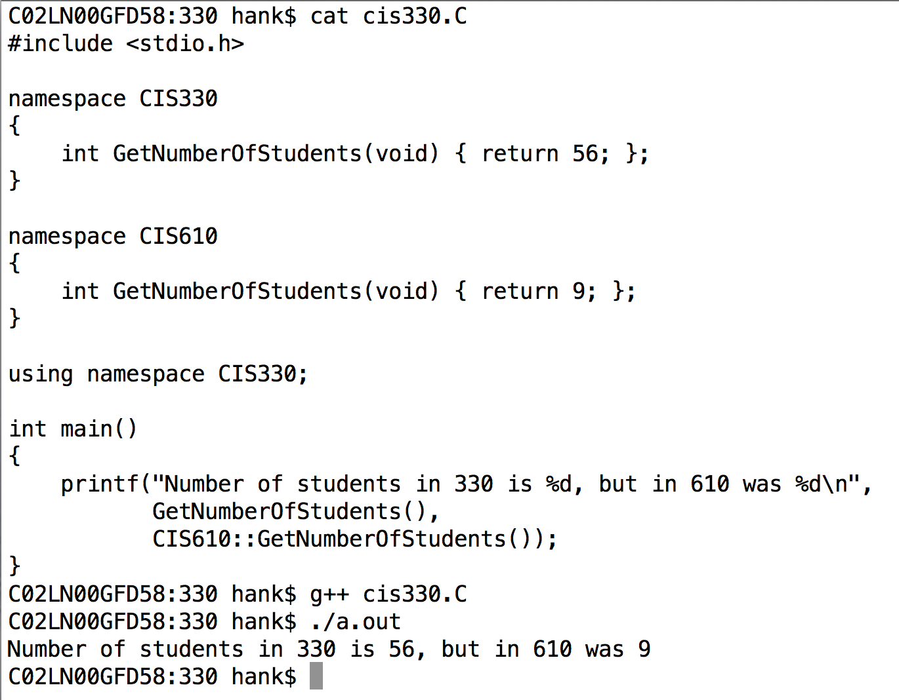
C++ also gives you access to mangling via “namespaces”
The “using” keyword makes all functions and variables from a namespace available without needing “::”.
And you can still access other namespaces.

Slide 77
Backgrounding
“&”: tell shell to run a job in the background
Background means that the shell acts as normal, but the command you invoke is running at the same time.
“sleep 60” vs “sleep 60 &”
When would backgrounding be useful?

Slide 78
Suspending Jobs
You can suspend a job that is running
Press “Ctrl-Z”
The OS will then stop job from running and not schedule it to run.
You can then:
make the job run in the background.
Type “bg”
make the job run in the foreground.
Type “fg”
like you never suspended it at all!!

Slide 79
Web pages
ssh –l <user name> ix.cs.uoregon.edu
cd public_html
put something in index.html
→ it will show up as
http://ix.cs.uoregon.edu/~<username>

Slide 80
Web pages
You can also exchange files this way
scp file.pdf <username>@ix.cs.uoregon.edu:~/public_html
point people to http://ix.cs.uoregon.edu/~<username>/file.pdf
Note that ~/public_html/dir1 shows up as http://ix.cs.uoregon.edu/~<username>/dir1
(“~/dir1” is not accessible via web)

