Slide 1
CIS 330: _ _ _ _ ______ _ _____ / / / /___ (_) __ ____ _____ ____/ / / ____/ _/_/ ____/__ __ / / / / __ \/ / |/_/ / __ `/ __ \/ __ / / / _/_// / __/ /___/ /_ / /_/ / / / / /> < / /_/ / / / / /_/ / / /____/_/ / /__/_ __/_ __/ \____/_/ /_/_/_/|_| \__,_/_/ /_/\__,_/ \____/_/ \____//_/ /_/
Lecture 16:
exceptions,
Virtual function table
May 18th, 2018
Hank Childs, University of Oregon

Slide 2
Project 3E
You will need to think about how to accomplish the data flow execution pattern and think about how to extend your implementation to make it work.
This prompt is vaguer than some previous ones
… not all of the details are there on how to do it

Slide 3
Project 3E

Slide 4
Project 3E
Worth 3% of your grade
Assigned today, due May 23

Slide 5
New Stuff: Exceptions

Slide 6
Exceptions
C++ mechanism for handling error conditions
Three new keywords for exceptions
try: code that you “try” to execute and hope there is no exception
throw: how you invoke an exception
catch: catch an exception … handle the exception and resume normal execution

Slide 7
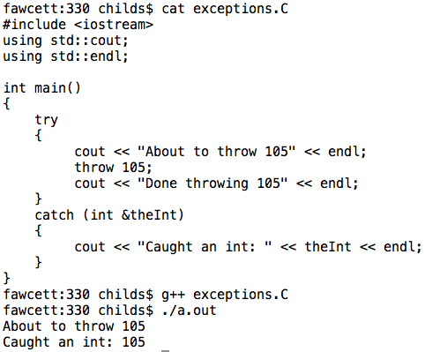
Exceptions

Slide 8
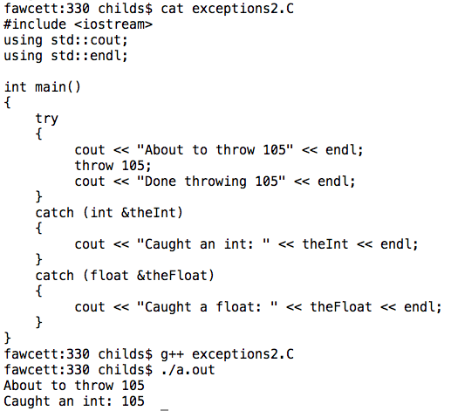
Exceptions: catching multiple types

Slide 9
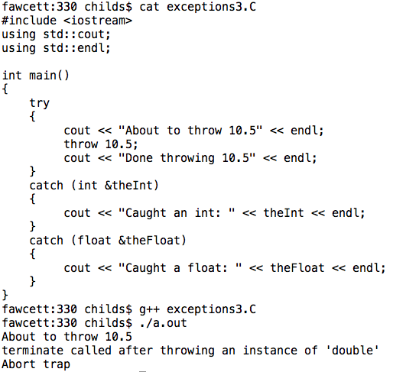
Exceptions: catching multiple types

Slide 10
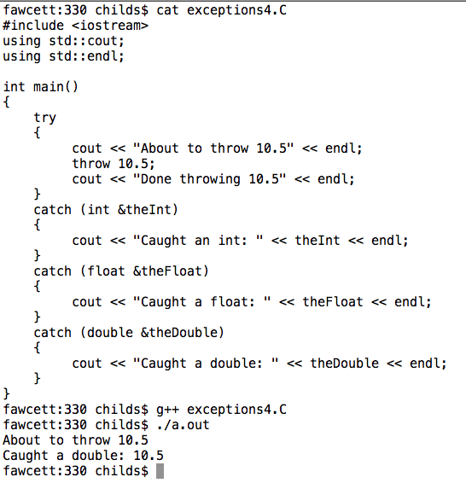
Exceptions: catching multiple types

Slide 11
Exceptions: throwing/catching complex types

Slide 12
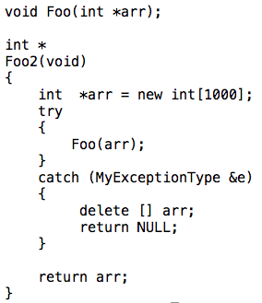
Exceptions: cleaning up before you return

Slide 13
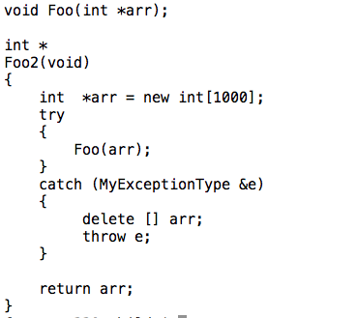
Exceptions: re-throwing

Slide 14
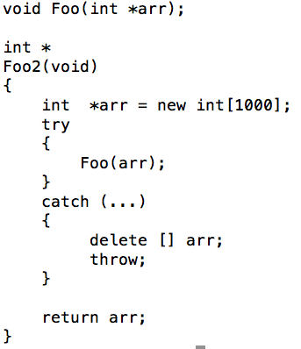
Exceptions: catch and re-throw anything

Slide 15
Exceptions: declaring the exception types you can throw

Slide 16
Exceptions: declaring the exception types you can throw ... not all it is cracked up to be
This will compile … compiler can only enforce this as a run-time thing.
As a result, this is mostly unused
(I had to read up on it)
But: “standard” exceptions have a “throw” in their declaration.

Slide 17
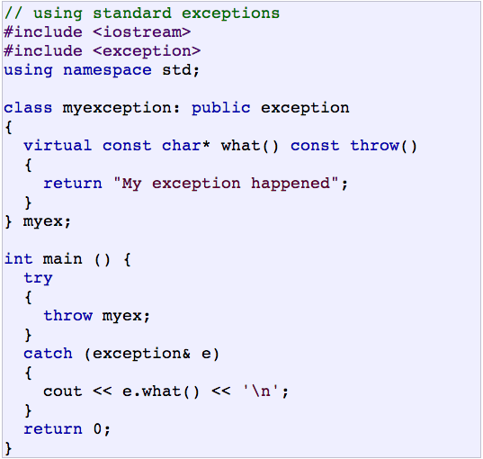
std::exception
c++ provides a base type called “std::exception”
It provides a method called “what”
Source: cplusplus.com

Slide 18
Exceptions generator by C++ standard library
Source: cplusplus.com

Slide 19
3F

Slide 20
Project 3F in a nutshell
Logging:
infrastructure for logging
making your data flow code use that infrastructure
Exceptions:
infrastructure for exceptions
making your data flow code use that infrastructure
The webpage has a head start at the infrastructure pieces for you.

Slide 21
Warning about 3F
My driver program only tests a few exception conditions
Your stress tests later will test a lot more.
Be thorough, even if I’m not testing it

Slide 22
3F timeline
Assigned tonight, due Saturday May 26th

Slide 23
3F: warning
3F will almost certainly crash your code
It uses your modules wrong!
You will need to figure out why, and add exceptions
gdb will be helpful

Slide 24
Review: Access Control

Slide 25
Two contexts for access control
class A : public B {
public:
A() { x=0; y=0; };
int foo() { x++; return foo2(); };
private:
int x, y;
int foo2() { return x+y; };
};
defines how a class inherits from another class
defines access controls for data members and methods

Slide 26
Inheritance (“class A : public B”)
public → “is a”
(I never used anything but public)
private → “implemented using”
(I have never used this, but see how it could be useful)
protected → the internet can not think of any useful examples for this

Slide 27
Access Control
class Hank
{
public/private/protected:
BankAccount hanksId;
};
Access control type | Who can read it
private | Only Hank class
public | Anyone
protected | Those who inherit from Hank

Slide 28
Class Vs Struct
Class:
Default inheritance is private
That’s why you add public (class A : public B)
Default access control is private
Struct:
Default inheritance is public
That’s why you don’t have to add public (struct A : B)
Default access control is public

Slide 29
Example of data flow (image processing)
FileReader
Crop
Transpose
Invert
Color
Concatenate
FileWriter

Slide 30
How C++ Does Methods

Slide 31
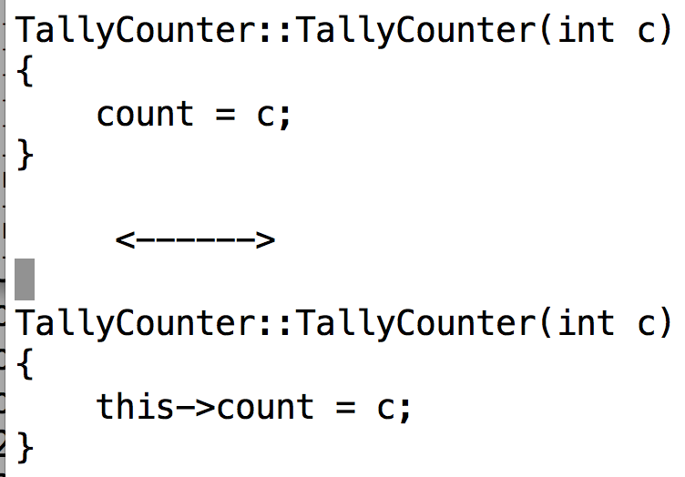
“this”: pointer to current object
From within any struct’s method, you can refer to the current object using “this”

Slide 32
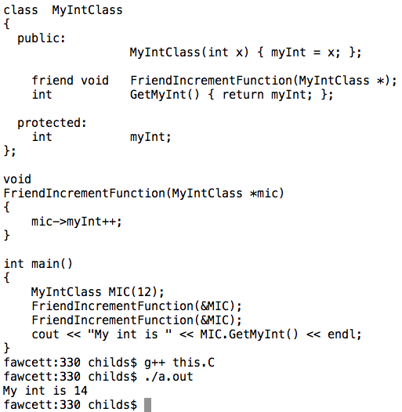
How methods work under the covers (1/4)

Slide 33
How methods work under the covers (2/4)
Addr. | Variable | Value
0x8000 | MIC/myInt | 12
Addr. | Variable | Value
0x8000 | MIC/myInt | 12
0x8004 | mic | 0x8000

Slide 34
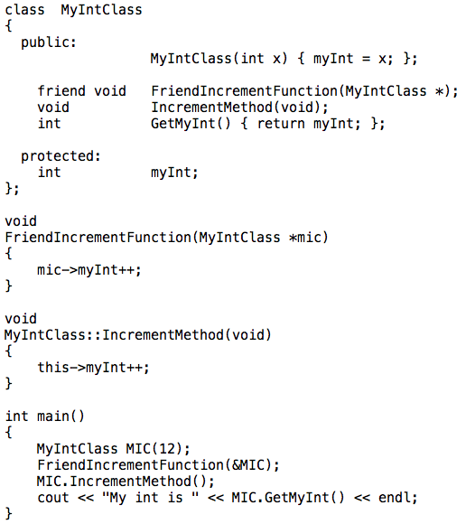
How methods work under the covers (3/4)

Slide 35
How methods work under the covers (4/4)
The compiler secretly slips “this” onto the stack whenever you make a method call.
It also automatically changes “myInt” to this->myInt in methods.
Addr. | Variable | Value
0x8000 | MIC/myInt | 12
Addr. | Variable | Value
0x8000 | MIC/myInt | 12
Addr. | Variable | Value
0x8000 | MIC/myInt | 12
0x8004 | mic | 0x8000
Addr. | Variable | Value
0x8000 | MIC/myInt | 13
0x8004 | this | 0x8000

Slide 36
Virtual Function Tables

Slide 37
Virtual functions
Virtual function: function defined in the base type, but can be re-defined in derived type.
When you call a virtual function, you get the version defined by the derived type

Slide 38
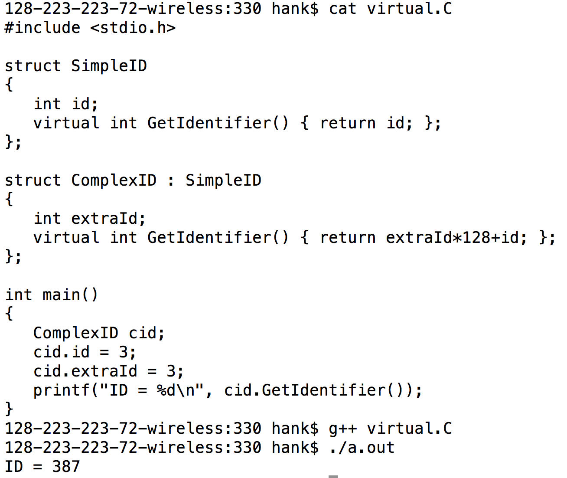
Virtual functions: example

Slide 39
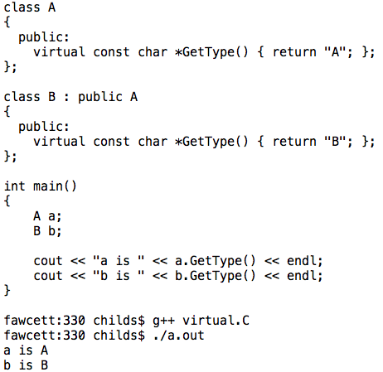
Picking the right virtual function
It seems like the compiler should be able to figure this out ...
it knows that a is of type A and
it knows that b is of type B
??????

Slide 40
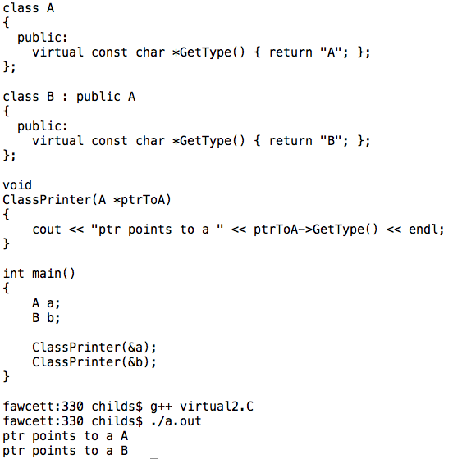
Picking the right virtual function
So how to does the compiler know?
How does it get “B” for “b” and “A” for “a”?
??????

Slide 41
Virtual Function Table
Let C be a class and X be an instance of C.
Let C have 3 virtual functions & 4 non-virtual functions
C has a hidden data member called the “virtual function table”
This table has 3 rows
Each row has the correct definition of the virtual function to call for a “C”.
When you call a virtual function, this table is consulted to locate the correct definition.

Slide 42
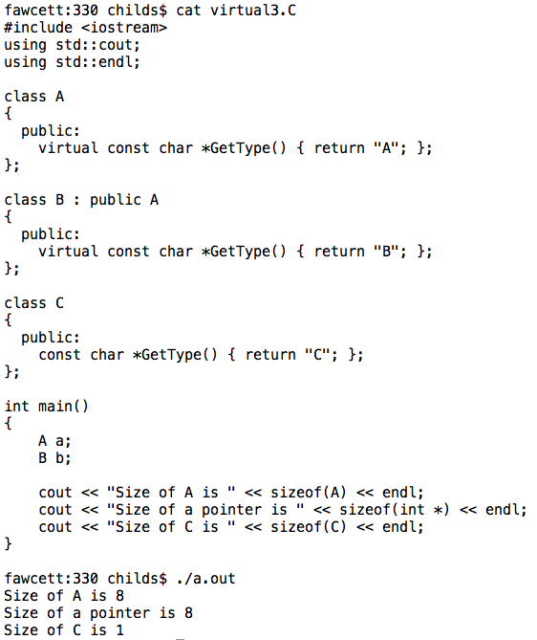
Showing the existence of the virtual function pointer with sizeof()
empty objects have size of 1?
why?!?
Answer: so every object has a unique address.
what will this print?

Slide 43
Virtual Function Table
Let C be a class and X be an instance of C.
Let C have 3 virtual functions & 4 non-virtual functions
Let D be a class that inherits from C and Y be an instance of D.
Let D add a new virtual function
D’s virtual function table has 4 rows
Each row has the correct definition of the virtual function to call for a “D”.

Slide 44
More notes on virtual function tables
There is one instance of a virtual function table for each class
Each instance of a class shares the same virtual function table
Easy to overwrite (i.e., with a memory error)
And then all your virtual function calls will be corrupted
Don’t do this! ;)

Slide 45
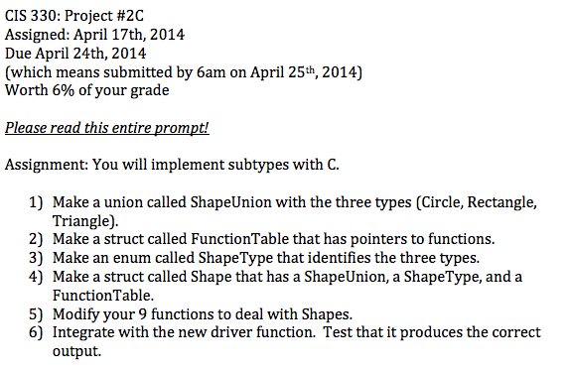
Virtual function table: example

Slide 46
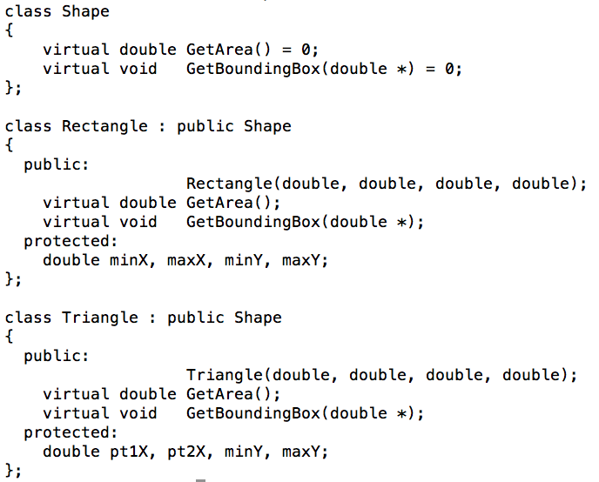
Virtual function table: example

Slide 47
Questions
What does the virtual function table look like for a Shape?
What does Shape’s virtual function table look like?
Trick question: Shape can’t be instantiated, precisely because you can’t make a virtual function table
abstract type due to pure virtual functions

Slide 48
Questions
What is the virtual function table for Rectangle?
(this is a code fragment from my 2C solution)

Slide 49
Calling a virtual function
Let X be an instance of class C.
Assume you want to call the 4th virtual function
Let the arguments to the virtual function be an integer Y and a float Z.
Then call:
(X.vptr[3])(&X, Y, Z);
The 4th virtual function has index 3 (0-indexing)
The pointer to the virtual function pointer (often called a vptr) is a data member of X
Secretly pass “this” as first argument to method

Slide 50
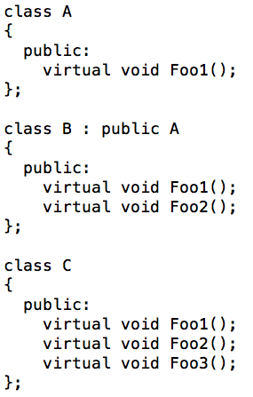
Inheritance and Virtual Function Tables
A
Foo1 | Location of Foo1
This whole scheme gets much harder with multiple inheritance, and you have to carry around multiple virtual function tables.
B
Foo1 | Location of Foo1
Foo2 | Location of Foo2
C
Foo1 | Location of Foo1
Foo2 | Location of Foo2
Foo3 | Location of Foo3
: public B
Same as B’s
This is how you can treat a C as a B

Slide 51
Virtual Function Table: Summary
Virtual functions require machinery to ensure the correct form of a virtual function is called
This is implemented through a virtual function table
Every instance of a class that has virtual functions has a pointer to its class’s virtual function table
The virtual function is called via following pointers
Performance issue

Slide 52
Now show Project 2D in C++
Comment:
C/C++ great because of performance
Performance partially comes because of a philosophy of not adding “magic” to make programmer’s life easier
C has very little pixie dust sprinkled in
Exception: ‘\0’ to terminate strings
C++ has more
Hopefully this will demystify one of those things (virtual functions)

Slide 53
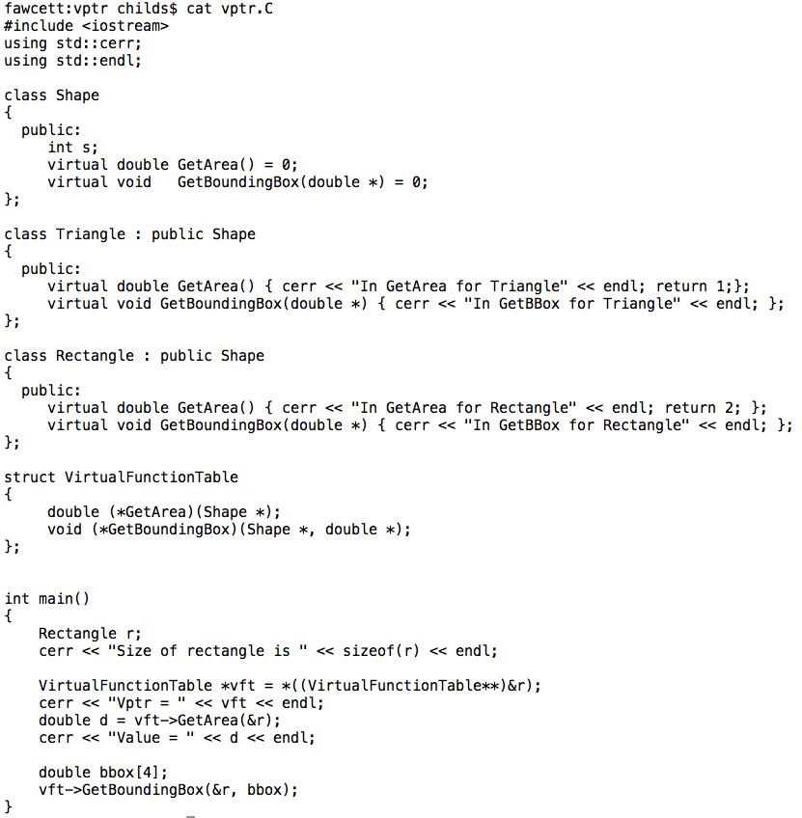
vptr.C

Slide 54
Pitfalls

Slide 55
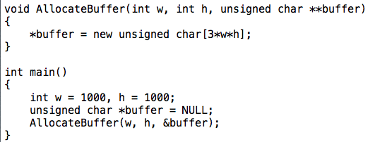
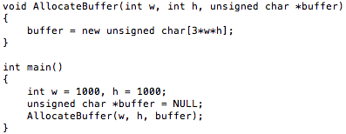
Pitfall #1
This is using call-by-value, not call-by-reference.

Slide 56
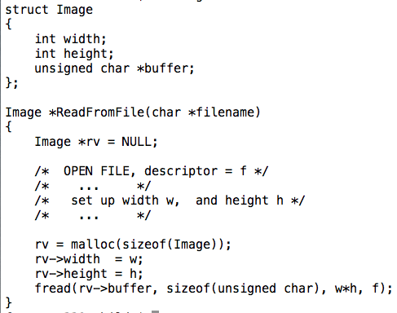
Pitfall #2

Slide 57
Pitfall #3
int *s = new int[6*sizeof(int)];

Slide 58
Pitfall #4
Assume:
int *X = new int[100];
What is sizeof(X)?
What is sizeof(*X)?

Slide 59
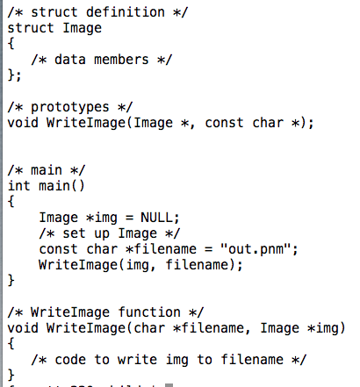
Pitfall #5

Slide 60
(not-a-)Pitfall #6
Top requires memory allocation / deletion, and does extra copy.

Slide 61
Pitfall #7
For objects on the stack, the destructors are called when a function goes out of scope
You may have a perfectly good function, but it seg-faults on return
Especially tricky for main
program ran to completion, and crashed at the very end

Slide 62
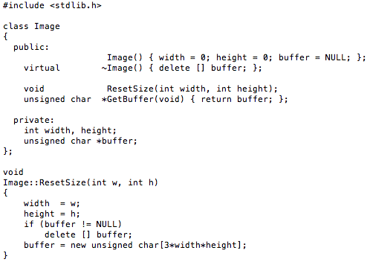
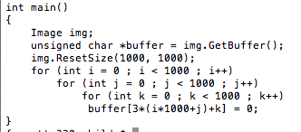
Pitfall #8

Slide 63
Bonus Topics

Slide 64
Backgrounding
“&”: tell shell to run a job in the background
Background means that the shell acts as normal, but the command you invoke is running at the same time.
“sleep 60” vs “sleep 60 &”
When would backgrounding be useful?

Slide 65
Suspending Jobs
You can suspend a job that is running
Press “Ctrl-Z”
The OS will then stop job from running and not schedule it to run.
You can then:
make the job run in the background.
Type “bg”
make the job run in the foreground.
Type “fg”
like you never suspended it at all!!

Slide 66
Web pages
ssh –l <user name> ix.cs.uoregon.edu
cd public_html
put something in index.html
→ it will show up as
http://ix.cs.uoregon.edu/~<username>

Slide 67
Web pages
You can also exchange files this way
scp file.pdf <username>@ix.cs.uoregon.edu:~/public_html
point people to http://ix.cs.uoregon.edu/~<username>/file.pdf
Note that ~/public_html/dir1 shows up as http://ix.cs.uoregon.edu/~<username>/dir1
(“~/dir1” is not accessible via web)

