Slide 1
CIS 330: _ _ _ _ ______ _ _____ / / / /___ (_) __ ____ _____ ____/ / / ____/ _/_/ ____/__ __ / / / / __ \/ / |/_/ / __ `/ __ \/ __ / / / _/_// / __/ /___/ /_ / /_/ / / / / /> < / /_/ / / / / /_/ / / /____/_/ / /__/_ __/_ __/ \____/_/ /_/_/_/|_| \__,_/_/ /_/\__,_/ \____/_/ \____//_/ /_/
Lecture 12:
C++ and structs
May 2nd, 2018
Hank Childs, University of Oregon

Slide 2
3A – post mortem

Slide 3
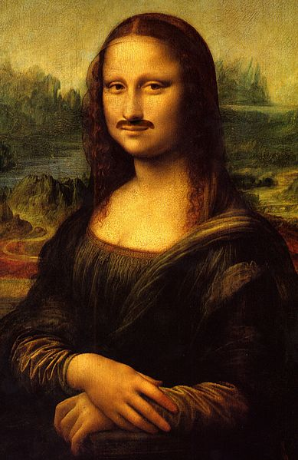
Why Can’t I Modify the Input in Yellow Diagonal
Imagine I handed you the Mona Lisa with you and asked you to produce a version with a moustache…
Would you?:
make a reproduction and add the moustache to the reproduction
vandalize the original

Slide 4
With Respect to 3B…

Slide 5
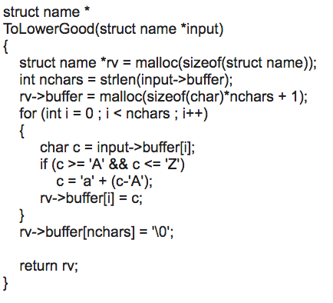
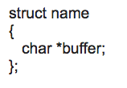
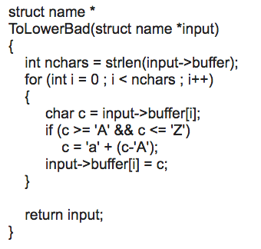
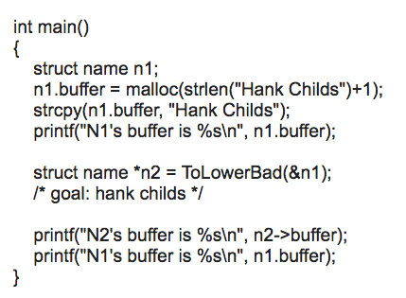
How to Make a Reproduction

Slide 6
REVIEW

Slide 7
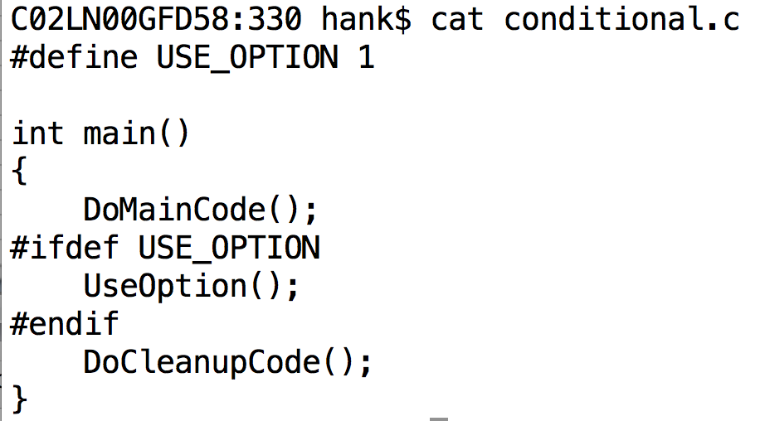
Conditional compilation

Slide 8
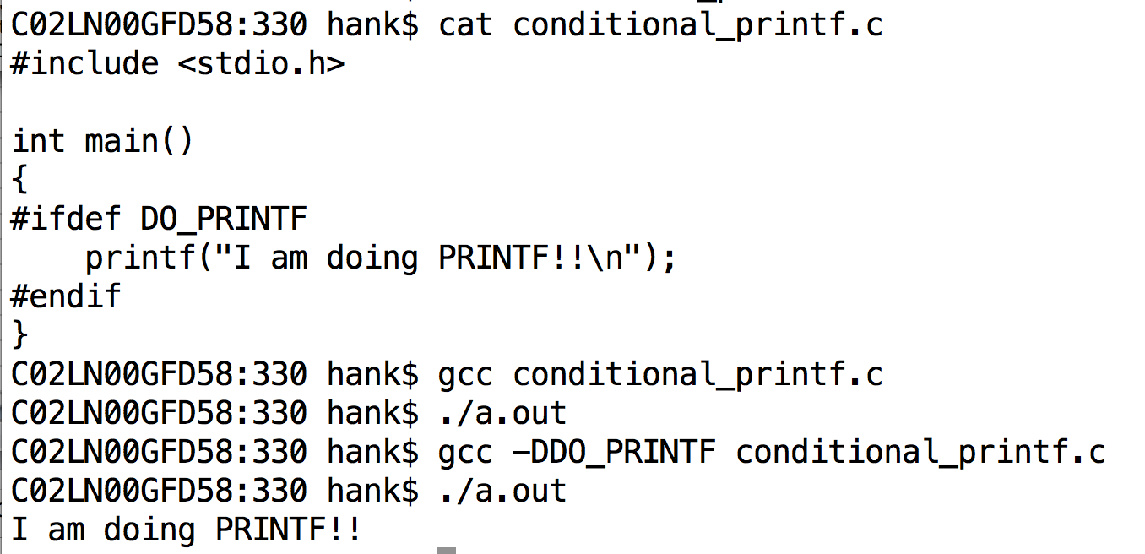
Conditional compilation controlled via compiler flags
This is how configure/cmake controls the compilation.

Slide 9
4 files: struct.h, prototypes.h, rectangle.c, driver.c
struct.h
struct Rectangle
{
double minX, maxX, minY, maxY;
};
prototypes.h
#include <struct.h>
void InitializeRectangle(struct Rectangle *r, double v1, double v2, double v3, double v4);
rectangle.c
#include <struct.h>
#include <prototypes.h>
void InitializeRectangle(struct Rectangle *r, double v1, double v2, double v3, double v4)
{
r->minX = v1; r->maxX = v2; r->minY = v3; r->maxY = v4;
}
#include <struct.h>
#include <prototypes.h>
int main()
{
struct Rectangle r;
InitializeRectangle(&r, 0, 1, 0, 1.5);
}
driver.c
What is the problem with this configuration?

Slide 10
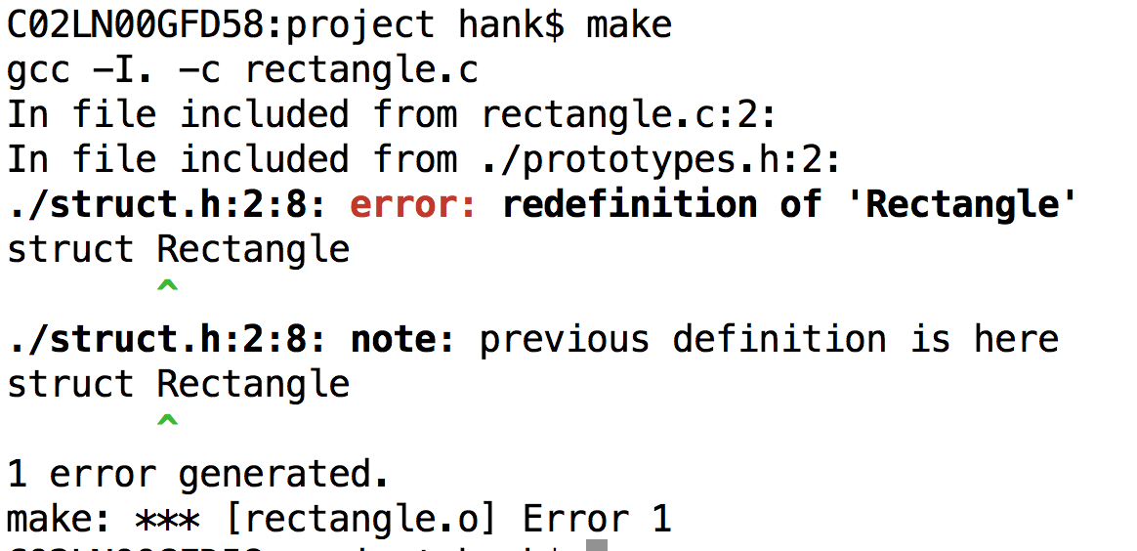
Compilation error

Slide 11
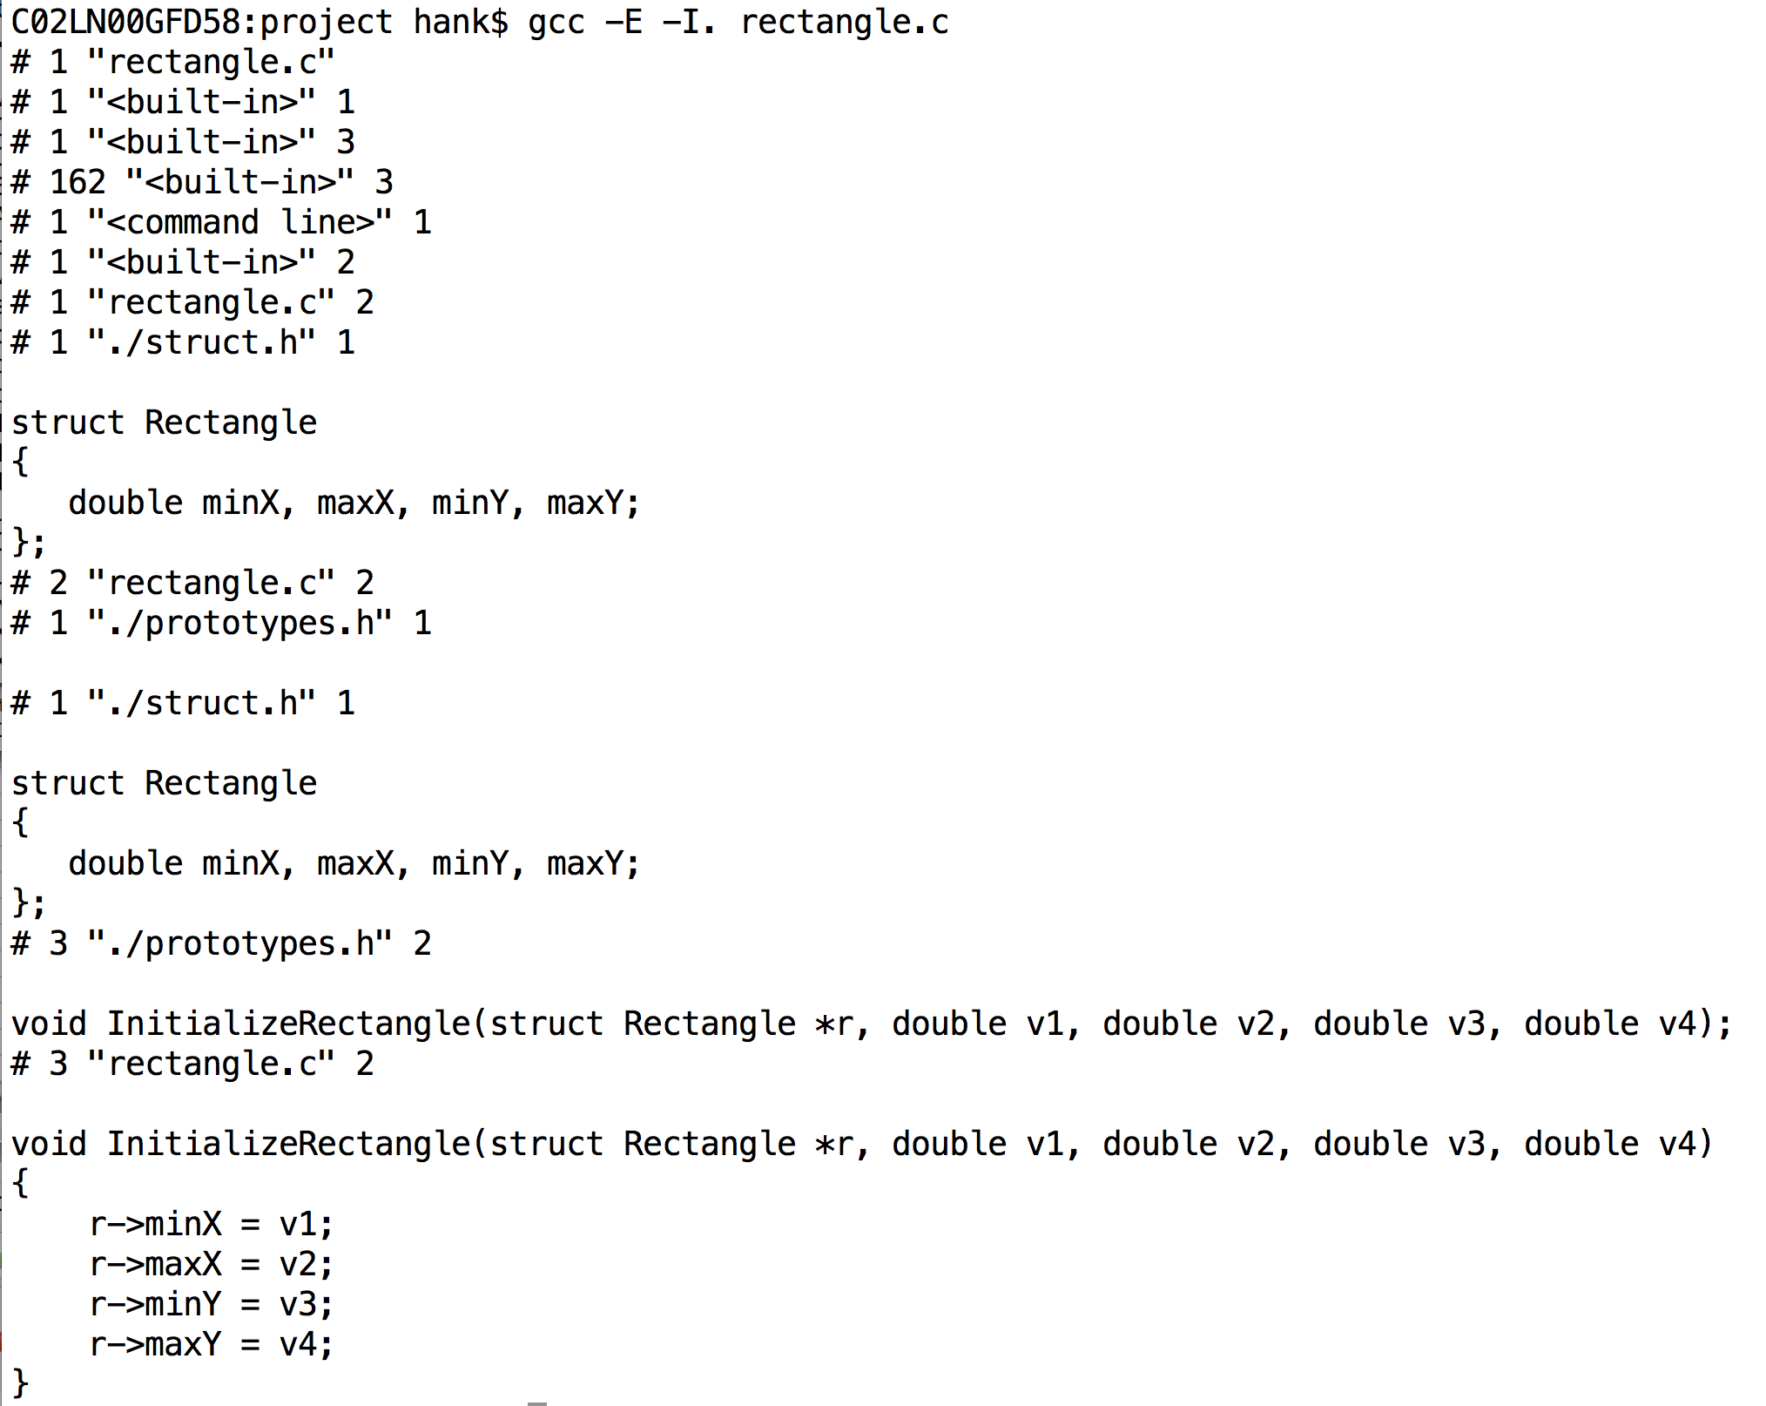
gcc –E rectangle.c

Slide 12
#ifndef / #define to the rescue
struct.h
#ifndef RECTANGLE_330
#define RECTANGLE_330
struct Rectangle
{
double minX, maxX, minY, maxY;
};
#endif
Why does this work?
This problem comes up a lot with big projects, and especially with C++.

Slide 13
There is more to macros…
Macros are powerful & can be used to generate custom code.
Beyond what we will do here.
Two special macros that are useful:
__FILE__ and __LINE__
(Do an example with __LINE__, __FILE__)

Slide 14
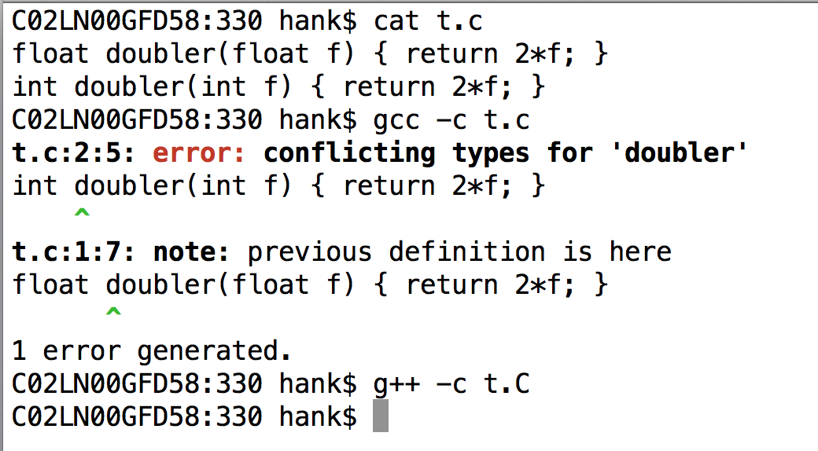
C++ will let you overload functions with different types

Slide 15
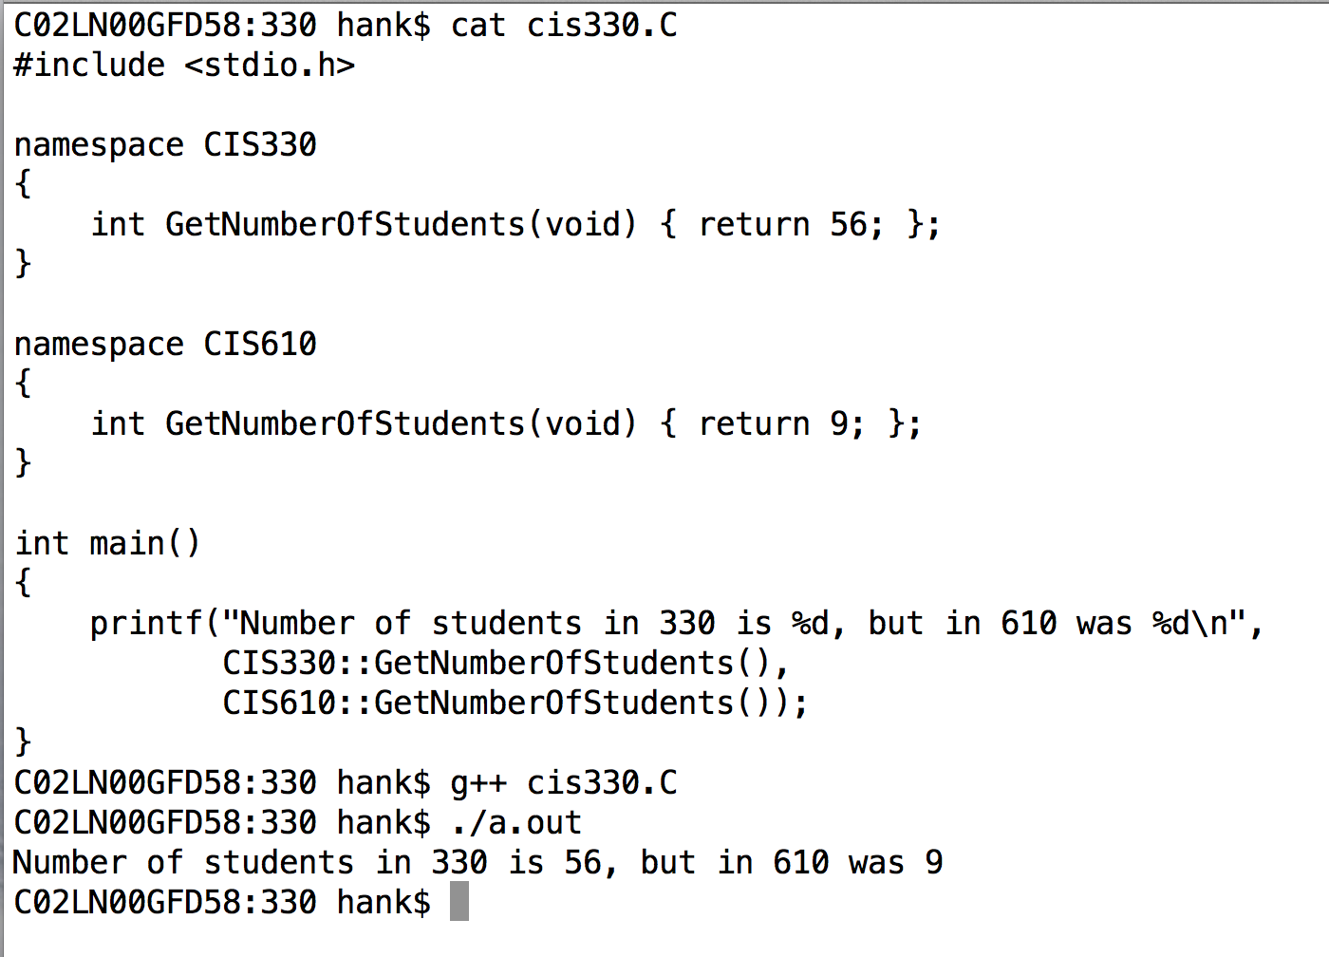
C++ also gives you access to mangling via “namespaces”
Functions or variables within a namespace are accessed with “::”
“::” is called “scope resolution operator”

Slide 16
References
A reference is a simplified version of a pointer.
Key differences:
You cannot do pointer manipulations
A reference is always valid
a pointer is not always valid
Accomplished with & (ampersand)
&: address of variable (C-style, still valid)
&: reference to a variable (C++-style, also now valid)
You have to figure out how ‘&’ is being used based on context.

Slide 17
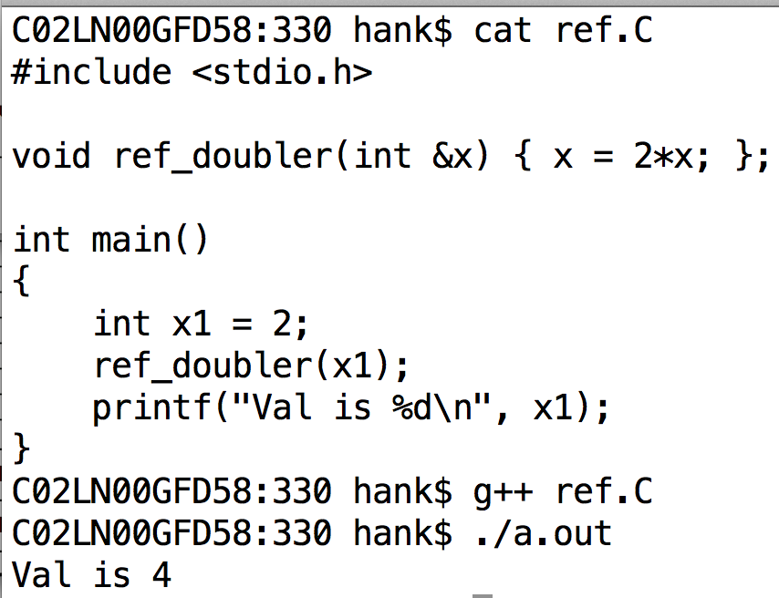
Examples of References

Slide 18
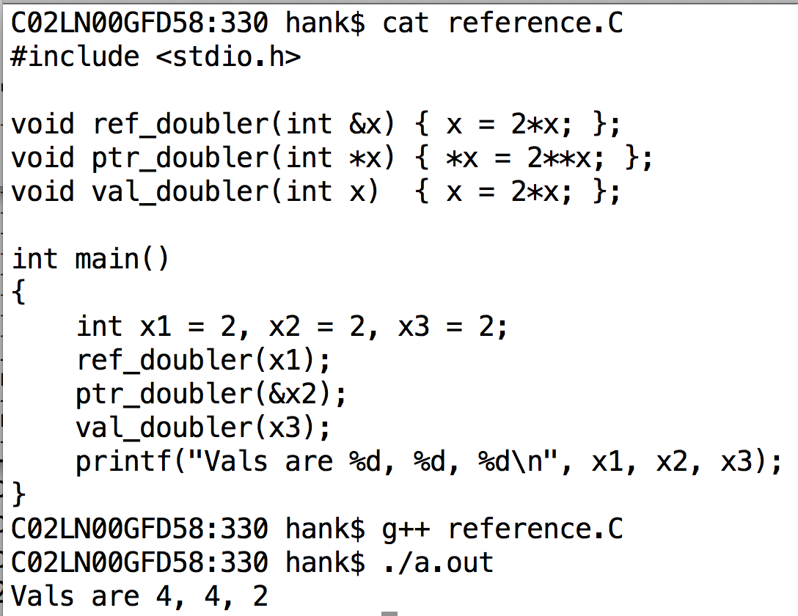
References vs Pointers vs Call-By-Value
ref_doubler and ptr_doubler are both examples of call-by-reference.
val_doubler is an example of call-by-value.

Slide 19
C++ and Structs

Slide 20
Learning classes via structs
structs and classes are closely related in C++
I will lecture today on changes on how “structs in C++” are different than “structs in C”
… when I am done with that topic (probably 1+ lectures more), I will describe how classes and structs in C++ differ.

Slide 21
3 Big changes to structs in C++
You can associate “methods” (functions) with structs

Slide 22
Methods vs Functions
Methods and Functions are both regions of code that are called by name (“routines”)
With functions:
the data it operates on (i.e., arguments) are explicitly passed
the data it generates (i.e., return value) is explicitly passed
stand-alone / no association with an object
With methods:
associated with an object & can work on object’s data
still opportunity for explicit arguments and return value

Slide 23
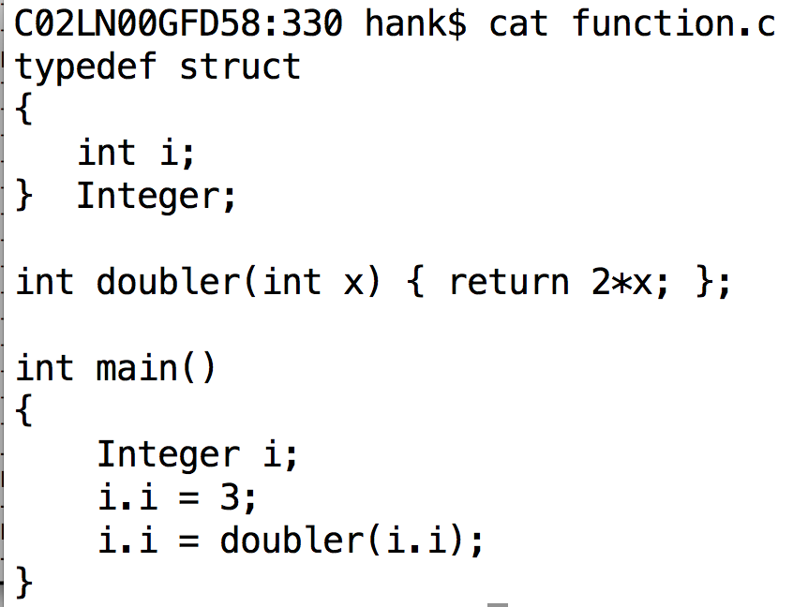
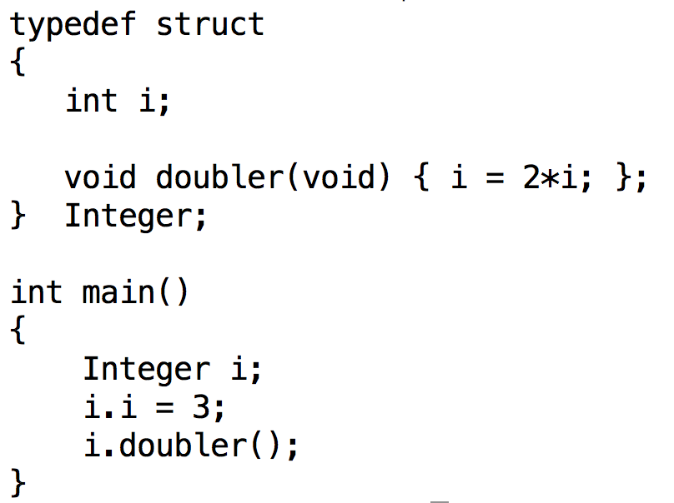
Function vs Method
(left) function is separate from struct
(right) function (method) is part of struct
(left) arguments and return value are explicit
(right) arguments and return value are not necessary, since they are associated with the object

Slide 24
Tally Counter
3 Methods:
Increment Count
Get Count
Reset

Slide 25
Methods & Tally Counter
Methods and Functions are both regions of code that are called by name (“routines”)
With functions:
the data it operates on (i.e., arguments) are explicitly passed
the data it generates (i.e., return value) is explicitly passed
stand-alone / no association with an object
With methods:
associated with an object & can work on object’s data
still opportunity for explicit arguments and return value

Slide 26
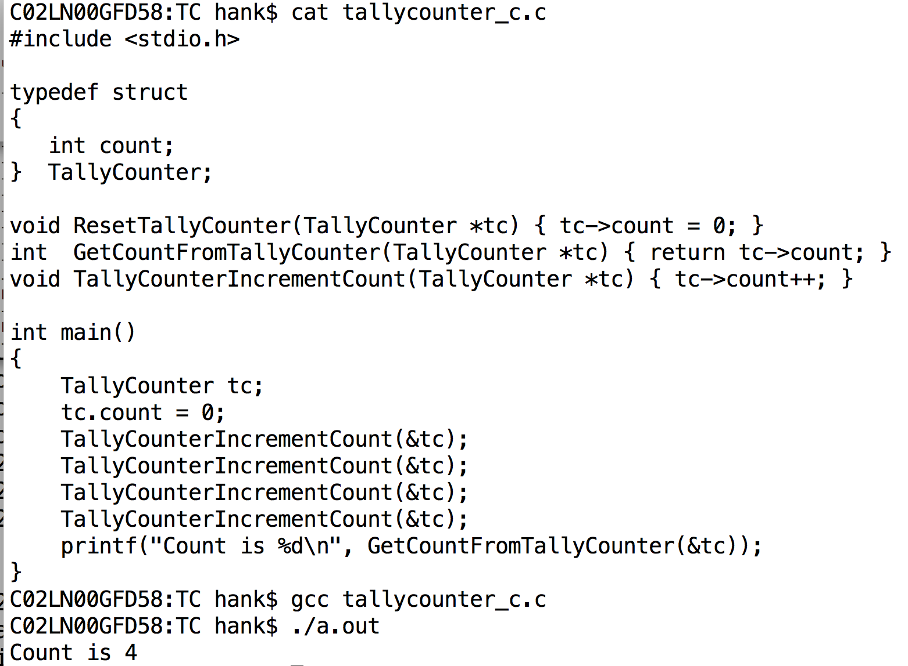
C-style implementation of TallyCounter

Slide 27
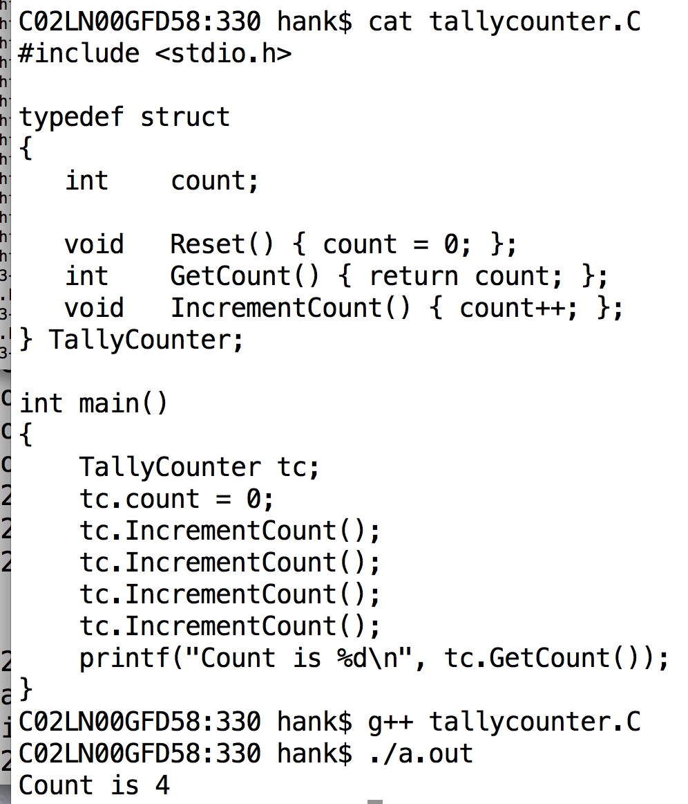
C++-style implementation of TallyCounter

Slide 28
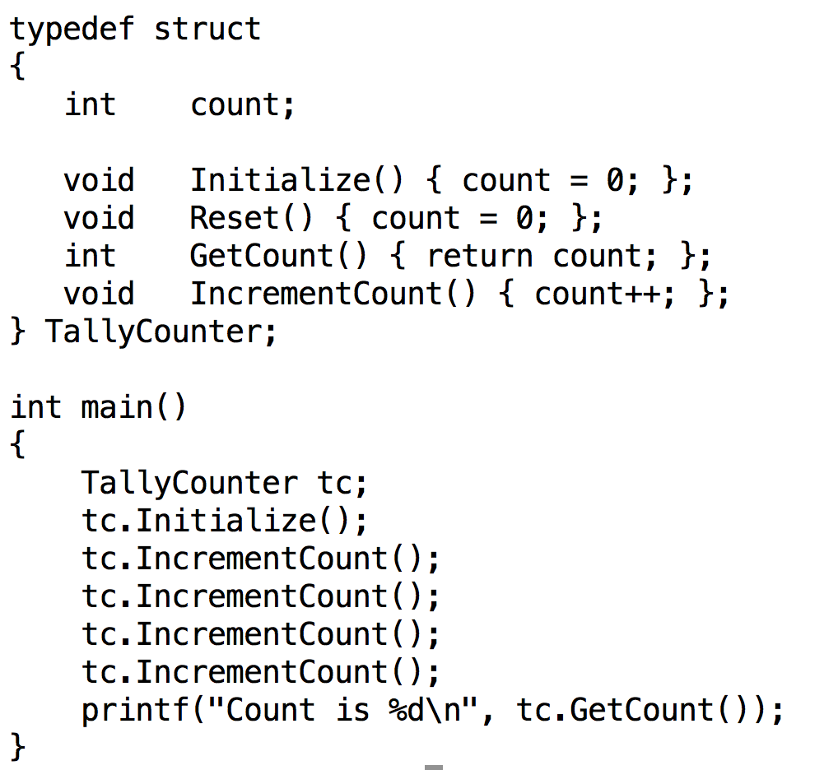

Slide 29
Constructors
Constructor: method for constructing object.
Called automatically
There are several flavors of constructors:
Parameterized constructors
Default constructors
Copy constructors
Conversion constructors
I will discuss these flavors in upcoming slides

Slide 30
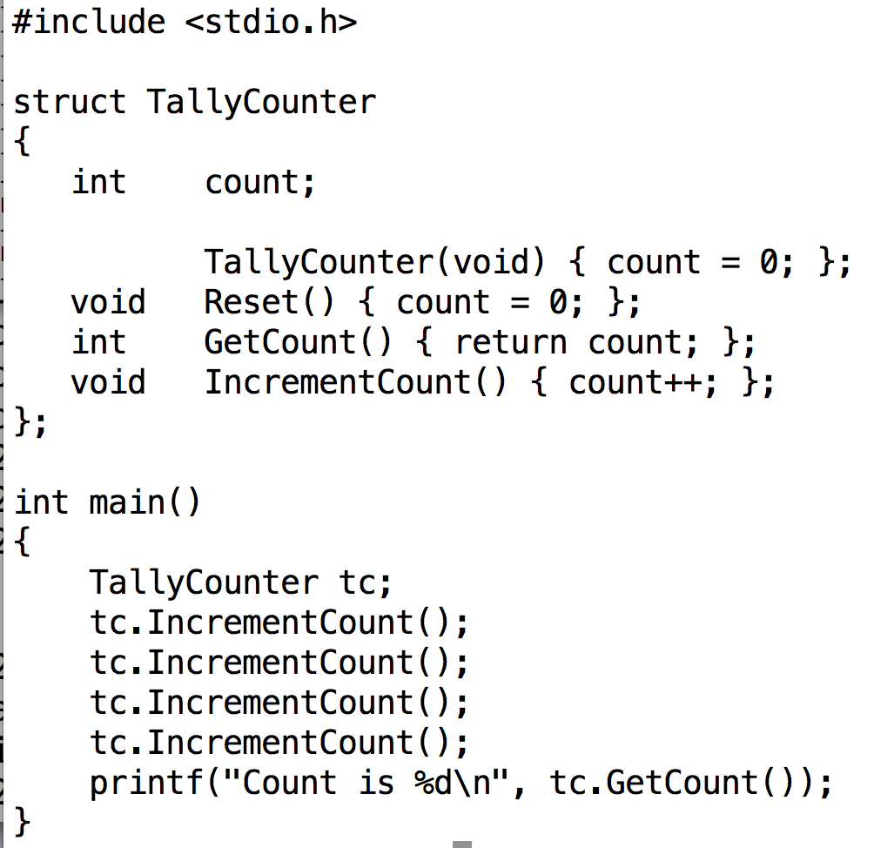
Note the typedef went away … not needed with C++.
Constructor is called automatically when object is instantiated
(This is the flavor called “default constructor”)
Method for constructor has same name as struct

Slide 31
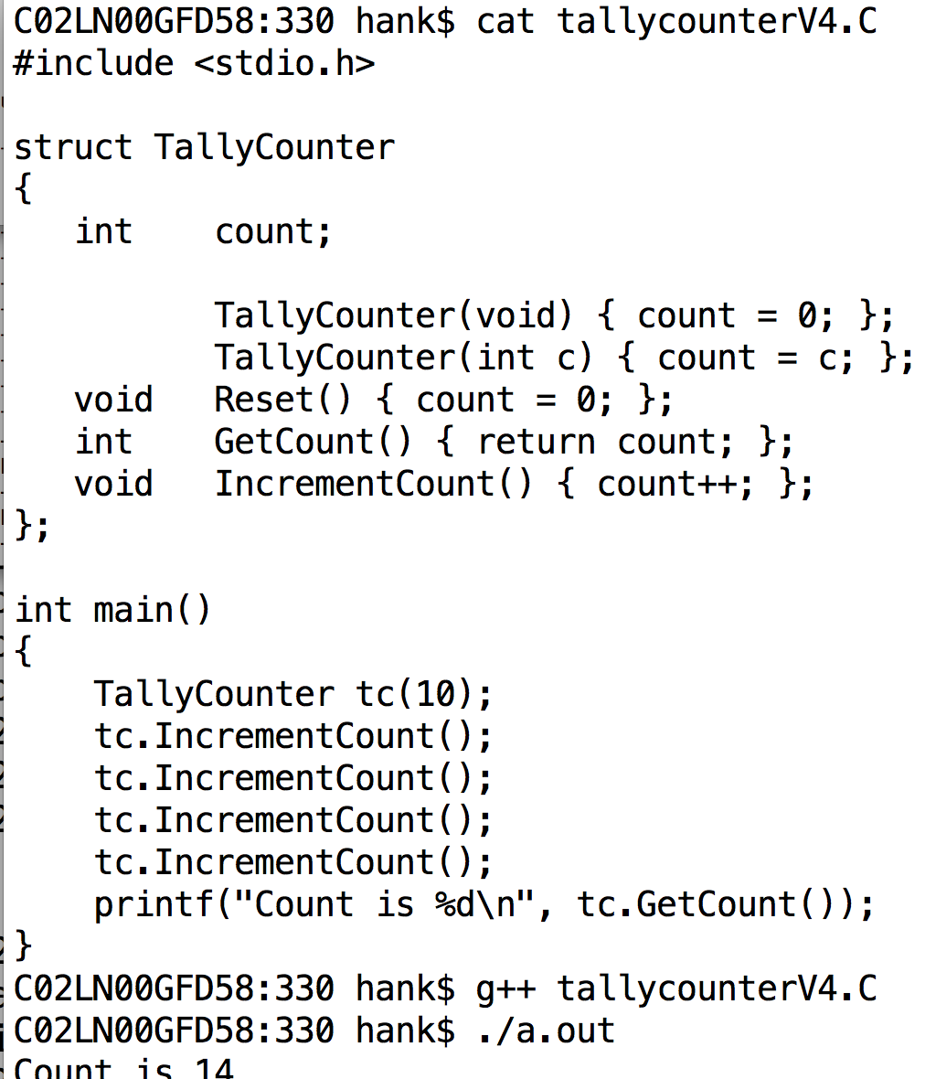
Argument can be passed to constructor.
(This is the flavor called “parameterized constructor”)

Slide 32
More traditional file organization
struct definition is in .h file
#ifndef / #define
method definitions in .C file
driver file includes headers for all structs it needs

Slide 33
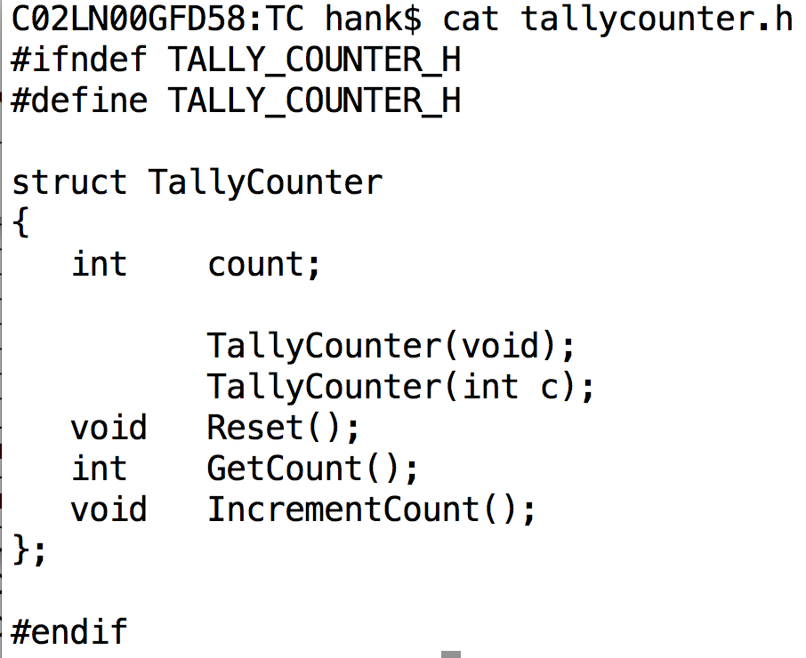
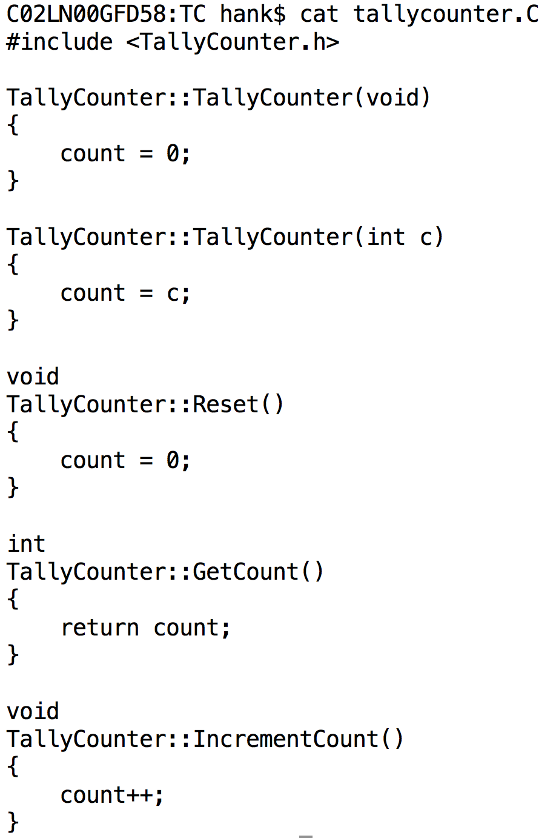
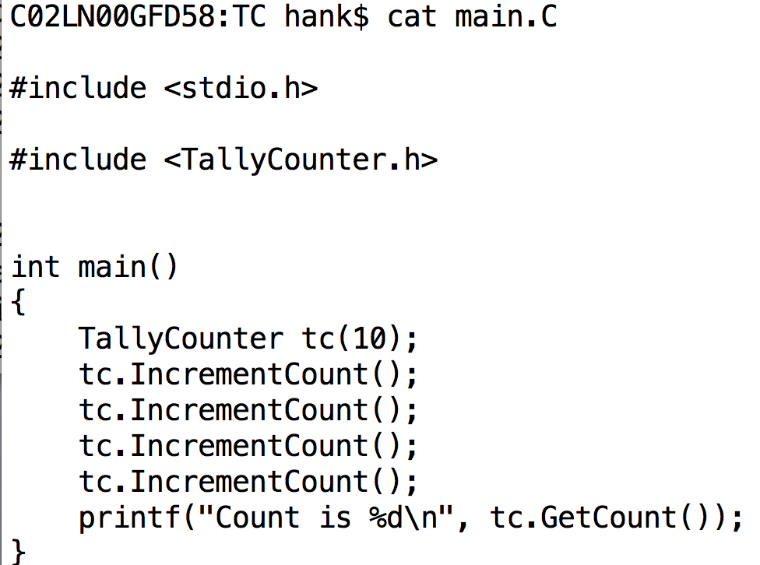
More traditional file organization
Methods can be defined outside the struct definition.
They use C++’s namespace concept, which is automatically in place.
(e.g., TallyCounter::IncrementCount)

Slide 34
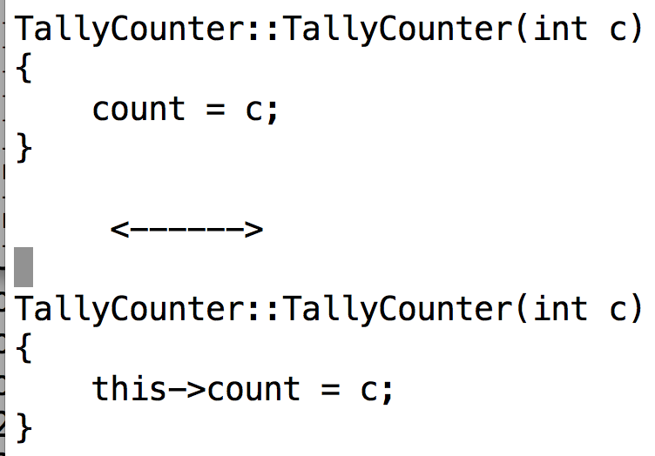
“this”: pointer to current object
From within any struct’s method, you can refer to the current object using “this”

Slide 35
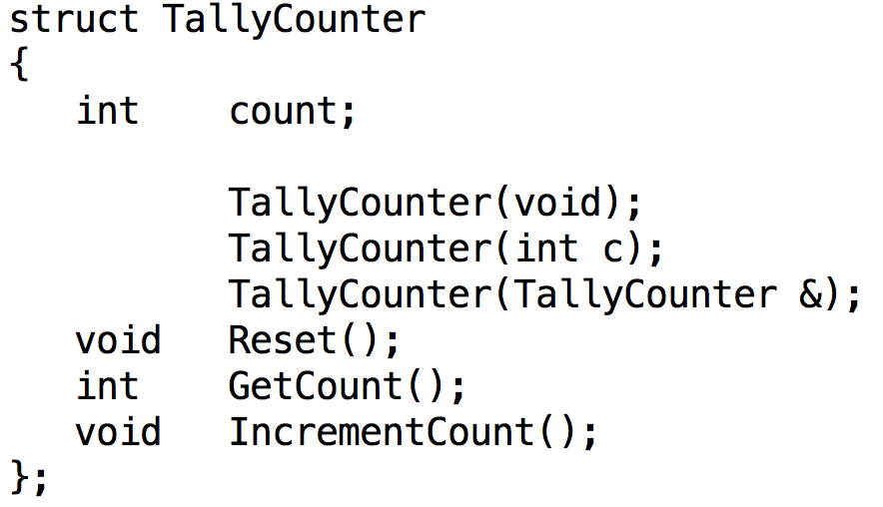
Copy Constructor
Copy constructor: a constructor that takes an instance as an argument
It is a way of making a new instance of an object that is identical to an existing one.

Slide 36
Constructor Types
Default constructor
Parameterized
constructor
Copy constructor

Slide 37
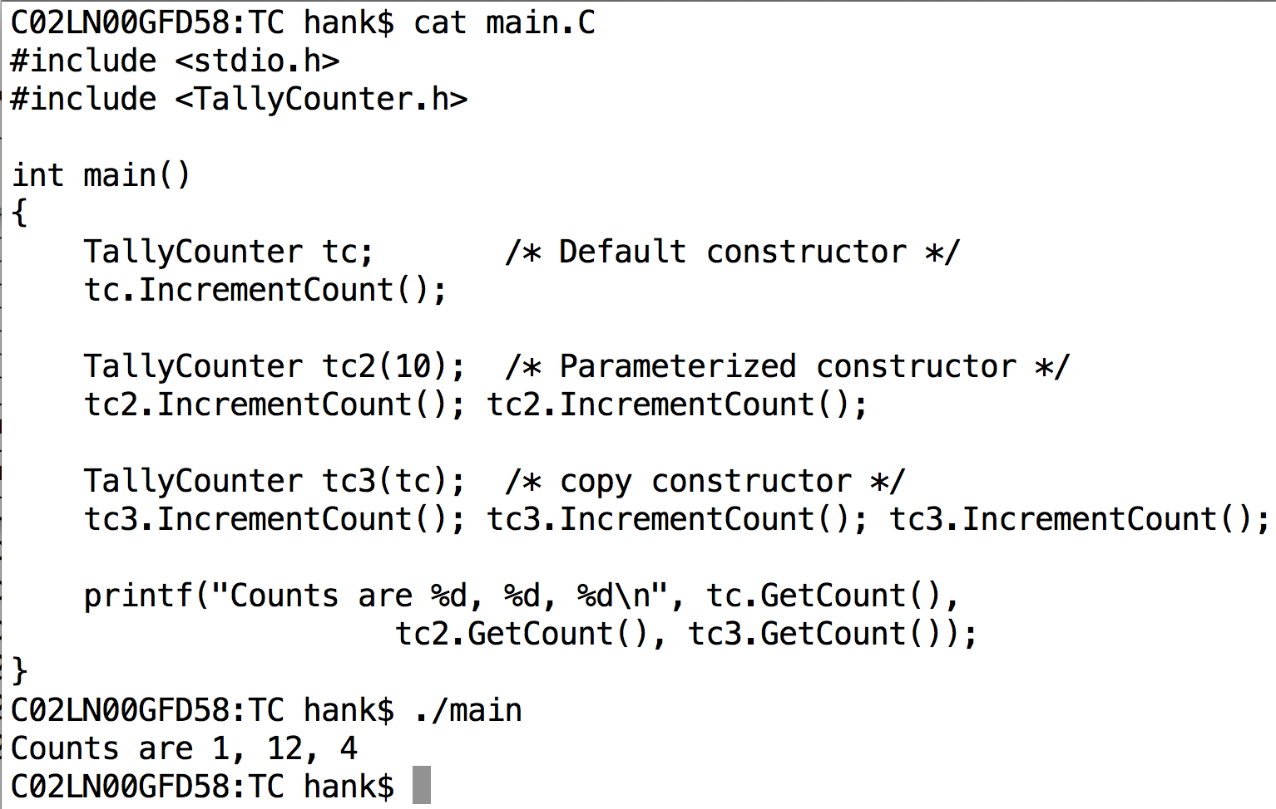
Example of 3 Constructors
????????????????

Slide 38
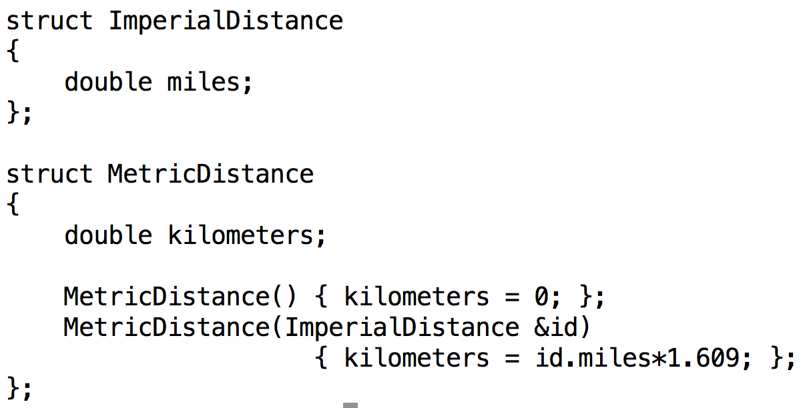
Conversion Constructor

Slide 39
3 big changes to structs in C++
You can associate “methods” (functions) with structs
You can control access to data members and methods

Slide 40
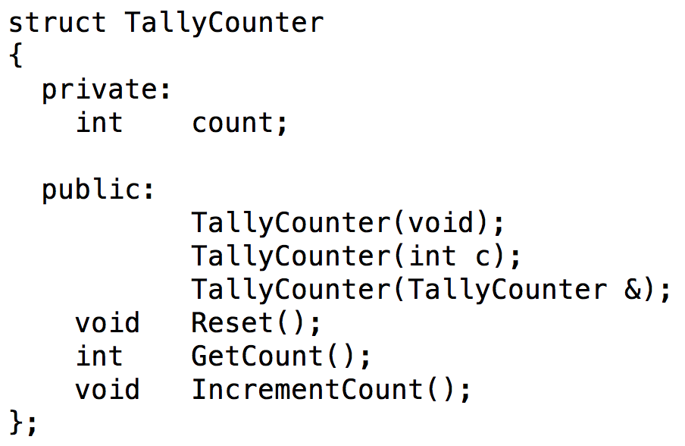
Access Control
New keywords: public and private
public: accessible outside the struct
private: accessible only inside the struct
Also “protected” … we will talk about that later
Everything following is private. Only will change when new access control keyword is encountered.
Everything following is now public. Only will change when new access control keyword is encountered.

Slide 41
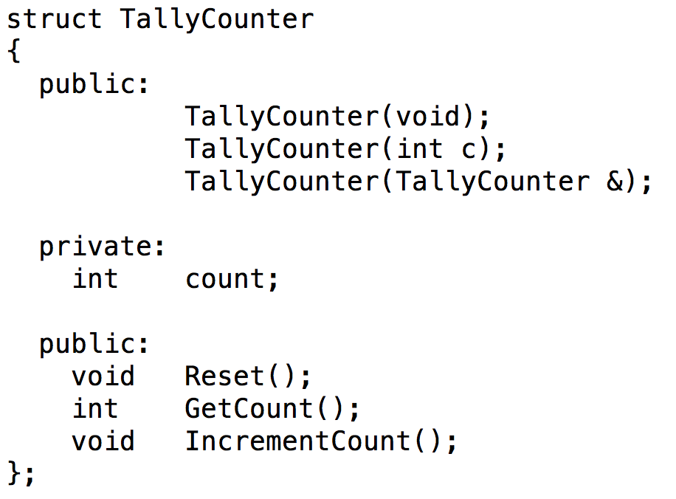
public / private
You can issue public and private as many times as you wish…

Slide 42
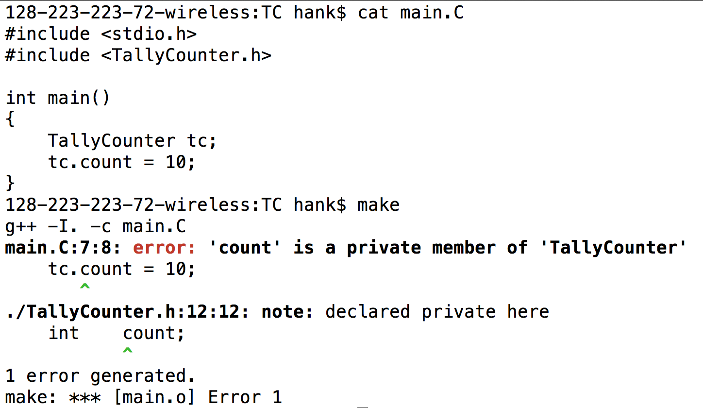
The compiler prevents violations of access controls.

Slide 43
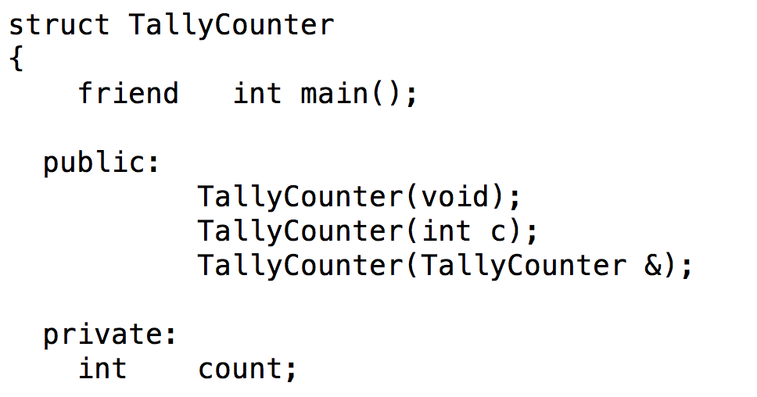
The friend keyword can override access controls.
Note that the struct declares who its friends are, not vice-versa
You can’t declare yourself a friend and start accessing data members.
friend is used most often to allow objects to access other objects.
This will compile, since main now has access to the private data member “count”.

Slide 44
class vs struct
class is new keyword in C++
classes are very similar to structs
the only differences are in access control
primary difference: struct has public access by default, class has private access by default
Almost all C++ developers use classes and not structs
C++ developers tend to use structs when they want to collect data types together (i.e., C-style usage)
C++ developers use classes for objects … which is most of the time
You should use classes!
Even though there isn’t much difference …

Slide 45
3 big changes to structs in C++
You can associate “methods” (functions) with structs
You can control access to data members and methods
Inheritance

Slide 46
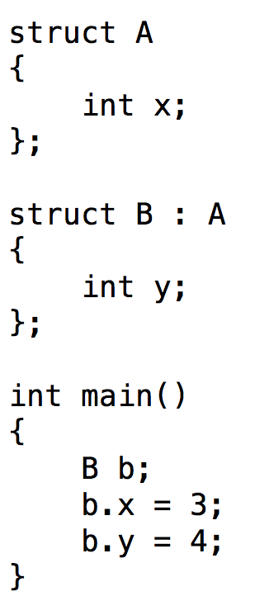
Simple inheritance example
Terminology
B inherits from A
A is a base type for B
B is a derived type of A
Noteworthy
“:” (during struct definition) → inherits from
Everything from A is accessible in B
(b.x is valid!!)

Slide 47
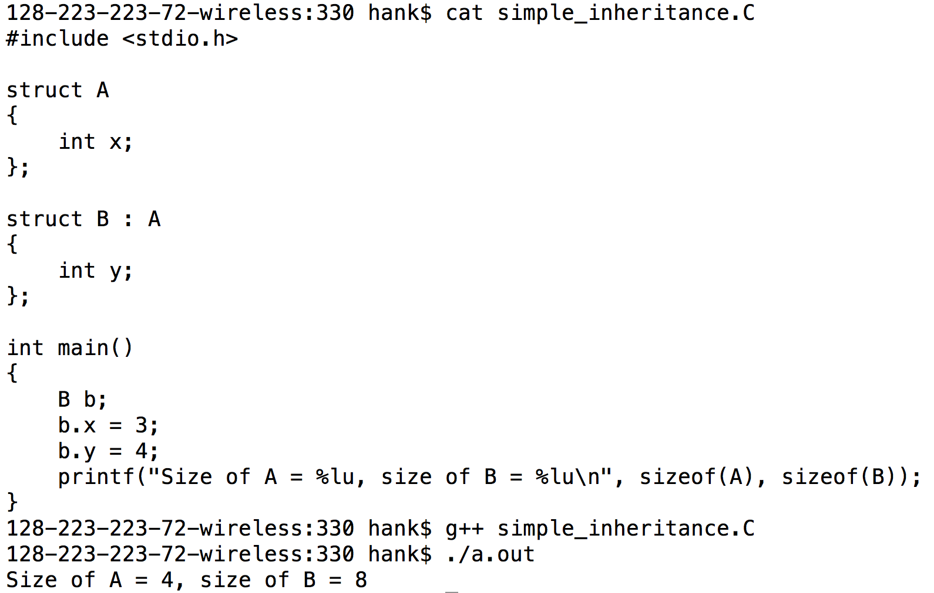
Object sizes

Slide 48
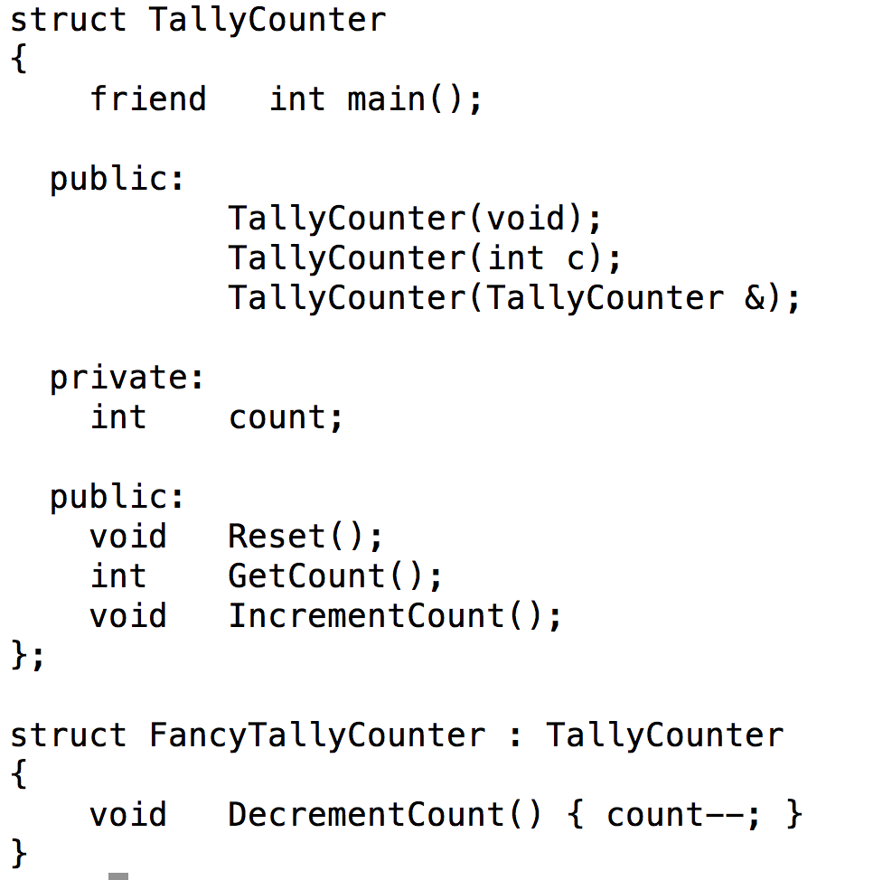
Inheritance + TallyCounter
FancyTallyCounter inherits all of TallyCounter, and adds a new method: DecrementCount

Slide 49
Virtual functions
Virtual function: function defined in the base type, but can be re-defined in derived type.
When you call a virtual function, you get the version defined by the derived type

Slide 50
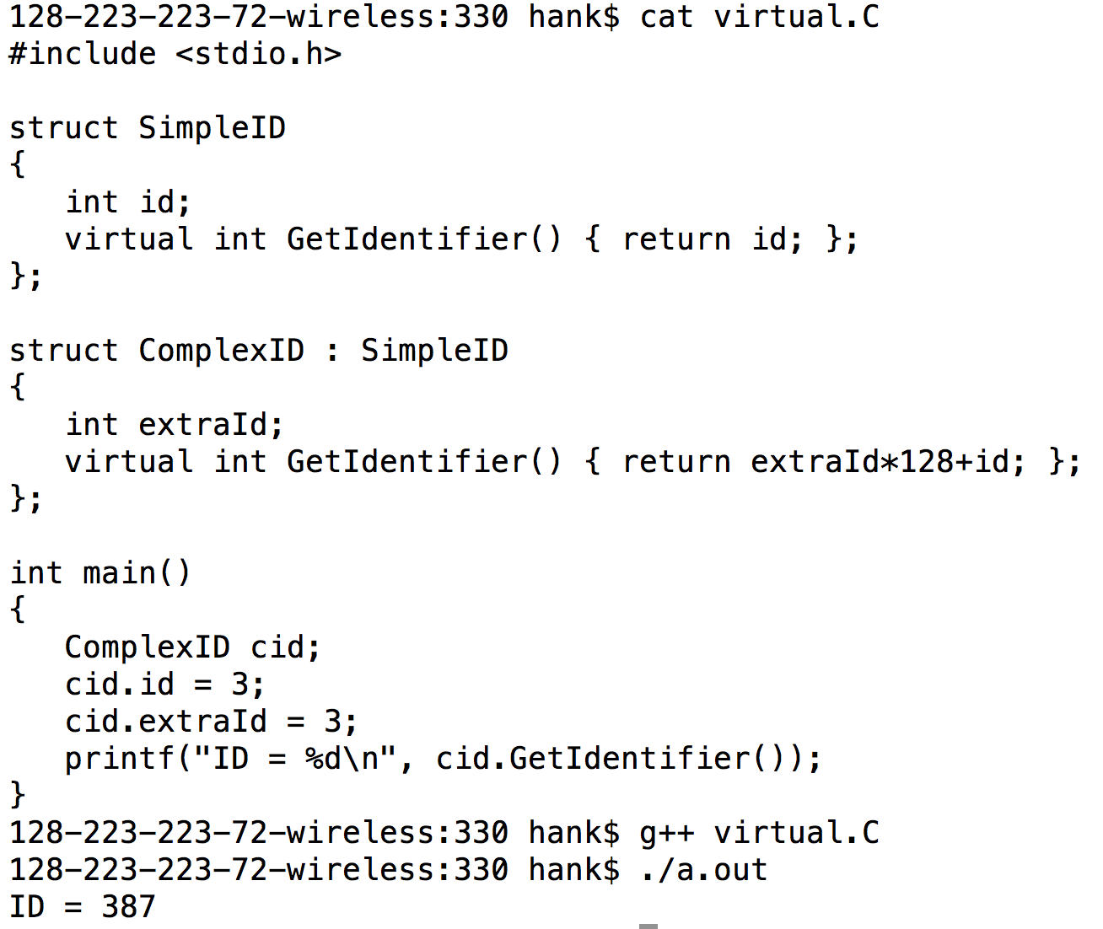
Virtual functions: example

Slide 51
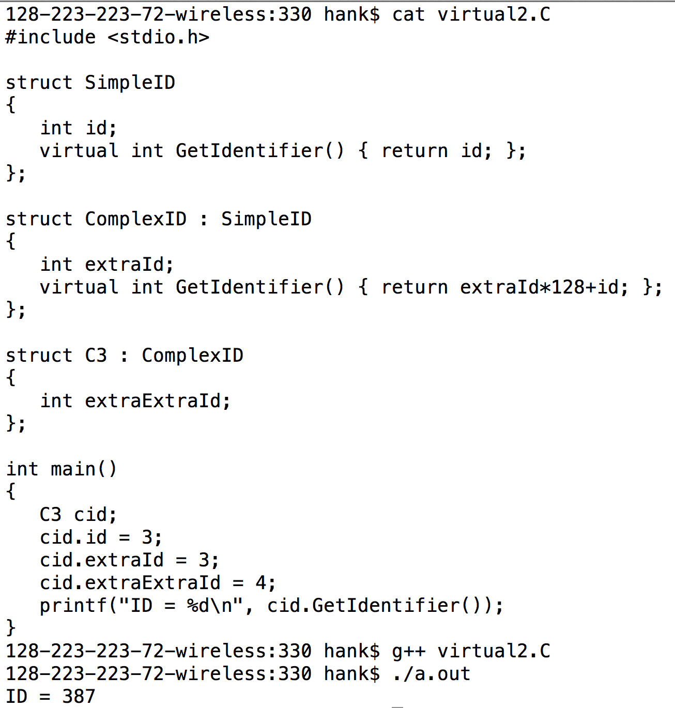
Virtual functions: example
You get the method furthest down in the inheritance hierarchy

Slide 52
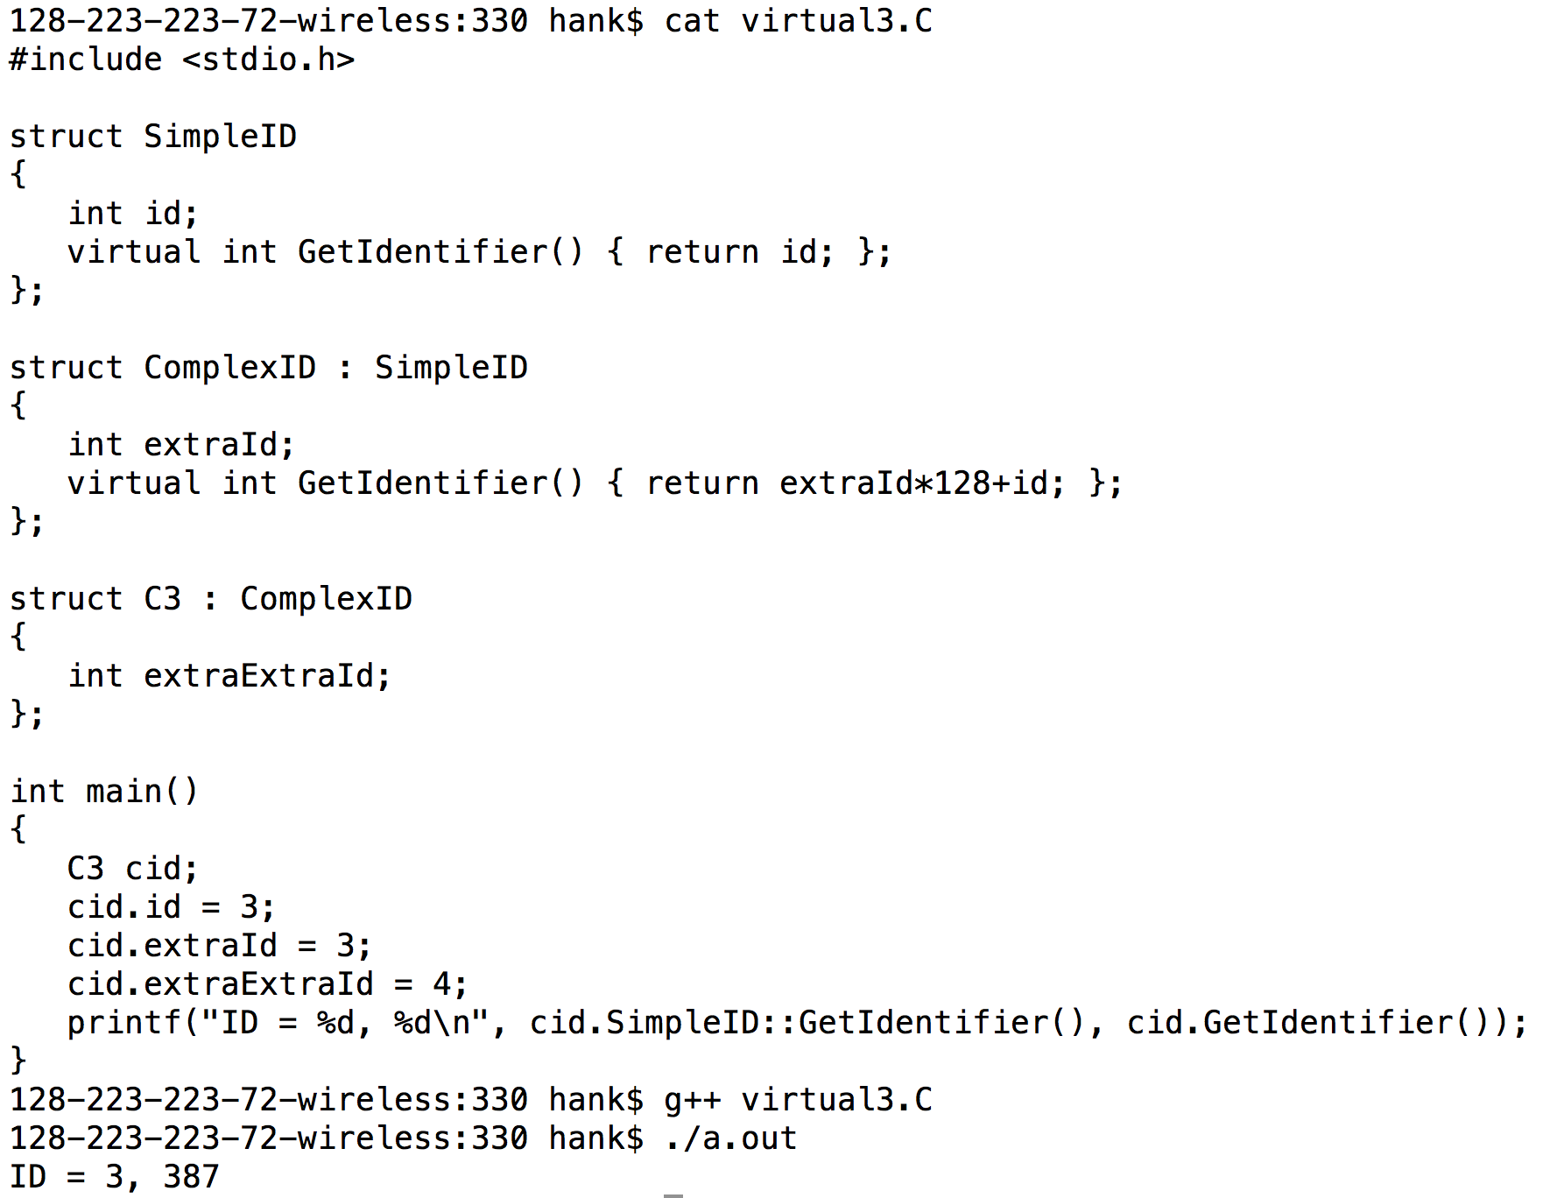
Virtual functions: example
You can specify the method you want to call by specifying it explicitly

Slide 53
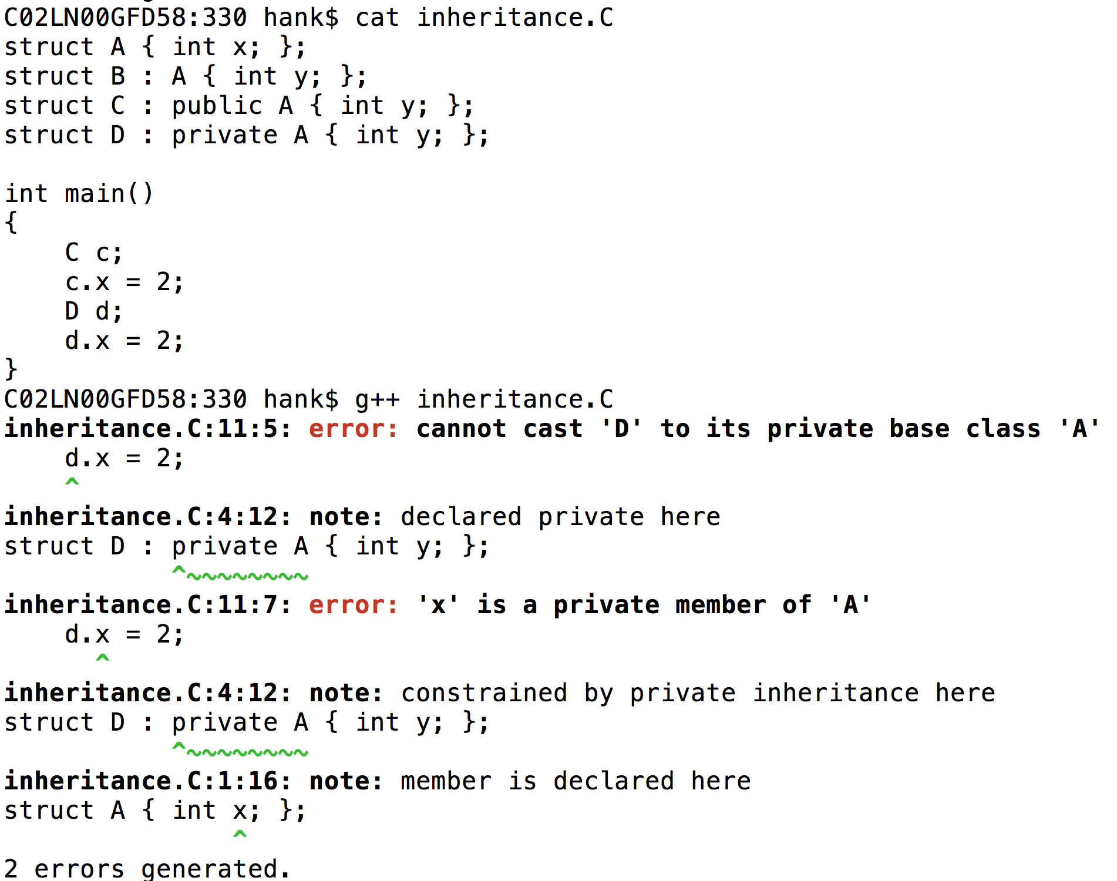
Access controls and inheritance
B and C are the same.
public is the default inheritance for structs
Public inheritance: derived types gets access to base type’s data members and methods
Private inheritance: derived types don’t get access.

Slide 54
One more access control word: protected
Protected means:
It cannot be accessed outside the object
Modulo “friend”
But it can be accessed by derived types
(assuming public inheritance)

Slide 55
Public, private, protected
 | Accessed by derived types* | Accessed outside object
Public | Yes | Yes
Protected | Yes | No
Private | No | No
* = with public inheritance

Slide 56
More on virtual functions upcoming
“Is A”
Multiple inheritance
Virtual function table
Examples
(Shape)

Slide 57
Bonus Topics

Slide 58
Backgrounding
“&”: tell shell to run a job in the background
Background means that the shell acts as normal, but the command you invoke is running at the same time.
“sleep 60” vs “sleep 60 &”
When would backgrounding be useful?

Slide 59
Suspending Jobs
You can suspend a job that is running
Press “Ctrl-Z”
The OS will then stop job from running and not schedule it to run.
You can then:
make the job run in the background.
Type “bg”
make the job run in the foreground.
Type “fg”
like you never suspended it at all!!

Slide 60
Web pages
ssh –l <user name> ix.cs.uoregon.edu
cd public_html
put something in index.html
→ it will show up as
http://ix.cs.uoregon.edu/~<username>

Slide 61
Web pages
You can also exchange files this way
scp file.pdf <username>@ix.cs.uoregon.edu:~/public_html
point people to http://ix.cs.uoregon.edu/~<username>/file.pdf
Note that ~/public_html/dir1 shows up as http://ix.cs.uoregon.edu/~<username>/dir1
(“~/dir1” is not accessible via web)

