Slide 1
CIS 330: _ _ _ _ ______ _ _____ / / / /___ (_) __ ____ _____ ____/ / / ____/ _/_/ ____/__ __ / / / / __ \/ / |/_/ / __ `/ __ \/ __ / / / _/_// / __/ /___/ /_ / /_/ / / / / /> < / /_/ / / / / /_/ / / /____/_/ / /__/_ __/_ __/ \____/_/ /_/_/_/|_| \__,_/_/ /_/\__,_/ \____/_/ \____//_/ /_/
Lecture 10:
building large projects,
beginning C++,
C++ and structs
April 30th, 2018
Hank Childs, University of Oregon

Slide 2
Outline
Review
Building Large Projects
Beginning C++
C++ & Structs

Slide 3
Function Pointers
Idea:
You have a pointer to a function
This pointer can change based on circumstance
When you call the function pointer, it is like calling a known function

Slide 4
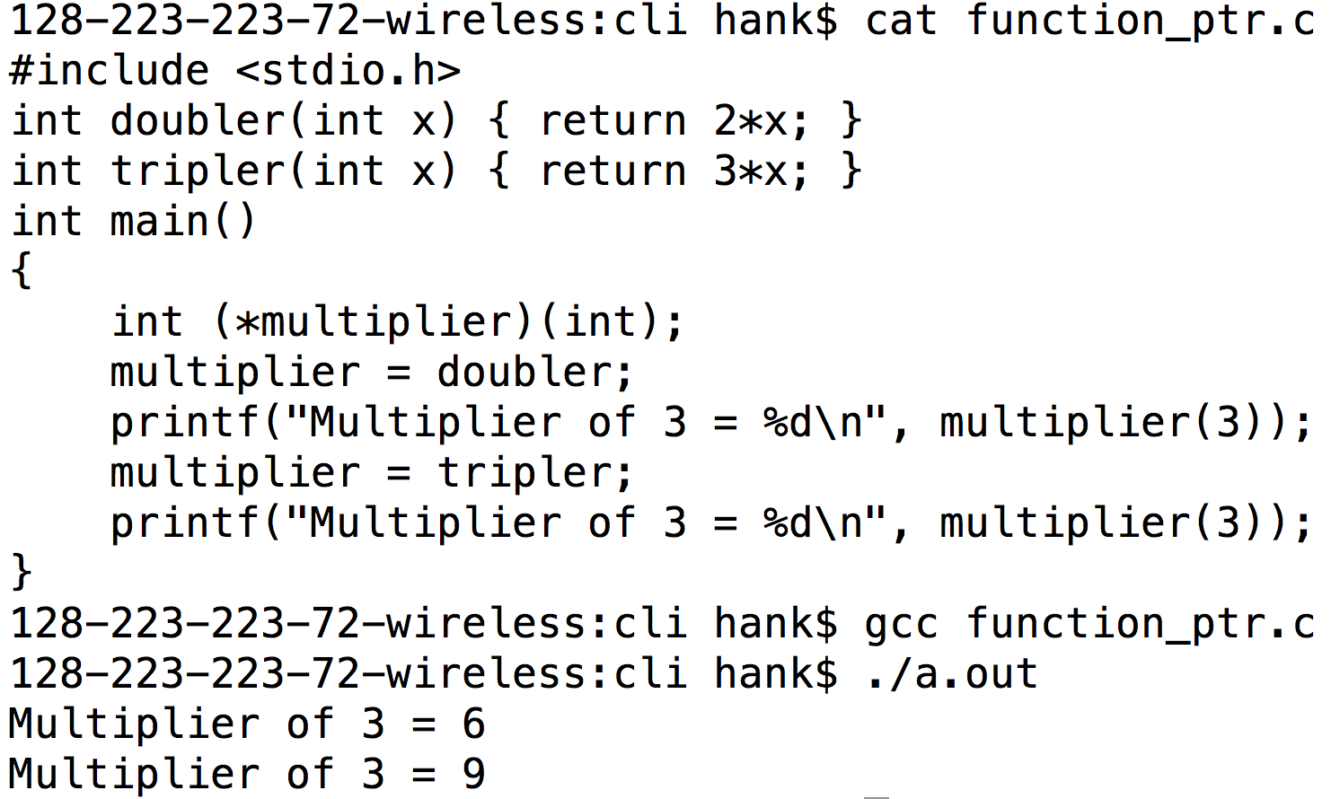
Function Pointer Example

Slide 5
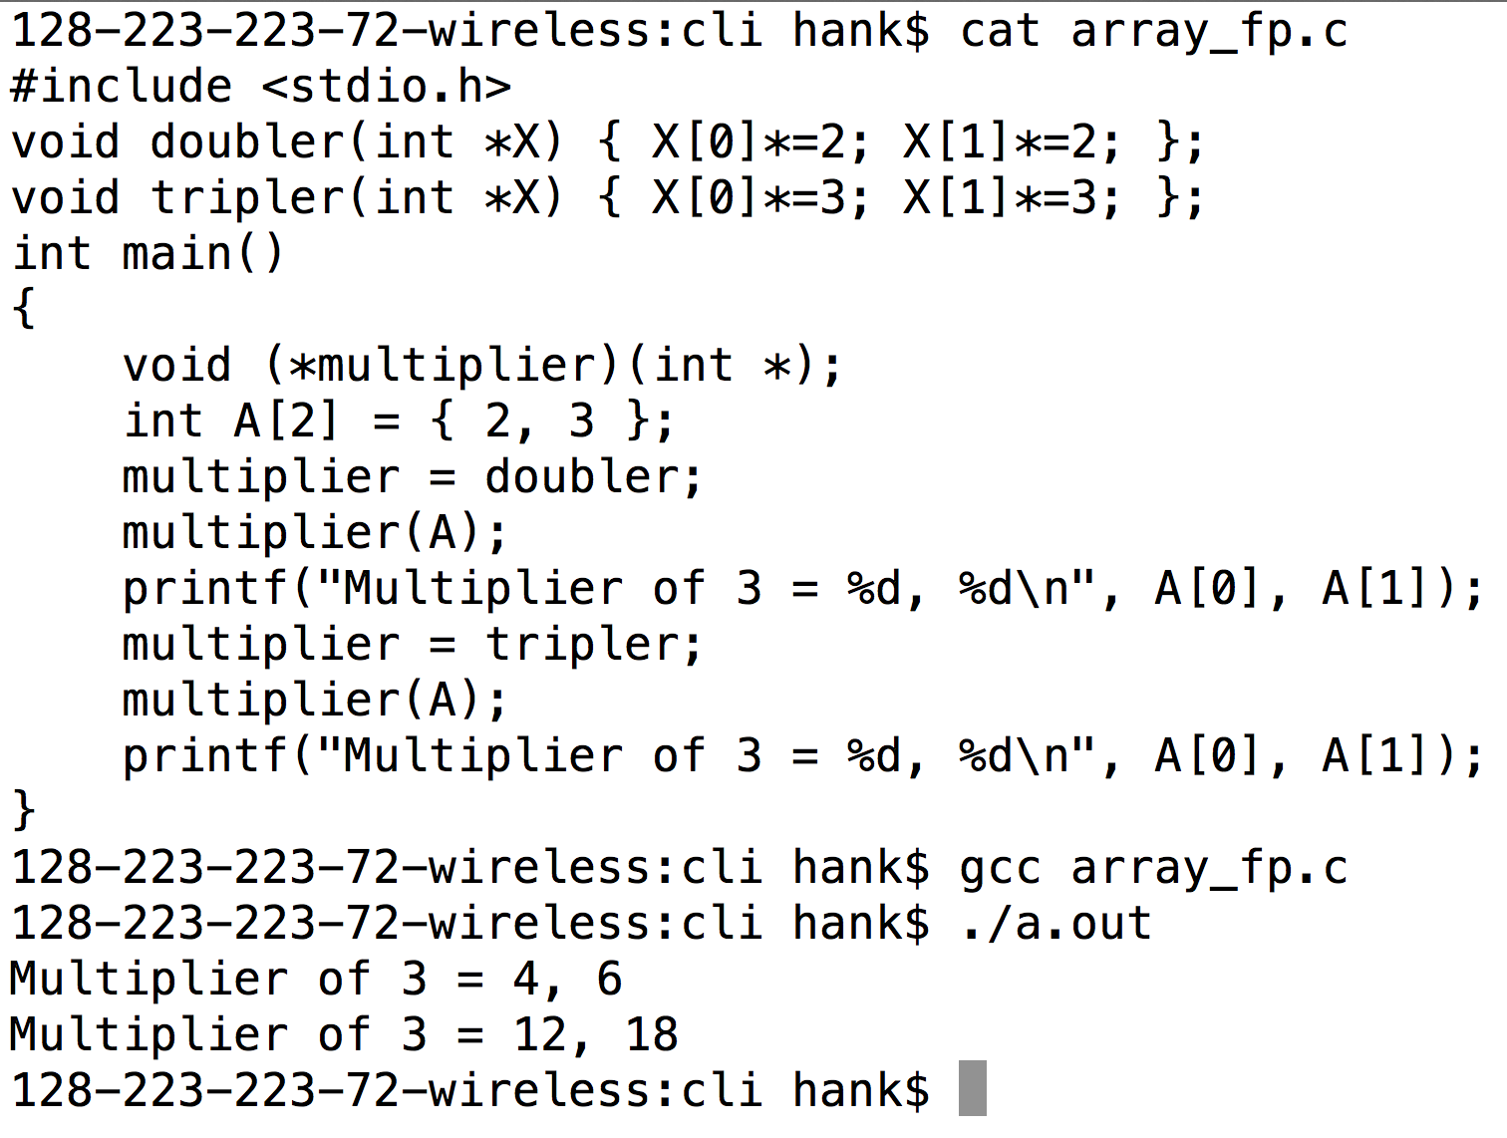
Function Pointer Example #2
Function pointer
Part of function signature
Don’t be scared of extra ‘*’s … they just come about because of pointers in the arguments or return values.

Slide 6
Simple-to-Exotic Function Pointer Declarations
void (*foo)(void);
void (*foo)(int **, char ***);
char ** (*foo)(int **, void (*)(int));
These sometimes come up on interviews.

Slide 7
Subtyping

Slide 8
Subtyping
Type: a data type (int, float, structs)
Subtype / supertype:
Supertype: the abstraction of a type
(not specific)
Subtype: a concrete implementation of the supertype
(specific)
The fancy term for this is “subtype polymorphism”

Slide 9
Subtyping: example
Supertype: Shape
Subtypes:
Circle
Rectangle
Triangle

Slide 10
Subtyping works via interfaces
Must define an interface for supertype/subtypes
Interfaces are the functions you can call on the supertype/subtypes
The set of functions is fixed
Every subtype must define all functions

Slide 11
Subtyping
I write my routines to the supertype interface
All subtypes can automatically use this code
Don’t have to modify code when new subtypes are added
Example:
I wrote code about Shapes.
I don’t care about details of subtypes (Triangle, Rectangle, Circle)
When new subtypes are added (Square), my code doesn’t change

Slide 12
Project 2D
You will extend Project 2C
You will do Subtyping
You will make a union of all the structs
You will make a struct of function pointers
This will enable subtyping
Goal: driver program works on “Shape”s and doesn’t need to know if it is a Circle, Triangle, or Rectangle.

Slide 13
Outline
Review
Building Large Projects
Beginning C++
C++ & Structs

Slide 14
3 files: prototypes.h, rectangle.c, driver.c
prototypes.h
struct Rectangle;
void IntializeRectangle(struct Rectangle *r, double v1, double v2, double v3, double v4);
rectangle.c
struct Rectangle
{
double minX, maxX, minY, maxY;
};
void IntializeRectangle(struct Rectangle *r, double v1, double v2, double v3, double v4)
{
r->minX = v1; r->maxX = v2; r->minY = v3; r->maxY = v4;
}
driver.c
#include <prototypes.h>
int main()
{
struct Rectangle r;
InitializeRectangle(r, 0, 1, 0, 1.5);
}

Slide 15
Makefile for prototypes.h, rectangle.c, driver.c
Makefile
proj2B: rectangle.o driver.o
gcc -o proj2B driver.o rectangle.o
driver.o: prototypes.h driver.c
gcc -I. -c driver.c
rectangle.o: prototypes.h rectangle.c
gcc -I. -c rectangle.c

Slide 16
Definition of Rectangle in rectangle.c Why is this a problem?
prototypes.h
struct Rectangle;
void IntializeRectangle(struct Rectangle *r, double v1, double v2, double v3, double v4);
rectangle.c
struct Rectangle
{
double minX, maxX, minY, maxY;
};
void IntializeRectangle(struct Rectangle *r, double v1, double v2, double v3, double v4)
{
r->minX = v1; r->maxX = v2; r->minY = v3; r->maxY = v4;
}
“gcc –c driver.c” needs to make an object file.
It needs info about Rectangle then, not later.
driver.c
#include <prototypes.h>
int main()
{
struct Rectangle r;
InitializeRectangle(&r, 0, 1, 0, 1.5);
}

Slide 17
New gcc option: “gcc –E”
The fix is to make sure driver.c has access to the Rectangle struct definition.
driver.c
#include <prototypes.h>
int main()
{
struct Rectangle r;
InitializeRectangle(r, 0, 1, 0, 1.5);
}
gcc –E shows what the compiler sees after satisfying “preprocessing”, which includes steps like “#include”.
# 1 "driver.c"
# 1 "<built-in>" 1
# 1 "<built-in>" 3
# 162 "<built-in>" 3
# 1 "<command line>" 1
# 1 "<built-in>" 2
# 1 "driver.c" 2
# 1 "./prototypes.h" 1
struct Rectangle;
void InitializeRectangle(struct Rectangle *r, double v1, double v2, double v3, double v4);
# 2 "driver.c" 2
int main()
{
struct Rectangle r;
InitializeRectangle(r, 0, 1, 0, 1.5);
}
gcc –E –I. driver.c
This is it. If the compiler can’t figure out how to make object file with this, then it has to give up.

Slide 18
4 files: struct.h, prototypes.h, rectangle.c, driver.c
struct.h
struct Rectangle
{
double minX, maxX, minY, maxY;
};
prototypes.h
#include <struct.h>
void InitializeRectangle(struct Rectangle *r, double v1, double v2, double v3, double v4);
rectangle.c
#include <struct.h>
#include <prototypes.h>
void InitializeRectangle(struct Rectangle *r, double v1, double v2, double v3, double v4)
{
r->minX = v1; r->maxX = v2; r->minY = v3; r->maxY = v4;
}
#include <struct.h>
#include <prototypes.h>
int main()
{
struct Rectangle r;
InitializeRectangle(&r, 0, 1, 0, 1.5);
}
driver.c
What is the problem with this configuration?

Slide 19
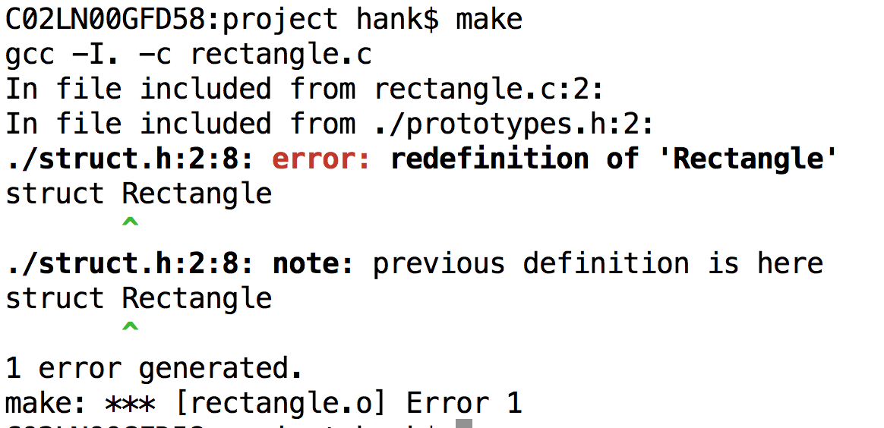
Compilation error

Slide 20
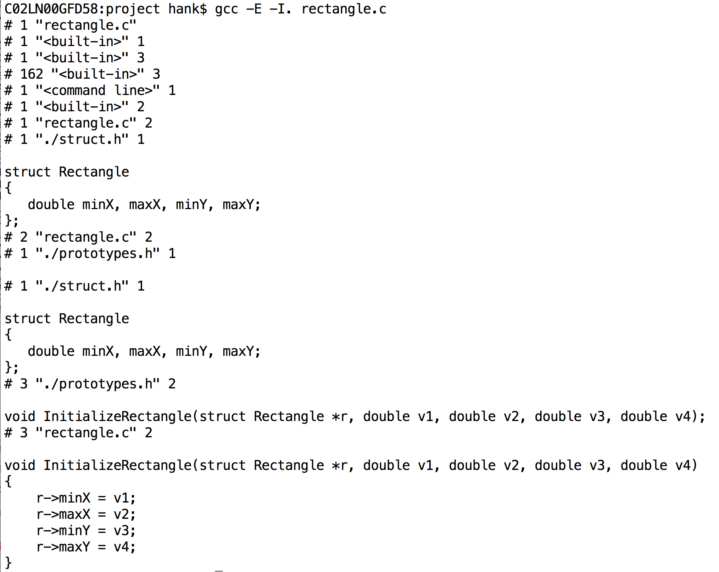
gcc –E rectangle.c

Slide 21
How to fix?
Solution #1: don’t include it twice
→ Turns out, that is hard
Solution #2: need more infrastructure – macros
(This motivates the next ten slides)

Slide 22
Preprocessor
Preprocessor:
takes an input program
produces another program (which is then compiled)
C has a separate language for preprocessing
Different syntax than C
Uses macros (“#”)
macro (“macroinstruction”): rule for replacing input characters with output characters

Slide 23
Preprocessor Phases
Resolve #includes
(we understand #include phase)
Conditional compilation (#ifdef)
Macro replacement
Special macros

Slide 24
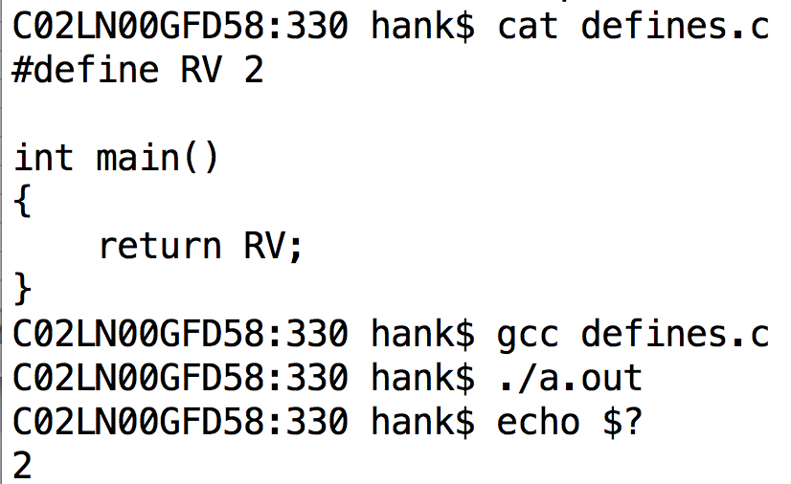
#define compilation
This is an example of macro replacement.

Slide 25
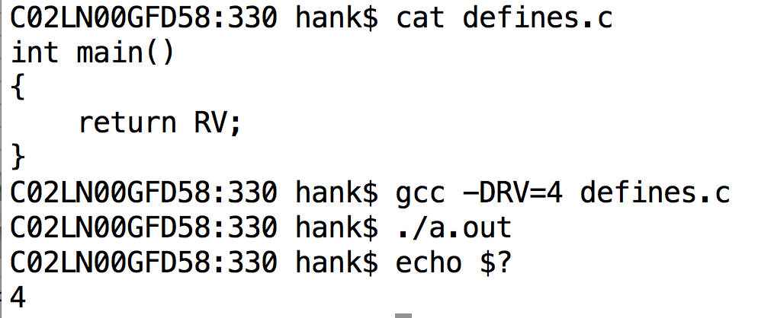
#define via gcc command-line option

Slide 26
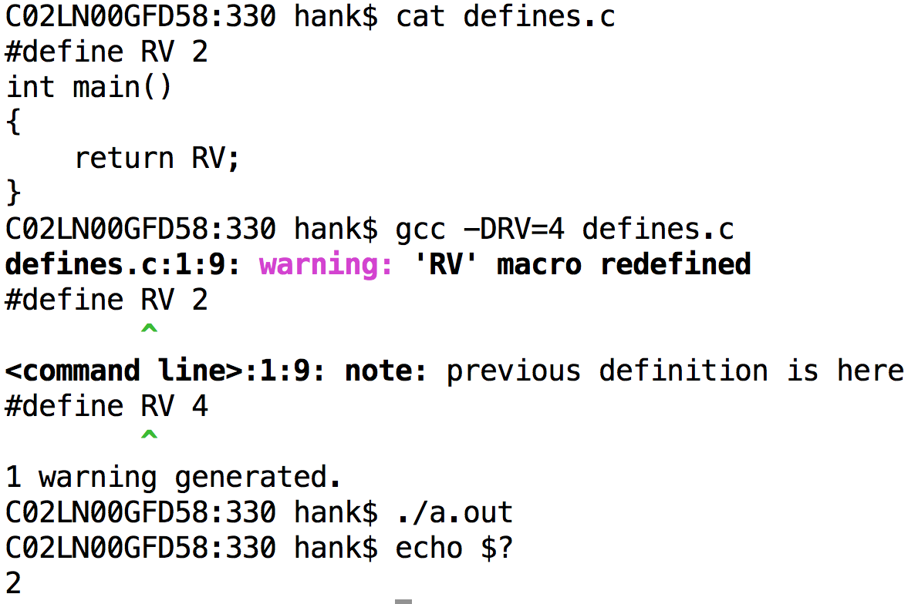
Conflicting –D and #define

Slide 27
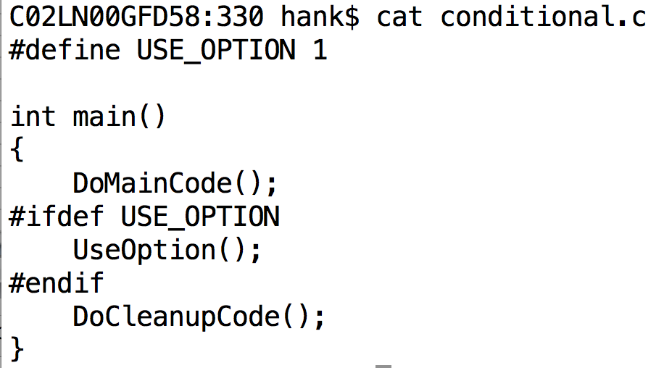
Conditional compilation

Slide 28
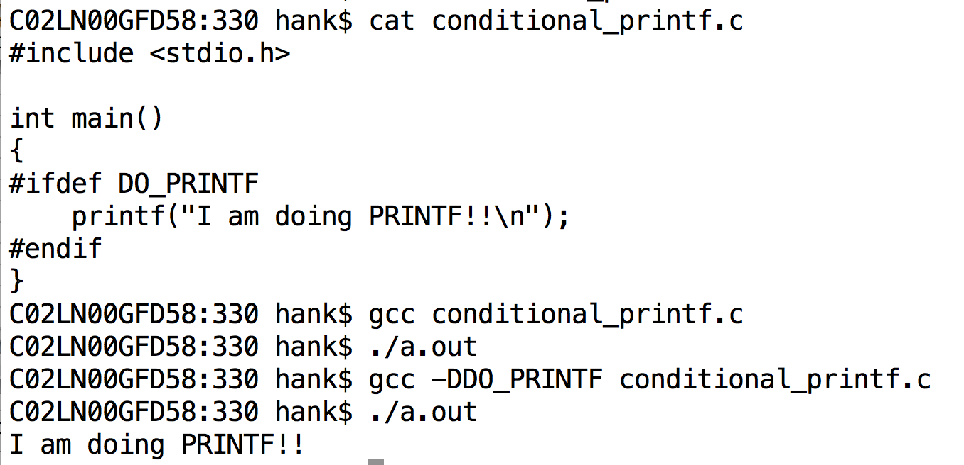
Conditional compilation controlled via compiler flags
This is how configure/cmake controls the compilation.

Slide 29
4 files: struct.h, prototypes.h, rectangle.c, driver.c
struct.h
struct Rectangle
{
double minX, maxX, minY, maxY;
};
prototypes.h
#include <struct.h>
void InitializeRectangle(struct Rectangle *r, double v1, double v2, double v3, double v4);
rectangle.c
#include <struct.h>
#include <prototypes.h>
void InitializeRectangle(struct Rectangle *r, double v1, double v2, double v3, double v4)
{
r->minX = v1; r->maxX = v2; r->minY = v3; r->maxY = v4;
}
#include <struct.h>
#include <prototypes.h>
int main()
{
struct Rectangle r;
InitializeRectangle(&r, 0, 1, 0, 1.5);
}
driver.c
What is the problem with this configuration?

Slide 30
Compilation error

Slide 31
gcc –E rectangle.c

Slide 32
#ifndef / #define to the rescue
struct.h
#ifndef RECTANGLE_330
#define RECTANGLE_330
struct Rectangle
{
double minX, maxX, minY, maxY;
};
#endif
Why does this work?
This problem comes up a lot with big projects, and especially with C++.

Slide 33
There is more to macros…
Macros are powerful & can be used to generate custom code.
Beyond what we will do here.
Two special macros that are useful:
__FILE__ and __LINE__
(Do an example with __LINE__, __FILE__)

Slide 34
Outline
Review
Building Large Projects
Beginning C++
C++ & Structs

Slide 35
Relationship between C and C++
C++ adds new features to C
Increment operator!
For the most part, C++ is a superset of C
A few invalid C++ programs that are valid C programs
Early C++ “compilers” just converted programs to C

Slide 36
A new compiler: g++
g++ is the GNU C++ compiler
Flags are the same
Compiles C programs as well
(except those that aren’t valid C++ programs)

Slide 37
.c vs .C
Unix is case sensitive
(So are C and C++)
Conventions:
.c: C file
.C: C++ file
.cxx: C++ file
.cpp: C++ file (this is pretty rare)
Gnu compiler will sometimes assume the language based on the extension … CLANG won’t.

Slide 38
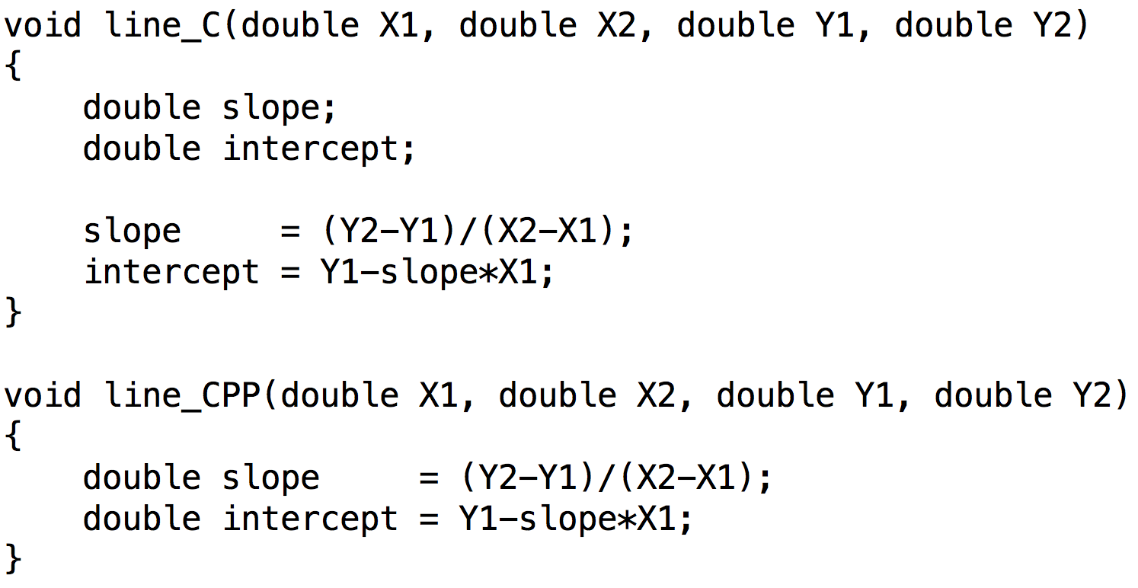
Variable declaration (1/2)
You can declare variables anywhere with C++!

Slide 39
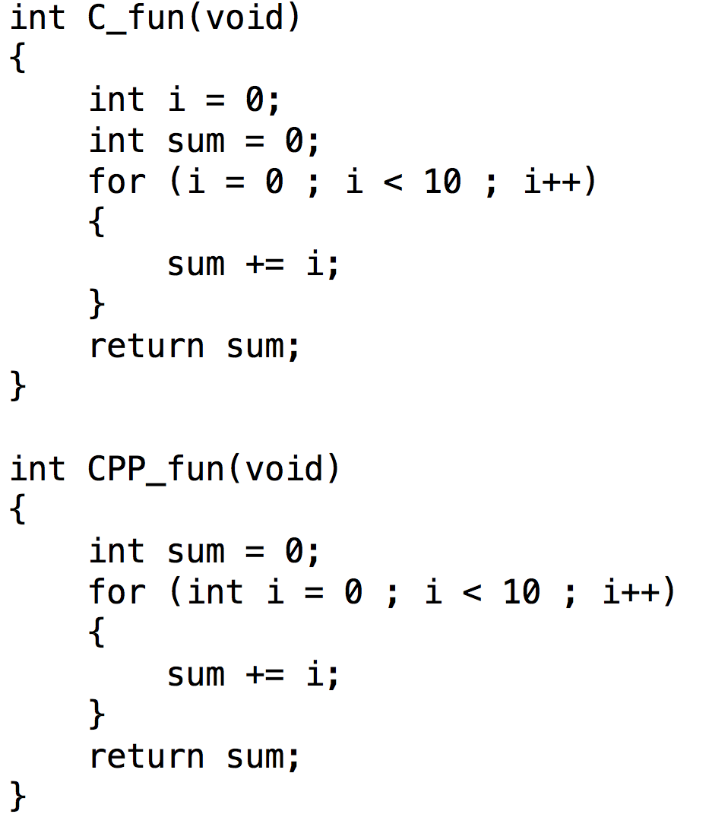
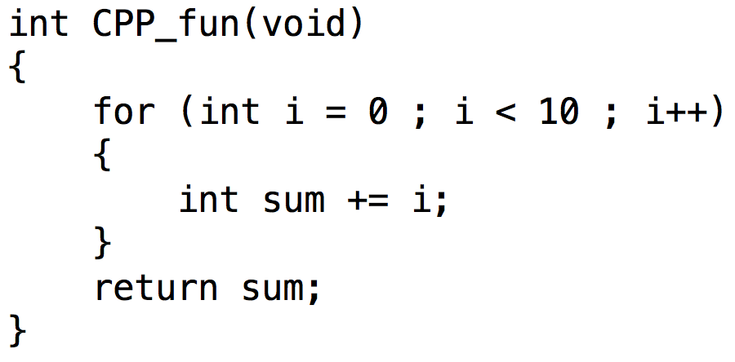
Variable declaration (2/2)
You can declare variables anywhere with C++!
Why is this bad?
What compiler error
would you get?

Slide 40
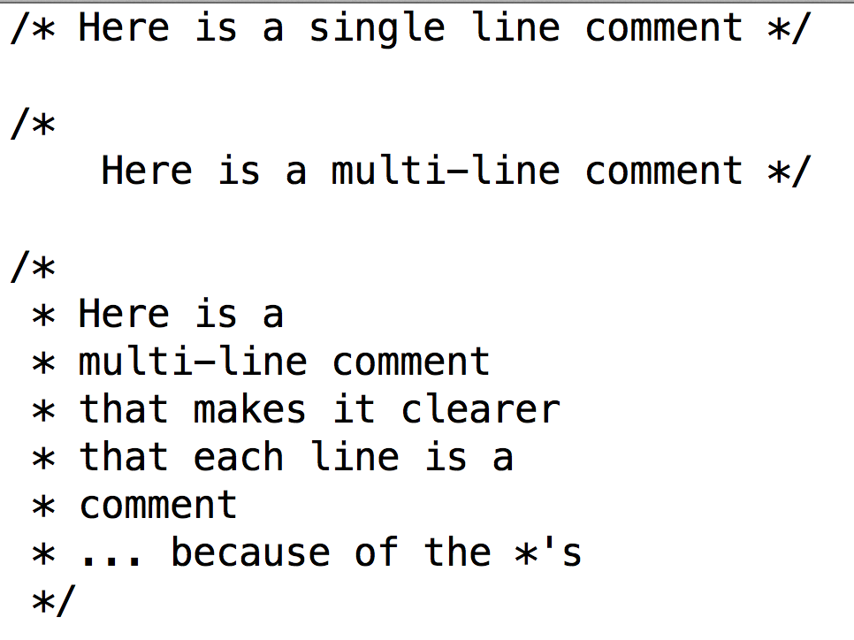
C-style Comments

Slide 41
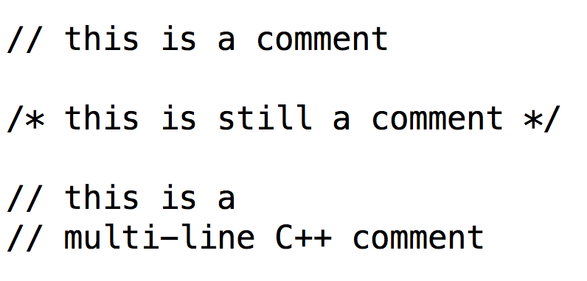
C++-style comments
When you type “//”, the rest of the line is a comment, whether you want it to be or not.

Slide 42
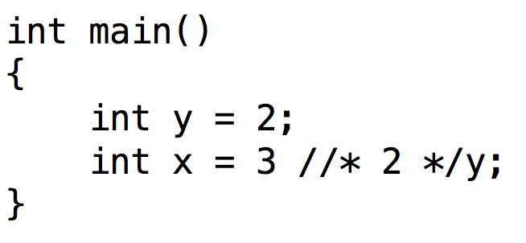
Valid C program that is not a valid C++ program
We have now learned enough to spot one (the?) valid C program that is not a valid C++ program
(lectured on this earlier)

Slide 43
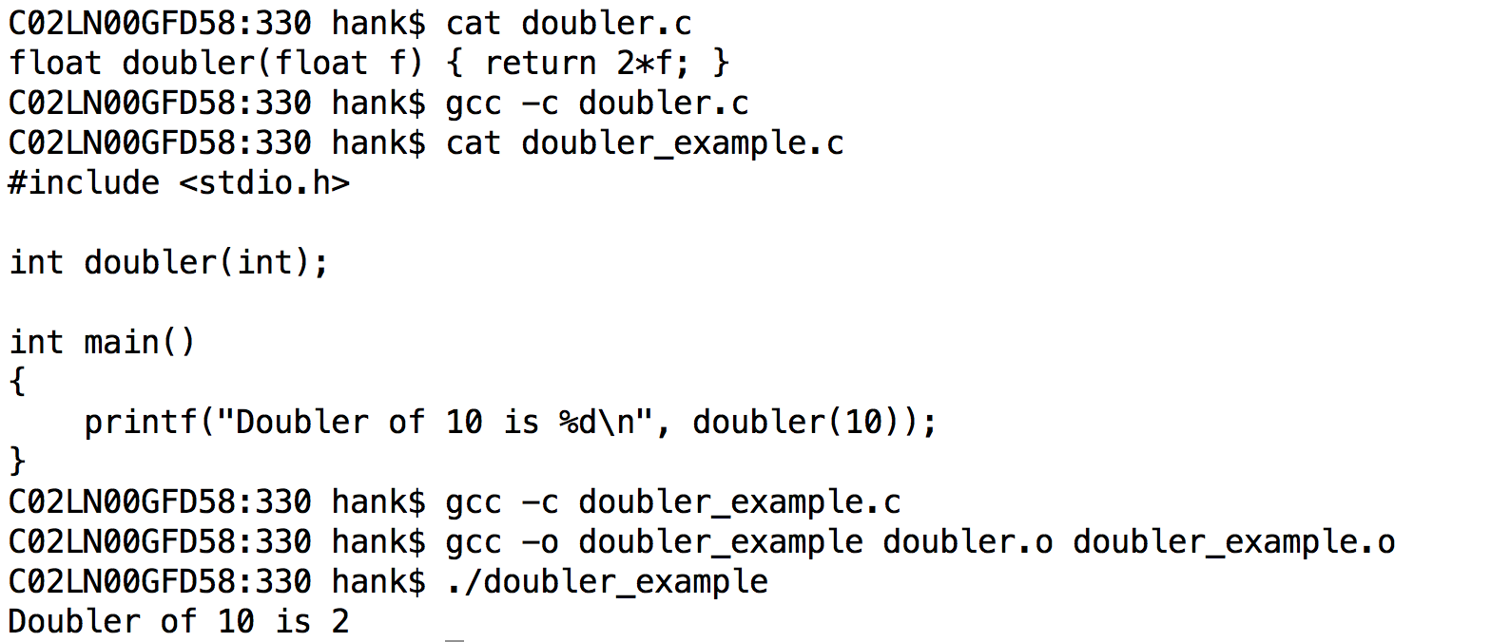
Problem with C…

Slide 44
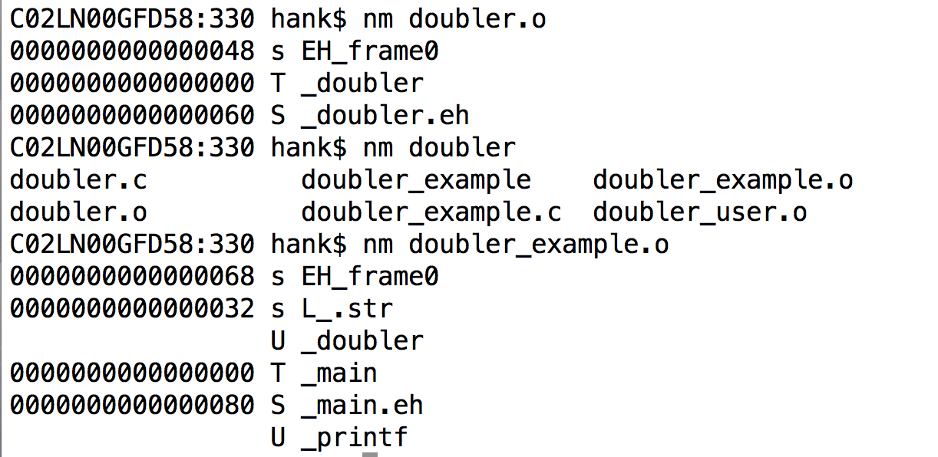
Problem with C…
No checking of type…

Slide 45
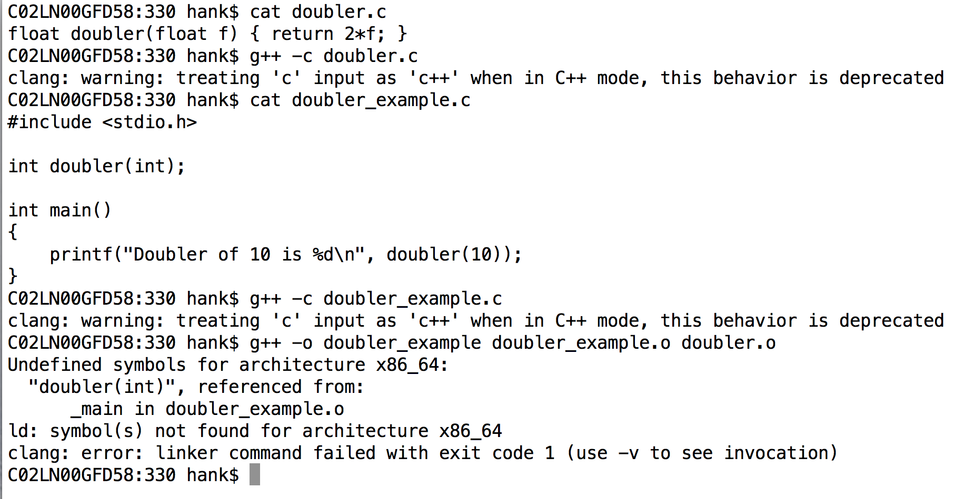
Problem is fixed with C++…

Slide 46
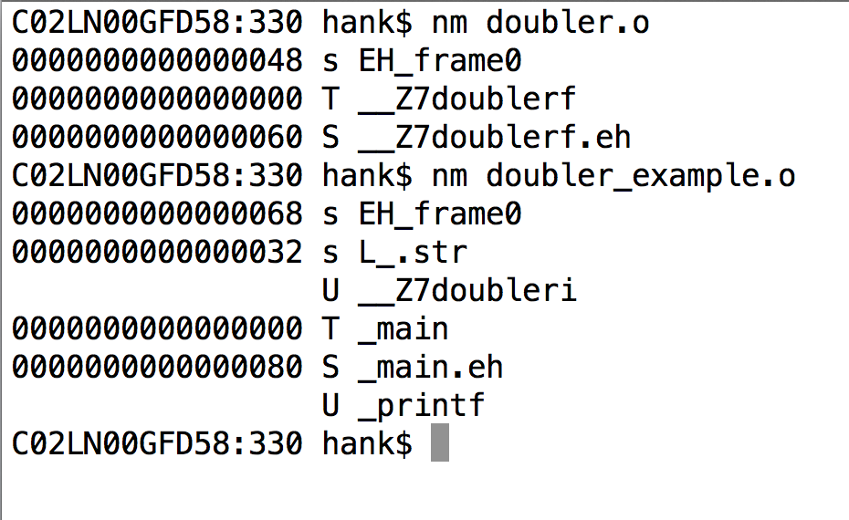
Problem is fixed with C++…
This will affect you with C++. Before you got unresolved symbols when you forgot to define the function. Now you will get it when the arguments don’t match up. Is this good?

Slide 47
Mangling
Mangling refers to combining information about arguments and “mangling” it with function name.
Way of ensuring that you don’t mix up functions.
Return type not mangled, though
Causes problems with compiler mismatches
C++ compilers haven’t standardized.
Can’t take library from icpc and combine it with g++.

Slide 48
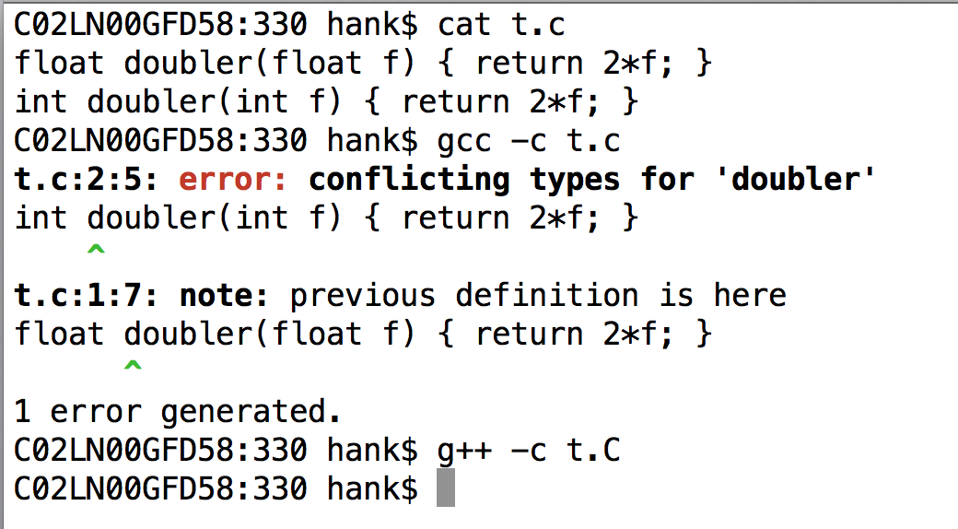
C++ will let you overload functions with different types

Slide 49
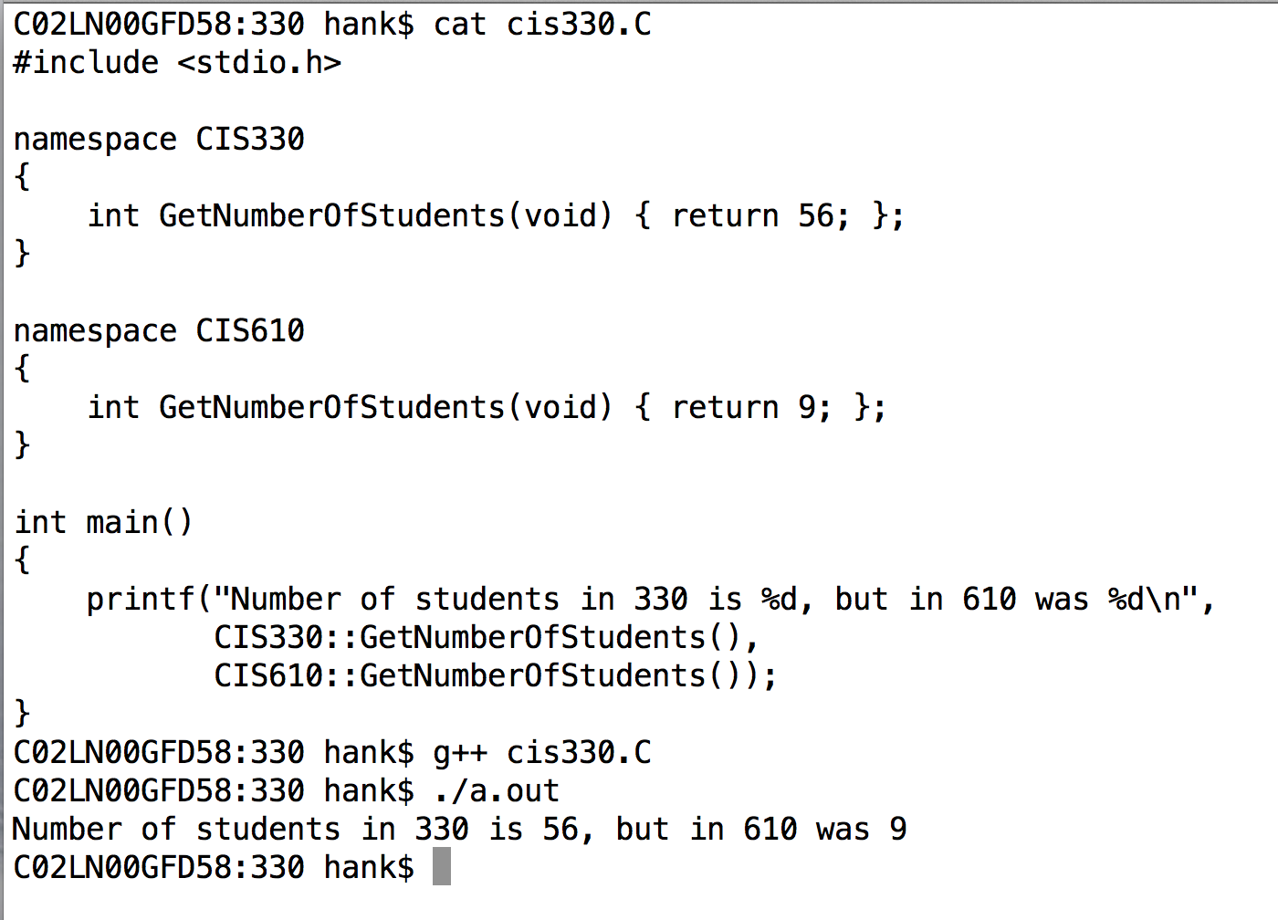
C++ also gives you access to mangling via “namespaces”
Functions or variables within a namespace are accessed with “::”
“::” is called “scope resolution operator”

Slide 50
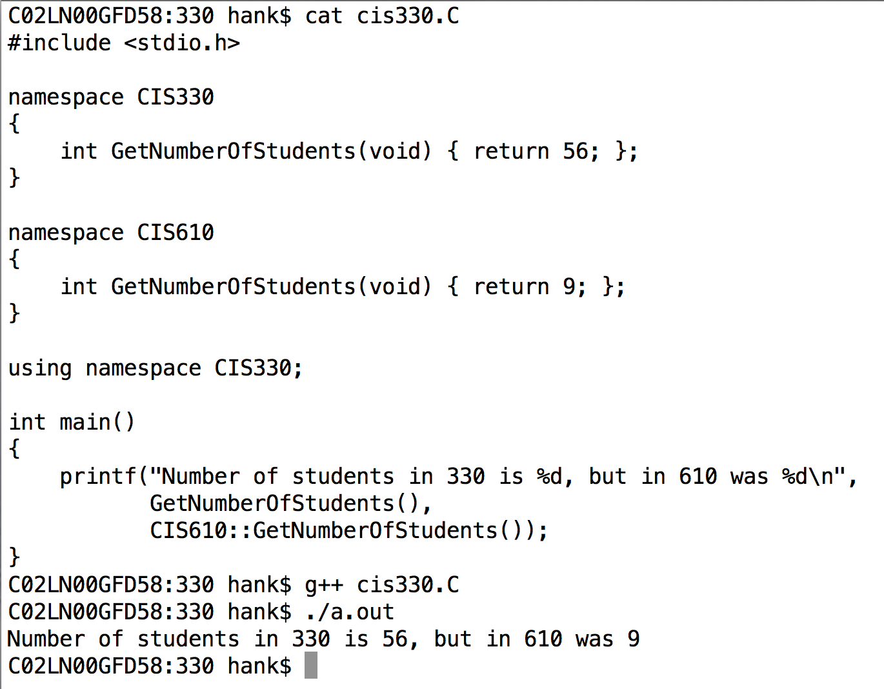
C++ also gives you access to mangling via “namespaces”
The “using” keyword makes all functions and variables from a namespace available without needing “::”.
And you can still access other namespaces.

Slide 51
References
A reference is a simplified version of a pointer.
Key differences:
You cannot do pointer manipulations
A reference is always valid
a pointer is not always valid
Accomplished with & (ampersand)
&: address of variable (C-style, still valid)
&: reference to a variable (C++-style, also now valid)
You have to figure out how ‘&’ is being used based on context.

Slide 52
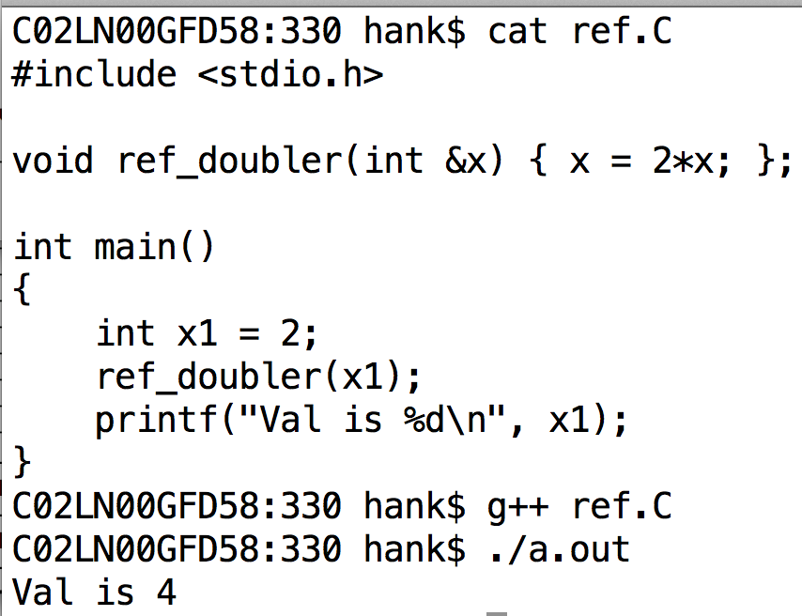
Examples of References

Slide 53
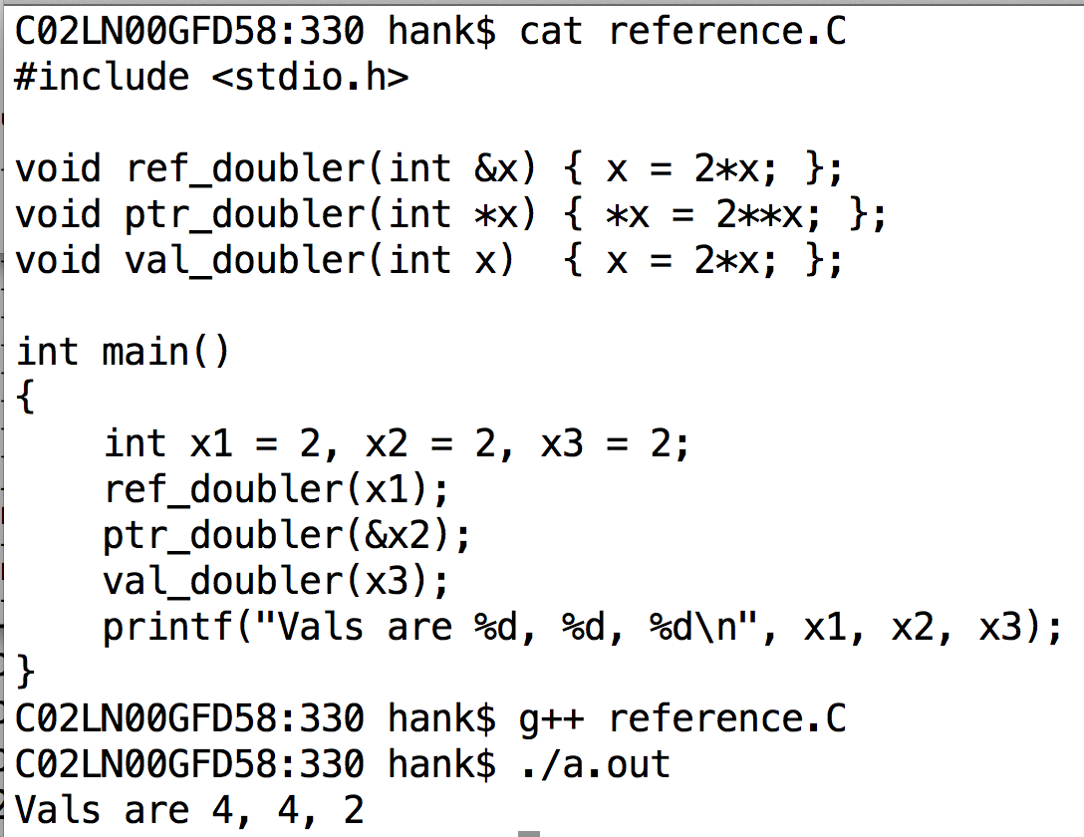
References vs Pointers vs Call-By-Value
ref_doubler and ptr_doubler are both examples of call-by-reference.
val_doubler is an example of call-by-value.

Slide 54
References
Simplified version of a pointer.
Key differences:
You cannot manipulate it
Meaning: you are given a reference to exactly one instance … you can’t do pointer arithmetic to skip forward in an array to find another object
A reference is always valid
No equivalent of a NULL pointer … must be a valid instance

Slide 55
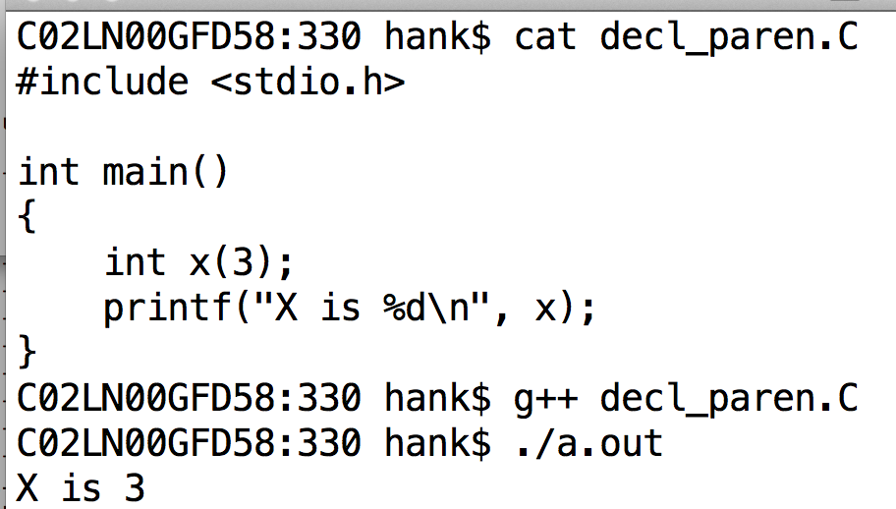
Different Misc C++ Topic: initialization during declaration using parentheses
This isn’t that useful for simple types, but it will be useful when we start dealing with objects.

Slide 56
Outline
Review
Building Large Projects
Beginning C++
C++ & Structs

Slide 57
Learning classes via structs
structs and classes are closely related in C++
I will lecture today on changes on how “structs in C++” are different than “structs in C”
… when I am done with that topic (probably 1+ lectures more), I will describe how classes and structs in C++ differ.

Slide 58
3 Big changes to structs in C++
You can associate “methods” (functions) with structs

Slide 59
Methods vs Functions
Methods and Functions are both regions of code that are called by name (“routines”)
With functions:
the data it operates on (i.e., arguments) are explicitly passed
the data it generates (i.e., return value) is explicitly passed
stand-alone / no association with an object
With methods:
associated with an object & can work on object’s data
still opportunity for explicit arguments and return value

Slide 60
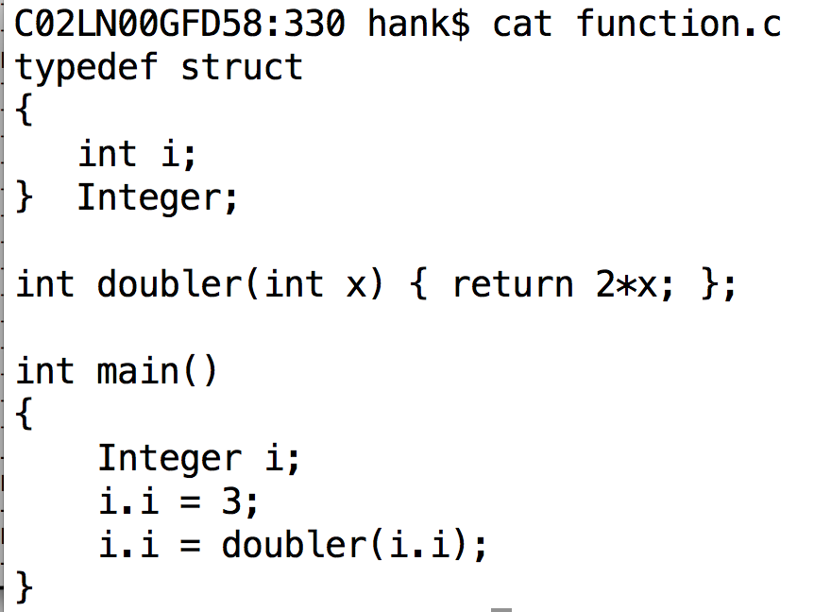
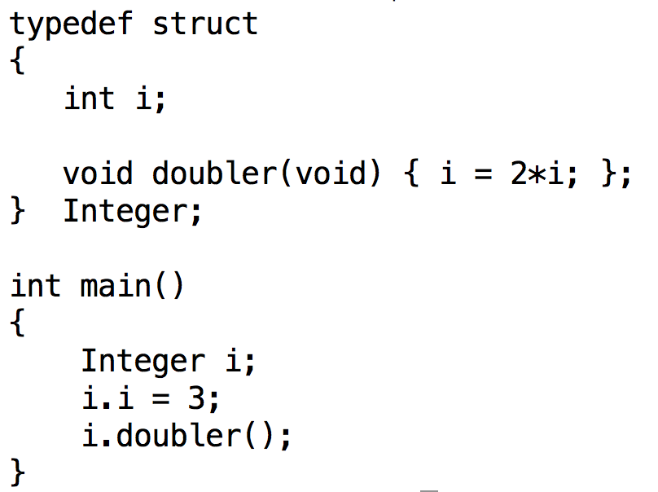
Function vs Method
(left) function is separate from struct
(right) function (method) is part of struct
(left) arguments and return value are explicit
(right) arguments and return value are not necessary, since they are associated with the object

Slide 61
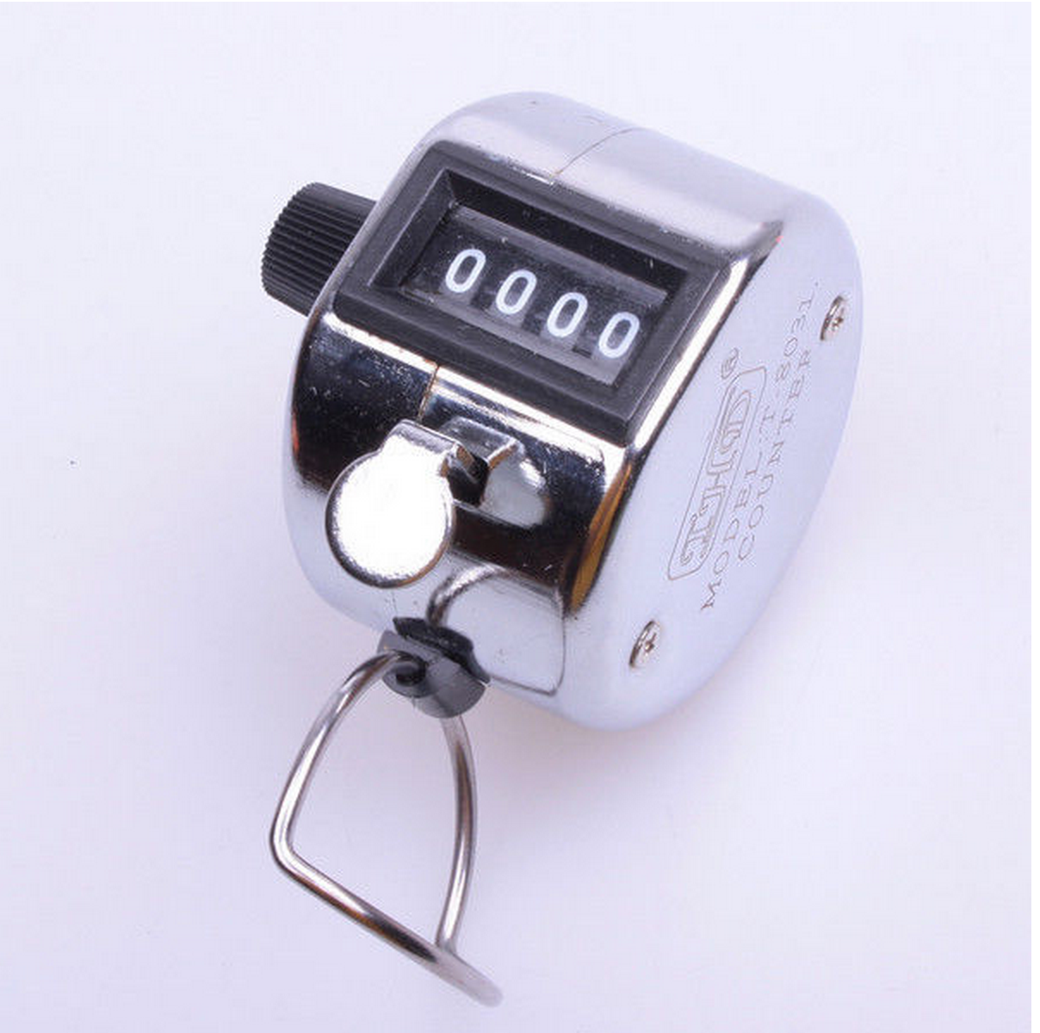
Tally Counter
3 Methods:
Increment Count
Get Count
Reset

Slide 62
Methods & Tally Counter
Methods and Functions are both regions of code that are called by name (“routines”)
With functions:
the data it operates on (i.e., arguments) are explicitly passed
the data it generates (i.e., return value) is explicitly passed
stand-alone / no association with an object
With methods:
associated with an object & can work on object’s data
still opportunity for explicit arguments and return value

Slide 63
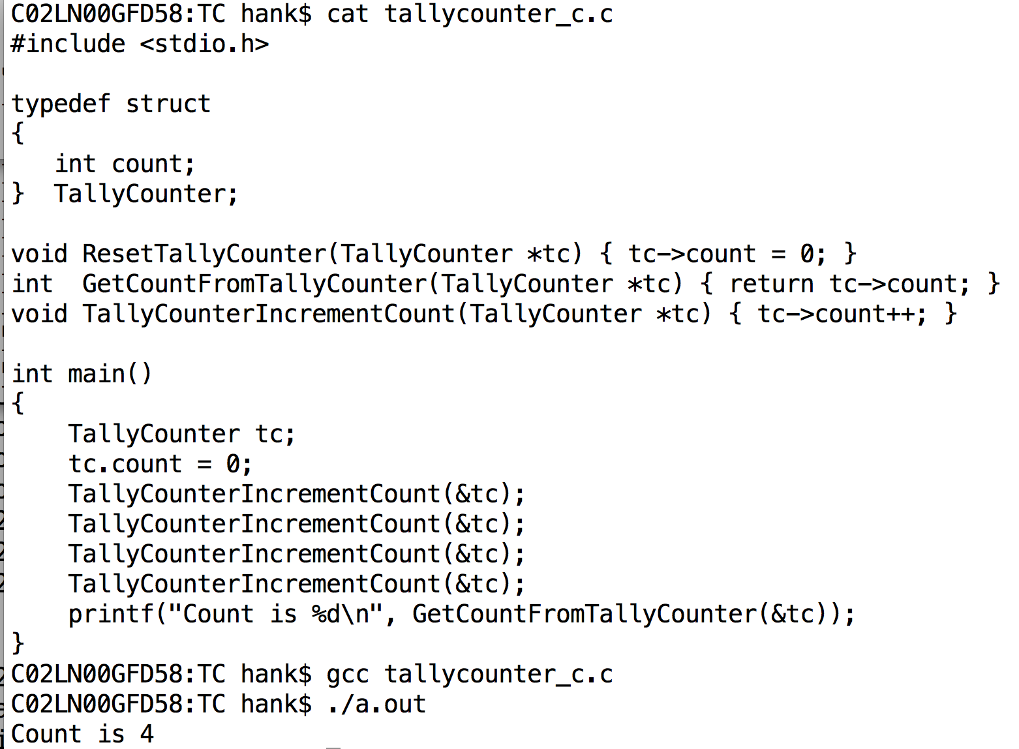
C-style implementation of TallyCounter

Slide 64
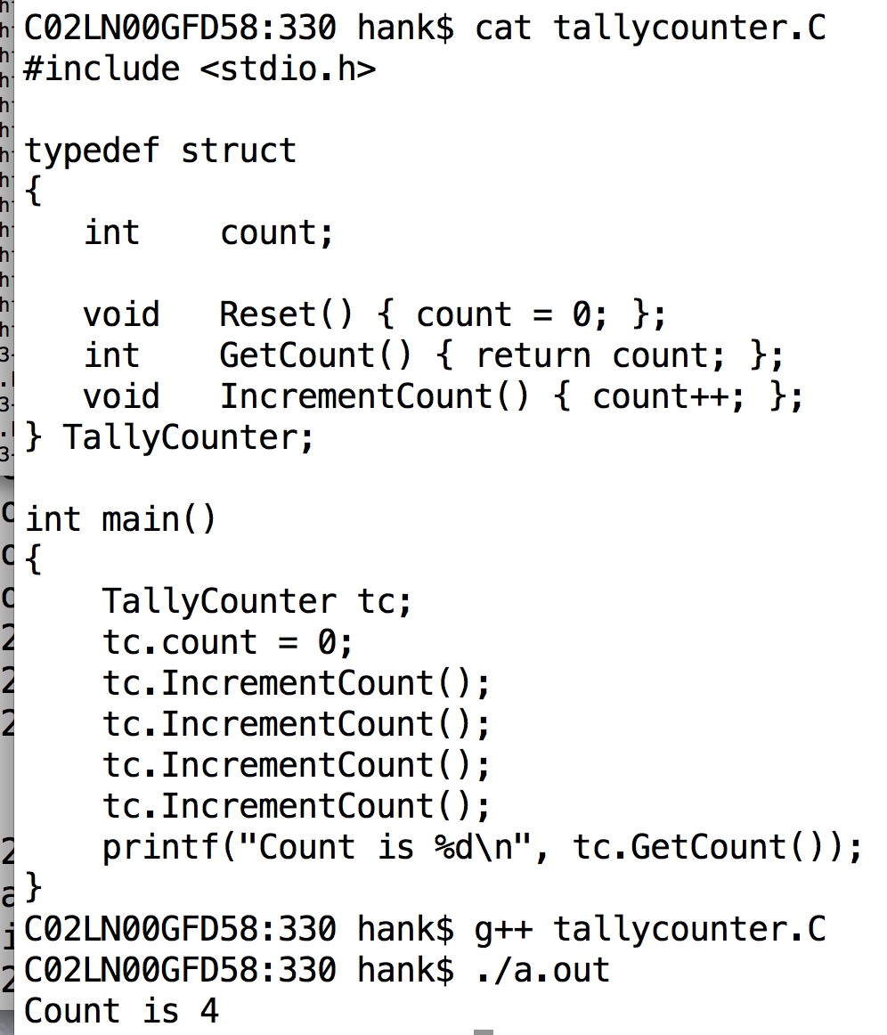
C++-style implementation of TallyCounter

Slide 65
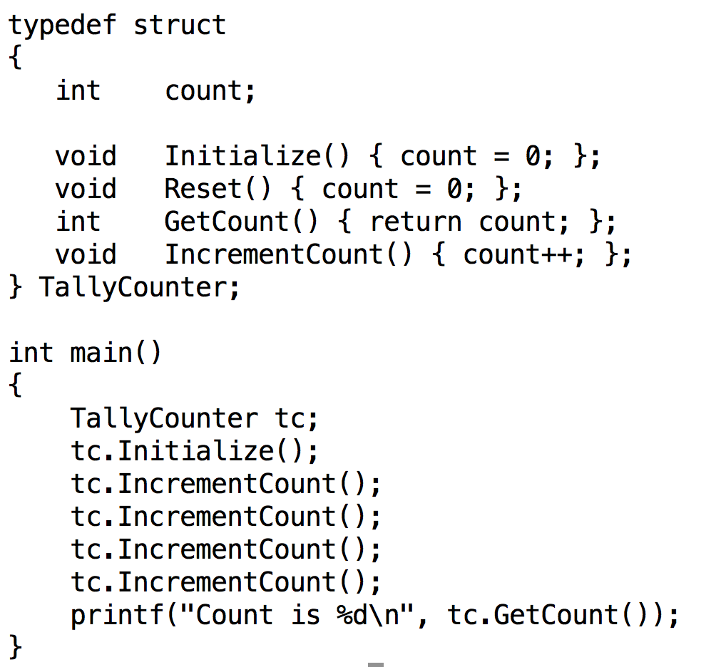

Slide 66
Constructors
Constructor: method for constructing object.
Called automatically
There are several flavors of constructors:
Parameterized constructors
Default constructors
Copy constructors
Conversion constructors
I will discuss these flavors in upcoming slides

Slide 67
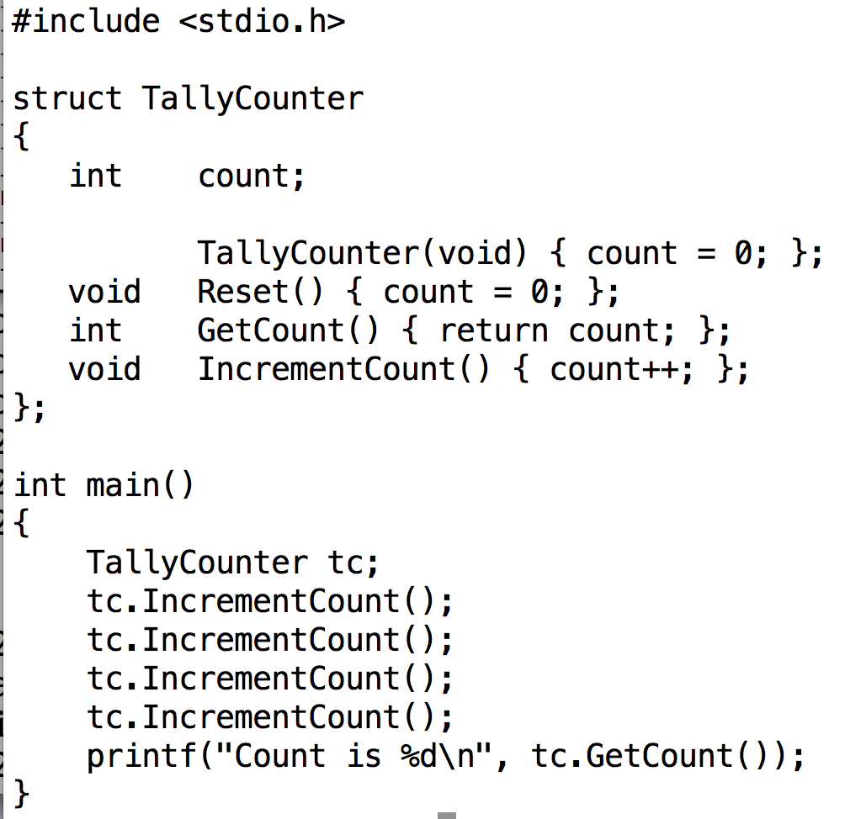
Note the typedef went away … not needed with C++.
Constructor is called automatically when object is instantiated
(This is the flavor called “default constructor”)
Method for constructor has same name as struct

Slide 68
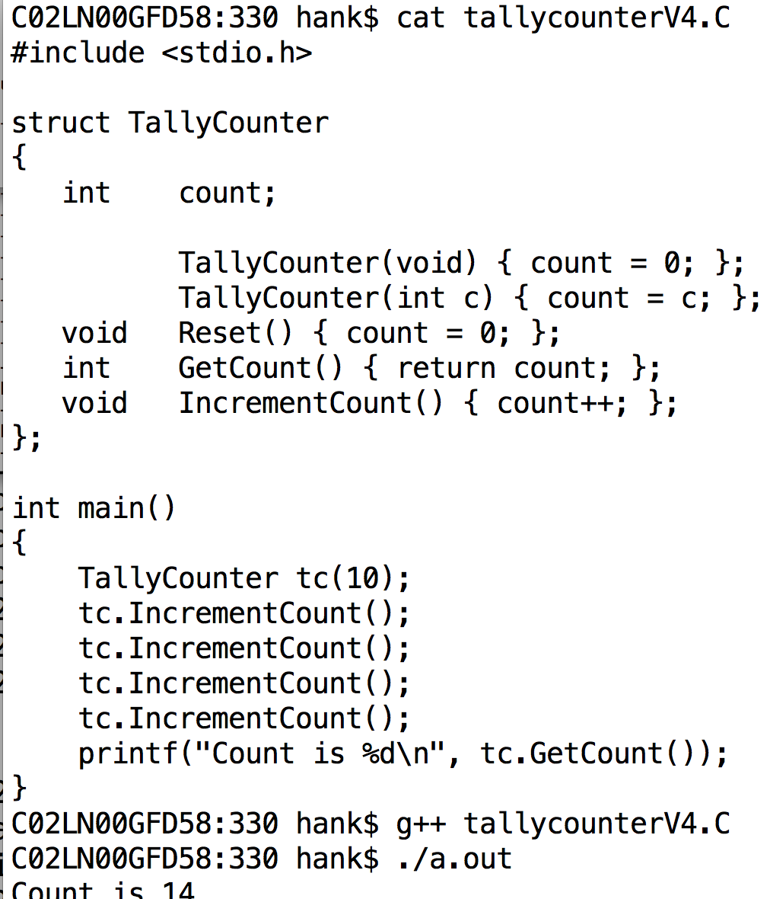
Argument can be passed to constructor.
(This is the flavor called “parameterized constructor”)

Slide 69
More traditional file organization
struct definition is in .h file
#ifndef / #define
method definitions in .C file
driver file includes headers for all structs it needs

Slide 70
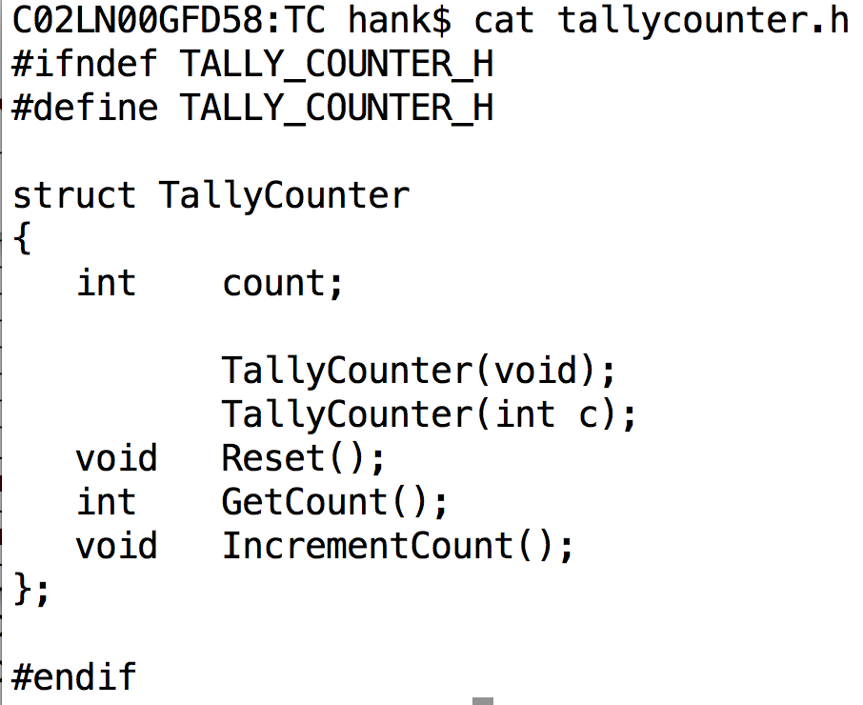
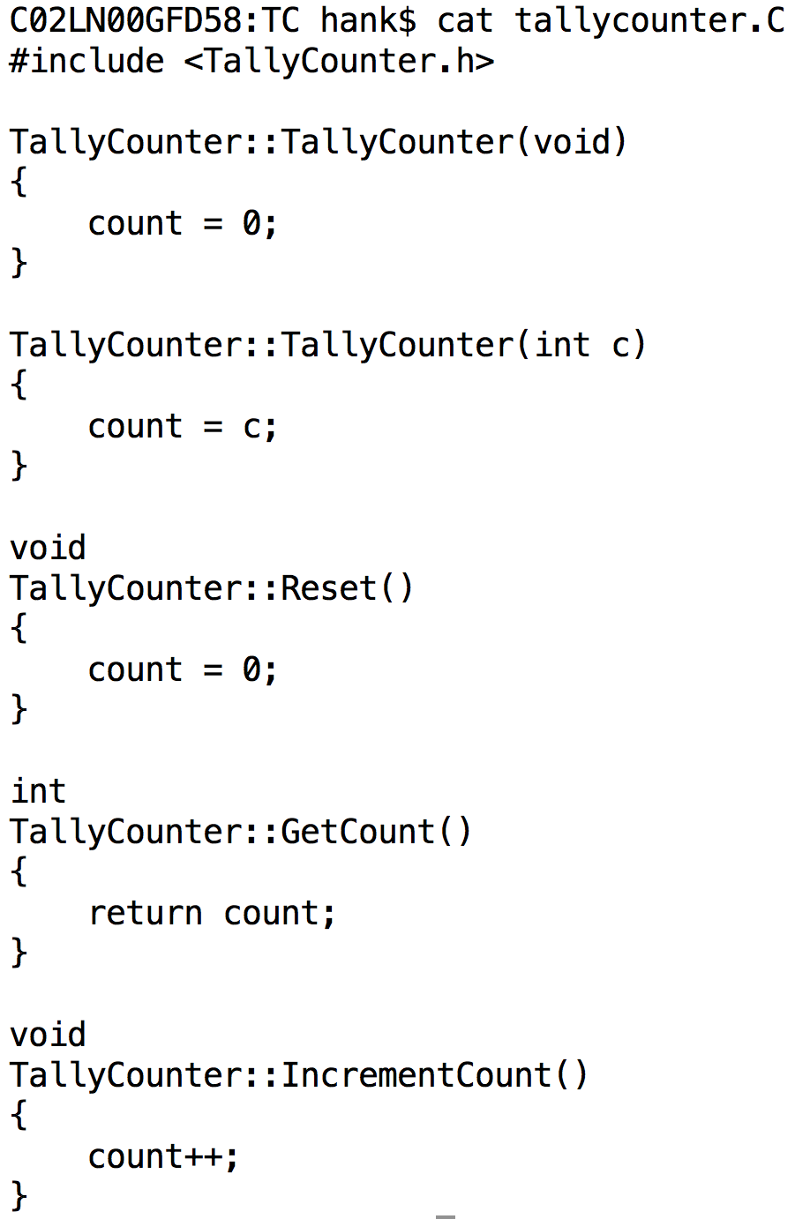
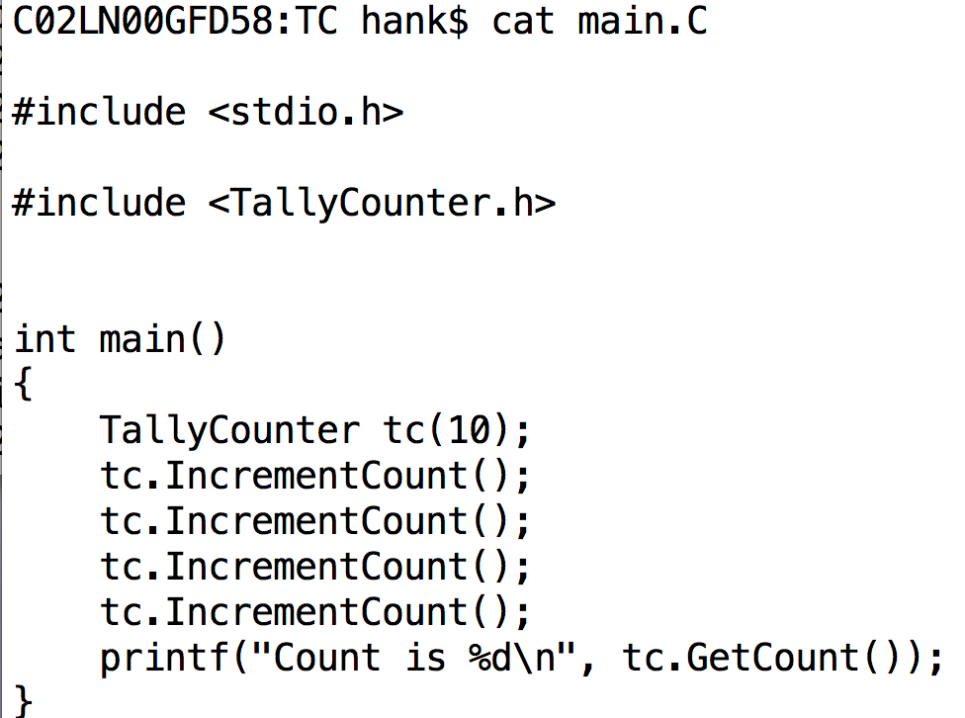
More traditional file organization
Methods can be defined outside the struct definition.
They use C++’s namespace concept, which is automatically in place.
(e.g., TallyCounter::IncrementCount)

Slide 71
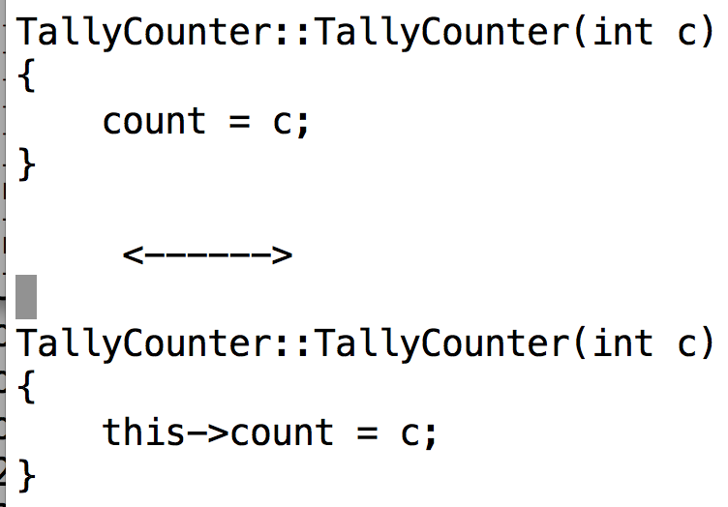
“this”: pointer to current object
From within any struct’s method, you can refer to the current object using “this”

Slide 72
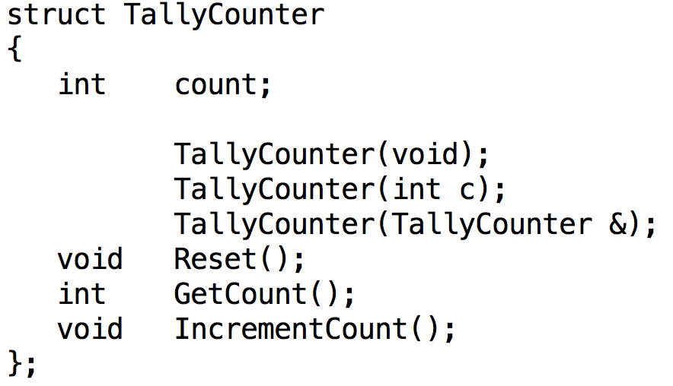
Copy Constructor
Copy constructor: a constructor that takes an instance as an argument
It is a way of making a new instance of an object that is identical to an existing one.

Slide 73
Constructor Types
Default constructor
Parameterized
constructor
Copy constructor

Slide 74
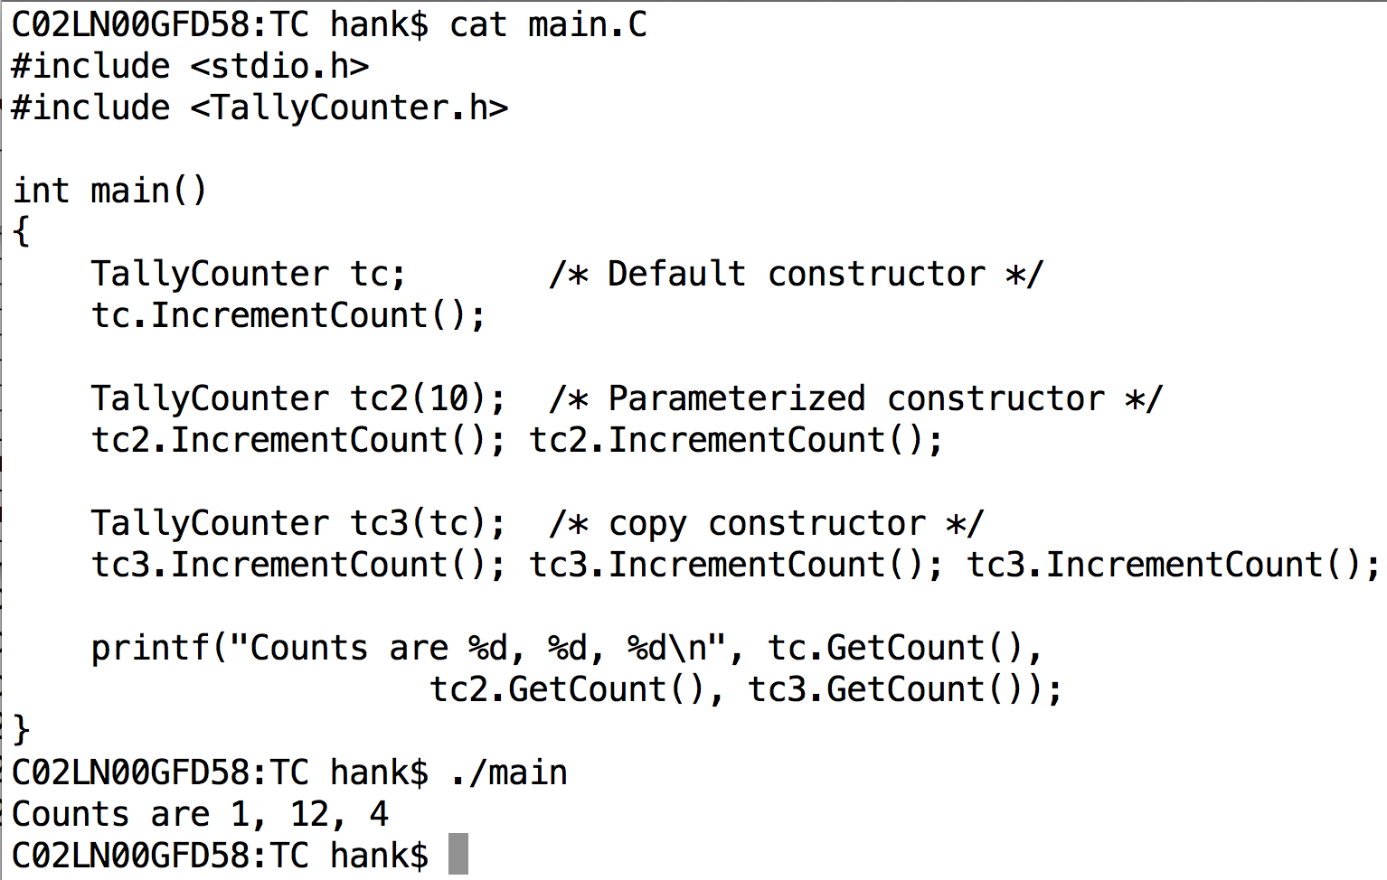
Example of 3 Constructors
????????????????

Slide 75
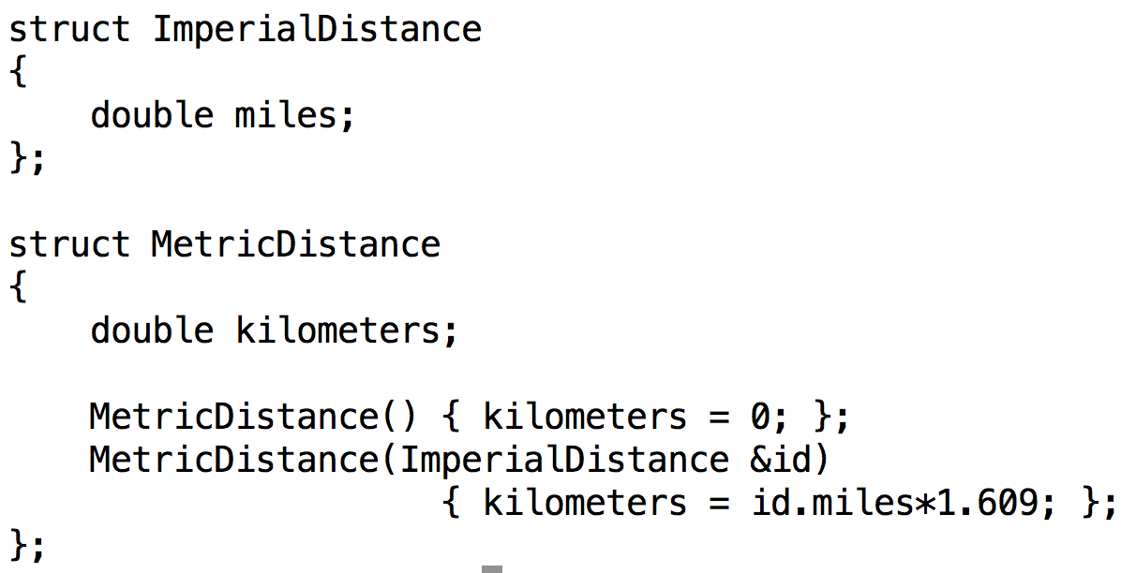
Conversion Constructor

Slide 76
3 big changes to structs in C++
You can associate “methods” (functions) with structs
You can control access to data members and methods

Slide 77
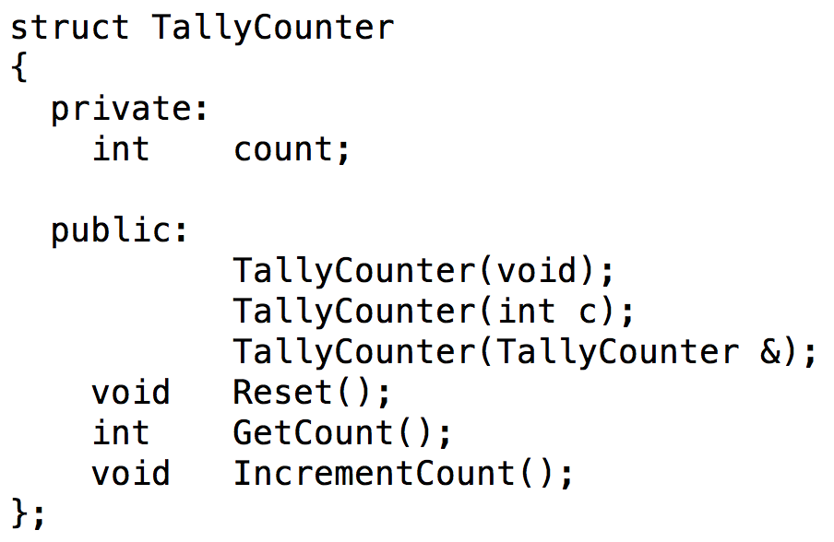
Access Control
New keywords: public and private
public: accessible outside the struct
private: accessible only inside the struct
Also “protected” … we will talk about that later
Everything following is private. Only will change when new access control keyword is encountered.
Everything following is now public. Only will change when new access control keyword is encountered.

Slide 78
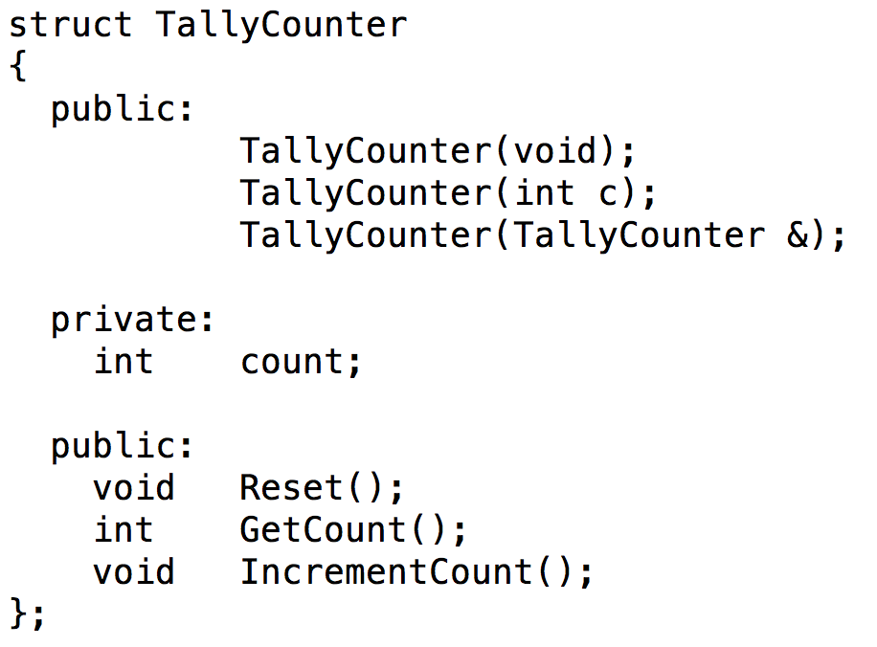
public / private
You can issue public and private as many times as you wish…

Slide 79
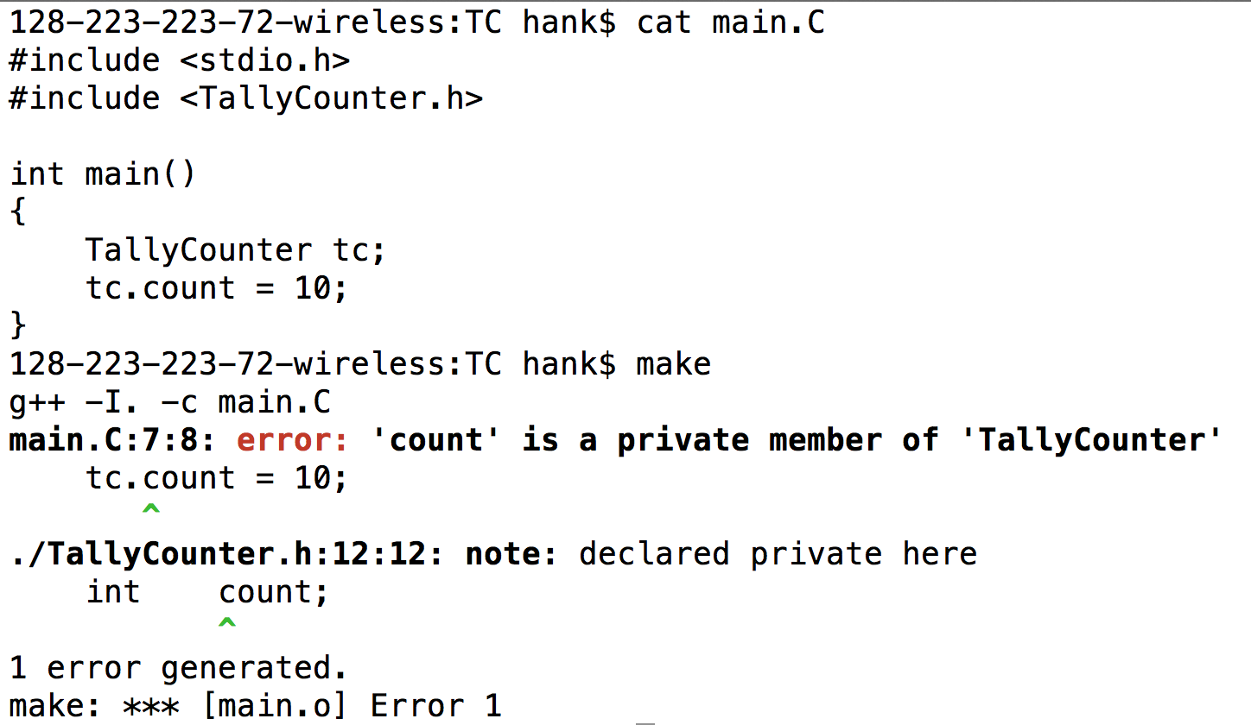
The compiler prevents violations of access controls.

Slide 80
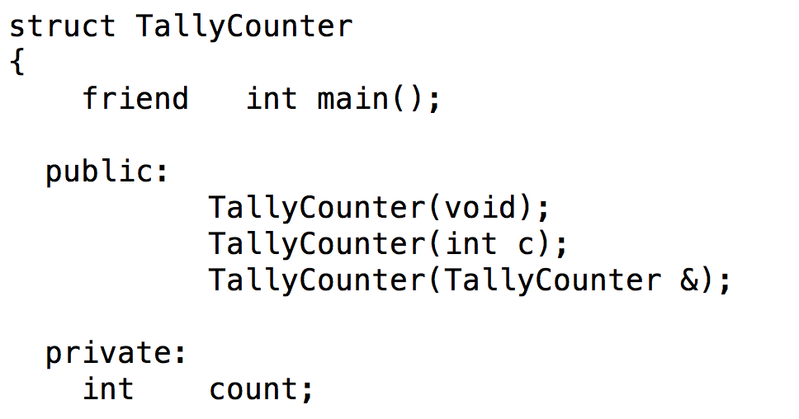
The friend keyword can override access controls.
Note that the struct declares who its friends are, not vice-versa
You can’t declare yourself a friend and start accessing data members.
friend is used most often to allow objects to access other objects.
This will compile, since main now has access to the private data member “count”.

Slide 81
class vs struct
class is new keyword in C++
classes are very similar to structs
the only differences are in access control
primary difference: struct has public access by default, class has private access by default
Almost all C++ developers use classes and not structs
C++ developers tend to use structs when they want to collect data types together (i.e., C-style usage)
C++ developers use classes for objects … which is most of the time
You should use classes!
Even though there isn’t much difference …

Slide 82
3 big changes to structs in C++
You can associate “methods” (functions) with structs
You can control access to data members and methods
Inheritance
We will discuss inheritance in a future lecture.

Slide 83
Bonus Topics

Slide 84
Backgrounding
“&”: tell shell to run a job in the background
Background means that the shell acts as normal, but the command you invoke is running at the same time.
“sleep 60” vs “sleep 60 &”
When would backgrounding be useful?

Slide 85
Suspending Jobs
You can suspend a job that is running
Press “Ctrl-Z”
The OS will then stop job from running and not schedule it to run.
You can then:
make the job run in the background.
Type “bg”
make the job run in the foreground.
Type “fg”
like you never suspended it at all!!

Slide 86
Web pages
ssh –l <user name> ix.cs.uoregon.edu
cd public_html
put something in index.html
→ it will show up as
http://ix.cs.uoregon.edu/~<username>

Slide 87
Web pages
You can also exchange files this way
scp file.pdf <username>@ix.cs.uoregon.edu:~/public_html
point people to http://ix.cs.uoregon.edu/~<username>/file.pdf
Note that ~/public_html/dir1 shows up as http://ix.cs.uoregon.edu/~<username>/dir1
(“~/dir1” is not accessible via web)

