Slide 1
CIS 330: _ _ _ _ ______ _ _____ / / / /___ (_) __ ____ _____ ____/ / / ____/ _/_/ ____/__ __ / / / / __ \/ / |/_/ / __ `/ __ \/ __ / / / _/_// / __/ /___/ /_ / /_/ / / / / /> < / /_/ / / / / /_/ / / /____/_/ / /__/_ __/_ __/ \____/_/ /_/_/_/|_| \__,_/_/ /_/\__,_/ \____/_/ \____//_/ /_/
Lecture 1:
Course Overview &
Introduction to Unix
April 2, 2018
Hank Childs, University of Oregon

Slide 2
Enrollment
Who’s in the class?
Who’s not?

Slide 3
Outline
Class Overview
My Background
Goals
Syllabus
Getting Started With Unix
Unix History
Shell Prompts
Files
File Editors
Project 1

Slide 4
Outline
Class Overview
My Background
Goals
Syllabus
Getting Started With Unix
Unix History
Shell Prompts
Files
File Editors
Project 1

Slide 5
Hi, I’m Hank…
Associate Professor of CIS at UO
Arrived at UO March 2013
Research interests include visualization, high-performance computing, computer graphics
Director of CDUX Research Group (9 PhD, 3 MS, 0 BS)

Slide 6
My Background
Previously:
Lawrence Livermore, 1999-2009
Lawrence Berkeley, 2009-2016
UC Davis 2009-2013
Education:
B.S. (CS/Math), 1994-1999
Ph.D., 2000-2006
I have spent 15 years programming,
almost exclusively using C, C++, and Unix
Notes:
Two takeaways: Unix/C/C++ very important, plus I know a lot about it

Slide 7
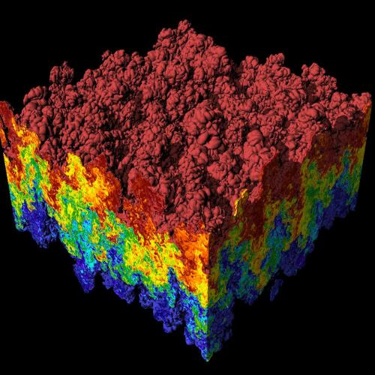
VisIt: Application for Visualizing and Analyzing of Very Large Data
Open source tool
1.5M lines of C++ code
also Python & Java bindings
Downloaded >200K times, run on many different UNIX environments
Because of these experiences, I am pretty conservative in what features I make use of.
I also served as the CSWA of multiple teams, leading SW integration efforts
Simulation of Rayleigh-Taylor Instability, run on LLNL BG/L supercomputer with MIRANDA code, visualized with VisIt

Slide 8
Outline
Class Overview
My Background
Goals
Syllabus
Getting Started With Unix
Unix History
Shell Prompts
Files
File Editors
Project 1

Slide 9
CIS 330 Goals
Goals: excellence in C, C++, and Unix
Why?
Many of our 400-level classes require strong knowledge in C, C++, and Unix
Critical for success with many development jobs
Development jobs are good jobs!!!
Programming Languages Beacon: http://www.lextrait.com/vincent/implementations.html

Slide 10
How Will We Develop Excellence in C, C++, and Unix?
Answer: many, many projects
Very hard to learn this material from lecture
Really need to get your hands dirty and “do it”

Slide 11
Goal: Getting Ready for 415
415
330
Difficulty
210
CIS Classes at UO

Slide 12
Outline
Class Overview
My Background
Goals
Syllabus
Getting Started With Unix
Unix History
Shell Prompts
Files
File Editors
Project 1

Slide 13
Syllabus is Online
http://ix.cs.uoregon.edu/~hank/330
Propose Hank OH as Tues 2-3, Fri 12-1
Brent’s OH TBD
Goal: OH all 5 days

Slide 14
Grading For This Course
Final: 30%
Projects: 70% (made up of multiple pieces)
Project 1: Learning Unix (5%)
1A (1%), 1B (2%), 1C (2%)
Project 2: C/C++ Primer (15%)
Project 3: Large System + Object Oriented Programming (40%)
Project 4: Debugging/Profiling (10%)
Extra Credit through:
Community participation
These percentages might be adapted as the quarter goes on.
I will notify you all via email and via class lecture if this happens.

Slide 15
Prerequisites For This Course
CIS 314 is the only prerequisite

Slide 16
Introductory Projects
Project | Assigned | Due | Task | % Grade
1A | 4/2 | 4/4 | Editing Files | 1%
1B | 4/6 | 4/11 | Scripts/Permissions | 2%
1C | 4/9 | 4/13 | Build | 2%
2A | 4/4 | 4/9 | Memory | 3%
2B | 4/13 | 4/18 | Unions + Function Pointers | 5%
… | … | … | … | …
(This is notional …
here to give you an idea)

Slide 17
This is scary…
From my end:
Huge amount of material to cover…
From your end:
Being asked to learn so much…
I really want to put you in a winning position
Let me know if you think I’m not
Take this seriously
You’ve probably never had a class like this before

Slide 18
Expectations
I ask you put a lot of time into this course, and I believe the payoff will be significant for each of you.
The grading is designed to make sure you are keeping up with the assignments.
Staying on top of the projects will be critical to succeeding in this class.

Slide 19
Expectations
The projects in this class will be hard work.
It is difficult to quote exactly how much time, since there is variation in background and programming skill.
I expect those who have less developed programming skills will find this class to be a considerable effort, but also that they will have significant improvement by the end of the course

Slide 20
This Class In a Nutshell…
Learn the basics of Unix so that we can be functional
More Unix introduced as needed throughout course
Learn more C, and gently ease into C++
Do a large C++-based project that embraces object-oriented programming
Learn basics of development: debugging and profiling
Most of the learning will happen with projects. The lectures are designed to help you do the projects.

Slide 21
Who Is This Class For?
I am assuming that you have never done Unix or C++ and only got minimal C in 314
The class is designed for this profile.
If you do know a lot of Unix/C/C++, then please try to avoid asking super advanced questions during lecture.
Rather, try asking and accept that I may say “too advanced” in response.

Slide 22
Norms for this class
Please ask questions
Please ask me to slow down
Please give feedback
Quiet classroom greatly valued

Slide 23
Do You Need To Attend Class?
Short answer: it would be dumb to miss class
Unless you are really, really good. Then: your call.
It is a really bad situation if you miss class and then want me or the TA’s to “catch you up”
we won’t do it
unless you had a good reason for missing (in which case, of course you will be accommodated)
99% of the material will come via lecture

Slide 24
20% of S16 class failed (~10% in S13, S14, S15)
How to fail
Get behind on projects
Stop attending class
Every class is basically on how to do the HW
How to succeed
Come to class
Get every project completed on time
Have a network

Slide 25
25% of S17 class failed
How did it get worse?
(stay tuned)

Slide 26
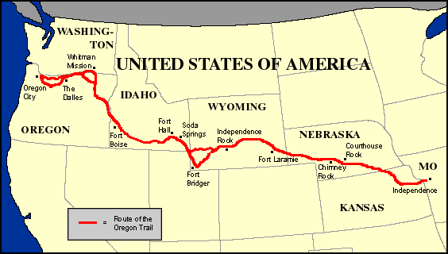
My mental model about getting behind in this class
If you get too far behind, then it will not be possible to catch up.

Slide 27
When does this class get hard?
If you have never done Unix, it might feel hard right away
If you have done Unix/C, it might feel a bit easy at the beginning, but don’t be fooled.
Project 3 is challenging for just about everyone

Slide 28
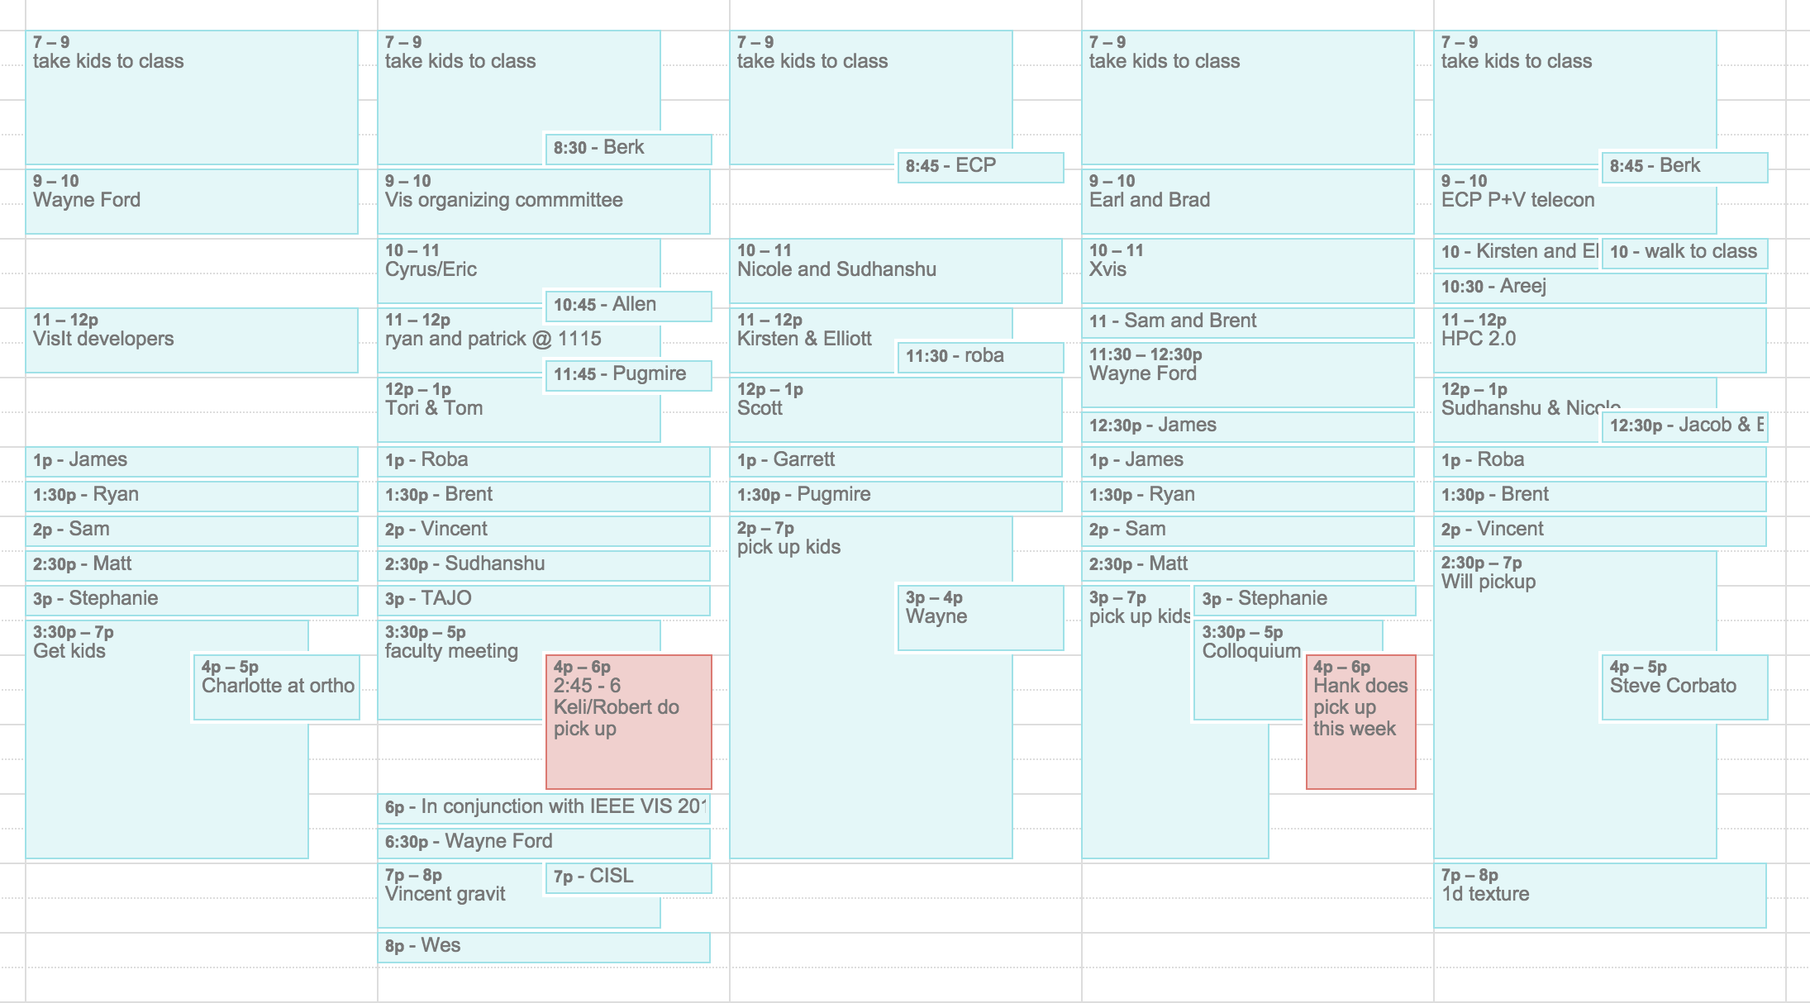
Norms for interacting with me
You are welcome to call me Hank
You can email me with a bug once
More than once becomes problematic
Getting in touch with me:
OH
I’m pretty good about email
If I don’t respond within 24 hours, resend
It is almost never a good idea to drop by my office without an appointment
If you want to meet personally, set up an appointment
http://cdux.cs.uoregon.edu/childs_calendar.html

Slide 29
Course Materials
PowerPoint lectures will be posted online.
I will “live code” frequently.
Textbook:
Past terms: none
This term: incorporating “C and Data Structures” by Sventek
On Canvas (legal statement next slide)

Slide 31
Academic Misconduct (1 of 2)
The programming projects are individual efforts
You may discuss the projects with your classmates.
Do not let someone look at your code on your screen. (BUT: helper can look at helpee’s code)
Absolutely, positively do not email code.
Do not search the internet for previous implementations (includes github)

Slide 32
Academic Misconduct (2 of 2)
If I detect collusion, all individuals involved will receive an F in the course immediately
I choose to not enumerate cases that involve collusion. Whiteboard conversations are fine. If appropriate, the helper can look at the helpee’s code. If you feel you are in a gray area, then you should email me.
Please note that if you are the one providing too much help, then you will also get an F

Slide 33
Late Passes
You have 2 "late passes."
Late passes allow you to turn in your project two days after the due date for full credit.
If you run out of late passes, then you may continue to earn half credit on any project.
Every unused late pass is worth 0% extra credit.
Don’t need to tell me if you want to use it
Late pass assignment will be a question on the final
All late projects will be scored at 50% and then credit from late passes will be awarded at the end of the term

Slide 34
Class Summary
This class will teach you about Unix, C, and C++
This class will improve your programming skills
This class will likely help you succeed at a job
This class will require a lot of work
The projects are the heart of the class
The lectures are designed to help you do the projects

Slide 35
IDEs
IDEs are great
… but in this class, we will learn how to get by without them
Many, many Unix-based projects don’t use IDEs
The skills you are using will be useful going forward in your careers

Slide 36
Accessing a Unix environment
Rm 100, Deschutes
Remote logins (ssh, scp)
Windows options
Cygwin / MSYS
Virtual machines
Who has home access to a Unix environment?
Who has Windows?

Slide 37
Outline
Class Overview
My Background
Goals
Syllabus
Getting Started With Unix
Unix History
Shells
Files
File Editors
Project 1

Slide 38
Reading
C and Data Structures:
Chapter 2.1, 2.2, 2.3, 2.4., 2.5, and 2.6.1.

Slide 39
Outline
Class Overview
My Background
Goals
Syllabus
Getting Started With Unix
Unix History
Shells
Files
File Editors
Project 1

Slide 40
What is Unix?
Operating system
Multi-tasking
Multi-user
Started at AT&T Bell Labs in late ’60s, early ‘70s
First release in 1973

Slide 41
What is Unix?
80s & 90s: many competing versions, all conforming to same standard
AIX (IBM), Solaris (Sun), HP-UX (Hewlett-Packard)
1990s: Linux takes off
Open source
2000s: commercial Unixes abandoned, companies use Linux, back Linux
Several variants of Linux
OS X: used on Macs since 2002
Meets Unix standard

Slide 42
Outline
Class Overview
My Background
Goals
Syllabus
Getting Started With Unix
Unix History
Shells
Files
File Editors
Project 1

Slide 43
Shells
Shells are accessed through a terminal program
Typically exposed on all Linux
Mac: Applications->Utilities->Terminal
(I always post this on the dock immediately upon getting a new Mac)

Slide 44
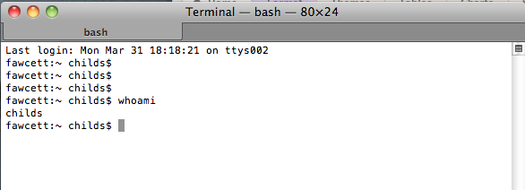
Shells
Shells are interpreters
Like Python
You type a command, it carries out the command

Slide 45
Shells
There are many types of shells
Two most popular:
sh (= bash & ksh)
csh (= tcsh)
They differ in syntax, particularly for
Environment variables
Iteration / loops / conditionals
The examples in this course will use syntax for sh

Slide 46
Environment Variables
Environment variables: variables stored by shell interpreter
Some environment variables create side effects in the shell
Other environment variables can be just for your own private purposes

Slide 47
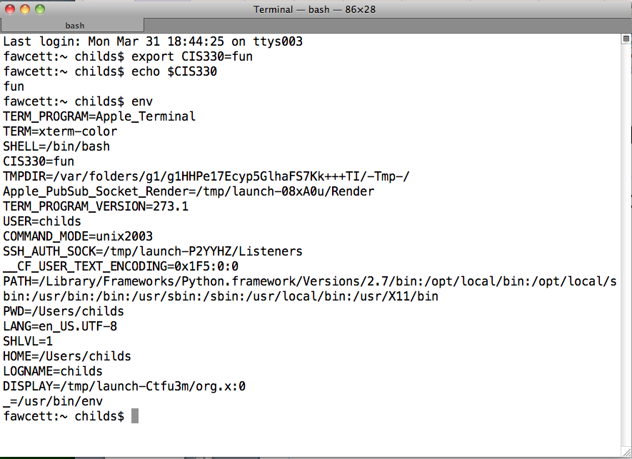
Environment Variables
New commands: export, echo, env

Slide 48
Shells
There is lots more to shells … we will learn about them as we go through the quarter

Slide 49
Outline
Class Overview
My Background
Goals
Syllabus
Getting Started With Unix
Unix History
Shells
Files
File Editors
Project 1

Slide 50
Files
Unix maintains a file system
File system controls how data is stored and retrieved
Primary abstractions:
Directories
Files
Files are contained within directories

Slide 51
Directories are hierarchical
Directories can be placed within other directories
“/” -- The root directory
Note “/”, where Windows uses “\”
“/dir1/dir2/file1”
What does this mean?
File file1 is contained in directory dir2,
which is contained in directory dir1,
which is in the root directory

Slide 52
Home directory
Unix supports multiple users
Each user has their own directory that they control
Location varies over Unix implementation, but typically something like “/home/username”
Stored in environment variables

Slide 53
Anatomy of shell formatting
Current
working
directory
Machine name
Username
“~” (tilde) is shorthand for your home directory
You can use it when invoking commands
The shell formatting varies over Unix implementation and can be customized with environment variables. (PS1, PS2, etc)

Slide 54
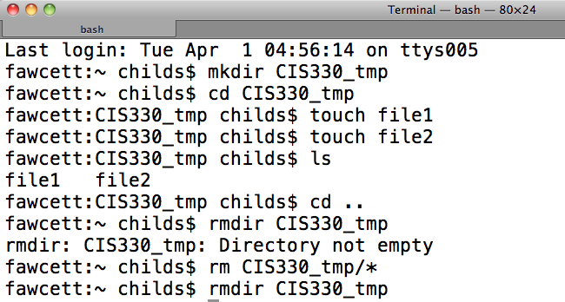
File manipulation
New commands: mkdir, cd, touch, ls, rmdir, rm

Slide 55
cd: change directory
The shell always has a “present working directory”
directory that commands are relative to
“cd” changes the present working directory
When you start a shell, the shell is in your “home” directory

Slide 56
Unix commands: mkdir
mkdir: makes a directory
Two flavors
Relative to current directory
mkdir dirNew
Relative to absolute path
mkdir /dir1/dir2/dirNew
(dir1 and dir2 already exist)

Slide 57
Unix commands: rmdir
rmdir: removes a directory
Two flavors
Relative to current directory
rmdir badDir
Relative to absolute path
rmdir /dir1/dir2/badDir
Removes badDir, leaves dir1, dir2 in place
Only works on empty directories!
“Empty” directories are directories with no files
Most Unix commands can distinguish between absolute and relative path, via the “/” at beginning of filename.
(I’m not going to point this feature out for subsequent commands.)

Slide 58
Unix commands: touch
touch: “touch” a file
Behavior:
If the file doesn’t exist
→ create it
If the file does exist
→ update time stamp
Time stamps record the last modification to a file or directory
Why could time stamps be useful?

Slide 59
Unix commands: ls
ls: list the contents of a directory
Note this is “LS”, not “is” with a capital ‘i’
Many flags, which we will discuss later
A flag is a mechanism for modifying a Unix programs behavior.
Convention of using hyphens to signify special status
“ls” is also useful with “wild cards”, which we will also discuss later

Slide 60
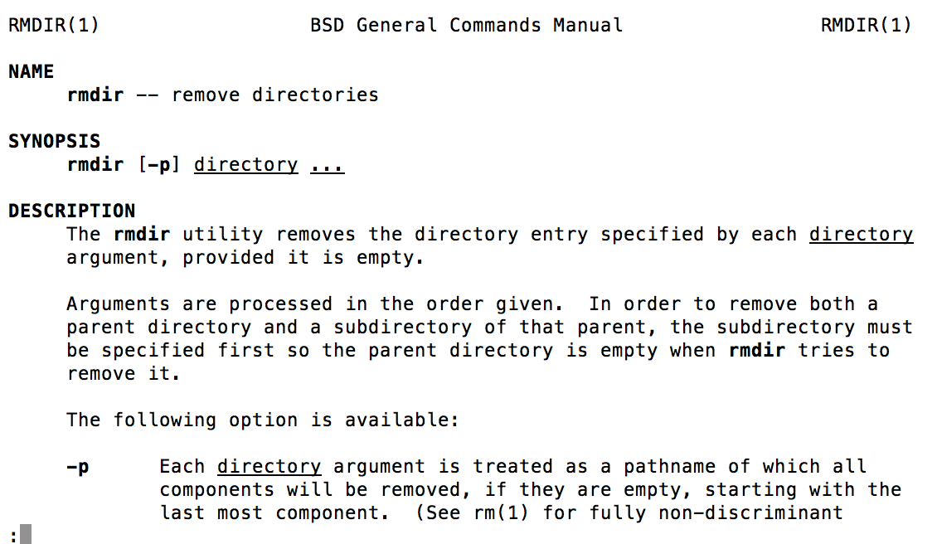
Important: “man”
Get a man page:
→ “man rmdir” gives:

Slide 61
Outline
Class Overview
My Background
Goals
Syllabus
Getting Started With Unix
Unix History
Shells
Files
File Editors
Project 1

Slide 62
File Editors
Existing file editors:
Vi
Emacs
Two or three hot new editors that everyone loves (and ultimately fade away and die)
This has been the state of things for 25 years
I will teach “vi” in this course.
You are welcome to use whatever editor you want.

Slide 63
My Mental Model for File Editors
vi
emacs
How efficient you can be after you are proficient
What you choose if you don’t use vi
Investment to be proficient with your editor

Slide 64
Vi has two modes
Command mode
When you type keystrokes, they are telling vi a command you want to perform, and the keystrokes don’t appear in the file
Edit mode
When you type keystrokes, they appear in the file.

Slide 65
Transitioning between modes
Command mode to edit mode
i: enter into edit mode at the current cursor position
a: enter into edit mode at the cursor position immediately to the right of the current position
I: enter into edit mode at the beginning of the current line
A: enter into edit mode at the end of the current line
There are other ways to enter edit mode as well

Slide 66
Transitioning between modes
Edit mode to command mode
Press Escape

Slide 67
Useful commands
yy: yank the current line and put it in a buffer
2yy: yank the current line and the line below it
p: paste the contents of the buffer
2pp: past the contents of the buffer two times
x: delete the character at the current cursor
“:100” go to line 100 in the file
Arrows can be used to navigate the cursor position (while in command mode)
So do h, j, k, and l
We will discuss more tips for “vi” throughout the quarter.
They will mostly be student-driven (Q&A time each class)

Slide 68
My first vi sequence
At a shell, type: “vi cis330file”
Press ‘i’ (to enter edit mode)
Type “I am using vi and it is fun” (text appears on the screen)
Press “Escape” (to enter command mode)
Press “:wq” (command mode sequence for “write and quit”)

Slide 69
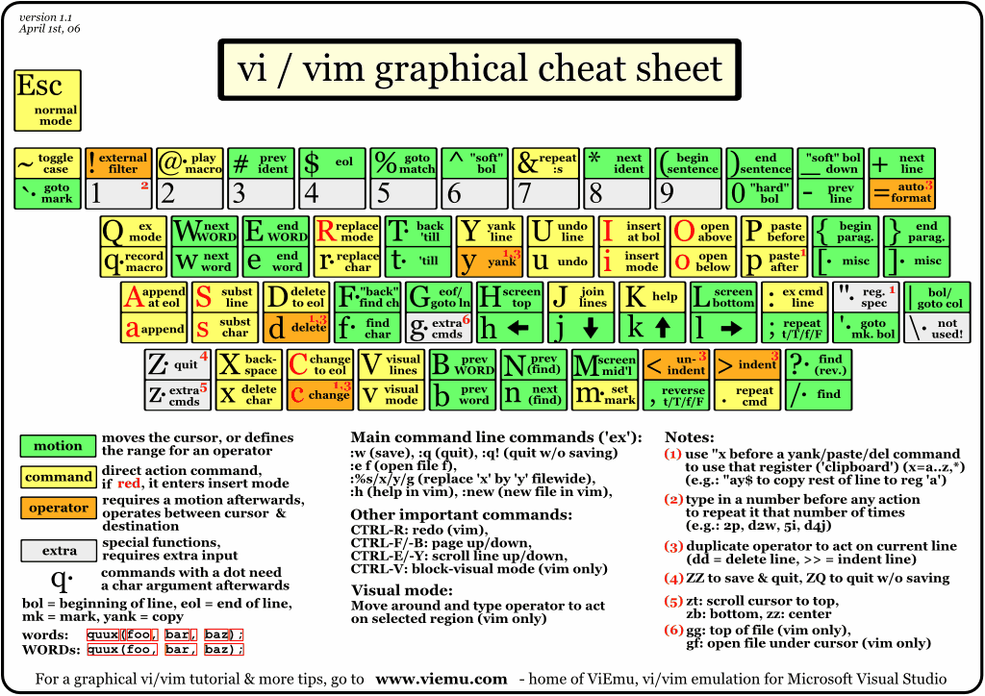
http://www.viemu.com/vi-vim-cheat-sheet.gif

Slide 70
vimtutor
Past students have liked vimtutor

Slide 71
Project 1A
Practice using an editor
Must be written using editor on Unix platform
I realize this is unenforceable.
If you want to do it with another mechanism, I can’t stop you
But realize this project is simply to prepare you for later projects
Due Wednesday (→ 6am Thursday)

Slide 72
Project 1A
Write >=300 words using editor (vi, emacs, other)
Topic: what you know about C programming language
Can’t write 300 words?
Bonus topic: what you want from this course
How will you know if it is 300 words?
Unix command: “wc” (word count)

Slide 73
Unix command: wc (word count)
(63 = lines, 252 = words, 1071 = character)

Slide 74
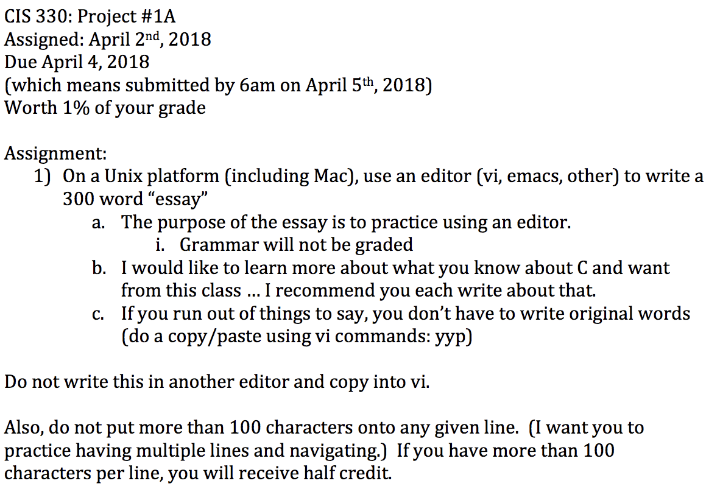
Project 1A

Slide 75
Accessing remote machines
Windows->Unix
??? (Hummingbird Exceed was the answer last time I used Windows)
Unix->Unix
ssh: secure shell
scp: secure copy
Also, ftp: file transfer protocol
ssh –l hank ix.cs.uoregon.edu
scp hank@ix.cs.uoregon.edu:~/file1 .

Slide 76
Note on Homeworks
Project 1A due on Wednesday
Project 2A will be assigned on Wednesday
Due in class on Monday
Project 1B will be assigned on Friday
Due on Weds, April 11
I will lecture on Friday (instead of lab)

Slide 77
How to submit
Canvas
If you run into trouble:
Email me your solution

Slide 78
Don’t forget
This lecture is available online
http://ix.cs.uoregon.edu/~hank/330
All project prompts are available online

