Slide 1
When Should We Trust Artificial Intelligence?
Daniel Lowd
Associate Professor
Dept. of Computer and Information Science
University of Oregon
January 24, 2019

Slide 2
What is this talk about?
I will (briefly) answer four big questions about artificial intelligence (AI):
How is AI used today?
How does AI work?
How can AI go wrong?
How can we reduce the risks?
Outside of the scope: Is that robot really sent from the future, and is it trying to kill you or protect you?

Slide 3
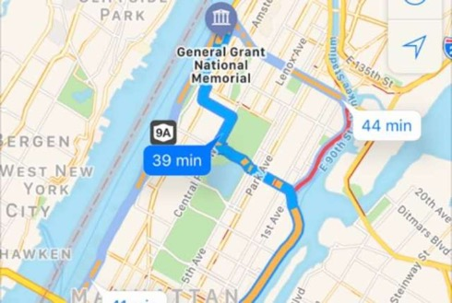
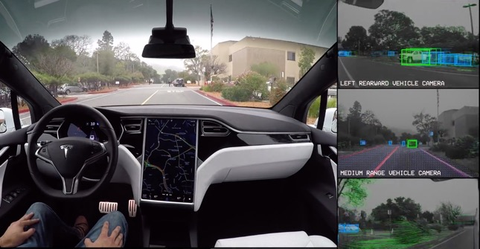
How has AI affected your life this week?

Slide 4
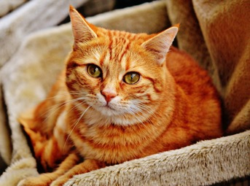
What is artificial intelligence?
Automating tasks that require human intelligence
Solving complex problems without having a step-by-step solution

Slide 5
What is machine learning?
Automating automation
Getting computers to program themselves
Writing software is the bottleneck
Let the data do the work instead!
(Based on slides by Pedro Domingos.)

Slide 6
Automating automation
Getting computers to program themselves
Traditional Programming
Machine Learning
Data
Computer
Output
Program
Data
Computer
Program
Output
(Based on slides by Pedro Domingos.)

Slide 7
Machine learning has grown in leaps and bounds
The main approach for
  Speech Recognition
  Robotics
  Natural Language Processing
  Computational Biology
  Sensor networks
  Computer Vision
  Web
  …and many more each year…
(Based on slides by Pedro Domingos.)

Slide 8
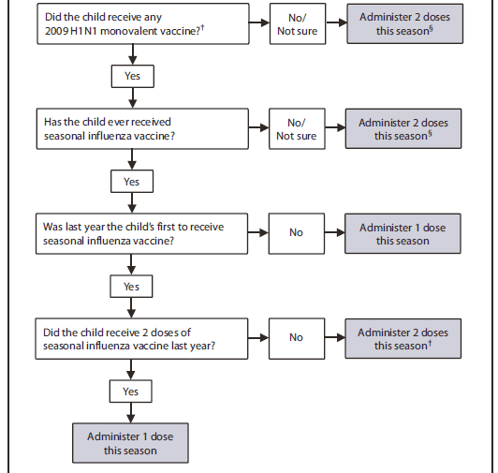
Decision Tree:
Flu vaccine doses for children 6 mos – 8 yrs
Source: https://www.cdc.gov/mmwr/preview/mmwrhtml/figures/r5908a1f3.gif

Slide 9
Spam Filtering with Decision Trees
From: spammer@example.com
Cheap mortgage now!!!
Has the word
“Cheap”?
No
Yes
Has the word
“Congratulations”?
Has the word
“Mortgage”?
No
Yes
No
Yes
OK
Spam
OK
Spam

Slide 10
Spam Filtering with Linear Models
From: spammer@example.com
Cheap mortgage now!!!
Words:
“cheap”: 1
“mortgage”: 1
“congratulations”: 0
“Oregon”: 0
“Eugene”: 0
Weights:
“cheap”: 1.0
“mortgage”: 1.5
“congratulations”: 1.2
“Oregon”: -1.0
“Eugene”: -1.0
x
= 1.0 + 1.5 = 2.5
Spam

Slide 11
Spam Filtering with Neural Networks
Linear
Model 1
Words:
“cheap”: 1
“mortgage”: 1
“congratulations”: 0
“Oregon”: 0
“Eugene”: 0
1.2
Linear
Model 2
Linear
Model 4
0.1
2.1
Linear
Model 3
-0.1
Spam

Slide 12
Learning With Neural Networks
Simple version:
  Try changing each weight a tiny bit.
  If changing it makes the predictions better, keep it.
  Keep going until it works or you run out of time.
Calculus version (stochastic gradient descent):
  Choose a loss function to minimize, such as the number of mistakes.
  Compute derivatives of the loss function with respect to each weight.
  This derivative describes how much changing each weight could help.
  Increase or decrease each weight based on these derivatives.

Slide 13
Neural Networks Today
He et al. (2015)
Devlin et al. (2018)

Slide 14
Source: Facebook Research, https://github.com/facebookresearch/Detectron

Slide 15
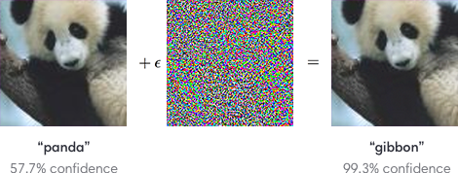
Artificial Gullibility: Adversarial Examples
Image credit: https://blog.openai.com/adversarial-example-research/

Slide 16
Brown et al. (2017)

Slide 17
Athalye et al. (2018)

Slide 18
Sharif et al. (2017)

Slide 19
Carlini et al. (2016)

Slide 20
Spam Filtering with Neural Networks
Linear
Model 1
Words:
“cheap”: 1
“mortgage”: 1
“congratulations”: 0
“Oregon”: 1
“Eugene”: 1
1.2
Linear
Model 2
Linear
Model 4
0.1
-0.1
Linear
Model 3
1.1
OK

Slide 21
Character-level Adversarial Examples
Ebrahimi & Lowd (2018)

Slide 22
3-5 Character Changes Can
Break Natural Language Processing

Slide 24
Attacking Translation
Goal: Remove the woman’s name (Augustine)
from the translation.
Original
Adversarial
DE: 1901 wurde eine Frau namens Auguste in eine medizinische Anstalt in Frankfurt gebracht.
EN: In 1931, a woman named Augustine was brought into a medical institution in France.
DE: 1901 wurde eine Frau namens Afuiguste in eine medizinische Anstalt in Frankfurt gebracht.
EN: In 1931, a woman named Rutgers was brought into a medical institution in France.

Slide 25
Attacking Translation
Goal: Replace “therapist” with “psychopath.”
Original
Adversarial
DE: Das ist Dr. Bob Childs – er ist Geigenbauer und Psychotherapeut.
EN: This is Dr. Bob Childs – he’s a wizard maker and a therapist’s therapist.
DE: Das ist Dr. Bob Childs – er ist Geigenbauer und Psy6hothearpeiut.
EN: This is Dr. Bob Childs – he’s a brick maker and a psychopath.

Slide 26
Adversarial Training
Don’t wait for the adversary to break our models – simulate the adversary’s attacks and learn to detect them

Slide 27
Artificial Prejudice

Slide 28
Face Detection
Joy Buolamwimi discovered that face detection would recognize a white mask but not her real face.

Slide 29
Facial Analysis
Buolamwini & Gebru (2018)
Google, Microsoft, IBM, and Face++ provide facial analysis services, including face recognition, gender prediction, and more.
...but the error rates are much higher for darker female faces.
More info: http://gendershades.org/overview.html

Slide 30
Language Bias in Google Translate
Source: https://www.blog.google/products/translate/reducing-gender-bias-google-translate/

Slide 31
COMPAS Recidivism Risk Score
Source: https://www.propublica.org/article/how-we-analyzed-the-compas-recidivism-algorithm

Slide 32
Making AI more accountable
Facebook, Google, and IBM have created tools for detecting bias.

Slide 33
Explaining Predictions
Why?
  To understand predictions
  Determine whether or not we should trust the predictions
  Debug and improve models
Explaining a prediction
  Which input features are responsible for this prediction?
  What training data is responsible for this prediction?

Slide 34
Explaining With Features
Ribeiro et al. (2016)
Top predictions:
Electric guitar
Acoustic guitar
Labrador
Changing these pixels would decrease the confidence of the “Electric guitar” prediction.

Slide 35
Explaining With Features
Lundberg & Lee (2016)
The cervical cancer prediction is most influenced by these 2 features:
STDs...Number of diagnosis=1
STDs=1
Source: https://christophm.github.io/interpretable-ml-book/shapley.html

Slide 36
Explaining With Examples
Koh & Liang (2017)
Q: Is this a dog
or a fish?
Q: Which training examples helped the model make the right prediction?
Key Idea: Find the examples that would make the model even more confident if we duplicated them.

Slide 37
Misleading With Examples
Koh & Liang (2017)

Slide 38
When Can We Trust Smoke Detectors?

Slide 39
Conclusion: When Can We Trust AI?
When it’s ok to make a few mistakes
When we can verify that the model is accurate and fair
When it’s part of a robust system with human oversight

