Slide 1
Learning Markov Network Structure with Decision Trees
Daniel Lowd
University of Oregon
<lowd@cs.uoregon.edu>
Joint work with:
Jesse Davis
Katholieke Universiteit Leuven
<jesse.davis@cs.kuleuven.be>

Slide 2
Problem Definition
Training Data
Markov Network Structure
F | W | A | S | C
T | T | T | F | F
F | F | T | T | F
F | T | T | F | F
T | F | F | T | T
F | F | F | T | T
Wheeze
Asthma
SEARCH
Flu
Smoke
SLOW
Cancer
P(F,W,A,S,C)
Applications: Diagnosis, prediction, recommendations, and much more!

Slide 3
Key Idea
Training Data
Decision Trees
Markov Network Structure
F | W | A | S | C
T | T | T | F | F
F | F | T | T | F
F | T | T | F | F
T | F | F | T | T
F | F | F | T | T
W
A
F=?
F
S
true
false
0.2
S=?
C
true
false
P(F,W,A,S,C)
0.5
0.7
P(C|F,S)
Result: Similar accuracy, orders of magnitude faster!

Slide 4
Outline
Background
Markov networks
Weight learning
Structure learning
DTSL: Decision Tree Structure Learning
Experiments

Slide 5
Markov Networks: Representation
Flu
Cancer
Smoke
Variables
Asthma
Wheeze
1.5
Smoke ∧ Cancer
Weight of Feature i
Feature i
(
)
1
Z
Σ
P(x) = exp w_{i} f_{i}(x)
i
(aka Markov random fields, Gibbs distributions, log-linear models, exponential models, maximum entropy models)

Slide 6
Markov Networks: Learning
Smoke ∧ Cancer
1.5
Weight of Feature i
Feature i
(
)
1
Z
Σ
P(x) = exp w_{i} f_{i}(x)
i
Two Learning Tasks
Weight Learning
Given: Features, Data
Learn: Weights
Structure Learning
Given: Data
Learn: Features

Slide 7
Markov Networks: Weight Learning
Maximum likelihood weights
Pseudo-likelihood
No. of times feature i is true in data
Expected no. times feature i is true according to model
Slow: Requires inference at each step
No inference: More tractable to compute

Slide 8
Markov Networks: Structure Learning [Della Pietra et al., 1997]
Given: Set of variables = {F, W, A, S, C}
At each step
Current model = {F, W, A, S, C, S ∧ C}
Candidate features:
Conjoin variables to features in model
{F ∧ W, F ∧ A, …, A ∧ C, F ∧ S ∧ C, …, A ∧ S ∧ C}
Select best candidate
New model = {F, W, A, S, C, S ∧ C, F ∧ W}
Iterate until no feature improves score
Downside: Weight learning at each step – very slow!

Slide 9
Bottom-up Learning of Markov Networks (BLM)
[Davis and Domingos, 2010]
Initialization with one feature per example
Greedily generalize features to cover more examples
Continue until no improvement in score
Initial Model
Revised Model
F | W | A | S | C
T | T | T | F | F
F | F | T | T | F
F | T | T | F | F
T | F | F | T | T
F | F | F | T | T
F1: F ∧ W ∧ A
F2: A ∧ S
F3: W ∧ A
F4: F ∧ S ∧ C
F5: S ∧ C
F1: W ∧ A
F2: A ∧ S
F3: W ∧ A
F4: F ∧ S ∧ C
F5: S ∧ C
Downside: Weight learning at each step – very slow!

Slide 10
L1 Structure Learning [Ravikumar et al., 2009]
Given: Set of variables= {F, W, A, S, C}
Do: L1 logistic regression to predict each variable
Construct pairwise features between target and each variable with non-zero weight
0.0
0.0
C
F
1.0
0.0
W
W
…
C
F
0.0
0.0
A
A
0.0
1.5
S
S
Model = {S ∧ C, … , W ∧ F}
Downside: Algorithm restricted to pairwise features

Slide 11
General Strategy: Local Models
Learn a “local model” to predict each variable given the others:
B
A
B
D
C
A
B
C
D
Combine the models into a Markov network
A
B
C
D
c.f. Ravikumar et al., 2009

Slide 12
DTSL: Decision Tree Structure Learning [Lowd and Davis, ICDM 2010]
Given: Set of variables= {F, W, A, S, C}
Do: Learn a decision tree to predict each variable
P(C|F,S) =
F=?
P(F|C,S) =
…
true
false
0.2
S=?
true
false
0.5
0.7
Construct a feature for each leaf in each tree:
F ∧ C ¬F ∧ S ∧ C ¬F ∧ ¬S ∧ C
F ∧ ¬C ¬F ∧ S ∧ ¬C ¬F ∧ ¬S ∧ ¬C

Slide 13
DTSL Feature Pruning [Lowd and Davis, ICDM 2010]
P(C|F,S) =
F=?
true
false
0.2
S=?
true
false
0.5
0.7
Original: F ∧ C ¬F ∧ S ∧ C ¬F ∧ ¬S ∧ C
F ∧ ¬C ¬F ∧ S ∧ ¬C ¬F ∧ ¬S ∧ ¬C
Pruned: All of the above plus F, ¬F ∧ S, ¬F ∧ ¬S, ¬F
Nonzero: F, S, C, F ∧ C, S ∧ C

Slide 14
Empirical Evaluation
Algorithms
DSTL [Lowd and Davis, ICDM 2010]
DP [Della Pietra et al., 1997]
BLM [Davis and Domingos, 2010]
L1 [Ravikumar et al., 2009]
All parameters were tuned on held-out data
Metrics
Running time (structure learning only)
Per variable conditional marginal log-likelihood (CMLL)

Slide 15
Conditional Marginal Log Likelihood
[Lee et al., 2007]
Measures ability to predict each variable separately, given evidence.
Split variables into 4 sets: Use 3 as evidence (E), 1 as query (Q) Rotate through all variables appear in queries
Probabilities estimated using MCMC (specifically MC-SAT [Poon and Domingos, 2006])

Slide 16
Domains
Compared across 13 different domains
2,800 to 290,000 train examples
600 to 38,000 tune examples
600 to 58,000 test examples
16 to 900 variables

Slide 17
Run time (minutes)

Slide 18
Run time (minutes)

Slide 19
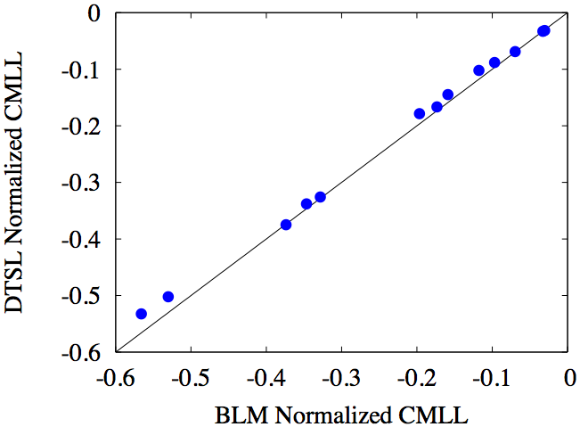
Accuracy: DTSL vs. BLM
DTSL Better
BLM Better

Slide 20
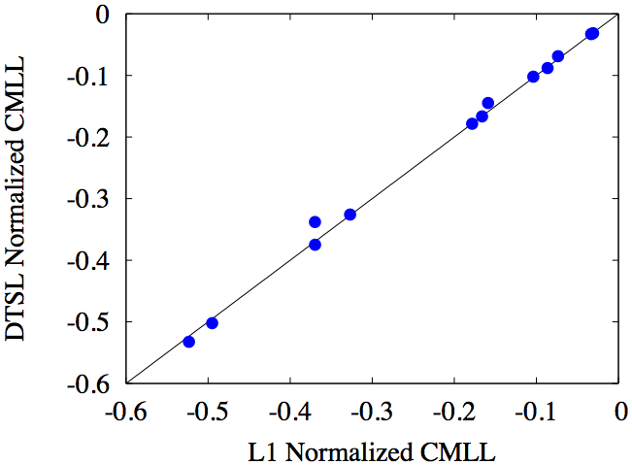
Accuracy: DTSL vs. L1
DTSL Better
L1 Better

Slide 21
Do long features matter?
DTSL Feature Length
DTSL Better
L1 Better

Slide 22
Results Summary
Accuracy
DTSL wins on 5 domains
L1 wins on 6 domains
BLM wins on 2 domains
Speed
DTSL is 16 times faster than L1
DTSL is 100-10,000 times faster than BLM and DP
For DTSL, weight learning becomes the bottleneck

Slide 23
Conclusion
DTSL uses decision trees to learn MN structures much faster with similar accuracy.
Using local models to build a global model is an effective strategy.
L1 and DTSL have different strengths
L1 can combine many independent influences
DTSL can handle complex interactions
Can we get the best of both worlds? (Ongoing work…)

