Slide 1
Can Artificial Intelligence
Fight Alternative Facts?
Daniel Lowd
Associate Professor
Dept. of Computer and Information Science
University of Oregon
April 23, 2019
Notes:
TITLE: Can Artificial Intelligence Fight Alternative Facts?
ABSTRACT:
Through the internet and social media, information is easier to find than ever before, but can we trust it? From pranks to parody to propaganda, we are exposed to misinformation every day. Fake news has been linked to vaccine panics, genocide in Myanmar, terrorist attacks in the U.S., and the outcome of the 2016 presidential election. Companies such as Facebook and Google have pledged to fight back with artificial intelligence, developing algorithms to detect falsehoods automatically. Will they succeed?
In this talk, I'll discuss the problem of detecting fake news automatically. I'll explain how neural networks can find patterns in text and graphs, how this can be used to detect fake news, and why there's still more to be done. I'll also discuss the future of fake information, including fake images and videos, and how artificial intelligence itself can be fooled. Artificial intelligence may not solve fake news on its own, but in collaboration with human intelligence and well-designed systems, it can be part of the solution.
BIO:
Daniel Lowd is an Associate Professor in the Department of Computer and Information Science at the University of Oregon. He first started studying spam filtering and other adversarial machine learning problems in 2004, as a PhD student at the University of Washington. Since joining the University of Oregon in 2009, he has investigated ways to make machine learning more robust on relational data like social networks. He has received an Army Research Office Young Investigator Award, a best paper award from the DEXA conference, and a Google Faculty Award. Ironically, his Google Faculty Award was marked as spam by the GMail spam filter.

Slide 2
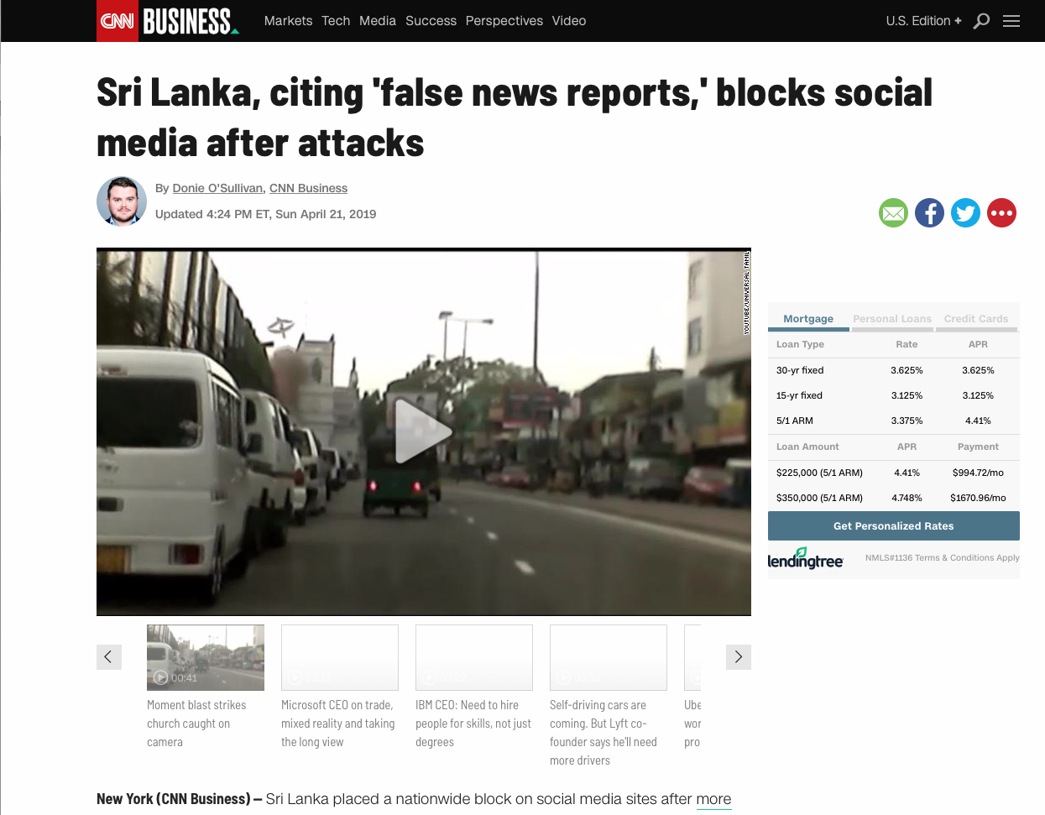
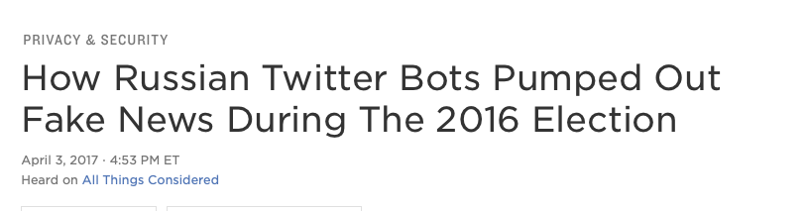
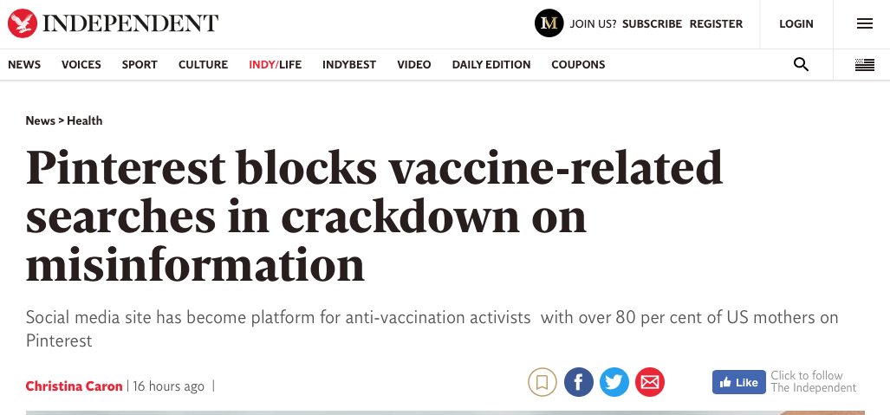
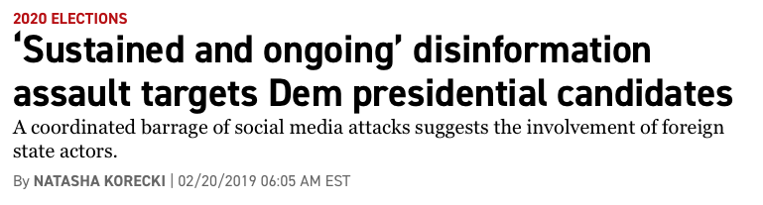
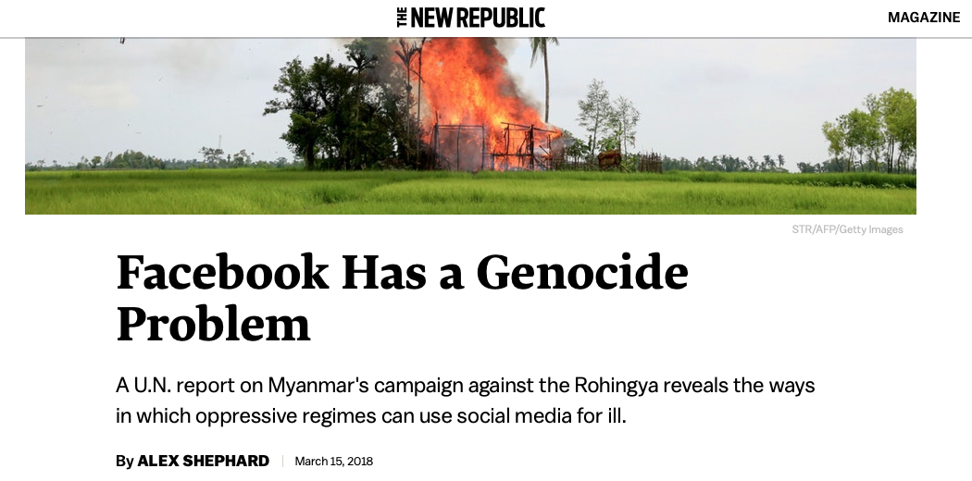
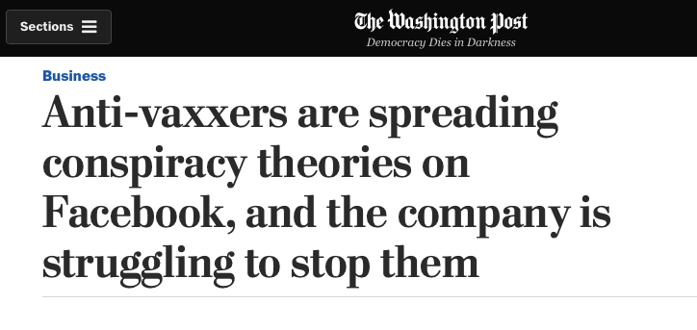
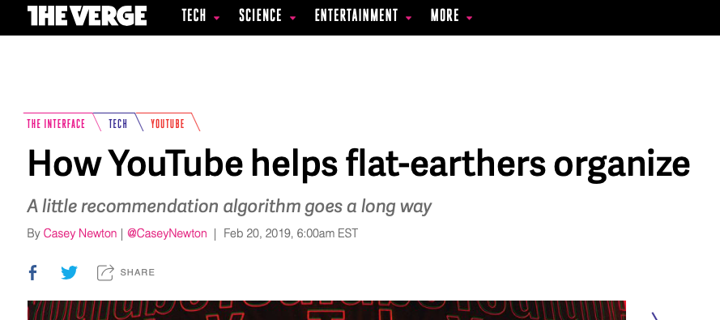

Slide 3

How has AI affected your information this week?

Slide 4
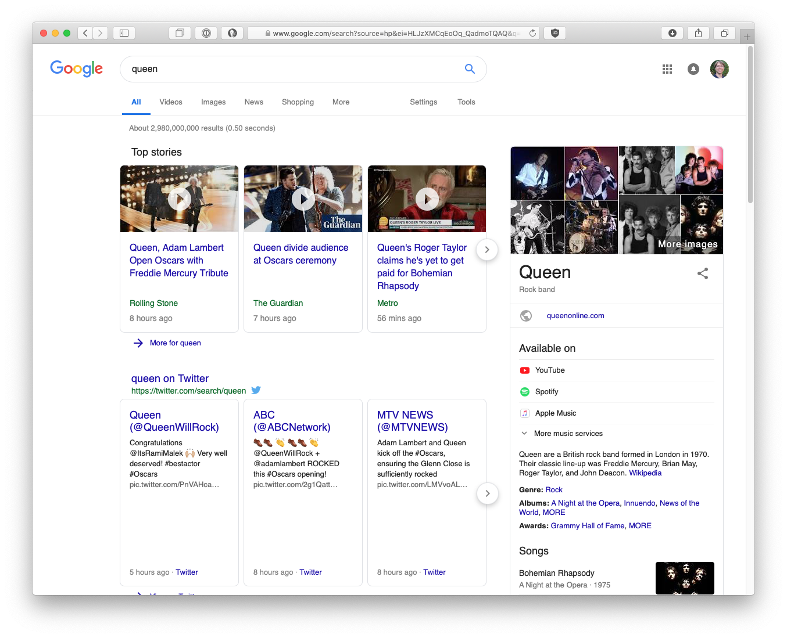
https://www.howtogeek.com/290919/how-facebooks-news-feed-sorting-algorithm-works/

Slide 5
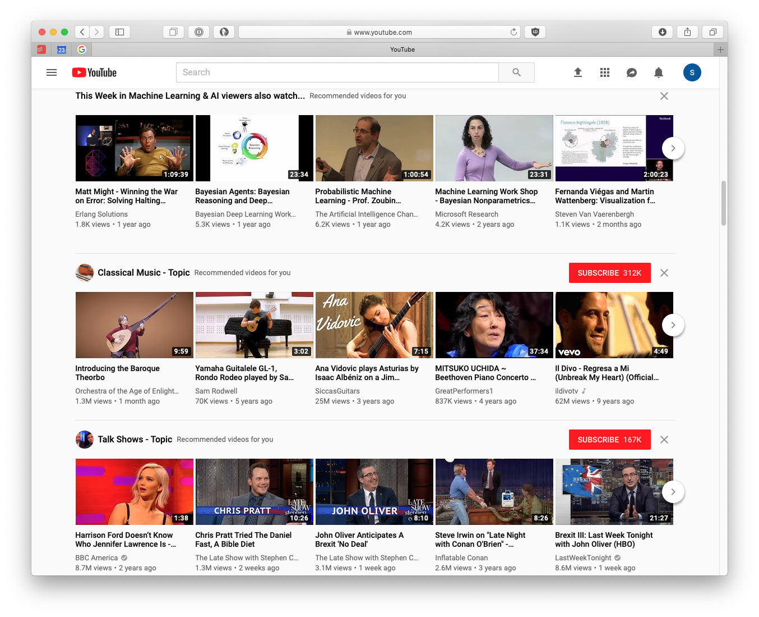

Slide 6


Slide 7
Overview
Social media is a powerful tool for spreading hate and lies.
In every online platform, AI is heavily involved in what content is blocked and what content is promoted.
Therefore, we need to understand the interaction between AI systems and misinformation. (We also need sociology, psychology, public policy, and more.)

Slide 8




What is this talk about?
Background: What is AI? How does it work?
Three types of human-computer deception:
1. How can AI stop humans tricking humans?
Example: Detecting fake news, phishing, fraud
X
?
2. How can humans trick AI?
Example: Adversarial examples, data poisoning
?
3. How can AI trick humans?
Example: Deep fakes, AI-generated fake news
?

Slide 9

What is artificial intelligence?
Automating tasks that require human intelligence
Solving complex problems without having a step-by-step solution

Slide 10
What is machine learning?
A branch of artificial intelligence
Solving complex problems by:
  Using data to fit a model
  Using the model to make predictions
  or recommendations (typically)
Examples:
Spam filters
Recommender systems (Netflix, Apple News)
Speech recognition
Language translation
https://en.wikipedia.org/wiki/File:Iris_dataset_scatterplot.svg
Creative Commons Attribution. Wikipedia user: Nicoguaro

Slide 11
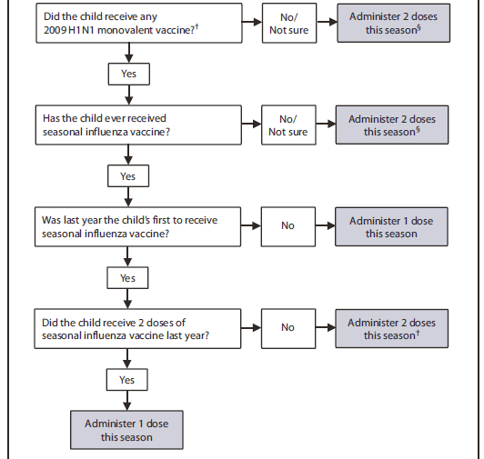
Decision Tree Model:
Flu vaccine doses for children 6 mos – 8 yrs
Source: https://www.cdc.gov/mmwr/preview/mmwrhtml/figures/r5908a1f3.gif
Notes:
This is an example of a predictive model, one developed by humans for humans. If you follow the flow chart, it will tell you the number of doses of flu vaccine to administer. Most machine learning models are something like this – a set of instructions that will lead you to an answer. There’s no risk that this will suddenly gain sentience.

Slide 12
Spam Filtering with Decision Tree Models
From: spammer@example.com
Cheap cheap mortgage now!!!
Has the word
“Cheap”?
No
Yes
Has the word
“Congratulations”?
Has the word
“Mortgage”?
No
Yes
No
Yes
OK
Spam
OK
Spam

Slide 13
Spam Filtering with Linear Models
From: spammer@example.com
Cheap cheap mortgage now!!!
Words:
“cheap”: 2
“mortgage”: 1
“congratulations”: 0
“Oregon”: 0
“Eugene”: 0
Weights:
“cheap”: 1.0
“mortgage”: 1.5
“congratulations”: 1.2
“Oregon”: -1.0
“Eugene”: -1.0
x
= 2*1.0 + 1*1.5
= 3.5
Spam
Notes:
Used by Google for predicting ad clicks. (1 BILLION features.)
Very effective, especially when you have good features.
Doesn’t look at important combinations of features, like “cheap” and “mortgage” appearing together.

Slide 14
Spam Filtering with Neural Network Models
Linear
Model 1
Words:
“cheap”: 2
“mortgage”: 1
“congratulations”: 0
“Oregon”: 0
“Eugene”: 0
1.2
Linear
Model 2
Linear
Model 4
0.1
2.1
Linear
Model 3
-0.1
Spam

Slide 15
Learning With Neural Networks
Simple version:
  Try changing each weight a tiny bit.
  If changing it makes the predictions better, keep it.
  Keep going until it works or you run out of time.
Calculus version (stochastic gradient descent):
  Choose a loss function to minimize, such as the number of mistakes.
  Compute derivatives of the loss function with respect to each weight.
  This derivative describes how much changing each weight could help.
  Increase or decrease each weight based on these derivatives.

Slide 16
Neural Networks Today: Deep Learning
He et al. (2015)
Devlin et al. (2018)

Slide 17
Source: Facebook Research, https://github.com/facebookresearch/Detectron

Slide 18
1. How can AI stop humans tricking humans?
X
?

Slide 19
Spam Filters For News
Choose features
Collect data
Fit a model
Make predictions!
Baly et al., 2018

Slide 20
What Features Predict Fake News?
Baly et al., 2018
Content: Words like “demonic” and “crisis actor”
News outlet: Short Wikipedia page with words like “extreme” and “conspiracy theory”
URL: special characters, complicated subdirectories
How well does it work?
65% accurate at predicting factuality (high/low/medium)

Slide 21
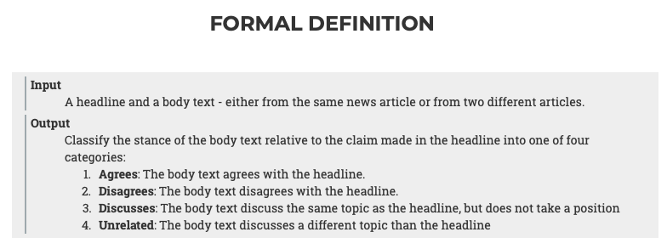
Can We Objectively Define Fake News?
The Fake News Challenge (FNC) evaluated AI for stance detection, checking headline consistency rather than accuracy.
http://www.fakenewschallenge.org

Slide 22
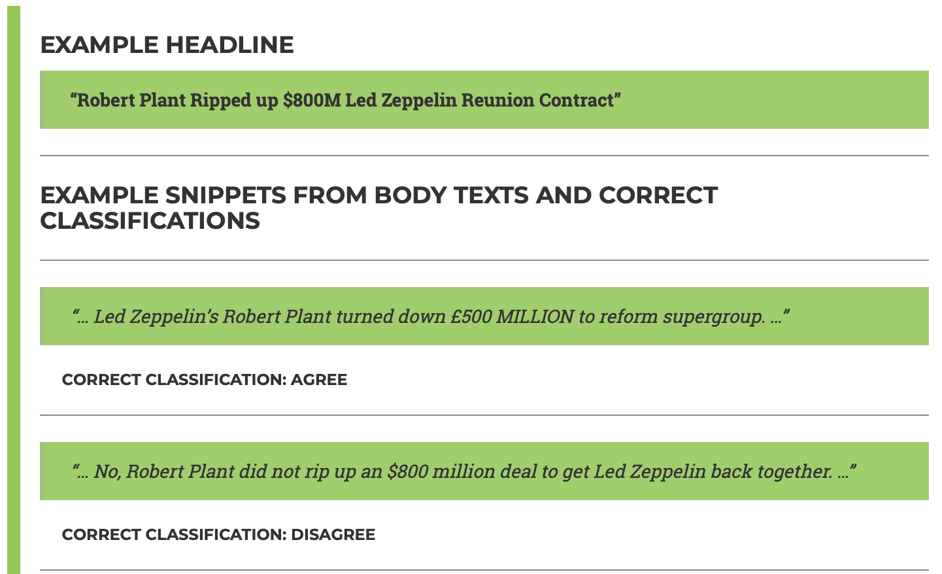
http://www.fakenewschallenge.org

Slide 23
Why Stance Detection?
Fact checking is hard
  Ambiguous ground truth
  Lack of good training data
  Complaints of bias
Stance detection is useful
  Find related articles that agree or disagree
  Determine truth consensus, weighted by credibility
Results: Winning team obtained 82% of the maximum possible score,
using gradient-boosted decision trees and a deep neural network.
https://github.com/Cisco-Talos/fnc-1

Slide 24
2. How can humans trick AI?
?

Slide 25
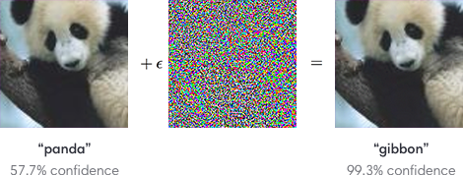
Adversarial Examples
Image credit: https://blog.openai.com/adversarial-example-research/

Slide 26
Athalye et al. (2018)

Slide 27
Sharif et al. (2017)

Slide 28
Carlini et al. (2016)

Slide 29
Adversarial Text
Ebrahimi & Lowd (2018)
Average changes required: 3-5 characters

Slide 31
Adversarial Translation
Goal: Remove the woman’s name (Augustine)
from the translation.
Original
Adversarial
DE: 1901 wurde eine Frau namens Auguste in eine medizinische Anstalt in Frankfurt gebracht.
EN: In 1931, a woman named Augustine was brought into a medical institution in France.
DE: 1901 wurde eine Frau namens Afuiguste in eine medizinische Anstalt in Frankfurt gebracht.
EN: In 1931, a woman named Rutgers was brought into a medical institution in France.

Slide 32
Adversarial Translation
Goal: Replace “therapist” with “psychopath.”
Original
Adversarial
DE: Das ist Dr. Bob Childs – er ist Geigenbauer und Psychotherapeut.
EN: This is Dr. Bob Childs – he’s a wizard maker and a therapist’s therapist.
DE: Das ist Dr. Bob Childs – er ist Geigenbauer und Psy6hothearpeiut.
EN: This is Dr. Bob Childs – he’s a brick maker and a psychopath.

Slide 33
Adversarial Training
Don’t wait for the adversary to break our models – simulate the adversary’s attacks and learn to detect them

Slide 34
3. How can AI trick humans?
?

Slide 35

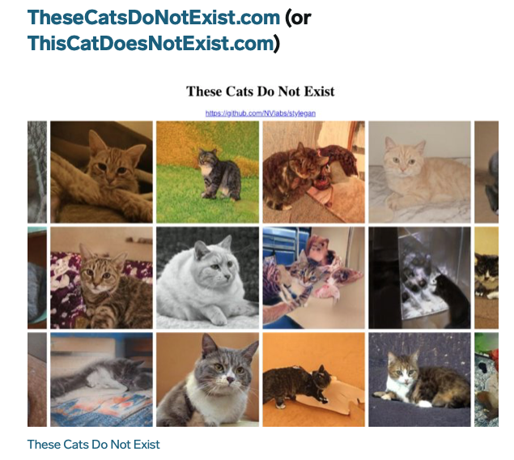
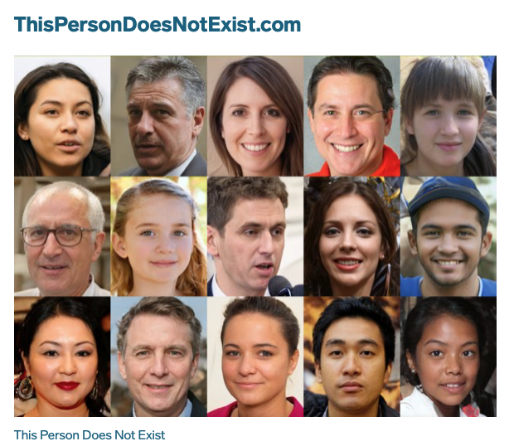
AI-Generated Images

Slide 36
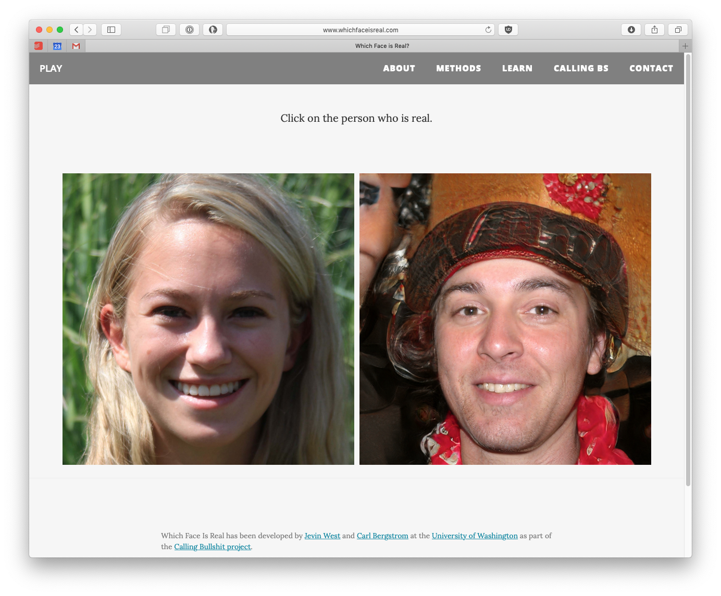
www.whichfaceisreal.com

Slide 37
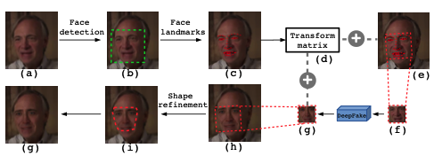
Deep Fakes
Train a neural network to produce variants of one person’s face
Automatically map that onto videos with another person’s face
Image by: Li and Lyu (2018)

Slide 38
Detecting Deep Fakes
Deconvolutions produce checkerboard patterns. (https://distill.pub/2016/deconv-checkerboard/)
Deep fake videos often lack key human
characteristics, such as a pulse or
blinking. (Li and Lyu, 2018a)
Deep fake videos have image warping artifacts. (Li and Lyu, 2018b)
...but will future Deep Fake variants have these same limitations?

Slide 39
Conclusion: Will Artificial Intelligence
Save Us … OR … Kill Us All?
Human
“I’m sorry, Dave.”
AI is a tool: AI is made by humans, used by humans, and works with humans.
Policy is essential: At best, AI will follow human policy (for better or worse).
Understanding is essential: AI is complex, but there are ways we can make it more robust and more intelligible, so we know when to trust it.

