Slide 1
In-Network Filtering of Distributed Denial-of-Service Traffic with Near-Optimal Rule Selection
Devkishen Sisodia, Jun Li, Lei Jiao
{dsisodia, lijun, jiao}@cs.uoregon.edu
CENTER FOR CYBER SECURITY & PRIVACY

Slide 2
Outline
Introduction
Offer-Based Model
Rule Selection Problem
ACO-Based Rule Selection Algorithm
Evaluation
Conclusion
2

Slide 3
Introduction
3

Slide 4
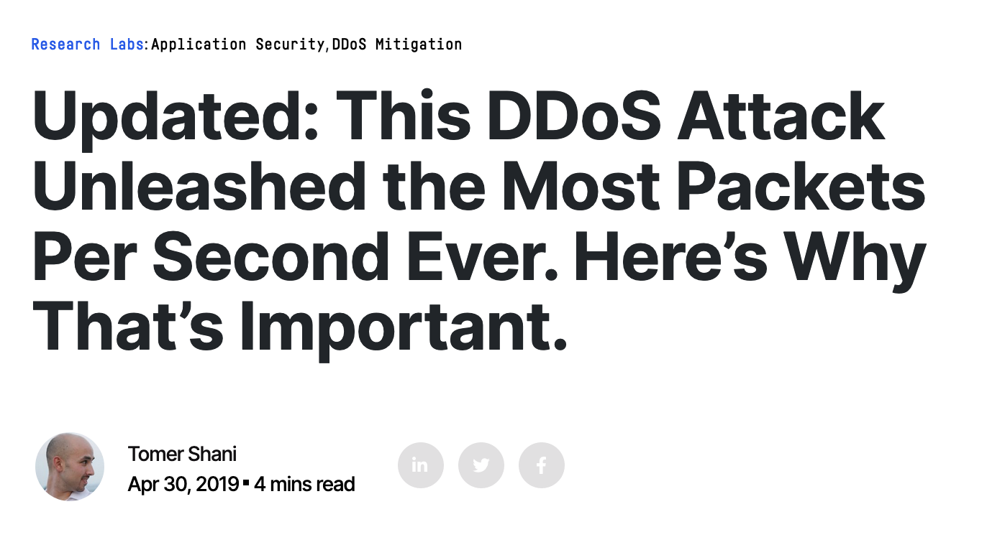
Large-Scale DDoS Attacks
Large scale distributed denial-of-service (DDoS) attacks are on the rise
Oct 2016: 1.2 Tbps (terabit per second)
Feb 2018: 1.3 Tbps
Mar 2018 : 1.7 Tbps
Jan 2019 : 500 Mpps (million packets per second)
Apr 2019: 580 Mpps
Feb 2020: 2.3 Tbps
Victim-end defense approaches: insufficient in mitigating large volume attacks
Alternative: in-network filtering approaches
victim’s
network
Introduction
In-Network Filtering of Distributed Denial-of-Service Traffic with Near-Optimal Rule Selection
AsiaCCS 2020

Slide 5
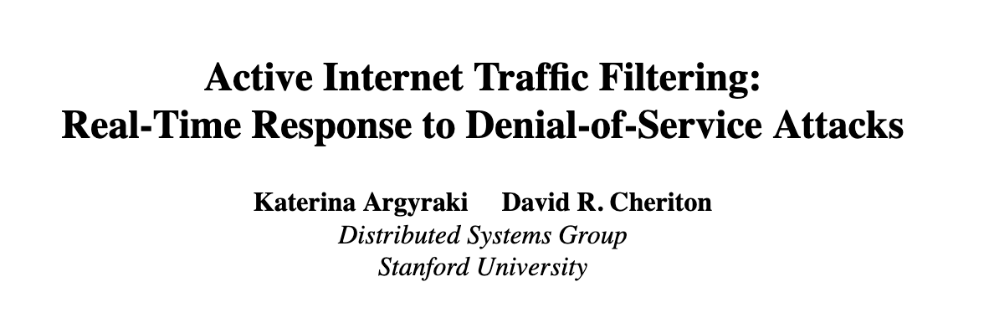
In-Network Filtering
Filter traffic at multiple locations on the Internet
General approach:
A DDoS defense agent generates DDoS-filtering rules
Places them at DDoS-filtering networks across the Internet
DDoS defense agent: victim
DDoS-filtering network: strategically located transit networks or scrubbing centers
Plethora of papers on in-network filtering approaches
All surveyed papers follow the directive-based model
Introduction
In-Network Filtering of Distributed Denial-of-Service Traffic with Near-Optimal Rule Selection
AsiaCCS 2020

Slide 6
Directive-Based Model for In-Network Filtering
Each DDoS-filtering network is obliged to deploy filtering rules
Two main optimization problems:
Rule generation: How to generate filtering rules given incoming traffic?
Rule placement: Which DDoS-filtering networks to select to deploy generated rules?
Assumptions:
DDoS-filtering networks are willing and able to deploy generated rules
Defense agent has complete knowledge of the filtering capabilities at the filtering networks
Advantage: simplifies the defense agent's decision process
Disadvantage: assumptions may not hold in the real-world
Introduction
In-Network Filtering of Distributed Denial-of-Service Traffic with Near-Optimal Rule Selection
AsiaCCS 2020

Slide 7
Questions
Is there a better operational model for in-network DDoS filtering?
Yes: offer-based model
If so, is there a new optimization problem associated with this model?
Yes: rule selection problem
If so, how can we solve this problem?
Ant Colony Optimization (ACO)-based rule selection algorithm
Introduction
In-Network Filtering of Distributed Denial-of-Service Traffic with Near-Optimal Rule Selection
AsiaCCS 2020

Slide 8
Offer-Based Model
8

Slide 9
Overview
Allows the defense agent to express its filtering needs
Plethora of mechanisms for filtering DDoS traffic:
Access control lists (ACLs)
Berkeley Packet Filters (BPFs)
Remotely Triggered Black Hole (RTBH) signals
BGP FlowSpec rules
SDN rules
Focus of this paper: filtering rules based on source IP prefixes (e.g., 162.243.141.0/24)
Offer-Based Model
In-Network Filtering of Distributed Denial-of-Service Traffic with Near-Optimal Rule Selection
AsiaCCS 2020

Slide 10
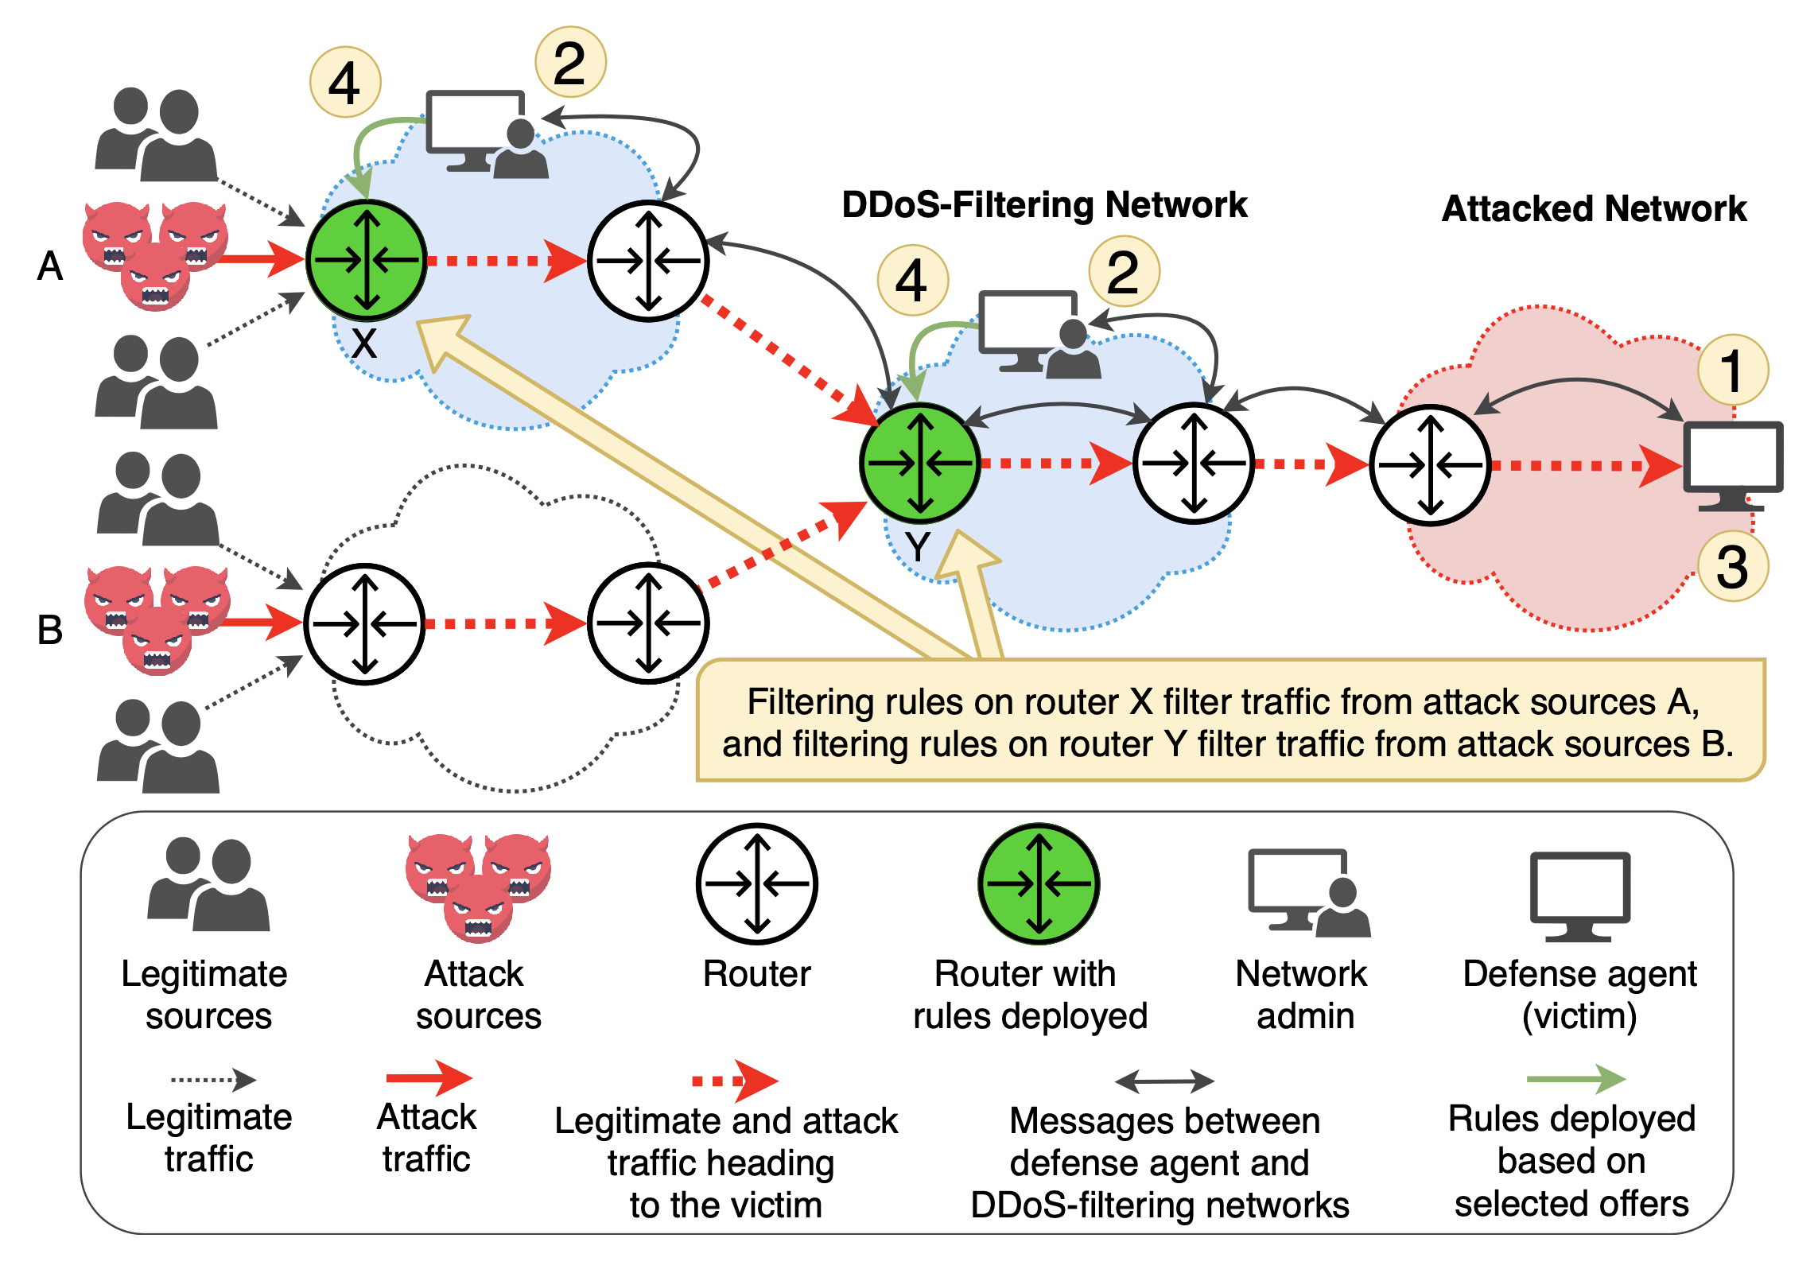
Operational Model
Step 1: defense agent generates rules
Step 2: filtering networks create offers
Offer: a set of rules a filtering network is willing to deploy on behalf of the defense agent
Step 3: defense agent selects offers
Step 4: filtering networks deploy rules in selected offers
Offer-Based Model
In-Network Filtering of Distributed Denial-of-Service Traffic with Near-Optimal Rule Selection
AsiaCCS 2020

Slide 11
Offer-Based Model vs. Directive-Based Model
Both models allow a defense agent to express filtering rules to all participating filtering networks
However, only the offer-based model allows all participating DDoS filtering networks to decide which rules they deploy
Offer-based model advantages:
Removes assumptions made by the directive-based model
More suitable for the real-world
Offer-based model disadvantage:
A new optimization problem arises: rule selection
Offer-Based Model
In-Network Filtering of Distributed Denial-of-Service Traffic with Near-Optimal Rule Selection
AsiaCCS 2020

Slide 12
The Need for Rule Selection
Significant drawback to source IP-based filtering: limited number of rules can be deployed at defending networks
Scarcity of memory space on routers/switches
Most high-end routers today only have enough TCAM space to support a few thousand filtering rules
Case in point: Mirai
50 million unique IP addresses spread all across the world
Infeasible to deploy a filtering rule for each /32 IP address -- very expensive!
Therefore, defense agent must aggregate rules
Ex: multiple /32 -> one /24; multiple /24 -> one /16
Aggregation leads to collateral damage!
Offer-Based Model
In-Network Filtering of Distributed Denial-of-Service Traffic with Near-Optimal Rule Selection
AsiaCCS 2020

Slide 13
Rule Selection Optimization Problem
Maximize the amount of DDoS traffic filtered, while limiting the amount of collateral damage incurred and money spent on deploying filtering rules.
Offer-Based Model
In-Network Filtering of Distributed Denial-of-Service Traffic with Near-Optimal Rule Selection
AsiaCCS 2020

Slide 14
Rule Selection Problem
14

Slide 15
Overview
Three main factors a defense agent must consider when selecting an offer:
Efficacy of the offer
Collateral damage incurred by the offer
Price of the offer
In this paper, we focus on maximizing the defense efficacy, while keeping the maximum total collateral damage and the maximum amount of money spent on defense as constraints
Rule Selection Problem
In-Network Filtering of Distributed Denial-of-Service Traffic with Near-Optimal Rule Selection
AsiaCCS 2020

Slide 16
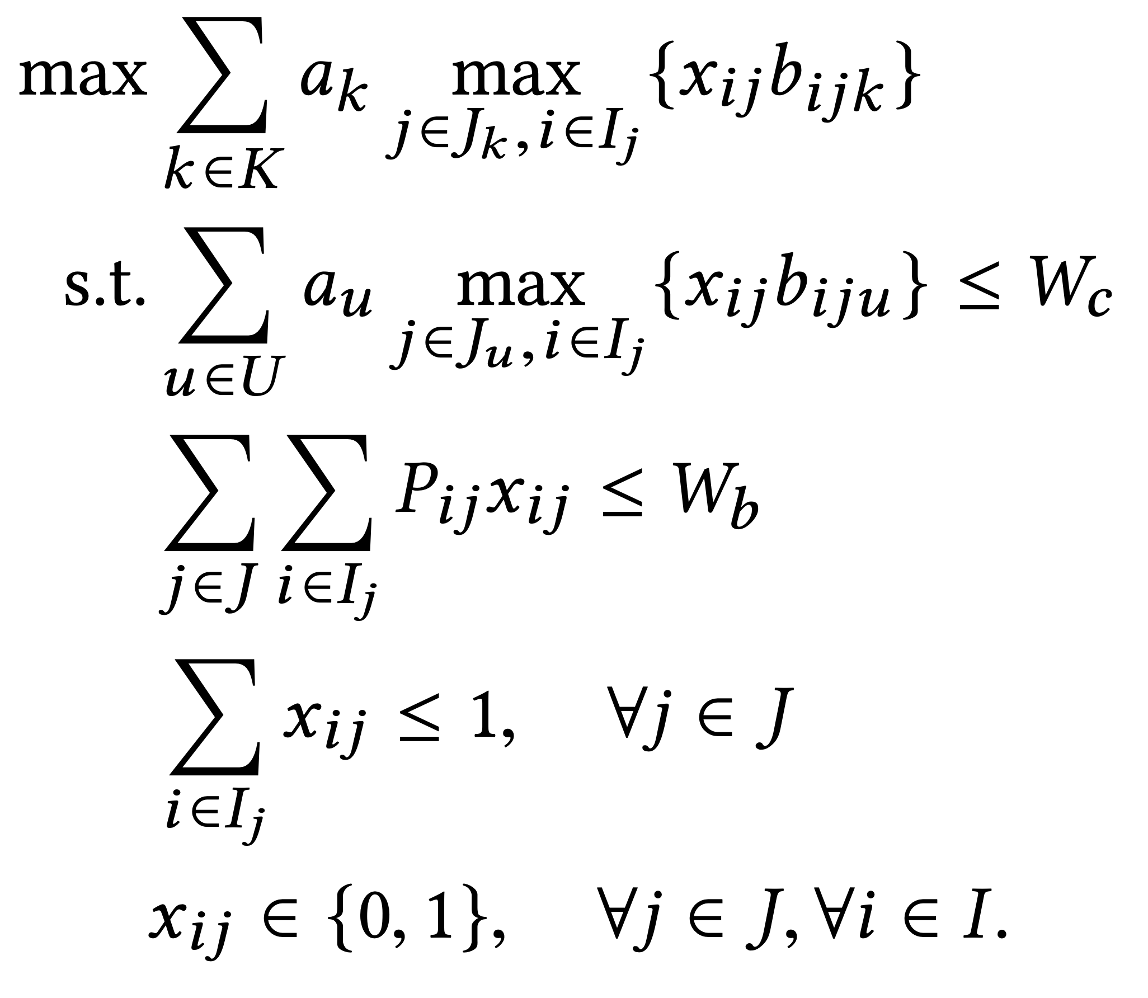
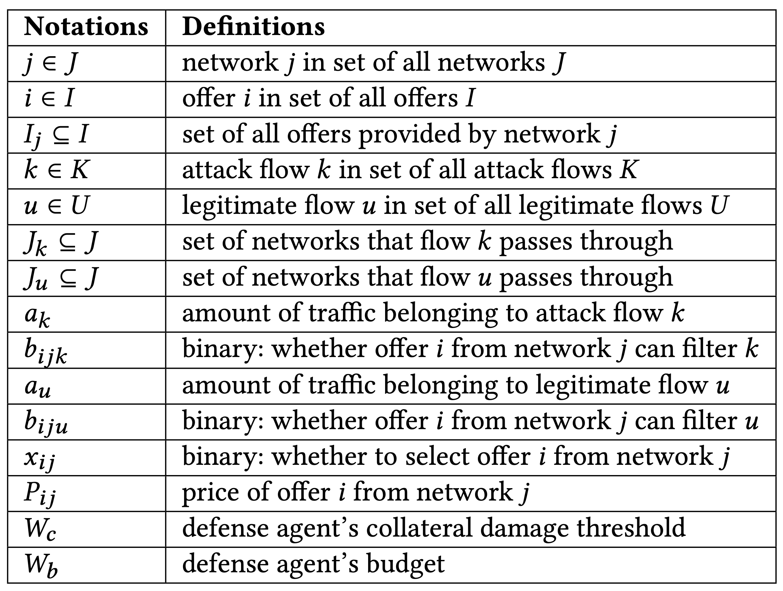
Formulation
maximize the total amount of attack traffic filtered
collateral damage constraint
budget constraint
limit to 1 selected
offer per network
offers are atomic
Rule Selection Problem
In-Network Filtering of Distributed Denial-of-Service Traffic with Near-Optimal Rule Selection
AsiaCCS 2020

Slide 17
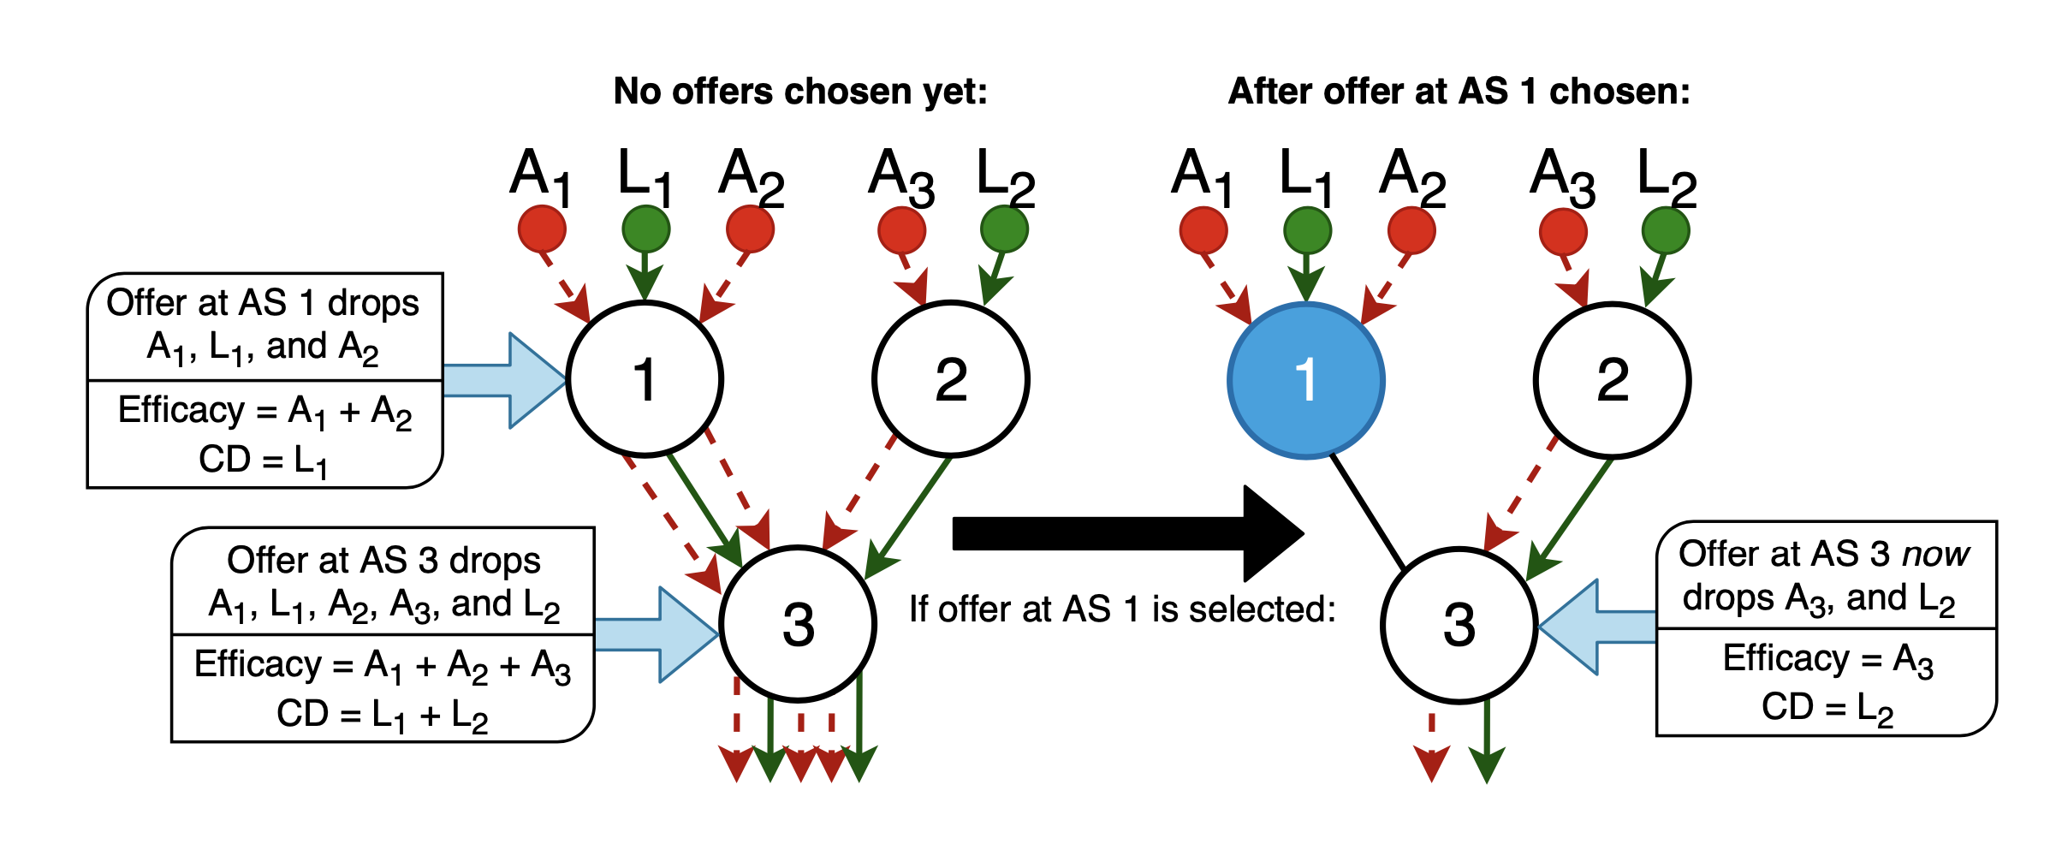
Challenges
NP-hard 0-1 multidimensional knapsack problem with value-dependent items
Offers are value-dependent items
Unlikely to be solved in pseudo-polynomial time
Can use algorithms for the general 0-1 knapsack problem as bases
Greedy & Naïve
Dynamic Programming
Branch-and-Bound
Ant Colony Optimization
Rule Selection Problem
In-Network Filtering of Distributed Denial-of-Service Traffic with Near-Optimal Rule Selection
AsiaCCS 2020

Slide 18
ACO-Based Rule Selection Algorithm
18

Slide 19
Analysis of Classical Algorithms
branch-and-bound
Greedy & naive algorithms
Advantage: linear time complexity (short runtimes)
Disadvantage: perform relatively poorly in most cases
Branch-and-bound-based algorithm
Advantage: optimal
Disadvantage: exponential time complexity (extremely long runtime)
Dynamic programming-based algorithm
Advantage: outperforms greedy and naive, significantly better runtime than branch-and-bound
Disadvantage: suboptimal
Optimal bound
ACO?
Optimality
dynamic programming
naive
Runtime
greedy
ACO-Based Rule Selection Algorithm
In-Network Filtering of Distributed Denial-of-Service Traffic with Near-Optimal Rule Selection
AsiaCCS 2020

Slide 20
Overview of the ACO Framework
Inspired by the foraging behavior of some ant species
Iterative algorithm
Each cycle, ants traverse a graph
Each ant builds a solution by walking from node to node
An ant chooses the next node partly based on the amount of pheromone laid on the path
At the end of a cycle, certain amount of pheromone is evaporated based on quality of the solution
Thus, ants in future cycles will be more attracted to solutions like the best ones previously constructed
Overall best solution is chosen at the end of last cycle
Challenge: Cannot be directly applied to the rule selection problem
Why?: correlated nature of offers and their potential for overlapping
Our contribution: develop an ACO-based algorithm for the rule selection problem
First time the classical ACO framework has been adapted and applied to the domain of in-network DDoS defense
ACO-Based Rule Selection Algorithm
In-Network Filtering of Distributed Denial-of-Service Traffic with Near-Optimal Rule Selection
AsiaCCS 2020

Slide 21
Example
1
Attack: A4, A5
Legitimate: None
Cost: $1
Victim’s Budget: $6
Victim’s Collateral Damage Threshold: 2
2
Attack: A1, A3, A4
Legitimate: G1
Cost: $2
3
Attack: A1, A2, A3, A4, A5
Legitimate: G1, G2, G3
Cost: $1
4
Attack: A2, A3, A4, A8
Legitimate: G2
Cost: $3
5
Attack: A1, A2, A6, A7
Legitimate: G1, G2
Cost: $2
Total of 5 offers, each containing rules that filter certain attack and legitimate flows, and the deployment cost.
ACO-Based Rule Selection Algorithm
In-Network Filtering of Distributed Denial-of-Service Traffic with Near-Optimal Rule Selection
AsiaCCS 2020

Slide 22
Step 1: Graph Construction
Attack: A4, A5
Legitimate: None
Cost: $1
1
Victim’s Budget: $6
Victim’s Collateral Damage Threshold: 2
Attack: A1, A3, A4
Legitimate: G1
Cost: $2
2
4
Attack: A2, A3, A4, A8
Legitimate: G2
Cost: $3
Attack: A1, A2, A3, A4, A5
Legitimate: G1, G2, G3
Cost: $1
3
5
Attack: A1, A2, A6, A7
Legitimate: G1, G2
Cost: $2
Construct a complete graph, where each node represents an offer. Initially all edges have an equal amount of pheromone.
ACO-Based Rule Selection Algorithm
In-Network Filtering of Distributed Denial-of-Service Traffic with Near-Optimal Rule Selection
AsiaCCS 2020

Slide 23
Step 2: Graph Traversal
Attack: A4, A5
Legitimate: None
Cost: $1
1
Victim’s Budget: $6
Victim’s Collateral Damage Threshold: 2
Attack: A1, A3, A4
Legitimate: G1
Cost: $2
2
4
Attack: A2, A3, A4, A8
Legitimate: G2
Cost: $3
Attack: A1, A2, A3, A4, A5
Legitimate: G1, G2, G3
Cost: $1
3
5
Attack: A1, A2, A6, A7
Legitimate: G1, G2
Cost: $2
Ant begins at random offer and chooses subsequent offers based on budget, collateral damage threshold, and attractiveness (amount of pheromone).
ACO-Based Rule Selection Algorithm
In-Network Filtering of Distributed Denial-of-Service Traffic with Near-Optimal Rule Selection
AsiaCCS 2020

Slide 24
Offers selected so far:
Cost so far: $1
Collateral damage so far: None
Efficacy: 2 (A4, A5)
Attack: A4, A5
Legitimate: None
Cost: $1
1
1
Victim’s Budget: $6
Victim’s Collateral Damage Threshold: 2
Attack: A1, A3, A4
Legitimate: G1
Cost: $2
2
4
Attack: A2, A3, A4, A8
Legitimate: G2
Cost: $3
Attack: A1, A2, A3, A4, A5
Legitimate: G1, G2, G3
Cost: $1
3
5
Attack: A1, A2, A6, A7
Legitimate: G1, G2
Cost: $2
Ant begins at random offer and chooses subsequent offers based on budget, collateral damage threshold, and attractiveness (amount of pheromone).
ACO-Based Rule Selection Algorithm
In-Network Filtering of Distributed Denial-of-Service Traffic with Near-Optimal Rule Selection
AsiaCCS 2020

Slide 25
Offers selected so far:
Cost so far: $3
Collateral damage so far: 1 (G1)
Efficacy: 4 (A1, A3, A4, A5)
Attack: A4, A5
Legitimate: None
Cost: $1
1
2
1
Victim’s Budget: $6
Victim’s Collateral Damage Threshold: 2
Attack: A1, A3, A4
Legitimate: G1
Cost: $2
2
4
Attack: A2, A3, A4, A8
Legitimate: G2
Cost: $3
Attack: A1, A2, A3, A4, A5
Legitimate: G1, G2, G3
Cost: $1
3
5
Attack: A1, A2, A6, A7
Legitimate: G1, G2
Cost: $2
Ant begins at random offer and chooses subsequent offers based on budget, collateral damage threshold, and attractiveness (amount of pheromone).
ACO-Based Rule Selection Algorithm
In-Network Filtering of Distributed Denial-of-Service Traffic with Near-Optimal Rule Selection
AsiaCCS 2020

Slide 26
4
Attack: A4, A5
Legitimate: None
Cost: $1
Offers selected so far:
Cost so far: $6
Collateral damage so far: 2 (G1, G2)
Efficacy: 6 (A1, A2, A3, A4, A5, A8)
1
2
1
Victim’s Budget: $6
Victim’s Collateral Damage Threshold: 2
Attack: A1, A3, A4
Legitimate: G1
Cost: $2
2
4
Attack: A2, A3, A4, A8
Legitimate: G2
Cost: $3
Attack: A1, A2, A3, A4, A5
Legitimate: G1, G2, G3
Cost: $1
3
5
Attack: A1, A2, A6, A7, A8
Legitimate: G1, G2
Cost: $2
Ant begins at random offer and chooses subsequent offers based on budget, collateral damage threshold, and attractiveness (amount of pheromone).
ACO-Based Rule Selection Algorithm
In-Network Filtering of Distributed Denial-of-Service Traffic with Near-Optimal Rule Selection
AsiaCCS 2020

Slide 27
4
Attack: A4, A5
Legitimate: None
Cost: $1
Ant #1 selected:
Efficacy: 6
1
2
1
Victim’s Budget: $6
Victim’s Collateral Damage Threshold: 2
Attack: A1, A3, A4
Legitimate: G1
Cost: $2
2
4
Attack: A2, A3, A4, A8
Legitimate: G2
Cost: $3
Attack: A1, A2, A3, A4, A5
Legitimate: G1, G2, G3
Cost: $1
3
5
Attack: A1, A2, A6, A7, A8
Legitimate: G1, G2
Cost: $2
Ant begins at random offer and chooses subsequent offers based on budget, collateral damage threshold, and attractiveness (amount of pheromone). Stops once it can no longer choose another offer due to constraints.
ACO-Based Rule Selection Algorithm
In-Network Filtering of Distributed Denial-of-Service Traffic with Near-Optimal Rule Selection
AsiaCCS 2020

Slide 28
4
Attack: A4, A5
Legitimate: None
Cost: $1
Ant #1 selected:
Efficacy: 6
1
2
Offers selected so far:
Cost so far: $2
Collateral damage so far: 2 (G1, G2)
Efficacy: 5 (A1, A2, A6, A7, A8)
5
1
Victim’s Budget: $6
Victim’s Collateral Damage Threshold: 2
Attack: A1, A3, A4
Legitimate: G1
Cost: $2
2
4
Attack: A2, A3, A4, A8
Legitimate: G2
Cost: $3
Attack: A1, A2, A3, A4, A5
Legitimate: G1, G2, G3
Cost: $1
3
5
Attack: A1, A2, A6, A7, A8
Legitimate: G1, G2
Cost: $2
Next ant in cycle begins its journey at random offer and chooses subsequent offers based on budget, collateral damage threshold, and attractiveness (amount of pheromone).
ACO-Based Rule Selection Algorithm
In-Network Filtering of Distributed Denial-of-Service Traffic with Near-Optimal Rule Selection
AsiaCCS 2020

Slide 29
4
Attack: A4, A5
Legitimate: None
Cost: $1
Ant #1 selected:
Efficacy: 6
1
2
4
Offers selected so far:
Cost so far: $5
Collateral damage so far: 2 (G1, G2)
Efficacy: 7 (A1, A2, A3, A4, A6, A7, A8)
5
1
Victim’s Budget: $6
Victim’s Collateral Damage Threshold: 2
Attack: A1, A3, A4
Legitimate: G1
Cost: $2
2
4
Attack: A2, A3, A4, A8
Legitimate: G2
Cost: $3
Attack: A1, A2, A3, A4, A5
Legitimate: G1, G2, G3
Cost: $1
3
5
Attack: A1, A2, A6, A7, A8
Legitimate: G1, G2
Cost: $2
Ant begins at random offer and chooses subsequent offers based on budget, collateral damage threshold, and attractiveness (amount of pheromone).
ACO-Based Rule Selection Algorithm
In-Network Filtering of Distributed Denial-of-Service Traffic with Near-Optimal Rule Selection
AsiaCCS 2020

Slide 30
4
Attack: A4, A5
Legitimate: None
Cost: $1
Ant #1 selected:
Efficacy: 6
1
2
4
1
Offers selected so far:
Cost so far: $6
Collateral damage so far: 2 (G1, G2)
Efficacy: 7 (A1, A2, A3, A4, A5, A6, A7, A8)
5
1
Victim’s Budget: $6
Victim’s Collateral Damage Threshold: 2
Attack: A1, A3, A4
Legitimate: G1
Cost: $2
2
4
Attack: A2, A3, A4, A8
Legitimate: G2
Cost: $3
Attack: A1, A2, A3, A4, A5
Legitimate: G1, G2, G3
Cost: $1
3
5
Attack: A1, A2, A6, A7, A8
Legitimate: G1, G2
Cost: $2
Ant begins at random offer and chooses subsequent offers based on budget, collateral damage threshold, and attractiveness (amount of pheromone).
ACO-Based Rule Selection Algorithm
In-Network Filtering of Distributed Denial-of-Service Traffic with Near-Optimal Rule Selection
AsiaCCS 2020

Slide 31
4
Attack: A4, A5
Legitimate: None
Cost: $1
Ant #1 selected:
Efficacy: 6
1
2
Ant #2 selected:
Efficacy: 7
5
4
1
1
Victim’s Budget: $6
Victim’s Collateral Damage Threshold: 2
Attack: A1, A3, A4
Legitimate: G1
Cost: $2
2
4
Attack: A2, A3, A4, A8
Legitimate: G2
Cost: $3
Attack: A1, A2, A3, A4, A5
Legitimate: G1, G2, G3
Cost: $1
3
5
Attack: A1, A2, A6, A7, A8
Legitimate: G1, G2
Cost: $2
Cycle continues until all ants in the colony have finished traversing the graph.
ACO-Based Rule Selection Algorithm
In-Network Filtering of Distributed Denial-of-Service Traffic with Near-Optimal Rule Selection
AsiaCCS 2020

Slide 32
Step 3: Updating Pheromone
Attack: A4, A5
Legitimate: None
Cost: $1
Ant #1 selected:
Efficacy: 6
4
1
Victim’s Budget: $6
Victim’s Collateral Damage Threshold: 2
1
2
Ant #2 selected:
Efficacy: 7
5
4
1
Attack: A1, A3, A4
Legitimate: G1
Cost: $2
2
4
Attack: A2, A3, A4, A8
Legitimate: G2
Cost: $3
Attack: A1, A2, A3, A4, A5
Legitimate: G1, G2, G3
Cost: $1
3
5
Attack: A1, A2, A6, A7, A8
Legitimate: G1, G2
Cost: $2
After each cycle, pheromone is dropped along path traversed by ants.
ACO-Based Rule Selection Algorithm
In-Network Filtering of Distributed Denial-of-Service Traffic with Near-Optimal Rule Selection
AsiaCCS 2020

Slide 33
Step 3: Updating Pheromone
Attack: A4, A5
Legitimate: None
Cost: $1
Ant #1 selected:
Efficacy: 6
4
1
Victim’s Budget: $6
Victim’s Collateral Damage Threshold: 2
1
2
Ant #2 selected:
Efficacy: 7
5
4
1
Attack: A1, A3, A4
Legitimate: G1
Cost: $2
2
4
Attack: A2, A3, A4, A8
Legitimate: G2
Cost: $3
Attack: A1, A2, A3, A4, A5
Legitimate: G1, G2, G3
Cost: $1
3
5
Attack: A1, A2, A6, A7, A8
Legitimate: G1, G2
Cost: $2
5
4
1
Pheromone is evaporated only from paths that do not make up the best solution so far (best solution so far: ).
ACO-Based Rule Selection Algorithm
In-Network Filtering of Distributed Denial-of-Service Traffic with Near-Optimal Rule Selection
AsiaCCS 2020

Slide 34
Attack: A4, A5
Legitimate: None
Cost: $1
Step 4: Save Best Solution So Far
1
Victim’s Budget: $6
Victim’s Collateral Damage Threshold: 2
Best solution so far:
Efficacy: 7
5
4
1
Attack: A1, A3, A4
Legitimate: G1
Cost: $2
2
4
Attack: A2, A3, A4, A8
Legitimate: G2
Cost: $3
Attack: A1, A2, A3, A4, A5
Legitimate: G1, G2, G3
Cost: $1
3
5
Attack: A1, A2, A6, A7, A8
Legitimate: G1, G2
Cost: $2
Before the start of a new cycle, save the best solution of the current cycle.
ACO-Based Rule Selection Algorithm
In-Network Filtering of Distributed Denial-of-Service Traffic with Near-Optimal Rule Selection
AsiaCCS 2020

Slide 35
Attack: A4, A5
Legitimate: None
Cost: $1
Step 5:
Start New Cycle & Repeat
1
Victim’s Budget: $6
Victim’s Collateral Damage Threshold: 2
Best solution so far:
Efficacy: 7
5
4
1
Attack: A1, A3, A4
Legitimate: G1
Cost: $2
2
4
Attack: A2, A3, A4, A8
Legitimate: G2
Cost: $3
Attack: A1, A2, A3, A4, A5
Legitimate: G1, G2, G3
Cost: $1
3
5
Attack: A1, A2, A6, A7, A8
Legitimate: G1, G2
Cost: $2
Start a new cycle, repeat the process until all cycles complete. Finally, select the best solution of all the cycles.
ACO-Based Rule Selection Algorithm
In-Network Filtering of Distributed Denial-of-Service Traffic with Near-Optimal Rule Selection
AsiaCCS 2020

Slide 36
Approaching Optimality
As the number of cycles approaches infinity, the overall best solution approaches the optimal solution
ACO-based algorithm will eventually find the optimal solution (albeit not in polynomial time)
ACO-Based Rule Selection Algorithm
In-Network Filtering of Distributed Denial-of-Service Traffic with Near-Optimal Rule Selection
AsiaCCS 2020

Slide 37
Evaluation
37

Slide 38
Methodology
Main two metrics:
Efficacy
Runtime
Compare ACO-based algorithm with greedy, naive, dynamic programming, and branch-and-bound-based algorithms
Evaluation
In-Network Filtering of Distributed Denial-of-Service Traffic with Near-Optimal Rule Selection
AsiaCCS 2020

Slide 39
Setup
Construct an AS-level Internet topology from RouteViews data on July 16, 2019
We use three different attack traces:
CAIDA 2007 DDoS attack trace
~4,700 attack sources
~1,400 source ASes
Merit’s RADb 2016 DDoS attack trace
~2,300 attack sources
~1,300 source ASes
Synthetic trace that follows the attack distribution of the September 2016 DDoS attack launched by the Mirai botnet on Krebs on Security
Evaluation
In-Network Filtering of Distributed Denial-of-Service Traffic with Near-Optimal Rule Selection
AsiaCCS 2020

Slide 40
Efficacy
Evaluation
In-Network Filtering of Distributed Denial-of-Service Traffic with Near-Optimal Rule Selection
AsiaCCS 2020

Slide 41
Efficacy
Both the greedy and naive algorithms perform underwhelmingly in all three attacks mainly due to uneven distribution of attack sources.
Evaluation
In-Network Filtering of Distributed Denial-of-Service Traffic with Near-Optimal Rule Selection
AsiaCCS 2020

Slide 42
Efficacy
While the dynamic programming algorithm achieves significantly better results than the greedy and naive algorithms, it performs worse than the ACO-based algorithm (in most cases).
Evaluation
In-Network Filtering of Distributed Denial-of-Service Traffic with Near-Optimal Rule Selection
AsiaCCS 2020

Slide 43
Efficacy
In conclusion, the ACO-based algorithm achieves the best results among the sub-optimal algorithms, and is relatively close to the optimal solution, regardless of the attack.
Evaluation
In-Network Filtering of Distributed Denial-of-Service Traffic with Near-Optimal Rule Selection
AsiaCCS 2020

Slide 44
Runtime
Evaluation
In-Network Filtering of Distributed Denial-of-Service Traffic with Near-Optimal Rule Selection
AsiaCCS 2020

Slide 45
Conclusion
45

Slide 46
Conclusion
Effective in-network DDoS defense is increasingly necessary
Fundamental dilemma: how to generate, select, and place rules effectively
This paper tackles the problem of rule selection for in-network DDoS defense
Contributions:
Introduce a new, offer-based operational model for in-network DDoS defense
Formulate the NP-hard rule selection problem for this model
Design a near-optimal algorithm for the rule selection problem
Evaluate our algorithm using a real-world-based Internet routing topology along with real and synthetic DDoS traffic traces
ACO-based algorithm outperforms the other rule selection algorithms under real-world attacks and performs only slightly worse than the optimal solution even at a large scale
Conclusion
In-Network Filtering of Distributed Denial-of-Service Traffic with Near-Optimal Rule Selection
AsiaCCS 2020

Slide 47
Acknowledgments
This project is in part the result of funding provided by the Science and Technology Directorate of the United States Department of Homeland Security under contract number D15PC00204. The views and conclusions contained herein are those of the authors and should not be interpreted necessarily representing the official policies or endorsements, either expressed or implied, of the Department of Homeland Security or the US Government. We further thank Ann Cox and anonymous reviewers of this paper for their comments.
A special thanks to my collaborators Dr. Jun Li and Dr. Lei Jiao, and the rest of the Center for Cyber Security and Privacy at the University of Oregon!
CENTER FOR CYBER SECURITY & PRIVACY
And thank you all for listening! Please feel free to direct any questions to my email address: dsisodia@cs.uoregon.edu
Acknowledgments
In-Network Filtering of Distributed Denial-of-Service Traffic with Near-Optimal Rule Selection
AsiaCCS 2020

