Slide 1


Securing the Smart Home via a Two-Mode Security Framework
Devkishen Sisodia, Samuel Mergendahl, Jun Li, and Hasan Cam
August 8, 2018
SecureComm 2018

Slide 2

This project is in part the result of funding provided by the Science and Technology Directorate of the United States Department of Homeland Security under contract number D15PC00204. The views and conclusions contained herein are those of the authors and should not be interpreted necessarily representing the official policies or endorsements, either expressed or implied, of the Department of Homeland Security or the US Government.

Slide 3
Table of Contents
Background & Motivation
The TWINKLE Framework
Case Study 1: DDoS Attack Detection by Transforming D-WARD
Case Study 2: Sinkhole Attack Detection by Transforming SVELTE
Feasibility and Drawbacks of TWINKLE
Conclusion

Slide 4
Table of Contents
Background & Motivation
  IoT Security and Privacy at Home
  Difficulties in IoT Security
  Dilemma
  Our Proposition – TWINKLE
The TWINKLE Framework
Case Study 1: DDoS Attack Detection by Transforming D-WARD
Case Study 2: Sinkhole Attack Detection by Transforming SVELTE
Feasibility and Drawbacks of TWINKLE
Conclusion

Slide 5
IoT Security and Privacy at Home
Internet of Things (IoT) supports various daily activities at home
  Security cameras that monitor a home
  Smart thermostats and lights for convenience
  Motion sensors capable of telling when an elderly person has fallen
However, IoT devices also present serious security and privacy concerns
Addressing such concerns is critical to gaining the benefits of IoT

Slide 6

The Difficulty of Securing a Smart Home
High level of heterogeneity
  High-powered vs. low-powered
  Plugged-in vs. battery-powered
  Regulary updated vs. never updated
Mesh networking
  Central entity such as border router cannot monitor communication between devices

Slide 7
Dilemma
Characteristics of IoT networks make it difficult to apply traditional security systems
Many traditional security systems run heavy-weight security features, either continuously or periodically
  Infeasible to run on many IoT devices
  Negatively impact the network – effects are compounded in IoT networks

Slide 8
Our Proposition – TWINKLE
Two-mode security framework
Runs light-weight security features most of the time
Only runs heavy-weight security features on-demand
Goal: achieve equal accuracy as traditional security systems while consuming less resources

Slide 9
Table of Contents
Background & Motivation
The TWINKLE Framework
  Overview
  The Two Modes
  The Three Components
  The Overall Architecture
Case Study 1: DDoS Attack Detection by Transforming D-WARD
Case Study 2: Sinkhole Attack Detection by Transforming SVELTE
Feasibility and Drawbacks of TWINKLE
Conclusion

Slide 10
TWINKLE: A Two-Mode Security Framework for the Smart Home
Address characteristics (and limitations) of IoT devices
Designed to preserve salient features of classic security solutions
Security applications (security solutions) can be plugged into TWINKLE
  When plugged into TWINKLE, applications will run in two distinct modes: regular mode and vigilant mode
Notes:
TWINKLE is designed not only to preserve the salient features of classic security solutions, but also address the resource limitations that IoT devices face.
Security applications can be plugged into TWINKLE
The central dilemma facing these security applications is that they must address the inadequacy of computing power and resources at smart home devices without compromising their efficacy.
When plugged into TWINKLE, security applications will run in two distinct modes: regular mode and vigilant mode

Slide 11
The Two Modes
Regular Mode: run a lightweight algorithm to monitor network and raise an alarm whenever suspicious behavior is detected
Vigilant Mode: run a more intensive algorithm to verify an attack and try to mitigate it

Slide 12
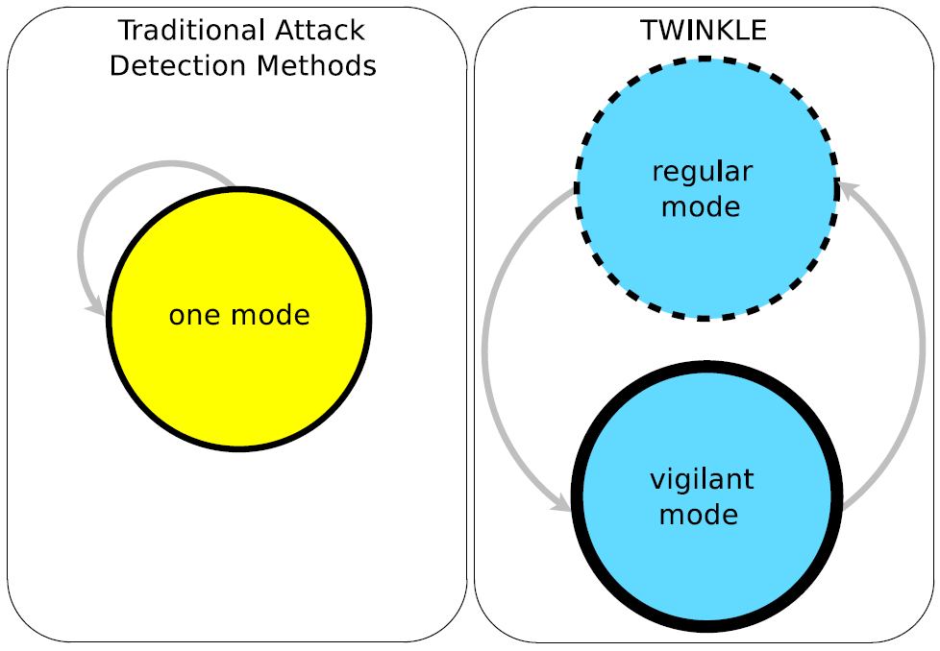
State Diagrams

Slide 13
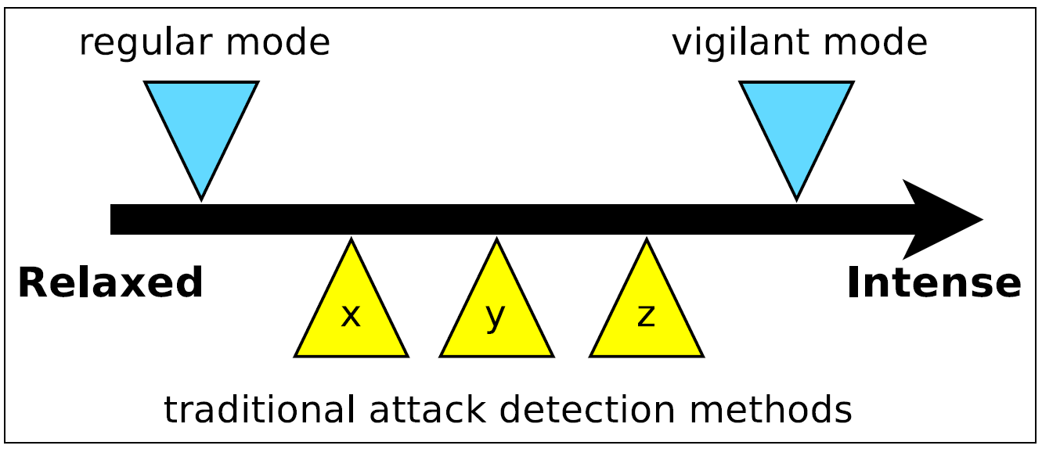
Resource Consumption

Slide 14
Twinkle’s Three Components
Manager
Policy Checker
Watchdog
Notes:
Three Main Components:
Manager
Watchdog
Policy Checker
In general, the manager and policy checker will be running at a central node, such as the border router of a smart home, and the watchdog can be running at every device.

Slide 15
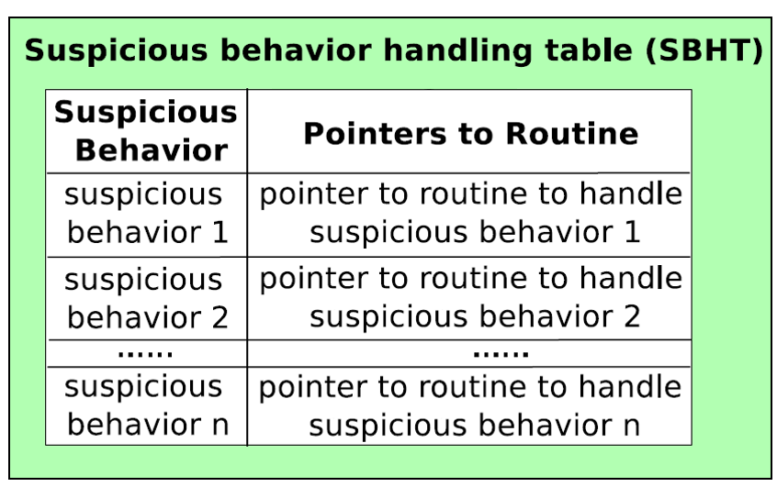
Manager
Maintains information of the smart home network
Supports a function to handle suspicious behavior, or the suspicious behavior handling function (SBHF)
Maintains a suspicious behavior handling table (SBHT)
Notes:
Maintains information of the smart home network, such as the network topology, routing information, or allowed bandwidth of each out bound connection
Maintains a suspicious behavior handling table (SBHT), in which for each suspicious behavior it points to a specific routine for handling that suspicious behavior

Slide 16
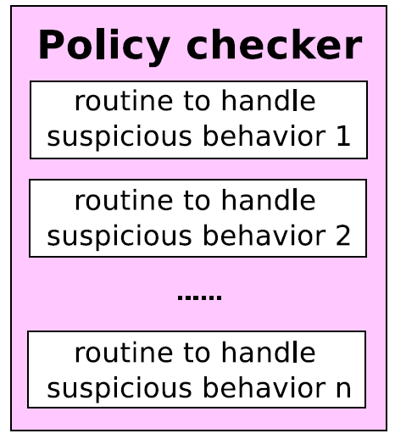
Policy Checker
Maintains routines for handling suspicious behavior
Such routines are usually heavyweight and should only be running in vigilant mode when invoked on-demand

Slide 17
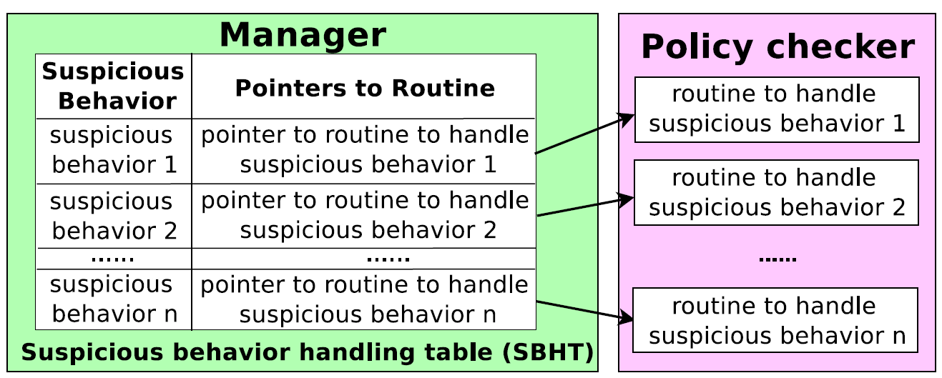
Interaction Between Manager and Policy Checker

Slide 18
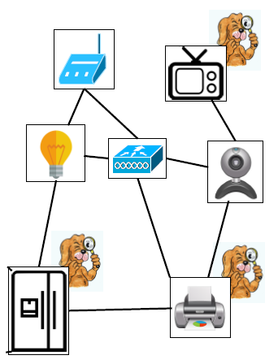
Watchdog
Lightweight process that monitors smart home for suspicious behavior
Multiple watchdogs can be running at multiple devices
Whenever a watchdog detects suspicious behavior, it invokes SBHF to process the suspicious behavior
As soon as function begins its execution, system will enter vigilant mode

Slide 19
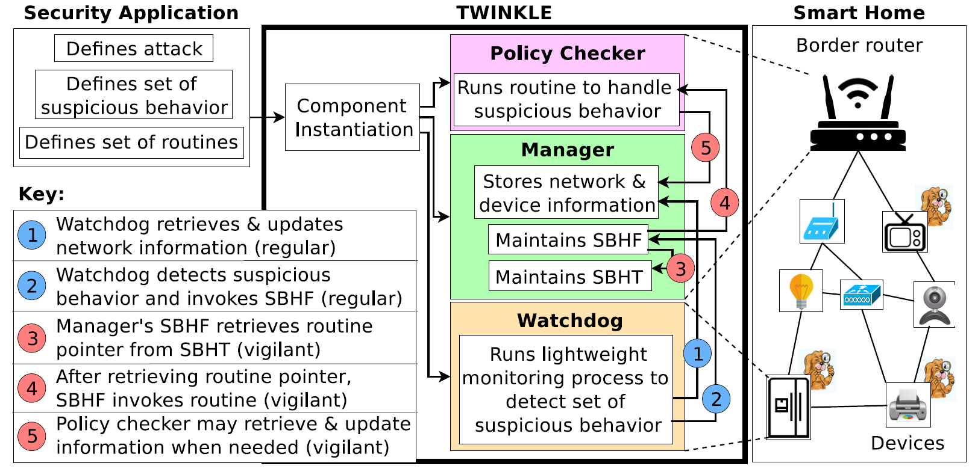
TWINKLE Architecture
Notes:
Include transitions for clarity

Slide 20
TWINKLE Architecture
Notes:
Include transitions for clarity

Slide 21
TWINKLE Architecture
Notes:
Include transitions for clarity

Slide 22
TWINKLE Architecture
Notes:
Include transitions for clarity

Slide 23
TWINKLE Architecture
1
Notes:
Include transitions for clarity

Slide 24
TWINKLE Architecture
2
Notes:
Include transitions for clarity

Slide 25
TWINKLE Architecture
3
Notes:
Include transitions for clarity

Slide 26
TWINKLE Architecture
4
Notes:
Include transitions for clarity

Slide 27
TWINKLE Architecture
5
Notes:
Include transitions for clarity

Slide 28
TWINKLE Architecture
Notes:
Include transitions for clarity

Slide 29
TWINKLE Architecture
Notes:
Include transitions for clarity

Slide 30
TWINKLE Architecture
Notes:
Include transitions for clarity

Slide 31
Table of Contents
Background & Motivation
Related Work
The TWINKLE Framework
Case Study 1: DDoS Attack Detection by Transforming D-WARD
Case Study 2: Sinkhole Attack Detection by Transforming SVELTE
Feasibility and Drawbacks of TWINKLE
Conclusion

Slide 32
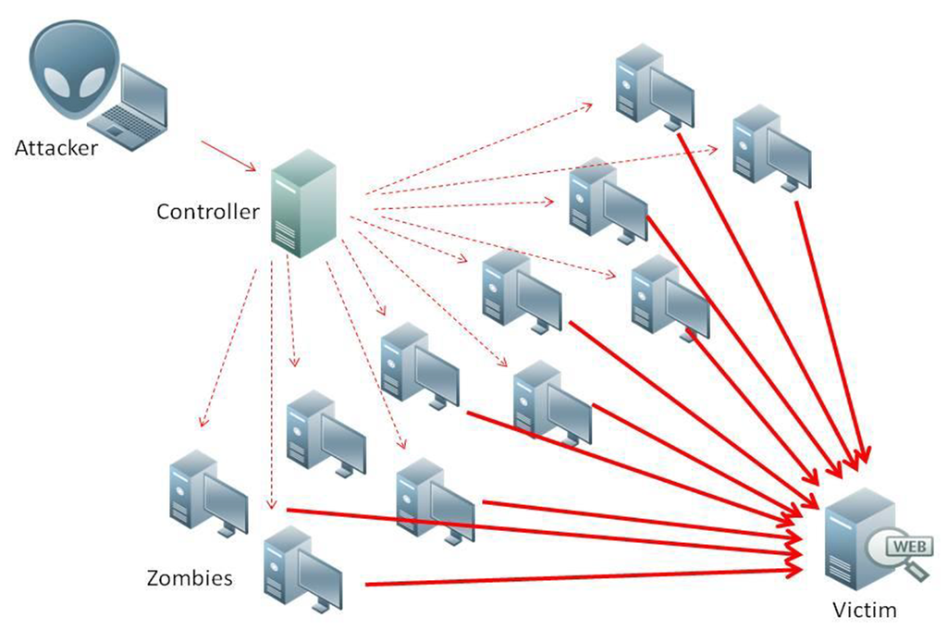
https://www.realnets.com/our-blog/massive-ddos-attacks-lizardstresser/

Slide 33

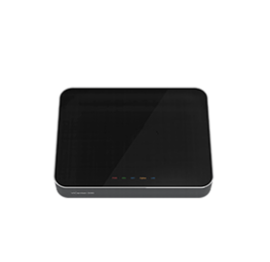







Slide 34
Prior Art: D-WARD Against DDoS Attacks
Source-end solution – deployed at border router
Classifies each aggregated flow (agflow) as good, suspicious, or attack
  agflow – each connection from devices in the network to a specific destination outside the network
If rate limit is followed for certain period of time, rate limit increases linearly and is eventually removed
Mirkovic, Jelena, and Peter Reiher. "D-WARD: A Source-End Defense Against Flooding Denial-of-Service Attacks." IEEE Transactions on Dependable and Secure Computing 2.3 (2005): 216-232.

Slide 35
Prior Art: D-WARD’s Shortcomings
D-WARD targeted towards traditional end-hosts
Could hurt benign devices if their connections are labeled as transient connections
While a traditional benign end-host can recover from the accidental loss of their packets, in a IoT environment such as a smart home, a benign device could instead suffer significantly from such a loss

Slide 36
D-WARD+: A Two-Mode Approach Against DDoS Attacks
Essential difference between D-WARD and D-WARD+: D-WARD+ does not drop traffic of transient connections, but instead leverages the fast retransmit mechanism of TCP congestion control

Slide 37
D-WARD+: A Two-Mode Approach Against DDoS Attacks
In regular mode:
  Watchdog passively monitors network
  Once attack agflow is detected, watchdog notifies manager
  Manager’s SBHF is invoked and system enters vigilant mode
In vigilant mode:
  Manager’s SBHF invokes agflow monitoring routine inside policy checker
  Agflow monitoring routine monitors each transient connection of attack agflow
  Alert device to cut sending rate in half if rate-limit is surpassed by sending it three duplicate ACK packets (signal)
  If device ignores signals, classify connection as bad and drop traffic
  Return to regular mode once all connections are below the rate-limit for a certain amount of time and receivers are not congested (determined by flow control)

Slide 38
Evaluation Setup
Implemented D-WARD+ and D-WARD in Java
2015 Dell XPS: 2.2 GHz Intel Core i5 processor, 8GB of RAM
Constructed a Bluetooth Personal Area Network (PAN)
Client device transfers 2.5 MB of data to the server through a router on which D-WARD+ and D-WARD are implemented
Client device performs simple and smart TCP flooding attacks
Client and server utilized TCP New Reno for congestion control

Slide 39
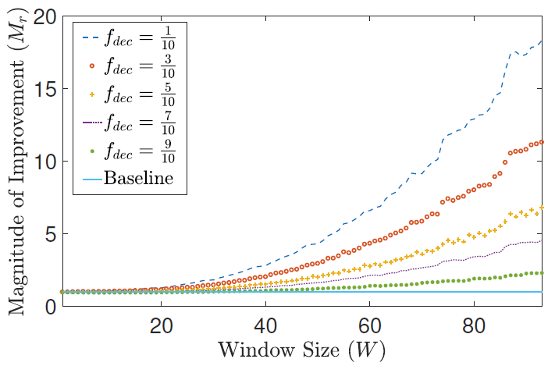
Improvement in Retransmissions

Slide 40
Improvement in Retransmissions

Slide 41
Improvement in Retransmissions

Slide 42
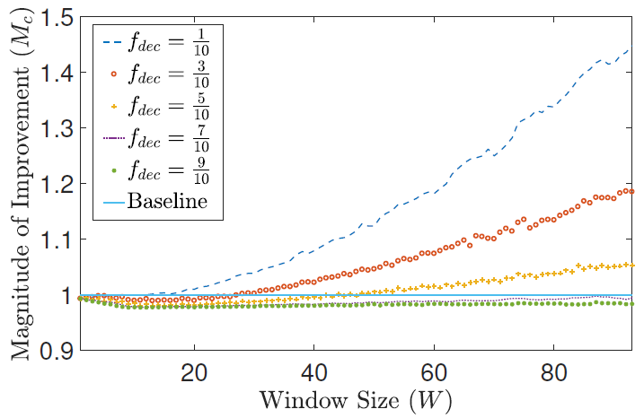
Improvement in Connection Duration

Slide 43
Improvement in Connection Duration

Slide 44
Improvement in Connection Duration

Slide 45
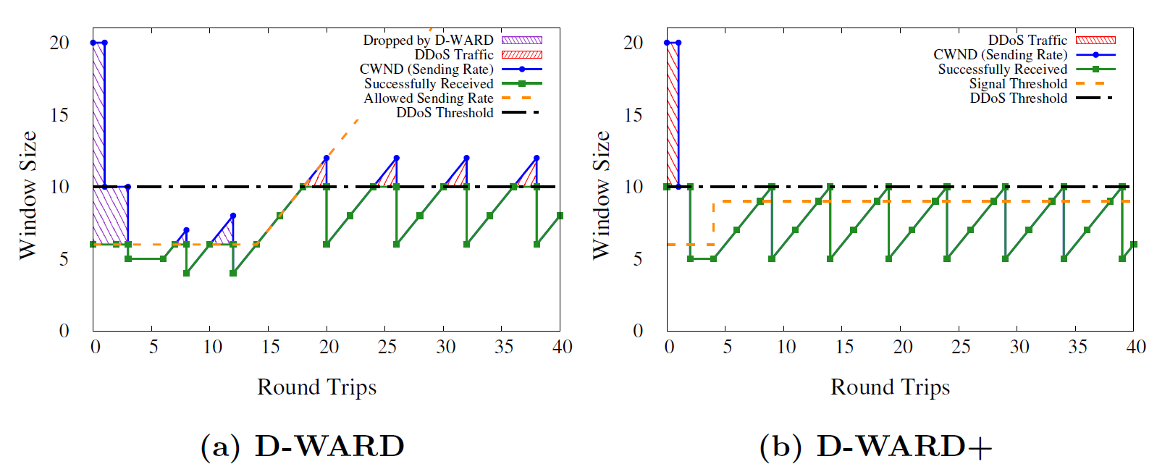
Effect on “Smart” Attacker

Slide 46
Effect on “Smart” Attacker
Victim is under DDoS Attack

Slide 47
D-WARD+ vs. D-WARD
Retransmission of packets: by minimizing the dropping of packets from benign devices, D-WARD+ reduces amount of retransmissions of benign devices
  Thus reducing network overhead and battery consumption
Connection duration: in most cases, by not dropping packets, D-WARD+ reduces connection duration
  Thus reducing data transfer time

Slide 48
Table of Contents
Background & Motivation
Related Work
The TWINKLE Framework
Case Study 1: DDoS Attack Detection by Transforming D-WARD
Case Study 2: Sinkhole Attack Detection by Transforming SVELTE
Feasibility and Drawbacks of TWINKLE
Conclusion
Notes:
In this case study, we transform SVELTE, an IDS for detecting sinkhole attacks in 6LoWPAN
networks, into a more resource-efficient security application on TWINKLE.

Slide 49
Sinkhole Attack
A compromised device announces a short path toward a destination node to attract traffic from other nodes to the destination, therefore intercepting or dropping the traffic and creating a sinkhole
Sinkhole attack via RPL (Routing Protocol over Low Powered and Lossy Networks) can happen when a device sends an advertisement message to its neighbors to lie that the device has a low rank
RPL’s self-healing and repair mechanisms are not resilient against sinkhole attacks

Slide 50
Prior Art: SVELTE Against the Sinkhole Attack in 6LoWPAN
Two main modules running on the border router of a 6LoWPAN network:
  A mapper which builds a routing map of the network
  Intrusion detection module which checks for the rank inconsistencies
One module running on the devices:
  Receives and responds to probing messages from border router
Raza, Shahid, Linus Wallgren, and Thiemo Voigt. "SVELTE: Real-time intrusion detection in the Internet of Things." Ad Hoc Networks 11.8 (2013): 2661-2674.
Notes:
Cite SVELTE!

Slide 51
Prior Art: SVELTE’s Shortcomings
SVELTE’s probing mechanism can increase network overhead, device battery consumption, and latency of detection
Every probe from the border router will increase network overhead
Every response from a device will increase network overhead and consume device’s battery
Worst of all, SVELTE has a dilemma in choosing the probing interval:
  A short interval will lead to a low latency in detecting sinkhole attacks, but a large overhead due to frequent probing and responding
  A long interval will result in a low overhead, but a high latency in detecting sinkhole attacks

Slide 52
SVELTE+: A Two-Mode Approach Against 6LowPAN Sinkhole Attacks
Essential difference between SVELTE+ and SVELTE: Border router will NOT probe the entire network periodically, but on demand

Slide 53
SVELTE+: A Two-Mode Approach Against 6LowPAN Sinkhole Attacks
In regular mode:
  Watchdogs passively monitors network
  Once a new rank advertisement occurs, all watchdogs in range of advertisement will notify manager
  Manager’s SBHF is invoked and system enters vigilant mode
In vigilant mode:
  Manager’s SBHF invokes sinkhole detection routine inside policy checker
  Sinkhole detection routine queries manager for up-to-date routing map
  Compares rank of watchdogs and suspect to find inconsistencies
    If inconsistency NOT found: update routing map and return to regular mode
    If inconsistency is detected: Policy checker invokes sinkhole mitigation routine and once routine is complete, return to regular mode

Slide 54
Evaluation Setup
Implemented SVELTE+ and SVELTE in Java
2015 Dell XPS: 2.2 GHz Intel Core i5 processor, 8GB of RAM
Randomly generated mesh IoT network topologies of varying size
Simulated RPL and sinkhole attacks through rank manipulation

Slide 55
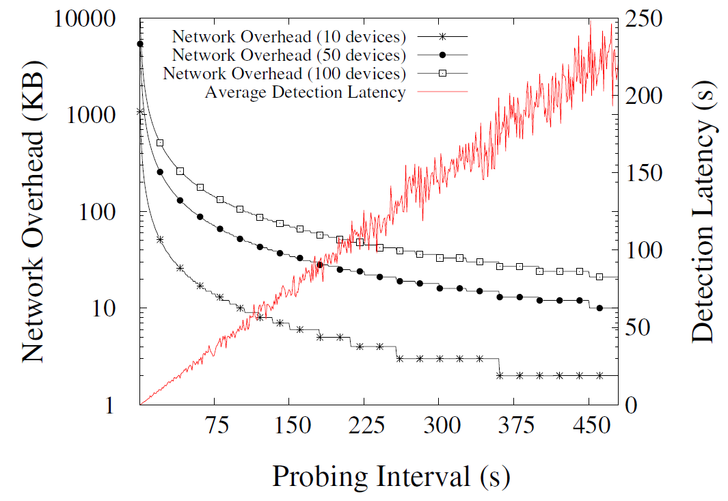
Effect of Probing Interval in SVELTE

Slide 56
Effect of Probing Interval in SVELTE

Slide 57

Effect of Probing Interval in SVELTE

Slide 58

Effect of Probing Interval in SVELTE

Slide 59
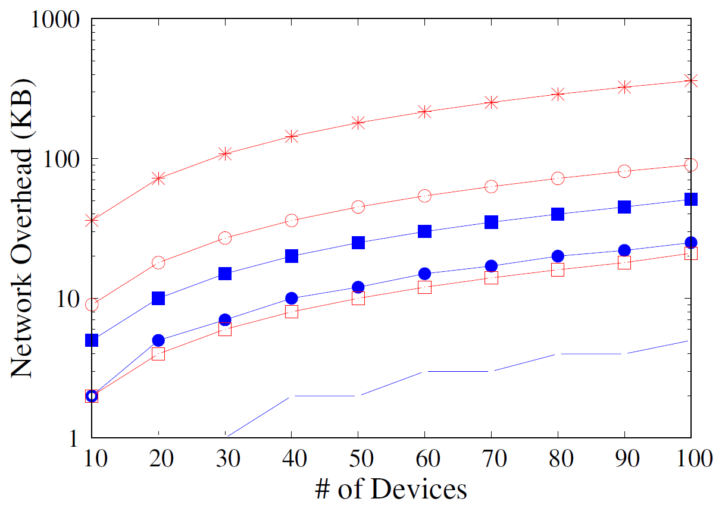
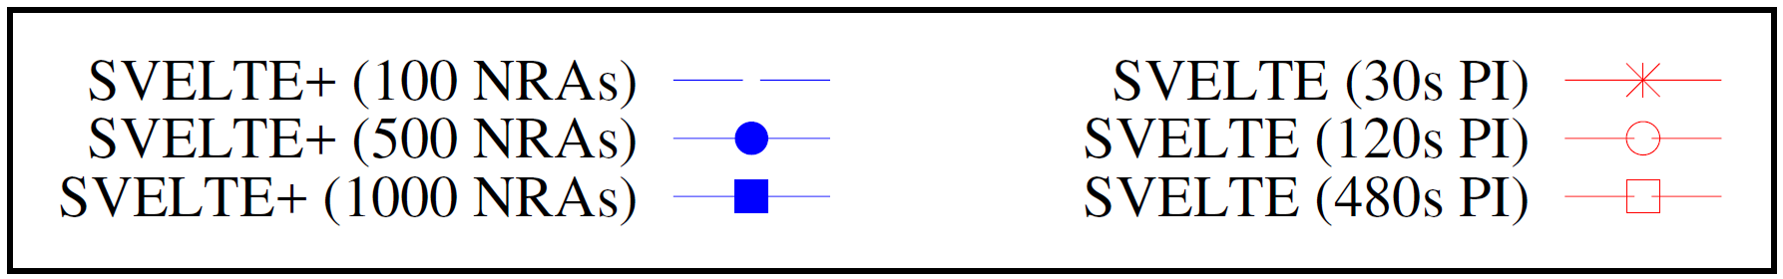
Difference in Network Overhead
PI: Probing Interval
NRA/D: New Rank Advertisements per Device
Notes:
Average Degree of 3

Slide 60
Difference in Network Overhead
PI: Probing Interval
NRA/D: New Rank Advertisements per Device
Notes:
Average Degree of 3

Slide 61
Difference in Network Overhead
PI: Probing Interval
NRA/D: New Rank Advertisements per Device
Notes:
Average Degree of 3

Slide 62
SVELTE+ vs. SVELTE
Detection latency: negligible in SVELTE+
  SVELTE+ does not wait for probing interval to check network
Network overhead and battery consumption: SVELTE+ may incur more overhead in the beginning as nodes join the network, but as the network stabilizes, the amount of times SVELTE+ switches to vigilant mode will be low

Slide 63
Table of Contents
Background & Motivation
Related Work
The TWINKLE Framework
Case Study 1: DDoS Attack Detection by Transforming D-WARD
Case Study 2: Sinkhole Attack Detection by Transforming SVELTE
Feasibility and Drawbacks of TWINKLE
Conclusion

Slide 64
Feasibility and Limitations of TWINKLE
Installing manager and policy checker on border router may not be feasible in certain environments
Installing watchdog on devices may also not be feasible in certain environments
  Installing on legacy devices?
  Installing on low-powered devices?
  Some environments may need to deploy devices whose sole purpose is to run Watchdog code

Slide 65
Table of Contents
Background & Motivation
Related Work
The TWINKLE Framework
Case Study 1: DDoS Attack Detection by Transforming D-WARD
Case Study 2: Sinkhole Attack Detection by Transforming SVELTE
Feasibility and Drawbacks of TWINKLE
Conclusion

Slide 66
Conclusion
Contributions:
  TWINKLE, a two-mode security framework that supports individual security applications that can handle specific attacks in a smart home environment
  Two-mode methodology: only run enough security features to detect suspicious behavior and add more security features on demand if needed
  Transformed two existing security solutions and made them more resource-efficient
Future Work:
  Implementing TWINKLE on a real IoT network
  Extending TWINKLE to include more than two modes

Slide 67
Thank you!

Slide 68
Appendix

Slide 69
Introduction

Slide 70
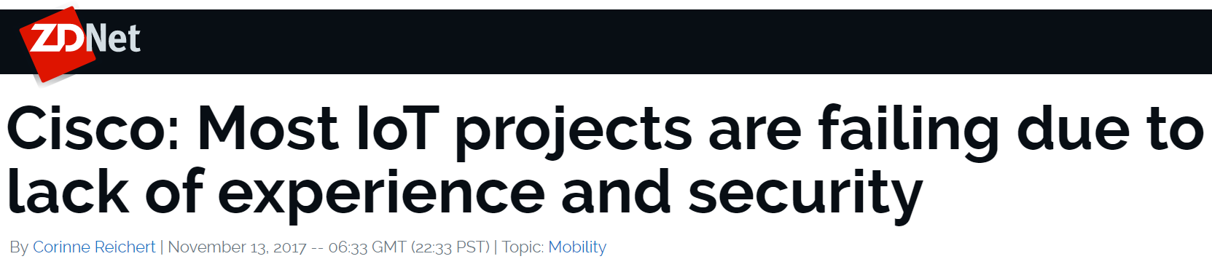

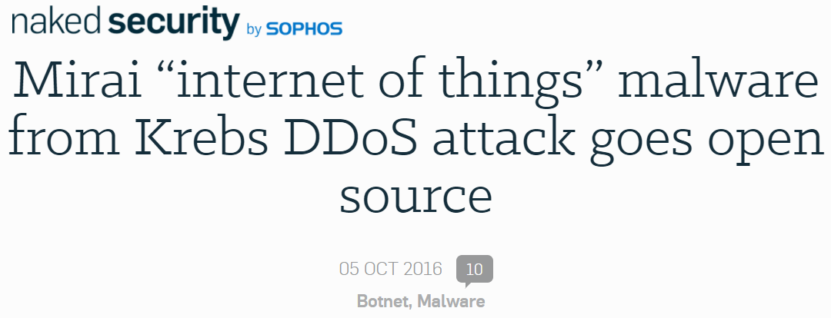
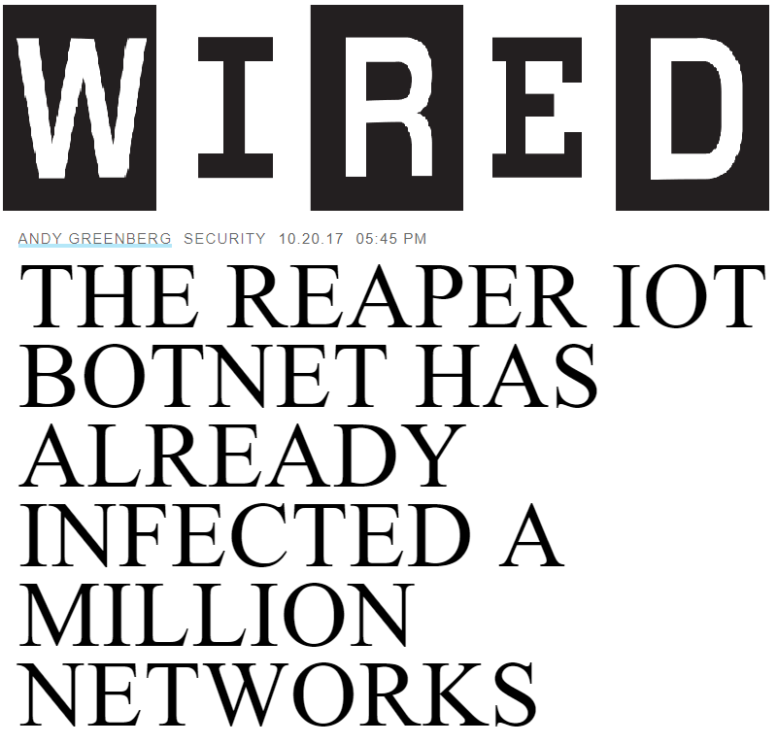
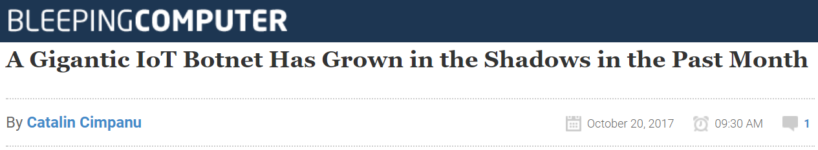
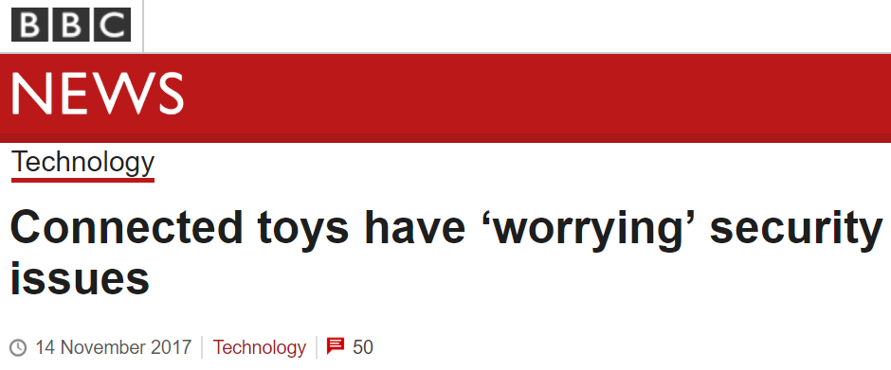
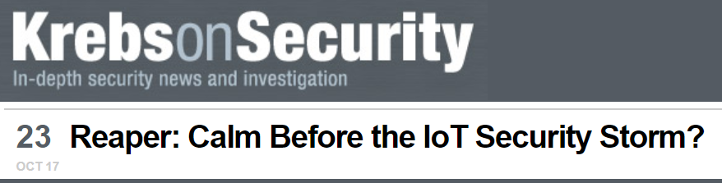
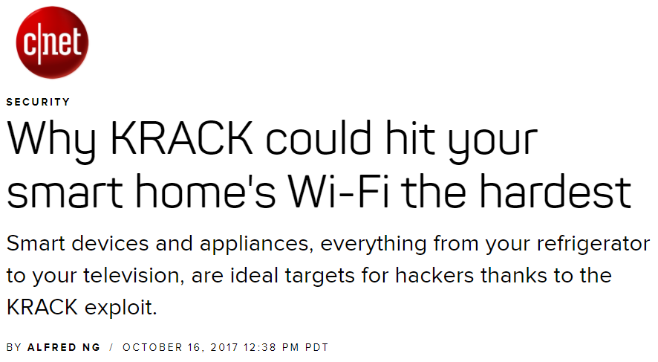

Slide 71
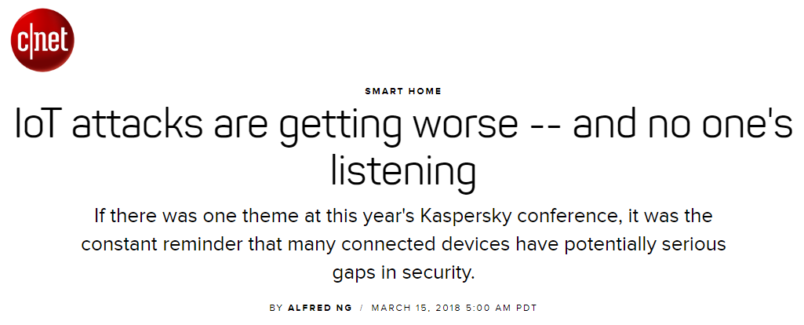
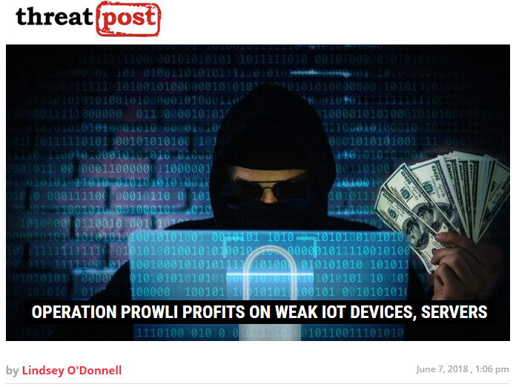
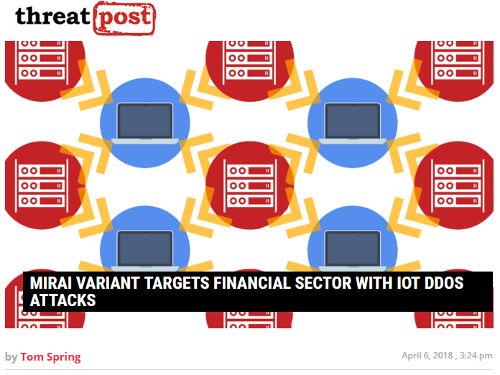
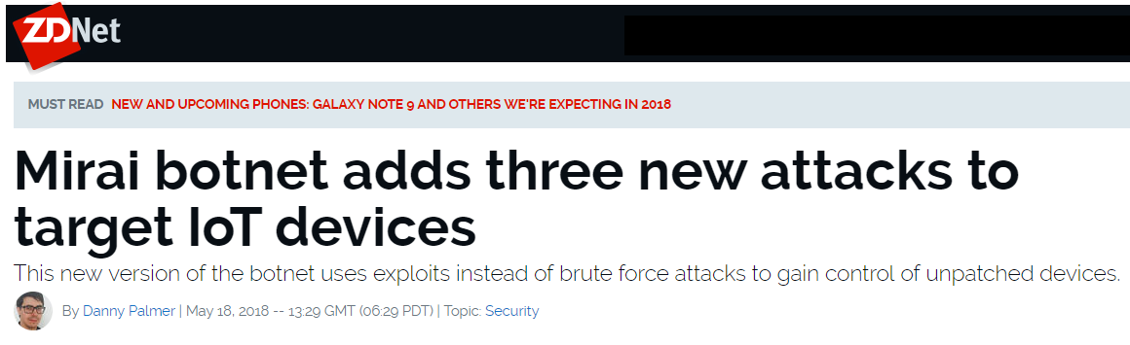
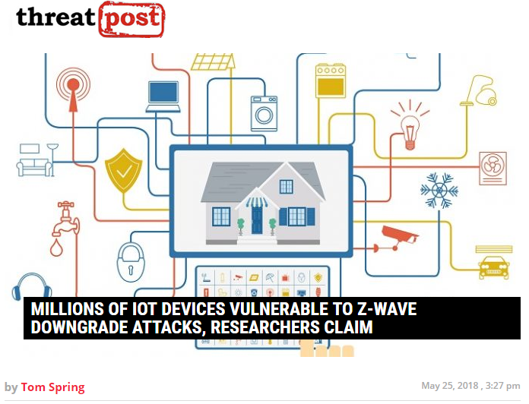
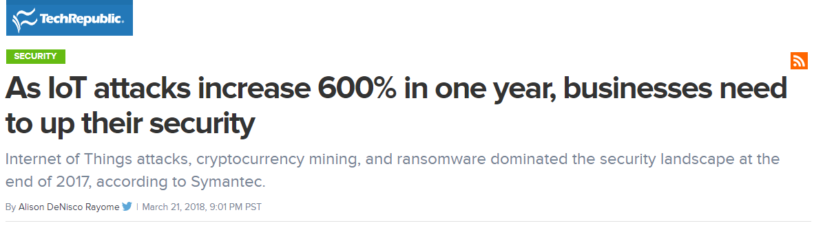
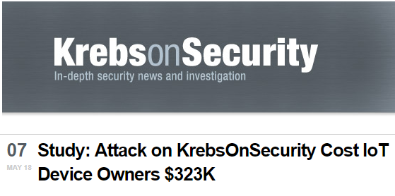

Slide 72


Slide 73

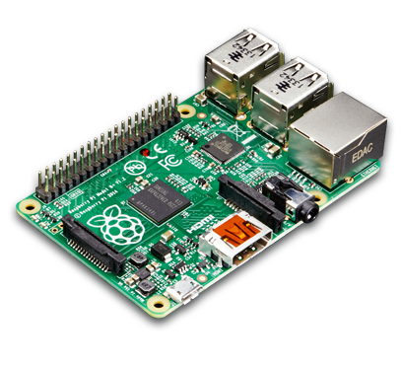


Slide 74


Slide 77


Slide 78



Slide 79



Slide 82


Slide 83
Related Work

Slide 84
Related Work
H. Abie et al., “Risk-based adaptive security for smart IoT in eHealth,” in Proceedings of the 7th International Conference on Body Area Networks. 2012
J. B. Bernabe et al., “Privacy-preserving security framework for a social-aware internet of things,” in International Conference on Ubiquitous Computing and Ambient Intelligence. 2014
A. K. Simpson et al., ”Securing vulnerable home IoT devices with an in-hub security manager,” in IEEE International Conference on Pervasive Computing and Communications Workshops. 2017
W. M. Kang et al., “An enhanced security framework for home appliances in smart home,” Humancentric Computing and Information Sciences. 2017

Slide 85
Related Work
H. Abie et al., “Risk-based adaptive security for smart IoT in eHealth,” in Proceedings of the 7th International Conference on Body Area Networks. 2012
J. B. Bernabe et al., “Privacy-preserving security framework for a social-aware internet of things,” in International Conference on Ubiquitous Computing and Ambient Intelligence. 2014
A. K. Simpson et al., “Securing vulnerable home IoT devices with an in-hub security manager,” in IEEE International Conference on Pervasive Computing and Communications Workshops. 2017
W. M. Kang et al., “An enhanced security framework for home appliances in smart home,” Humancentric Computing and Information Sciences. 2017

Slide 86
Watchdog
Watchdog
Watchdog
Manager
Watchdog
Policy Checker
Watchdog

Slide 87
Architecture

Slide 88
TWINKLE Architecture: Security Applications
TWINKLE will instantiate manager, policy checker, and watchdog according to the security application
Security application must:
  Define the attack it targets and suspicious behavior that its watchdog should monitor
  Develop routines to handle each suspicious behavior
  Plug these routines into the policy checker
  Populate the suspicious behavior handling table with every suspicious behavior that the security application is concerned about and the routine that handles the suspicious behavior

Slide 89
TWINKLE Architecture: Elf
TWINKLE provides a dynamic mechanism for a security application to install its watchdog at any device needed
Unlike the manager or policy checker that can run at a central node, depending on the security application in question, the watchdog may need to run on arbitrary devices in the smart home
TWINKLE deploys a lightweight process called elf at each device that may be a candidate for running a watchdog
TWINKLE can communicate with the elf on the device to ship, install, and eventually run watchdog code on the device

Slide 90
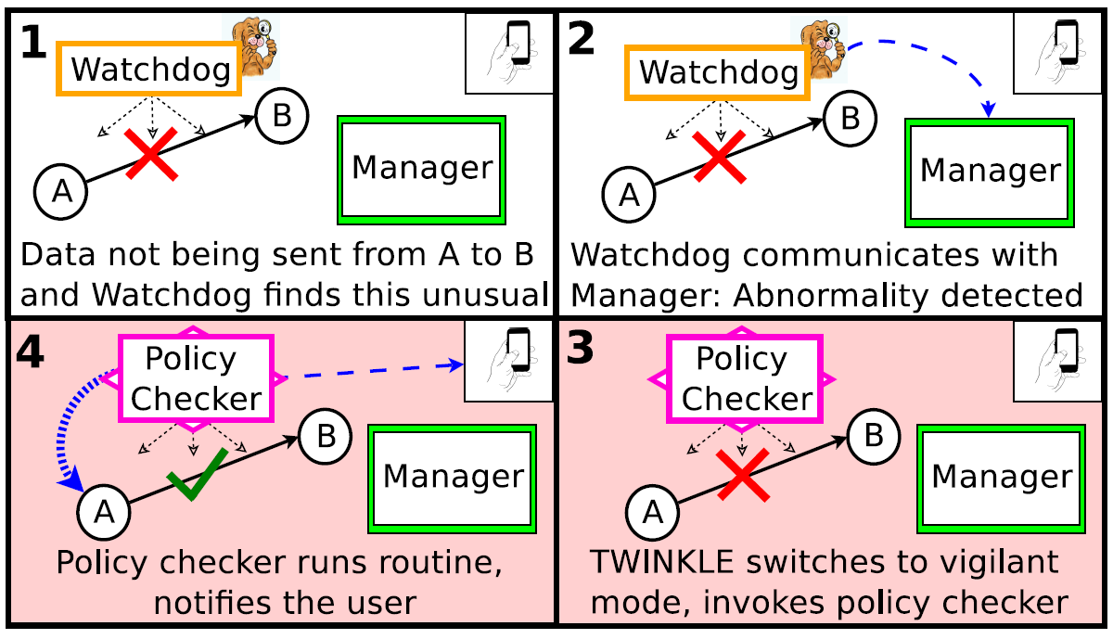
TWINKLE Handling a Jamming Attack

Slide 91
Case Study 1

Slide 92
Prior Art: D-WARD Against DDoS Attacks
Source-end solution – deployed at border router
Classifies each aggregated flow (agflow) as good, suspicious, or attack
  agflow – each connection from devices in the network to a specific destination outside the network
Each connection in an attack agflow is classified as good, bad, and transient
Classification is done based on ratio of sent packets to received packets
Rate limits each bad and transient connection by dropping traffic to a fraction (f_{dec}) of the window size (W)
If rate limit is followed for certain period of time, rate limit increases linearly and is eventually removed
Mirkovic, Jelena, and Peter Reiher. "D-WARD: A Source-End Defense Against Flooding Denial-of-Service Attacks." IEEE Transactions on Dependable and Secure Computing 2.3 (2005): 216-232.

Slide 93
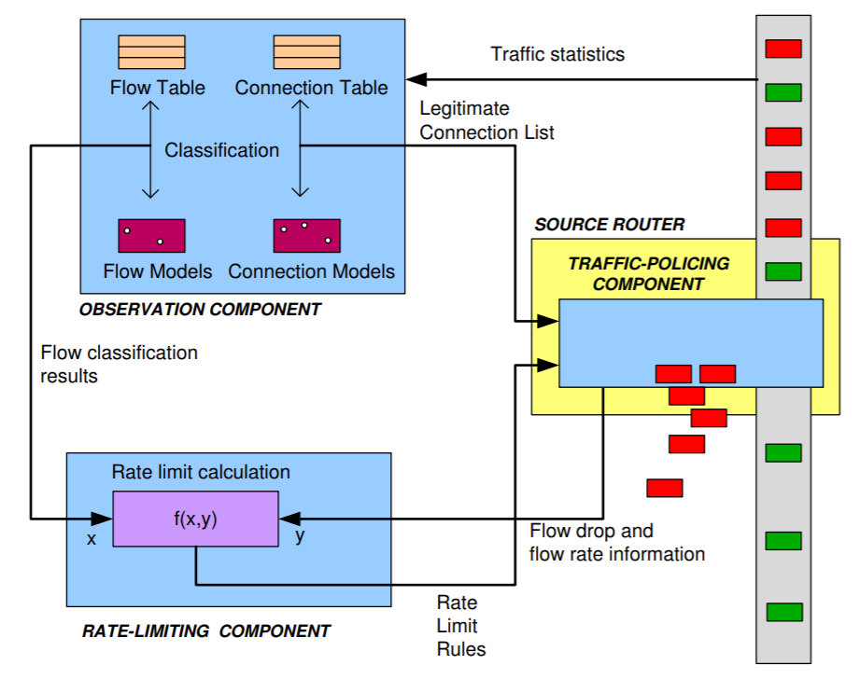
Prior Art: D-WARD’s Three Modules
93
Observation module: classifies each agflow and each connection in a bad or transient agflow
Rate-limiting module: calculates and updates rate-limit
Traffic-policing module: drops all traffic surpassing the rate-limit

Slide 94
D-WARD+: A Two-Mode Approach Against DDoS Attacks
Manager: keeps track of rate-limit of every connection in every attack aggregated flows or agflows (equivalent to rate-limiting module)
Policy checker: consists of an agflow monitoring routine (equivalent to observation module for connections and traffic-policing module)
Watchdog: monitors the suspicious behavior of each agflow and has the agflow monitoring routine invoked if it detects an attack agflow (equivalent to observation module for agflows)
All components are installed on the border router

Slide 95
Effect on “Smart” Attacker

Slide 96
Effect on “Smart” Attacker
Victim is under DDoS Attack

Slide 97
In Conclusion
Based on the two-mode design, D-WARD+ is more suitable to a smart home environment than D-WARD. By not literally dropping packets as in D-WARD, D-WARD+ instead informs devices to transmit more slowly. Doing so avoids retransmissions of packets from benign devices, thus lowering network overhead and power consumption.

Slide 98
Case Study 2

Slide 99
6LoWPAN Networks
6LoWPAN (IPv6 over Low power Wireless Personal Area Networks): a wireless technology that combines IPv6 and Low-power Wireless Personal Area Networks (LoWPAN) to enable low-powered devices to communicate using an Internet protocol
6LoWPAN uses RPL (Routing Protocol over Low Powered and Lossy Networks) as its routing protocol

Slide 100
6BR
A
B
C
D
E
F
G
Notes:
RPL creates a graph called Destination Oriented Directed Acyclic Graph (DODAG) where every node is a device in the network and the sink is the root (border router)
Each node in a DODAG has a set of parents, including a preferred parent, where every parent is a potential next hop to reach the root
Moreover, every node in a DODAG has a rank to represent the distance between the device and the root (the distance can be calculated in a number of ways, the simplest being hop-count)
Each device periodically sends out a DODAG Information Object (DIO) message to advertise its rank
A device can also solicit DIO messages from its neighbors by sending them DODAG Information Solicitation (DIS) messages
An entering device, upon the receipt of DIO messages from its neighboring devices, will create its set of parents, choose the preferred parent, and calculate its own rank (which is greater than the rank of each of its parents)

Slide 101
6BR
Rank = 0
A
B
Rank = 1
C
D
E
Rank = 2
F
G
Rank = 3
Notes:
RPL creates a graph called Destination Oriented Directed Acyclic Graph (DODAG) where every node is a device in the network and the sink is the root (border router)
Each node in a DODAG has a set of parents, including a preferred parent, where every parent is a potential next hop to reach the root
Moreover, every node in a DODAG has a rank to represent the distance between the device and the root (the distance can be calculated in a number of ways, the simplest being hop-count)
Each device periodically sends out a DODAG Information Object (DIO) message to advertise its rank
A device can also solicit DIO messages from its neighbors by sending them DODAG Information Solicitation (DIS) messages
An entering device, upon the receipt of DIO messages from its neighboring devices, will create its set of parents, choose the preferred parent, and calculate its own rank (which is greater than the rank of each of its parents)

Slide 102
6BR
Rank = 0
A
B
Rank = 1
C
D
E
Rank = 2
F
G
Rank = 3
Notes:
RPL creates a graph called Destination Oriented Directed Acyclic Graph (DODAG) where every node is a device in the network and the sink is the root (border router)
Each node in a DODAG has a set of parents, including a preferred parent, where every parent is a potential next hop to reach the root
Moreover, every node in a DODAG has a rank to represent the distance between the device and the root (the distance can be calculated in a number of ways, the simplest being hop-count)
Each device periodically sends out a DODAG Information Object (DIO) message to advertise its rank
A device can also solicit DIO messages from its neighbors by sending them DODAG Information Solicitation (DIS) messages
An entering device, upon the receipt of DIO messages from its neighboring devices, will create its set of parents, choose the preferred parent, and calculate its own rank (which is greater than the rank of each of its parents)

Slide 103
6BR
Rank = 0
A
B
Rank = 1
C
D
E
Rank = 2
H
F
G
Rank = 3
Notes:
RPL creates a graph called Destination Oriented Directed Acyclic Graph (DODAG) where every node is a device in the network and the sink is the root (border router)
Each node in a DODAG has a set of parents, including a preferred parent, where every parent is a potential next hop to reach the root
Moreover, every node in a DODAG has a rank to represent the distance between the device and the root (the distance can be calculated in a number of ways, the simplest being hop-count)
Each device periodically sends out a DODAG Information Object (DIO) message to advertise its rank
A device can also solicit DIO messages from its neighbors by sending them DODAG Information Solicitation (DIS) messages
An entering device, upon the receipt of DIO messages from its neighboring devices, will create its set of parents, choose the preferred parent, and calculate its own rank (which is greater than the rank of each of its parents)

Slide 104
6BR
Rank = 0
A
B
Rank = 1
C
D
E
Rank = 2
H sends out DIS
H
F
G
Rank = 3
Notes:
RPL creates a graph called Destination Oriented Directed Acyclic Graph (DODAG) where every node is a device in the network and the sink is the root (border router)
Each node in a DODAG has a set of parents, including a preferred parent, where every parent is a potential next hop to reach the root
Moreover, every node in a DODAG has a rank to represent the distance between the device and the root (the distance can be calculated in a number of ways, the simplest being hop-count)
Each device periodically sends out a DODAG Information Object (DIO) message to advertise its rank
A device can also solicit DIO messages from its neighbors by sending them DODAG Information Solicitation (DIS) messages
An entering device, upon the receipt of DIO messages from its neighboring devices, will create its set of parents, choose the preferred parent, and calculate its own rank (which is greater than the rank of each of its parents)

Slide 105
6BR
Rank = 0
A
B
Rank = 1
C, D, F send H DIO (includes their rank)
C
D
E
Rank = 2
H
F
G
Rank = 3
Notes:
RPL creates a graph called Destination Oriented Directed Acyclic Graph (DODAG) where every node is a device in the network and the sink is the root (border router)
Each node in a DODAG has a set of parents, including a preferred parent, where every parent is a potential next hop to reach the root
Moreover, every node in a DODAG has a rank to represent the distance between the device and the root (the distance can be calculated in a number of ways, the simplest being hop-count)
Each device periodically sends out a DODAG Information Object (DIO) message to advertise its rank
A device can also solicit DIO messages from its neighbors by sending them DODAG Information Solicitation (DIS) messages
An entering device, upon the receipt of DIO messages from its neighboring devices, will create its set of parents, choose the preferred parent, and calculate its own rank (which is greater than the rank of each of its parents)

Slide 106
6BR
Rank = 0
A
B
Rank = 1
H creates parent set (C, D) and chooses preferred parent (C)
C
D
E
Rank = 2
H
F
G
Rank = 3
Notes:
RPL creates a graph called Destination Oriented Directed Acyclic Graph (DODAG) where every node is a device in the network and the sink is the root (border router)
Each node in a DODAG has a set of parents, including a preferred parent, where every parent is a potential next hop to reach the root
Moreover, every node in a DODAG has a rank to represent the distance between the device and the root (the distance can be calculated in a number of ways, the simplest being hop-count)
Each device periodically sends out a DODAG Information Object (DIO) message to advertise its rank
A device can also solicit DIO messages from its neighbors by sending them DODAG Information Solicitation (DIS) messages
An entering device, upon the receipt of DIO messages from its neighboring devices, will create its set of parents, choose the preferred parent, and calculate its own rank (which is greater than the rank of each of its parents)

Slide 107
6BR
Rank = 0
A
B
Rank = 1
C
D
E
Rank = 2
H
F
G
Rank = 3

Slide 108
6BR
Rank = 0
A
B
Rank = 1
C advertises new Rank = 1
C
D
E
Rank = 2
H
F
G
Rank = 3

Slide 109
6BR
Rank = 0
A
B
Rank = 1
Which causes D and F to choose it as a preferred parent
C
D
E
Rank = 2
H
F
G
Rank = 3

Slide 110
Prior Art: SVELTE Against the Sinkhole Attack in 6LoWPAN
Two main modules running on the border router (6BR) of a 6LoWPAN network:
  6LoWPAN Mapper (6Mapper): gathers information about the network and determines the routing map (DODAG rooted at 6BR)
  Intrusion detection module: checks the rank inconsistency in data obtained by 6Mapper to detect sinkhole attacks
6Mapper sends probing messages to all nodes in network at regular intervals (e.g., 2 minutes)
Each node then sends a response message to 6Mapper, which includes its node ID, node rank, parent ID, and all of its neighbors’ IDs and ranks.
Raza, Shahid, Linus Wallgren, and Thiemo Voigt. "SVELTE: Real-time intrusion detection in the Internet of Things." Ad Hoc Networks 11.8 (2013): 2661-2674.
Notes:
Cite SVELTE!

Slide 111
SVELTE+: A Two-Mode Approach Against 6LowPAN Sinkhole Attacks
Manager (6BR): 6Mapper module from SVELTE
Policy checker (6BR): two suspicious behavior handling routines
  Sinkhole detection routine (i.e., the intrusion detection module from SVELTE) that inspects the ranks of nodes in the routing map to determine if a sinkhole attack is occurring
  Sinkhole mitigation routine that SVELTE+ newly introduced to mitigate a detected sinkhole attack
Watchdog (device): monitors the ranks of its neighbors and alerts the manager of a suspicious behavior when it receives a new rank advertisement

Slide 112
In Conclusion
SVELTE+ can reduce the latency in detecting sinkhole attacks to a negligible amount because the watchdog immediately invokes the suspicious behavior handler whenever a new rank is advertised, without having to wait for the next probing interval, as in SVELTE. SVELTE+ also decreases the network overhead and device power consumption as compared to SVELTE as a result of on-demand probing versus periodic probing.

