Slide 1
PathFinder: Capturing DDoS Traffic Footprints on the Internet Lumin Shi, Mingwei Zhang, Jun Li, and Peter Reiher IFIP Networking 2018 May 14, 2018

Slide 2
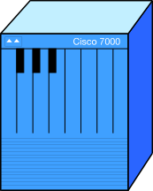
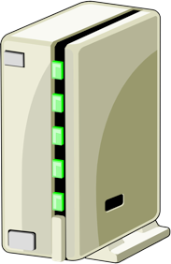
DDoS Attacks
Many defenses depend on filtering traffic
But where?
AS
AS
AS
AS
AS
AS
AS
AS
AS
AS
AS
AS
AS
AS

Slide 3
One Obvious Constraint
Filtering big attacks must be more distributed
AS
AS
AS
AS
AS
AS
AS
AS
AS
AS
AS
Here it’s too late
AS
AS
AS

Slide 4
Another Obvious Constraint
You can’t filter traffic if it isn’t there!
But where is it?
AS
AS
AS
AS
AS
AS
AS
AS
AS
AS
AS
AS
AS
AS
AS
AS
Now you have choices
AS
AS
AS
AS

Slide 5
PathFinder
PathFinder points out these choices
ASes that sending traffic towards you
Telling you where filtering might work
Using existing router capabilities
Effective in partial deployment
With options for costs and levels of detailed information

Slide 6
The Basic Approach
1. Client asks PathFinder to locate traffic paths
2. PathFinder queries participating ASes
3. They report to Pathfinder on traffic to the target they observe
4. Pathfinder sends aggregate report to the client

Slide 7
Building AS Reports
1. The AS gets reports from its egress routers about traffic to victim
2. It uses those reports to build a summary report to send to PathFinder
Here’s where a lot of careful design was required

Slide 8
PathFinder Operation Modes
Source-agnostic:
“I only care about whether you’re carrying traffic going to me”
Source-aware:
“I also need to know where it’s coming from (and maybe how much)”

Slide 9
Why Does Mode Matter?
Source-agnostic mode is easy
We just need to mark if we see traffic to a victim
Source-aware is harder
We need to keep track of source addresses (at least prefixes)
And maybe volume per address/prefix

Slide 10
Considering Our Case
I see traffic from this source 1.2.3.4
Source-agnostic:
Yes, I see traffic to you
DONE!
Source-aware:
What if there aren’t two source addresses?
And I see traffic from this other source 5.6.7.8
What if there are two million?
1.2.3.4
5.6.7.8
We need a scalable method to record and report that information

Slide 11
The PFTrie Structure
A form of prefix tree
To store source IP addresses that a participating PathFinder node has seen
Compactly, without wasting space for what you haven’t
While being able to extract the full set you’ve seen
The position on the tree is the address

Slide 12
A PFTrie in Action
We’ve already stored address X.111
Now we see address X.101, so we have to store that
X
We don’t have a node for the 0 yet, so put it in
1
Now we have a record that we saw X.101
We also don’t have a node for the final 1 yet, so put that in, as well
0
1
1
1

Slide 13
Optimizing the PFTrie
We’ve seen both X.100 and X.101
X
So the PFTrie has a node for both
1
Replace them with a single node marked as representing both
0
1
Another optimization: only store prefixes, not entire addresses
0
1
1

Slide 14
Why Not Bloom Filters?
They would be smaller than PFTries
But they’re harder to traverse
The client needs to know what addresses were seen
Bloom filters would need to be queried for each address
Or we could infer filtering locations
Not helpful with spoofing or asymmetric routing

Slide 15
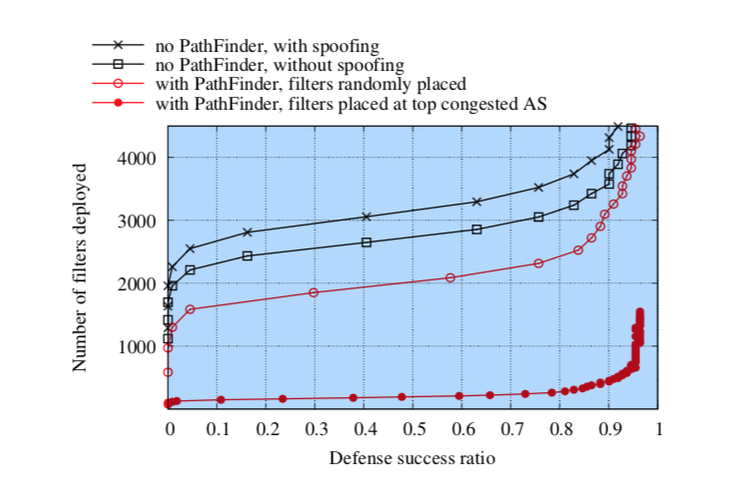
Some Performance Results
PathFinder: 90% effective with 500 filters
No PathFinder: 90% effective with 3500 filters
Spoofed packets 50%
likely to be filtered
Asymmetric routing
30% likely
Simulated 100,000 bot attack, 25 Mbps per bot
Without PathFinder, filters placed by inference
PathFinder in source-agnostic mode
PathFinder in source-aware mode

Slide 16
Conclusions
PathFinder assists DDoS defenses in choosing the most effective locations
PathFinder uses existing router features
PathFinder is more effective and cheap than previous approaches
PathFinder might be useful for other purposes

