Slide 1
Toward Explainable and Adaptable Detection and Classiﬁcation of Distributed Denial-of-Service Attacks
MLHat: The First International Workshop on Deployable Machine Learning for Security Defense
Yebo Feng, Jun Li
University of Oregon
{yebof, lijun}@cs.uoregon.edu

Slide 2
Distributed Denial-of-Service (DDoS) attack
Distributed Denial-of-Service (DDoS) attacks, by attacking (e.g., ﬂooding) the bandwidth or resources of a victim (e.g., a web server) on the Internet from multiple compromised systems (e.g., a botnet), disrupt the services of the victim and make it unavailable to its legitimate users.
The key to effectively preventing and mitigating DDoS attacks is prompt and accurate DDoS detection and classification.

Slide 3
Detection & classification of DDoS
Decades of research and industry efforts have led to a myriad of DDoS detection and classiﬁcation approaches. Nowadays, many researchers begin to harness machine learning in classifying DDoS attacks. However, such methods have two negative aspects:
The prediction results are inexplicable. An unexplainable result may lead to unexpected collateral damage when conducting access control.
Learning-based methods are not adaptive. A model trained in one environment cannot easily apply to another environment.

Slide 4
Overview of our work
In this paper, we propose a learning-based DDoS traffic detection and classiﬁcation method.
It utilizes a modiﬁed k-nearest neighbors algorithm to detect DDoS threats.
It then conducts ﬁne-grained traffic classiﬁcation using risk degree sorting with grids.
To improve efficiency, we use a k-dimensional tree to partition the searching space, shortening the time for queries signiﬁcantly.
Compared with the previous learning-based approaches, this method is highly explicable and adaptive.

Slide 5
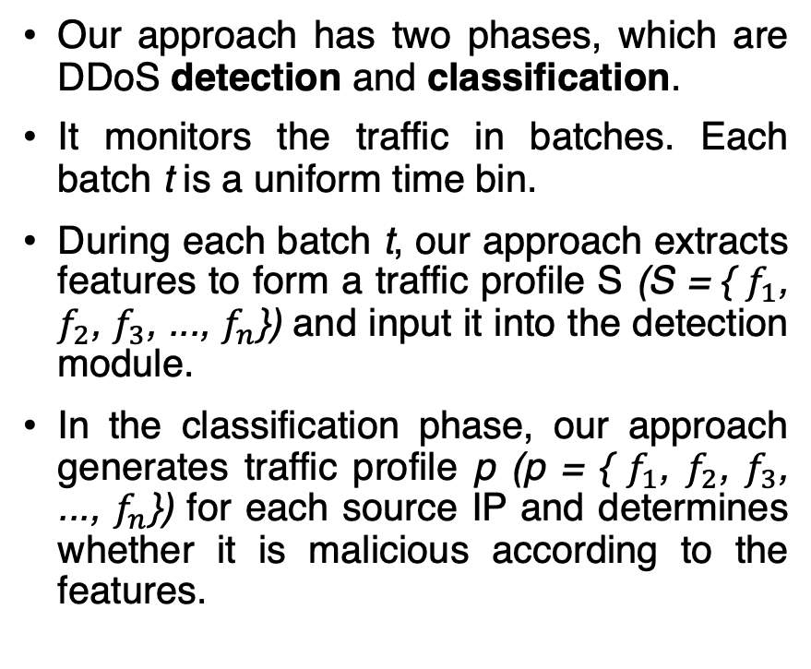
Methodology
Our approach has two phases, which are DDoS detection and classiﬁcation.
It monitors the traffic in batches. Each batch t is a uniform time bin.
During each batch t, our approach extracts features to form a traffic proﬁle S (S = { $f_{1}$, $f_{2}$, $f_{3}$, ..., $f_{n}$}) and input it into the detection module.
In the classification phase, our approach generates traffic profile p (p = { $f_{1}$, $f_{2}$, $f_{3}$, ..., $f_{n}$}) for each source IP and determines whether it is malicious according to the features.

Slide 6
Phase one: detection of DDoS traffic
We use k-nearest neighbors (KNN) algorithm in the detection of DDoS traffic.
Although it takes no time to train the model, the prediction requires a time complexity of O(nlogn) to complete. Hence, we leverage the KD tree to partition the searching space, reducing the number of data points to enumerate.
Furthermore, our approach generates a decision-tree liked structure out of the KD tree, reducing the time complexity for traffic monitoring to nearly O(d).

Slide 8
Phase two: DDoS classification
Design philosophy: the traffic proﬁle is currently in a malicious position, and we need to conduct access control on some of the sources, so that the traffic proﬁle can return to a benign area.
First step: calculate the shortest distance p from the current position to a benign area.

Slide 9
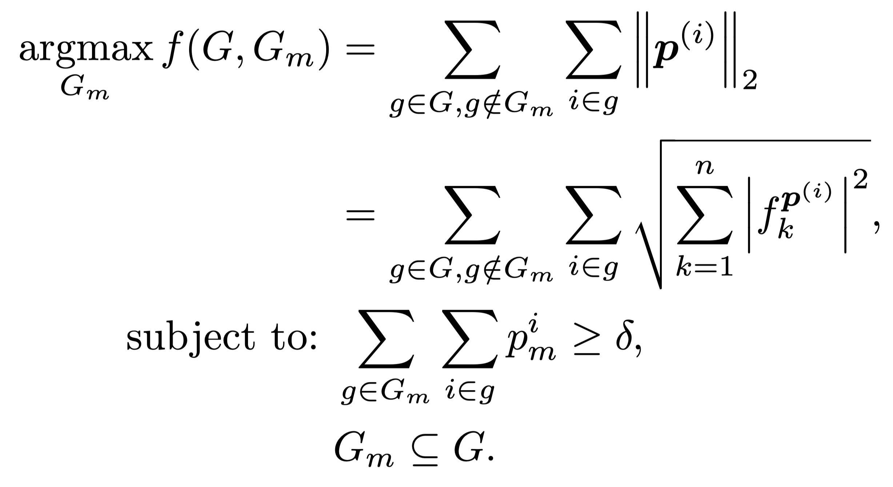
We conduct the classiﬁcation for malicious sources by building traffic proﬁles for each IP address.
Then, mark IP as malicious in a particular order (according to p) until the overall traffic proﬁle returns to a benign area.
We also need to minimize the impact on other features of the overall traffic proﬁle S when determining the malicious IPs. We consider this as an optimization problem with two constraints

Slide 10
Deriving the optimal solution of this optimization problem is expensive.
We conduct the grid partitioning on the searching space to accelerate the IP classiﬁcation. It can drive a near-optimal solution.

Slide 11
Adaptability
Users do not need to retrain the proposed model to ﬁt it into a diﬀerent network environment. They can easily use some prior knowledge to refit the model:
If we have the traffic measurement information about the new environment, we can normalize the KNN searching space from the trained environment to the new environment according to the two networks’ traﬃc distributions.
If the traﬃc monitoring system can obtain labeled traﬃc with the system running, we can eﬃciently conduct online learning on the proposed model.
In some circumstances, the user of this method may know some incomplete threshold values or rules in the new network environment. They can then build a decision tree based on the preliminary knowledge and merge it with the trained classiﬁer, a tree-like data structure.

Slide 12
Evaluation
We trained our method with four DDoS datasets (DRAPA 2009, CAIDA 2007, FRGP NTP Flow Data, and DDoS Chargen 2016).
The detection and classification accuracies outperform FastNetMon.
It can detect and classify DDoS traffic with a delay of around 5 seconds (tested on a 50Gbps link).

Slide 13
Thanks!
This project is the result of funding provided by the Science and Technology Directorate of the United States Department of Homeland Security under contract number D15PC00204. The views and conclusions contained herein are those of the authors and should not be interpreted necessarily representing the oﬃcial policies or endorsements, either expressed or implied, of the Department of Homeland Security or the US Government.

